Slide 1
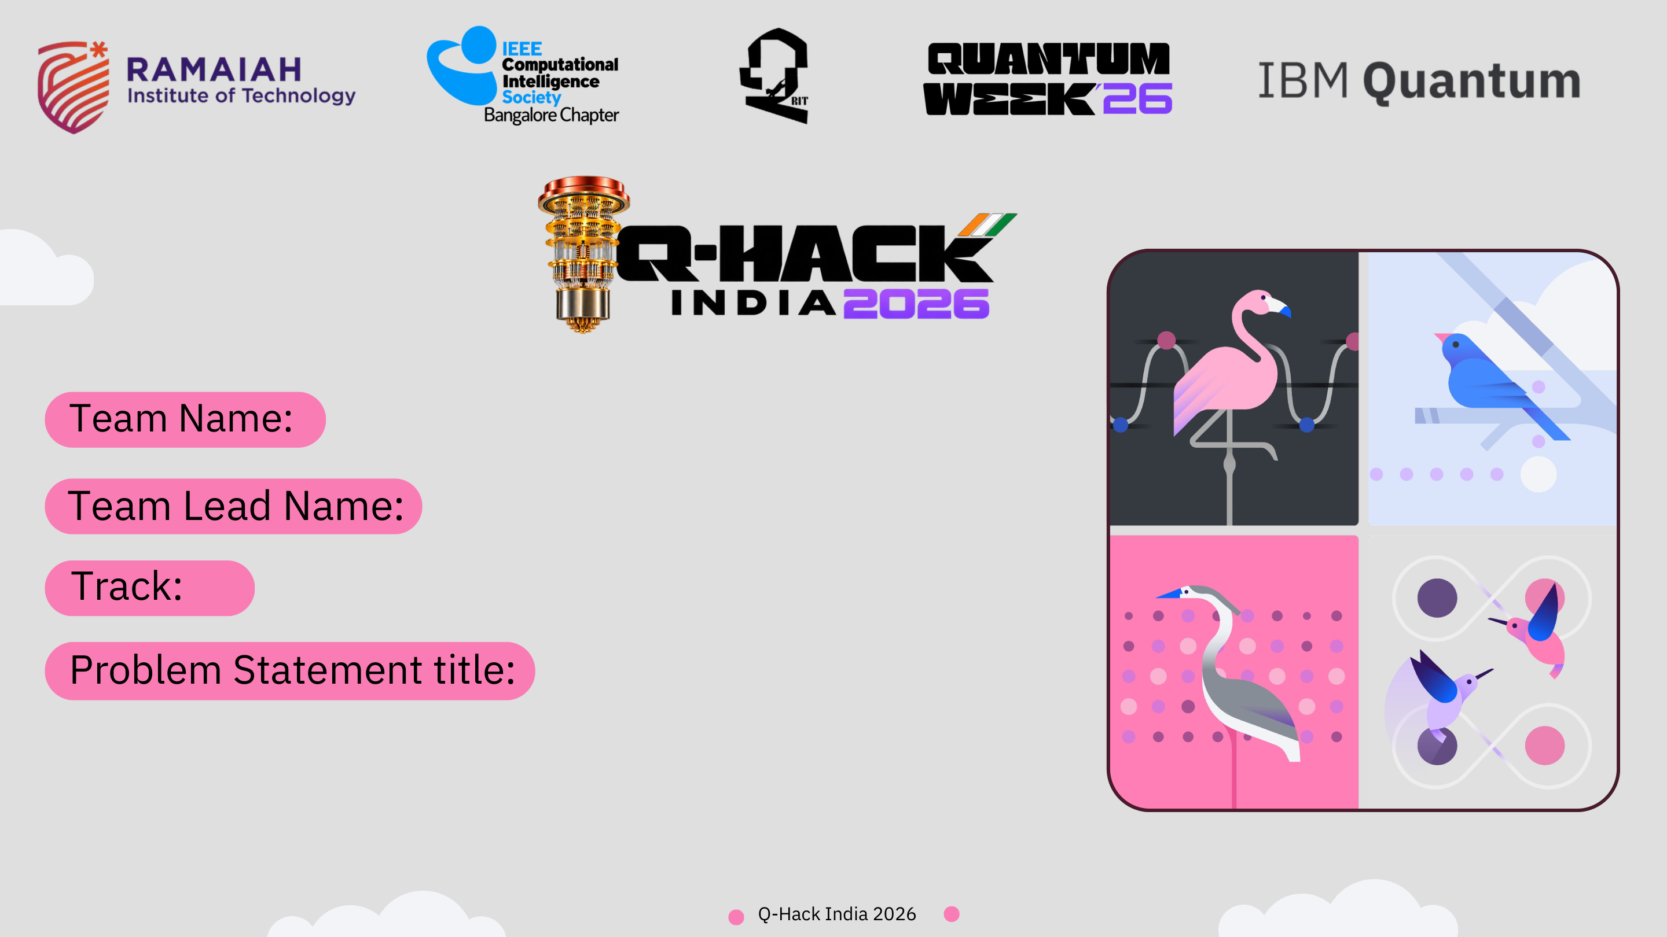
Q-Rescue: PairCover-Q
Coverage-aware multi-call ambulance dispatch as a QUBO, solved with QAOA and verified against exact classical optimisation

Slide 2
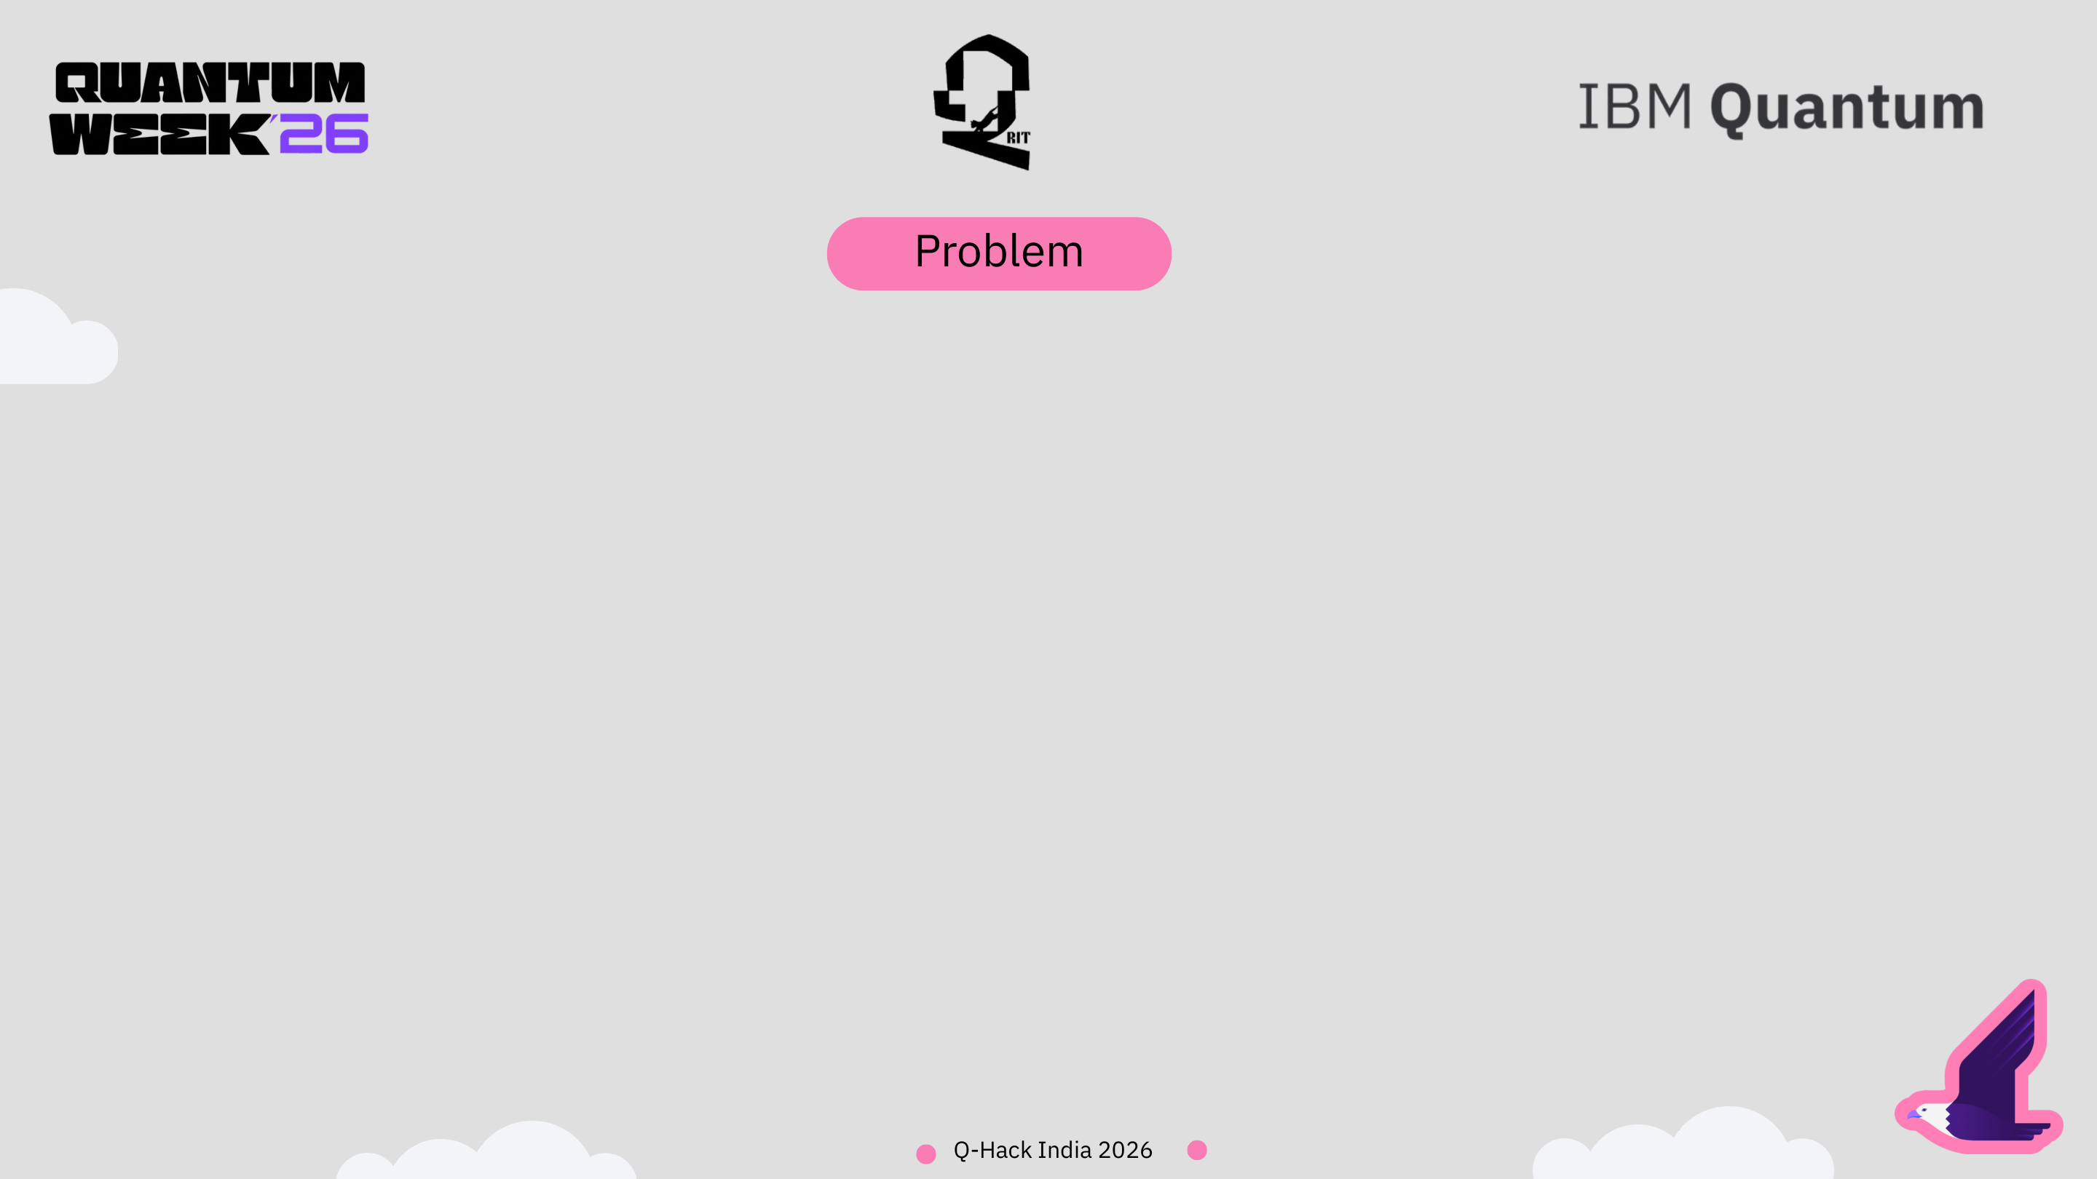
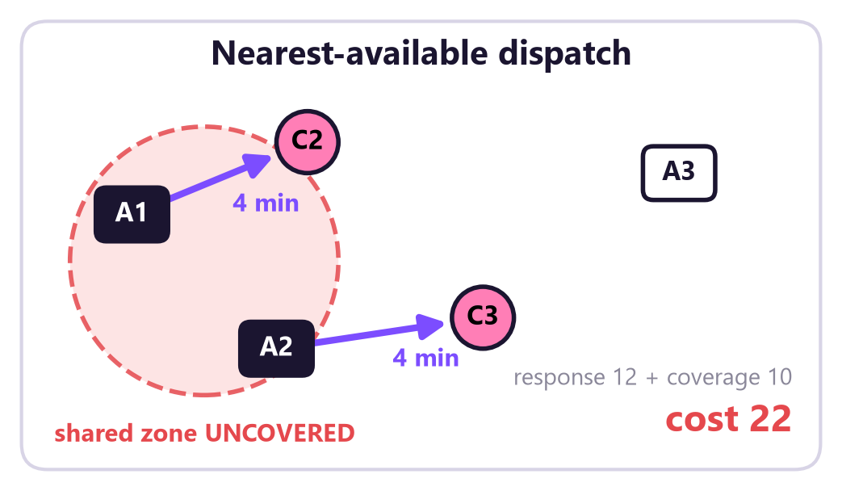
Sending the nearest ambulance to every call can leave a whole zone with no ambulance at all.
• Context. 108 dispatch centres assign each emergency to the closest idle unit, one call at a time.
• What goes wrong. When several calls arrive together, two ambulances that back each other up can both leave. The zone they shared is then uncovered for the next caller.
• Why the usual maths misses it. The damage depends on which pair of units leaves, not on any single unit. A per-ambulance cost cannot express that.
• Our question. Can we choose all assignments in one shot so response stays fast and no shared zone is stripped?
Our 6-variable test case (synthetic): A1 and A2 are each other's only backup. Greedy sends both, saves 1 minute, and uncovers their zone.

Slide 3
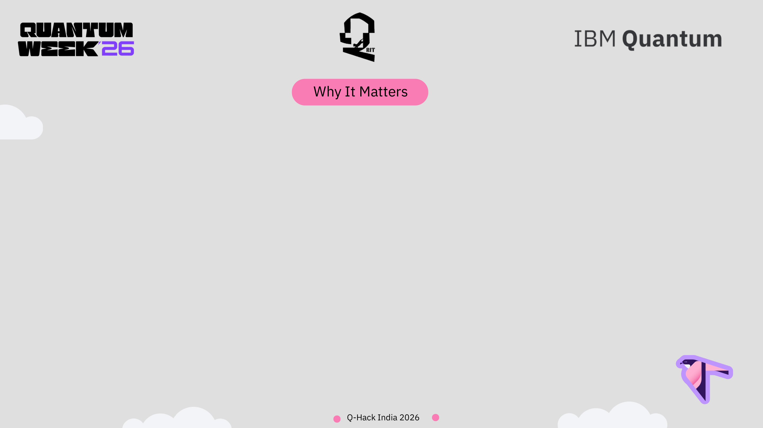
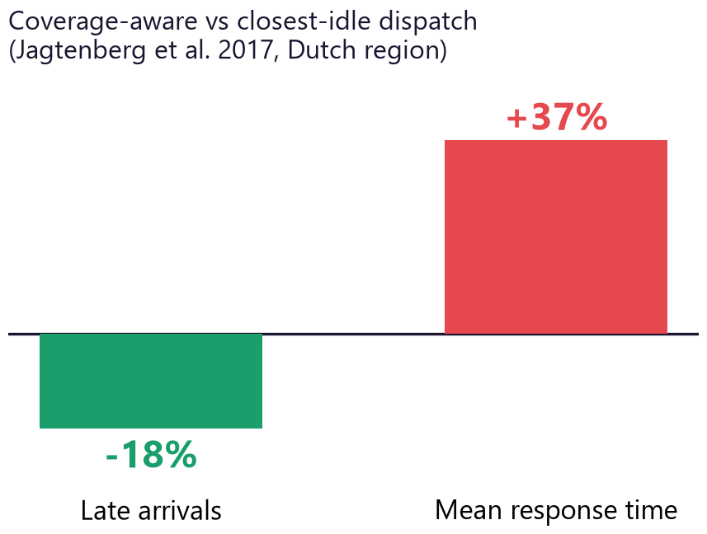
Who faces it: dispatchers, ambulance crews and the next patient who calls from the zone left empty.
1,237
14 min 24 s
June 2026
-18% / +37%
ambulances in Tamil Nadu's 108 fleet (Nov 2021) [8]
statewide average response time, 2020-21 [8]
National Ambulance Services guidelines reported to call for data-driven deployment [9]
late arrivals vs mean response time under a coverage-aware rule [3]
• Every dispatch is also a coverage decision. An ambulance on a call is unavailable for roughly an hour; the area it leaves still generates emergencies.
• The trade-off is real and measured. In a Dutch region, a coverage-aware rule cut late arrivals by 18% but raised mean response time by 37% [3]. Coverage is not free, so it has to be priced explicitly.
• India is moving this way. Press coverage of the 2026 national guidelines describes integrated dispatch centres and deployment driven by call patterns and hotspots [9].
• Honest scope. An Indian-city study found dispatch-rule changes alone gave about 1% more served calls [7]. We target a decision-support formulation, not a claim of lives saved.

Slide 4
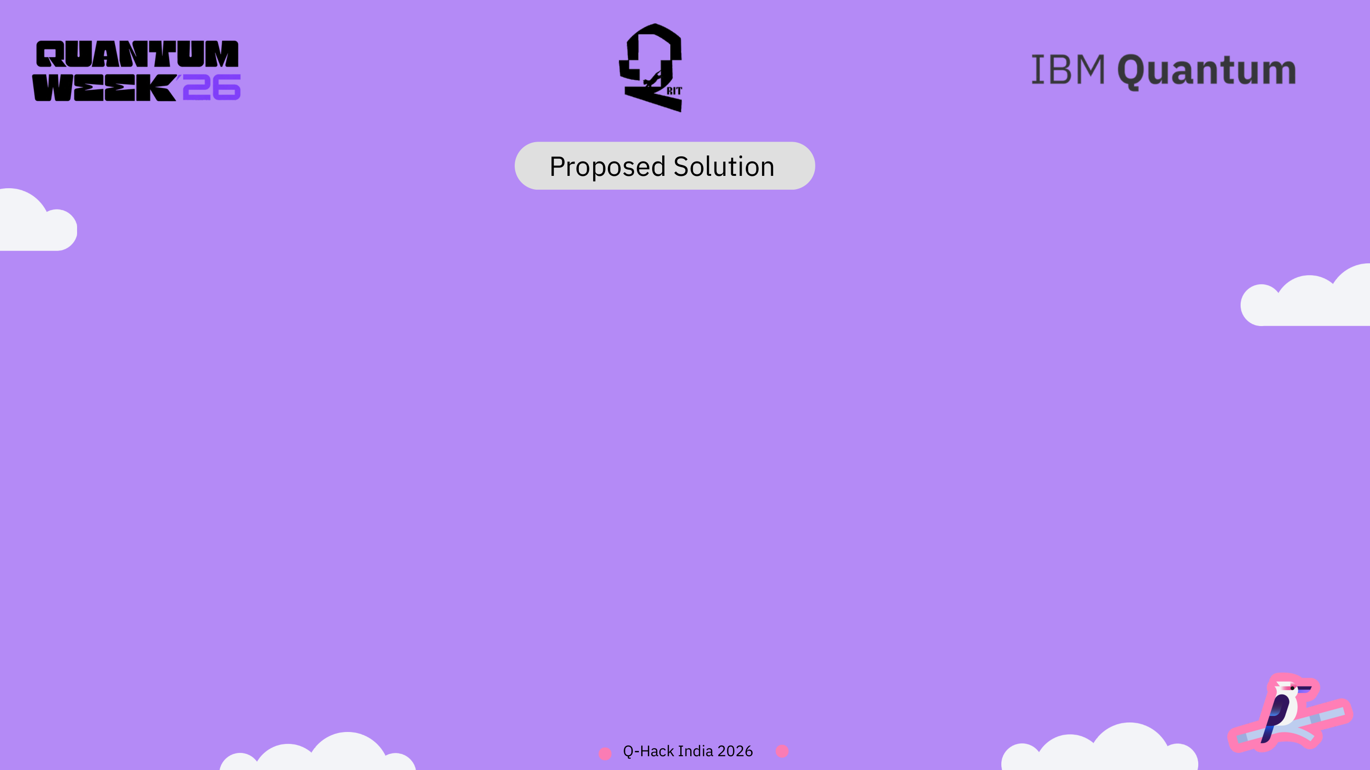
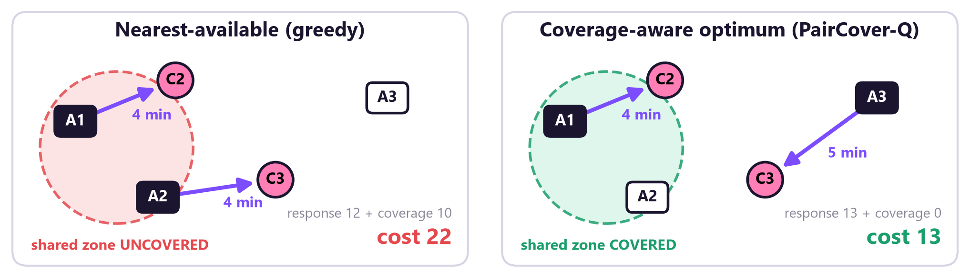
PairCover-Q: one optimisation that assigns all pending calls together and charges a price when two mutual-backup ambulances leave at once.
• Greedy: cost 22. A1 and A2 both go; shared zone uncovered.
• PairCover-Q: cost 13. A3 takes the lower-priority call 1 minute slower; A2 stays to cover the zone.
• Safety built in. The critical call C1 is pre-assigned to the nearest unit outside the optimiser, so coverage can never delay a top-priority patient.
• Checked, not trusted. Every answer is re-validated from raw tables and compared with the exact optimum.
Minimise priority-weighted response time + unserved-call penalty + λ · g₁₂ · D₁ · D₂
D₁·D₂ = 1 only if both backup units are dispatched. That product is the pairwise coverage term.

Slide 5

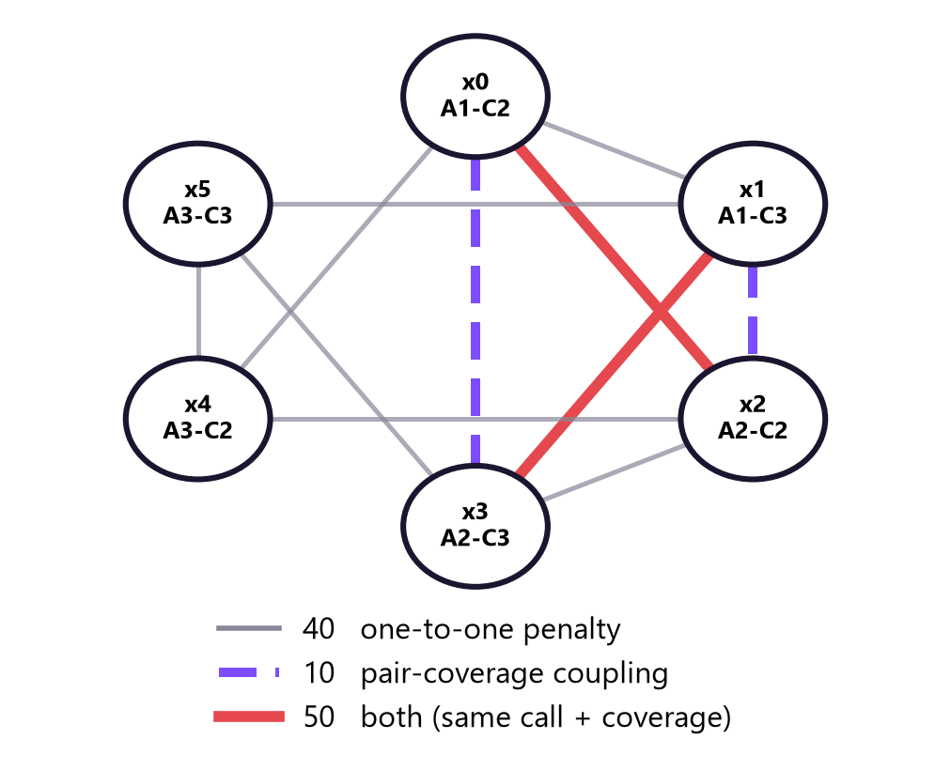
The coverage term couples pairs of decisions, which is exactly the structure a QUBO and an Ising Hamiltonian express natively.
• Without the pair term this is linear assignment, solved exactly in polynomial time. No quantum method is justified.
• With it, the objective is genuinely quadratic in binary variables: 6 qubits, one per eligible ambulance-call pair, 11 ZZ couplings, no slack or ancilla qubits.
• Direct mapping to QAOA. x = (1 - Z)/2 turns the QUBO into a cost Hamiltonian; each coupling becomes one RZZ gate per layer.
• Quantum is the methodology, not the speed-up. At 6 qubits brute force takes under a millisecond. We claim a verified, quantum-ready formulation and an honest benchmark, not quantum advantage.
• Why it is worth doing. Pair-coupled problems grow as 2ⁿ; small verified instances are how a formulation earns trust before larger devices.
QUBO coupling graph of our scenario (from generate_qubo_scenario2)

Slide 6
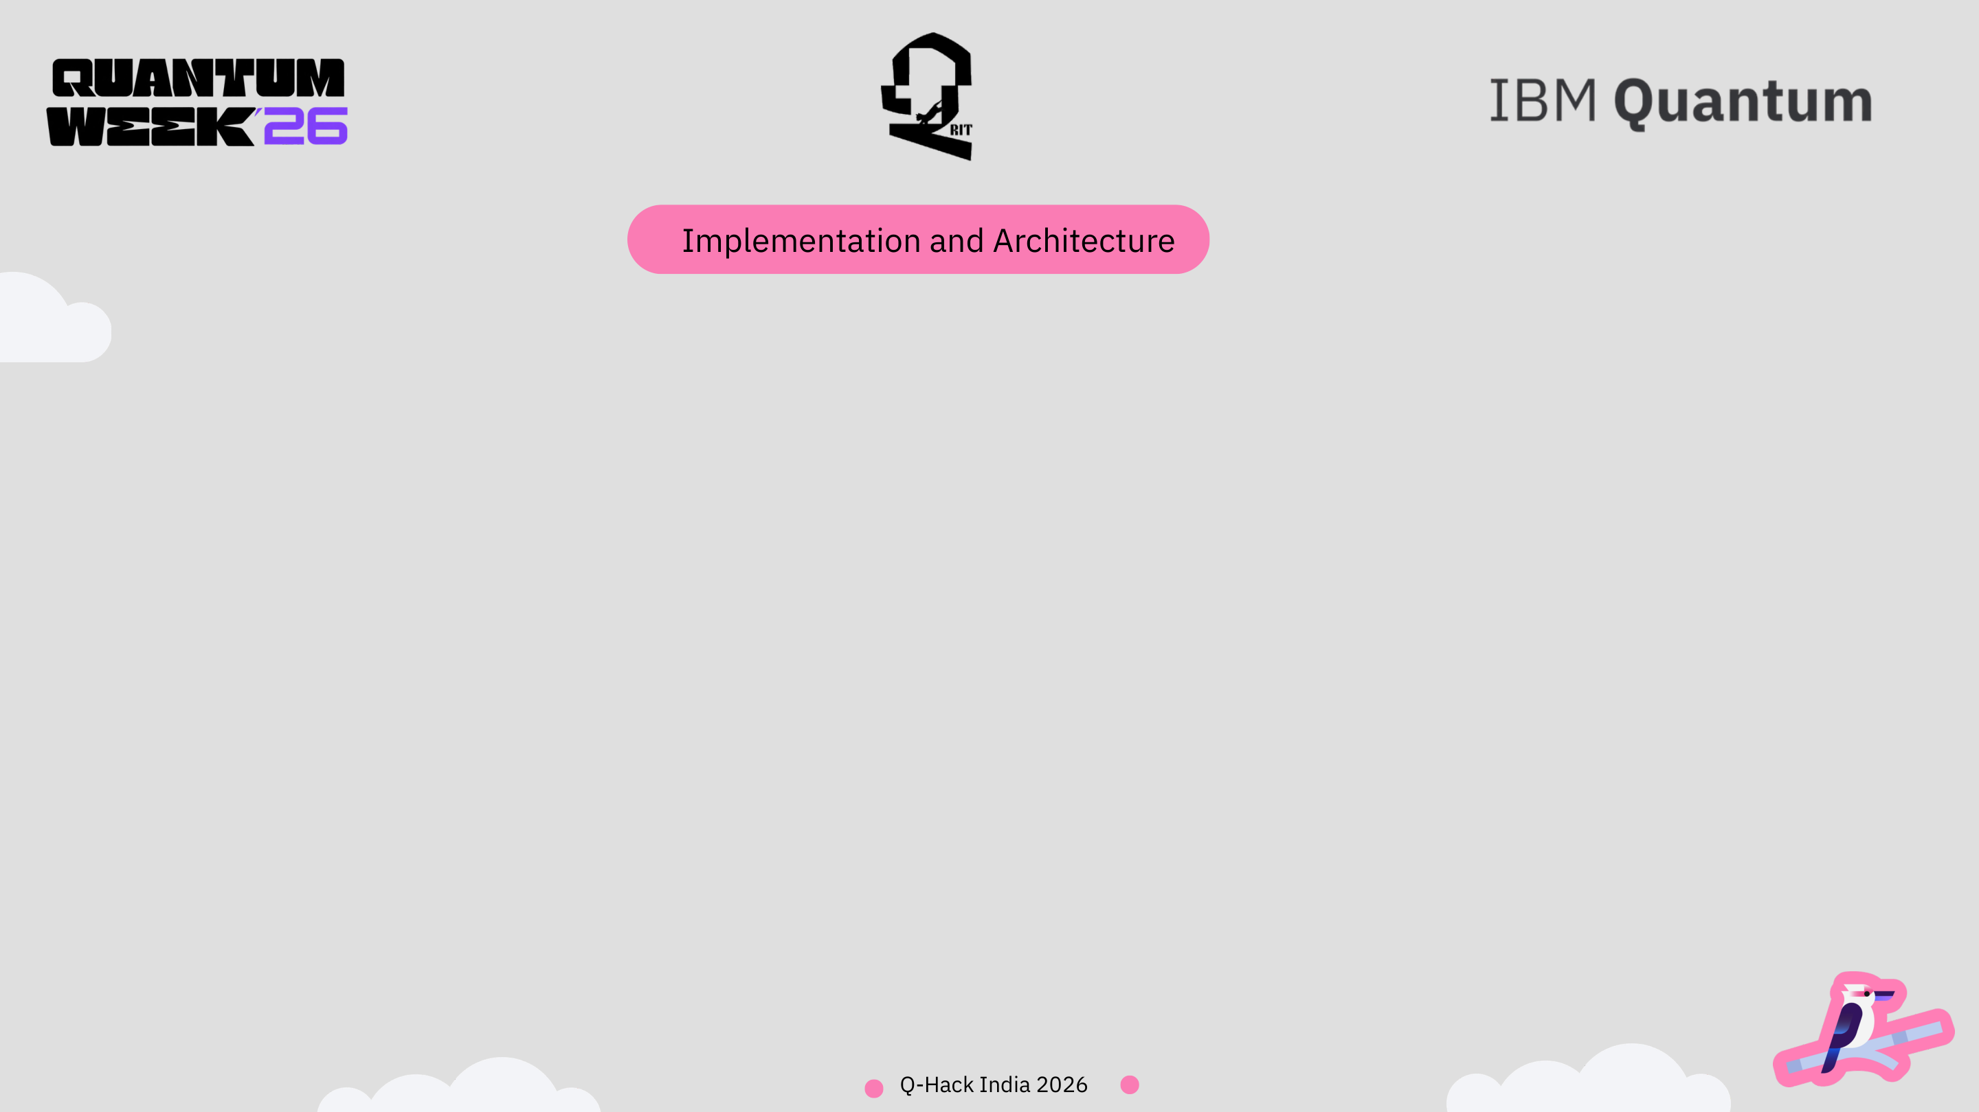
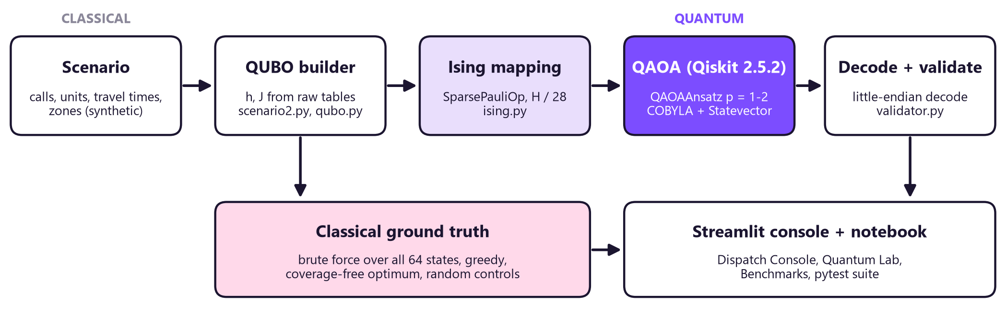
Hybrid pipeline: classical code builds and checks the problem, a quantum circuit samples it, classical code validates every sample.
Quantum components
QAOAAnsatz on a SparsePauliOp cost Hamiltonian, X mixer, depth p = 1-2. StatevectorEstimator for <H>, StatevectorSampler for 10,000 shots. Hamiltonian scaled by its largest coefficient (28).
Classical components
QUBO builder, exhaustive solver over all 64 states, greedy baseline, COBYLA optimiser (rhobeg 0.5), uniform-random controls, hard-constraint validator with little-endian decoding.
Stack
Python 3.13, Qiskit 2.5.2, qiskit-aer 0.17.2, SciPy, NumPy, Streamlit 1.65, Plotly, pytest. Pinned requirements.txt; no archived qiskit-optimization dependency.

Slide 7
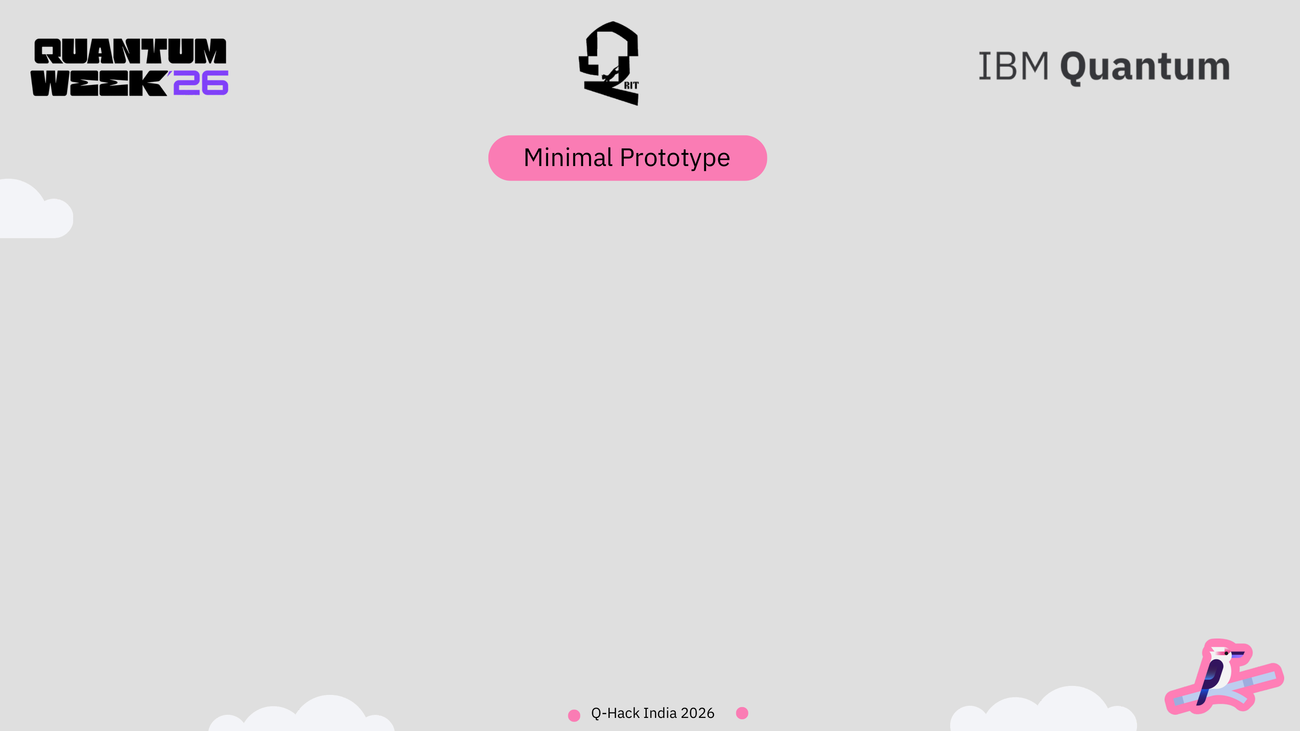
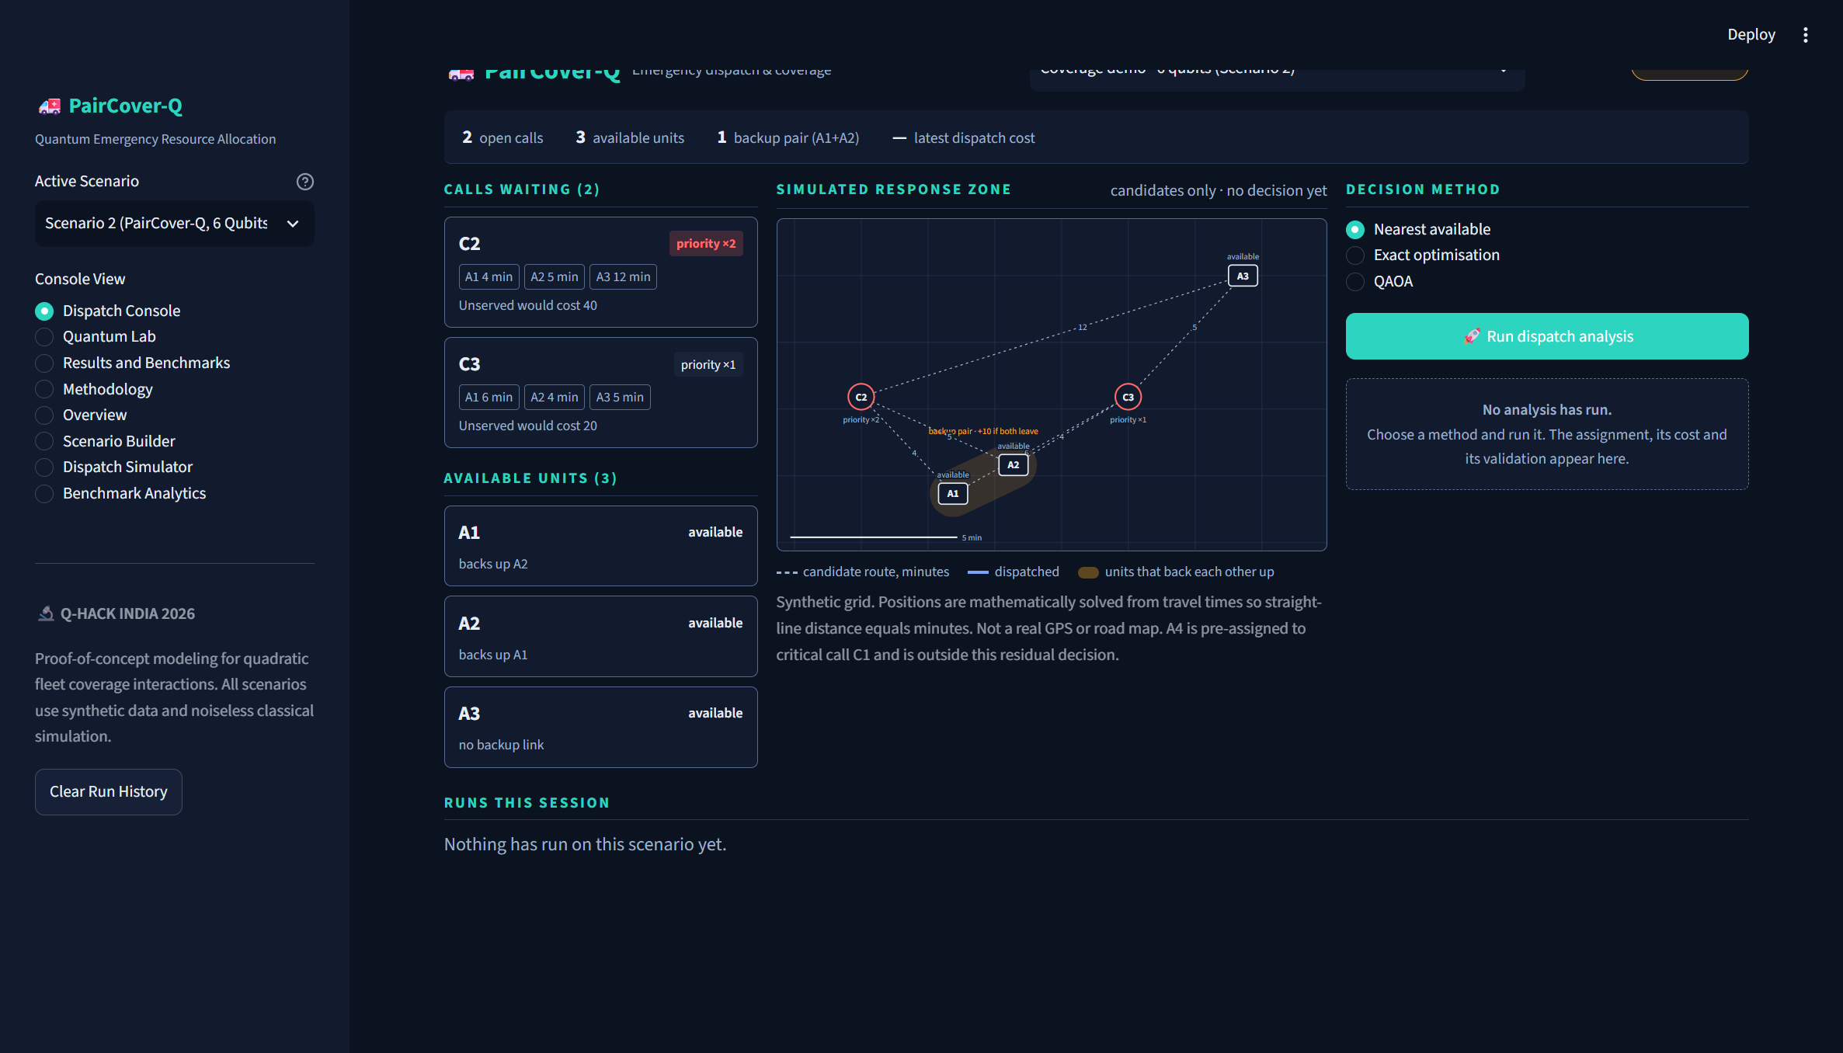
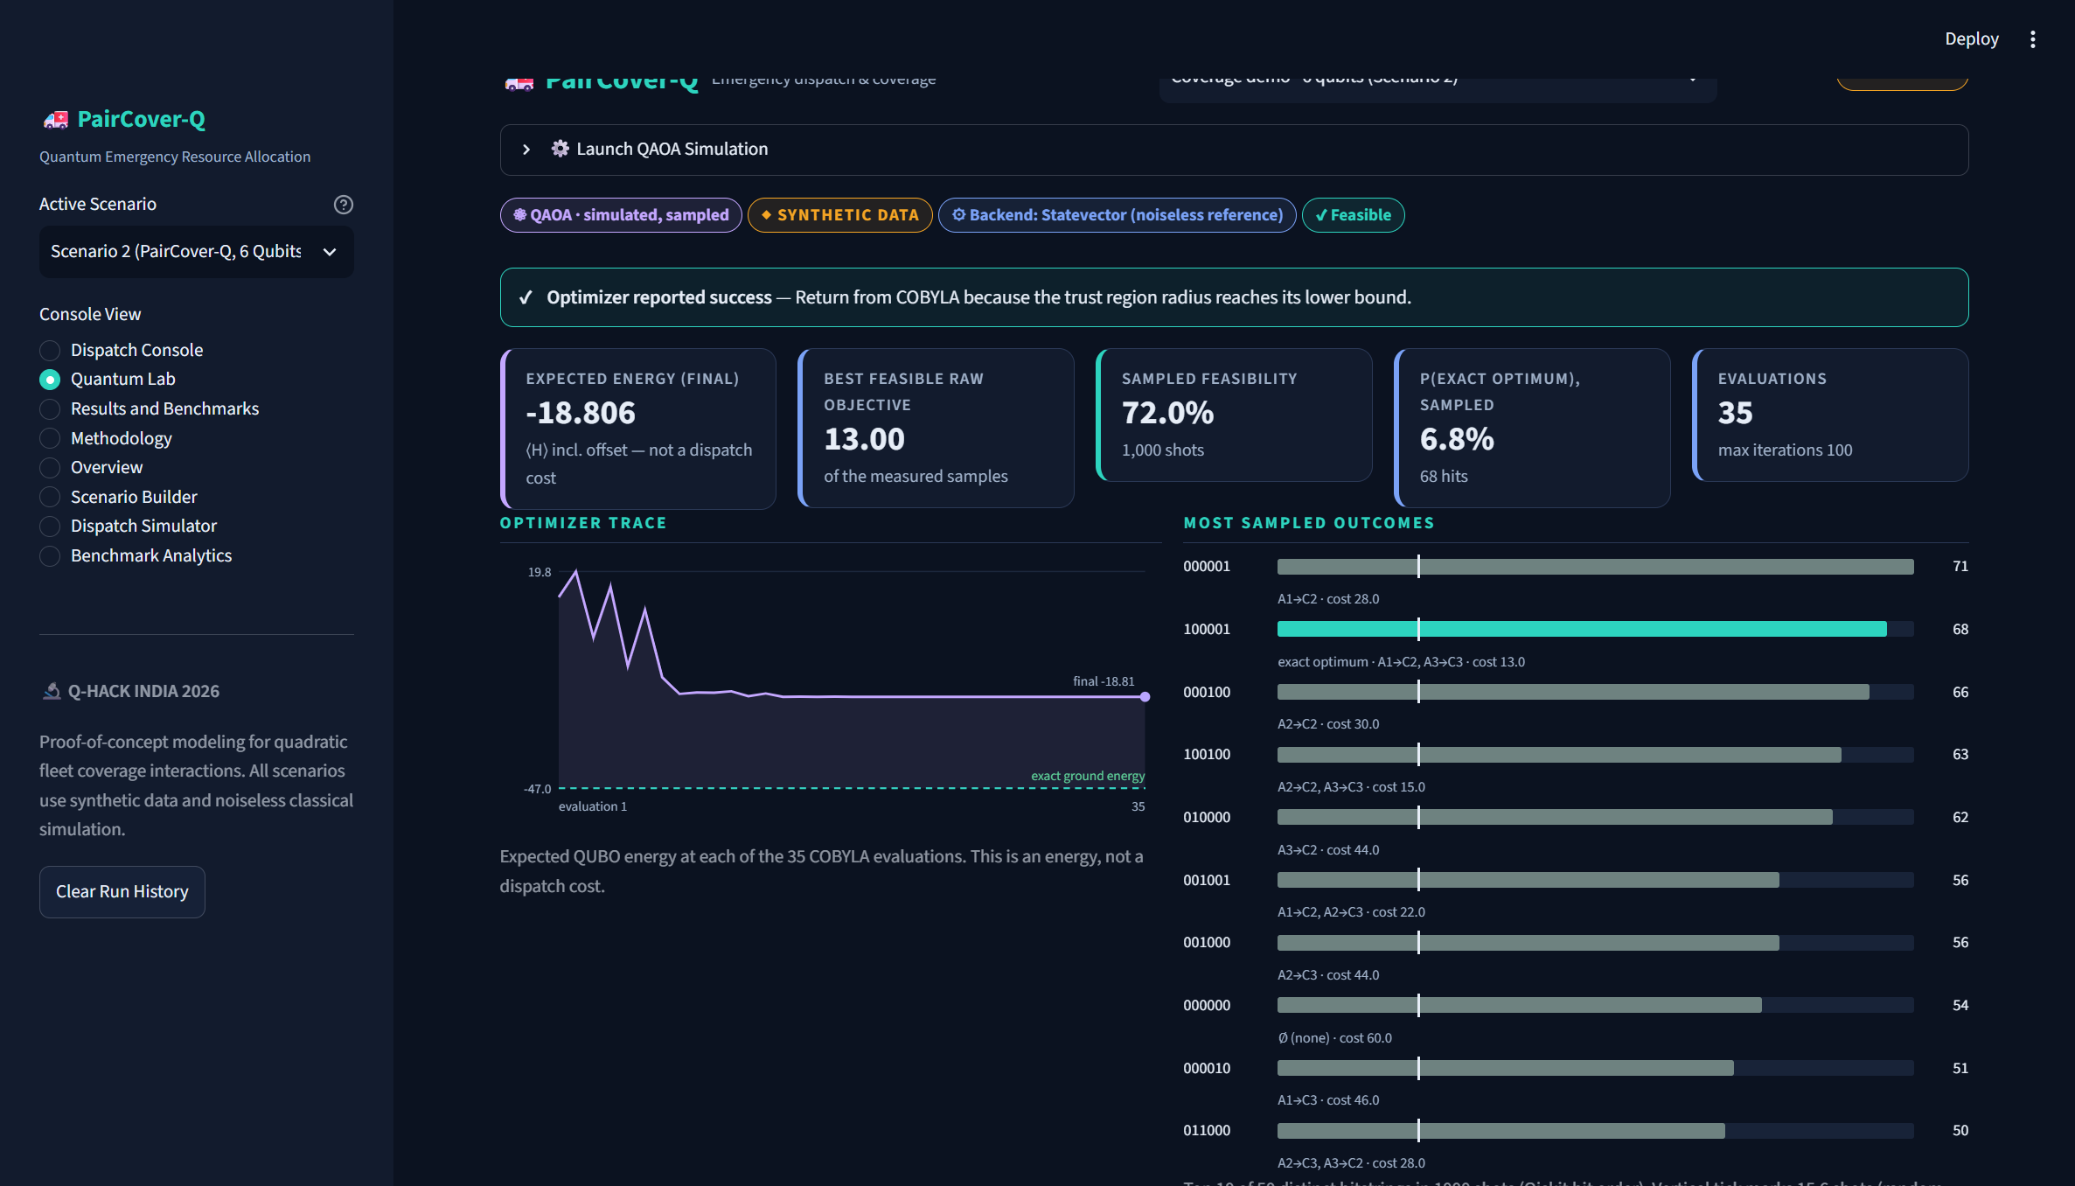
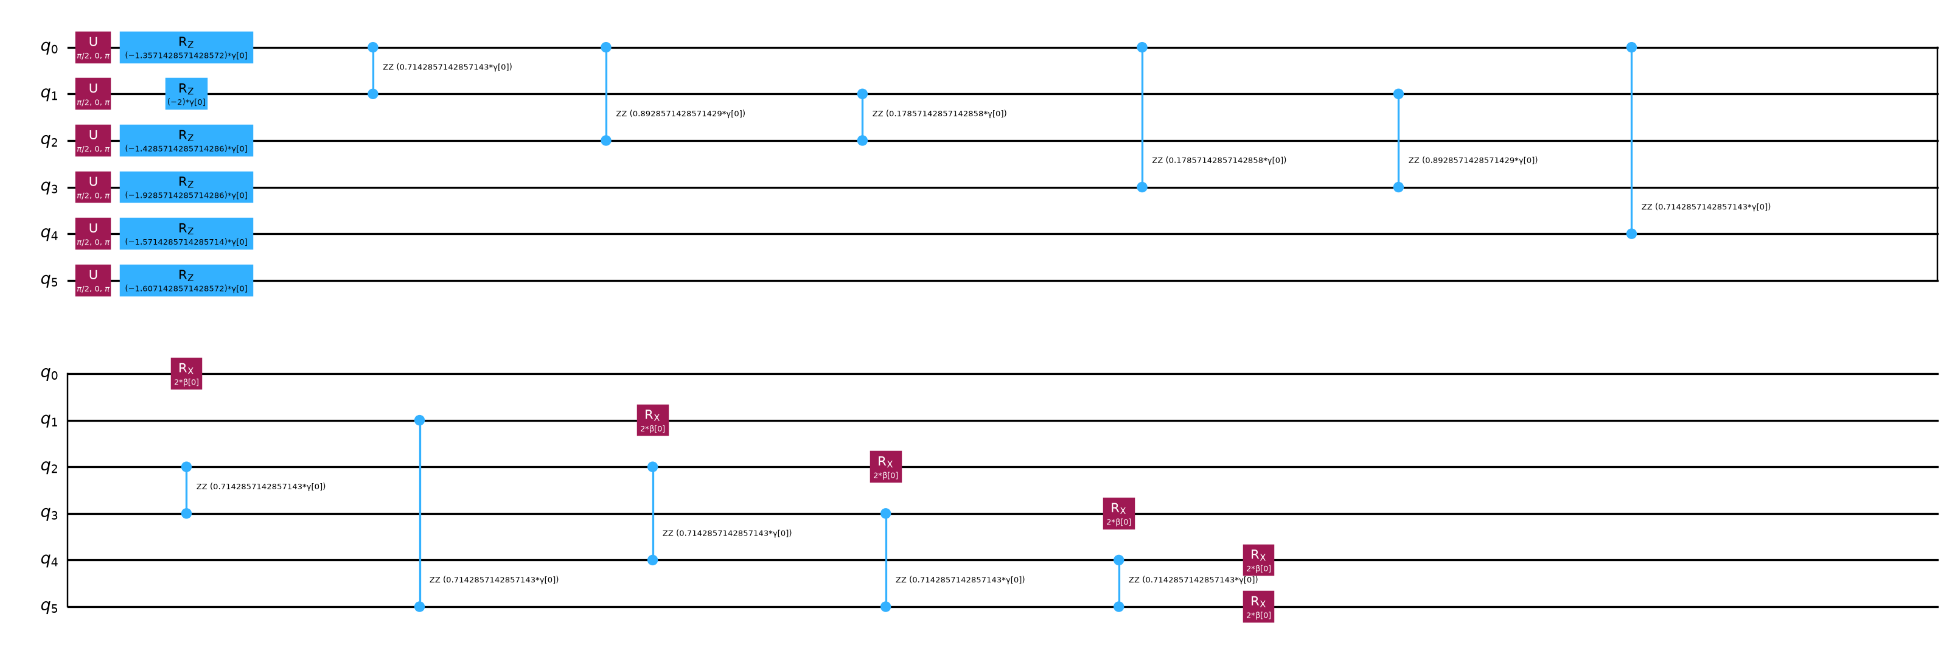
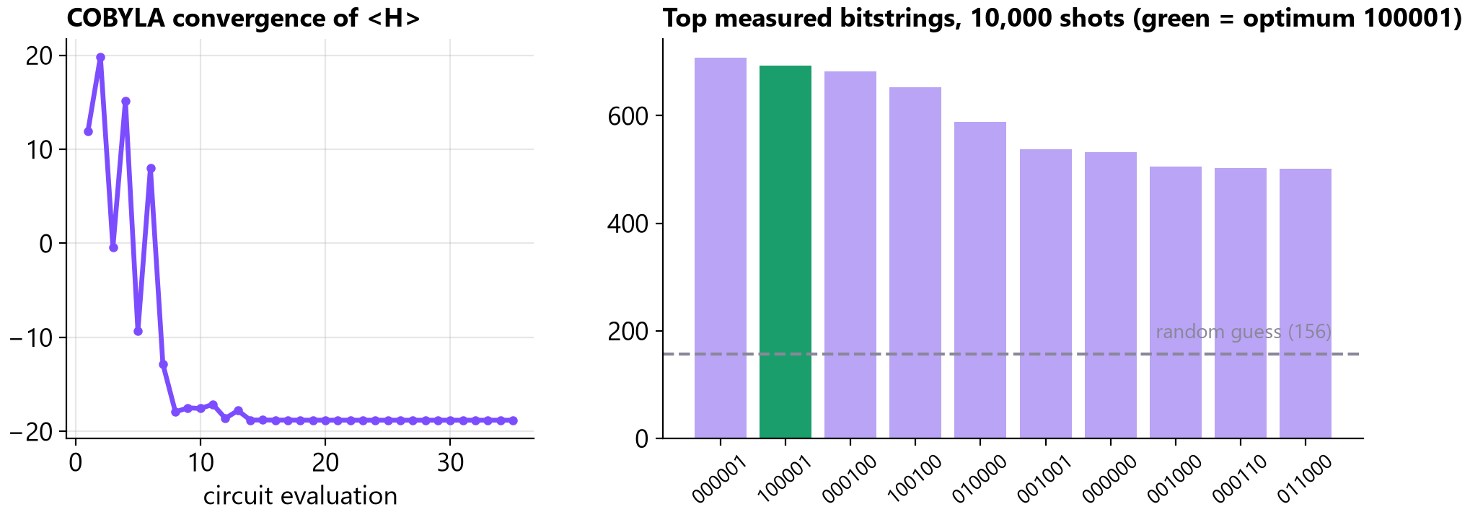
A working Streamlit console, a runnable notebook and a tested Python package. Everything below is output from our own code.
What exists today
6-qubit QAOA circuit: depth 10, 11 RZZ + 6 RX per layer
4-view Streamlit console
Runnable demo notebook
5- and 6-qubit scenarios
Audit script, 10,000 shots
Automated pytest suite
Public GitHub repository
Dispatch Console: calls, units, backup-pair map
Quantum Lab: live QAOA run, 35 evaluations, 6.8% optimum
Left: our QAOA circuit as built by Qiskit (p = 1). Right: recorded run, p = 1, seed 10, noiseless statevector simulator.

Slide 8
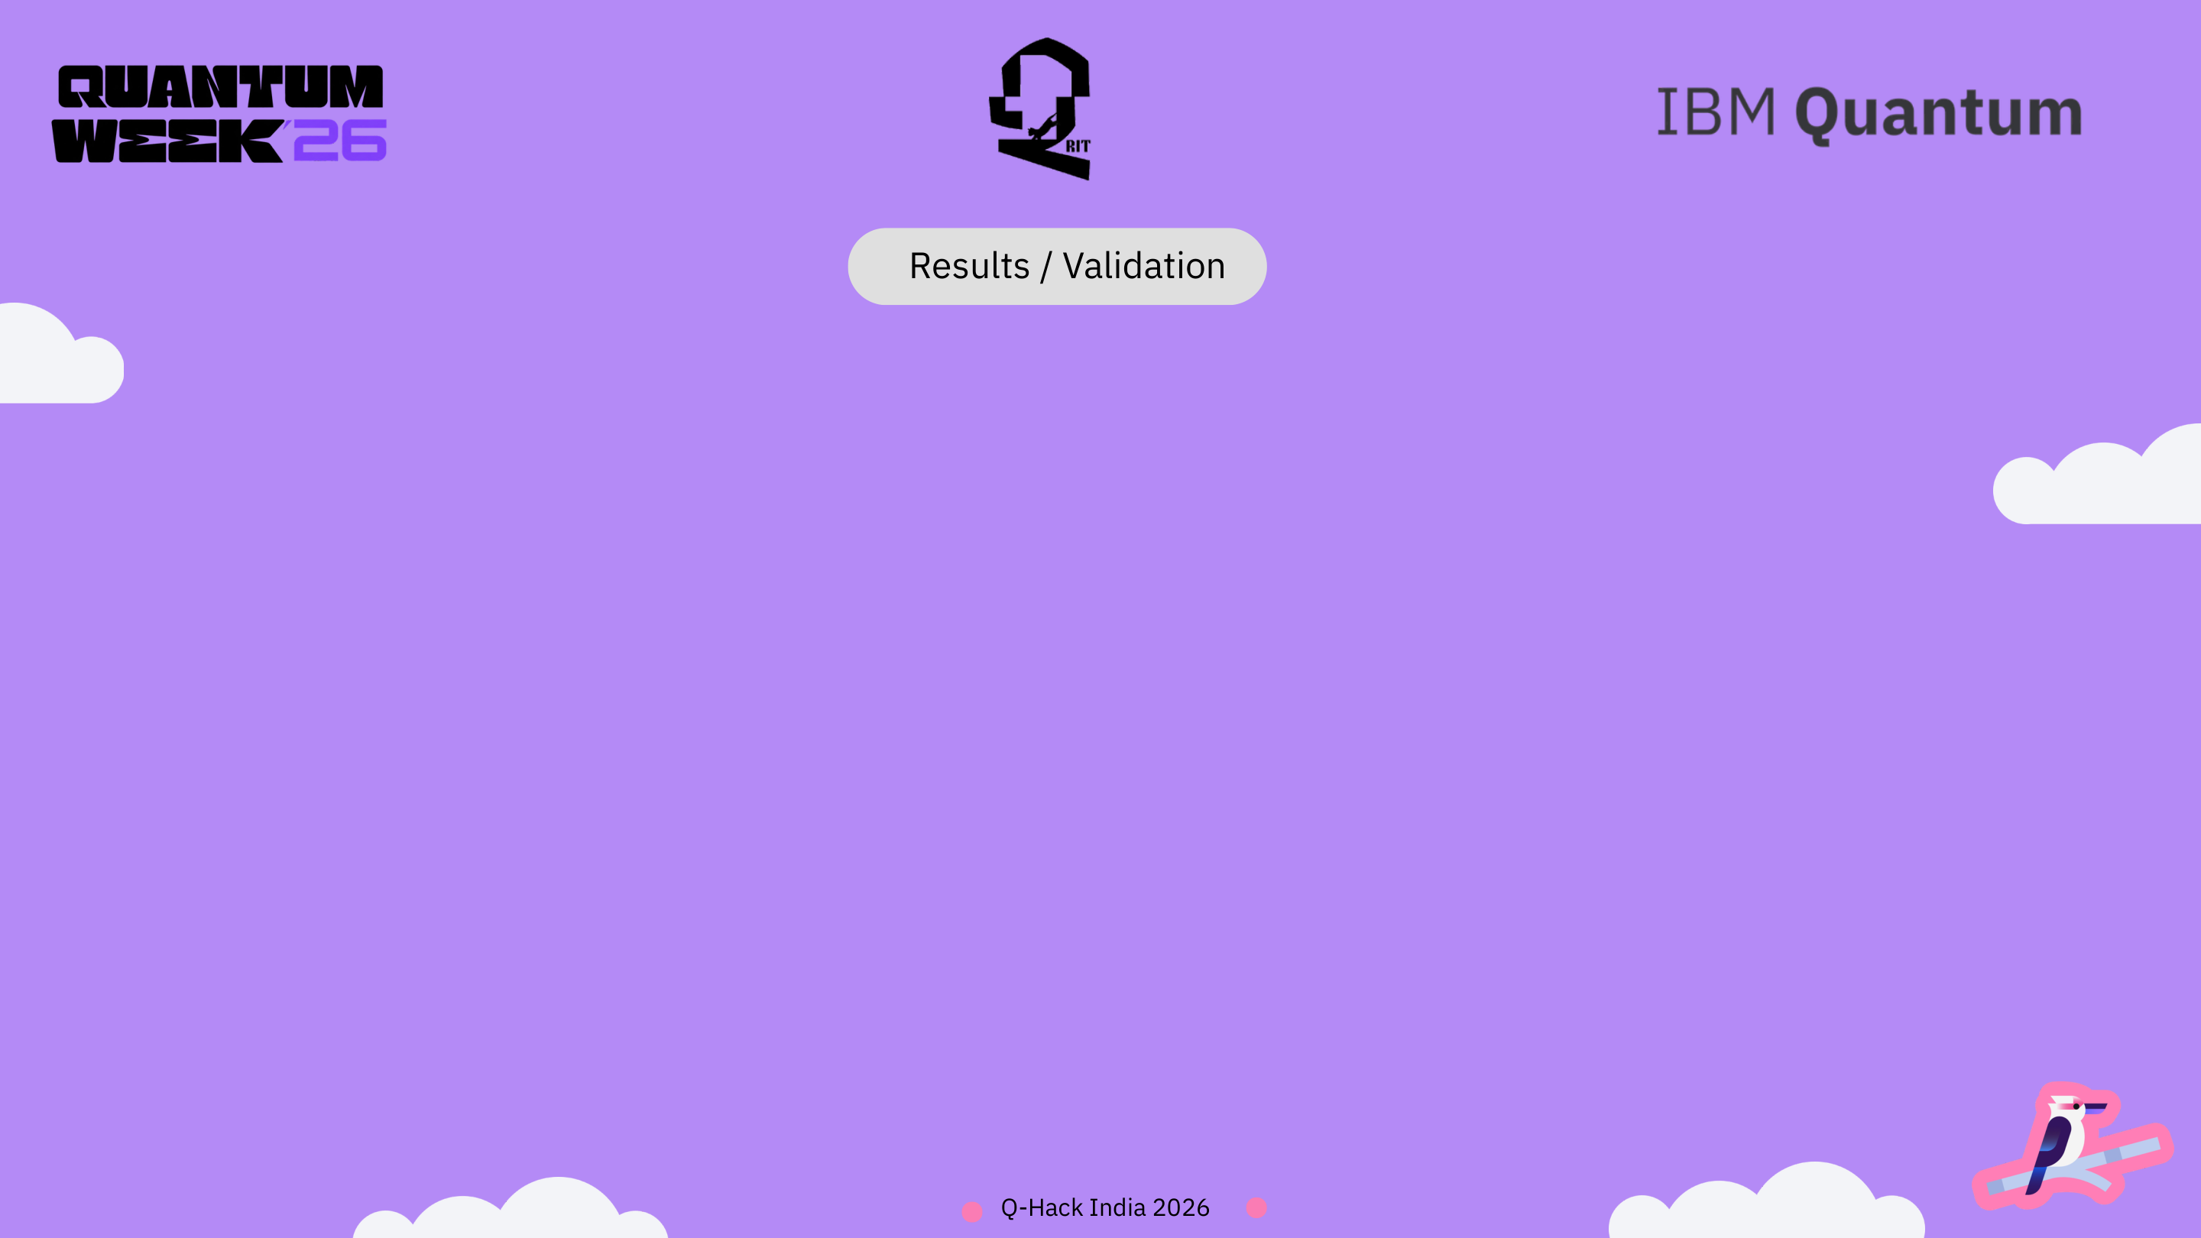
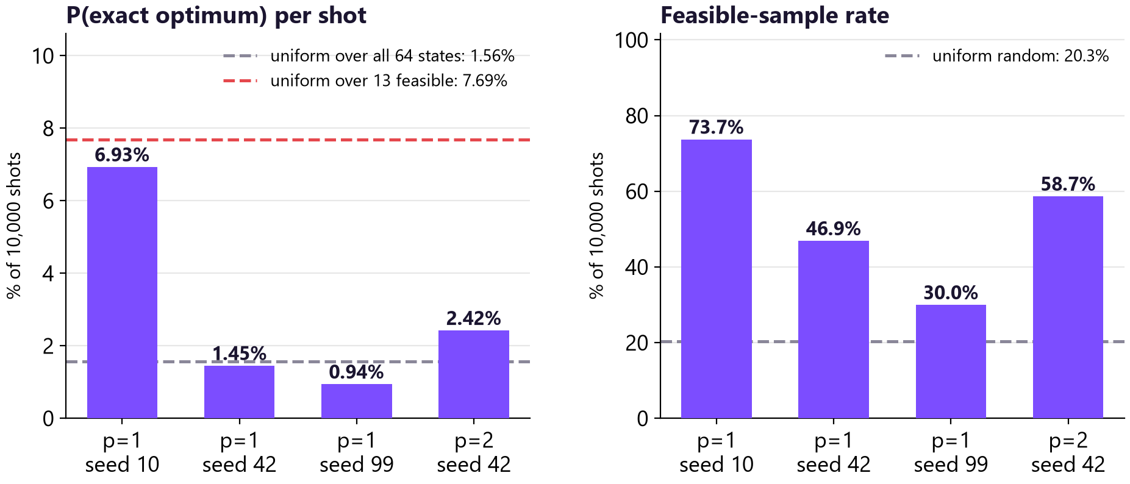
Validated: the formulation is exact and coverage-aware dispatch beats greedy. Not shown: any quantum advantage.
Method
Assignment
Cost
Exact coverage-aware
A1-C2, A3-C3
13
Greedy nearest
A1-C2, A2-C3
22
Coverage-free optimum
A1-C2, A2-C3
22
QAOA best feasible
A1-C2, A3-C3
13
Synthetic 6-qubit scenario; all 64 states enumerated. Cost = weighted response minutes + coverage penalty. QUBO minimum equals the constrained optimum.
• Coverage-aware optimum costs 13 vs 22 for greedy (41% lower) for one extra minute on the lower-priority call.
• QAOA found the exact optimum in all 4 audited runs; best run: 73.7% feasible samples (random: 20.3%) and 6.93% optimum probability (random: 1.56%).
• It is seed-sensitive and still below the 7.69% of uniform sampling over feasible states. Two of four runs fell below random. We report that as a finding.

Slide 9
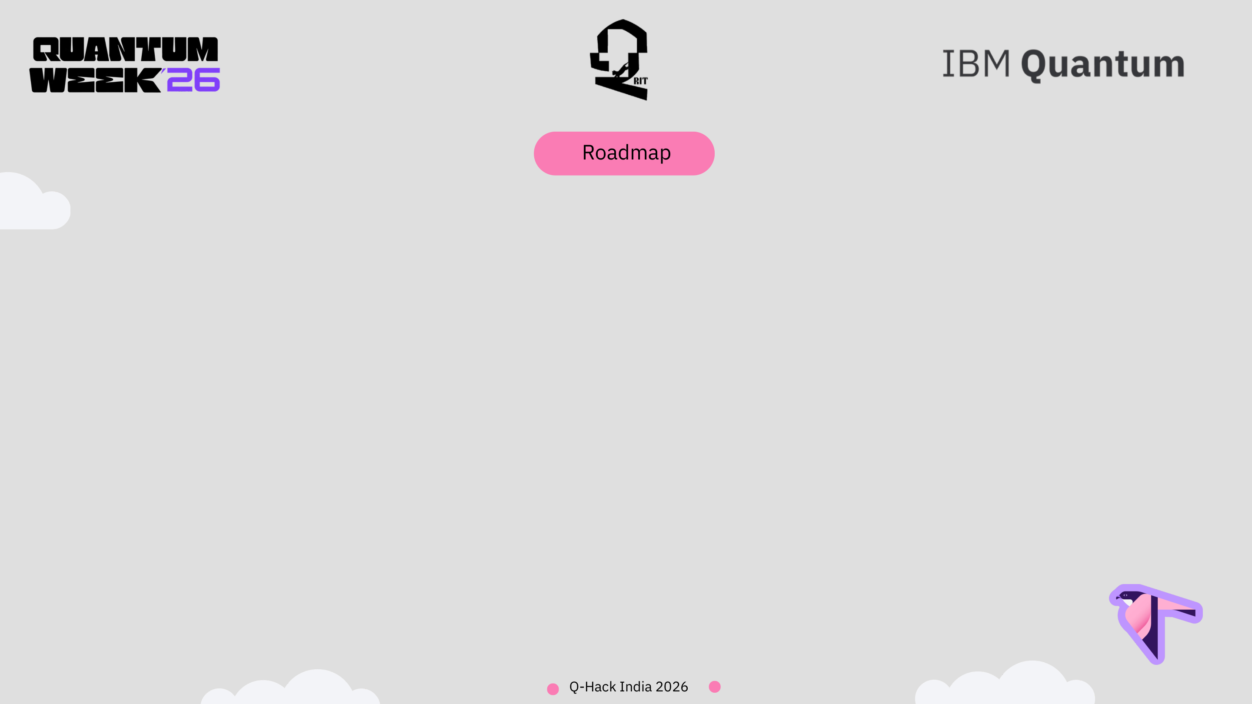
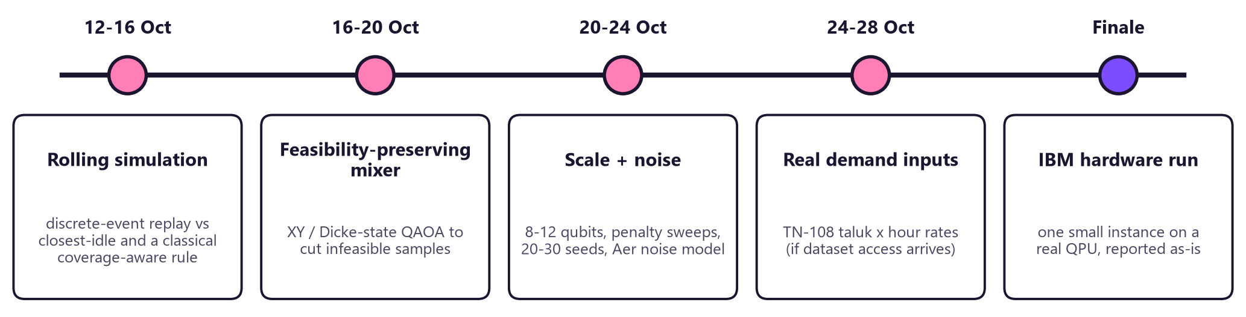
Round 2 goal: move from one verified snapshot to evidence over time, larger instances and a real quantum device.
• Success measure: late-arrival rate and mean response reported together against closest-idle, with the exact solver as reference at every size we can enumerate.
• Will not claim: real-time deployment, live GPS or traffic, or quantum speed-up, unless the experiments show it.

Slide 10

[1] Cumming & Thomas (2022), Using a quantum computer to solve a real-world problem (ambulance location, QAOA). arxiv.org/abs/2211.13080
[2] Chancellor, Cumming & Thomas (2020), Standardized methodology for quantum computing use cases. arxiv.org/abs/2006.05846
[3] Jagtenberg, Bhulai & van der Mei (2017), Dynamic ambulance dispatching: is closest-idle always optimal? doi.org/10.1007/s10729-016-9368-0
[4] Andersson & Värbrand (2007), Decision support tools for ambulance dispatch and relocation. doi.org/10.1057/palgrave.jors.2602174
[5] Glover, Kochenberger & Du (2018), A tutorial on formulating and using QUBO models. arxiv.org/abs/1811.11538
[6] Lucas (2014), Ising formulations of many NP problems. arxiv.org/abs/1302.5843
[7] Marla, Krishnan & Deo (2021), Managing EMS vehicle operations in an Indian city, IISE Transactions. doi.org/10.1080/24725854.2020.1802086
[8] MCC / TNHSRP (2022), 108 ambulance services in Tamil Nadu: report. hss.iitm.ac.in/ctap/wp-content/uploads/2023/01/108-Final-Report.pdf
[9] Outlook India (2026), Centre rolls out national framework to standardise ambulance services (press report). www.outlookindia.com/healthcare-spotlight/centre-rolls-out-first-national-framework-to-standardise-ambulance-services
[10] IBM Quantum, QAOA tutorial and bit-ordering guide (Qiskit 2.x). quantum.cloud.ibm.com/docs/en/tutorials/quantum-approximate-optimization-algorithm
[11] TNHSP, 108 Ambulance research dataset request page (not used in Round 1; all data synthetic). www.tnhsp.org/pages/view/108_Application
Acknowledgement. Inspired by the coverage-aware dispatch idea in [2-4] and the ambulance QUBO of [1]. The pairwise assignment formulation, code, tests and experiments are our own work; the repository is not a fork. Scenario data is synthetic. Results are from a noiseless simulator.

