Slide 1
Notes:
PRESENTER: Divya · about 0:30
Good morning, everyone. We are Team Evric, in the Quantum Computing and Optimization track, and our team lead is Gautham M A.
Our project is PairCover-Q: quantum-assisted ambulance allocation for optimized emergency response.
I'm Divya, and I will start with the problem. Then Harsha will explain our solution and the mathematics behind it. After that we will show you our working app, our simulation results and our results from real IBM quantum computers. Finally, Jayasuriya will compare real quantum computing with classical computing and talk about the impact.

Slide 2
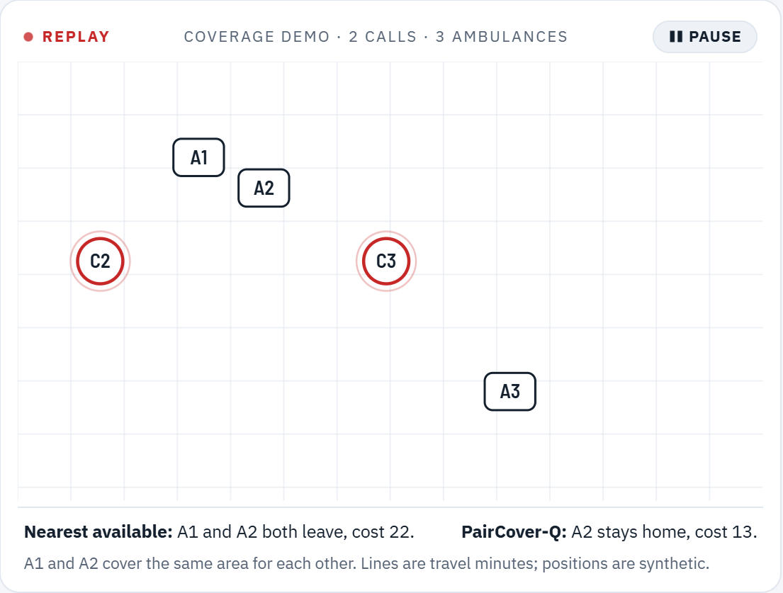
Sending the nearest ambulance can leave a whole area without backup
Problem
22
13
Nearest available
PairCover-Q
A1 and A2 both leave; their shared area has no backup.
A2 stays home; C3 waits one minute longer.
41% lower cost on the same two calls
Nearest-first dispatch handles one call at a time. When calls coincide it can strip a neighbourhood of every ambulance that covers it.
Screenshot · our app's coverage replay
Notes:
PRESENTER: Divya · about 1:00
Today, most ambulance dispatch follows one simple rule: send the nearest free ambulance to each emergency. For one call at a time, that works.
But look at this example from our app. Two emergencies, C2 and C3, arrive together, and we have three free ambulances. A1 and A2 are backup partners: they cover the same neighbourhood for each other.
The nearest-ambulance rule sends A1 to C2 and A2 to C3. Both partners leave, and their whole area is left with no backup. In our cost model that plan costs 22.
PairCover-Q keeps A2 at home and sends A3 to C3 instead. C3 waits just one minute longer, but the area stays protected. The cost drops to 13. That is 41 percent lower, on the same two calls.
So the problem is not only who is closest. It is how to plan several calls together so that no area is left empty.

Slide 3
India's ambulance policy now asks for intelligent dispatch, and backups are scarce
Why It Matters
Intelligent dispatch
The 2026 National Ambulance Services guidelines call for integrated command centres, intelligent dispatch and data-driven deployment.
Where PairCover-Q fits
Decision support in a 108 command centre when several calls arrive together.
It recommends who goes where so no area is left without backup; the dispatcher decides.
Tamil Nadu's 108 research dataset lists the fields a pilot needs.
More simultaneous calls means more qubits.
Source: ETV Bharat, June 2026 (NAS 2026 guidelines)
1 per 5 lakh
NHM norm: one advanced life support ambulance per 5 lakh people, one basic per lakh. A lost backup is hard to replace.
Source: MoHFW press release; Rajya Sabha answer, 11 Mar 2025
20 / 30 min
Karnataka's 108 contract targets 20 min average urban and 30 min rural: every minute counts against a fixed target.
Source: CAG audit of Karnataka 108 services
Notes:
PRESENTER: Divya · about 0:50
Why does this matter in India? First, policy is moving this way. The 2026 National Ambulance Services guidelines call for integrated command centres, intelligent dispatch and data-driven deployment.
Second, ambulances are scarce. The national norm is one advanced life support ambulance for every 5 lakh people. When a backup is gone, it is hard to replace.
Third, services work against fixed targets. For example, Karnataka's 108 service targets 20 minutes in cities and 30 minutes in rural areas, so every minute counts.
PairCover-Q is decision support for a 108 command centre at exactly the moment several calls arrive together. It recommends who goes where; the dispatcher still decides.
Now Harsha will explain how we solve it.

Slide 4
PairCover-Q: one qubit per dispatch decision, with backup coverage built in
Proposed Solution
1
2
3
4
5
Calls arrive
QUBO
QAOA circuit
Run
Check
Waiting calls, free ambulances, travel minutes
One yes/no variable per ambulance–call pair
Qiskit 2.5, ramp start, depth 1–3
Simulator, IBM noise copy, real IBM chip
Against the exact solver and random guessing
COST WE MINIMISE
Σ priority × travel minutes + Σ unserved-call penalty + λ × coverage lost
Solved jointly for all active calls, not one call at a time. Losing a backup pair is a product of two yes/no variables, so it fits a QUBO natively.
Notes:
PRESENTER: Harsha · about 0:50
Thank you, Divya. Our idea is to turn dispatch into one optimisation problem for all active calls together, instead of one call at a time.
It works in five steps. One: we take the waiting calls, the free ambulances and the travel times. Two: we build a QUBO, with one yes-or-no variable for every possible ambulance-to-call pair. Each variable becomes one qubit. Three: we build a QAOA circuit in Qiskit. Four: we run it on a simulator, on IBM's noise copy of a real chip, and on real IBM quantum computers. Five: we check every answer against an exact classical solver and against random guessing.
The cost we minimise has three parts: priority-weighted travel time, a penalty if a call is left unserved, and a penalty for coverage lost when ambulances leave their area.
The key point: losing a backup pair is a product of just two yes-or-no variables. That is exactly the form a QUBO accepts, so coverage needs no extra qubits.

Slide 5
Dispatch with backup coverage becomes a QUBO, then an Ising Hamiltonian
Mathematical Model
Decision
xᵤⱼ ∈ {0, 1} = 1 if ambulance u goes to call j
Only eligible pairs get a variable: the unit arrives within 12 minutes, or it is the nearest one
Objective
F(x) = Σ wⱼ tᵤⱼ xᵤⱼ + Σ Uⱼ (1 − Σᵤ xᵤⱼ) + λ Σᵤ cᵤ yᵤ + λ Σ g(a,b) · y(a) · y(b)
Priority × travel, unserved-call penalty Uⱼ, coverage a unit holds alone (cᵤ) or with its backup partner (g)
Constraints
Σⱼ xᵤⱼ ≤ 1 (one call per ambulance) Σᵤ xᵤⱼ ≤ 1 (one ambulance per call)
yᵤ = Σⱼ xᵤⱼ says whether ambulance u leaves its station
QUBO WE SEND TO QAOA
Penalty P = max (Uⱼ − wⱼ tᵤⱼ) + 1
The smallest value that provably makes every minimum a valid plan.
To qubits: xₖ = (1 − Zₖ) / 2
gives C = Σ h′ₖ Zₖ + Σ J′ₖₗ Zₖ Zₗ, the Hamiltonian QAOA runs.
H(x) = Σₖ hₖ xₖ + Σₖ,ₗ Jₖₗ xₖ xₗ
hₖ = wⱼ tᵤⱼ − Uⱼ + λ cᵤ
Jₖₗ = P if same ambulance or same call
Jₖₗ += λ g(a,b) if a, b are backup partners
Notes:
PRESENTER: Harsha · about 1:10
Here is the exact model in our code. The decision variable x-u-j is 1 if ambulance u goes to call j. We only create variables for useful pairs: the ambulance can arrive within 12 minutes, or it is the nearest one. That keeps the circuit small.
The objective F of x has four terms. First, call priority times travel minutes. Second, a penalty U-j for every call nobody serves. Third, the coverage an ambulance holds on its own, lost if it leaves. Fourth, the shared coverage of a backup pair, lost only if both partners leave. That last term is y-a times y-b, a product of two variables.
The constraints are simple: one call per ambulance and one ambulance per call. A quantum circuit cannot enforce constraints directly, so we move them into the cost as a penalty P.
This gives our QUBO, H of x, with linear terms h-k and pair terms J-k-l. We choose P as the largest possible gain plus one. That is the smallest value that provably makes every minimum a valid plan. We also measured that this tight penalty works better for QAOA than a large one.
Finally, we substitute x equals one minus Z, over two. That turns the QUBO into an Ising Hamiltonian C, which is what the quantum computer runs.

Slide 6
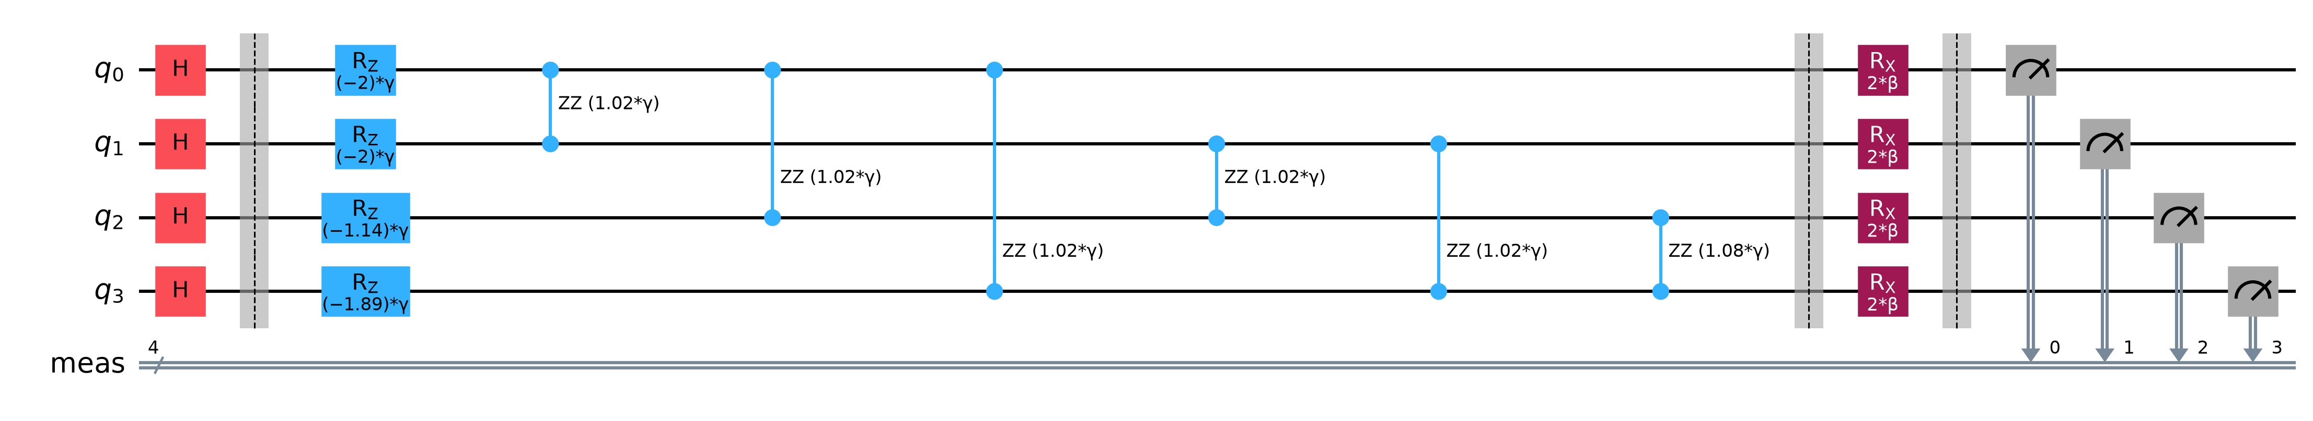
QAOA explores all dispatch plans at once: our real 4-qubit circuit
Why Quantum?
Our circuit for the 4-qubit problem, depth p = 1, drawn by Qiskit · qubit q2 = A3 → C1, the best plan
|ψ(γ, β)⟩ = Πₗ exp(−iβₗ B) exp(−iγₗ C) |+⟩⊗ⁿ B = Σₖ Xₖ minimise ⟨ψ| C |ψ⟩ over γ, β
1
Superpose
2
Cost layer
3
Mixer
4
Optimise, measure
H on every qubit puts all 2ⁿ dispatch plans in play
RZ and RZZ write each plan's cost into its phase
RX lets plans interfere; low-cost plans gain probability
COBYLA tunes γ, β; 4,096 shots decoded to plans
Notes:
PRESENTER: Harsha · about 1:00
Why quantum? Because our problem is already a QUBO, and QAOA, the Quantum Approximate Optimization Algorithm, is the standard algorithm for QUBOs on today's quantum computers.
This is our real circuit for a 4-qubit dispatch problem, drawn by Qiskit. Step one: the H gates put every possible dispatch plan into superposition at once. Step two, the cost layer: RZ and RZZ rotations, whose angles are our QUBO coefficients, write each plan's cost into its phase. There is one RZZ for every pair of coupled choices. Step three, the mixer: RX rotations let the plans interfere, so low-cost plans gain probability.
A classical optimiser, COBYLA, tunes the angles gamma and beta to minimise the expected cost. Then we measure 4,096 times and decode every bitstring back into a dispatch plan. In this circuit, qubit 2 is A3 going to call 1, which is the best plan.
So it is a hybrid: the quantum circuit explores, and classical code builds, tunes and checks. Now my teammate will show it working, and the results.

Slide 7
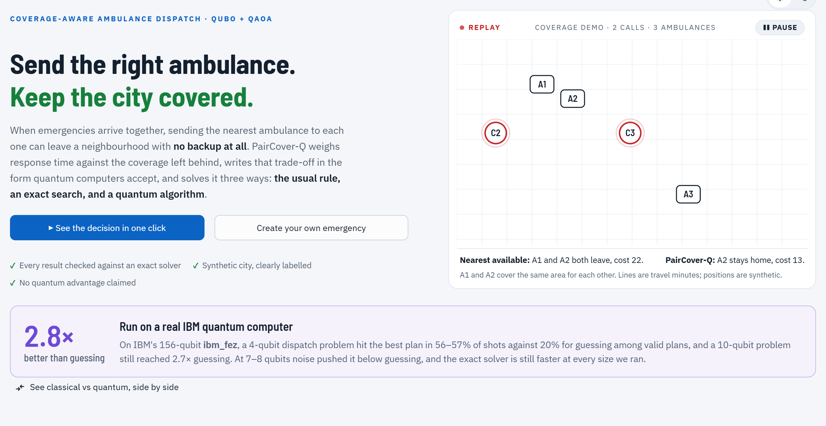
A live web app: the same problem, solved classically and on a real IBM quantum computer
Working Prototype
1
Home
“See the decision in one click”: 22 → 13, plus the hardware headline
2
Classical vs Quantum
Nearest, exact, QAOA simulator and real ibm_fez side by side: answers, hit rates, gates, timings
3
Real hardware chart
Strongest problem at each size, 4 to 10 qubits, on the real chip
4
Create your own emergency
Screenshot · Home page of our app, with the hardware headline
Place calls on a map; every solver runs live
Streamlit · Qiskit 2.5 · IBM Runtime · 149 tests · public GitHub
Notes:
PRESENTER: You · about 1:45 (live demo)
Thank you, Harsha. Everything we have described runs in a live web app. Let me show you.
[Click Home, then 'See the decision in one click'.] This runs the nearest-ambulance rule and our exact optimiser on the example Divya showed. You can see the cost go from 22 to 13, and A2 stays home.
[Open Quantum, then Classical vs Quantum, '4 qubits, depth 2'.] This page solves the same problem four ways. The nearest rule and the exact search run live in under a millisecond. QAOA on the simulator runs live too. And these rows are the same circuit run on IBM's real 156-qubit chips. Each row shows the answer, how often it hit the best plan, the gate count and the time.
[Click '6 qubits, depth 2'.] At 6 qubits, look: the nearest rule now picks a worse plan than the exact solver, because it ignores coverage. And the real chip is only around random guessing here. We will come back to that.
[If time allows: Try it, then Create your own emergency.] You can also place your own emergencies on a map and every solver runs live.

Slide 8
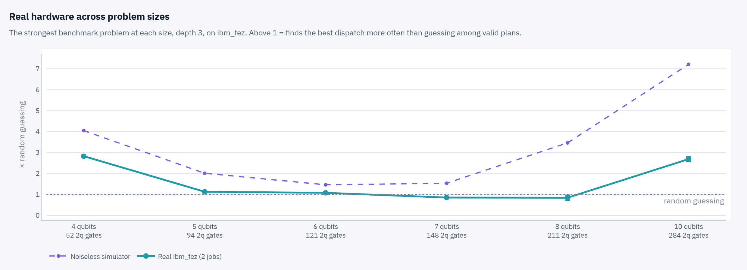
On a real IBM quantum computer, QAOA finds the best dispatch up to 2.8× more often than guessing
Results / Validation
2.8×
4 qubits
Top answer = best plan, 2 of 2 runs
2.7×
10 qubits
Still ahead with 284 two-qubit gates
Screenshot · our app · ibm_fez, depth 3, strongest problem at each size
2 chips
Above the dotted line = better than guessing. Noise keeps 24–74% of the noiseless gain: the limit is the hardware, not the algorithm.
9 jobs on IBM Heron
ibm_fez, ibm_marrakesh
Notes:
PRESENTER: You · about 1:00
Our mentor told us that real hardware results would be our biggest advantage, so we ran them. In total, 9 jobs on two IBM Heron chips with 156 qubits each: ibm_fez and ibm_marrakesh.
This chart shows the strongest problem at each size, from 4 to 10 qubits. Above the dotted line means the chip finds the best dispatch more often than random guessing among valid plans. The dashed line is the noiseless simulator, and the solid line is the real chip.
At 4 qubits the real chip finds the best plan 2.8 times more often than guessing, and the best plan was its most frequent answer in both runs. Even at 10 qubits, with 284 two-qubit gates, it is still 2.7 times better. At 7 and 8 qubits, noise pushes it slightly below guessing.
The noiseless line stays above guessing at every size. So the limit is hardware noise, not our algorithm. We also checked that this is not just a noise bias: the chip beats a noise-only baseline on every problem.

Slide 9
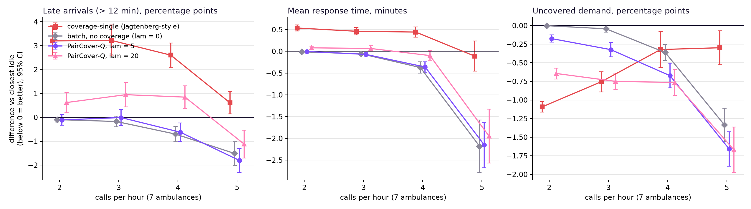
Planning simultaneous calls together cut response time by 2.15 minutes
Results / Validation
−2.15 min
−1.8 pts
4 of 4
Mean response, 5 calls/hour
Late arrivals
Loads with less uncovered demand
95% CI −2.67 to −1.63 vs nearest-available
Same load, same calls for every policy
2 to 5 calls/hour, 7 ambulances
Synthetic city · 7 ambulances · 7 days × 30 runs · negative is better
Notes:
PRESENTER: You · about 0:50
One example is not enough, so we also tested the method over time. We built a simulated city, 24 by 24 kilometres, with 7 ambulances and 6 stations, and ran it for 7 days, 30 times at each call load. Every policy saw exactly the same calls.
At 5 calls per hour, mean response time fell by 2.15 minutes compared with nearest-available, with a 95 percent confidence interval of 1.63 to 2.67 minutes. Late arrivals fell by 1.8 points. And uncovered demand fell at all 4 loads we tested.
To be honest about it: most of the response-time gain comes from planning simultaneous calls together, and the coverage term lowers uncovered demand. The city is synthetic; a real pilot would use 108 call logs.
Now Jayasuriya will compare real quantum computing with classical computing.

Slide 10
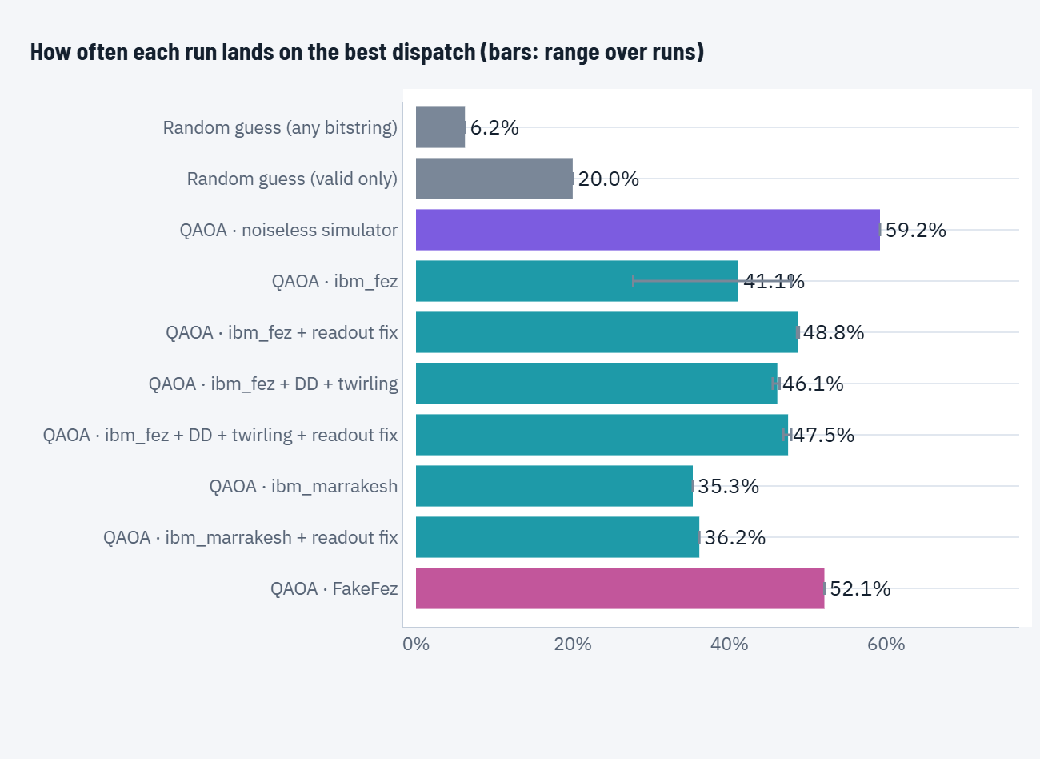
Today classical is faster; we measured exactly where the hardware stands
Quantum vs Classical
Method | Time to answer
Exact classical search (CPU) | < 1 ms
QAOA, noiseless simulator | 1–4 ms
IBM chip, empty queue (Marrakesh) | 11 s
IBM chip, busy queue (Fez) | 12–20 min
… of which on the quantum chip | 3–5 s
What limits the chip
Readout correction: +1 point. Decoupling + twirling: no gain.
The limit is two-qubit gate noise; zero-noise extrapolation is next.
No quantum advantage claimed.
Screenshot · 4 qubits, depth 2: hit rate per run
Notes:
PRESENTER: Jayasuriya · about 1:15
Thank you. Let me be direct about quantum versus classical, because this is where many projects overclaim.
On speed, classical wins today. The exact classical search answers in under a millisecond. The noiseless quantum simulator takes one to four milliseconds. On real IBM hardware, a job took 11 seconds with an empty queue and up to 20 minutes with a busy queue, even though the circuits ran on the chip for only 3 to 5 seconds.
How do we run on the real chip? We transpile our circuit with Qiskit to the chip's native gates. The 4-qubit circuit becomes 33 two-qubit gates on four physical qubits. We submit it through Qiskit Runtime with 4,096 shots, and every job carries calibration circuits for readout errors.
We tried error mitigation. Readout correction added about one point. Dynamical decoupling and twirling did not help. We also saw the same circuit, on the same qubits, go from 28 to 48 percent within two hours, so the chip drifts. That tells us the real limit is two-qubit gate noise.
So we claim no quantum advantage. What we do claim is a complete quantum pipeline, from an emergency to a real IBM chip and back to a correct dispatch decision, with an honest, measured boundary of where it helps today.

Slide 11
What is new, what it changes, and what comes next
Innovation and Roadmap
WHAT IS NEW
ROADMAP
1
Coverage as a pairwise term
Done
Real IBM hardware: 9 jobs, 2 chips, 4–10 qubits
No extra (ancilla) qubits for coverage
2
Provably safe, tight penalty
Next
Zero-noise extrapolation for two-qubit gate noise
Every minimum is valid; 2.16× vs 0.62× at 4P
Next
XY mixer: keep samples valid (45–71% today)
3
Small circuits by design
~2 qubits per decision; 8–12 when calls coincide
Next
More chips, more days (28% → 48% drift seen)
4
Honest hardware validation
2 IBM chips, repeats, mitigation, baselines
Pilot
Real 108 call logs, decision support for dispatchers
Impact: faster response · no area left without backup · a pipeline that grows with quantum hardware
Notes:
PRESENTER: Jayasuriya · about 1:00
What is new in our work? Four things. One: coverage is a pairwise term, so coverage-aware dispatch needs no extra qubits. Two: a penalty that is provably safe and tight. Three: small circuits by design, because only useful pairs get a qubit. Most real decisions need about 2 qubits, and 8 to 12 only when calls coincide. Four: honest validation on two real IBM chips, with repeats, mitigation and baselines.
The impact: faster response by planning calls together, balanced coverage so no area is left empty, and a pipeline that is ready to grow with quantum hardware, because more simultaneous calls means more qubits.
Our roadmap attacks exactly the limit we measured. The real hardware run is done. Next is zero-noise extrapolation for gate noise, an XY mixer to keep samples valid, runs on more chips and more days, and then a pilot with real 108 call logs from Tamil Nadu's research dataset.

Slide 12
References and Sources
1. TNHSP, 108 Ambulance research dataset (Tamil Nadu)
https://www.tnhsp.org/pages/view/108_Application
2. IBM Quantum Platform and Qiskit documentation
https://quantum.cloud.ibm.com/docs
3. Farhi, Goldstone, Gutmann (2014), Quantum Approximate Optimization Algorithm
https://arxiv.org/abs/1411.4028
4. Zhou et al. (2020), QAOA performance and INTERP, PRX 10, 021067
https://arxiv.org/abs/1812.01041
5. Lucas (2014), Ising formulations of many NP problems
https://arxiv.org/abs/1302.5843
6. Jagtenberg et al. (2017), Is closest-idle always optimal?
https://doi.org/10.1007/s10729-016-9368-0
7. ETV Bharat (June 2026), National Ambulance Services guidelines 2026
https://www.etvbharat.com/en/bharat/national-ambulance-services-gui…
8. MoHFW, ambulance norms (ALS per 5 lakh, BLS per 1 lakh)
https://mohfw.gov.in/press-info/8546
Thank you
Questions?
Code, reports and IBM hardware results:
github.com/gautham-code505/PairCover-Q-
Notes:
PRESENTER: Jayasuriya · about 0:20
These are our sources, and all our code, reports and hardware results are public on GitHub.
To close: we took ambulance dispatch from a QUBO to a real IBM quantum computer and back to a correct decision, and we measured honestly where quantum helps today. Thank you. We are happy to take your questions.

