Slide 1
Exploratory Data Analysis
Employee Attrition data
Gautham Periyasamy
Tharanitharan Ramajayam
Vivaswan Jinturkar

Slide 2
HR Analytics
HR Analytics helps human resources to interpret data, find out the trends & help take required steps to keep the organization running smoothly & profitably.
It has helped human resources to be more active and gain involved role in an organization's planning & objectives.
Retaining employees is one of the major tasks of the Human resource department, employees being the biggest asset of any company.
Thus studying the impact of various factors on employee attrition becomes a major part of HR analytics.
The data has 1,470 data points (rows) and 20 features (columns) describing each employee’s background and characteristics; with whether they are still in the company or whether they have gone to work somewhere else.

Slide 3
Sr.No | Varaibles | Description
1 | Age | The age of the employee
2 | Attrition | 1:Ex-employee 0:Current Employee
3 | BusinessTravel | Non travel, travel frequently, travel rarely
4 | Department | Human Resources, R&D,Sales
5 | EducationField | HR,Life Sciences,Medical,Marketing,Other, Technical Degree
6 | EnvironmentSatisfaction | Rated on the scale of 1 to 4,1 being lowest and 4 being Highest
7 | Gender | Gender of the Employee
8 | JobInvolvement | Rated on the scale of 1 to 4,1 being lowest and 4 being Highest
9 | JobLevel | Rated on the scale of 1 to 4,1 being lowest and 4 being Highest
10 | JobSatisfaction | Rated on the scale of 1 to 4,1 being lowest and 4 being Highest
11 | MaritalStatus | Single,Married or Divorsed
12 | MonthlyIncome | The monthly salary of the employee
13 | OverTime | Whether the employee does Overtime work or not
14 | TotalWorkingYears | Total work Experience in years
15 | WorkLifeBalance | Rated on the scale of 1 to 4,1 being lowest and 4 being Highest
16 | YearsAtCompany | Total experience at current company in years
17 | YearsInCurrentRole | Years working in current profile
18 | YearsSinceLastPromotion | Years since last promotion
19 | YearsWithCurrManager | Years with current Manager
20 | DistanceFromHome | Distance between office and home

Slide 4
Hypothesized Impactors
We feel that these 6 variables might have the most impact on attrition.
Age
Monthly Income
Distance from Home
Years since last promotion
Job satisfaction
Overtime

Slide 5
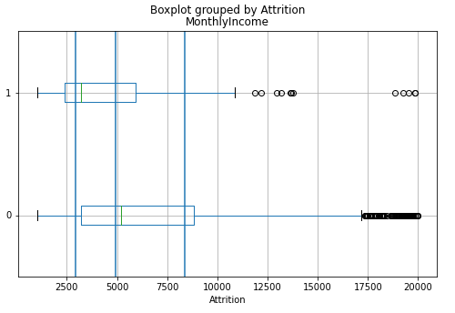
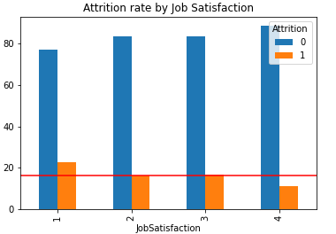
Results for hypothesized variables

Slide 6
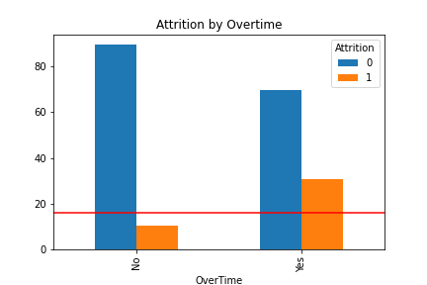
Variables influencing attrition- Monthly Income, Job satisfaction, Overtime

Slide 7
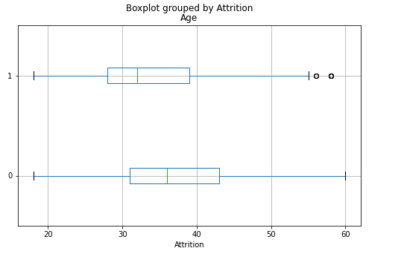
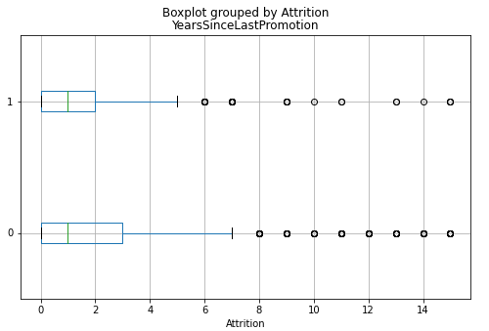
Variable not having major impact on attrition-Age, Years since last promotion and Distance from home

Slide 8
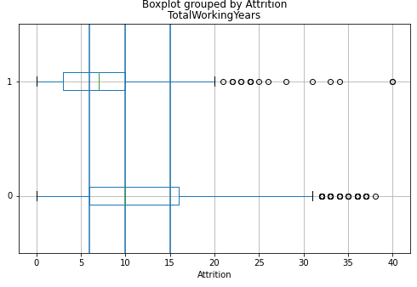
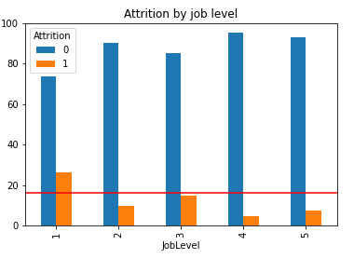
Variables analysed after hypothesis

Slide 9
Conclusion
The top 5 variables which impacted attrition were-
Overtime
Monthly Income
Job level
Total Working Years
Job Satisfaction.

Slide 10
Some extra Insights
People who travelled frequently had higher attrition
People from some specific educational backgrounds have high attrition
When people switch to a new manager or to a new role 25% of them quit within a year
Singles have higher rate of attrition(25%)
People with low satisfaction of the work environment had higher attrition rates.
Gender has no effect on attrition
Job level and Monthly income are positively corelated
Department and educational background are highly associated

