Slide 1
REP.AI a real-time repcounter which makes your exercise easier
Review 0

Slide 2
Introduction & Objective
Artificial Neural Network plays undoubtedly important role in the modern technology
Mostly it is used in technologies with smart real world applications; the most popular applications being computer vision, speech recognition, and natural language processing
Following the recent advances in technology, the ability to track sports and workout activities has broadened its horizons by the spread of off-the-shelf wearable devices, specifically smartwatches or smart-bands
The rep counter uses the recent advances in Deep Learning algorithms, the information acquired from conventional frame sensors can be used to infer the human body pose for further analysis
Specifically, one can contemplate the performance of body movements throughout physical exercises to provide feedback to the individual.
Therefore, we propose a system for workout repetition counting and validation based on a set of skeleton-based and deep semantic features that are obtained from a 2D human pose estimation network

Slide 3
Motivation :
In todays world many are interested in working out but not every workout is efficient as it seems
So this Application detects the efficiency of the workout by determining the number of reps performed by the user
Using this we can keep track of the count of the workout by selecting the type of workout you’re choosing

Slide 4
How to we perform this?
01
03
Dataset
02
Exploring the best combination of features and cameras
Methodology
Under the scope of our approach, a video-based dataset of individuals performing five common CrossFit-specific exercises is being acquired over time
Concerning the different features presented in the representation module, we have carried out tests with four combinations of them in an incremental manner for each physical exercise
This section aims to overview our proposal of a system that focuses on counting valid repetitions for the previously mentioned physical exercises

Slide 5
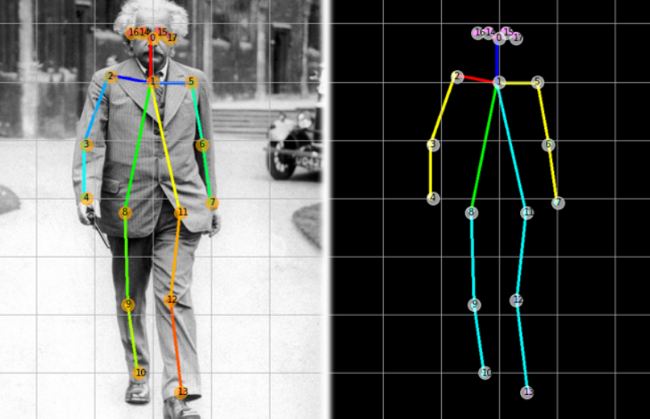
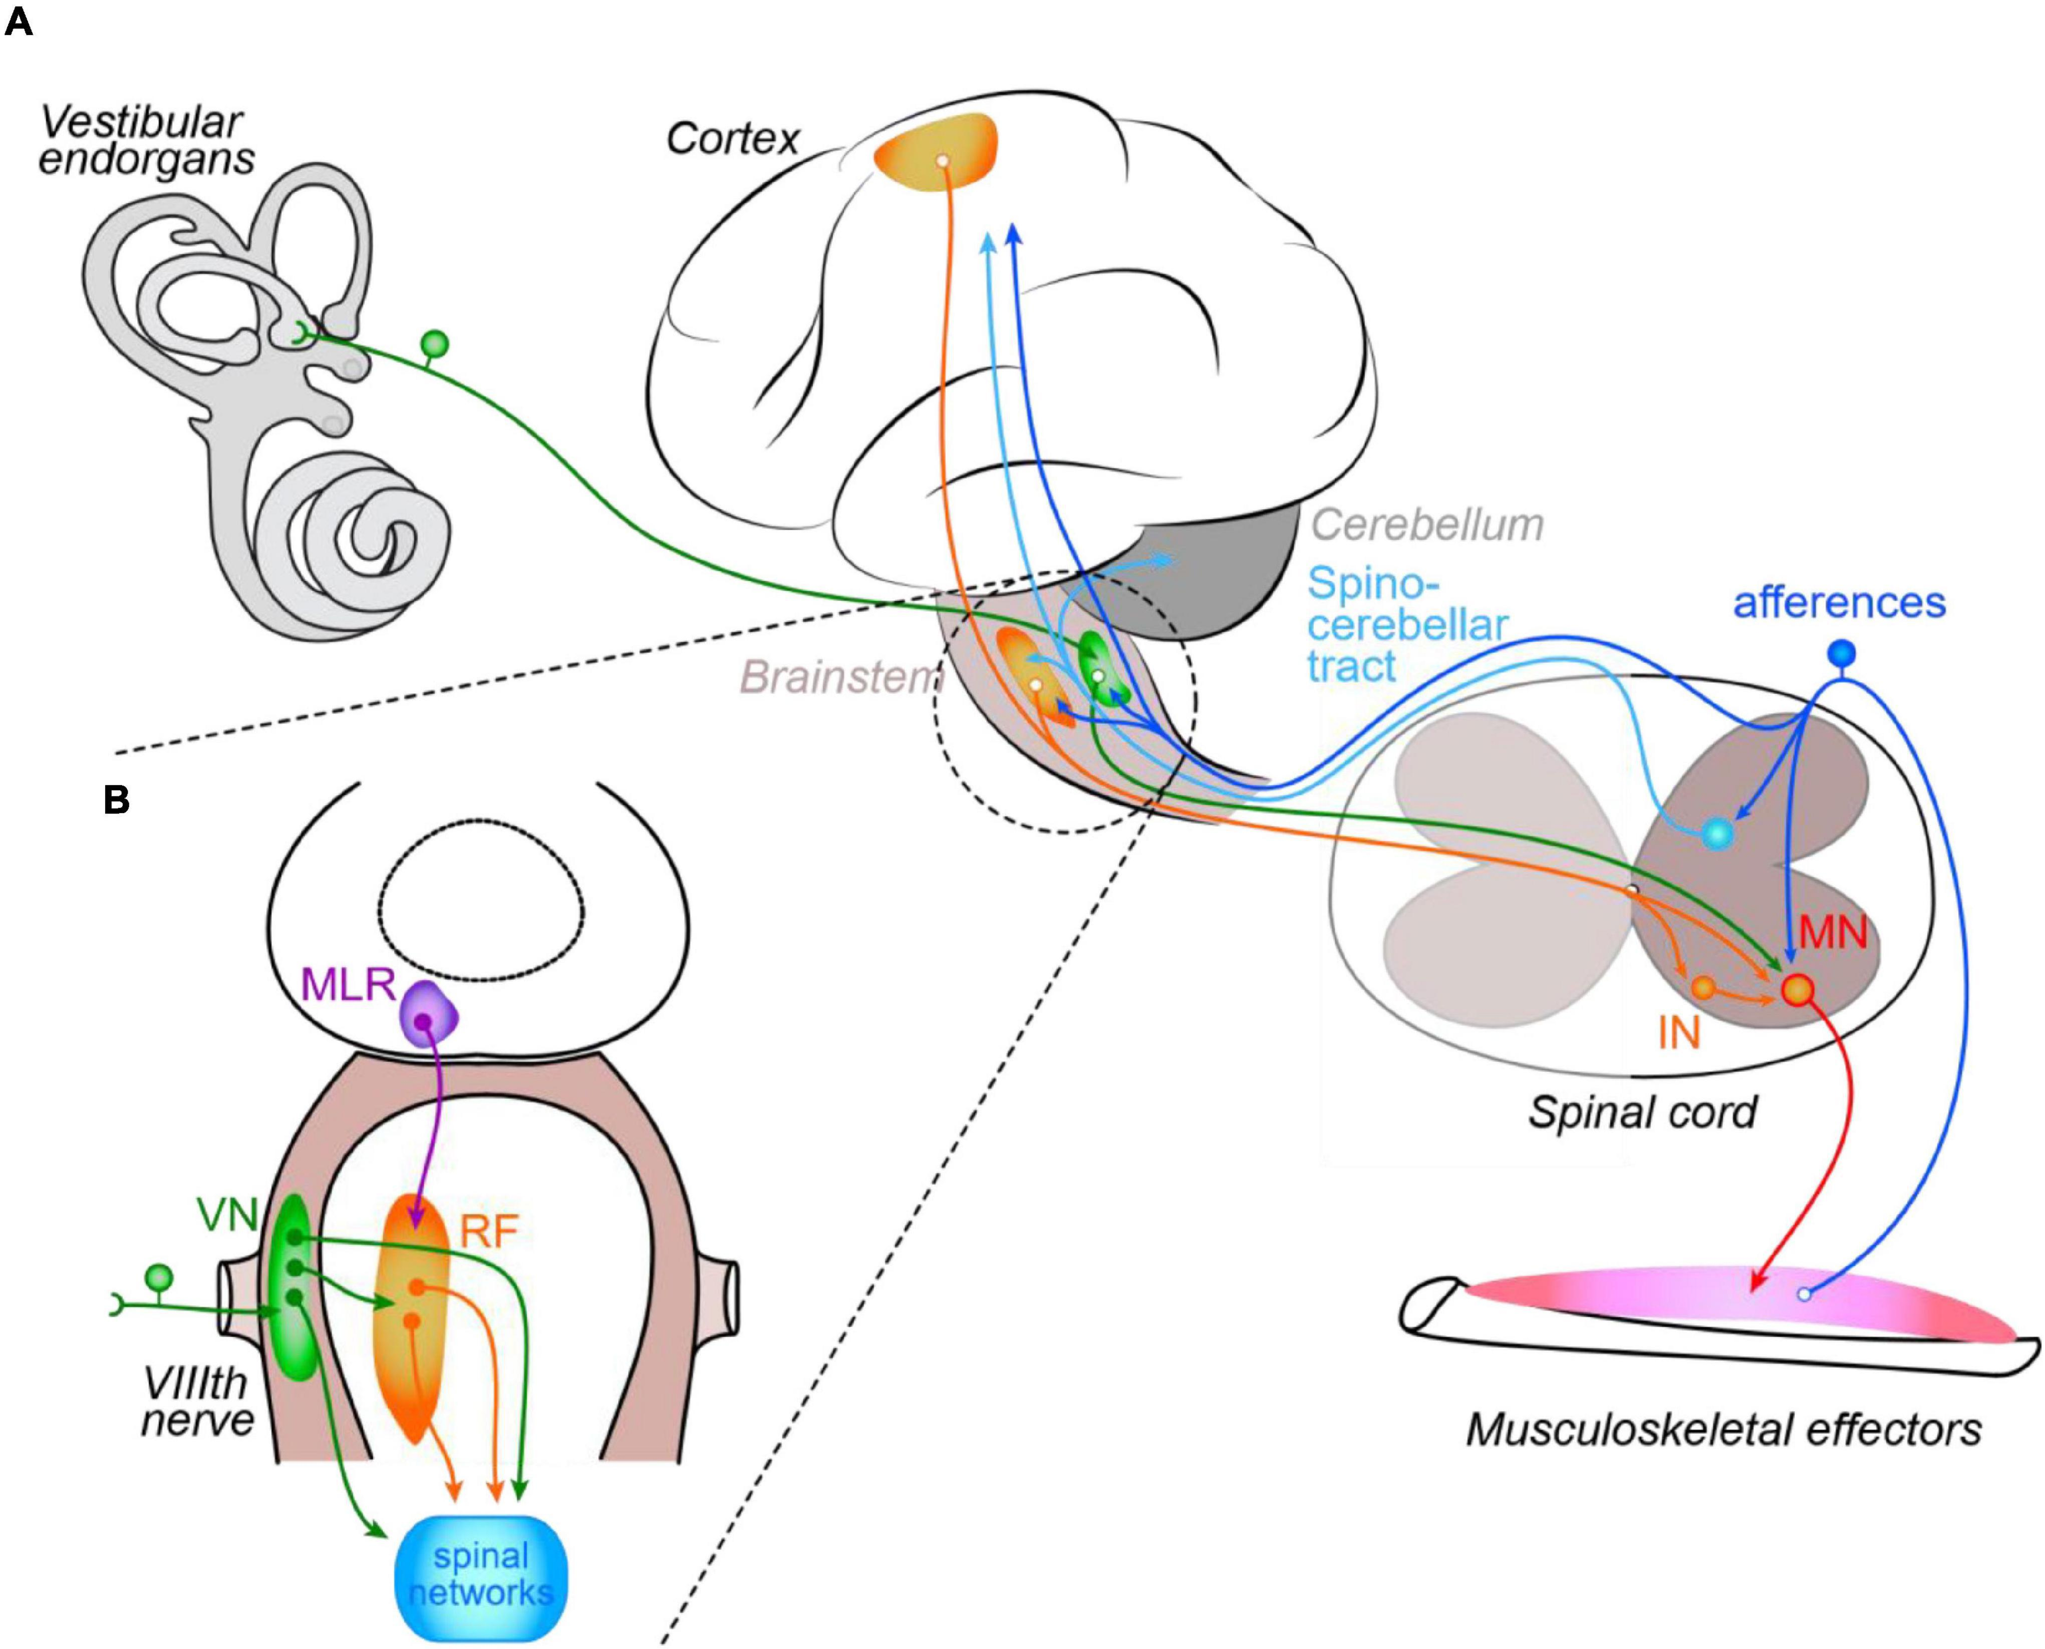
Firstly the posture is recognised by the camera and its detected using the application of computer vision
Then, using the methodologies of Neural networks, the data is sent to the neural effectors to sense and count the rep of the CrossFit exercise

Slide 6
Literature Review:
1. Pose estimation from video plays a critical role enabling the overlay of digital content and information on top of the physical world in augmented reality, sign language recognition, full-body gesture control, and even quantifying physical exercises, where it can form the basis for yoga, dance, and fitness applications.
2. The pose estimation component of the pipeline predicts the location of all 33 person keypoints with three degrees of freedom each (x, y location and visibility) plus the two virtual alignment keypoints described above. Unlike current approaches that employ compute-intensive heatmap prediction, our model uses a regression approach that is supervised by a combined heat map/offset prediction of all keypoints.
3. Specifically, during training we first employ a heatmap and offset loss to train the center and left tower of the network. We then remove the heatmap output and train the regression encoder (right tower), thus, effectively using the heatmap to supervise a lightweight embedding.
4. The following is done using regression method, in the list of regression method we have used KNN Regression.

Slide 7
5. K-Nearest Neighbour is one of the simplest Machine Learning algorithms based on Supervised Learning technique.
6. K-NN algorithm assumes the similarity between the new case/data and available cases and put the new case into the category that is most similar to the available categories.K-NN algorithm stores all the available data and classifies a new data point based on the similarity. This means when new data appears then it can be easily classified into a well suite category by using K- NN algorithm.
7. Once the joints are figured and skeletal structure is attained the logic for every exercise is put into place. The coordinated movement off the points helps in plotting position and when the position is obtained it’s is read as a pose and the counter is incremented.

Slide 8
1. Deep 3D human pose estimation: A review JinbaoWang^{a1}ShujieTan^{a1}XiantongZhen^{be}ShuoXu^{c}FengZhengªZhenyuHe^{d}LingShao^{b} Received 12 August 2020, Revised 13 May 2021, Accepted 14 May 2021, Available online 24 May 2021, Version of Record 9 June 2021
References:
2. Vision-based hand pose estimation: A review AliErolªGeorgeBebisªMirceaNicolescuªRichard D.Boyle^{b}XanderTwombly^{b}
Received 13 September 2005, Accepted 13 October 2006, Available online 19 January 2007.

Slide 9
3. Review and analysis of solutions of the three point perspective pose estimation problem Bert M. Haralick, Chung-Nan Lee, Karsten Ottenberg & Michael Nölle
References:
4. The Progress of Human Pose Estimation: A Survey and Taxonomy of Models Applied in 2D Human Pose Estimation
5. A Systematic Review of the Application of Camera-Based Human Pose Estimation in the Field of Sport and Physical Exercise
Received: 27 June 2021 / Revised: 30 August 2021 / Accepted: 3 September 2021 / Published: 7 September 2021

Slide 10
6. Human Pose Estimation from Monocular Images: A Comprehensive Survey – Wenjuan Gong Received: 4 July 2016 / Revised: 23 September 2016 / Accepted: 2 November 2016 / Published: 25 November 2016
References:
7. K-Nearest Neighbor(KNN) Algorithm for Machine Learning
8. Exploiting Offset-guided Network for Pose Estimation and Tracking
9. MediaPipe Pose - https://google.github.io/mediapipe/solutions/pose.html
10. Human Pose Estimation
By – Rohit Josyula
https://arxiv.org/pdf/2110.06877.pdf

Slide 11
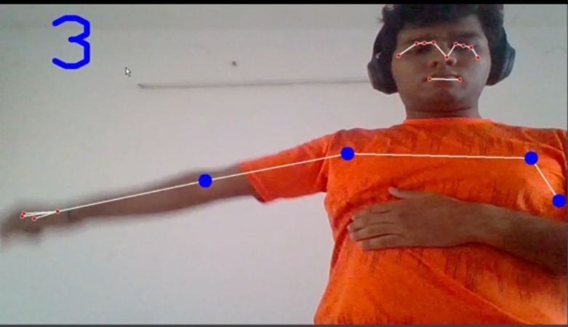
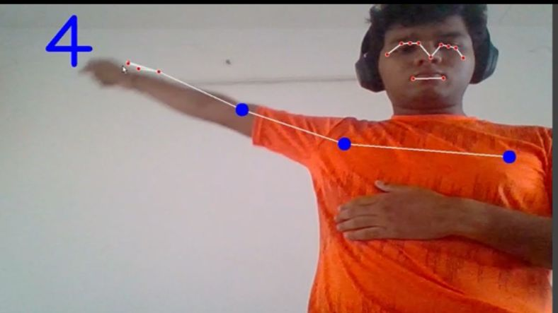
Screenshots

Slide 12
Thank you, a workout by
Sanjiv
Gautham
Gaurav
Abel

