Slide 1
Results interpretation

Slide 2
Data formatting
Categorical → numeric
Relevant columns are retained by performing chi-square test and retaining the columns with high p values.
In spark categorical data was manually converted into numeric data using same values as those in R

Slide 3
Classification(Decision tree)
Done with top 5 values.
Label to predict → Attitude towards advertising
Features → Attitude towards spamming, Internet privacy laws, key escrow encryption, children's privacy.
The model shows that generally people have negative attitude towards advertisers collecting private information. However belong to a group where they have no opinion on or neither agree nor disagree that there should be strict laws to protect the privacy are slightly less negative in their opinion towards advertisers collecting data. They also have an opinion towards the key escrow encryption. Meaning these people are not completely alien to the issue of privacy having known what it means.
People agree that strong laws should exist neither agree nor disagree with advertisers collecting data. Cannot comment on the attitude towards spam because people with wide range of reactions towards spam are included
The predictions made with this model gave an accuracy of around 54%

Slide 4
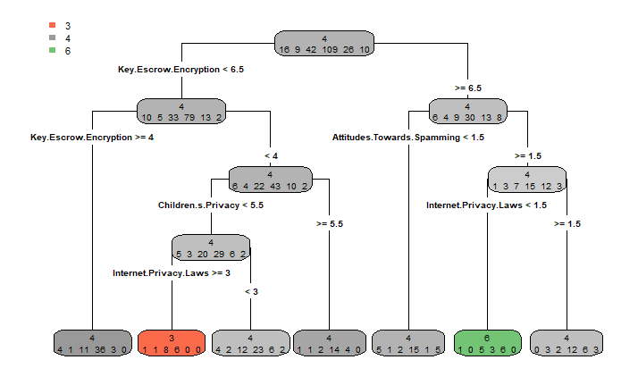
Regression

Slide 5
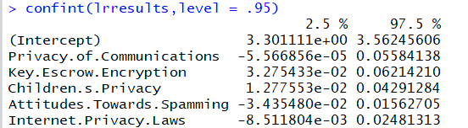
Regression
Linear regression was used to calculate the coefficients and intercept
The intercept says that everyone has a somewhat negative opinion towards the advertisers collecting private data. Privacy in general have negative effect on the advertisers collecting data

Slide 6
Regression
This means that when people are not so stringent with the privacy issue they do not mind advertisers using the private data to their benefit. Like maybe showing relevant ads or informing about offers for relevant products.
Similarly people who interact with more messages which include spamming are more positive towards advertisers collecting data
On the other hand this idea is not favored by people who are concerned with children's privacy and those who trust key escrow encryption

Slide 7
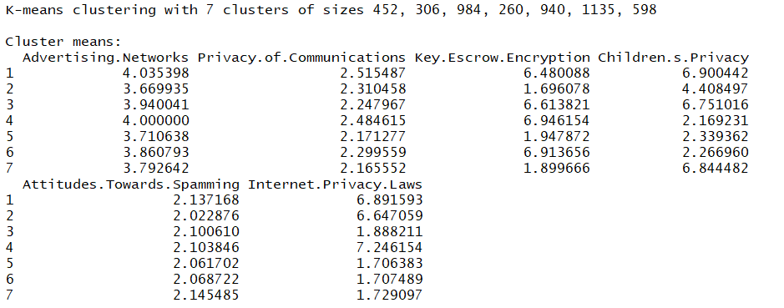
Clustering

Slide 8
Clustering
Based on their opinions people can be divided into 7 clusters
In all the clusters people have similar attitude toward spam and privacy.
rows represent clusters and columns represent the general attitude of the clusters on various activities
All clusters have negative attitude. It represents various factors which contribute towards negativity.
Represents various other opinion groups when the opinion towards advertising is negative.

