Slide 1
Malayalam Parser for Dataset Creation
Design Presentation
Guided by:
Dr. Mary Priya Sebastian
Fathima Jennath
Gautham C Sudheer
Godwin Gino
Mohammed Basil

Slide 2
Contents
Introduction
Problem Definition
Objectives
Functional Requirements of the Product
System Architecture
Datasets (if any)
UI Design
Work Division – Gantt Chart
Software/Hardware Requirements
Conclusion
References

Slide 3
Introduction
Importance of Natural Language Processing (NLP) in regional languages
Focus on the specific relevance of Malayalam in the context of NLP applications.
Challenges associated with the scarcity of annotated datasets.
Analyze both the syntactic and semantic structures of Malayalam sentences
Applications such as sentiment analysis, named entity recognition, etc.
Potential impact on advancing research and applications specific to the Malayalam

Slide 4
Problem Definition
To create a Malayalam Parser for dataset creation, involving data collection, preprocessing, manual annotation, and training using various parsing approaches to address the scarcity of annotated datasets in Malayalam for NLP applications.

Slide 5
Objectives
Data Collection
Gather text data from diverse sources in Malayalam language
Aim for a sufficient volume of data to represent the language's usage patterns adequately
Data Preprocessing
Perform tokenization, normalization, and cleaning of the collected data
Handle any inconsistencies or noise in the data to ensure quality

Slide 6
Objectives
Manual Annotation
Annotate a representative subset of the preprocessed data with grammatical and syntactic information
Employ linguistic experts or proficient annotators to ensure accurate annotations.
Parser Development
Train the parser using the annotated dataset to understand Malayalam syntax and semantics

Slide 7
Functional Requirements
Parse and analyze Malayalam language text to identify linguistic components such as words, phrases, and sentences.
Determine grammatical structure, syntax, and semantics of Malayalam sentences to facilitate accurate linguistic analysis.
Provide functionality for part-of-speech tagging, syntactic parsing, and semantic analysis tailored for the Malayalam language.

Slide 8
Functional Requirements
Support for handling compound words, inflections, and variations in word forms commonly found in Malayalam text.
Generation of a part-of-speech tagged dataset, named entity dataset, and sentimental tagged dataset, contributing to the advancement of language processing technologies in Malayalam
Implement a user-friendly interface that allows users to input Malayalam text for analysis

Slide 9
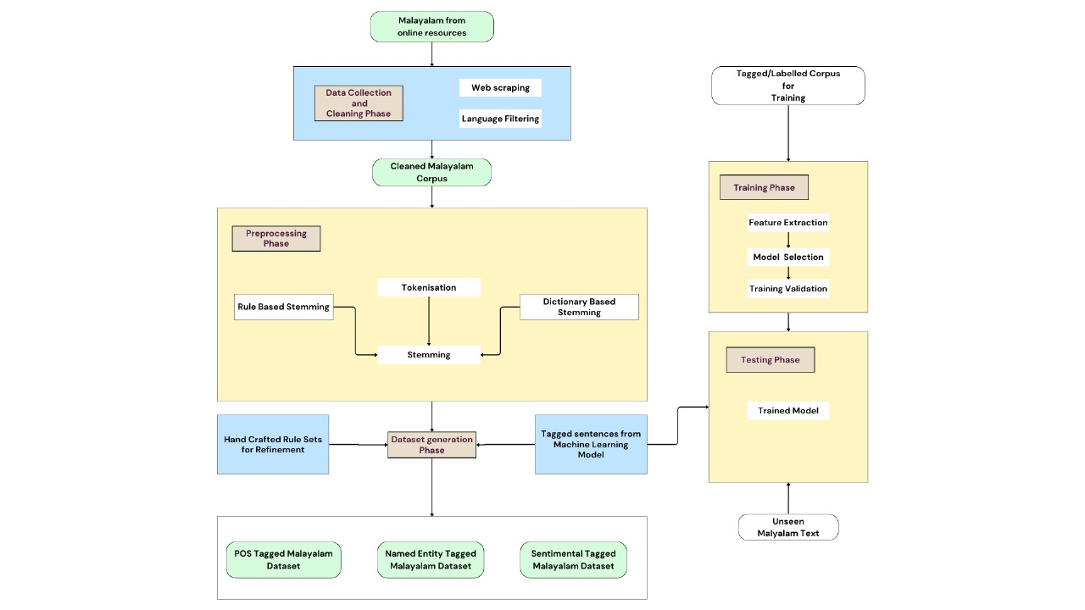
System Design

Slide 10
Data Collection and Cleaning Phase

Slide 11
Data Preprocessing

Slide 12
Training and Testing

Slide 13
Output

Slide 14
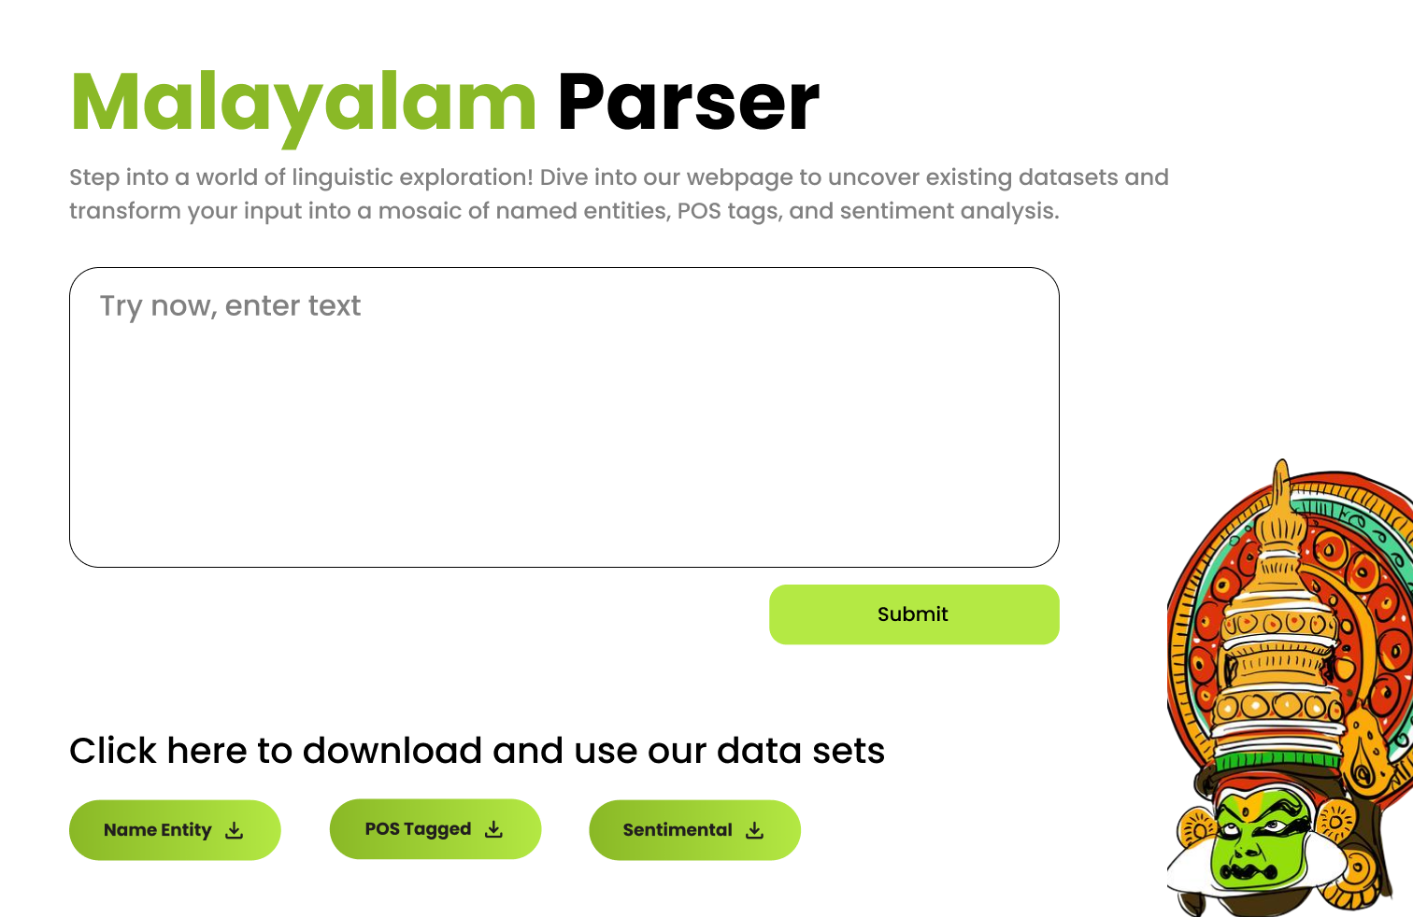
UI Design

Slide 15
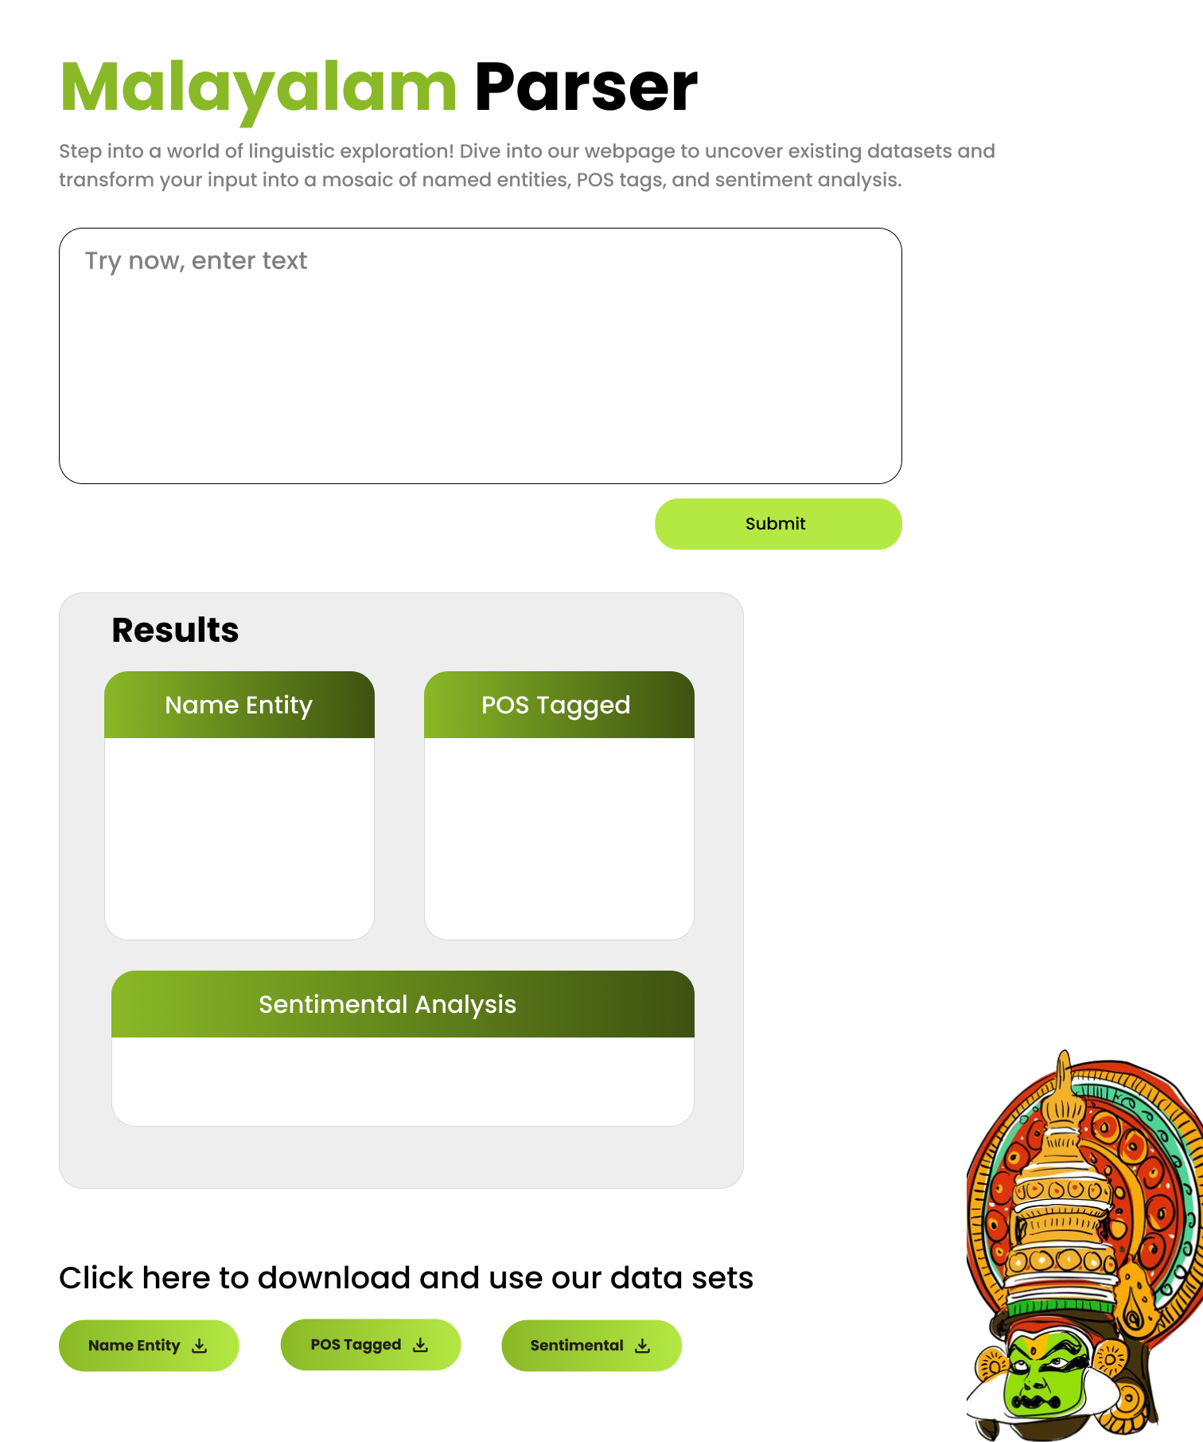
UI Design

Slide 16
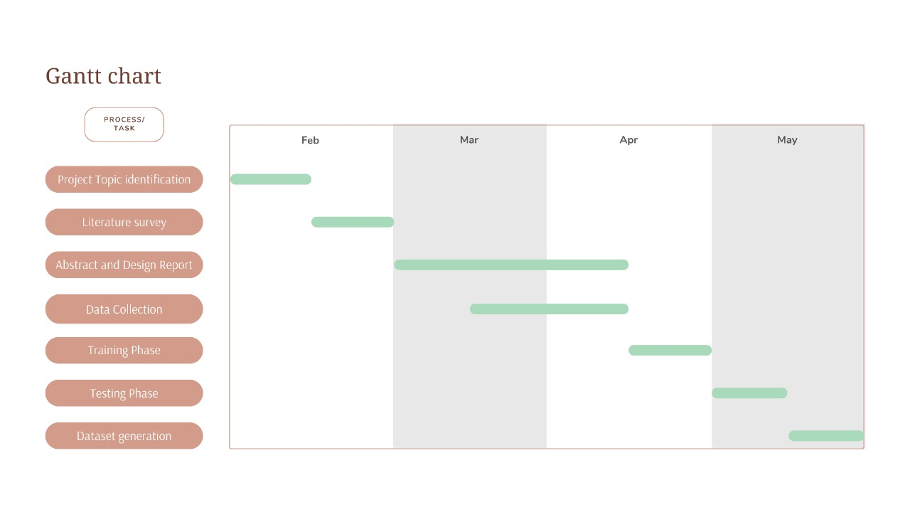
Work Division

Slide 17
Software / Hardware Requirements
Windows 10 or later
MacOS 10.13 High Sierra or later
Ubuntu 18.04 LTS or later
A modern processor (e.g., Intel Core i5 or equivalent)
Sufficient RAM (at least 4GB)
Available storage space for software installation
Python (version 3.6 or later)
Other programming languages and frameworks suitable for NLP development like NLTK, spaCy, scikit-learn, TensorFlow, etc. may be necessary

Slide 18
Conclusion
A comprehensive Malayalam language processing tool facilitating accurate linguistic analysis and dataset generation for NLP applications.
Parsing and analysis of Malayalam text, enabling identification of linguistic components and determination of grammatical structure, syntax, and semantics
Generates part-of-speech tagged, named entity, and sentiment-tagged datasets
Contribute significantly to the advancement of language processing technologies in Malayalam.

Slide 19
Thank you

