Slide 1
Malayalam Parser for Dataset Creation
Design Presentation
Guided by:
Dr. Mary Priya Sebastian
Fathima Jennath
Gautham C Sudheer
Godwin Gino
Mohammed Basil

Slide 2
Contents
Introduction
Problem Definition
Objectives
Functional Requirements of the Product
System Architecture
Datasets (if any)
UI Design
Work Division – Gantt Chart
Software/Hardware Requirements
Conclusion
References

Slide 3
Introduction
Importance of Natural Language Processing (NLP) in regional languages
Focus on the specific relevance of Malayalam in the context of NLP applications.
Challenges associated with the scarcity of annotated datasets.
Analyze both the syntactic and semantic structures of Malayalam sentences
Applications such as sentiment analysis, named entity recognition, etc.
Potential impact on advancing research and applications specific to the Malayalam

Slide 4
Problem Definition
To create a Malayalam Parser for dataset creation, involving data collection, preprocessing, manual annotation, and training using various parsing approaches to address the scarcity of annotated datasets in Malayalam for NLP applications.

Slide 5
Objectives
Data Collection
Gather text data from diverse sources in Malayalam language
Aim for a sufficient volume of data to represent the language's usage patterns adequately
Data Preprocessing
Perform tokenization, normalization, and cleaning of the collected data
Handle any inconsistencies or noise in the data to ensure quality

Slide 6
Objectives
Manual Annotation
Annotate a representative subset of the preprocessed data with grammatical and syntactic information
Employ linguistic experts or proficient annotators to ensure accurate annotations.
Parser Development
Train the parser using the annotated dataset to understand Malayalam syntax and semantics

Slide 7
Functional Requirements
Parse and analyze Malayalam language text to identify linguistic components such as words, phrases, and sentences.
Determine grammatical structure, syntax, and semantics of Malayalam sentences to facilitate accurate linguistic analysis.
Provide functionality for part-of-speech tagging, syntactic parsing, and semantic analysis tailored for the Malayalam language.

Slide 8
Functional Requirements
Support for handling compound words, inflections, and variations in word forms commonly found in Malayalam text.
Generation of a part-of-speech tagged dataset, named entity dataset, and sentimental tagged dataset, contributing to the advancement of language processing technologies in Malayalam
Implement a user-friendly interface that allows users to input Malayalam text for analysis

Slide 9
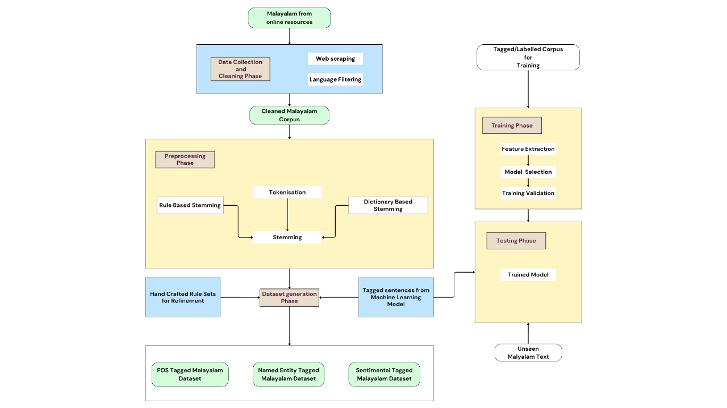
System Design

Slide 10
Data Collection and Cleaning Phase

Slide 11
Data Preprocessing

Slide 12
Training and Testing

Slide 13
Output

Slide 14
Algorithm
1. Data Collection:
Use web scraping techniques to gather Malayalam text data from online sources.
Apply language filtering to ensure only Malayalam text is retained.
Store the collected data in a structured format for further processing.
2. Data Cleaning:
Remove irrelevant information or non-textual content.
Eliminate errors and inconsistencies, such as misspellings or formatting issues.
Filter out special characters or symbols that do not contribute to the linguistic content.
3. Preprocessing:
Tokenization: Split the cleaned text into individual words or tokens.
Stemming: Reduce inflected words to their base form to simplify the text for analysis.

Slide 15
Algorithm
4. Annotation:
Manually annotate a subset of the preprocessed data with desired linguistic information
Use linguistic expertise to ensure the accuracy and consistency of annotations.
5. Feature Extraction:
Extract relevant features from the annotated data
Word embeddings, syntactic features, or semantic features.
Design feature representations that capture linguistic properties essential for the parsing.
6. Model Selection:
Rule-set generation
Rule-based parsing and machine learning-based parsing.

Slide 16
Algorithm
7. Model Training:
Train the selected parsing model using the annotated data and extracted features.
Optimize model parameters and hyperparameters to improve performance.
Validate the model using cross-validation techniques to ensure generalization
8. Evaluation:
Evaluate the trained model's performance on a separate test set
Analyze the model's strengths and weaknesses to identify areas for improvement.
9. Refinement:
Refine the parsing model based on the evaluation results and feedback
Iteratively improve the model's accuracy and robustness

Slide 17
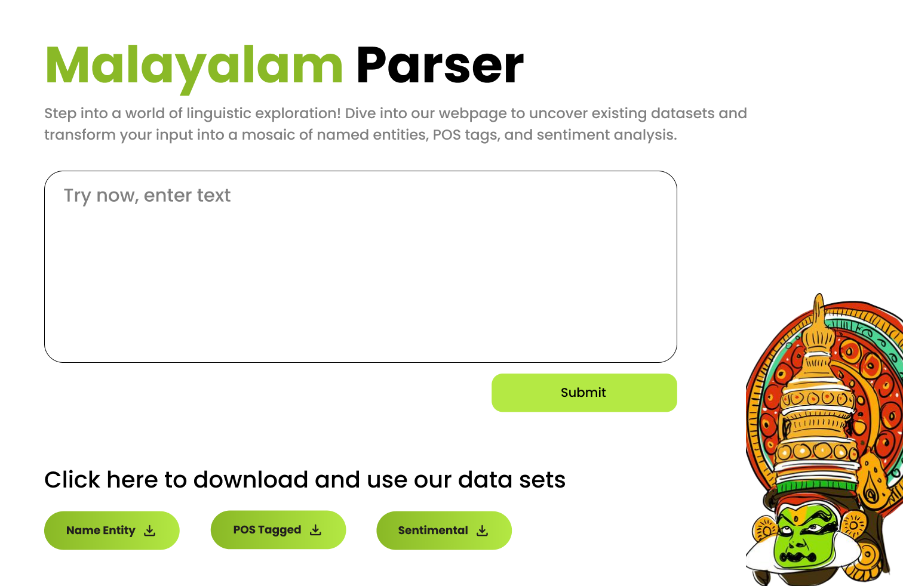
UI Design

Slide 18
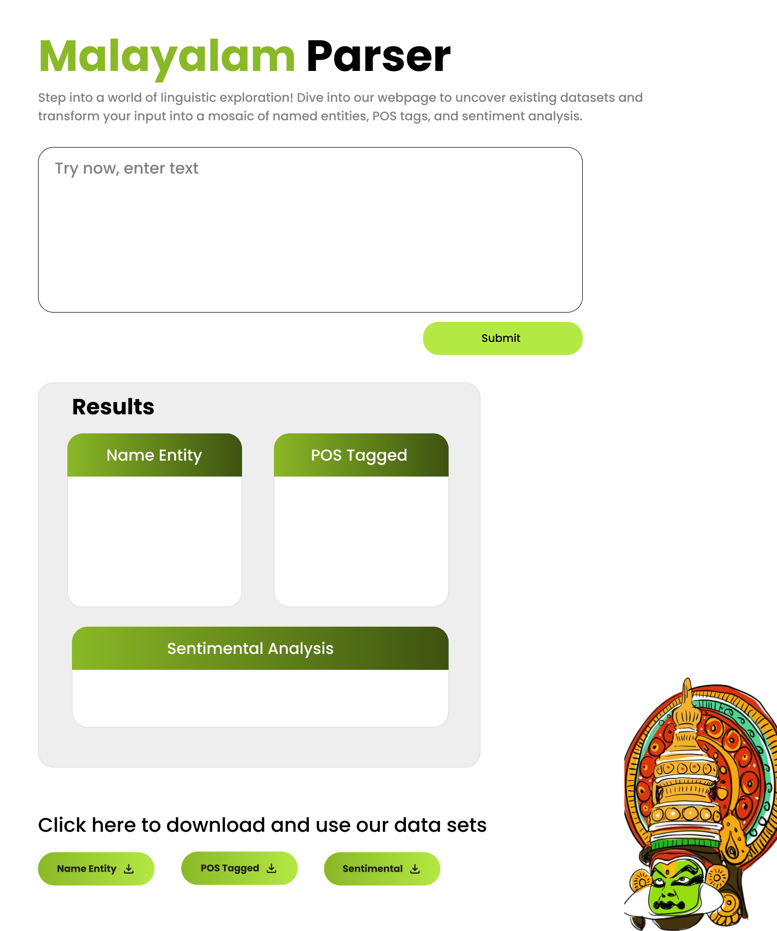
UI Design

Slide 19
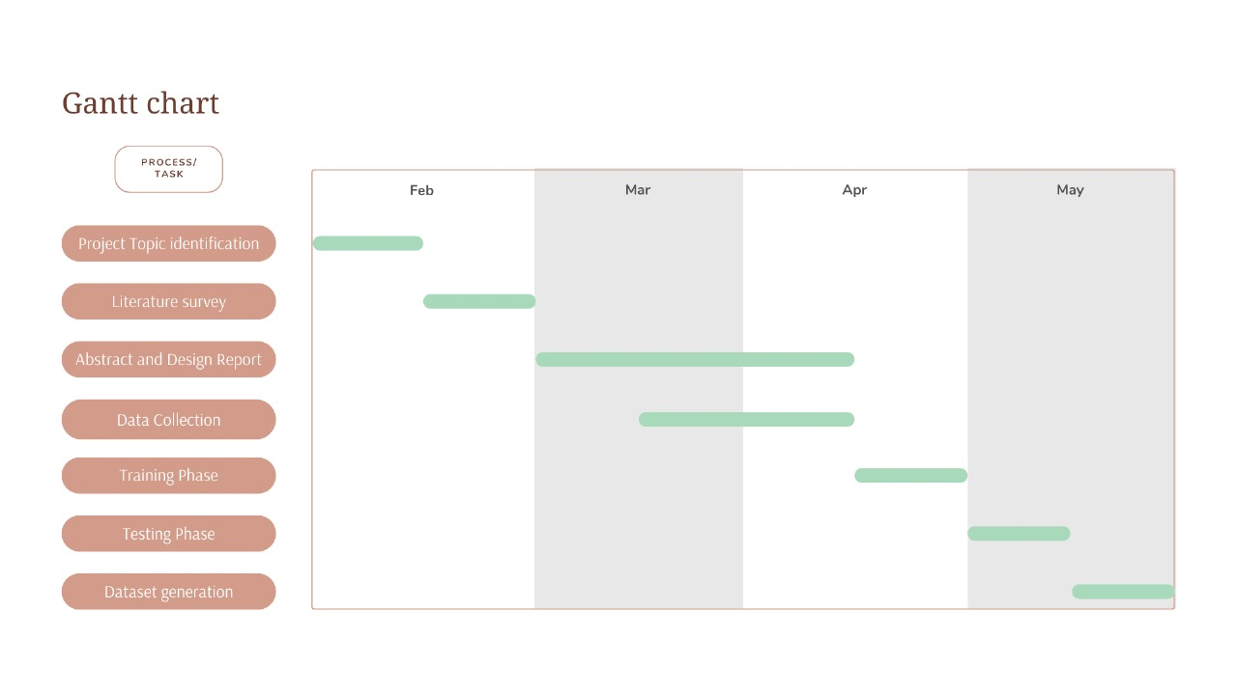
Work Division

Slide 20
Software / Hardware Requirements
Windows 10 or later
MacOS 10.13 High Sierra or later
Ubuntu 18.04 LTS or later
A modern processor (e.g., Intel Core i5 or equivalent)
Sufficient RAM (at least 4GB)
Available storage space for software installation
Python (version 3.6 or later)
Other programming languages and frameworks suitable for NLP development like NLTK, spaCy, scikit-learn, TensorFlow, etc. may be necessary

Slide 21
Conclusion
A comprehensive Malayalam language processing tool facilitating accurate linguistic analysis and dataset generation for NLP applications.
Parsing and analysis of Malayalam text, enabling identification of linguistic components and determination of grammatical structure, syntax, and semantics
Generates part-of-speech tagged, named entity, and sentiment-tagged datasets
Contribute significantly to the advancement of language processing technologies in Malayalam.

Slide 22
References
Asopa, S., and Sharma, N. (2021) A Hybrid Parser Model for Hindi Language. Indian Journal of Computer Science and Engineering (IJCSE), Vol. 12(1).
Chen, D., and Manning, C. D. (2014). A Fast and Accurate Dependency Parser using Neural Networks. Proceedings of the 2014 Conference on Empirical Methods in Natural Language Processing (EMNLP).
Nair, L. R. (2013). Language Parsing and Syntax of Malayalam Language. 2nd International Symposium on Computer, Communication, Control and Automation (3CA 2013).
Berger, A. L., Della Pietra, V. J., and Della Pietra, S. A. (1996). A Maximum Entropy Approach to Natural Language Processing. Association for Computational Linguistics, Vol 22(1).
Mestry, A., Shende, S., Mahadik, A., and Virnodkar, S. (2014). A Parser: Simple English Sentence Detector and Correction. International Journal of Engineering Research and Technology (IJERT).

Slide 23
References
Sethi, N., Agrawal, P., Madaan, V., and Singh, S. K. (2016). A Novel Approach to Paraphrase Hindi Sentences using Natural Language Processing. Indian Journal of Science and Technology, Vol 9(28).
Smith, D. A., and Eisner, J. (2008). Dependency Parsing by Belief Propagation. Proceedings of the 2008 Conference on Empirical Methods in Natural Language Processing, Page 145- 156.
Bharati, A., Kulkarni, A., and Chaudhury, S. (2007). English Parsers: Some Information- based Observations.
Jayan, J. P., and R, R. (2009). A Morphological Analyzer for Malayalam - A Comparison of Different Approaches. International Journal of Computer Science and Information Technology. Vol 2(2), Page 155-160.
Vaidya, A., Choi, J. D., Palmer, M., and Narasimhan, B. (2011). Analysis of the Hindi Proposition Bank using Dependency Structure. Proceedings of the Fifth Law Workshop (LAW V), Page 21-29.

Slide 24
References
Rajan, M., T.S, R., and Bhojane, V. (2014). Information Retrieval in Malayalam Using Natural Language Processing. International Journal of Scientific and Engineering Research, Vol 5(6)
Rajan, M., Thirumalai, R., and Kumar, V. (2006). Development of a Tamil Parser using Natural Language Processing Techniques. A survey of the state of the art in tamil language technology Vol 6(10).
Venkatesh, R., Kumar, S., and Arumugam, P. (2014). Building a Lexical Analyzer for Tamil Texts using NLP Approaches. 2014 International Conference on Advances in ICT for Emerging Regions (ICTer).
Thavareesan, S., and Mahesan, S. (2019). Sentiment Analysis in Tamil Texts: A Study on Machine Learning Techniques and Feature Representation.2019 IEEE 14th Conference on Industrial and Information Systems (ICIIS).

Slide 25
References
Pai, T. V., Devi, J. A., and Aithal, P. S. (2020). A Systematic Literature Review of Lexical Analyzer Implementation Techniques in Compiler Design. International Journal of Applied Engineering and Management Letters (IJAEML), Vol 4(2), Page 285-301.
Simmons, R. F., and Burger, J. F. (1968). A Semantic Analyzer for English Sentences. Mechanical Translation and Computational Linguistics, Vol 11.

Slide 26
Thank you

