Slide 1
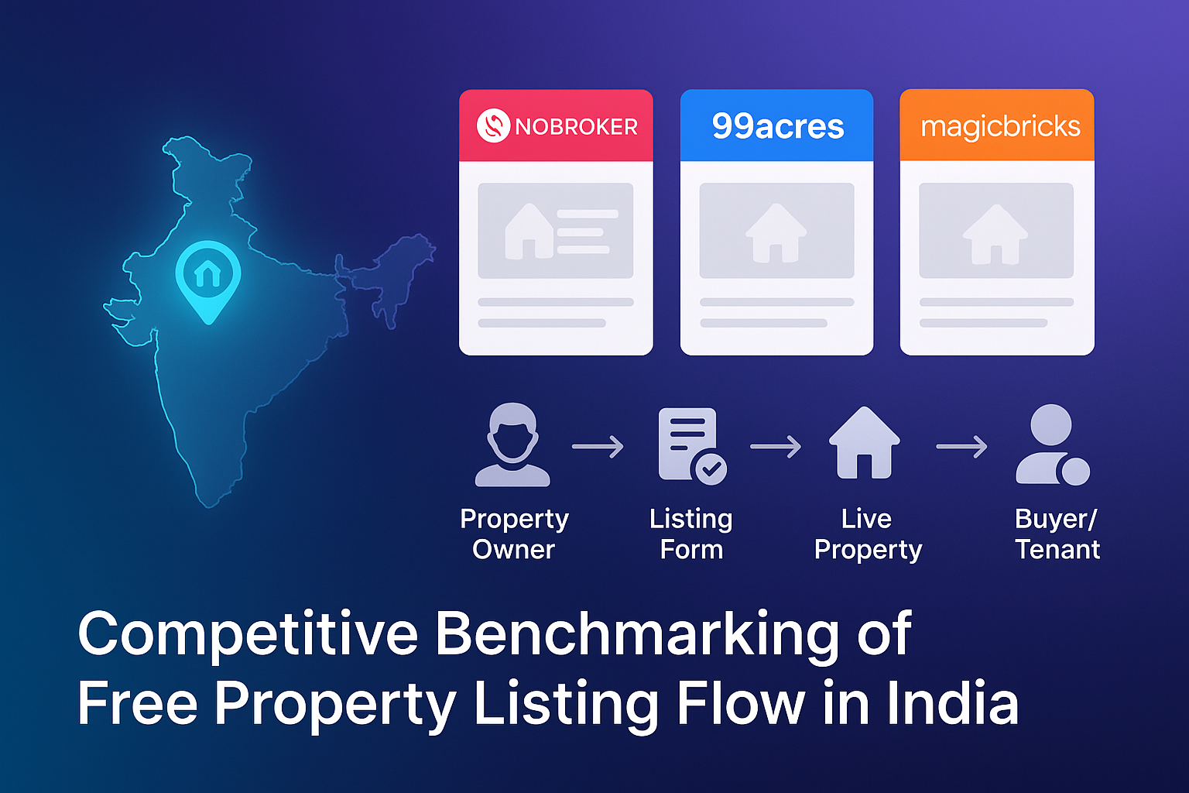

Slide 2
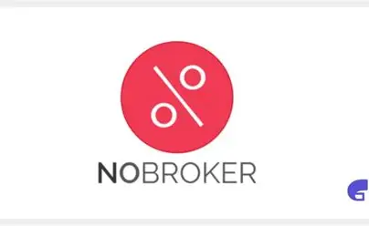
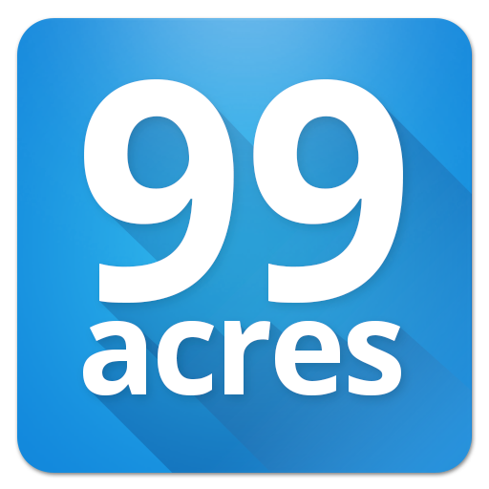

SCOPE OF STUDY:
Analyze the free property listing process for property owners
Platforms analyzed: NoBroker, 99acres, MagicBricks
Goal: Understand listing flows, highlight solved problems, and spot gaps

Slide 3
ANALYTICAL APPROACH:
Onboarding: Evaluation of login options (OTP, email, full signup)
Property Details Form: Assessment of mandatory vs optional fields
Photos & Videos: Ease of upload and content quality
Pricing & Location: Map integration, auto-suggestions, and accuracy
Post-listing Leads: Dashboard visibility, lead management, and verification process

Slide 4
COMPARATIVE INSIGHTS:
STEP | NoBroker | 99acres | MagicBricks
Onboarding | 🟩 OTP Login,frictionless | 🟨Lengthy,multiple steps | 🟩 Streamlined,intuitive
Form | 🟩 Smart suggestions,low friction | 🟥 Many mandatory fields | 🟩 Balanced,clear,user friendly
Photos | 🟨Basic Upload | 🟨Standard Upload only | 🟩 AI-assisted, enhanced visuals
Pricing & Location | 🟩 Auto-suggests rent,fast | 🟥 Magic picker, cumbersome | 🟩 Smooth ,Intuitive
Post-Listing | 🟨Pain plan push | 🟨Leads delayed till verification | 🟥 Aggressive upsells
Insight: NoBroker excels in speed and simplicity, 99acres emphasizes trust and coverage, MagicBricks focuses on marketing polish and visibility.

Slide 5
HOW PLATFORMS ADDRESS CORE NEEDS:
NoBroker:Direct, Cost-Efficient Connections
Pain Points Addressed:
Eliminates broker fees, reducing costs for owners and tenants
Enables direct communication, improving transparency and trust
Simplified onboarding and listing form minimize friction
Impact: Owners save money and time; tenants gain direct access to verified listings

Slide 6
2. 99acres – Trust & Reach
Pain Points Addressed:
Verification processes increase listing credibility
Broad platform reach ensures higher visibility for property owners
Standardized forms enforce completeness of information
Impact: Reduces uncertainty for tenants, builds trust and reliability for listings
3. MagicBricks – Marketing & Visibility
Pain Points Addressed:
AI-enhanced photo uploads improve listing presentation
Premium placement increases visibility and lead quality
Smooth pricing & location suggestions reduce cognitive load
Impact: Properties attract more interest, owners can market listings effectively

Slide 7
NoBroker | 99acres | MagicBricks
Eliminates broker fees | Verified listings | AI-enhanced photos
Direct owner-tenant connection | Broad reach | Premium placement
Simplified onboarding | Standardized forms | Smooth pricing & location
Impact: Owners save money and connect directly with tenants | Impact: Increased trust and listing visibility | Impact: Better listing presentation and higher engagement

Slide 8
STRATEGIC RECOMMENDATIONS:
RECOMMENDATION | RATIONALE & EXPECTED IMPACT
Smart Autofill & Price Suggestions | What: Pull property details from maps, suggest rent/sale prices using comparable listings. Why: Reduces manual effort, speeds up listing creation, increases accuracy. Impact: Fewer abandoned listings, faster onboarding, more confident users.
Progressive Form Design | What: Present a short form first; reveal advanced fields later Why: Minimizes drop-offs and cognitive load Impact: Improves completion rate without compromising data quality

Slide 9
Conclusion / Key Takeaways:
Platform positioning differs:
NoBroker → Cost-efficiency & speed
99acres → Trust & scale
MagicBricks → Marketing & visibility
Common frictions remain: Long forms, upselling, delayed leads
Strategic opportunity: Simplify onboarding, automate data, balance monetization with trust
Closing Insight: Future growth lies in reducing friction while sustaining monetization.

