Slide 1
Connected intelligent cars
How can we improve cars in traffic?
Mohammad Amir
Daniel Smetankin
Satish Singh
Mohammad Wasef
Gauthier de Borrekens

Slide 2
Goals
Making cars more intelligent
Setting up a widespread traffic network

Slide 3
1. How does it work?
Let’s start

Slide 4
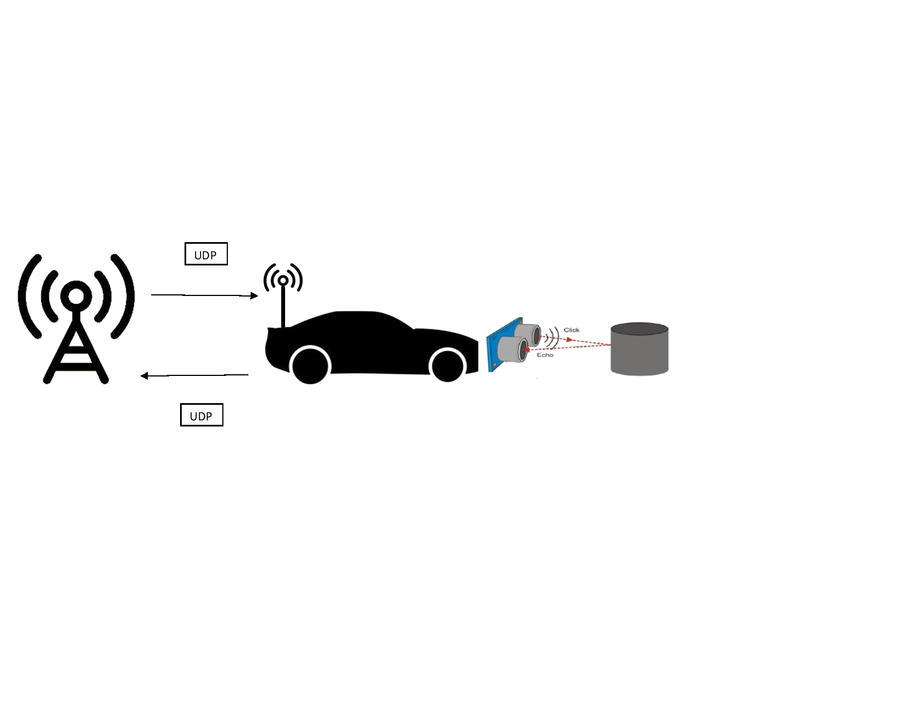
How does it work?
Distance Measurement
Speed adjustment
Data collection

Slide 5
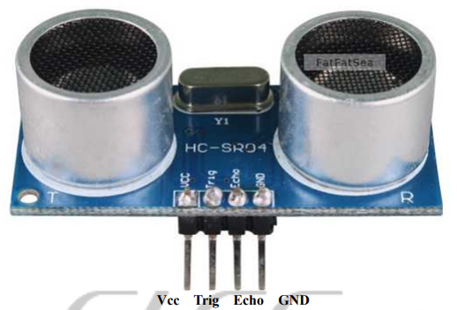
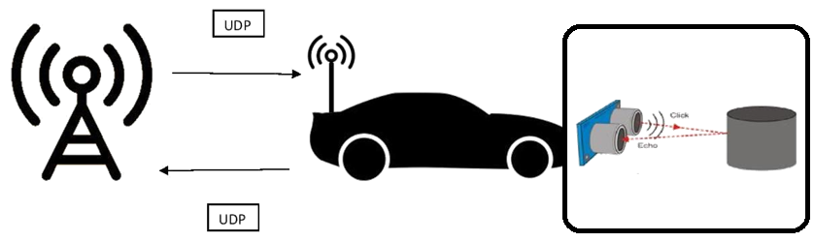
Distance measurement
HC-SR04 Sonar ranging module
Generates soundwaves
Measures delay of echo

Slide 6
Speed adjustments
Aims for 1m distance
Bigger distance causes increase in speed
Smaller distance causes decrease in speed

Slide 7
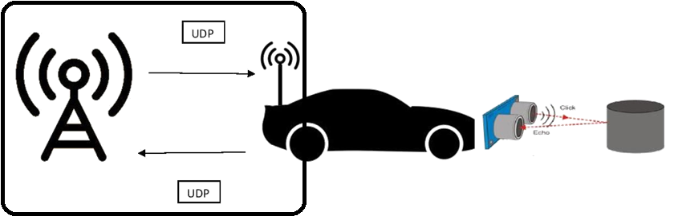
Data collection
Ubuntu server
Car sends speed and distance
Visualisation

Slide 8
2. Materials
Let’s start

Slide 9
Materials
RC cars
H-Bridge
NodeMCU
HC SR04 sensor
Battery pack

Slide 10
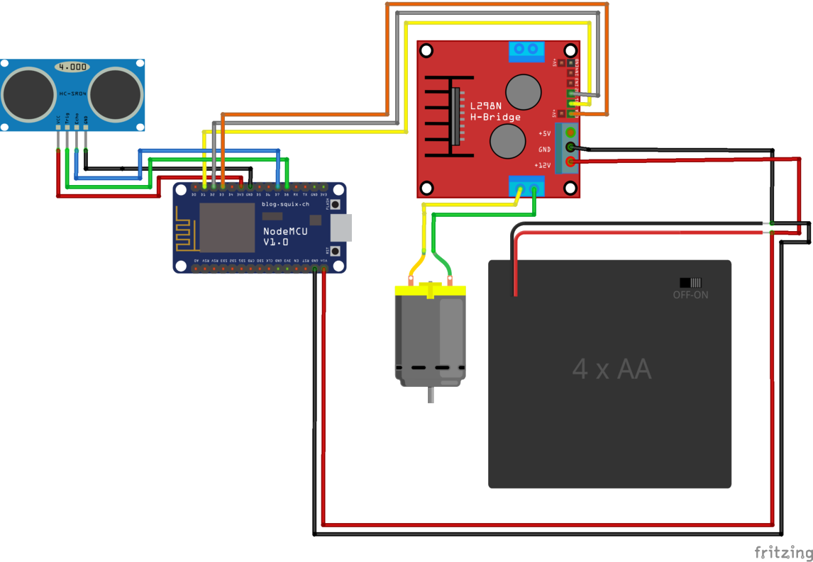
Circuit

Slide 11
3. Software
Let’s start

Slide 12
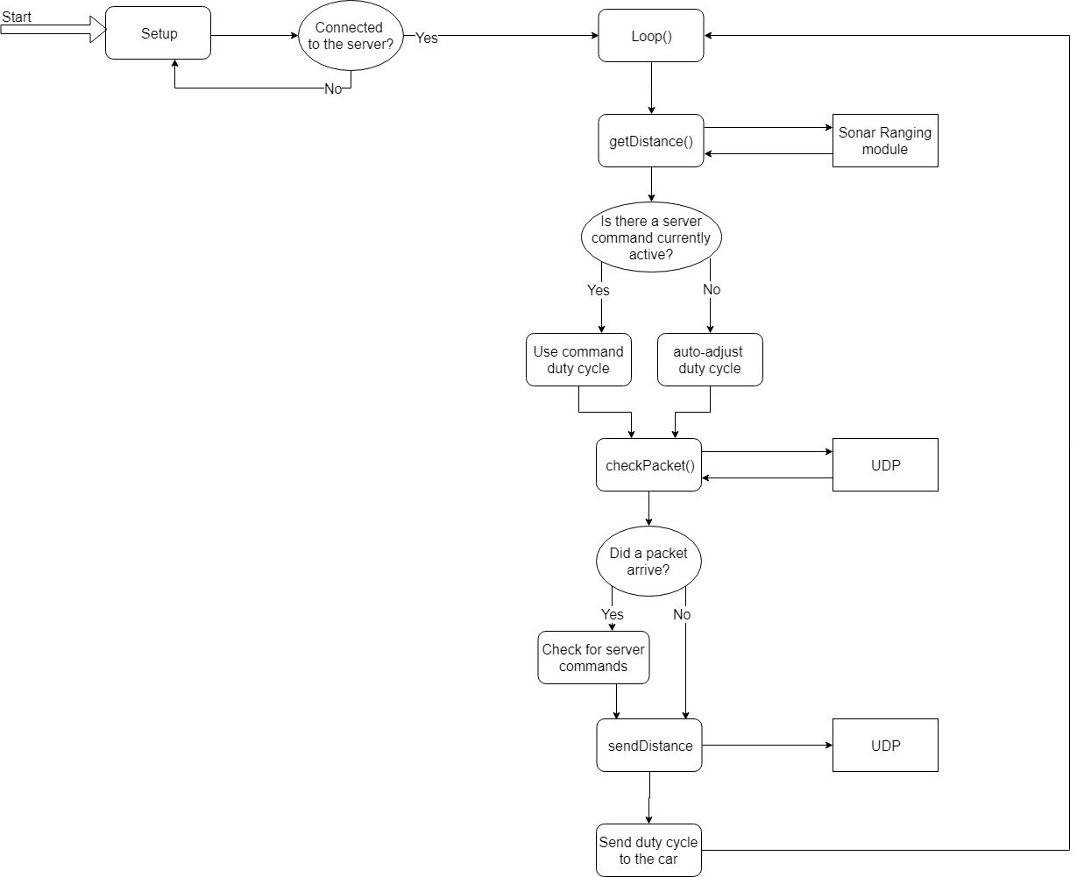
Flowchart

Slide 13
4. Experiment
Let’s start

Slide 14
Setup
Car with connection to server
Fixed distance to obstacle
Start driving
Graph the speed over time

Slide 15
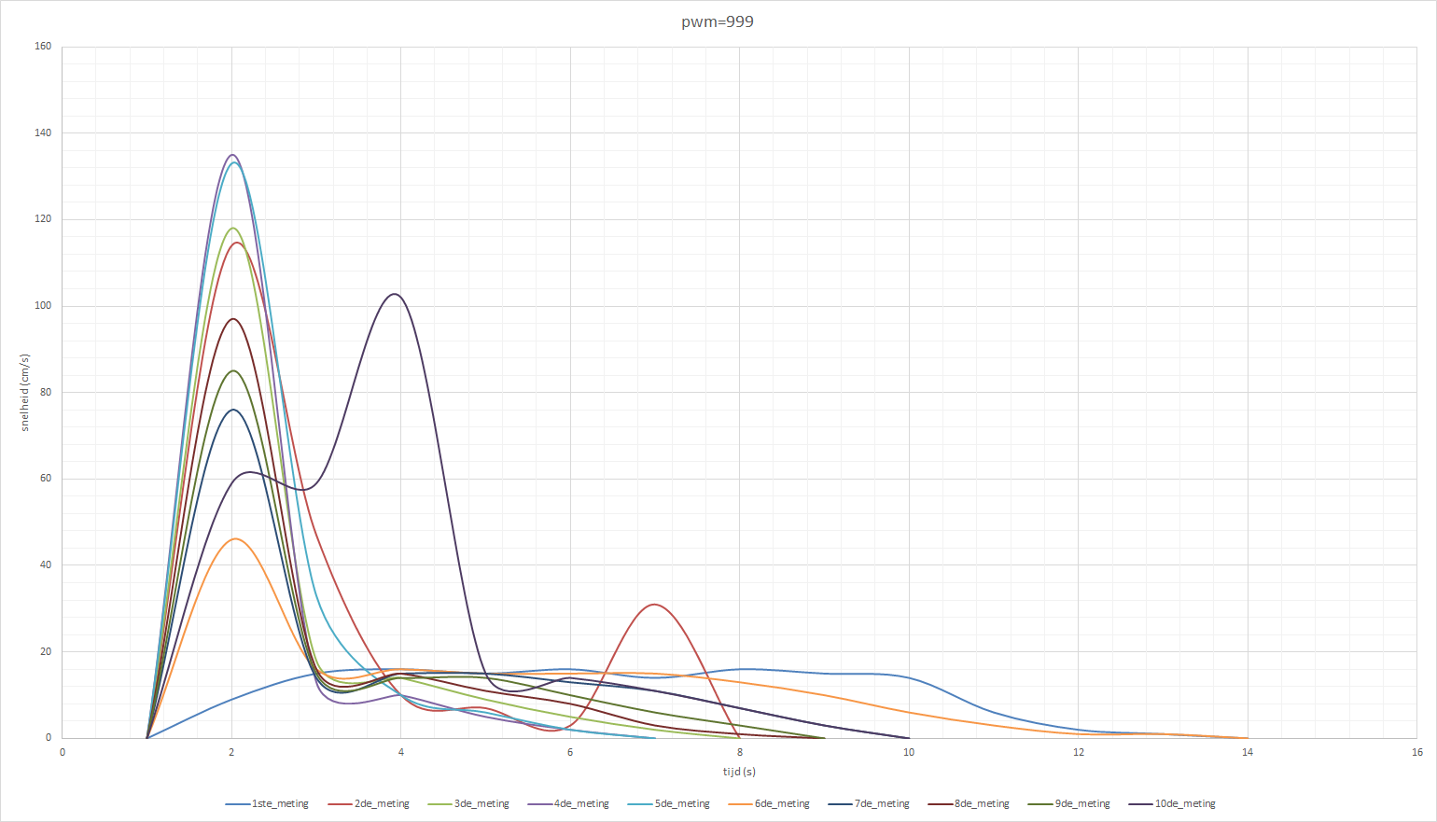
Graph: Velocity to time

Slide 16
5. Conclusion
Let’s start

Slide 17
How can we improve cars in traffic?
Reducing accidents by making the cars more intelligent
Centralizing traffic information to increase reliability
Smart routing to avoid traffic jams

Slide 18

THANKS!
Any questions?

