Slide 1


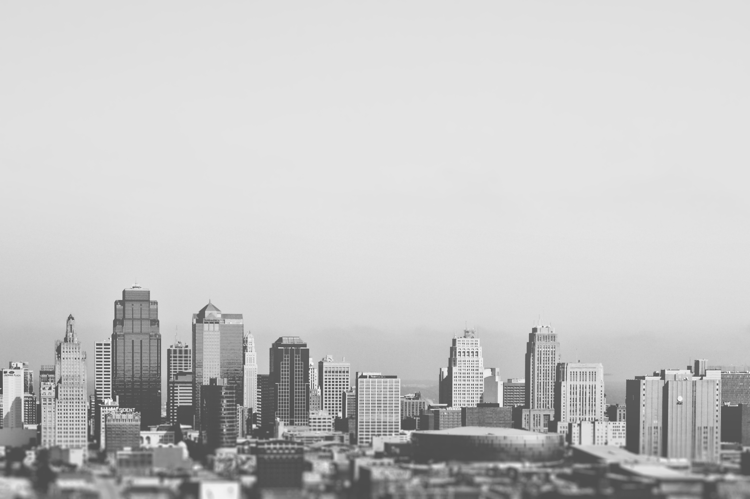
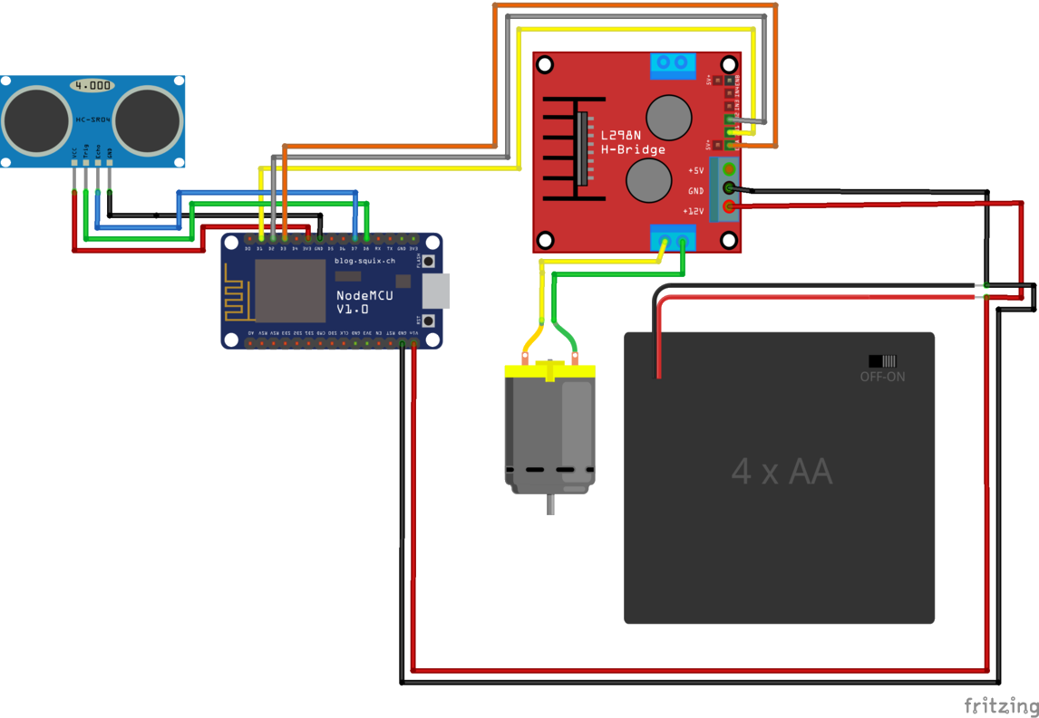
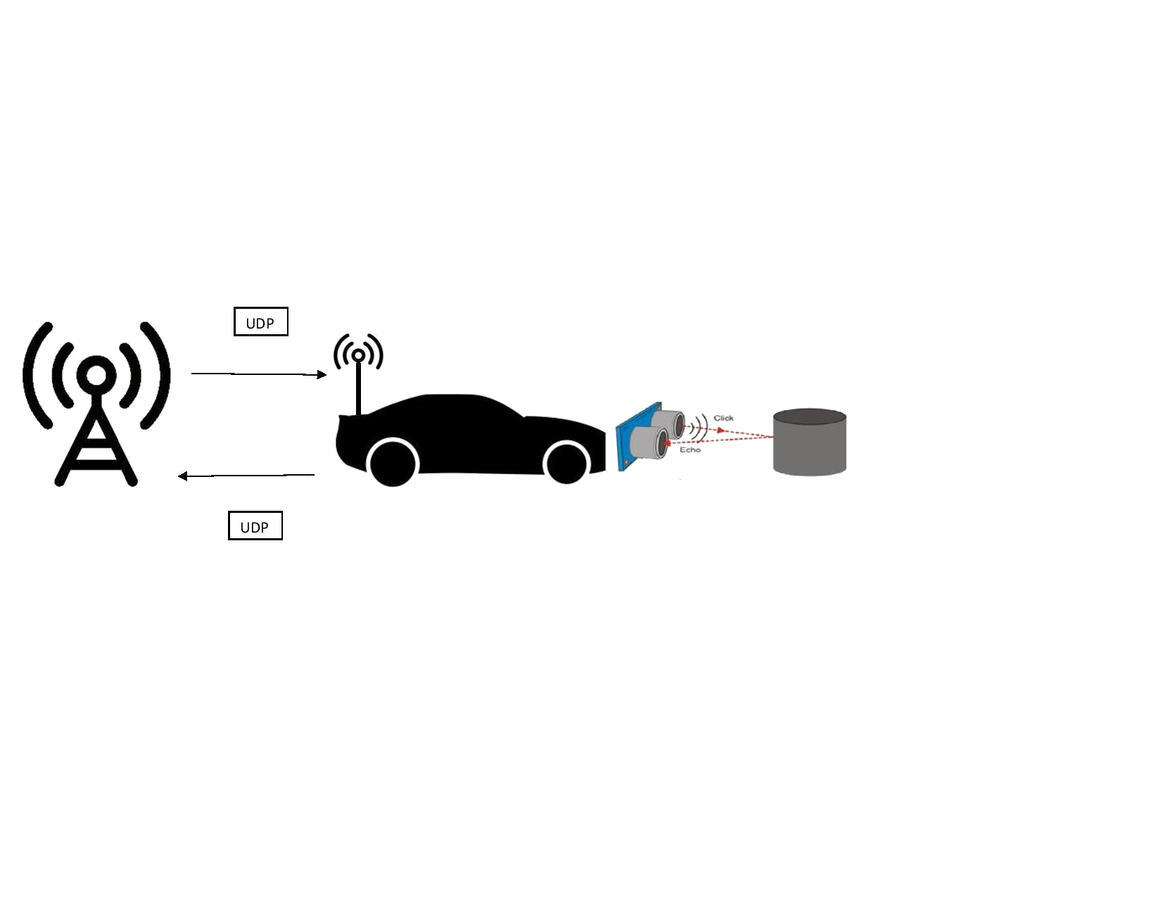
Connected Intelligent Cars
How can we improve cars in traffic?
Introduction
Components
Experiment + result
The goal of this project is to improve cars and their role in everyday traffic. This can be realized by establishing two main things:
Making cars more intelligent. The cars will be able to gather a great variety of information like the position of other cars and obstacles on the road.
Setting up a widespread Traffic Network This network will gather information from every car to route cars more efficiently or send out a emergency break in case of an accident.
1. Microcontroller: A NodeMCU with Built-in WiFi
2. H-bridge to connect the power to the servo motor
3. 4-AA Battery holder to provide 6V of power
4. HC-SR04 Ultrasonic sensor to measure the distance
5. Servo-motor to drive the wheels
6. Ubuntu server to communicate with the NodeMCU
An experiment was conducted to test the speed and braking distance of a car.
A car is placed at a fixed distance to an object and turned on.
This car would then adjust its speed according to the distance to said object, ultimately coming to a halt before touching the object.
Both the speed and the measured distance are sent to the server where the graph is plotted of the speed and PWM over time.
% Add graph of Speed & PWM over time (if reliable) %
% Add picture maybe?
% % Maybe make this paragraph bigger & switch it with
% Components to focus on the experiment + result?
%
% (!!!) Maybe we should make this experiment but with % (!!!) multiple cars instead of car to object & plot both % (!!!) cars to that graph?
% (!!!) or not cause we don’t have time
%
How does it work?
The RC cars are equipped with a microcontroller which uses the ultrasonic sensor to measure the distance to any object in front of the car which is then used to control the speed of the car.
This information gets wrapped in a UDP packet and sent to a Ubuntu server which gathers, processes and saves all this data.
The server can also send commands to the cars like a break in case of emergency
Conclusion
How can we improve cars in traffic?
Making cars more intelligent proves to be effective at reducing accidents as you take away some of the responsibilities of the driver which is more likely to make mistakes.
Furthermore, a traffic network will reduce traffic jams by routing cars through more unusual routes which aren’t always kept in mind by the driver.
This project is just a demonstration of some possible ideas of this concept. We definitely see this project take a bigger scope once realized. One possible future is the traffic network controlling all the self-driving cars which further decreases the chance of errors
We would like to thank Prof. Simon Sleutel and Prof. Willy Loockx for assisting us throughout this project. We are also grateful for the University of Antwerp which let us use the workspace and all the materials needed to create this project

