Slide 1
Free and Open Source Software
Mircroproject

Slide 2
Team Members
Gautham S - S4 CSA 49
Gokul Raj - S4 CSA 50
Gopika V - S4 CSA 51
Gracemol Joy - S4 CSA 52

Slide 3
Introduction
The application displays network statistics information in human readable form.This is achieved through the cat /proc/net/netstat command in Linux.
The application was made using PyQt4. The program uses several widgets to accomplish the task,namely:
A label which contains a statement
Two push buttons
A text edit

Slide 4
Program Code
import os
import sys
from PyQt4.QtCore import *
from PyQt4.QtGui import *
def main():
app = QApplication(sys.argv)

Slide 5
w = MyWindow()
w.setWindowTitle("Network Statistics")
w.setGeometry(720,320,500,500)
w.show()
sys.exit(app.exec_())
class MyWindow(QWidget):
def __init__(self, *args):
QWidget.__init__(self, *args)

Slide 6
abel = QLabel(self.tr("Click Display to display the network statistics"))
self.le = QPushButton("Display")
self.te = QTextEdit()
self.btn = QPushButton("Exit")
layout = QVBoxLayout(self)

Slide 7
layout.addWidget(label)
layout.addWidget(self.le)
layout.addWidget(self.te)
layout.addWidget(self.btn)
self.setLayout(layout)
self.le.clicked.connect(self.run_command)
self.btn.clicked.connect(quit)

Slide 8
def run_command(self):
cmd = '''cat /proc/net/netstat |awk '(f==0) { i=1; while ( i<=NF) {n[i] = $i; i++ }; f=1; next}(f==1){ i=2; while ( i<=NF){ printf "%s = %d\\n", n[i], $i; i++}; f=0} ' '''
stdouterr = os.popen4(cmd)[1].read()
self.te.setText(stdouterr)
if __name__ == "__main__":
main()

Slide 9
Working
The application has two buttons one to display and one to exit. Display displays the information upon clicking
Upon receiving the signal the program is made to run the run_command function, where the command for displaying network statistics is given. The awk command is used to display it in human readable form.The standard output of the command is displayed in the textedit box meaning the information is displayed in the textedit box. The exit button exits from the app.

Slide 10
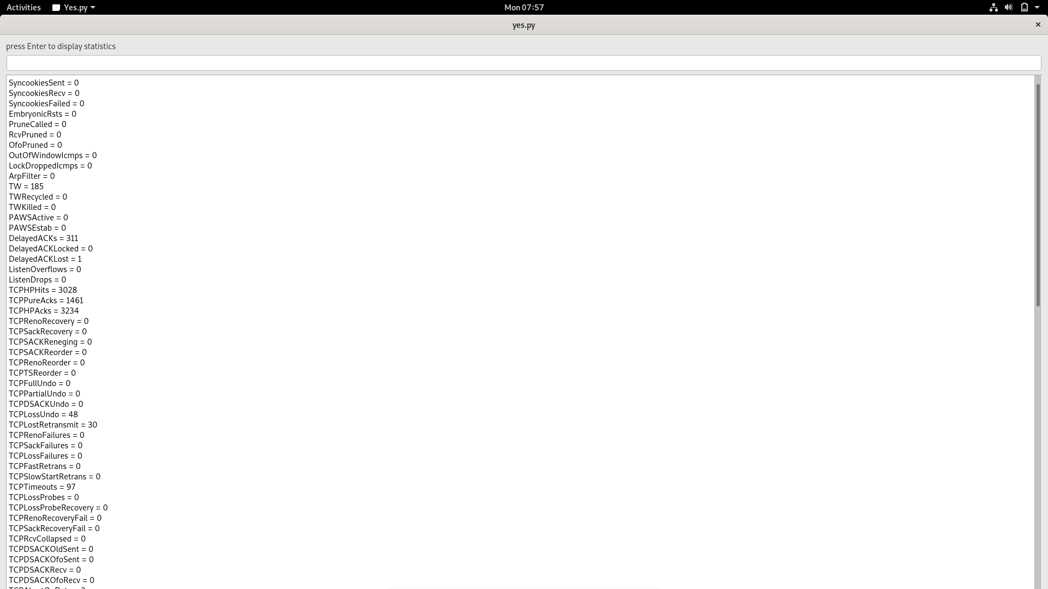
Output

Slide 11
Conclusion
Developed an application using PyQt4 that displays network statistics information in human readable form.

