Slide 1
Intro to Constraint Programming
Gautham Venkataraman
Notes:
Name
Masters student CS at TU Delft

Slide 2
Contents
What are Constraint Satisfaction Problems?
Defining a Constraint Satisfaction Problem
Modelling vs Solving
Demo 1 - Cryptarithmetic problem
Demo 2 - Find k largest elements in an array
Demo 3 - Solving Sudoku
Real life applications
Notes:
Going to try to get to the demo ASAP because we only learn by doing something not reading about it
Before CP we have to talk about CSPs, the class of problems CP deals with

Slide 3
Note:-
Programming in this context refers to planning.
Notes:
The historical context is they named it around WW2

Slide 4
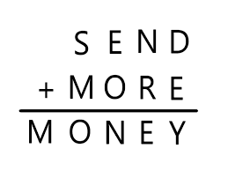
What are Constraint Satisfaction Problems?
Example 1 :- Assign a distinct digit for each of the letters such that the following equation holds.
Notes:
I want to motivate what CSPs are with two examples. You probably get this from your family whatsapp group titled “you’re a genius if you can solve this”. We will revisit this in the demo.

Slide 5
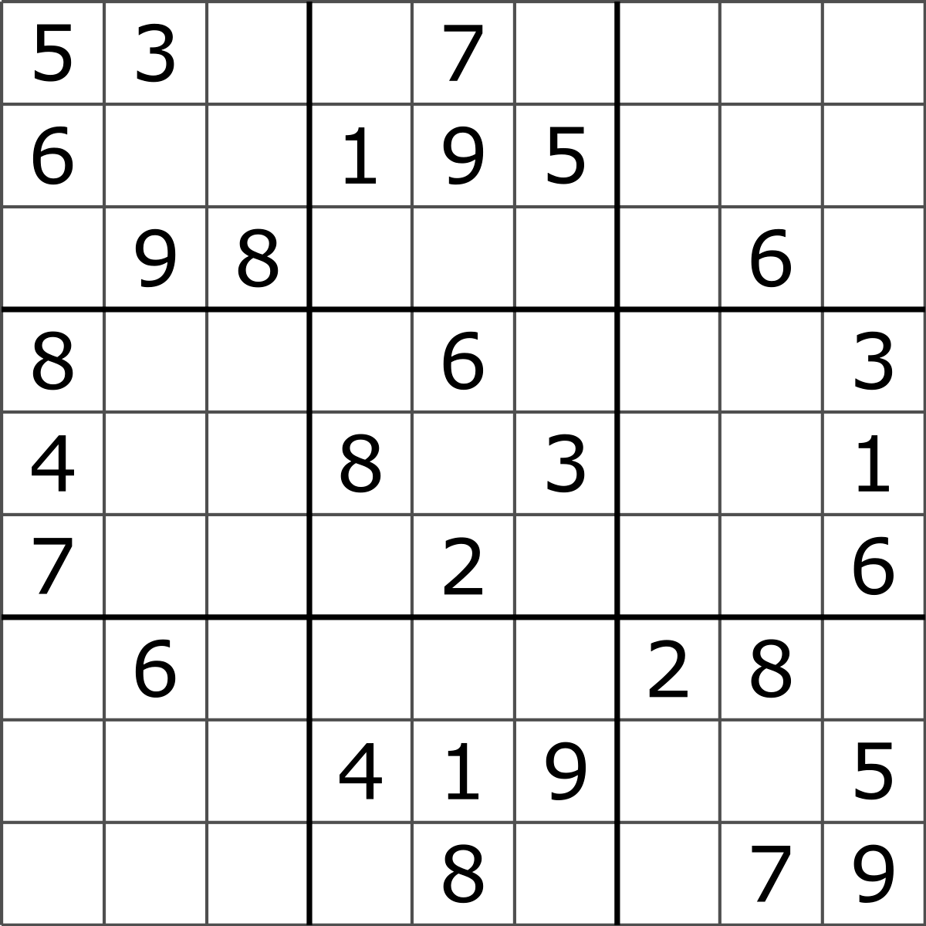
What are Constraint Satisfaction Problems?
Example 2 :- Sudoku
Notes:
This is another classic example. You need to fill the boxes such that your row, column and small 3x3 subgrids are distinct.

Slide 6
Defining a Constraint Satisfaction Problem
Formally defined as;
Bunch of Variables V = {v1, v2, v3 …. Vn}
Domains for each variable D = {d1, d2, d2 … dn}
Constraints over the variables C = {c1, c2, c3 .. cn}
Notes:
You have a bunch of variables
Domains or the set of possible values for each of those variables
The constraints or how those variables are related to each other.
Here each letter is a variable
0-9 is the domain of all those variables
And the constraints are things like d + e must equal y.
Just keep this in the back of your head for the demo.

Slide 7
Constraint Programming is the field of research that deals with constraint satisfaction problems.

Slide 8
Modelling vs Solving
We are NOT trying to write algorithms to solve CSPs.
We are simply trying to mathematically model our problems as a CSP.
A CSP model is then fed to a CP solver to get solutions.
Examples of modelling frameworks - MiniZinc, google ORtools
Examples of CP solvers - GeCode, ORtools’ native CP-SAT solver
We will be using ORtools python API for our demo.
Notes:
Before going ahead with the demo, I just want to shed some light on what we’re trying to do dealing with these CSPs.
(slides)
There are two parts, modelling and then solving. Smarter people than you and I have written solvers which work on CSPs. We are shamelessly going to use those solvers once we have defined our problem as a CSP.

Slide 9
Installing ORtools
`pip3 install ortools`
Note :- ortools is a bit verbose, so don’t get lost in the specifics of the code.

Slide 10
Demo 1 - Cryptarithmetic problem
Notes:
Only one possible solution? In base 10 yes.

Slide 11
Demo 2 - Find k largest elements in an array
Notes:
Only one possible solution? In base 10 yes.

Slide 12
Demo 3 - Solving Sudoku
Notes:
Only one possible solution? In base 10 yes.

Slide 13
Real life applications - Capacitated Vehicle Routing problem with pickups, delivery and time windows
The problem:-
N vehicles
Each vehicle has capacity C1, C2, C3 … CN kgs
Each vehicle has a average speed S1, S2, S3 .. SN km/h
You have L pickups / deliveries
Each of the pickups / deliveries can only be serviced within their Time windows T0, T1, … TL
Your depot is located at (x0, y0), and the pickups and delivery locations are {(x1,y1) (x2,y2) .. (xL,yL)}
Plan a route for each of the vehicles such that the total distance traversed is minimal subject to the above constraints.

Slide 14
Real life applications - Capacitated Vehicle Routing problem with pickups, delivery and time windows
Image Credit - https://github.com/Rintarooo/VRP_DRL_MHA

Slide 15
Thank you!
Code and slides available at - https://github.com/gauthsvenkat/CP_examples

