Slide 1

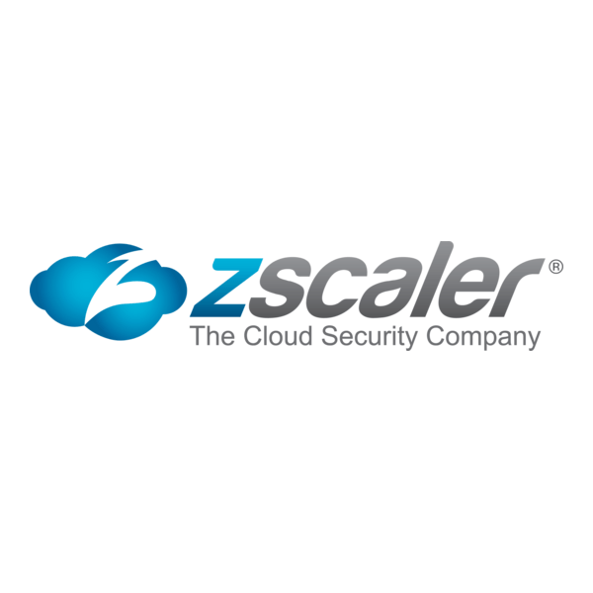

GitHub Copilot Egress vs DLP Risk
Problem statement and risk acknowledgement for SageMaker Studio (interactive) users running VS Code
Key tension: Required outbound HTTPS to GitHub/Copilot endpoints vs. data exfiltration exposure when traffic is not TLS-inspected.
Amazon SageMaker Studio
Zscaler Internet Access (ZIA)
GitHub Copilot
Notes:
[Sources] - https://docs.github.com/en/copilot/reference/copilot-allowlist-reference (required allowlist domains for Copilot) - https://www.awsicon.com/icon/sagemaker (SageMaker icon used on this slide) - https://www.awsicon.com/static/images/Service-Icons/Analytics/64/png5x/SageMaker.png (SageMaker icon file) - https://seeklogo.com/images/Z/zscaler-logo-D039667E12-seeklogo.com.png (Zscaler logo image) - https://bootflare.com/wp-content/uploads/2025/08/GitHub-Copilot-icon-Logo.png (GitHub Copilot icon image) [/Sources]

Slide 2
Problem statement
SageMaker Studio (interactive) users run VS Code with the GitHub Copilot extension. Copilot requires outbound HTTPS to specific GitHub and Copilot service domains.
Functional requirement
Security requirement
To enable Copilot, the environment must allow outbound HTTPS to:
• GitHub auth + API
• Copilot inference endpoints
• (Optionally) telemetry endpoints
Allowing domain-level access creates a DLP exposure:
• Users can authenticate with personal GitHub accounts
• Code/data can be uploaded via GitHub web UI or API
• Without TLS inspection, content-based DLP controls cannot reliably detect/stop uploads
Scope: server-side egress for SageMaker Studio (interactive) workloads via ZIA with domain-based policy (no TLS inspection).
Notes:
[Sources] - https://docs.github.com/en/copilot/reference/copilot-allowlist-reference (Copilot requires outbound access to GitHub/Copilot domains) - https://www.zscaler.com/blogs/company-news/making-case-inspecting-corporate-ssl-traffic (encrypted channels can be used to circumvent DLP; inspection needed) [/Sources]

Slide 3
Validated Copilot connectivity requirements (domains)
Minimum outbound HTTPS (TCP 443) destinations typically required for VS Code GitHub Copilot:
Domain
Purpose
github.com/login/*
Authentication
api.github.com/user
User/session management
api.github.com/copilot_internal/*
Copilot user management
copilot-proxy.githubusercontent.com
Copilot suggestions API
origin-tracker.githubusercontent.com
Copilot suggestions API
*.githubcopilot.com/*
Copilot suggestions API (core)
Often required / optional (depends on org settings and features):
• copilot-telemetry.githubusercontent.com/telemetry • collector.github.com/* • default.exp-tas.com • github.com/enterprises/<ENTERPRISE>/* (EMU only)
Note: Your current allowlist (github.com, api.github.com, *.githubcopilot.com) is directionally correct but may be incomplete without the githubusercontent.com endpoints listed above.
Notes:
[Sources] - https://docs.github.com/en/copilot/reference/copilot-allowlist-reference (table of required Copilot allowlist domains) [/Sources]

Slide 4
Current egress pattern (what is being enabled)
GitHub + Copilot
public endpoints
SageMaker Studio
(Interactive)
ZIA (proxy)
Policy: domain allowlist
TLS inspection: OFF
• github.com
• api.github.com
• *.githubcopilot.com
• copilot-proxy.githubusercontent.com
• origin-tracker.githubusercontent.com
VS Code + Copilot extension
Server-side egress
Encrypted HTTPS passthrough
Key risk implication
Allowlisting these domains enables bidirectional encrypted sessions to GitHub. With no TLS inspection, the proxy cannot reliably identify or block sensitive content uploads (source code, datasets, credentials) to GitHub web/API endpoints.
Notes:
[Sources] - https://docs.github.com/en/copilot/reference/copilot-allowlist-reference (Copilot requires allowlisting GitHub/Copilot endpoints) - https://www.zscaler.com/resources/reference-architectures/tls-ssl-inspection-zscaler-internet-access.pdf (without decryption/inspection you are blind to many threats; DLP relies on decryption) - https://www.awsicon.com/static/images/Service-Icons/Analytics/64/png5x/SageMaker.png (SageMaker icon image) - https://seeklogo.com/images/Z/zscaler-logo-D039667E12-seeklogo.com.png (Zscaler logo image) - https://bootflare.com/wp-content/uploads/2025/08/GitHub-Copilot-icon-Logo.png (GitHub Copilot icon image) [/Sources]

Slide 5
DLP risk: credible data exfiltration paths
Exfil paths enabled by domain allow
Why it is hard to stop
If github.com and api.github.com are reachable, users can authenticate and upload data using the web UI or APIs (repos, gists, issues, releases).
With TLS inspection disabled, the proxy typically cannot perform content-based DLP decisions on encrypted uploads (it only sees SNI / destination).
Two concrete examples (not hypothetical):
Example 1: Personal GitHub repo / gist upload
Example 2: API-based exfil (scripted)
User signs in with a personal GitHub account
Copies source code or data snippets from Studio
Pushes to a private repo or creates a gist over HTTPS
Outcome: data leaves your controlled boundary
User generates a personal token (PAT) and uses api.github.com
Creates repo, commits content, uploads artifacts/releases
Traffic is encrypted and looks “normal” at the domain level
Outcome: fast, automated, hard to detect without inspection
Notes:
[Sources] - https://docs.github.com/en/copilot/reference/copilot-allowlist-reference (domains that must be reachable for Copilot) - https://www.zscaler.com/resources/reference-architectures/tls-ssl-inspection-zscaler-internet-access.pdf (DLP relies on decryption; without inspection you are blind) - https://seeklogo.com/images/Z/zscaler-logo-D039667E12-seeklogo.com.png (Zscaler logo image) - https://bootflare.com/wp-content/uploads/2025/08/GitHub-Copilot-icon-Logo.png (GitHub Copilot icon image) [/Sources]

Slide 6
Why “domain allow + no TLS inspection” is a DLP control gap
What the proxy can see (typically):
So DLP decisions become coarse:
• Destination domain (SNI)
• Port/protocol
• Timing/volume
Not the payload (code/data) unless decrypted
• Allow/deny only by domain/category
• No reliable detection of sensitive content
• Limited ability to block uploads selectively
Result: DLP exposure increases
Evidence from Zscaler guidance (paraphrased):
• Encrypted channels are used to bypass DLP controls and exfiltrate sensitive data.
• To realize DLP and other security controls, TLS/SSL traffic must be decrypted and inspected.
Interpretation for this use case: if we allow github.com and api.github.com without decryption, we are explicitly accepting a residual risk that sensitive data could be uploaded undetected.
Notes:
[Sources] - https://www.zscaler.com/blogs/company-news/making-case-inspecting-corporate-ssl-traffic (encrypted channels can circumvent DLP; interception needed) - https://www.zscaler.com/resources/reference-architectures/tls-ssl-inspection-zscaler-internet-access.pdf (DLP and other controls rely on decryption/inspection) [/Sources]

Slide 7
Mitigation options (what actually changes the risk)
Risk HIGH
Risk ↓
A) Accept & document residual risk
B) TLS inspect only GitHub/Copilot
Keep domain allowlist and no TLS inspection. Add compensating controls (least privilege IAM, logging, user training). Fastest, highest residual DLP risk.
Enable decryption/inspection only for github.com / api.github.com / Copilot endpoints to allow content DLP and more granular policy. Higher operational overhead.
Identity control
Visibility
C) Enforce Enterprise Access Restrictions (EMU)
D) Strengthen egress control/logging in AWS
If using Enterprise Managed Users, configure proxy header injection to block personal accounts on github.com/api.github.com (requires “break and inspect” proxy).
Use managed firewalling and monitoring for Studio internet traffic (domain filtering, inspection, logging) via AWS Network Firewall + NAT patterns.
Notes:
[Sources] - https://docs.github.com/en/enterprise-cloud@latest/admin/configuring-settings/hardening-security-for-your-enterprise/restricting-access-to-githubcom-using-a-corporate-proxy (Enterprise access restrictions require break-and-inspect proxy + header injection; supported endpoints include github.com/*, api.github.com/*, *.githubcopilot.com) - https://aws.amazon.com/blogs/machine-learning/securing-amazon-sagemaker-studio-internet-traffic-using-aws-network-firewall/ (domain/URL filtering, packet inspection, and monitoring patterns for SageMaker Studio internet traffic) [/Sources]

Slide 8
Decision framing & recommendation
What is accurate to state in your risk acknowledgement:
1) Copilot requires egress to GitHub/Copilot endpoints (per GitHub allowlist docs). 2) Allowing github.com/api.github.com at domain level enables data uploads (web + API), including with personal accounts. 3) With TLS inspection disabled, content-based DLP controls are materially weakened because sensitive payloads remain encrypted.
Recommendation (pragmatic):
If DLP is a hard requirement: implement TLS inspection for the GitHub/Copilot destinations (Option B) and, if feasible, enforce Enterprise Access Restrictions (Option C) to prevent personal account usage.
If DLP is not a hard requirement: proceed with domain allowlist, but explicitly document the residual exfiltration risk and add compensating controls (least privilege, monitoring, and clear policy).
Notes:
[Sources] - https://docs.github.com/en/copilot/reference/copilot-allowlist-reference (Copilot allowlist requirements) - https://www.zscaler.com/resources/reference-architectures/tls-ssl-inspection-zscaler-internet-access.pdf (DLP relies on decryption/inspection) - https://docs.github.com/en/enterprise-cloud@latest/admin/configuring-settings/hardening-security-for-your-enterprise/restricting-access-to-githubcom-using-a-corporate-proxy (enterprise access restrictions require break-and-inspect + header injection) [/Sources]

