Slide 1
Wise Words from Bruce Perry
Neuroscientist, The Child Trauma Institute, USA
‘We live in strange times. Modern Western Society has benefitted from advances in technology, communications, transportation, social justice and economies beyond the dreams of our ancestors. And yet our society seems to be incapable of ensuring that our children grow up safe, predictable, relationally enriched, humane environments.’

Slide 2
MPG: a new force in social action
Mission statement - We are working towards a more mindful society – one that is mindful of that we are more than the sum of individuals and that together we can create greater individual and communal wellbeing. Towards this goal we will disseminate evidence-based psychological, biological and social research to enable individuals and societies as a whole to thrive.

Slide 3
IT DOESN’T HAVE TO BE THIS WAY! IT’S ALL PREVENTABLE

Slide 4
More Bruce Perry:
‘Adults interpret the actions, words, expressions of children through the distorting filter of their own beliefs. In the lives of most infants and children, these common misinterpretations are relatively benign. In many cases however these misinterpretations can be highly destructive. The most dramatic example occurs when the impact of traumatic events on children is minimized. It is an ultimate irony that at the time when a human is most vulnerable to the effects of trauma- during infancy and childhood-, adults generally presume the most resilience.’

Slide 5
Influence Policy Formation
Advise on Commissions and Select Committees
Instigate Commissions and Select Committees
Advise individual MP’s and Ministers
Work with a cross-party group of Lords

Slide 6
Input into the Media.
Organise conferences aimed at media, politicians and policy makers on the lines of ‘Hug a Hoodie’/ Celebrities to help deliver the message.
Programming:
To begin devising ideas for broadcast including documentaries and mainstream ideas, i.e. CSI type series, inserts into Soaps. Radio programmes.
Books:
Pitch book ideas to mass market. Change the ‘Misery’ genre to illustrate psychological issues through expert’s case histories.
Become Pundits:
MPG experts to be called on to comment on a wide range of bio/psycho/social issues on mainstream news and current affairs programmes on TV and Radio.
Become proactive pundits, i.e. letters in Newspapers signed by experts highlighting support for or failings in present policy.

Slide 7
Influence biopsychosocial education:
Gain access to organisations delivering national curriculum and degree courses: Possible entry to new humanities course for teens.

Slide 8
Some of our organisations.
Knowledge organisations who will feed a biopsychosocial model of expertise.
The Centre for Emotional Development
The Child Mental Health Centre
WaTCH
The Children’s Clinic Brighton
Wave Trust ( TBC)
Association for Infant Mental Health :this is the organisation with all the famous people. Sue Gerhardt, Penelope Leach etc
International Attachment Association
Family Fair

Slide 9
Organisations that are mutually advantageous. I.e. those who can provide celebrity, media professionals and networking opportunities. Those whose work we can promote and increase their knowledge base and influence on policy.
Nordoff Robbins/ Music Therapy
Knight Ayton/ Agents for broadcasters, journalists, clinicians and scientists

Slide 10
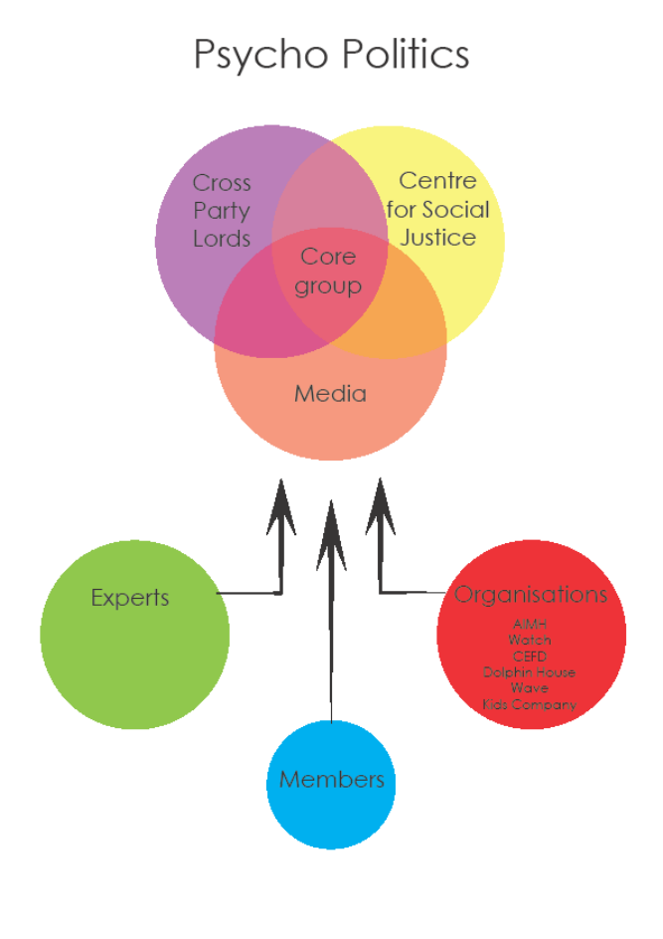
The Plan.

Slide 11
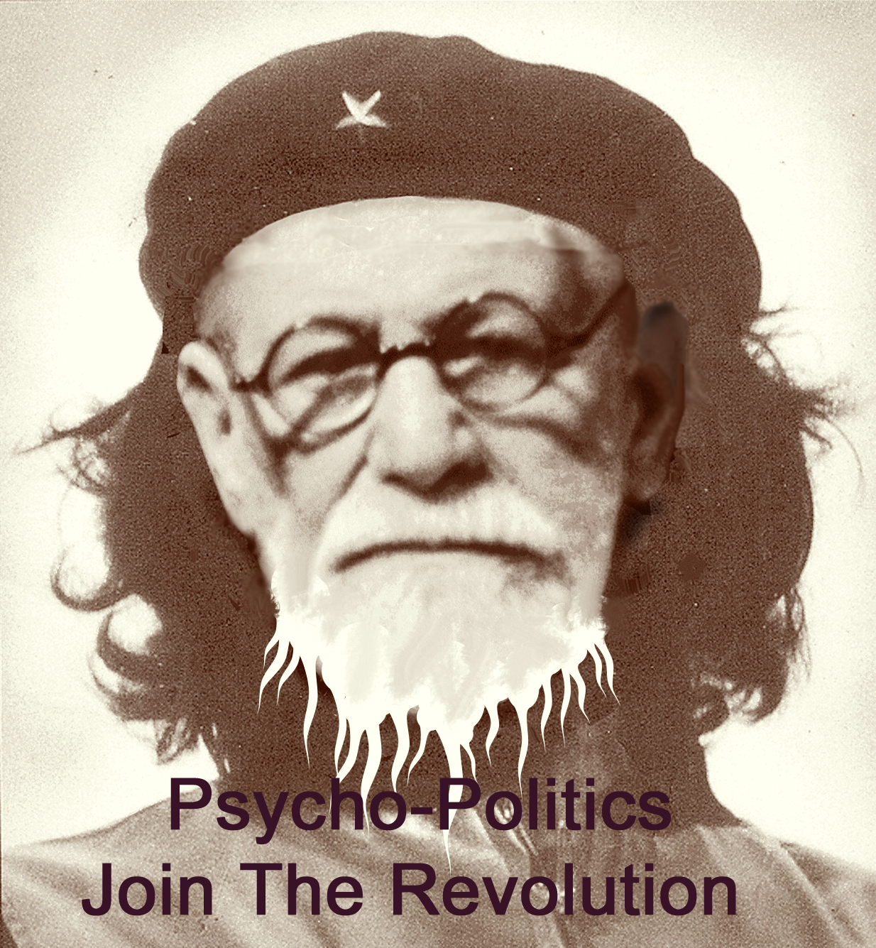

Slide 12
Psycho-politics and the CSJ: Perfect Partners for the future understanding of everything.

