Slide 1
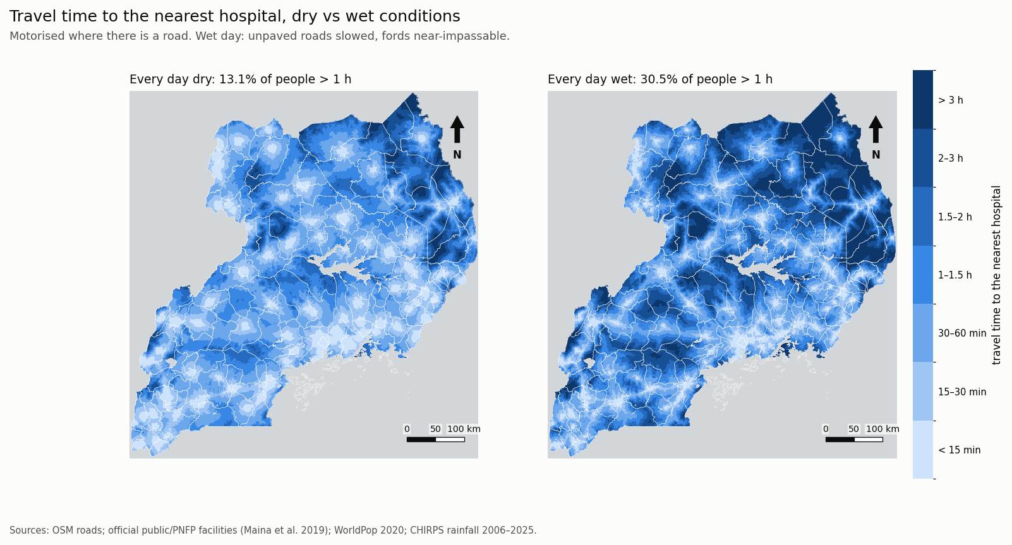
RESEARCH PRESENTATION
When the Rains Come
Seasonal access to health care, schools and markets in Uganda
A month-by-month travel-time model built from open data:
OpenStreetMap, WorldPop, CHIRPS rainfall and the Ministry of Health facility list
Charles Gava · 2026
Travel time to the nearest hospital on a wet day
Notes:
This study asks how much Uganda's rainy seasons lengthen journeys to essential services, where, in which months, and for whom. The cover map shows modelled travel time to the nearest hospital if every road were wet: darker blue means longer journeys.

Slide 2
BACKGROUND
Roads, and the journeys on them, change with the seasons
1
Two rainy seasons a year
The long rains peak around March to May and the short rains around September to November. Each brings runs of days wet enough to turn murram roads to mud.
THE GAP
Standard accessibility maps assume a single, dry-weather speed for each road, all year round.
2
A largely unpaved network
Most rural roads are earth or gravel, and many cross rivers by fords rather than bridges. Wet earth roads lose much of their speed; a flooded ford can close a route entirely.
They cannot say how many people lose timely access in the wet months, where, or whether the loss falls evenly. That is what planners need to schedule maintenance, outreach and bridges.
3
Many journeys are made on foot
Where there is no vehicle or boda boda at hand, travel is on foot, and it is slowest exactly when paths are wet.
Notes:
Uganda has a bimodal rainfall regime. Most of its road network is unpaved and many rural routes cross rivers by fords. Conventional friction-surface accessibility models use one fixed speed per road class, so they describe access on a dry day and miss the seasonal swing entirely.

Slide 3
WHAT THIS STUDY ASKS
Research problem
1
How much?
MAIN QUESTION
How many more people fall beyond 1 hour (or 2 hours) of a service when it rains?
How much do Uganda's rainy seasons lengthen journeys to hospitals, health centres, schools, markets and towns?
2
When?
Which months are worst, and has the pattern shifted since 1981–2000?
3
Where?
Which districts, sub-counties, hospital catchments and river crossings?
Benchmark: the WHO / Lancet Commission target is surgical and obstetric care within 2 hours. We also use a 1-hour threshold for hospitals.
4
For whom?
Women of reproductive age, children under 5, the poorest fifth, refugee-hosting areas, people on foot.
Notes:
The central question has four parts: magnitude, timing, geography and equity. The two-hour benchmark comes from the Lancet Commission on Global Surgery and WHO.

Slide 4
METHODOLOGY · INPUTS
Data: all public, no new surveys
1
Roads
2
Destinations
3
Population
OpenStreetMap
Ministry of Health list (Maina et al. 2019)
WorldPop 2020, 1 km grid
~690,000 segments with class, surface (where tagged), bridges and fords
Public and not-for-profit facilities by level; schools, markets and towns from OSM
~244,000 populated cells, with age and sex structure for women 15–49 and children under 5
4
Rainfall
5
Wealth & boundaries
6
Validation
CHIRPS daily, 1981–2025
Meta Relative Wealth Index; HDX
DHS 2016, 15 regions
45 years of satellite rainfall give each cell's share of wet days in each month
Wealth quintiles; district and sub-county boundaries for aggregation
Regional health indicators, including women citing distance as a barrier to care
Notes:
All inputs are open. 22 hospitals and HC IVs with clearly wrong coordinates were moved to their OpenStreetMap location (see data/facility_relocations.csv).

Slide 5
METHODOLOGY · TRAVEL-TIME MODEL
A friction surface that gets wet
01
02
03
04
05
Friction surface
Wet-day speeds
Wet-day chance
Monthly cost
Least-cost paths
Each 1 km cell takes the speed of the fastest road through it.
Gravel keeps 70%, earth 40%, footpaths 60%. A road over a ford drops to 0.5 km/h.
CHIRPS: ≥10 mm of rain, or the day after ≥25 mm, gives each cell's share of wet days per month.
Expected crossing time mixes dry and wet speeds by that share.
Travel time to the nearest destination, every month, by road and on foot.
EXPECTED TIME TO CROSS A CELL IN A MONTH
TWO TRAVEL MODES
t = (1 − f) / vdry + f / vwet
Motorised: road speeds, motorcycle taxis on paths
Walking: 5 km/h, slower on wet earth
f = share of wet days in that cell and month (CHIRPS)
Notes:
A ford only cuts off a cell when it is the only way through, because other roads in the same 1 km cell keep their speed. The wet-day rule comes from the companion paper on construction delays (lost earthworks days). All parameters live in PARAMS in scripts/model.py.

Slide 6
METHODOLOGY · SCENARIOS AND BREAKDOWNS
Analysis design
A
Destinations
B
Scenarios
Hospitals
HC IV or hospital (emergency obstetric care)
Any health facility
Secondary schools, markets, towns
Every day dry; every day wet
Each of the 12 months
Rainfall of 1981–2000 vs 2006–2025
C
Breakdowns
D
Checks
District, sub-county, hospital catchment
Women 15–49 and children under 5
Wealth quintiles; refugee-hosting sub-counties
16 sensitivity runs varying every assumption
Validation against DHS 2016 (15 regions)
72 river crossings ranked by time saved
Notes:
Results reported are for 2006–2025 rainfall and the official facility list, unless stated. Alternative runs use OSM facilities and walking-only travel.

Slide 7
RESULTS · WHEN
April adds ~2.3 million people beyond an hour of a hospital
13.1%
every day dry
18.1%
April, peak of the long rains
30.5%
every day wet
of Ugandans more than 1 hour from a hospital by road
Share of population more than 1 hour from a hospital by road. April is the worst month in 79 of 135 districts. Sources: OSM; MoH facility list; WorldPop 2020; CHIRPS 2006–2025.
Notes:
The year has two peaks, following the two rainy seasons: April (18.1%) and October (17.4%). The difference between dry weather and April is about 5 percentage points, roughly 2.3 million people. The curve for 1981–2000 rainfall is almost identical: the seasonal cycle matters much more than the long-term trend.

Slide 8
RESULTS · WHERE
On a wet day, the one-hour hospital zone shrinks sharply
13.1% → 30.5%
of people beyond 1 hour, dry vs fully wet.
Hardest hit
The north-east (Karamoja), the west and the Lake Kyoga basin, where hospitals are sparse and roads unpaved.
Notes:
The fully wet map is an upper bound: it assumes every day is wet. Monthly results mix the two according to each cell's share of wet days.

Slide 9
RESULTS · FOR WHOM
The rains fall on everyone, but the burden doesn't
POOREST FIFTH
23% → 32%
beyond 1 h of a hospital, dry vs April. On foot to any facility: 30% → 36%.
RICHEST FIFTH
0.8% → 1.0%
the seasons barely touch them.
REFUGEE-HOSTING SUB-COUNTIES
22% → 33%
against 13% → 18% elsewhere (14 sub-counties with an OSM refugee site).
Share more than 1 hour from a hospital by road, by Relative Wealth Index quintile.
Notes:
The poorest start furthest away and the rains add the most to their journeys. Wealthier areas are close to facilities and on better roads. The seasonal gap is an inequality gap that recurs on a known timetable.

Slide 10
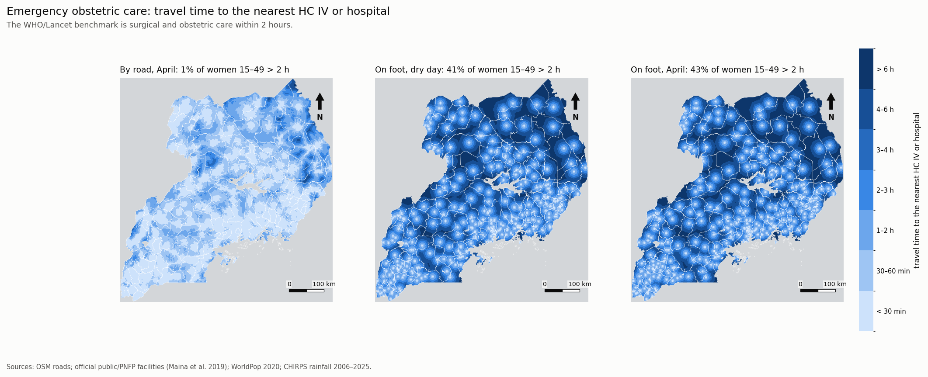
RESULTS · FOR WHOM
Walking, not roads, is the barrier to obstetric care
0.9% → 1.2%
41% → 43%
16.5% → 19.9%
of women 15–49 more than 2 h away by road (dry → April)
more than 2 h away on foot (dry → April)
of everyone more than 1 h on foot from any facility
Notes:
Emergency obstetric care is proxied by the nearest HC IV or hospital, against the 2-hour benchmark. A woman with a boda boda or a vehicle is almost always within reach; a woman who has to walk often is not, and the rains make it worse.

Slide 11
RESULTS · WHERE
The loss concentrates in a few catchments and sub-counties
Hospital catchments: extra people beyond 1 hour in April
Sub-counties with the largest April jumps
Malongo
59% → 93%
Mayuge
Butoloogo
26% → 84%
Mubende
Kagulu
33% → 66%
Buyende
Kyangwali
54% → 77%
Kikuube · refugee settlement
Share of people more than 1 hour from a hospital by road, dry weather → April.
Notes:
Clusters are in Busoga, around Mubende and Kassanda, in Lango and along the Lake Victoria shore. District health teams could use these worst-month figures to pre-position ambulances, stock and outreach.

Slide 12
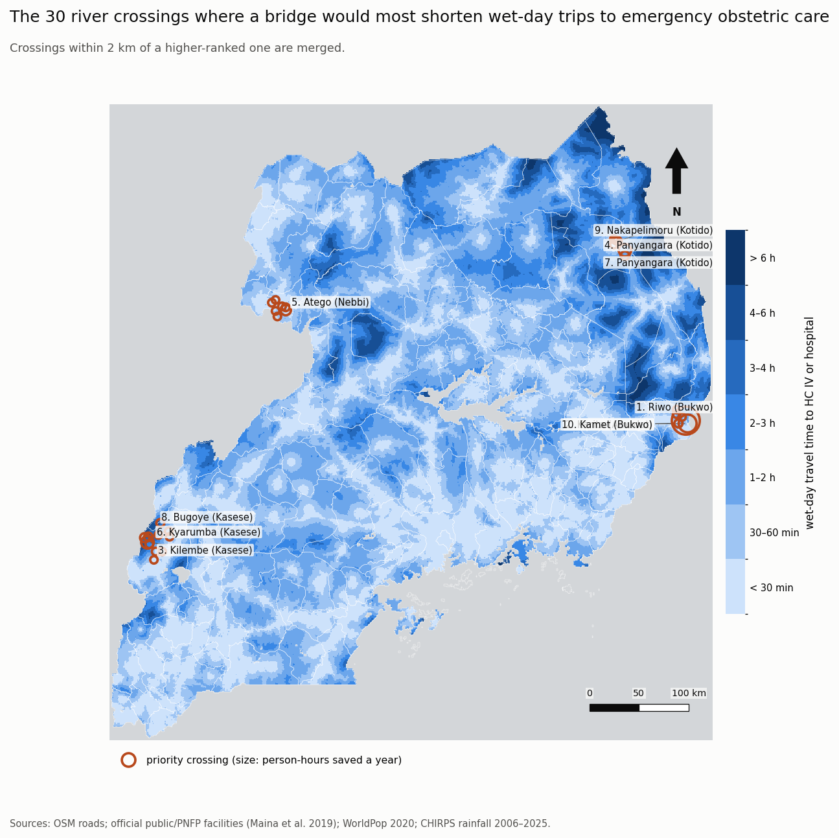
RESULTS · WHAT COULD BE DONE
A handful of river crossings matter a great deal
72 distinct fords were ranked by the wet-day travel time a bridge would save on trips to emergency obstetric care.
1
Riwo, Bukwo
~7,000 people brought within 1 h on wet days, incl. 1,500 women 15–49
2
Karita, Amudat
~1,500 people within 1 h; 630 women
3
Kilembe, Kasese
Footpath ford: ~2,700 person-hours saved per wet day; next is Panyangara, Kotido
A starting list for district engineers, to be checked on the ground.
Notes:
All top three are on secondary roads in the east and north-east. Crossings within 2 km of a higher-ranked one are merged.

Slide 13
RESULTS · ROBUSTNESS
The seasonal rise survives every robustness test
Sensitivity: April rise in points, by wet-day definition
VALIDATION AGAINST DHS 2016
ρ ≈ 0.8
Modelled access vs share of women citing distance as a barrier to care, across 15 regions (ρ = 0.81–0.83, p < 0.001).
Still ρ = 0.52–0.59 after controlling for wealth (p = 0.02–0.05).
Not predictive of facility births or vaccination at regional level: Karamoja has poor access but ~80% facility births.
16 variants of speeds, fords, surfaces, walking speed and facility source: the April rise is positive in all.
District rankings agree with the baseline (Spearman 0.88–1.00).
Notes:
Report the April rise as a range: about 1 to 10 points, 5 central. The seasonal test of whether facility births dip in bad months needs DHS birth-level microdata.

Slide 14
DISCUSSION
Discussion: what the findings mean
1
Access has a calendar
2
The seasonal gap is an equity gap
Dry-weather maps understate exclusion. The worst month, not the average day, should anchor access targets, and it is predictable years ahead.
The poorest fifth, refugee-hosting areas and people on foot lose the most, on the same timetable every year.
3
Transport, not just distance
4
Small, targeted works pay
For emergency obstetric care, a ride matters more than a road. Motorcycle ambulances and maternity waiting homes target the binding constraint.
Grade and drain feeder roads before the long rains, and bridge the few fords that cut off the most people.
Notes:
The national seasonal pattern under 1981–2000 rainfall is almost the same as under 2006–2025: the seasonal cycle, not the long-term rainfall trend, drives access. This links back to the companion construction-delay paper: when a road contract slips into the rainy season, it delays the road and extends the isolation it was meant to fix.

Slide 15
DISCUSSION
Limitations and next steps
!
OSM completeness
!
Facility list
Most roads lack a surface tag, so class defaults set wet speeds. Treating untagged secondary/tertiary roads as earth shifts district ranks most (ρ 0.90).
Dates from about 2018 and excludes private for-profit facilities; relocations need a manual check.
!
Refugee sites
!
Ferries
Incomplete in OSM; UNHCR settlement boundaries would allow a full breakdown.
Not modelled: Kalangala and Buvuma appear cut off.
!
Rainfall
!
Validation
CHIRPS and TAMSAT disagree on northern trends; the seasonal cycle is less affected.
Regional only. Testing whether births shift in bad months needs DHS microdata.
A model describes what the roads allow, not what every family actually does.
Notes:
Next steps: ground-truth the crossing list, add UNHCR settlement boundaries, model ferries, and run the seasonal births test with DHS birth-level data.

Slide 16
CONCLUSION
Uganda's access problem has a season, a place and a face
13% → 18%
23% → 32%
43%
beyond 1 h of a hospital in April: ~2.3 million more people
the poorest fifth, against ~1% for the richest
of women 15–49 more than 2 h on foot from emergency obstetric care in April
Plan by season and by place: time maintenance before April, target the poorest, and bridge the right crossings.
Interactive map: gavacharles.github.io/uganda-rainy-season-access
Notes:
Thank you. Questions.

