Slide 1
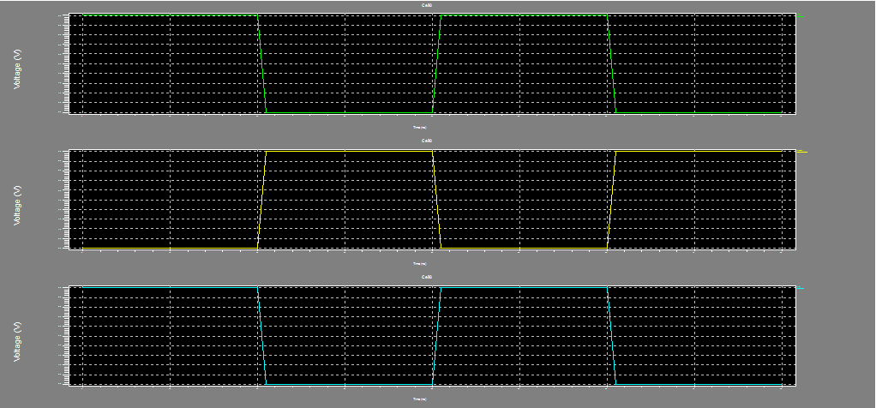
6T SRAM

Slide 2
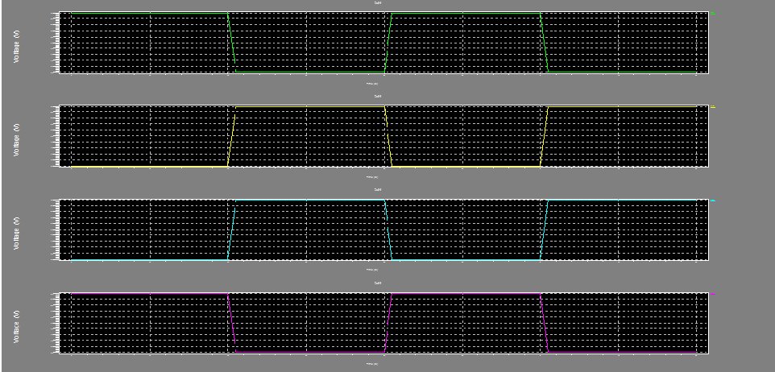
Schematic 9T

Slide 3
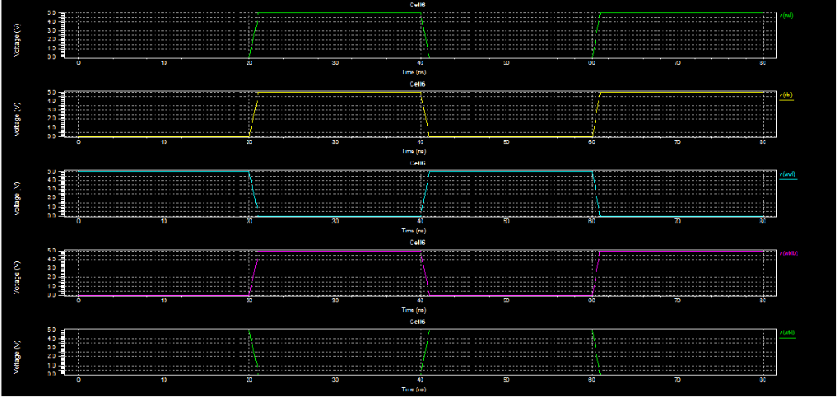
EXISTING 9T

Slide 4
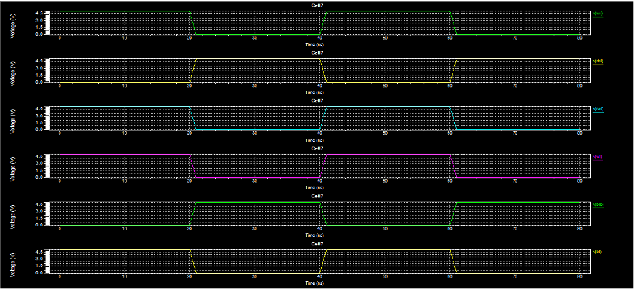
PROPOSED 9T

Slide 5
Write operation
Different SRAM cells | Power results in watts
6TSRAM | 1.89244*10^-007
Schematic 9TSRAM | 1.612464*10^-006
Existing 9TSRAM | 2.585899*10^-007
Proposed 9TSRAM | 4.147333*10^-005

Slide 6
Read operation
Different SRAM cells | Power results in watts
6TSRAM | 1.892446*10^-007
Schematic 9TSRAM | 1.042286*10^-006
Existing 9TSRAM | 3.918873*10^-006
Proposed 9TSRAM | 1.641564*10^-004

