Slide 1
Enhancement Test
CONFIDENTIAL
Notes:
These are speaker notes for testing

Slide 2
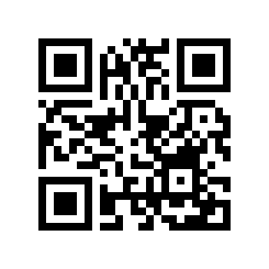
Content
Point 1
CONFIDENTIAL

