Slide 1
WEB APPLICATION FOR SYMBOL TABLE GENERATOR
CSA1471
COMPILER DESIGN FOR DATA FLOW ANALYSIS
Presented by :
G . Vivek (192210286)
B . Bhanu Prakash (192211934)
K . Umesh chandra(192210308)

Slide 2
Symbol Tables:
Symbol Table is an important data structure created and maintained by the compiler in order to keep track of semantics of variables i.e. it stores information about the scope and binding information about names, information about instances of various entities such as variable and function names, classes, objects, etc
The symbol tables are typically used in compilers. Basically compiler is a program which scans the application program (for instance: your C program) and produces machine code.
During this scan compiler stores the identifiers of that application program in the symbol table. These identifiers are stored in the form of name, value address, type.
Here the name represents the name of identifier, value represents the value stored in an identifier, the address represents memory location of that identifier and type represents the data type of identifier.
Thus compiler can keep track of all the identifiers with all the necessary information.

Slide 3
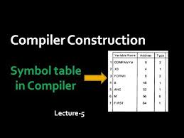
Challenges in Manual Symbol Tables
Creating symbol tables manually is prone to errors and time-consuming.
Maintaining context and scope for variables is challenging manually.
Manual updates can lead to inconsistencies in large codebases.
Handmade symbol tables lack automation and integration efficiencies.

Slide 4
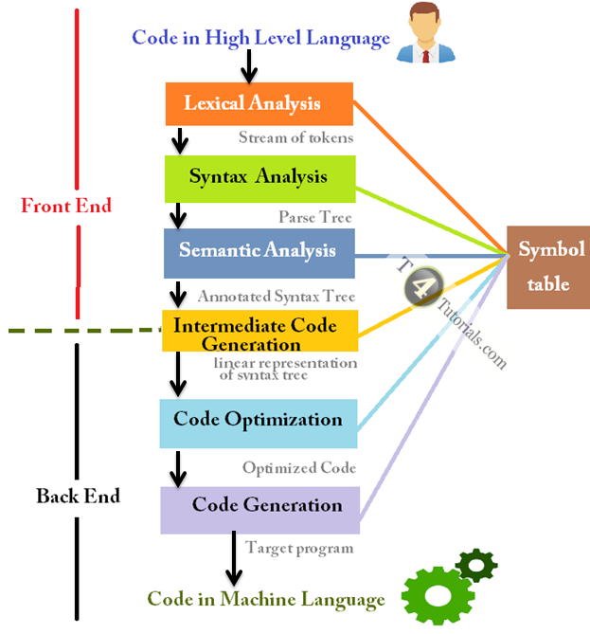
operations on Symbol Table :
Following operations can be performed on symbol table-
1. Insertion of an item in the symbol table.
2. Deletion of any item from the symbol table.
3. Searching of desired item from symbol table.

Slide 5
Uses of symbol table in various phases
Lexical Analysis: Creates new table entries in the table, for example like entries about tokens.
Syntax Analysis: Adds information regarding attribute type, scope, dimension, line of reference, use, etc in the table.
Semantic Analysis: Uses available information in the table to check for semantics i.e. to verify that expressions and assignments are semantically correct(type checking) and update it accordingly.
Intermediate Code generation: Refers symbol table for knowing how much and what type of run-time is allocated and table helps in adding temporary variable information.
Code Optimization: Uses information present in the symbol table for machine-dependent optimization.
Target Code generation: Generates code by using address information of identifier present in the table.

Slide 6
Applications of Symbol Table
Resolution of variable and function names: Symbol tables are used to identify the data types and memory locations of variables and functions as well as to resolve their names.
Resolution of scope issues: To resolve naming conflicts and ascertain the range of variables and functions, symbol tables are utilized.
Symbol tables, which offer quick access to information such as memory locations, are used to optimize code execution.
Code generation: By giving details like memory locations and data kinds, symbol tables are utilized to create machine code from source code.
Error checking and code debugging: By supplying details about the status of a program during execution, symbol tables are used to check for faults and debug code.
Code organization and documentation: By supplying details about a program’s structure, symbol tables can be used to organize code and make it simpler to understand.

Slide 7
Prototype of the webpage

Slide 8
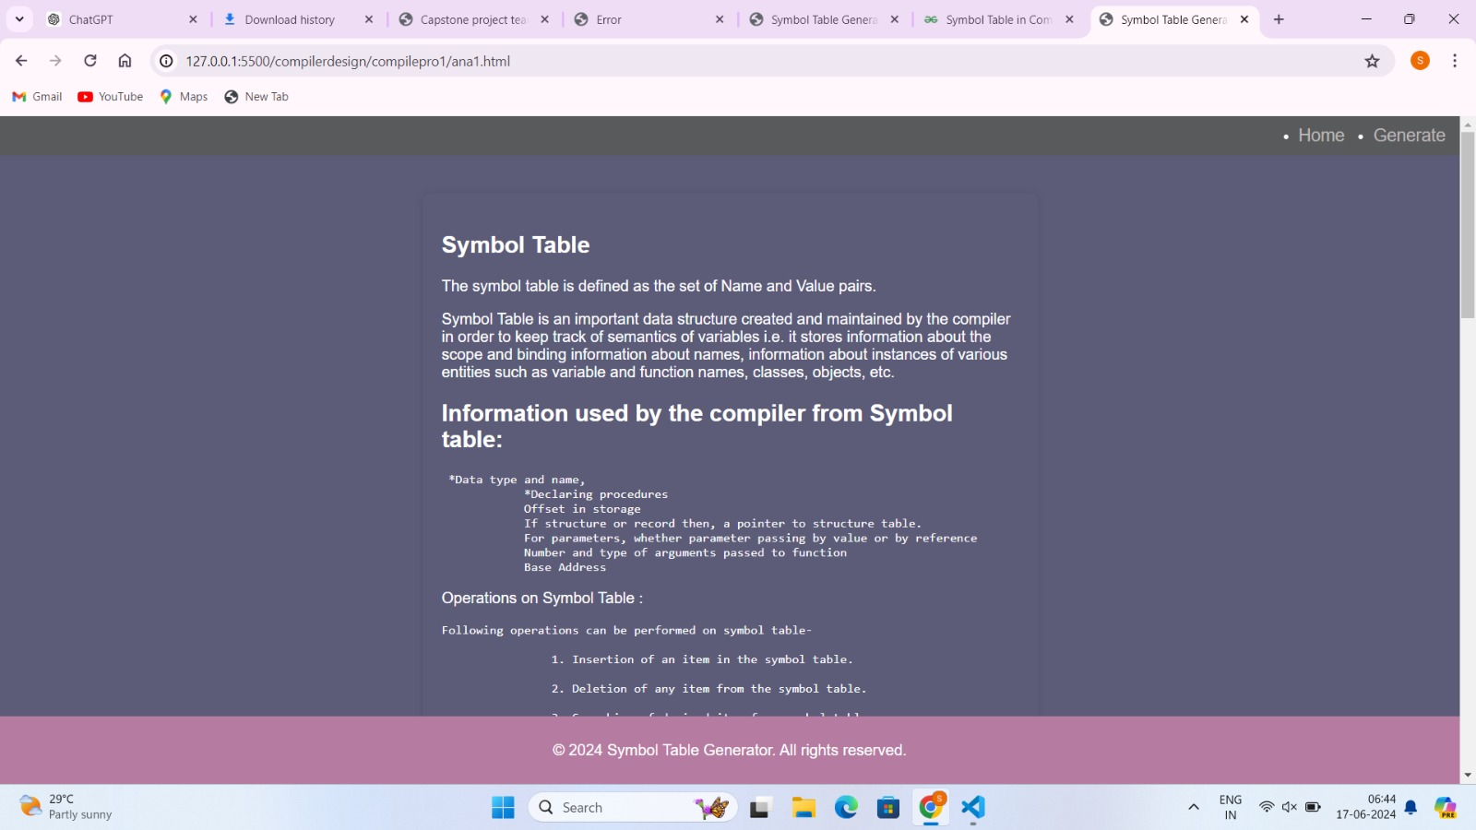
Web Page

Slide 9
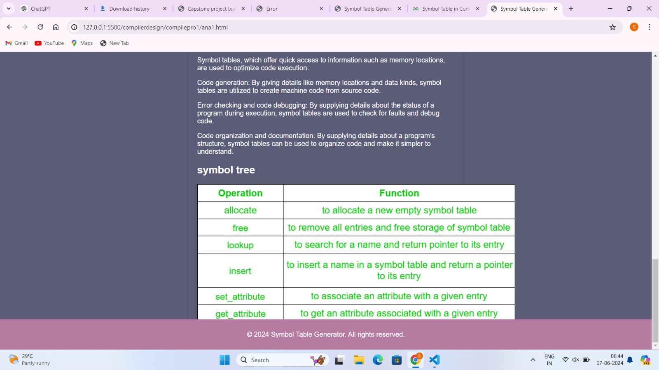

Slide 10
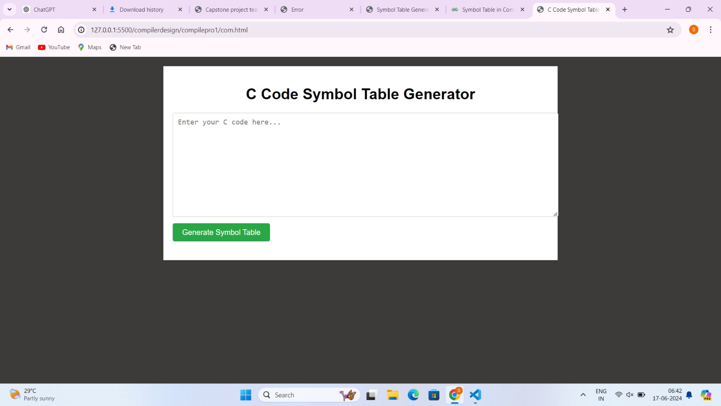
Symbol table generating page:

Slide 11
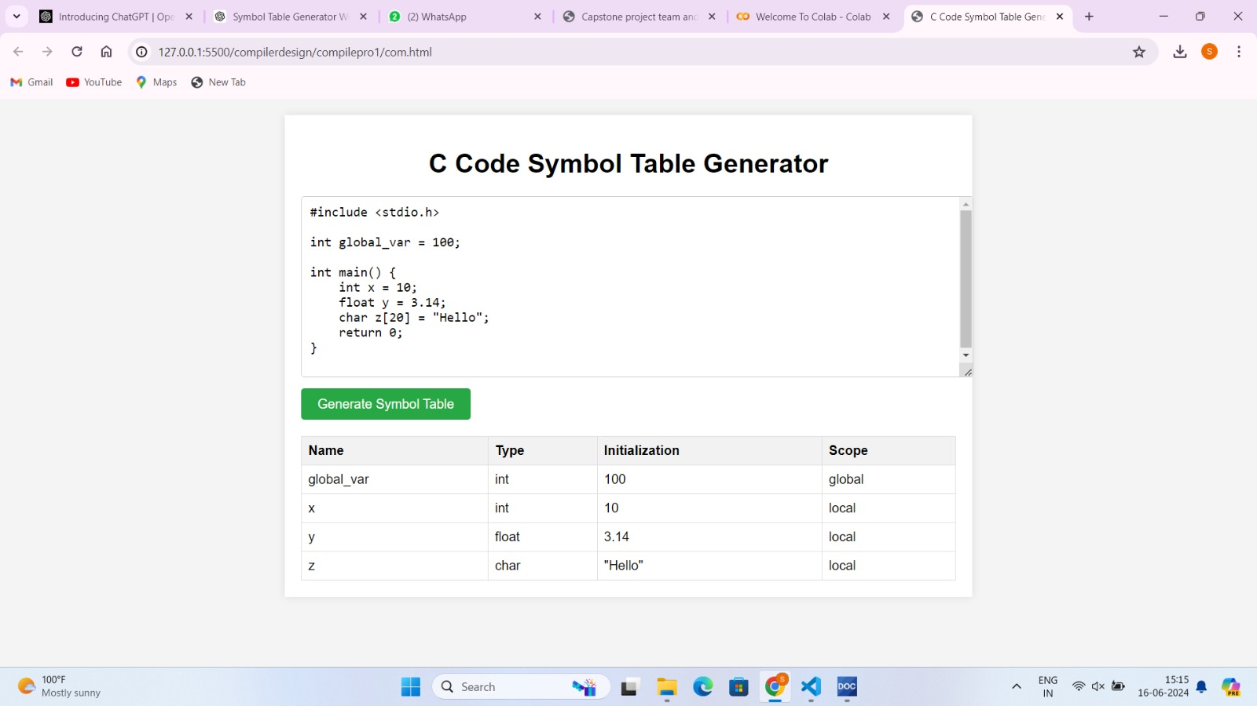

Slide 12

Conclusion and Future Directions
Future developments will focus on advanced symbol analysis, collaborative features, community engagement, and mobile accessibility to further empower developers worldwide. We are dedicated to ensuring our tool remains a valuable asset in optimizing software development processes.
In conclusion, our symbol table generator website enhances coding efficiency by simplifying symbol management for developers. With positive user feedback guiding our enhancements, we are committed to expanding language support, integrating with popular IDEs, and improving performance.

Slide 13
Thank
you!

