Slide 1


‘Cloud Tweeter’
Gavin Smith
n10138196
CAB432 Cloud Computing, 2020
Queensland University of Technology

Slide 2
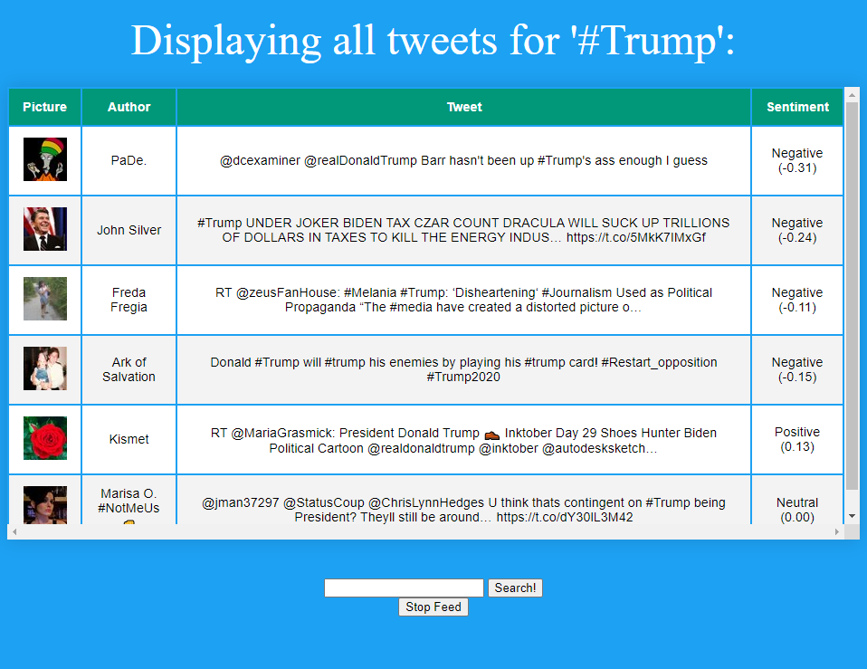
The App
Twitter feed generator
User searches for a hashtag, and the application pulls all the tweets corresponding to the query!
Provides a sentiment analysis for each tweet

Slide 3
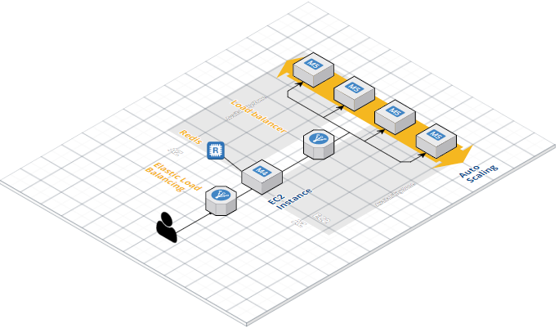
The Architecture
https://cloudcraft.co/

Slide 4
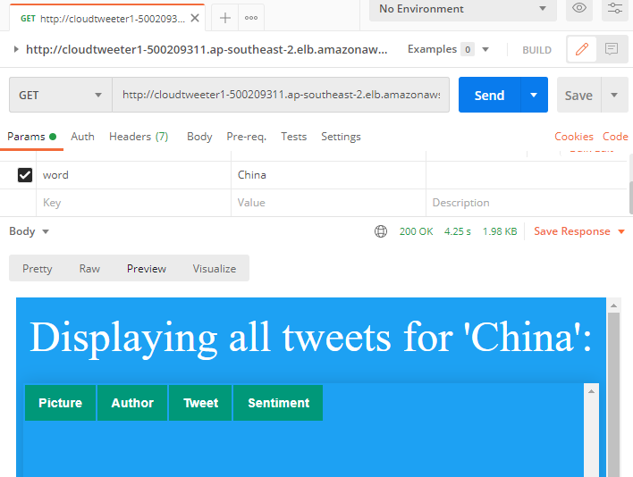
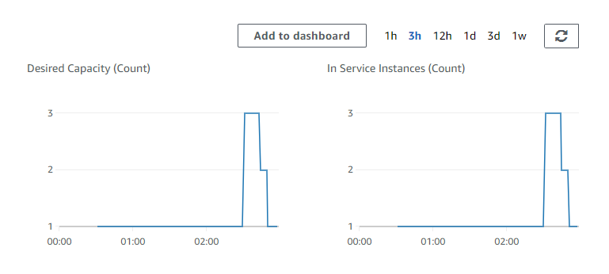
Scaling
Utilized Postman to send request to our DNS provided from AWS.
This triggered the scaling.
Evidence of scaling shown.
Screenshots were captured on 24/10/2020

Slide 5
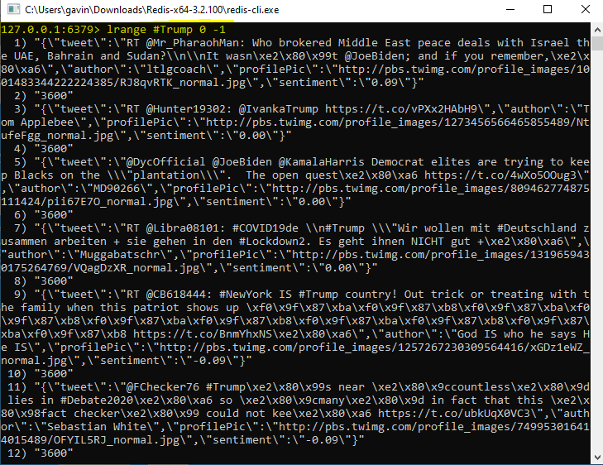
Persistence
Utilized Redis to store search query and the corresponding tweets for a session.
Pulling all information corresponding to ‘#Trump’

Slide 6
