Slide 1
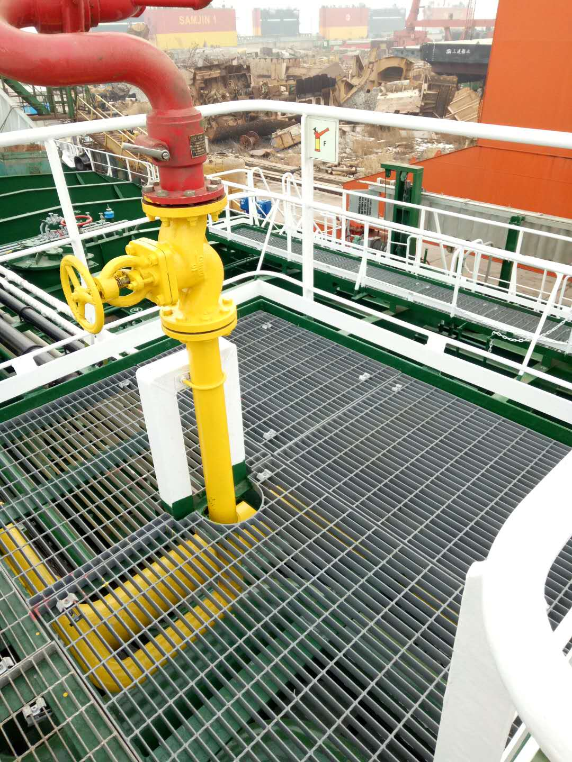
About Us
Bearing the dream of being a professional supplier of steel grating, handrails, ladders and related light steel structure in serving industry engineering projects, three colleagues founded Yantai Ston Metal Co., Ltd. in the city of Yantai, China in 2019.
From the beginning, we regard “people” as the top important asset of the company. Therefore, we are dedicated to projects which the team can learn and improve continously.
Thanks to the efforts of our team, as a new player in the markert, we have sucessfully fulfilled the supply in several projects both in China and Australia. Through these records, the company is getting more and more recognition from our customers.

