Slide 1
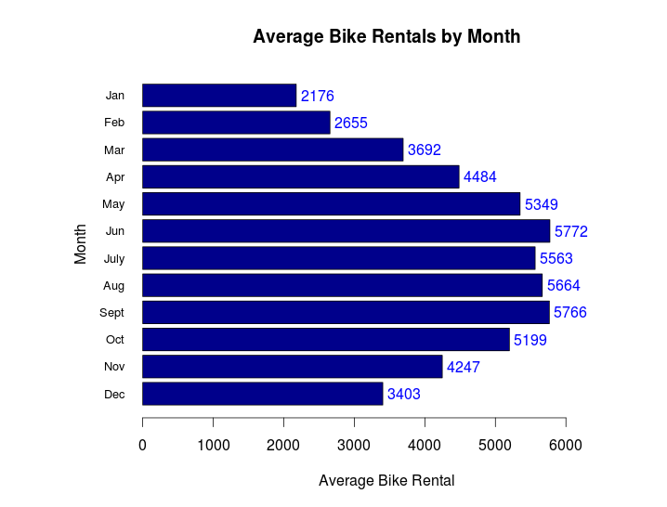
Average Monthly Bike Rental varies from 2176 to 5772
Recommended Action:
  Can we predict bike rentals on the environment & seasonal settings?

