Slide 1
Pre-Test App: Helping Learner Drivers Succeed
Gavin Cunningham
C21483936

Slide 2
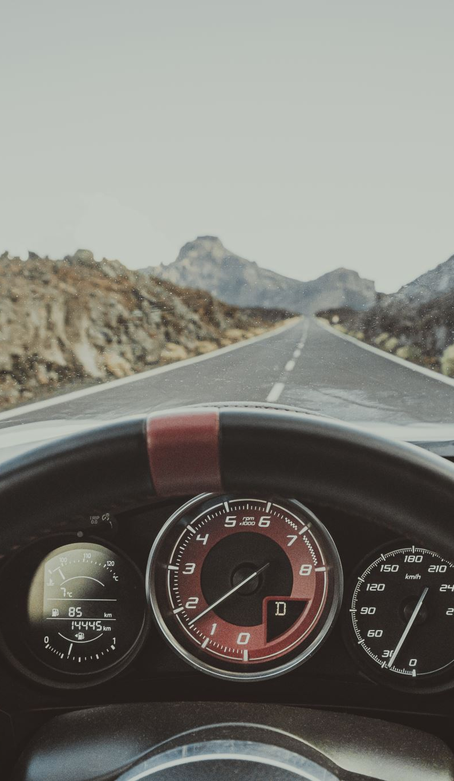
Introduction
What is Pretest?
Why is Pretest needed?
Key Features:
  Road condition monitoring,
  Driver attention tracking,
Notes:
Pre test is a mobile application that can be used by new and learner drivers to monitor their driving in order to practice for their driving test.
Why is pre test need.
Pre test is need due to it being extremely costly to get lesson for your driving test. It cost roughly 50 euro an hour and 12 hours are required at a minimum.
After the lessons are completed most people wont get another lesson and will just sit their test. The problem is that most people will develop bad habits and this aims to catch them and stop them.

Slide 3

Background Research
Current solutions are too costly
The technologies that can be used in this application
Under standing user's requirements
The Incremental Methodology
Notes:
The current solution that are out there are made for industrial use in large companies to monitor their drivers not for 1 person

Slide 4
System Architecture
Client-side Modules
Camera Module
Sensor Data Module
Route Module
Server-side Modules
Feedback Module
Data Storage

Slide 5
Work flow
Setup
Permissions for camera and sensors
Select routes or create custom routes
Real-time monitoring
Captures data from sensors and cameras
Data analysis
Identifies faults
Feedback
Generates report

Slide 6
Testing Plan
Unit Testing: Testing individual modules like video processing and sensor data.
Integration Testing: Ensuring modules work together seamlessly.
System Testing: Testing complete application functionality.
Real-world Testing: Evaluate accuracy with real drivers.

Slide 7
Current results
How is the app working
What results does the app output
Does it help learner drivers

Slide 8

Future Work
Real-Time Warning
Gamification to increase user interest
Increase Compatibility

Slide 9
Thank You

