Slide 1
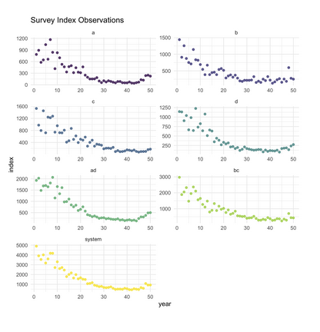
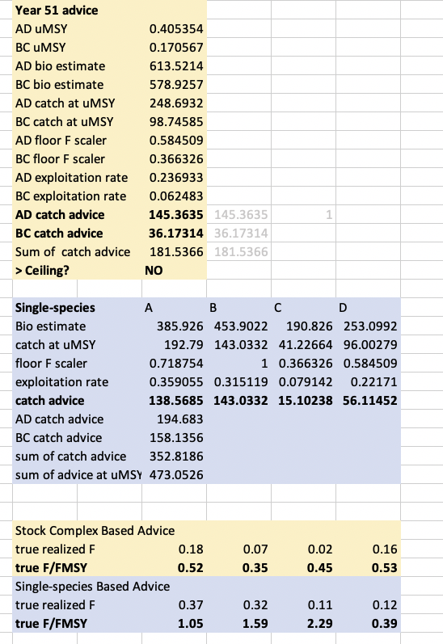
Demonstration of ecosystem-based catch advice
Assessment/Mgmt Tab, Scenario Tab
Show time series or kobe plot status
[radio]
Set catch ceiling?
[radio yes/no]
SS or Stock Complex assessments?
[radio ss/ms]
Target reference point
[slider]
Floor threshold
[slider]
Set floor using Avg status or minimum?
[radio]
* Control-rule
Individual species
Stock Complexes
Whole System
Output table

Slide 2
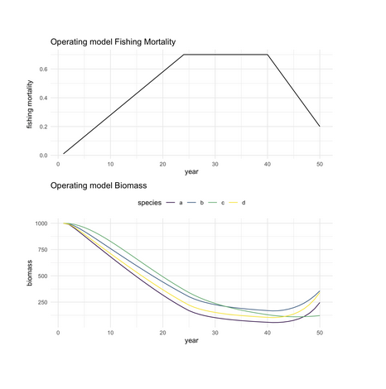
Demonstration of ecosystem-based catch advice
Assessment/Mgmt Tab, Scenario Tab (OPERATING MODEL)
Show time series or kobe plot status
[radio]
Initial Stock Status
[radio depleted, @target, betw]
F pattern
F linkages
[radios]
[sliders]
Species interactions
[radios]
[sliders]

Slide 3
Demonstration of ecosystem-based catch advice
Assessment/Mgmt Tab, Scenario Tab, Example text tab
Show time series or kobe plot status
[radio]
Set catch ceiling?
[radio yes/no]
SS or Stock Complex assessments?
[radio ss/ms]
Target reference point
[slider]
Floor threshold
[slider]
Set floor using Avg status or minimum?
[radio]
Individual species
Stock Complexes
Whole System
Text & Graphs
Step through, make text compatible with Hydra option, etc.
Walk through of both a simple and a more complicated example

