Slide 1
GLMs II : Logistic Regression Zuur Chapter 6.2
MAR 536 Biological Statistics II
February 09 2023

Slide 2


Lecture Outline
Logistic Regression
Assumptions
Probability
Odds
Logit transform
Portuguese Sole Nursery Habitat
Survival of melanoma patients
Tilefish Maturity
… with thanks to Tiffany Cunningham

Slide 3
What is logistic regression?
Type of generalized linear model.
Regression with a response (dependent) variable that is dichotomous categorical (0 or 1) and explanatory variables that can be either continuous or discrete.
Examples:
Whether a gene is turned off (=0) or on (=1) as a function of levels of various proteins
Whether an individual died (=0) or survived (=1) some event as a function of behaviour, morphology, etc.
Presence (=1) or absence (=0) of a species at a sampling location as a function of environmental variables.

Slide 4
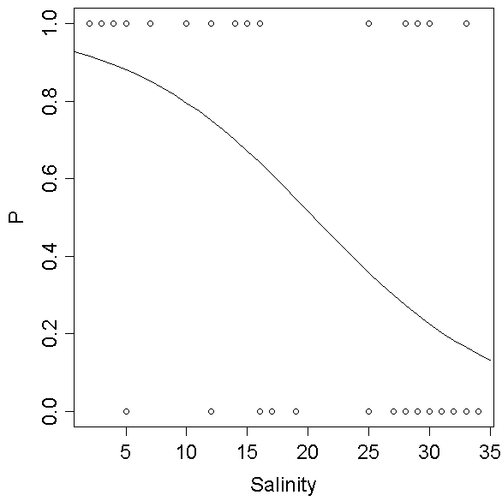
Why use logistic regression?
Logistic regression is often used because the relationship between the dependent variable and a predictor is non-linear.
Some times data quality necessitates reduction to binary outcome (e.g. presence/absence)

Slide 5
Assumptions
The outcome must be discrete (0,1).
Linearity in the logit – the regression equation should have a linear relationship with the logit form of the response variable
Logit: this is the natural log of the odds ratio
L_{i}=Ln(P_{i}/1-P_{i})

Slide 6
Probability
Probability has a floor and a ceiling (0,1)
As a result the same change in X has a different effect on Y depending on how close the curve corresponding to any X value comes to the minimum or maximum Y value
So, the relationship is non-linear and non-additive.

Slide 7
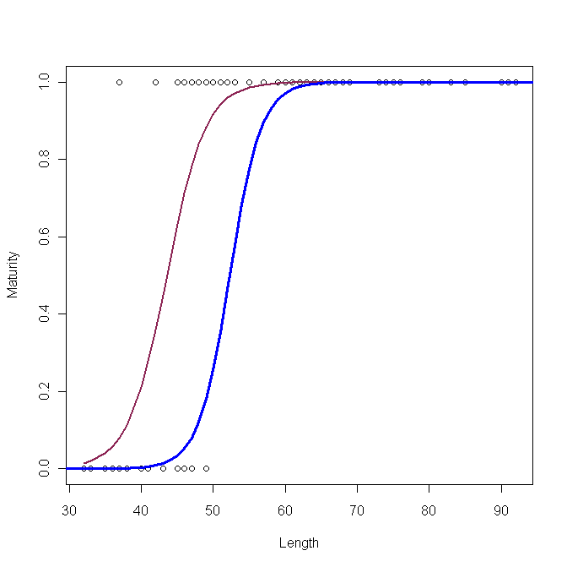
Tilefish Maturity Example
2008 1982

Slide 8
Odd Ratios & Logits
Probabilities
P=0.6 (i.e. there is a 60% probability, or 60% ‘odds’, that a 45cm tilefish is mature).
Odds Ratio
O_{i}=(P_{i}/1-P_{i})=0.60/0.40 = 1.5 (i.e., 1.5 times more likely that a 30cm tilefish is mature than immature).
Unlike probabilities, odds have no ceiling, so odds increase greatly with small changes at the upper ceiling.
Logistic regression tests the effect of explanatory variables on the odds ratio.
Logit = natural logarithm of the odds
L_{i}=Ln(P_{i}/1-P_{i})
Log odds have no floor or ceiling.

Slide 9
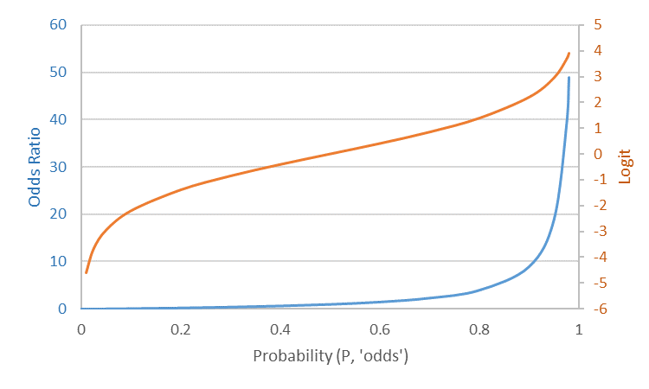
Odds Ratios & Logits
Logit
Odds Ratio

Slide 10
Odds ratio
It is often useful to interpret odds ratios
e.g. , if a female tilefish at 30cm has a probability of 0.25 for being mature and a male at 30 cm has a probability of 0.125, then the female has an odds ratio of 2 (i.e., is twice as likely to be mature at 30 cm than the male).

Slide 11
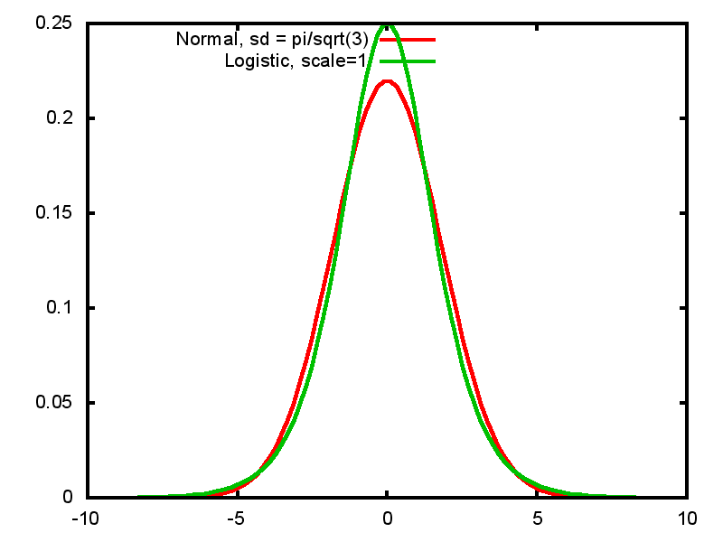
~ Normality
The logit has no floor or ceiling and is symmetric about the midpoint.
Probability of 0.5 → odds of 1 → logit=0 (midpoint)
… but small differences in probabilities at the tails (~0 or ~1), result in large differences in the logit

Slide 12
Linearity
The logit is a link function that transforms the mean of a dichotomous variable to a normal distribution and transforms a non-linear relationship of the categorical variable with its explanatory variables into a linear one.

Slide 13
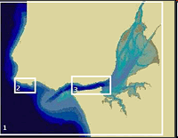

Chap 21: Presence/Absence of Solea solea
Taugus Estuary (Portugal) nursery habitat

Slide 14
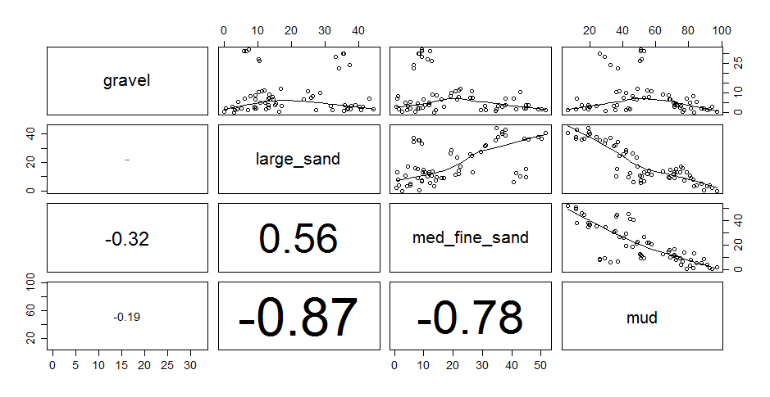
Exploration - Pairplot

Slide 15
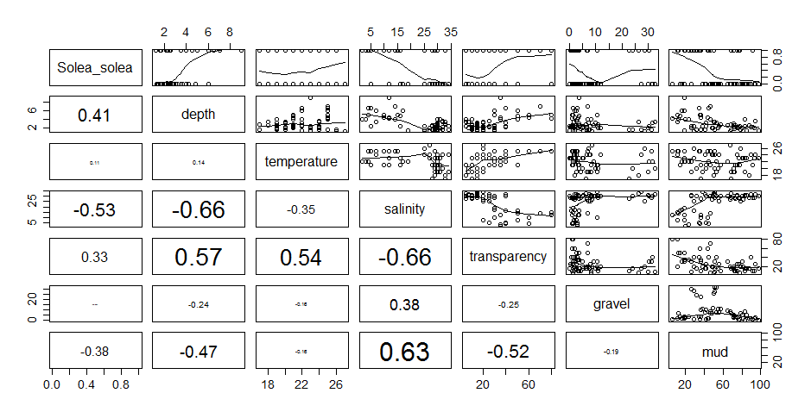
Exploration - Pairplot

Slide 16
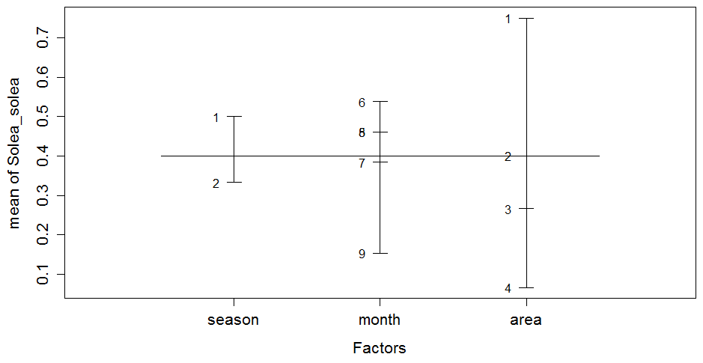
Exploration – Design Plot
Notes:
Proportion of presence

Slide 17
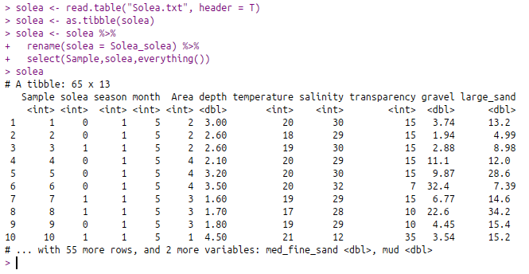
The data:
Monthly surveys of sole density (expressed as presence 1 or absence 0)

Slide 18
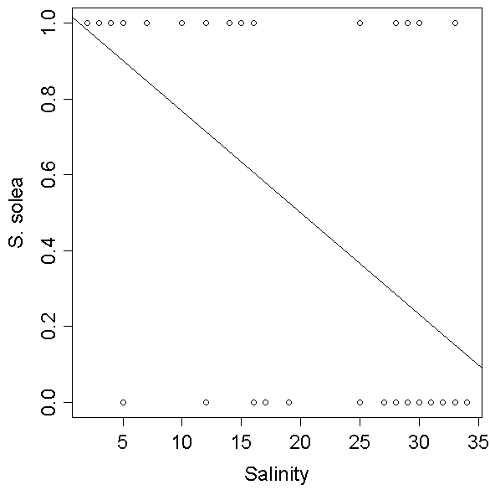
Presence/Absence and Salinity

Slide 19
Maximum Likelihood
A likelihood function can be used to estimate regression parameters for bivariate, multivariate, and nonlinear data
Maximum likelihood estimation finds model parameter values most likely to give rise to the data.

Slide 20
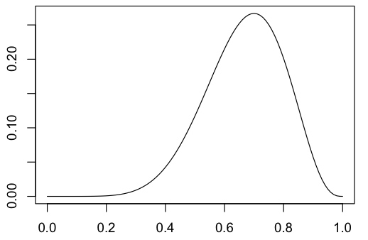
Maximum Likelihood
L = ∏ {P_{i}^{Yi} * (1-P_{i})^{1-Yi}}
L: likelihood
P_{i}: estimated probability values from logistic regression
Y_{i} = 0 or 1 (specifies event)
Iterative search to find regression parameters that maximize likelihood.
L
P

Slide 21
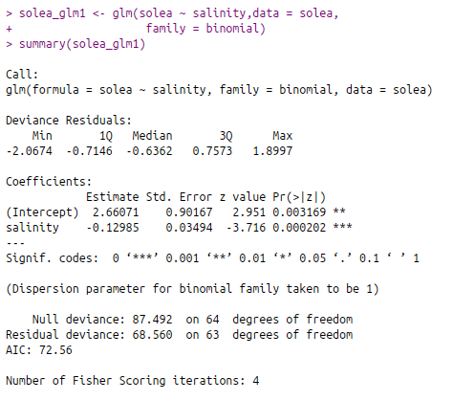
Regression output
GLM is model used for logistic regression in R

Slide 22
Significance
Coefficient/SE = z-score (one-tailed)
(Coefficient/SE)^2 = z-sq (chi-sq distribution)
Testing significance for samples <100 is risky, because the properties of logistic regression with small sample sizes are not well understood.
p-values aren’t that useful for large sample sizes; may indicate significance when relationship is not so significant.
BIC – Bayesian information criterion
BIC = z² – ln(n)
BIC>0 → significant

Slide 23
BIC scale of significance
0-2 Weak
2-6 Moderate
6-10 Strong
10+ Wicked Strong
BIC=-3.716^2 – ln(61) = 9.7
Coefficients:
Estimate Std. Error z value Pr(>|z|)
(Intercept) 2.66071 0.90167 2.951 0.003169 **
salinity -0.12985 0.03494 -3.716 0.000202 ***

Slide 24
Interpreting regression coefficients
Logged odds: a one unit change in the explanatory variable has a change in the logged odds of one coefficient value.
Odds: exponentiate the coefficients – then a one unit change in the X variable has a multiplicative effect of exp(coefficient) change in the odds
A coefficient of 0 doesn’t change the odds
A coefficient > 0 increases the odds
A coefficient < 0 decreases the odds

Slide 25
Interpretation- example
Coefficients:
Estimate Std. Error z value Pr(>|z|)
(Intercept) 2.66071 0.90167 2.951 0.003169 **
salinity -0.12985 0.03494 -3.716 0.000202 ***
Signif. codes: 0 ‘***’ 0.001 ‘**’ 0.01 ‘*’ 0.05 ‘.’ 0.1 ‘ ’ 1
A one unit increase in salinity decreases the probability of catching sole by 12% (1- e^{-0.12985}).

Slide 26
Predicting the relationship
P_{i}n_{i} <- (exp(2.66 -0.13*salinity_{i}))/1+(exp(2.66 -0.13*salinity_{i}))
Coefficients:
Estimate Std. Error z value Pr(>|z|)
(Intercept) 2.66071 0.90167 2.951 0.003169 **
salinity -0.12985 0.03494 -3.716 0.000202 ***
Signif. codes: 0 ‘***’ 0.001 ‘**’ 0.01 ‘*’ 0.05 ‘.’ 0.1 ‘ ’ 1
The expected number of sole is given by P_{i}n_{i} for every salinity value, with a variance = n_{i}P_{i}(1-P_{i}).
n_{i} = # of samples with the same salinity value

Slide 27
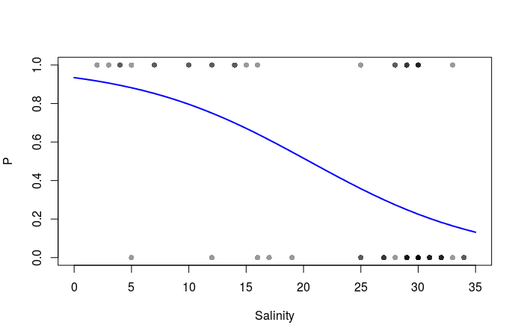
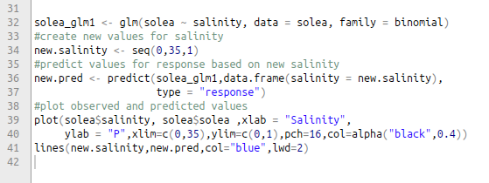
Observed and Fitted values

Slide 28
Variance
Variance is calculated as
Var(Y_{i}) = n_{i}P_{i}(1-P_{i})
Where n_{i} = sample size for given X variable
P_{i} is the probability of an event occurring at the given X value
Overdispersion can occur if the observed variance is greater than the predicted variance. In this case a dispersion parameter must be used to correct for this bias.

Slide 29
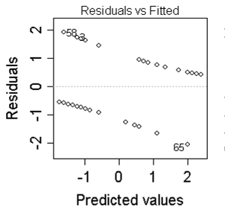
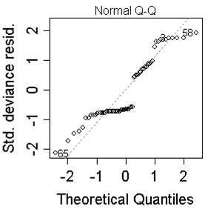
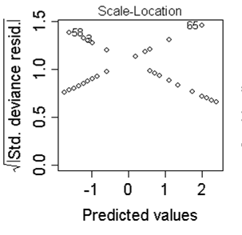
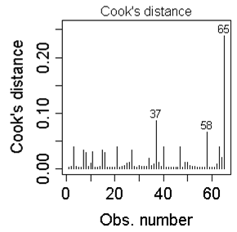
Validation Plots

Slide 30
Alternative to Logistic Regression
If the distributional assumptions are met, discriminant function analysis of two groups (0,1) may be more powerful, but it often overestimates the association using discrete predictors.

Slide 31
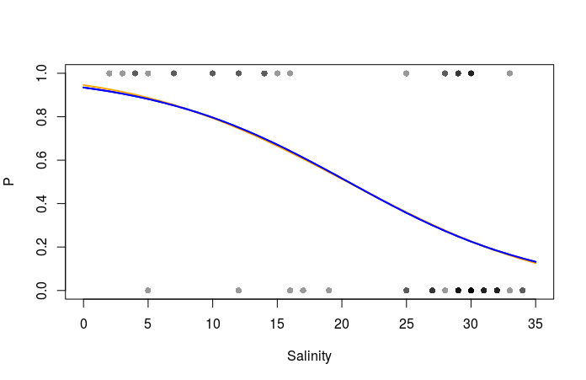
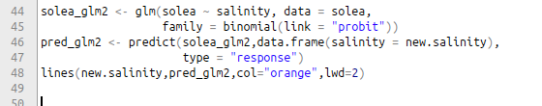
Binomial GLM with probit link

Slide 32
melanoma example
boot::melanoma dataset
Survival outcomes of patients that had surgery to remove malignant melanomas.
Status at end of study: Alive / Dead
Measurements included: thickness of tumour, whether tumour was ulcerated, sex of patient, age, etc.
thickness of tumour & presence of ulceration thought to be important prognostic variables.

Slide 33
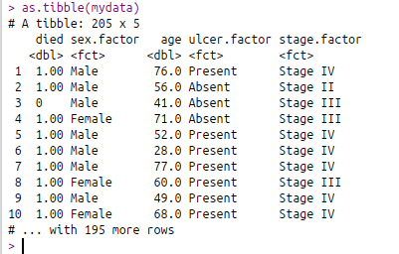
The data…

Slide 34
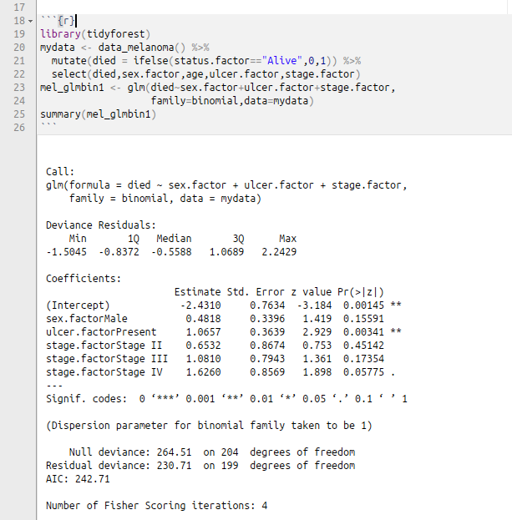
Model with sex, ulcer, & thickness (stage) as factors.
Ulceration of tumour moderately associated with patients dying.
(BIC = 3.25)

Slide 35
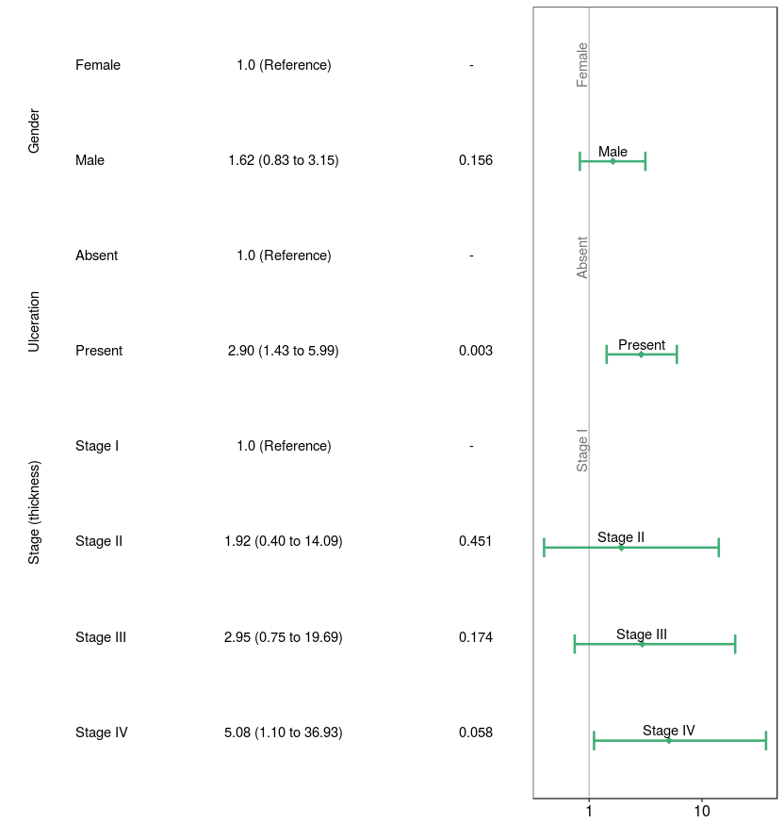
Odds ratios via Forest plot

Slide 36
Summary
Logistic Regression is a form of Generalized Linear Model that uses a logit function to a allow linear prediction of a binary response variable.
Observations at tails (P~0 or P~1) have greater influence on estimates.
Interpretation of effect size and significance requires an understanding of the odds ratio.
Bayesian Information Criterion is useful for evaluating strength of relationship and model comparison.
Data exploration and model validation techniques can be applied with the binary distribution.

Slide 37
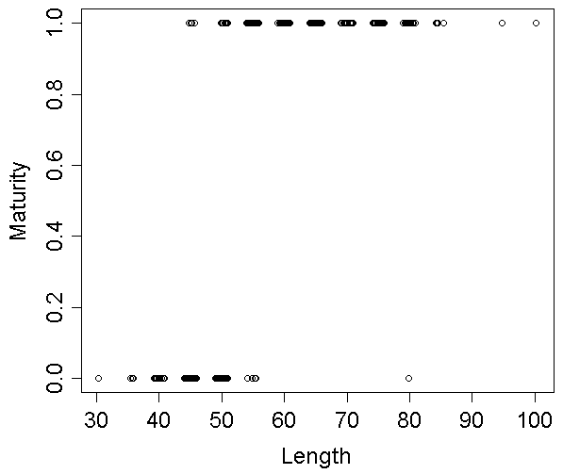
Tilefish Maturity
group length response
1 F 30 0
2 F 35 0
3 F 35 0
4 F 35 0
5 F 40 0
6 F 40 0
7 F 40 0
8 F 40 0
9 F 40 0
10 F 40 0
11 F 40 0
12 F 40 0
13 F 40 0
14 F 40 0
15 F 40 0
16 F 40 0
17 F 40 0
18 F 40 0
19 F 40 0
20 F 40 0
21 F 40 0
22 F 45 0
23 F 45 0
355 F 85 1
356 F 85 1
357 F 85 1
358 F 85 1
359 F 95 1
360 F 100 1
plot(jitter(tile_fem$length), tile_fem$response,
xlab = "Length", ylab = "Maturity")

Slide 38
Tilefish Maturity
tile_logist <- glm(response ~ length, data = tile_fem, family = binomial)
Coefficients:
Estimate Std. Error z value Pr(>|z|)
(Intercept) -24.01847 2.90163 -8.278 < 2e-16 ***
length 0.45909 0.05601 8.197 2.47e-16 ***

Slide 39
Tilefish Maturity
Females
Males

Slide 40
Tilefish Maturity

Slide 41
Tilefish Maturity

