Slide 1
Principal Components Analysis
MAR 536 Biological Statistics II
March 02 2023
Acknowledgements: Ashley Weston Asci, Steve Cadrin

Slide 2
Multiple Variables vs. ‘Multivariate’
Multiple Variable Statistics
Multivariate Statistics
Prediction of response variable as a function of explanatory variables (multiple regression, GLMs, GAMs, …)
All assume that explanatory variables are NOT correlated.
Explore patterns of variation or group membership based on multiple response variables (Principal Components Analysis, Discriminant Function Analysis, …).
All RELY on correlation among variables.

Slide 3
Multivariate statistics
Two general types of problems:
Ordination
What are associations among variables?
How similar are ‘sites’ based on measurements of multiple variables?
How do similarities in response variables associate with environmental variables?
Classification
Do groupings in the data correspond to variance?
Can we separate data into groups based on similarities in observations of multiple variables?

Slide 4
Overview of Methods
Data
Exploration
not too
many zeros
Discriminant
Analysis
linear
relationships
known
group
membership
Principal
Component
Analysis
unimodal
explanatory
variables
Canonical
Correspondence
Analysis
Correspondence
Analysis
Redundancy
Analysis
unimodal
lots of
zeros
correlated variables
R-Technique
Principle Coordinate Analysis
Nonmetric Multidimensional Scaling
correlated observations
explanatory
variables
Q-Technique
- Mantel test
- Analysis of Similarities

Slide 5
Ordination
The arrangement of units in some order
Several descriptors are usually observed for each object under study
Interested in characterizing main trends of variation of the objects with respect to all descriptors
Scatter plots of all object/descriptor combinations is tedious & difficult to interpret
Multivariate approach uses a scatter plot with as many axes as there are descriptors

Slide 6
Principle Components of Variation
Principal component analysis (PCA) is used to investigate patterns of variance in multivariate data by deriving a few uncorrelated indices based on objective combinations of correlated variables.

Slide 7
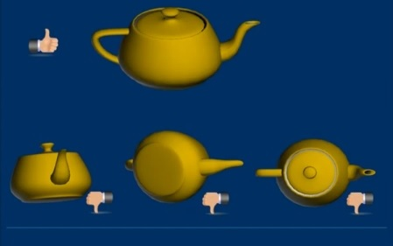
Principal Components Analysis
What is the best picture of a teapot that gives you the most information about its shape?

Slide 8
Principal Components of Variation
Principal component analysis (PCA) is used to investigate patterns of variance in multivariate data by deriving a few uncorrelated indices based on objective combinations of correlated variables.
The composite variable that explains most of the total variance in the data (s²₁+s²₂+…s²_{k}) is the first principle component. (PC1=v_{1,1}x₁+v_{1,2}x₂+…v_{1,k}x_{k})
PC2 is the composite variable that explains most of the residual variance after PC1 is removed (PC2=v_{2,1}x₁+v_{2,2}x₂+…v_{2,k}x_{k}), etc.

Slide 9
Principal Components of Variation
Eigenvector elements (v_{i,j}) and eigenvalues (λ_{j}, proportion of variance explained) are derived through eigenanalysis of the correlation matrix or variance-covariance matrix,
(L = V’ R V)
deriving uncorrelated variables, from correlated variables.

Slide 10
Eigenanalysis

Slide 11
Why and when to use PCA
Find patterns in data
Simpler description of the system
Directions of maximum variance of data- better explained than the usual x,y- plane
Deals with correlated data
Are descriptors appropriate?
Quantitative
Multivariate normal distribution
Not too many zeros

Slide 12
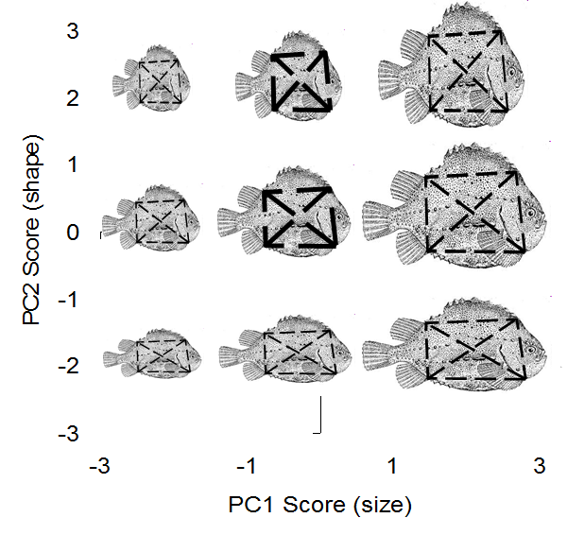
Size and Shape
PC1 accounts for most of the covariance and is positively correlated with all dimensions of size, because all dimensions increased during growth.
General size is accounted for by PC1, and most of the residual variance caused by shape differences is resolved by PC2.
PC2 is positively correlated with some variables, and negatively correlated with others.
depths
lengths

Slide 13
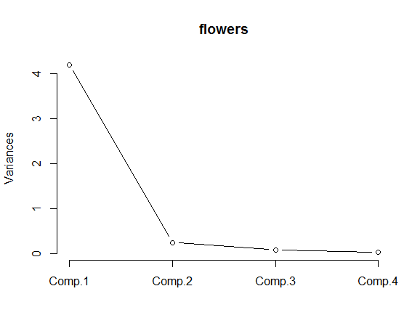
Interpreting Principal Components
Scree plot
Eigenvalues vs. principal component number
Retain principal components needed to account for a certain percentage of the total variation (80%)
For correlation-based PCA retain all principal components with variance>1
Broken stick – randomization test to determine ‘significance’.
Notes:
Look for “elbow”

Slide 14

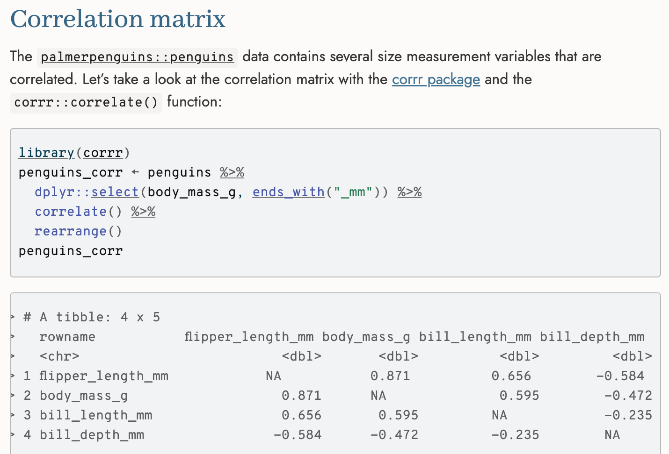
PCA with Palmer Penguins
Allison Horst

Slide 15
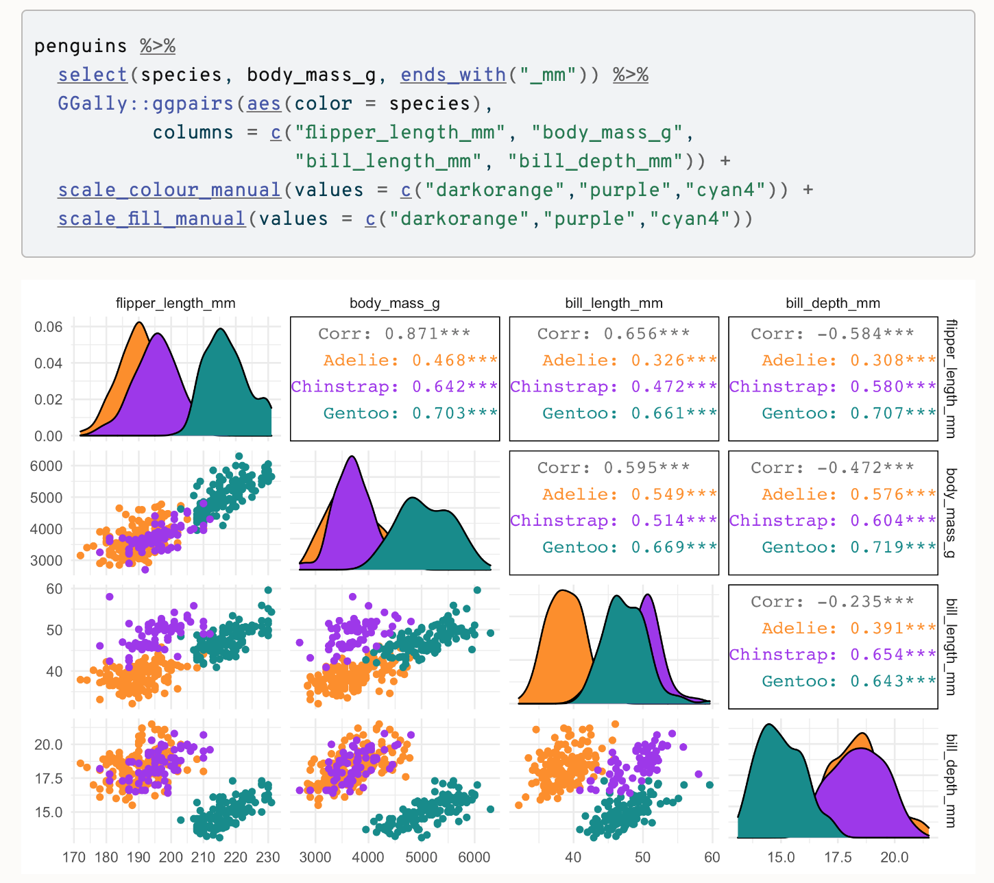
PCA with Palmer Penguins
Allison Horst

Slide 16
PCA with Palmer Penguins
PCA in R, courtesy of Allison Horst
Allison Horst

Slide 17
Principal Components Analysis
Eigenanalysis transforms the correlation matrix, R, to a series of components with successively less contribution to the total variance
The vector of eigenvalues (L) has elements that correspond to the amount of total variance explained by each component.
The matrix of eigenvectors (V) can be used to transform the data matrix to principal component scores (P).

Slide 18
Principal Components Analysis
Eigenanalysis of the correlation matrix (R) for an ‘unscaled’ PCA.
PCA can also use eigenanalysis of the variance-covariance matrix (C) to maintain relative scales of variables in the total variance.

Slide 19
PCA using Matrices in R
> Y <- matrix(c(1,3,3, 3,6,8, 10,15,21),3,3)
> Y
[,1] [,2] [,3]
[1,] 2 3 10
[2,] 3 6 15
[3,] 3 8 21
> # matrix of means
> U <- rbind(matrix (colMeans(Y),ncol=3),matrix (colMeans(Y),ncol=3),matrix (colMeans(Y),ncol=3))
> U
[,1] [,2] [,3]
[1,] 2.666667 5.666667 15.33333
[2,] 2.666667 5.666667 15.33333
[3,] 2.666667 5.666667 15.33333
> # deviation matrix
> D <- Y - U
> D
[,1] [,2] [,3]
[1,] -0.666667 -2.666667 -5.333333
[2,] 0.333333 0.333333 -0.333333
[3,] 0.333333 2.333333 5.666667
> # sum-of-squares cross-products matrix
> S <- t(D) %*% D
> S
[,1] [,2] [,3]
[1,] 0.6666667 2.666667 5.333333
[2,] 2.6666667 12.666667 27.333333
[3,] 5.3333333 27.333333 60.666667

Slide 20
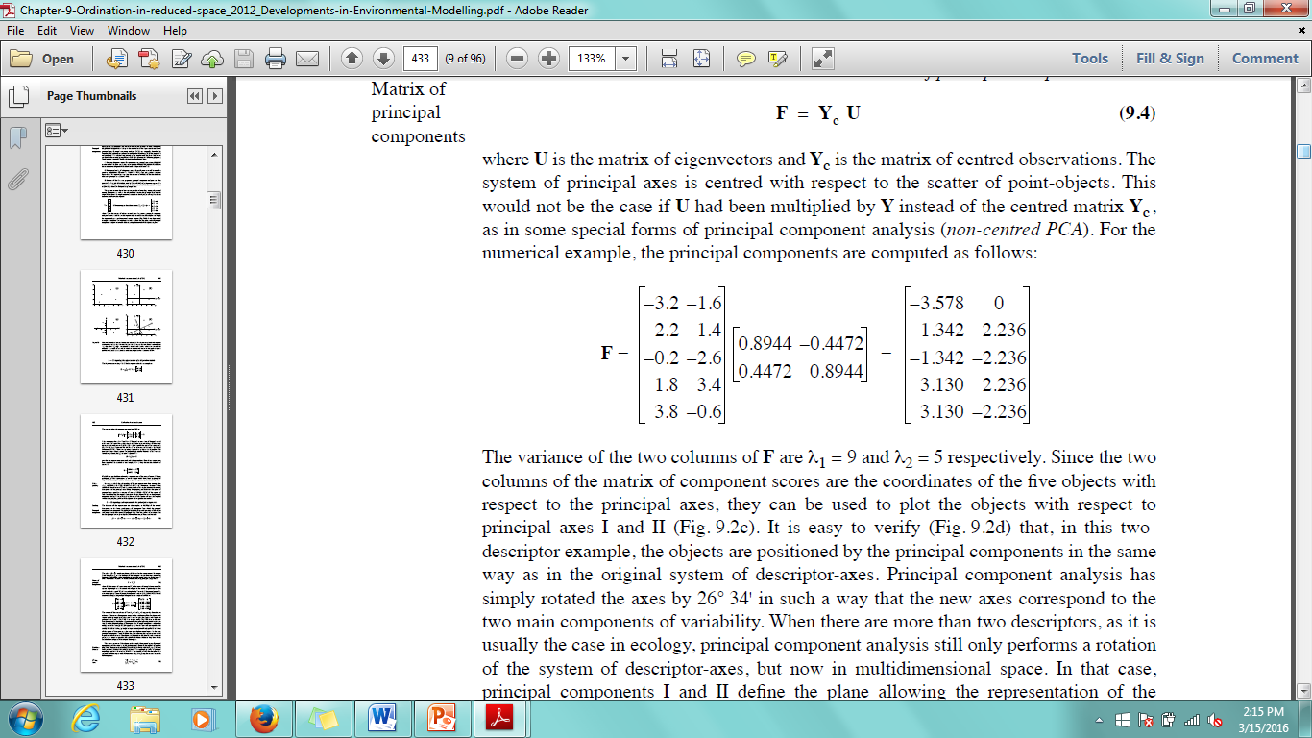
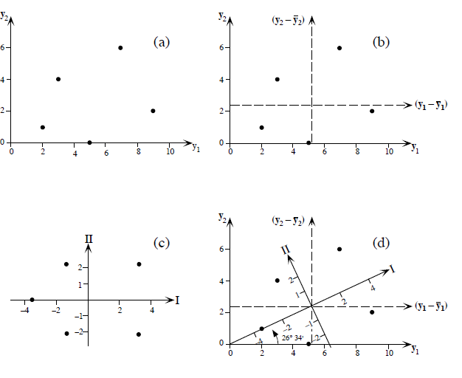
Matrix of principal components
Principal components give the position of objects on the new principal axes.
i.e. columns of principal component matrix are coordinates with respect to the principal axes.
Axes have been rotated to correspond with the main components of variability.
When > 2 descriptors, still a rotation, but in multidimensional space.

Slide 21
PCA using Matrices in R
> # variance-covariance matrix
> C <- (1/(nrow(S)-1)) * S
> C
[,1] [,2] [,3]
[1,] 0.3333333 1.333333 2.666667
[2,] 1.3333333 6.333333 13.666667
[3,] 2.6666667 13.666667 30.333333
> # correlation matrix
> R <- C / diag(diag(sqrt(C))) %*% t(cbind(diag(sqrt(C)),diag(sqrt(C)),diag(sqrt(C))))
> R
[,1] [,2] [,3]
[1,] 1.0000000 0.9176629 0.8386279
[2,] 0.9176629 1.0000000 0.9860214
[3,] 0.8386279 0.9860214 1.0000000
> # eigenanalysis of R
> L <- eigen(R)$values
> L
[1] 2.829526 1.7047e-01 -7.876e-18
> perc <- L / nrow(R)
> perc
[1] 9.432e-01 5.683e-02 -2.625e-18
> V <- eigen(R)$vectors
> V
[,1] [,2] [,3]
[1,] 0.5618300 0.7917027 0.2399041
[2,] 0.5927884 -0.1830136 -0.7842882
[3,] 0.5770173 -0.5828489 0.5721347
> P <- Y %*% V
> P
[,1] [,2] [,3]
[1,] 8.672198 -4.794125 3.848291
[2,] 13.897480 -7.465708 4.596004
[3,] 18.545161 -11.328829 6.460236

Slide 22
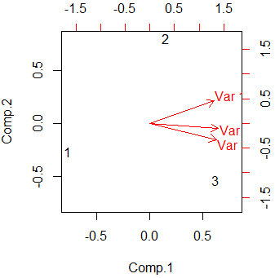
PCA in R
> Y <- matrix (c(1,3,3,3,6,8,10,15,21),3,3) > PCA<-princomp(Y,cor=TRUE) > summary(PCA) Importance of components: Comp.1 Comp.2 Comp.3 Standard deviation 1.6821196 0.41288458 0 Proportion of Variance 0.9431754 0.05682456 0 Cumulative Proportion 0.9431754 1.00000000 1 > loadings(PCA) Loadings: Comp.1 Comp.2 Comp.3 [1,] 0.562 0.792 0.240 [2,] 0.593 -0.183 -0.784 [3,] 0.577 -0.583 0.572 Comp.1 Comp.2 Comp.3 SS loadings 1.000 1.000 1.000 Proportion Var 0.333 0.333 0.333 Cumulative Var 0.333 0.667 1.000 > biplot(PCA)
>

Slide 23
What kind of descriptors do you have?
Dimensionally homogenous – same units
Analysis on dispersion (covariance) matrix
Not dimensionally homogenous – different units
Variances cannot be added
Variables must be standardized
Analysis on correlation matrix
Sensitive to scaling of original variables
PCA is not scale invariant.

Slide 24
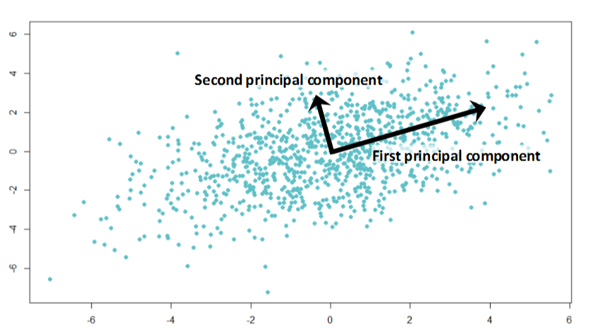
Summary
Principal Components Analysis is a multivariate extension of bivariate statistical analysis.
PCA helps to explore patterns in large datasets by deriving composite variables that explain the maximum variance as a function of measured variables but are uncorrelated.
(Dimension reduction)
Composite variables are derived through eigenanalysis.
There are as many Principal Components as variables, the first 2 or 3 are usually done for visualization.

Slide 25

Additional reading
Legendre, P. and Legendre, L.F., 2012. Numerical ecology (Vol. 24). Elsevier.

