Slide 1
MAR 536: Biological Statistics II
Lecture 13
Linear mixed effects models
(Acknowledgements: André Punt, Arni Magnusson, Jim Thorson)
18 March 2025

Slide 2
Today’s Outline
Review of linear models
Introduction to mixed effects models
Parameter estimation for linear mixed effects models

Slide 3
Linear modeling review LMs, GLMs, NLMs
LM and GLM are used to describe whether and how a response variable depends on a combination of predictors.
Predictors can be numeric (continuous) or factors (categorical).
Linear
Quite flexible as it is
Generalized
Any error distribution
Nonlinear
Any relationship between Y and X
closed form solution
iterative solution

Slide 4
What are Fixed and Random Effects?
Fixed Effects:
Parameters associated with the entire population or with certain repeatable levels of experimental units.
Random Effects:
Parameters associated with individual experimental units drawn at random from a population.
A mixed effects model is a model that has both fixed effects and random effects.
Classical (frequentist) and Bayesian methods can be used to estimate the parameters of mixed effects models.
Often the same random effect is assigned to observations sharing a common classification factor:
Consider length-at-age data for several (randomly selected) stocks of a species. The random factor is stock and the observations are length-at-age data.
Random effects can be thought of as ways of modeling the covariance structure of the data.

Slide 5
Linear Mixed Effects Models
Vector of fixed effects
Observations for group i
Vector of random effects
The traditional linear modeling framework is a special case
of this model in which there are no random effects.

Slide 6
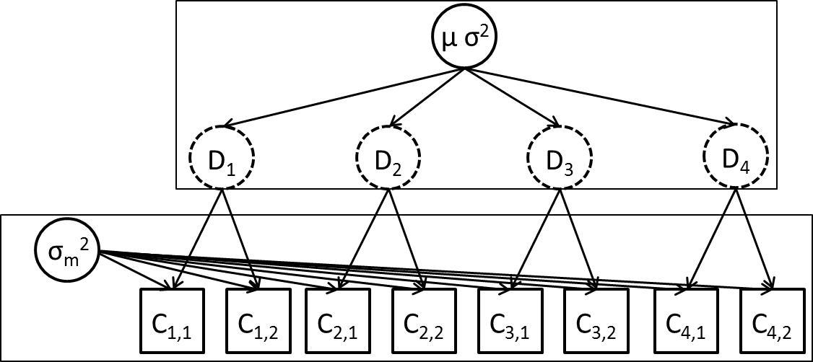
Example 1: Streams [lecture-13.Rmd] (sensu Pinheiro and Bates, Chapter 1)
We are estimating fish density in streams.
We select six streams at random and determine the density at each stream multiple times.
The questions:
What is the density in a typical stream?
What is the variation in density among streams?
What is the variation in density estimates within a stream?
We would like to separately estimate measurement and between-site variability.

Slide 7
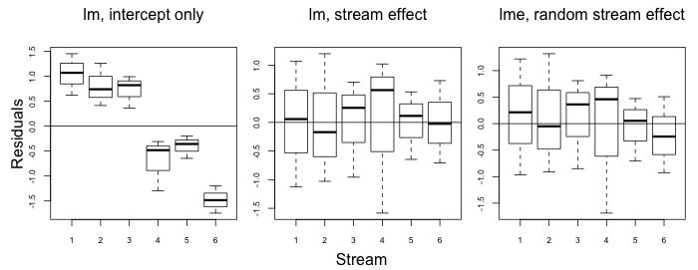
Fitting linear models
Stream
This analysis attributed all the error to within-stream variation. It is clear there is between-stream variation in density but we have no way to comment on it.

Slide 8
Fitting linear models
The residual pattern has been removed, but we have no overall mean and no way to comment on between-stream variance. We cannot say anything about the population of streams.

Slide 9
Example 1: Streams mixed effects model
We construct a mixed effects model as follows:
β is the mean density across the population,
b_{i} is a random variable representing the deviation from the population mean for stream i
ε_{i,j} is a random variable representing the deviation for observation j from mean density for stream i, i.e.

Slide 10
Fitting linear mixed effects models
These estimates are similar to the linear model with separate “stream effects” (but would not be if this was an unbalanced design).

Slide 11
Mixed Effects Modeling (some notes)
Residuals are assumed to be independent, normally distributed random variables with constant variance.
Random effects are assumed to be normally distributed.
This only works if the streams have been selected at random from the population of streams.
Mixed effects models are also called hierarchical models.
This model has 3 parameters (β, σ and σ_{b}).
There are ways to estimate the random effects. (we will often be interested in their values)

Slide 12
Estimation of mixed effects models
Maximum Likelihood Estimation (MLE)
is the vector of fixed effects parameters.
are the parameters controlling the distribution for the random effects.
We integrate across the random effects.
Effectively weight the probability of the observations given values for random effects by the probability of those values.
In the linear case, closed form solutions exist. For nonlinear models, either evaluate numerically or use approximations.

Slide 13
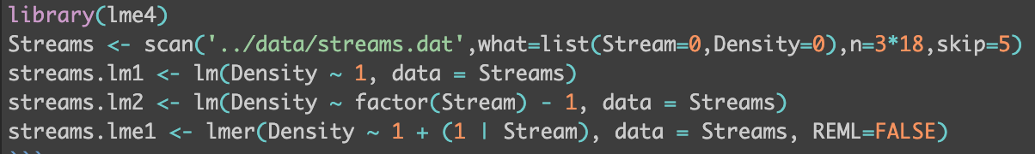
Estimating using R
lmer() in lme4, lme() in package nlme
nlme() used to fit nonlinear models
The call to lmer() gives the fixed effects as usual (the intercept in this case), and denotes the groupings for the random component of the model.

Slide 14
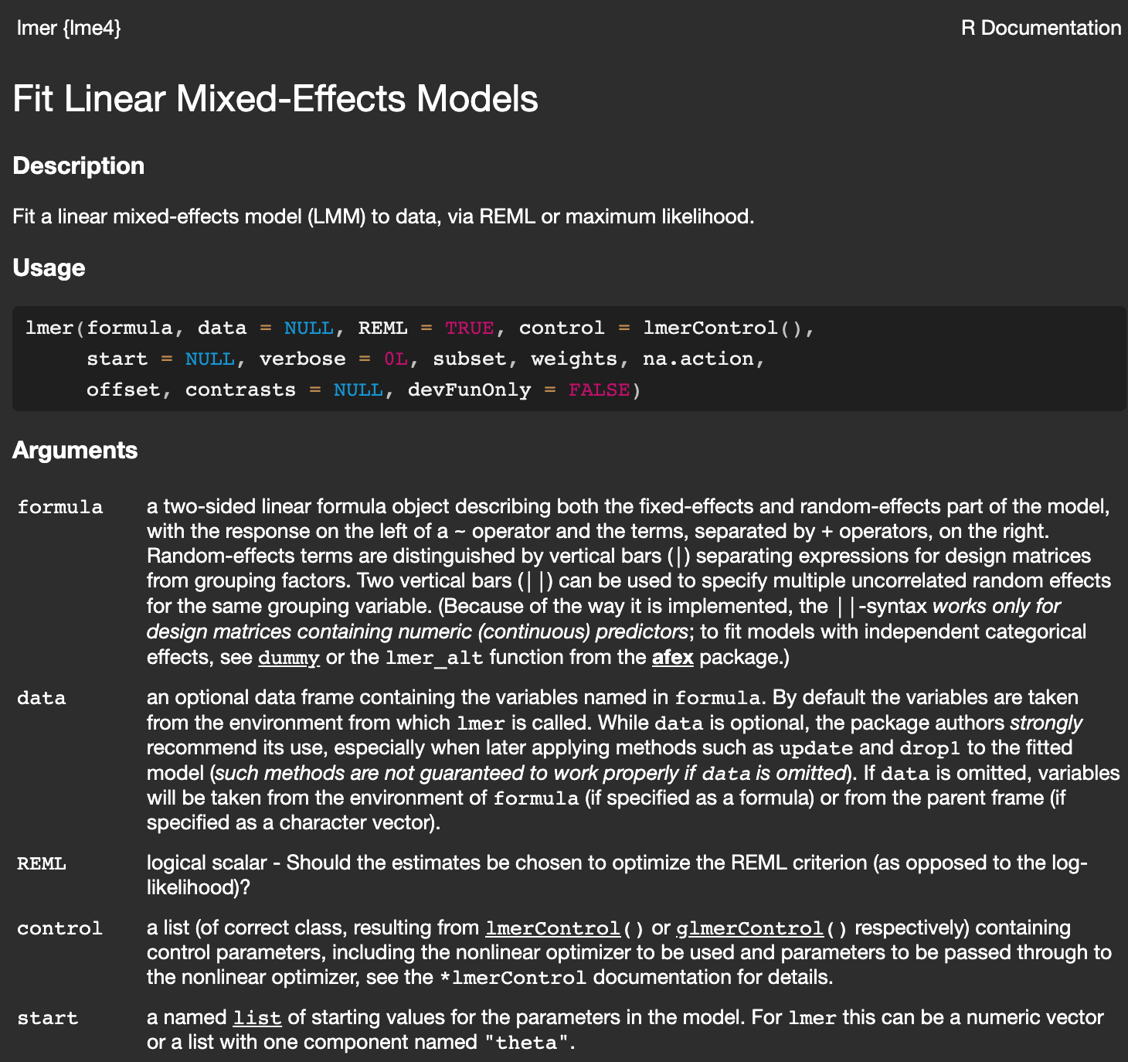
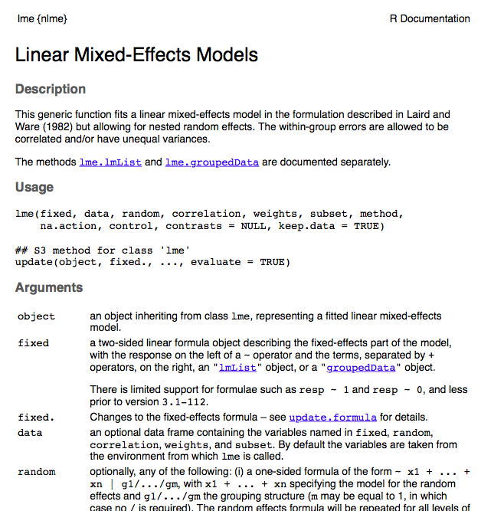
?lmer
Fit using ML or restricted maximum likelihood (REML). REML more robust but more gnarly equations.

Slide 15
?lme
Fit using ML or restricted maximum likelihood (REML). REML more robust but more gnarly equations.

Slide 16
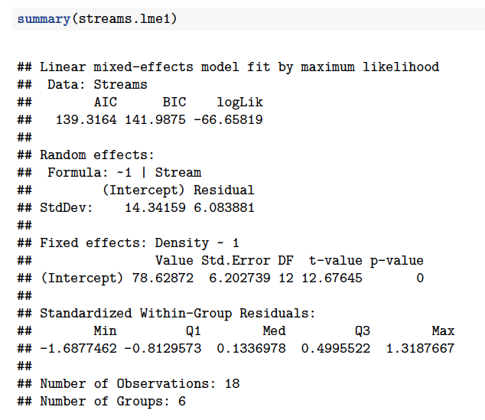
lme() output
among stream variation
within stream variation
fixed effects

Slide 17
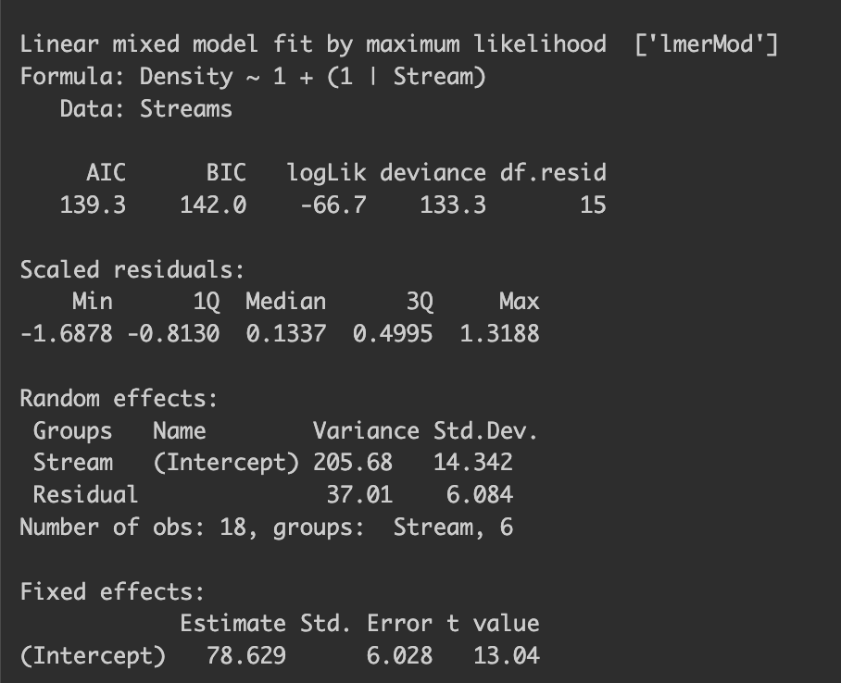
lmer() output
among stream variation
within stream variation
fixed effects

Slide 18
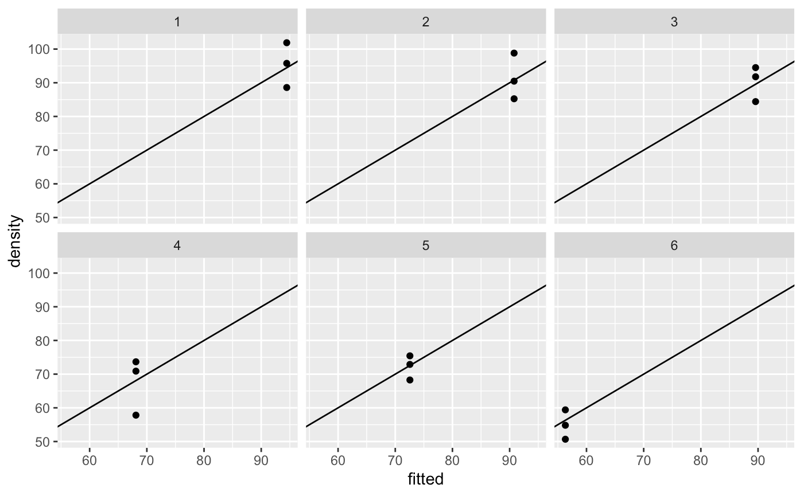
Fit of the model
Always plot your data and results!

Slide 19
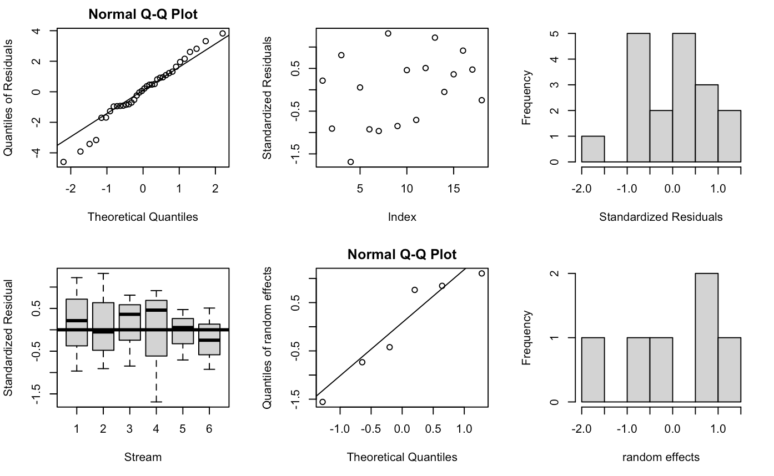
Inspecting residuals, etc.

Slide 20
Model selection with both fixed and random effects (Zuur et al. 2009)
Set the fixed effects based on “as many explanatory variables as possible”.
Select a random effects structure using AIC (using REML).
Fix the random effects structure and compare fixed effects options (using ML estimation). [Likelihood tests do not work with REML]
Compute the final model using REML.

Slide 21
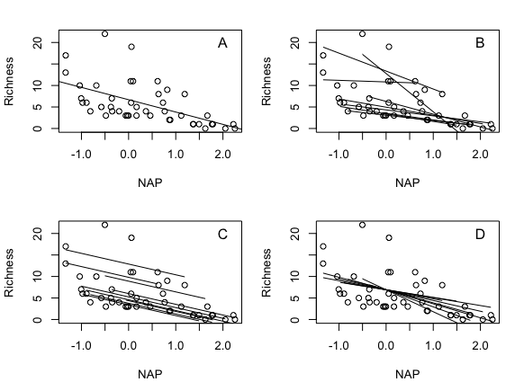
Chapter 8: RIKZ data, species richness Samples from 9 beaches

Slide 22
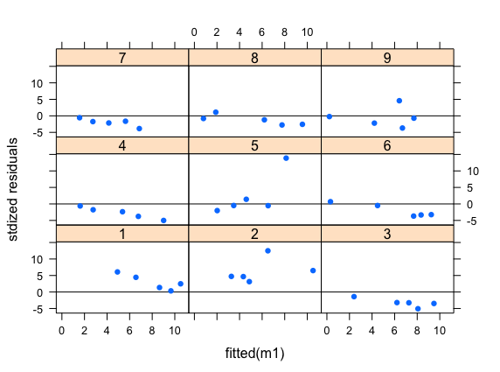
RIKZ data, species richness residuals from linear model with single slope and intercept

Slide 23
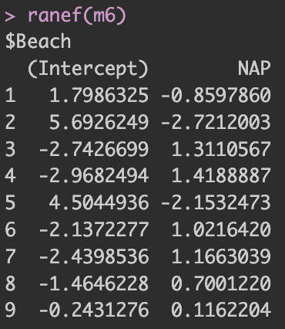
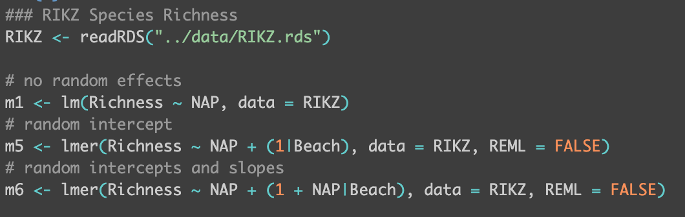
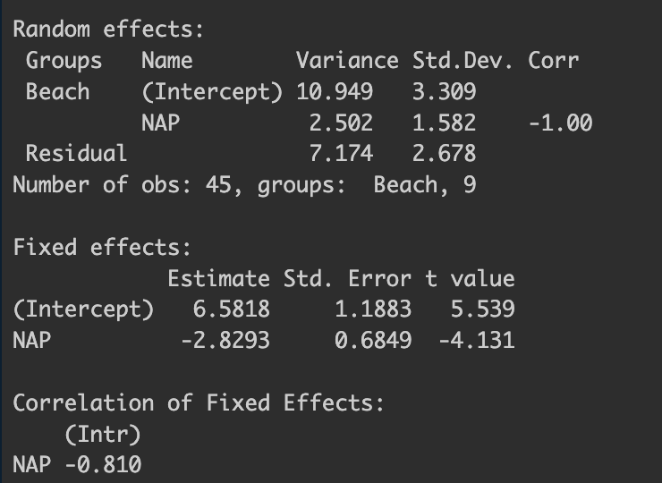
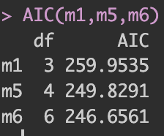
RIKZ data, species richness
Mixed effects models (beach as grouping)
random intercepts
random intercepts & slopes

Slide 24
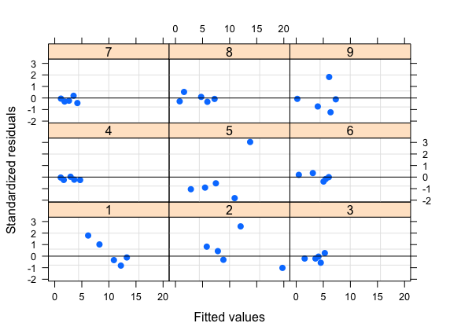
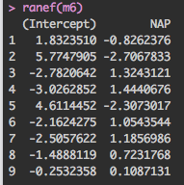
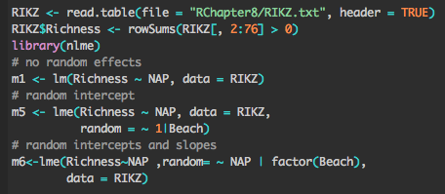
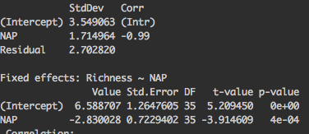

Improve residual pattern considerably when including slope and intercept as random effects

Slide 25
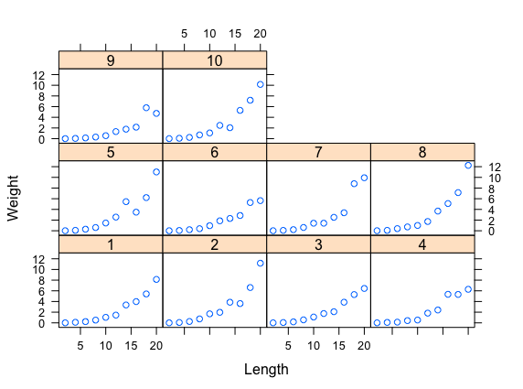
Example 3: Weight-length relationships
We select 10 individual fish at random and measure their lengths and weights as they grow.
We are interested in whether a or b differ among individuals.

Slide 26
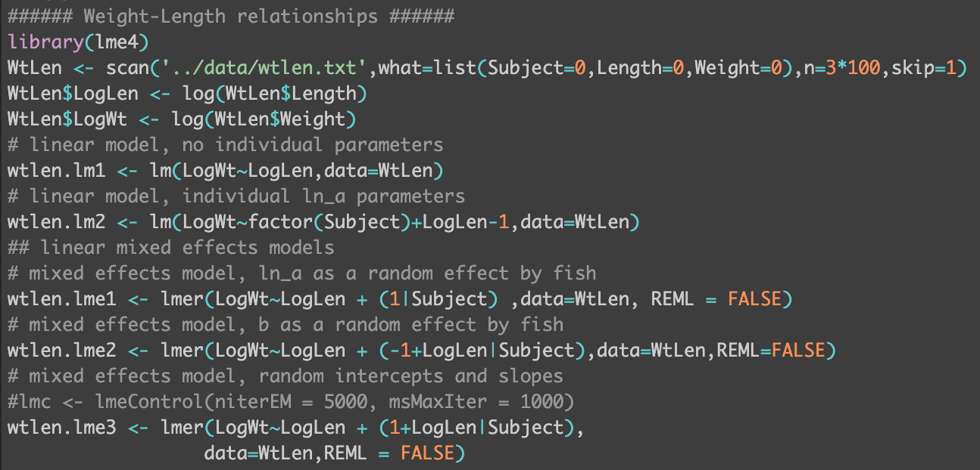
Example 3: Weight-length relationships
We select 10 individual fish at random and measure their lengths and weights as they grow.
We are interested in whether a or b differ among individuals.

Slide 27
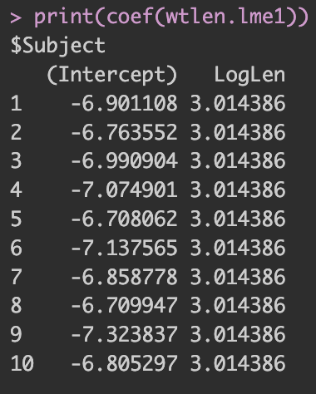
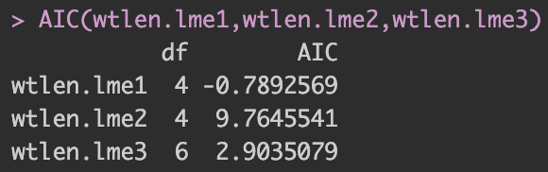
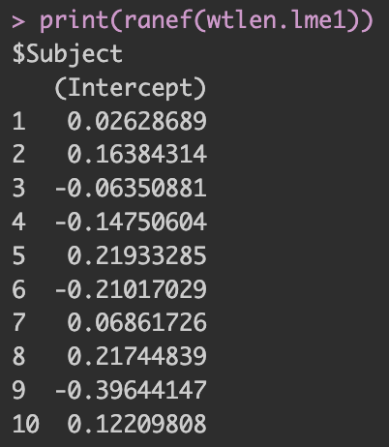
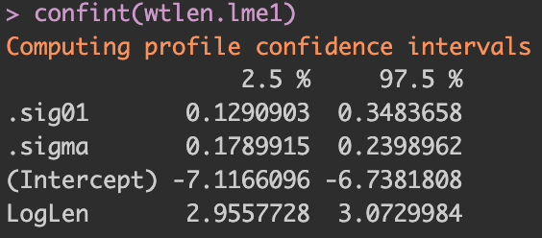
Model with unique intercepts is ‘best’.

Slide 28
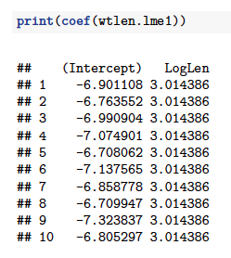
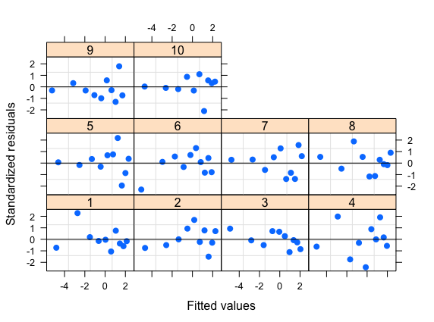
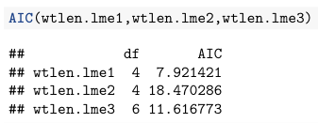
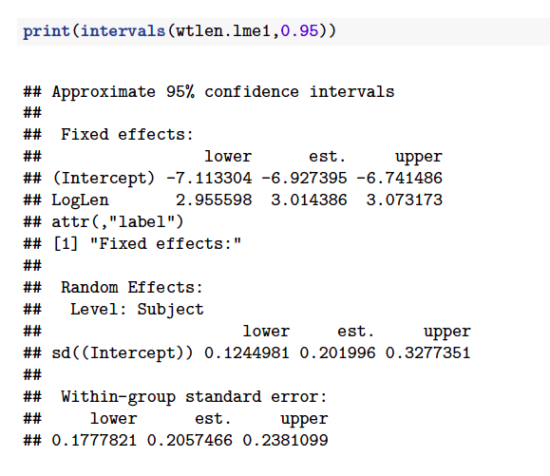
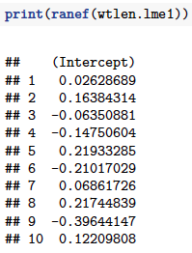
Model with unique intercepts is ‘best’.

Slide 29
Tricks and Traps
If you use REML estimation, you can only compare models with the same fixed-effects structure.
The standard output does not provide:
the “best estimates” of the random effects - use coef(lmout) or ranef(lmout) to find them.
the confidence intervals for the variance parameters – use confint(lmout, 0.95)
{broom.mixed} provides bindings to the ‘broom’ functions for mixed effects models

Slide 30
Extending the linear mixed model
A non-linear relationship between the response variable and the covariates:
2. A non-normal distribution for the random effects.
3. A non-normal distribution for the within- group variability.

Slide 31
Fitting non-linear mixed effects models
R can be used to fit non-linear mixed effects models (function nlme).
To fit non-linear mixed effects models using EXCEL you need to evaluate the integral numerically, or apply a method such as the Laplace approximation.
is the value of ε obtained by maximizing given fixed values of θ and τ, and is the determinant of the matrix of second derivatives.
This approximation is exact when the distribution of random effects (given their hyper-prior and the available data) is exactly proportional to a multivariate normal distribution. (It is a convenient approximation in other cases)
Skaug & Fournier (2006), Thorson & Minto (2015)

Slide 32
Recommended Reading
Bolker et al. (2008). Generalized linear mixed models: a practical guide for ecology and evolution. TREE: 24: 127-35.
Pinheiro, J.C. & Bates, D.M. (2000). Mixed-Effects Models in S and S-PLUS. New York: Springer-Verlag.
Skaug, H. J., & Fournier, D. A. (2006). Automatic approximation of the marginal likelihood in non-gaussian hierarchical models. Computational Statistics & Data Analysis, 51(2), 699-709.
Thorson, J. T., & Minto, C. (2014). Mixed effects: a unifying framework for statistical modelling in fisheries biology. ICES Journal of Marine Science: Journal du Conseil, fsu213.
Venables, W. N., & Dichmont, C. M. (2004). GLMs, GAMs and GLMMs: an overview of theory for applications in fisheries research. Fisheries Research, 70(2), 319-337.
Zuur et al. (2009). Mixed-effects Models and Extensions in Ecology with R. New York: Springer-Verlag.

