Slide 1
End of semester Review
MAR 536 Biological Statistics II
May 1st 2025

Slide 2
Course Description
Student-led learning in statistical analysis of ecological data.
Guided learning in advanced statistical analysis, as applied to ecological research and other fields of marine science.
Advanced concepts in probability, hypothesis testing, and estimation will be presented by students, including analyses of example data sets and problems.
Students will be required to learn and present topics to the class that are relevant to their graduate research, and complete a class project.
A computer lab, focused on introductory and intermediate programming and analysis using R.

Slide 3
Course Objectives
Self-learning in advanced quantitative concepts and methods
Familiarity with advanced statistical methods
Experience communicating advanced quantitative topics
Experience in statistical programming

Slide 4
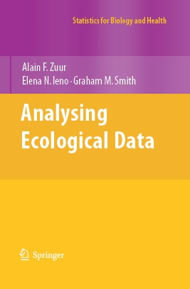
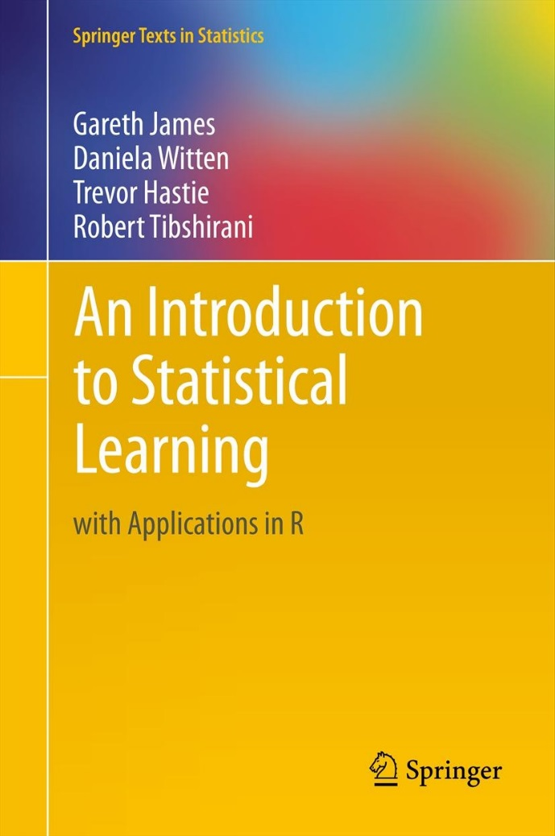
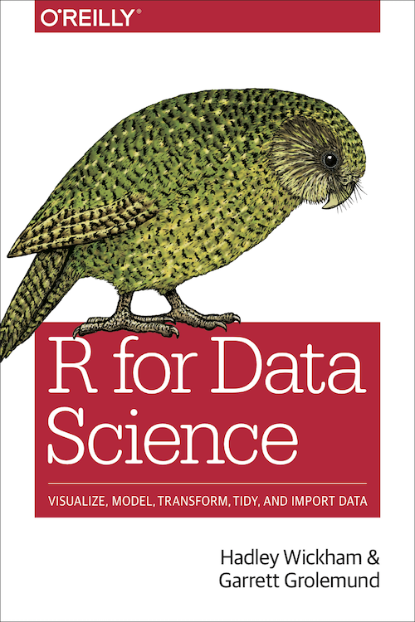

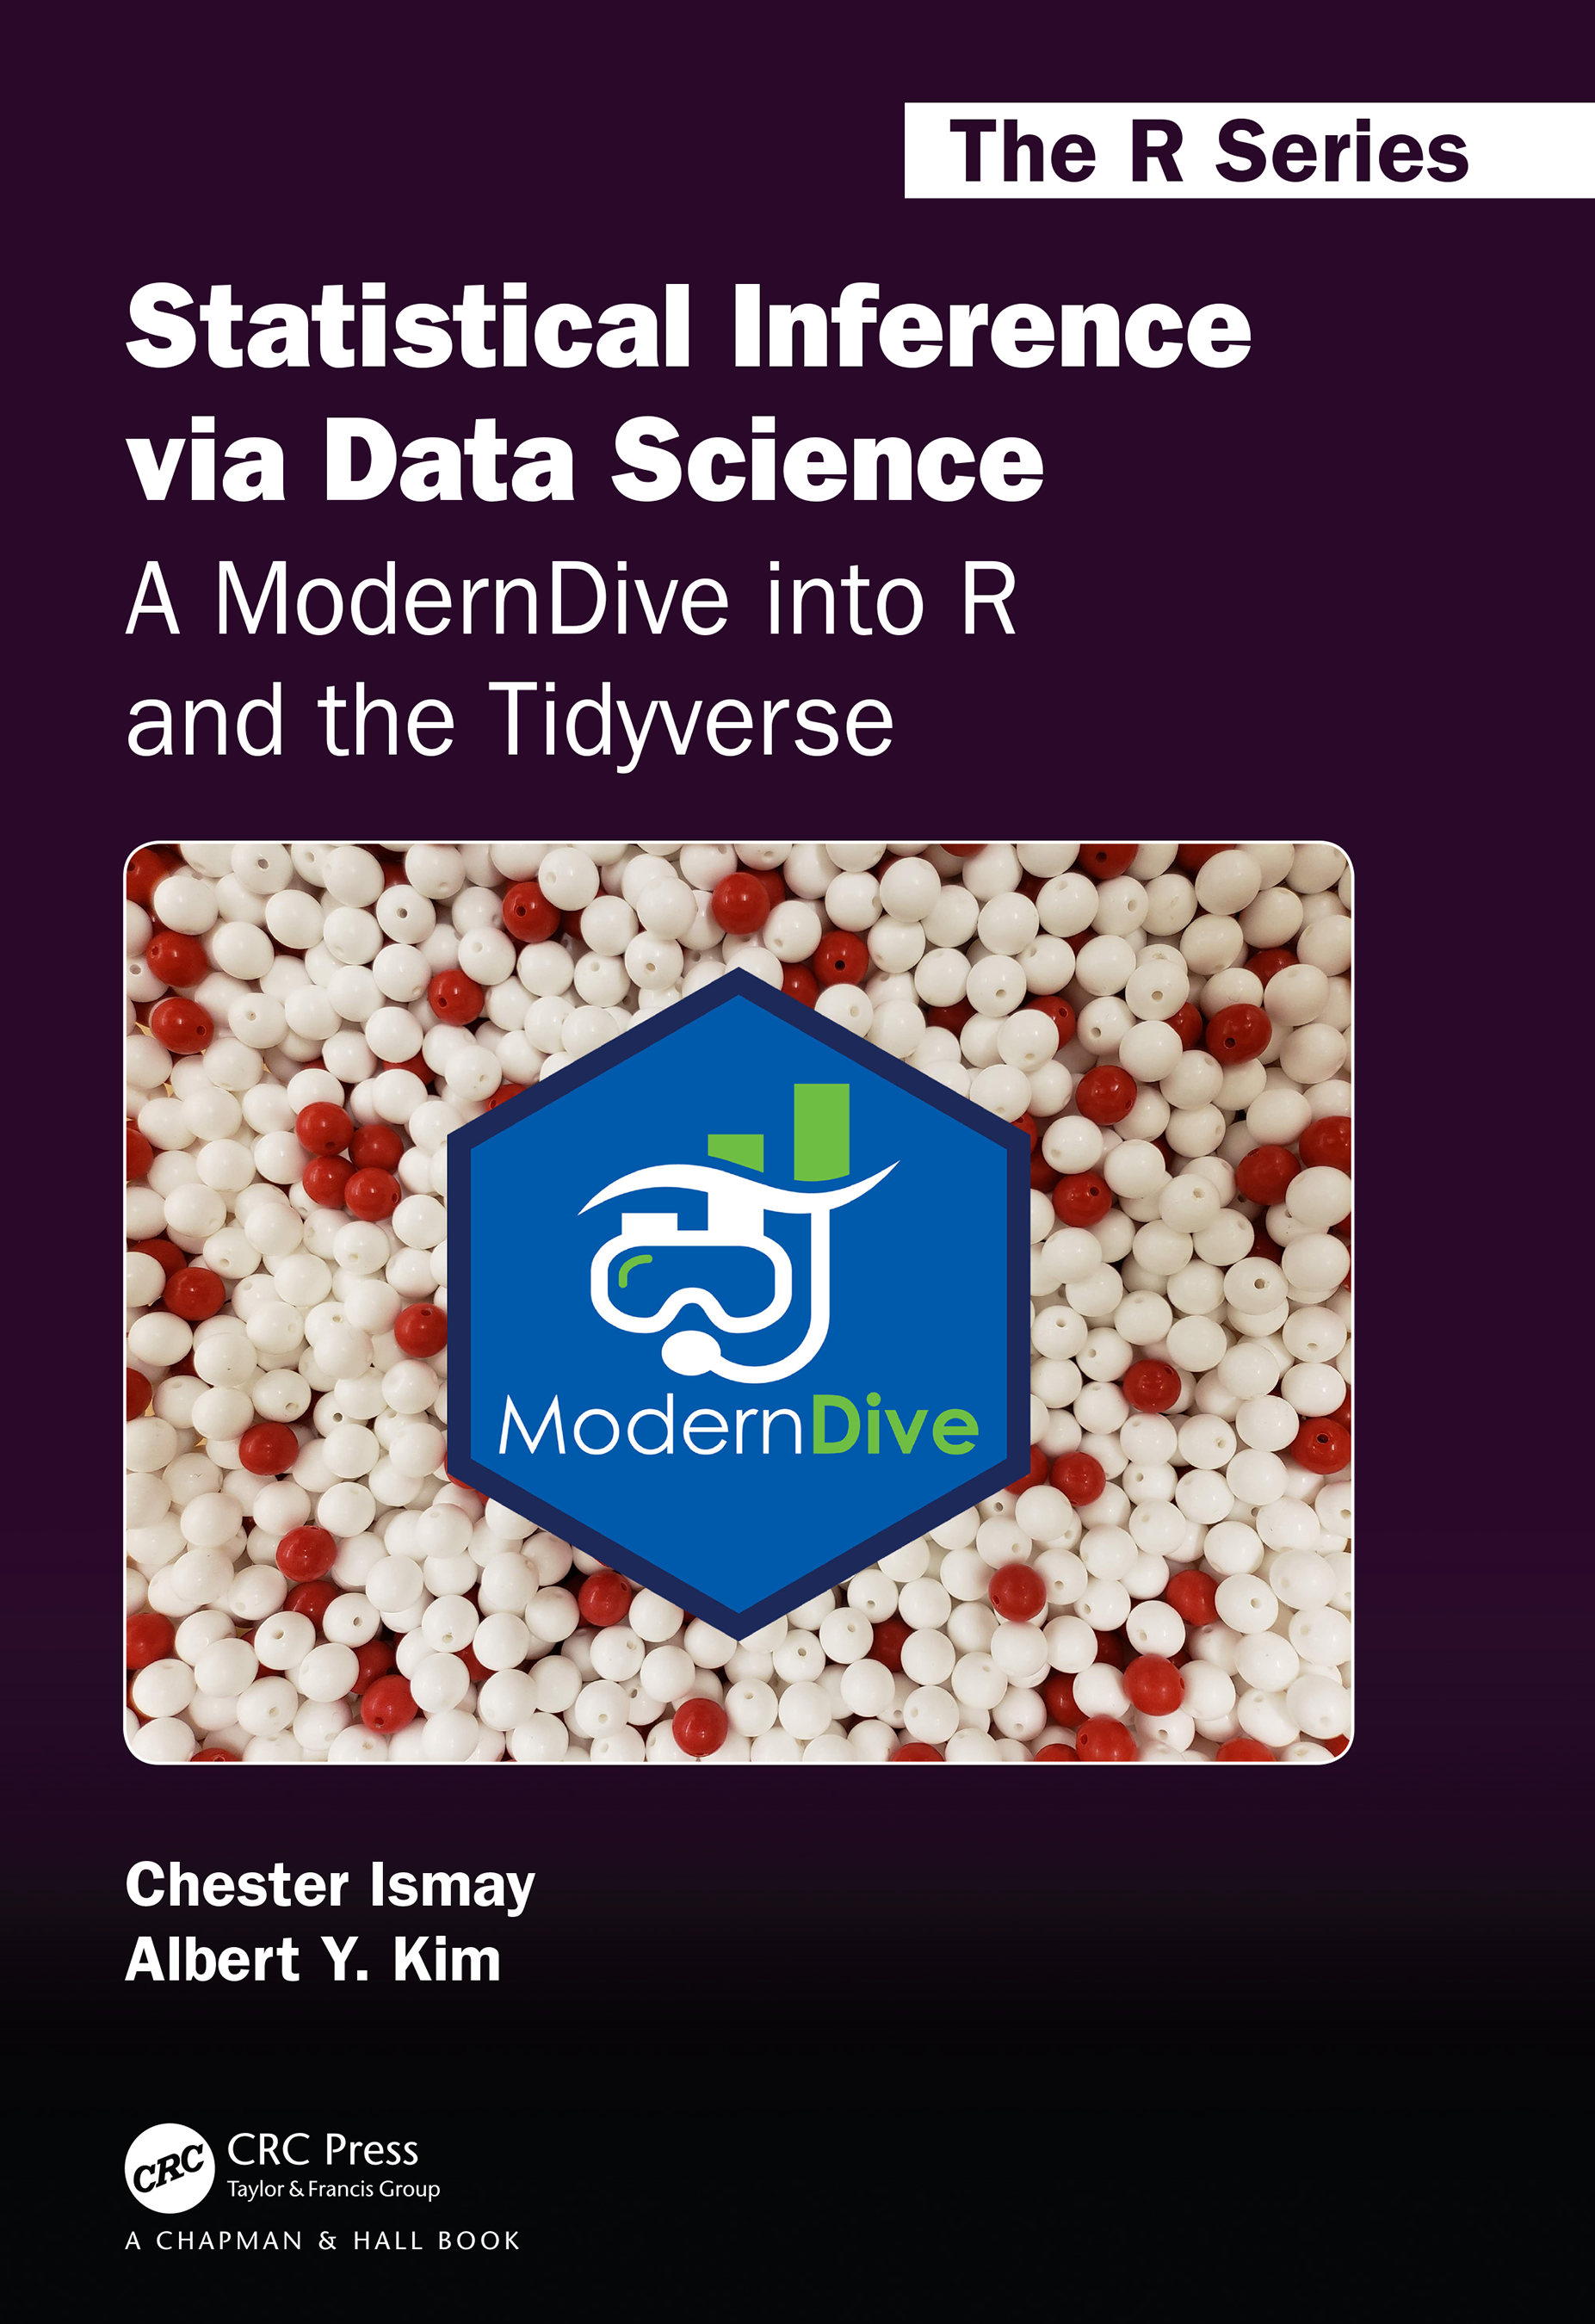
Texts

Slide 5
Ordination
Likelihood
Prinicpal Component Analysis
PCoA, CCA,
NMDS
GAMs
Probability
Generalized Linear Modeling
Zero-inflated models
Linear regression
Discriminant Function Analysis
Logistic regression
Hypothesis testing
Mixed effects models
classification
Spatial autocorrelation
Simulation
Quantifying uncertainty
Data exploration
Interpeting statistical results
Regression trees
Model checking, validation
Data wrangling
Inference
Data visualization
Summarizing model output
Functional programming
Reproducible scientific workflows

Slide 6
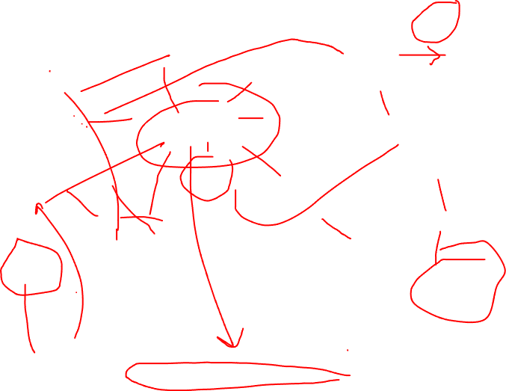
Ordination
Likelihood
Prinicpal Component Analysis
PCoA, CCA,
NMDS
GAMs
Probability
Generalized Linear Modeling
Zero-inflated models
Linear regression
Discriminant Function Analysis
Logistic regression
Hypothesis testing
Mixed effects models
classification
Spatial autocorrelation
Simulation
Quantifying uncertainty
Data exploration
Interpeting statistical results
Regression trees
Model checking, validation
Data wrangling
Inference
Data visualization
Summarizing model output
Functional programming
Reproducible scientific workflows

Slide 7


Slide 8
Breakout Questions
What did you like most about this course?
What was something you would have liked to have covered in this class, or covered more of?
Were the course texts useful?
Did the R labs set you up for your own analyses?

Slide 9
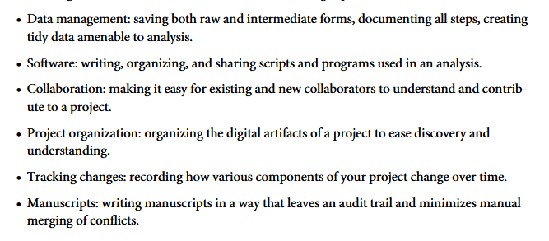
Best Good Enough practices
Wilson G, Bryan J, Cranston K, Kitzes J, Nederbragt L, Teal TK (2017) Good enough practices in scientific Computing. PLoS Comput Biol 13(6): e1005510. https://doi.org/10.1371/journal.pcbi.1005510

Slide 10
Broad course topics
Building foundations
Probability, estimation, uncertainty, matrix algebra
Model evaluation, validation, model selection
Statistical computing
Linear modeling
Generalized linear models
Extensions - mixed effects, zero-inflated models, nonlinear terms, GAMs, spatial, …
Multivariate statistics
Ordination (PCA, etc.)
Classification (LDA, regression trees, etc.)

Slide 11
“If you don’t understand how the golem processes information, then you can’t interpret the golem’s output”
(McElreath 2020, Chap 1.2)

Slide 12
What next?
Aimed to give flavor of methods, & equip students with skills/comfort to go forward in learning and applying advanced methods
More statistics courses / texts
Many topics could have their own course
Probability & inferential statistics (look at stats departments)
Data science, statistical computing
Ecological modeling, advanced population models
Hierarchical modeling
Machine learning

Slide 13
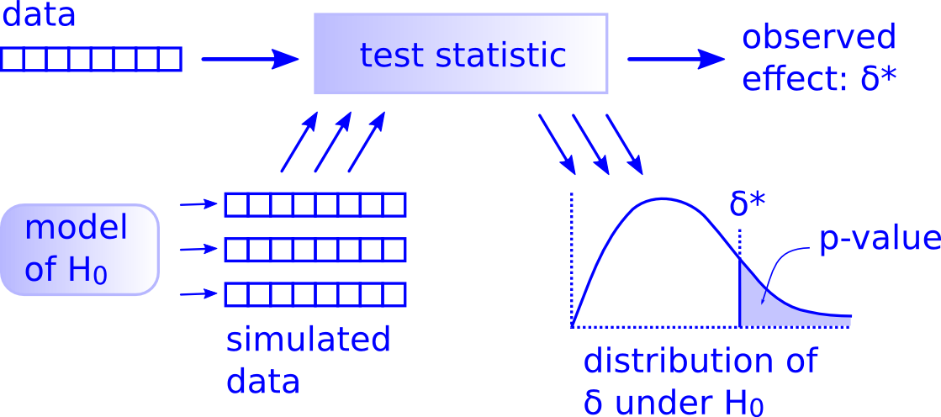
“There is only one test”
All statistical tests ask the same question:
"Is the apparent effect real, or is it due to chance?"
Differences lie in the assumptions & simplifying approximations to compute p-values efficiently.
http://allendowney.blogspot.com/2011/05/there-is-only-one-test.html

Slide 14
Statistical Rethinking
Going beyond ‘significant’ effects & recipes, develop statistical literacy
Specify hypotheses for explanations of data- construct models to test these.
Evaluate support in data for these models
Compare strength of evidence for alternative models
Make predictions based on statistical inference
Compute uncertainty associated with inference and predictions

Slide 15
Overview of Bivariate Methods
Transformation
- response variable?
explanatory variable?
- residuals?
Normality
- histograms
- Q-Q plots
Collinearity
-pairplots
PCA
coplots
Lattice plots
Data
Exploration
Outliers
- dotplots
- boxplots
Linear relationships
Nonlinear relationships
Linear
Regression
Additive
Modeling
Verify linearity or nonlinearlity
violation of
homogeneity
violation of
homogeneity
Generalized
Linear Modeling
Generalized
Additive Modeling

Slide 16
Overview of Multivariate Methods
Data
Exploration
not too
many zeros
Discriminant
Analysis
linear
relationships
known
group
membership
Principal
Component
Analysis
unimodal
explanatory
variables
Canonical
Correspondence
Analysis
Correspondence
Analysis
Redundancy
Analysis
unimodal
lots of
zeros
correlated variables
R-Technique
Principle Coordinate Analysis
Nonmetric Multidimensional Scaling
correlated observations
explanatory
variables
Q-Technique
- Mantel test
- Analysis of Similarities

Slide 17
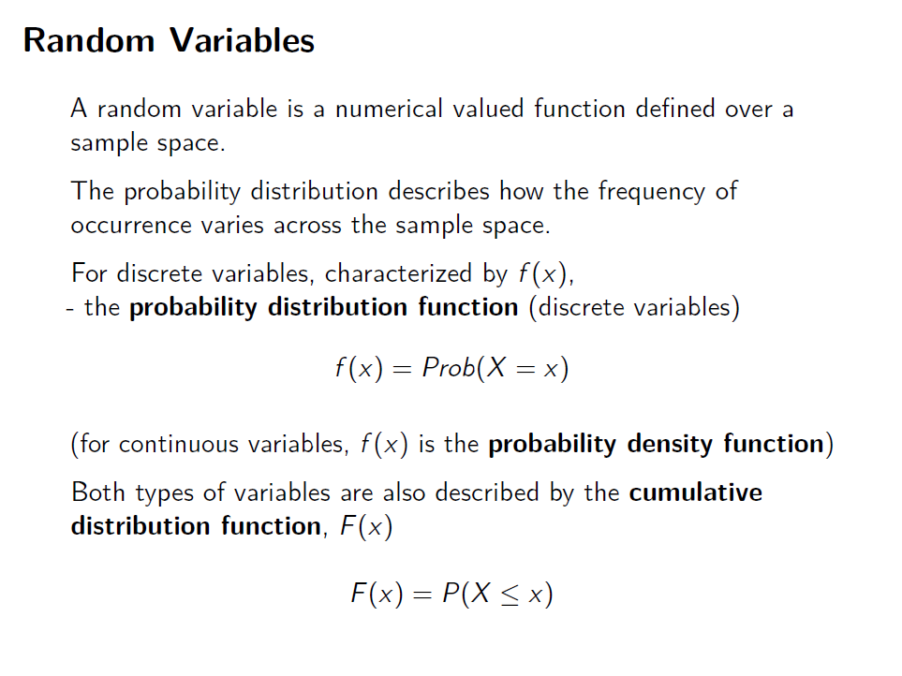

Slide 18
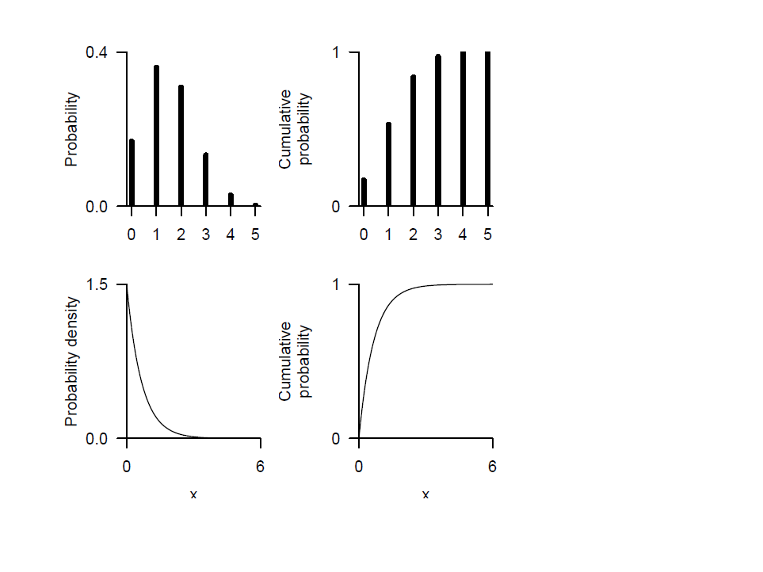

Slide 19
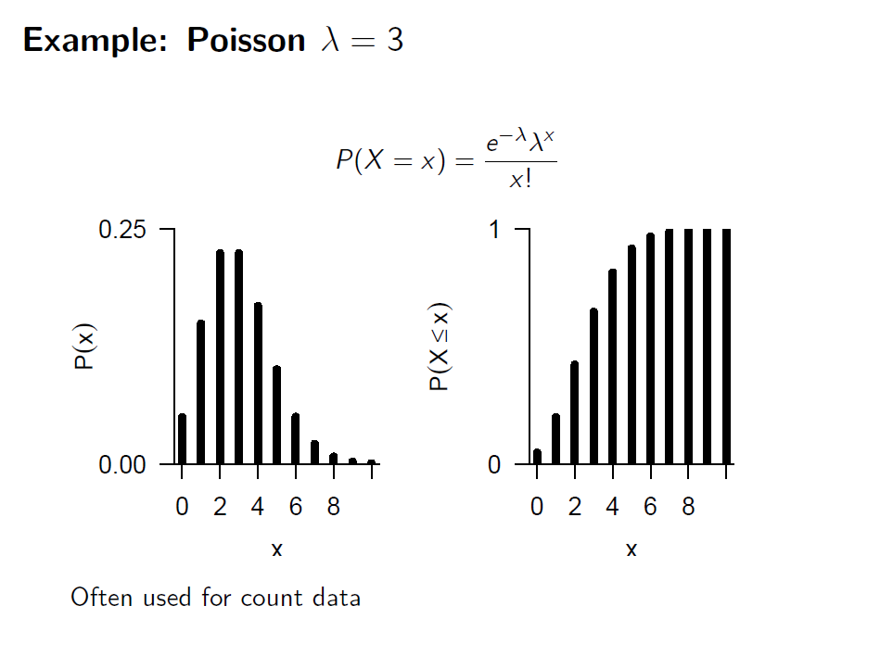

Slide 20
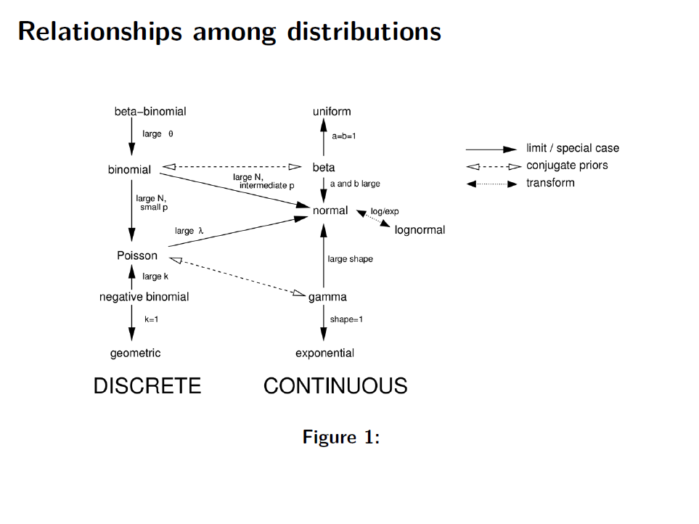

Slide 21
Review: Linear Regression
Implications of linear regression assumptions:
Species richness is expected to be zero at NAP ~2.4.
Large probability of negative richness at even intermediate NAP levels
Unequal variances

Slide 22
Model Validation
Important model assumptions need to be inspected:
Scatterplot of residuals on fitted values and scale-location plot show unequal variance.
Q-Q plot shows non-normality
Cook’s distance indicates influential observations.

Slide 23
Generalized Linear Models
Attempt to accommodate variance heterogeneity and non-normal behavior by offering a range of distributional types that cover common mean-variance relationships
useful for obviously non-normal data
provide alternatives to data transformation; e.g., Y’ = log(Y + c)
first defined by Nelder and Wedderburn (1972)
(but principles extend earlier)

Slide 24
Poisson Regression
link function
Log link for Poisson:
Distributional assumption:
Model:
Expected:
Notes:
Poisson models with log-links are often called log-linear models and are used for frequency data

Slide 25
Poisson Regression
No negative fitted values, negative realizations not possible
Notes:
Red crosses are observed values, curve is fitted Poisson regression curve (exponential), density distributions show probability of other realizations at the given NAP value (one distribution and µ for each observed value)

Slide 26
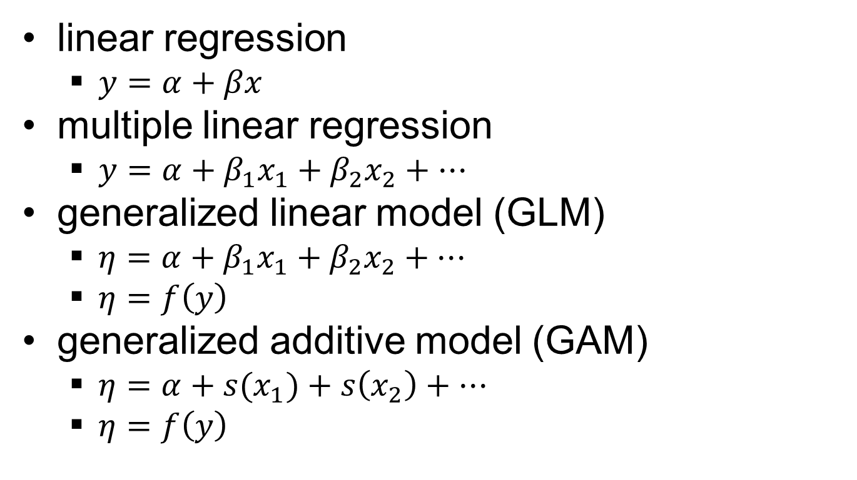

Statistical Modeling
What if my data aren’t normal?
How does x affect y?
How do some x’s affect y?
What if the relationships aren’t linear?
Notes:
**GO SLOWLY**
Expand on simpler concepts to build up general case
How does x affect y? -- linear regression
How do some x’s affect y? – multiple linear regression
What if my data aren’t normal? – GLM
specify the proper distribution for the response (e.g. binomial, Gamma, beta)
predictor function is linear
link function connects the predictor to the scale of the response (e.g. use logit link to connect the linear predictor to a probability (between 0 and 1)
What if the relationships aren’t linear? – GAM
specify the proper distribution for the response (e.g. binomial, Gamma, beta)
predictor function adds together smooths (like a running moving average, curvy lines that smooth out some noise; e.g. temperature is not expected to be linear – it should have an optimal range)
link function connects the predictor to the scale of the response (e.g. use logit link to connect the linear predictor to a probability (between 0 and 1)

Slide 27

Model Selection
Finding the best set of explanatory variables is subjective unless a criterion is specified.
All criteria are functions of goodness-of-fit (e.g., residual sum-of-squares), number of parameters (e.g., explanatory variables, p) and sample size (n)
Adjusted R² (portion of explained variance; larger values are better):
Akaike Information Criterion (model dispersion; smaller values are better):

Slide 28
Model Selection
Just like R², AIC should only be used as a general guide (e.g., can ‘accept’ non-significant effects).
F-tests, model fit, and residual patterns should also be considered.
Selection criteria ignore multiple comparisons (i.e., type-I error) and co-linearity (assume independent explanatory variables).
Partial linear regression can also be used to determine if an explanatory variable should be included in a model.

Slide 29
Overview of Multivariate Methods
Data
Exploration
not too
many zeros
Discriminant
Analysis
linear
relationships
known
group
membership
Principal
Component
Analysis
unimodal
explanatory
variables
Canonical
Correspondence
Analysis
Correspondence
Analysis
Redundancy
Analysis
unimodal
lots of
zeros
correlated variables
R-Technique
Principle Coordinate Analysis
Nonmetric Multidimensional Scaling
correlated observations
explanatory
variables
Q-Technique
- Mantel test
- Analysis of Similarities

Slide 30
Multivariate statistics
Two general types of problems:
Ordination
What are associations among variables?
How similar are ‘sites’ based on measurements of multiple variables?
How do similarities in response variables associate with environmental variables?
Classification
Do groupings in the data correspond to variance?
Can we separate data into groups based on similarities in observations of multiple variables?

Slide 31
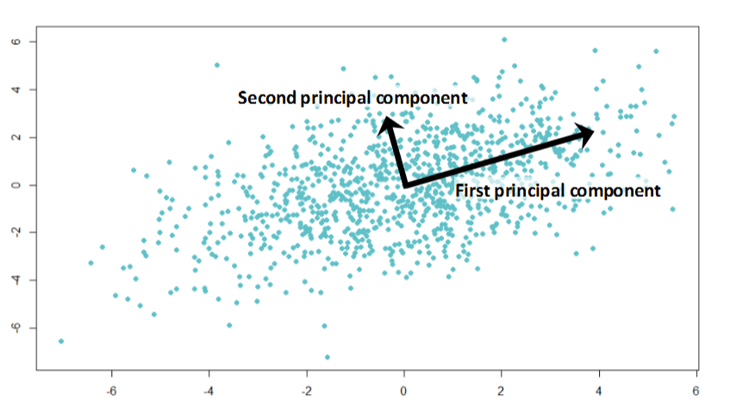
Ordination e.g. Principal Components Analysis
Principal Components Analysis is a multivariate extension of bivariate statistical analysis.
PCA helps to explore patterns in large datasets by deriving composite variables that explain the maximum variance as a function of measured variables but are uncorrelated.
(Dimension reduction)
Composite variables are derived through eigenanalysis.
There are as many Principal Components as variables, the first 2 or 3 are usually done for visualization.

Slide 32
Discriminant Analysis
Linear discriminant analysis (LDA) finds the linear combinations of the original variables that gives the best possible separation between known groups.
Classify observations into groups
Determine the most parsimonious way to classify groups
Test classification accuracy
Investigate differences among groups
Identify variables that are different among groups
Identify variables that are not as different among groups

Slide 33
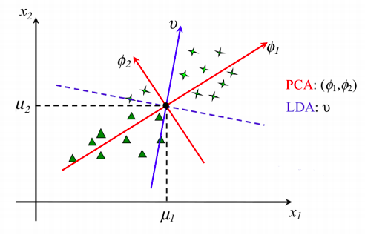
PCA vs Discriminant Analysis

