Slide 1
Cluster Analysis (James et al. Section 10.3)
MAR 536 Biological Statistics II
April 17 2025
Gavin Fay
Acknowledgements: Steve Cadrin, Allison Horst

Slide 2
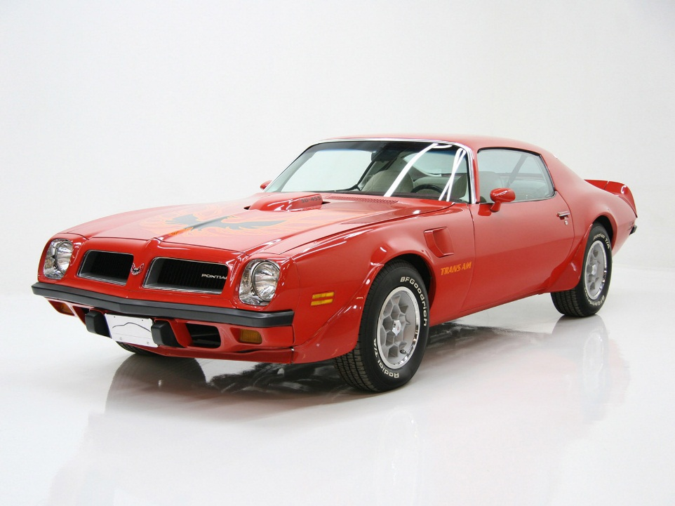
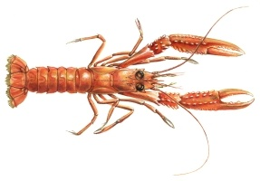
Lecture Outline
library(datasets)
data(mtcars)
Background (Tan et al. 2008)
Similarity and Distance
Clustering Algorithms (1974 Motor Trend data, Yau 2013)
Hierarchical
K-Means
Model based
Q-Mode & R-mode
Nephrops CPUE (Sec 17.5)
http://mendel.informatics.indiana.edu

Slide 3
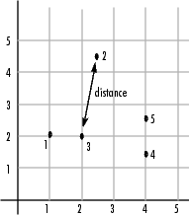
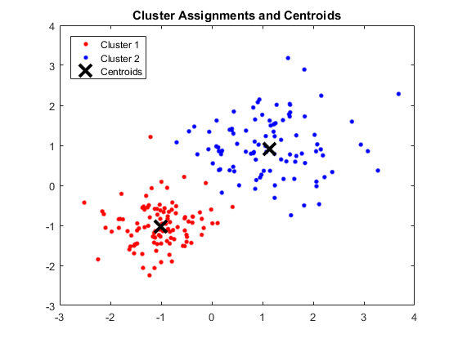
Background
Traditional data exploration involved plotting observations in variable space, depicting Euclidean distances.
‘Clusters’ of similar observations are formed with short inter-observation distances.
Distances among clusters can be derived using ‘centroids’(bi-variate or multivariate averages) within groups.
Computing power provides a host of distance metrics and clustering algorithms for hyper-dimensional clustering.
X2
X1
X2
X1

Slide 4
Background
Clustering is entirely empirical (derived from patterns in observed data, ‘unsupervised classification’) rather than theoretical (mechanistic hypothesis or process of similarity or difference, ‘supervised classification’).
Based on statistical distance (X₁ is closer to X₂ than X₃)
Distance (0=no difference)
Similarity (S=1-D)
Based on posterior probability (greater probability that X₁ and X₂ are in the same cluster than X₁ and X₃) with no a priori hypothesis.

Slide 5
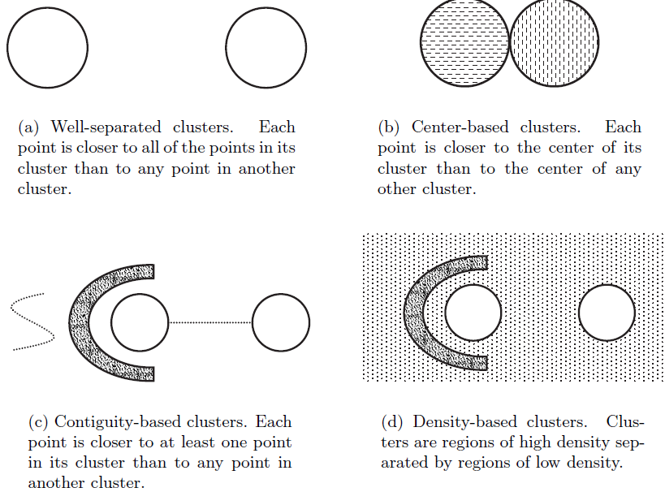
Types of Clusters

Slide 6
Distance Metrics
Euclidean distance
The most commonly chosen type of distance between i and j.
The geometric distance in the multidimensional space (p).
Squared Euclidean distance
places greater weight on samples that are further apart.
City-block (Manhattan) distance.
The effect of single large differences (outliers) is less
Inverse correlation
Based on bivariate correlation (r) includes

Slide 7
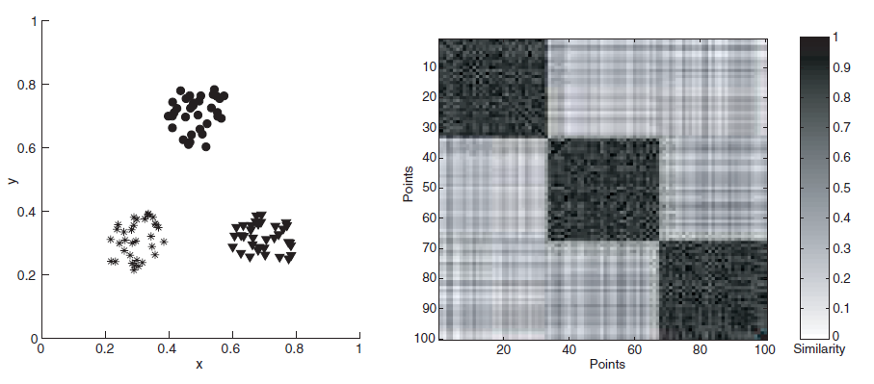
Distance Matrices
Each pairwise distance (among each pair of observations) is arranged in a square matrix.

Slide 8
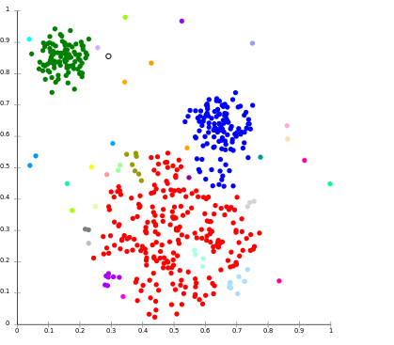
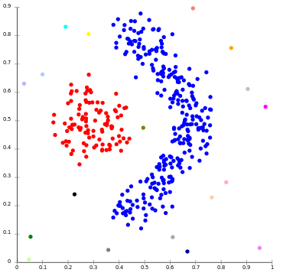
Clustering Methods
Hierarchical:
Members of lower-order clusters become members of higher-order clusters (i.e., connectivity clustering)
Algorithms connect similar observations to form clusters, and similar clusters are grouped into higher order clusters.
e.g., single linkage

Slide 9
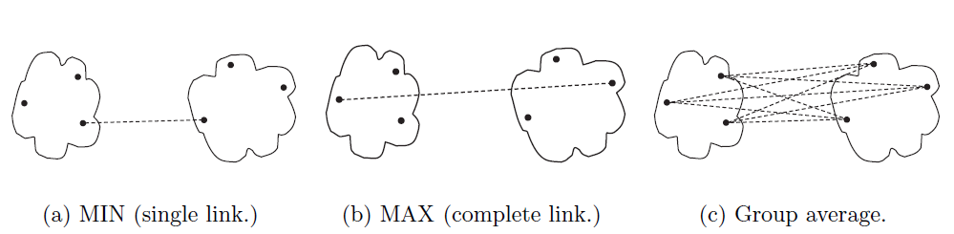
Among-Cluster Distances
‘single linkage’ – ‘nearest-neighbor’ or minimum distance within clusters
‘complete linkage’ – ‘furthest neighbor’ or maximum distance between clusters
‘average linkage’ - Unweighted Pair Group Method with Arithmetic mean (UPGMA)

Slide 10
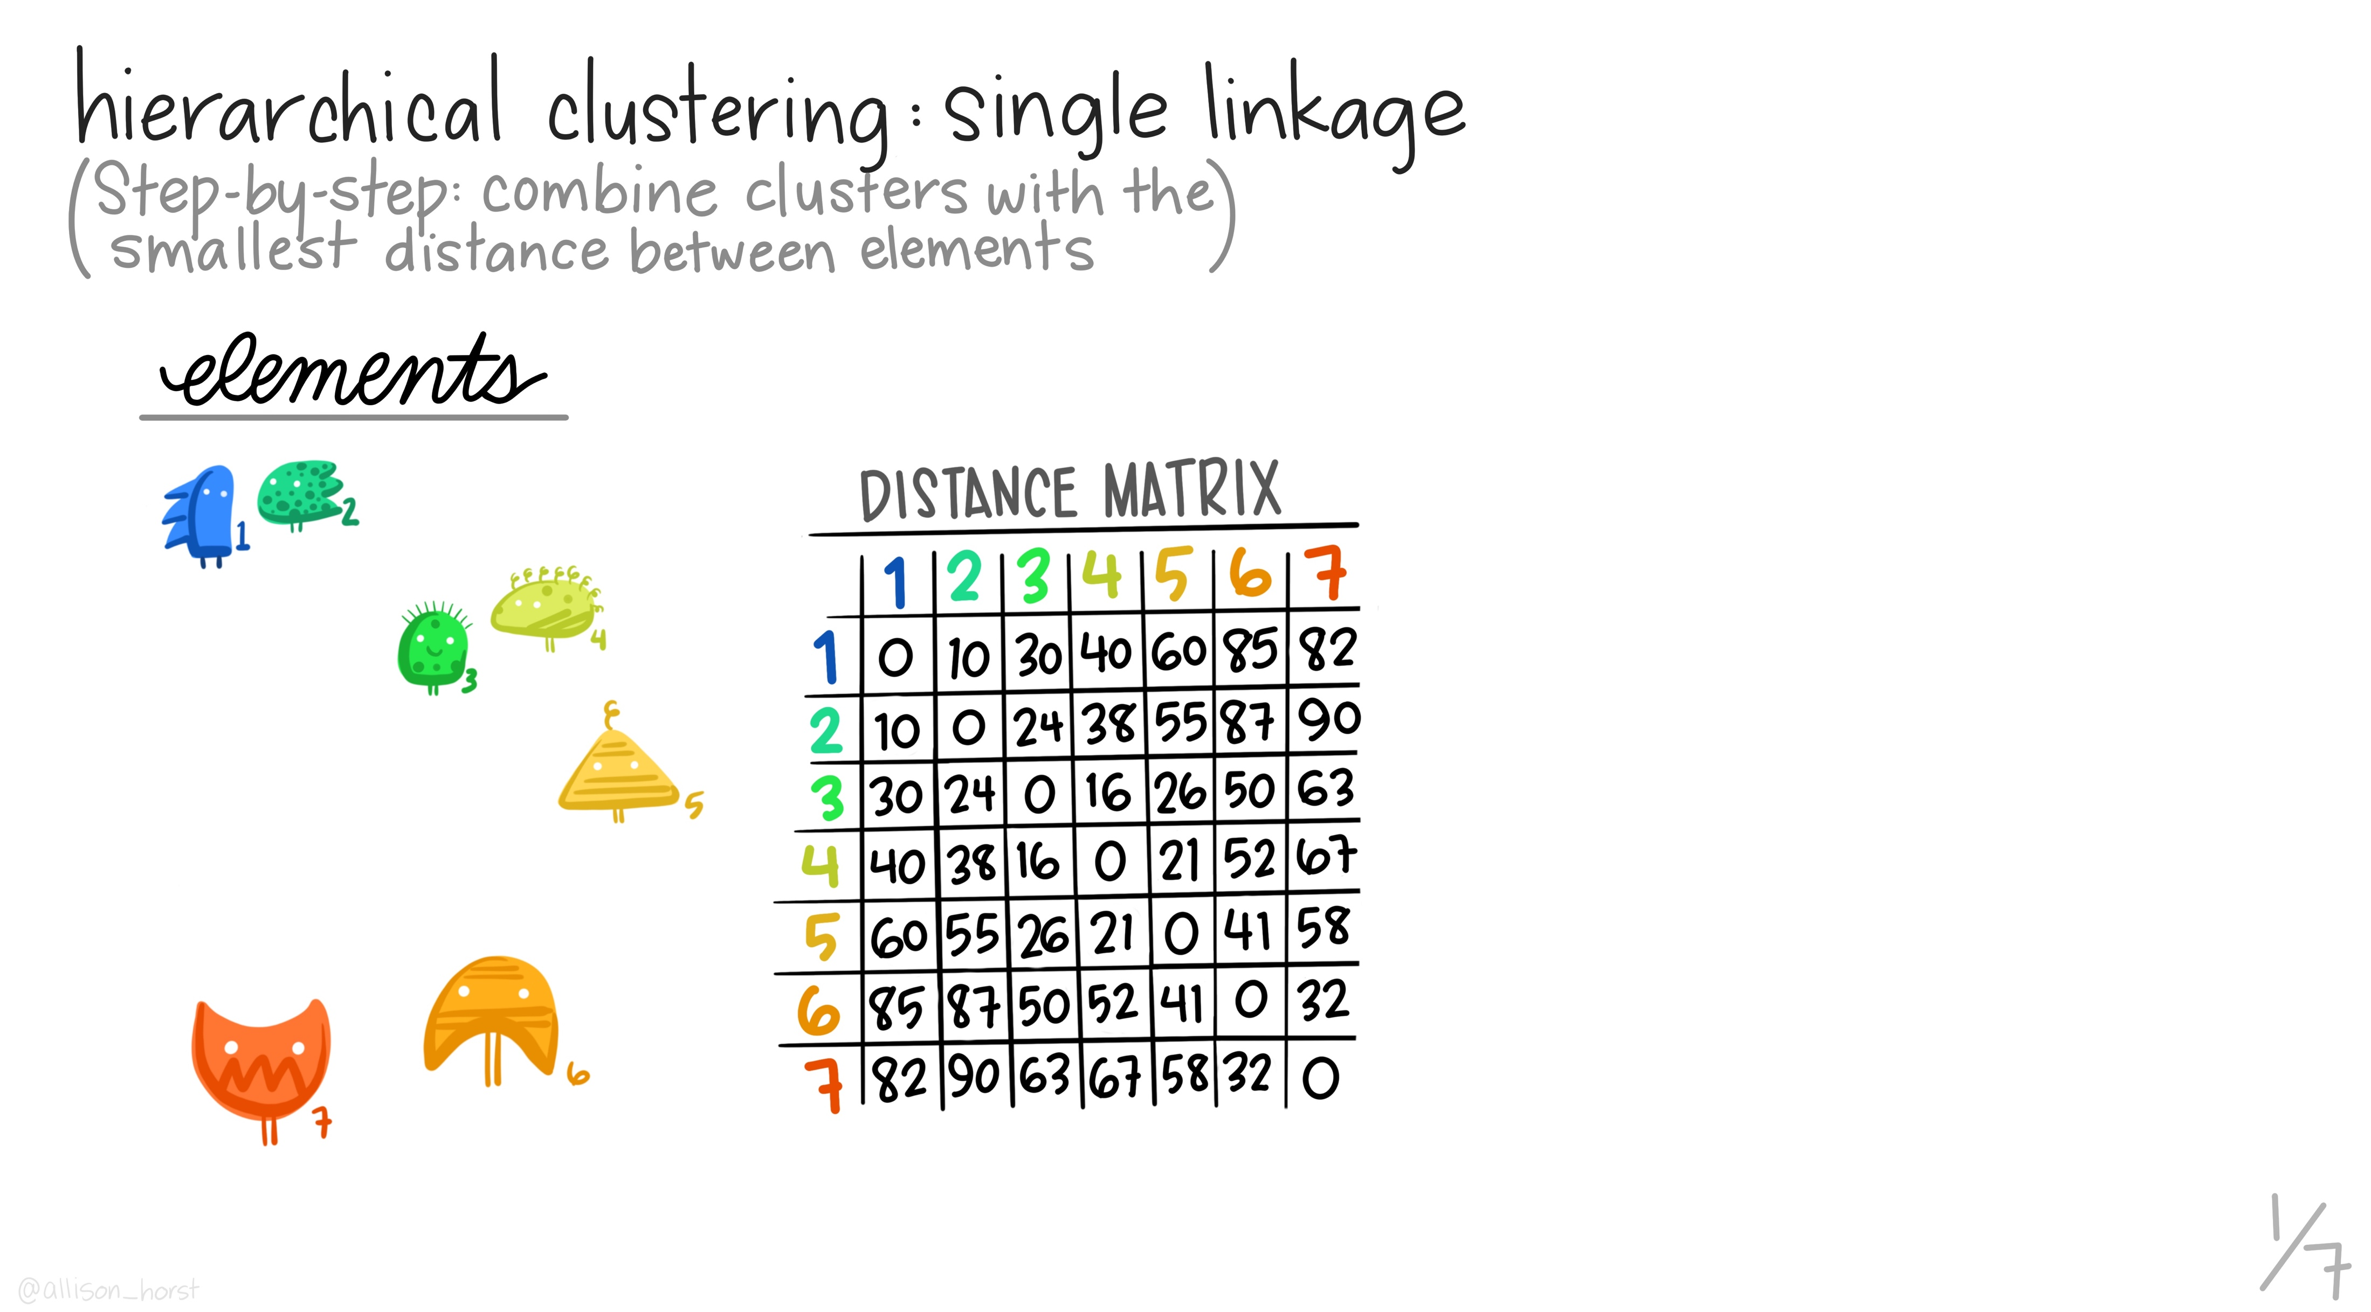
Artwork by @allison_horst

Slide 11
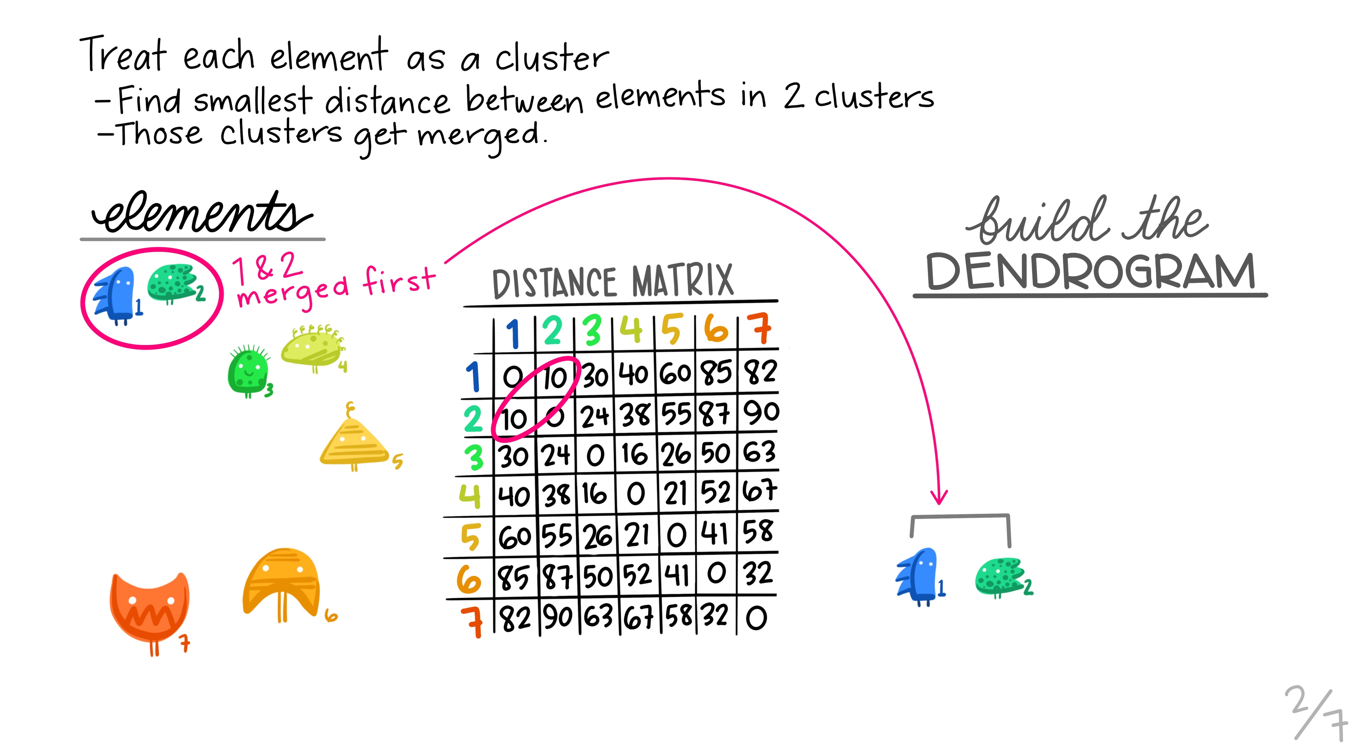
Artwork by @allison_horst

Slide 12
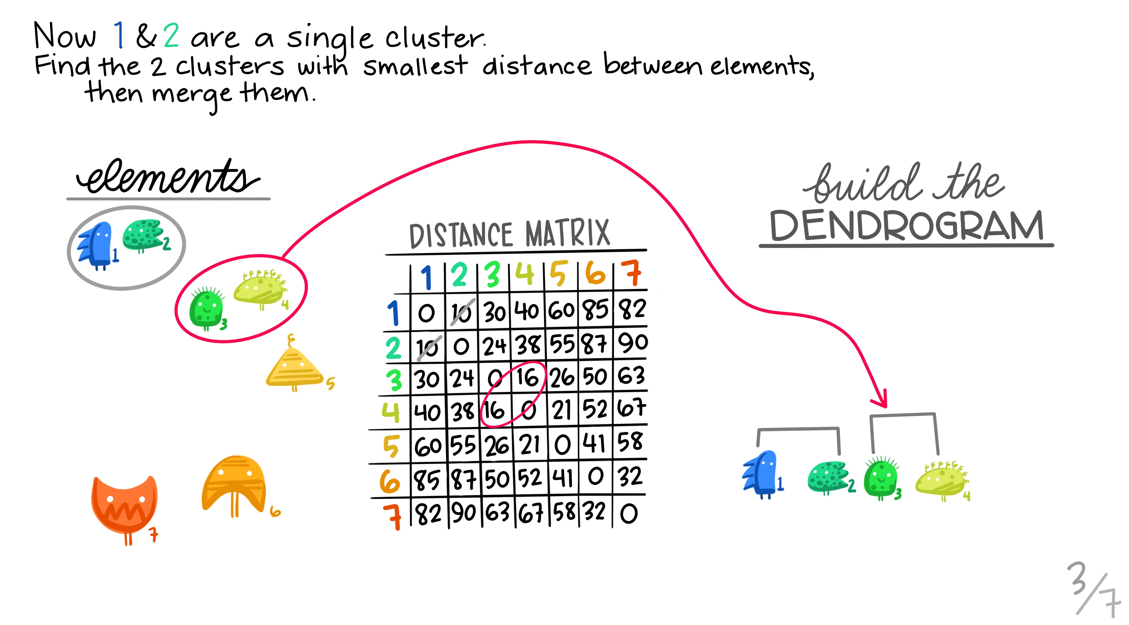
Artwork by @allison_horst

Slide 13
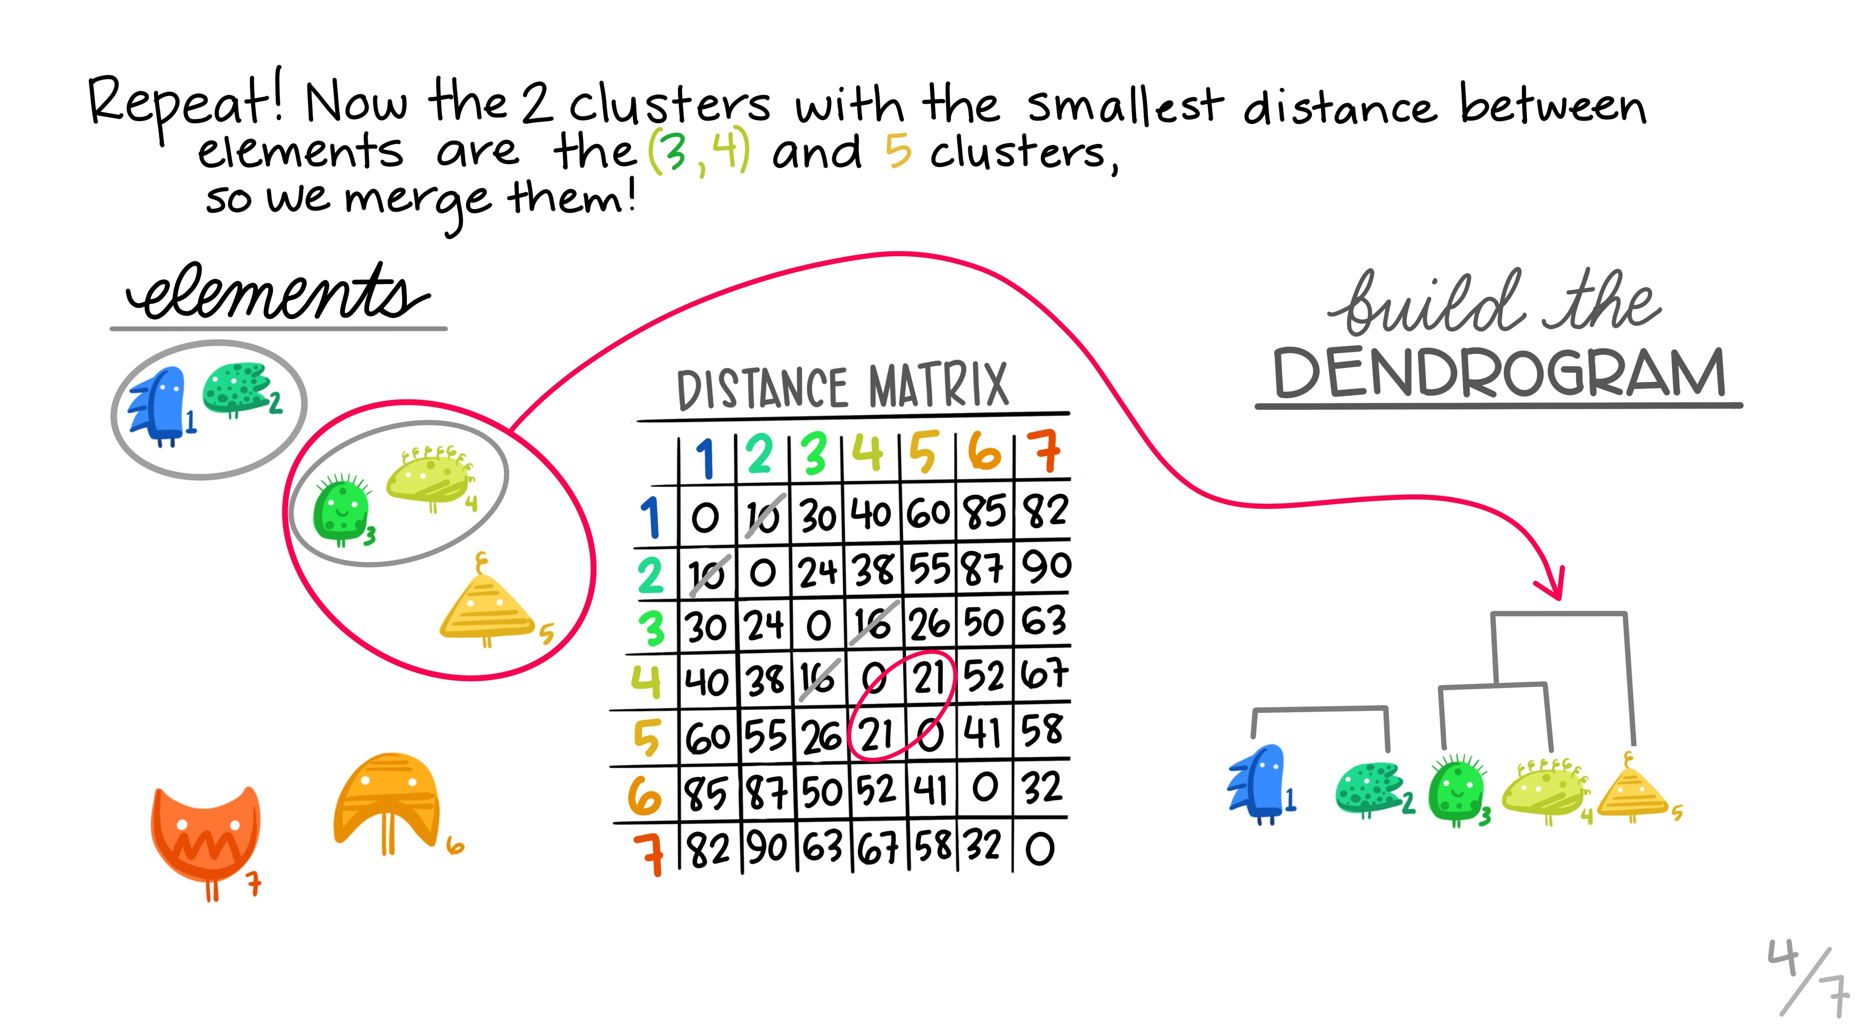
Artwork by @allison_horst

Slide 14
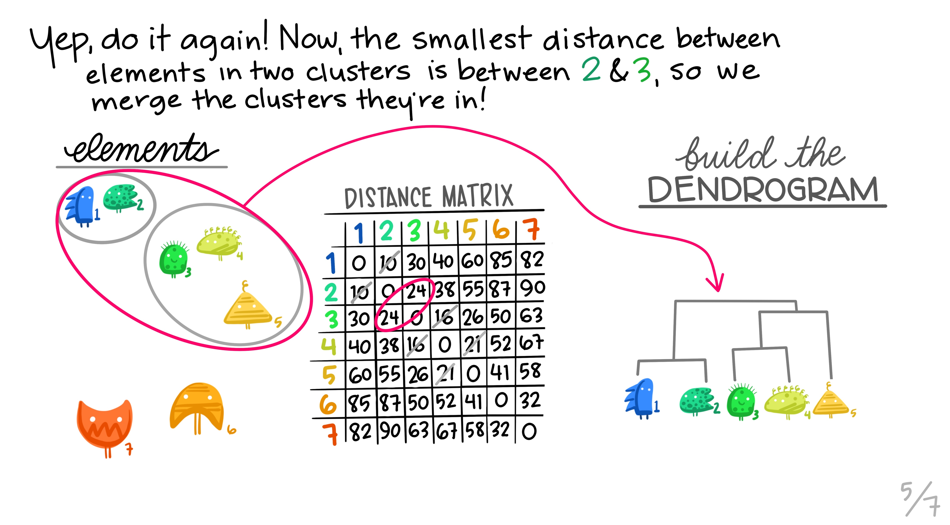
Artwork by @allison_horst

Slide 15
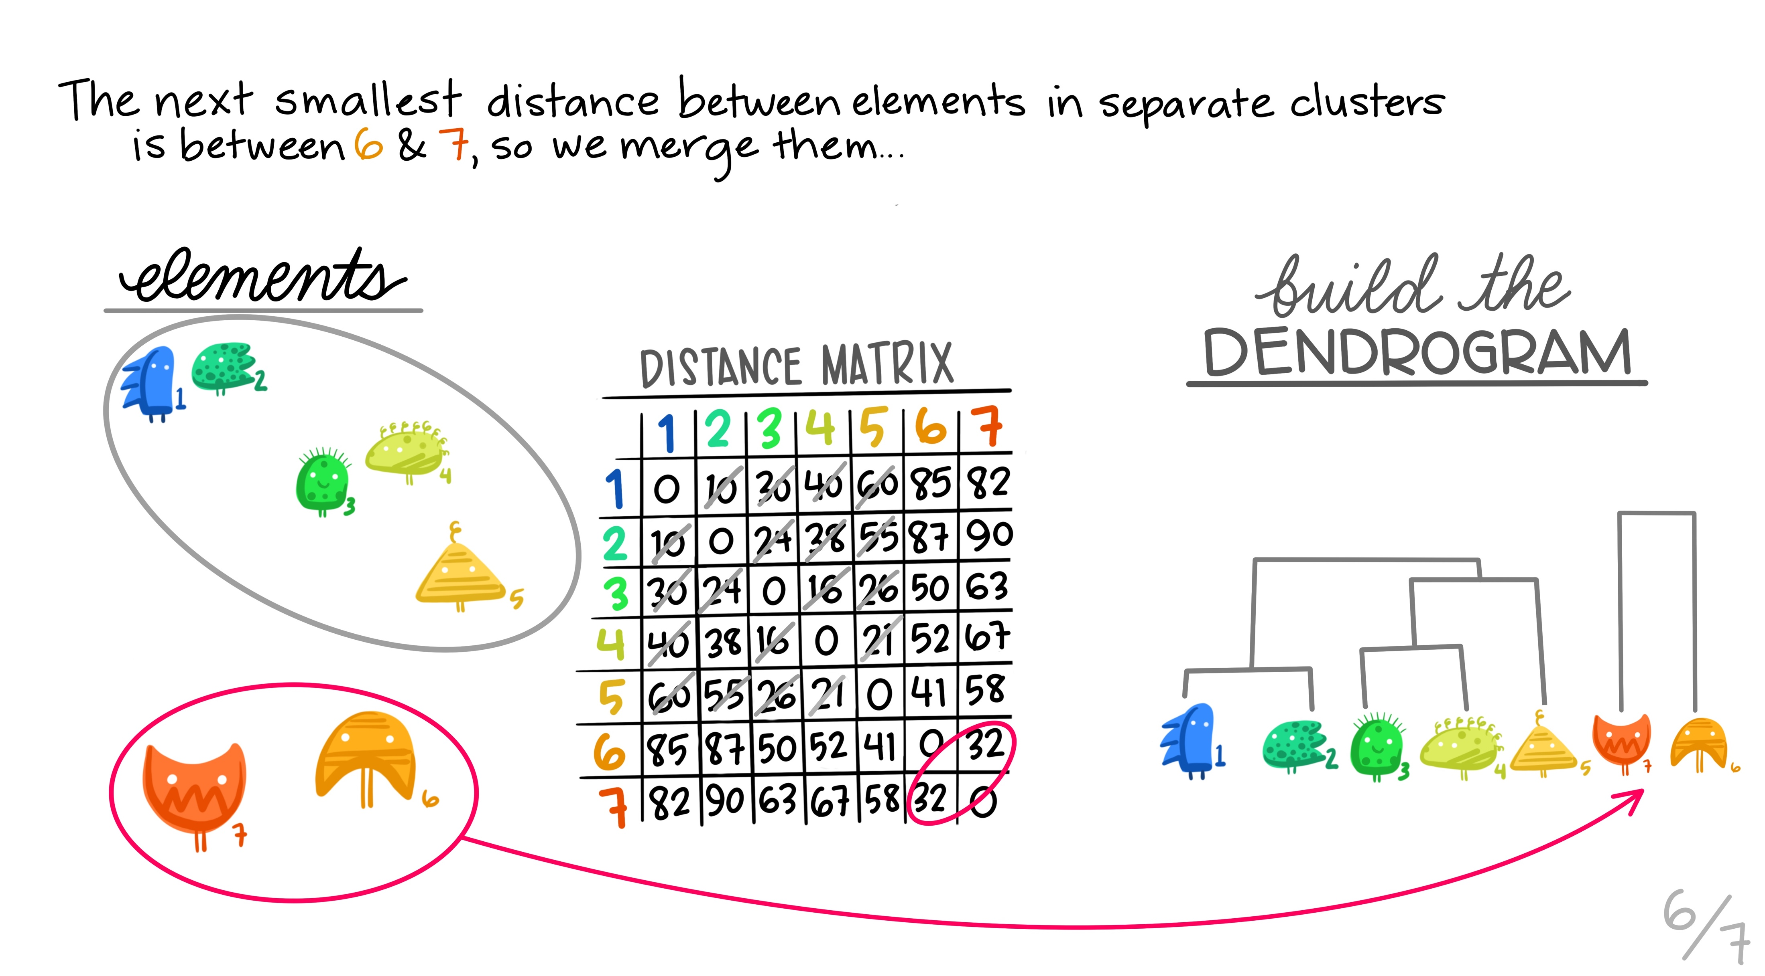
Artwork by @allison_horst

Slide 16
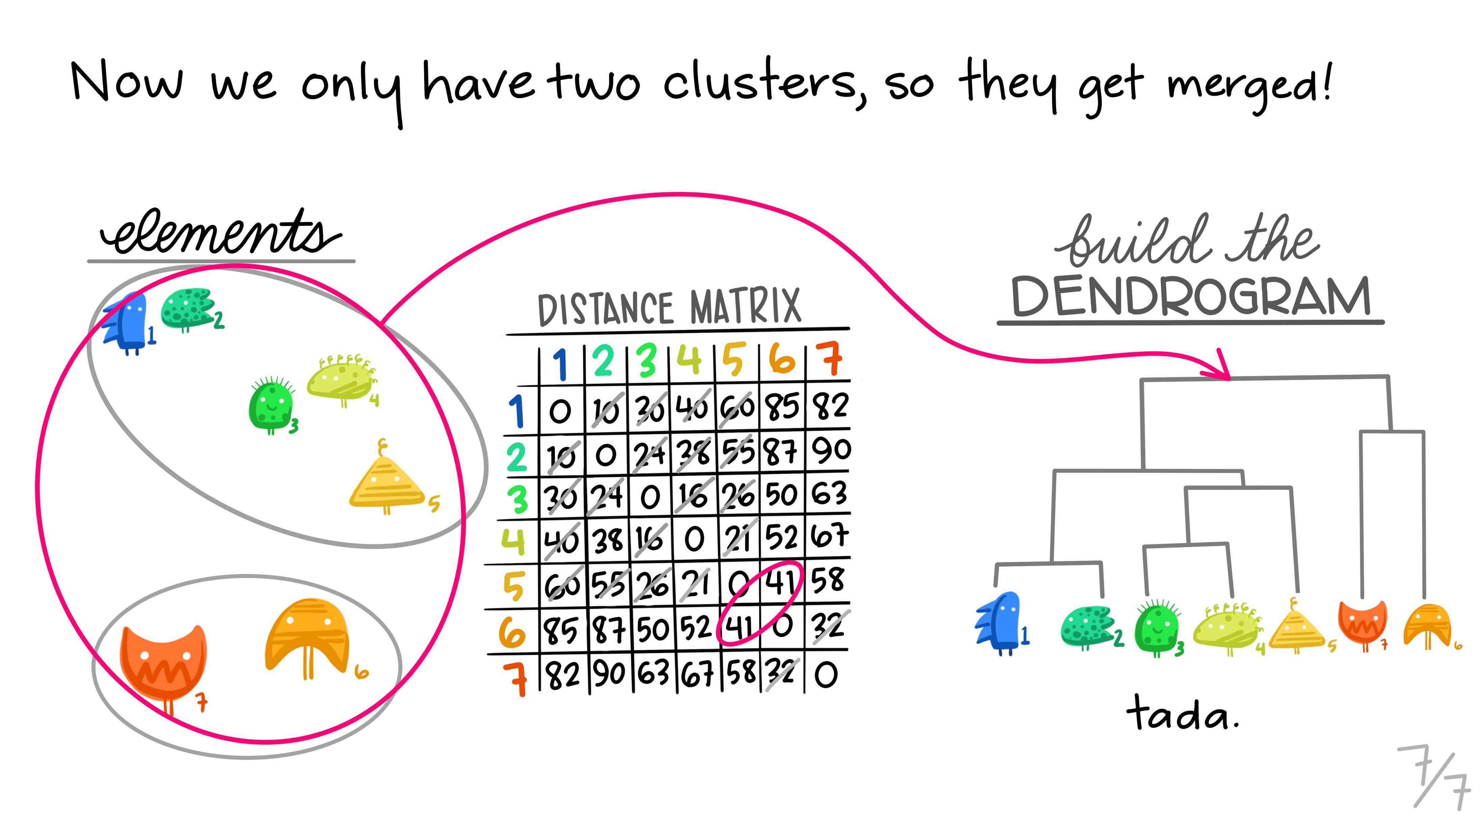
Artwork by @allison_horst

Slide 17
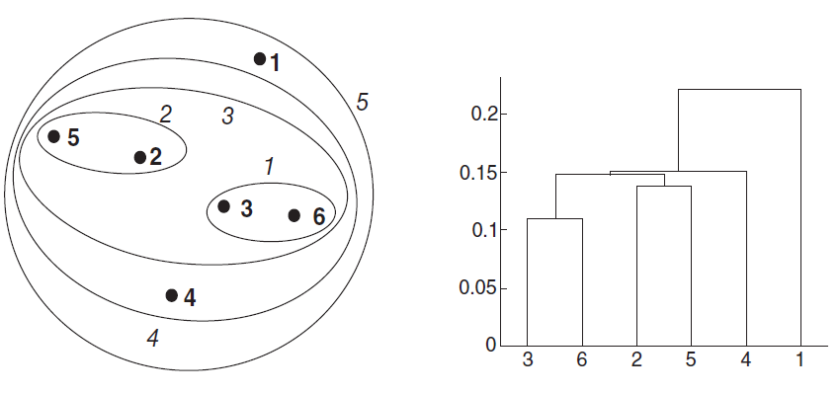
Hierarchical Clustering
Single Linkage (6 points, 5 clusters)

Slide 18
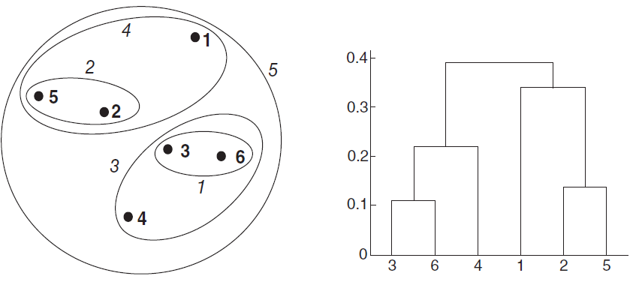
Hierarchical Clustering
Complete Linkage (6 points, 5 clusters)

Slide 19
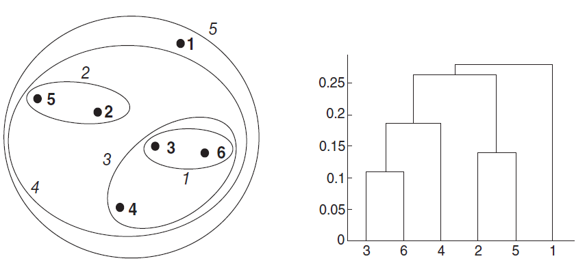
Hierarchical Clustering
Average Linkage (6 points, 5 clusters)

Slide 20
Hierarchical Clustering Methods
Agglomerative - starting with observations and aggregating them into clusters
Ward’s method is based on minimum variance within clusters
Divisive - starting with all observations and dividing into clusters.

Slide 21
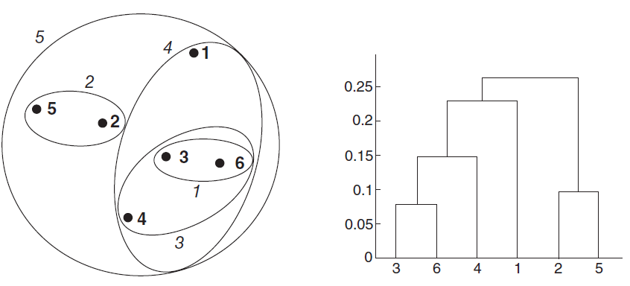
Hierarchical Clustering
Ward’s Method (6 points, 5 clusters)

Slide 22

Multi-Dimensional Data
Cluster algorithms require raw observations or derived distances
> mtcars mpg cyl disp hp drat wt ... Mazda RX4 21.0 6 160 110 3.90 2.62 ... Mazda RX4 Wag 21.0 6 160 110 3.90 2.88 ... Datsun 710 22.8 4 108 93 3.85 2.32 ...
...
> x <- mtcars["Honda Civic",] > y <- mtcars["Camaro Z28",] > dist(rbind(x, y)) # Euclidean distance Honda Civic Camaro Z28 335.89
> z <- mtcars["Pontiac Firebird",] > dist(rbind(y, z)) Camaro Z28 Pontiac Firebird 86.267
Notes:
miles per gallon (variable mpg), and about its engine – the number of cylinders (cyl) and carburetors (carb), its displacement in cubic inches (disp), its gross horsepower (hp), as well as whether it is a V- or a straight engine (vs). In addition, we are given information about each model’s rear axle ratio (drat), weight in thousands of pounds (wt), and quarter-mile time in seconds (qsec). The variable gear contains the number of forward gears, while am indicates whether the automobile has an automatic or manual transmission

Slide 23
Data Input
> dist(as.matrix(mtcars))
> d <- dist(as.matrix(mtcars)) # distance matrix
Mazda RX4 Mazda RX4 Wag Datsun 710 …
Mazda RX4 Wag 0.6153251
Datsun 710 54.9086059 54.8915169
Hornet 4 Drive 98.1125212 98.0958939 150.9935191
Hornet Sportabout 210.3374396 210.3358546 265.0831615 …
Valiant 65.4717710 65.4392224 117.7547018 …
Duster 360 241.4076490 241.4088680 294.4790230 …
…

Slide 24
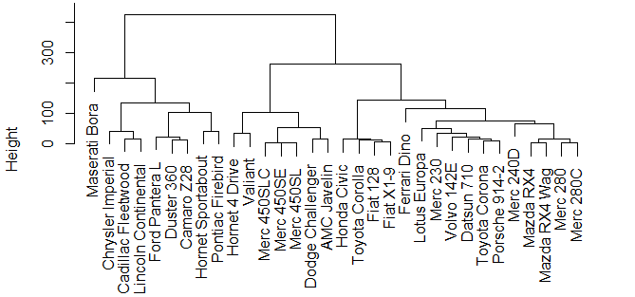
Hierarchical Complete Linkage
> d <- dist(as.matrix(mtcars)) # distance matrix > hc <- hclust(d) # hierarchical complete linkage > plot(hc) # plot the dendrogram

Slide 25
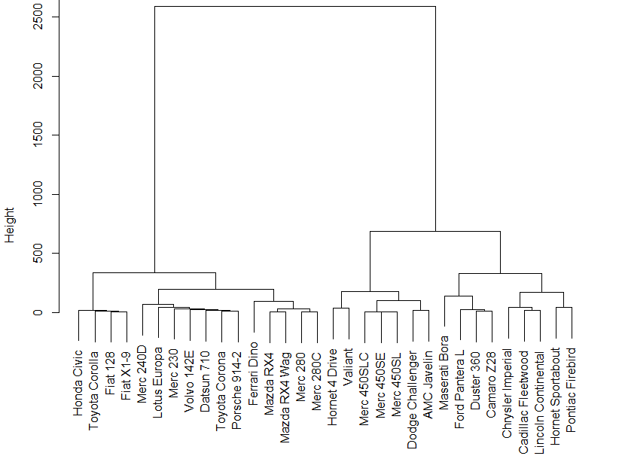
Ward
fit <- hclust(d, method="ward.D")

Slide 26
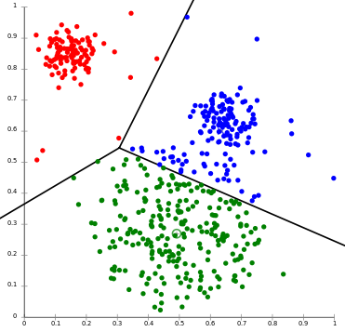
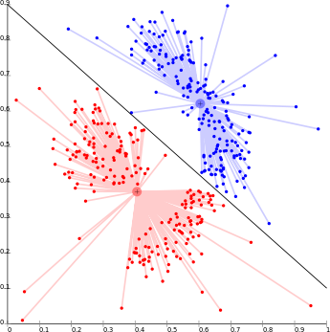
Clustering Methods
Non-Hierarchical: ‘k-means’ - identifies partitions which optimizes within-group homogeneity for a known number of groups
(e.g., k=3 or k=2)
Doesn’t always identify natural clusters
fit <- kmeans(d, 3)

Slide 27
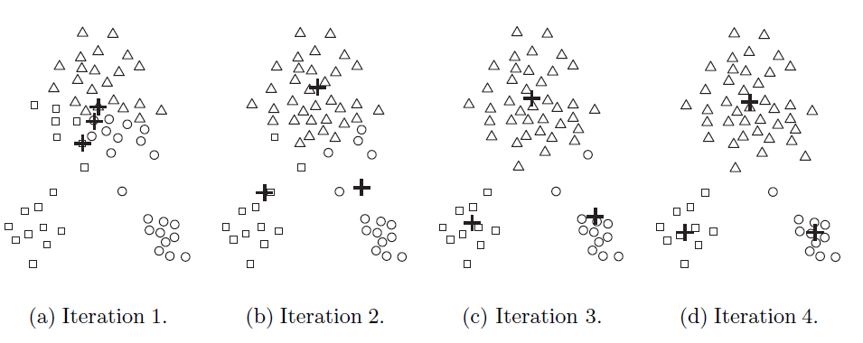
K-Means
Choose number of clusters (k=?)
Each observation is classified to a random centroid.
Centroids are iterated until the total within-cluster distance is minimized.

Slide 28
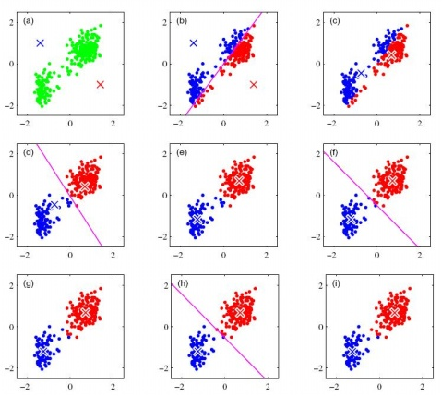
k-means is a special case of Expectation-Maximization algorithm
Expectation: what are the clusters given the current cluster means?
Initialize with random locations for cluster means (k=2)
Maximization: what are the values for the means that maximize the objective function?
(minimize within group SS)
Next iteration Expectation.

Slide 29
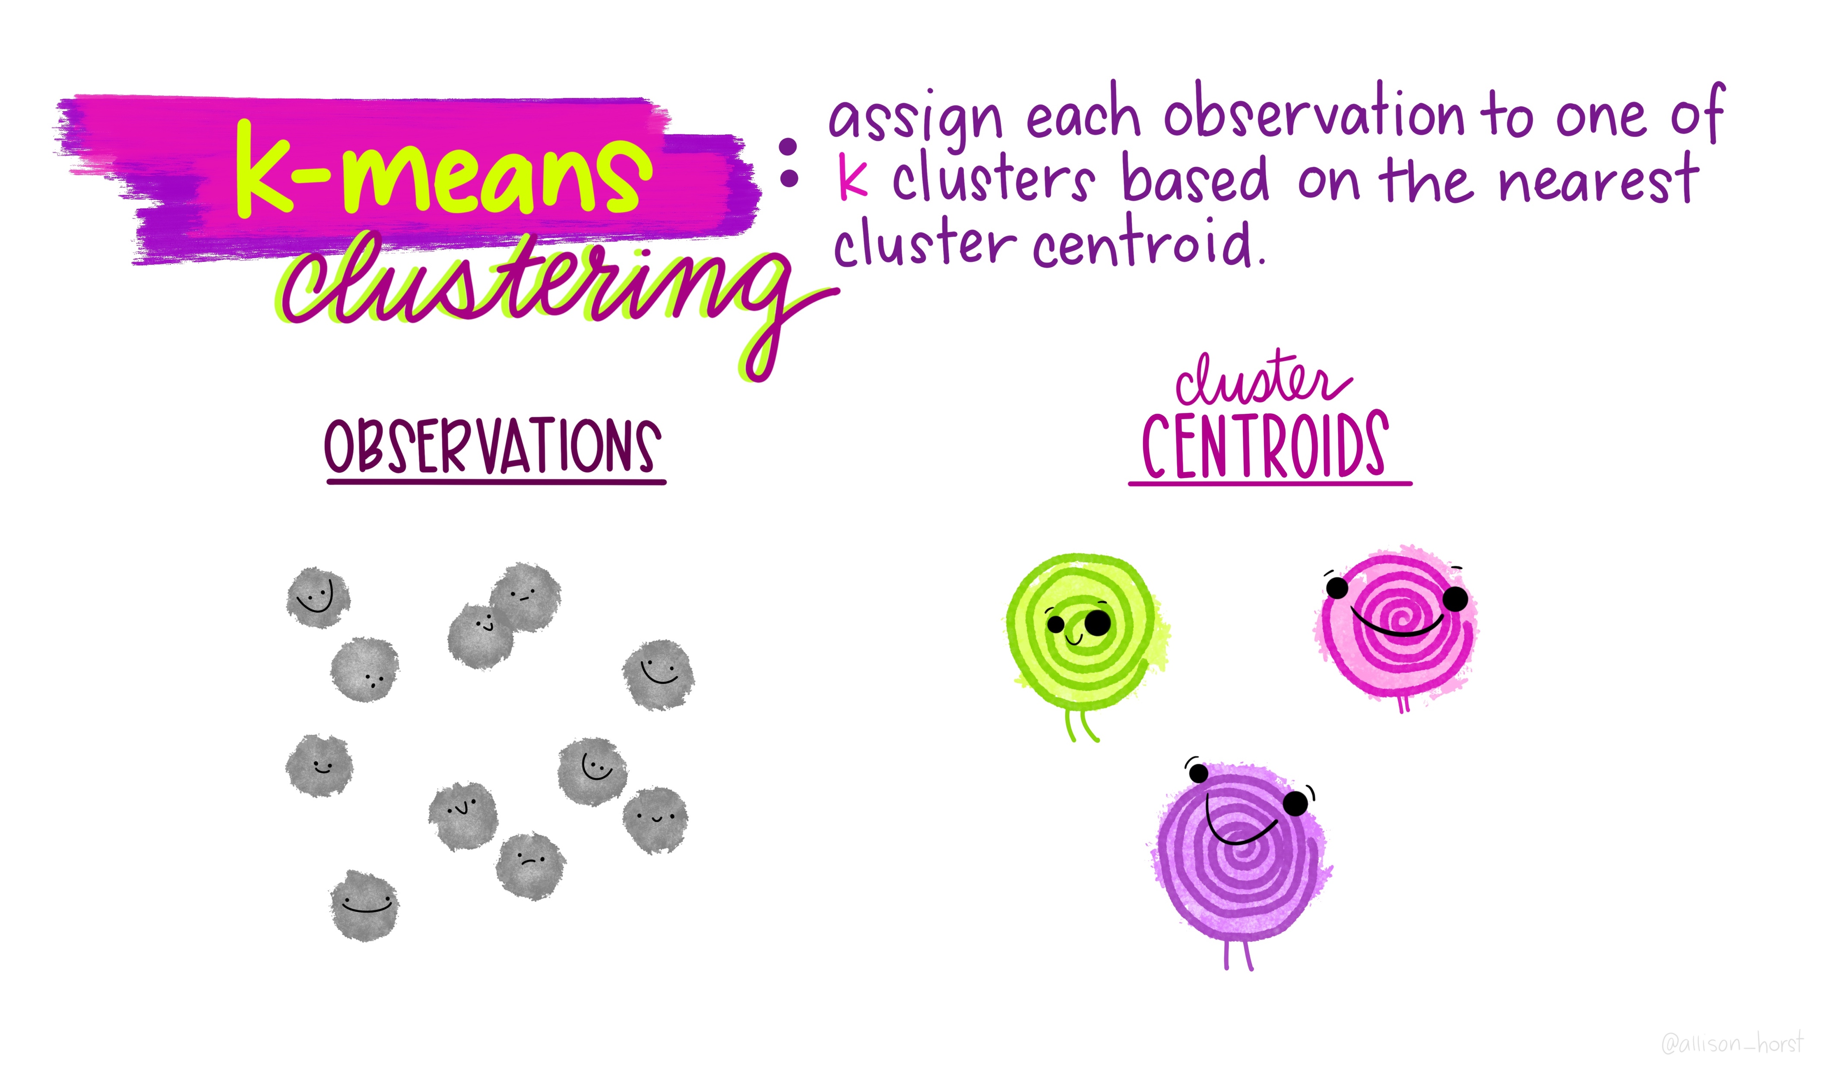
https://twitter.com/allison_horst/status/1250477975130140672
Artwork by @allison_horst

Slide 30
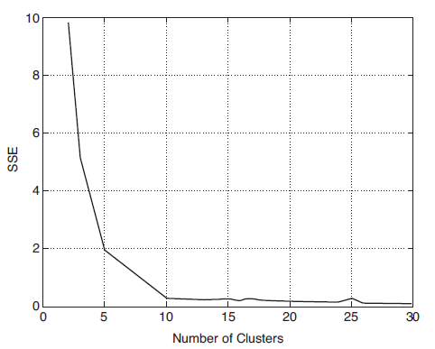
K-Means
The optimal number of clusters can be evaluated using variability within-clusters

Slide 31
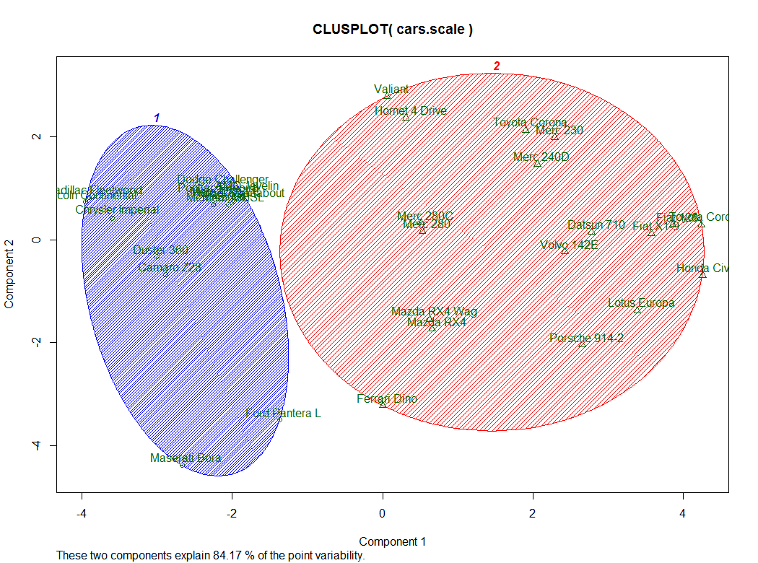

K-Means (k=2)
kmeans <- kmeans(d, 2)
library(cluster)
clusplot(kmeans, kmeans$cluster, color=TRUE, shade=TRUE, labels=2, lines=0)

Slide 32
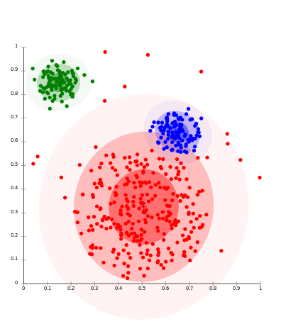
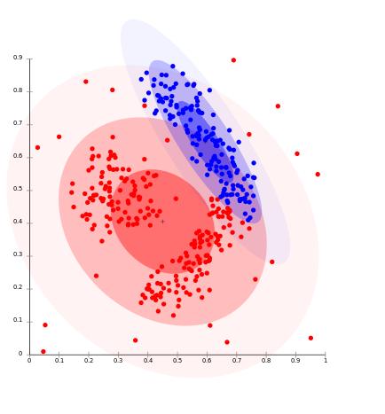
Clustering Methods
Non-Hierarchical: distribution-based
Observations have probability of belonging to each cluster
Fair representation of center-based clusters; not for contiguity-based clusters

Slide 33
Model Selection
Model based approaches assume a variety of data models and apply maximum likelihood estimation and Bayes criteria to identify the most likely model and number of clusters.
library(mclust) fit <- Mclust(mydata)

Slide 34
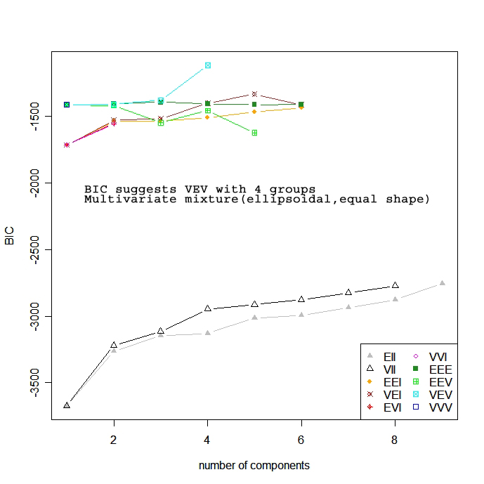
library(mclust) fit <- Mclust(mydata) plot(fit) # plot results

Slide 35
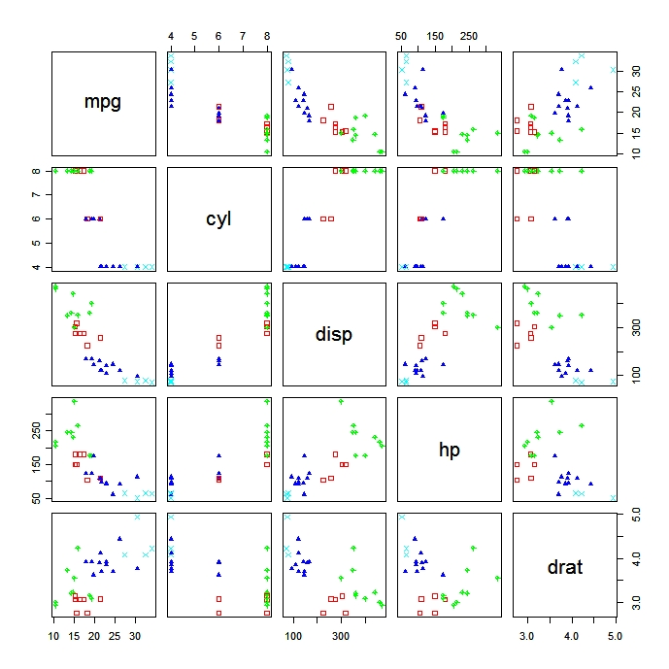
summary(fit) # display the best model

Slide 36
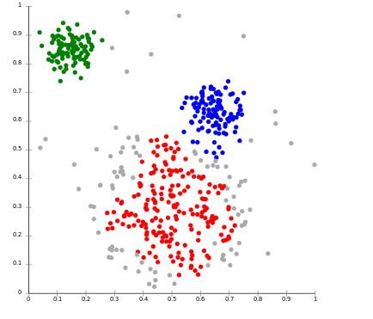
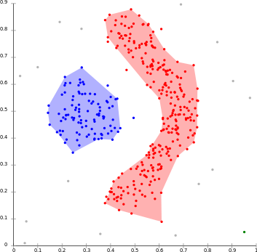
Clustering Methods
Non-Hierarchical: density-based – determines clusters based on regions of high density, observations in low-density regions are considered outliers.
Fair representation of center-based (except ‘outliers’) and contiguity clusters

Slide 37
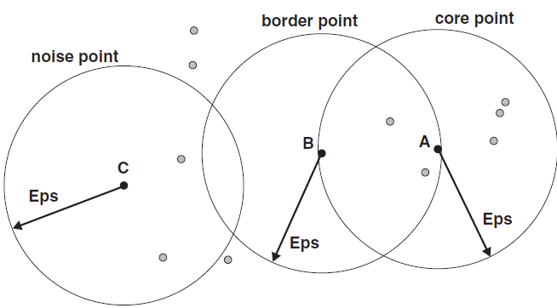
Density-Based Clustering
Density-based spatial clustering of applications with noise (DBSCAN)
Observations are categorized based on a radius (ε), in which the radius or the minimum cluster size are user defined.

Slide 38
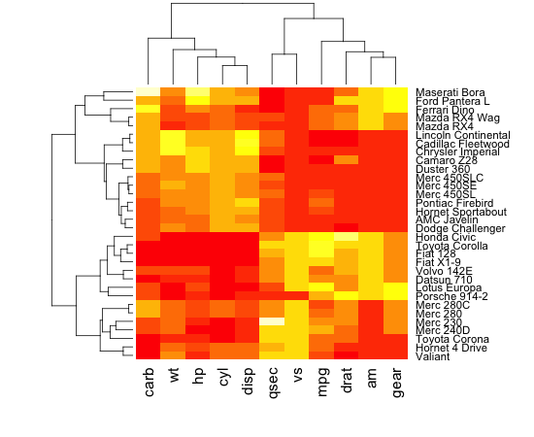
R-Mode
Clustering observations is termed ‘Q-mode’ (based on differences or similarity between observations).
Clustering variables is termed ‘R-mode’ (the correlation matrix R is a metric of similarity among variables)

Slide 40
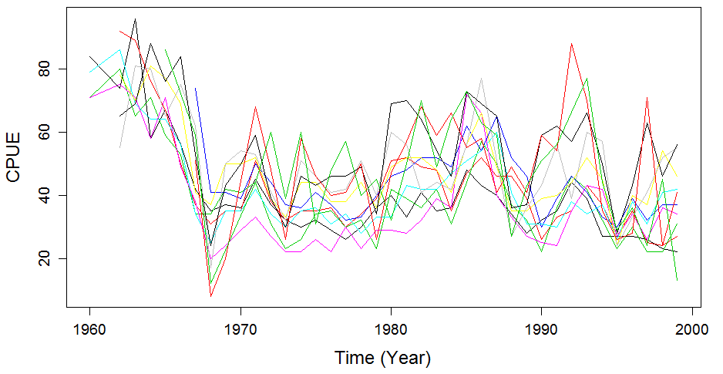
16. Nephrops CPUE
Nephrops catch-per-unit-effort in 11 fishery management areas south of Iceland.

Slide 41
17 Trends & Changes
17.5 Chronological clustering
Dynamic factor analysis (e.g., min/max autocorrelation factor analysis, MAFA) is a tool to examine trends in multivariate time series (or other longitudinal data). “PCA for time series”
Cluster analysis is a multivariable method for exploring data when it is known a priori that the data form natural groups.

Slide 42
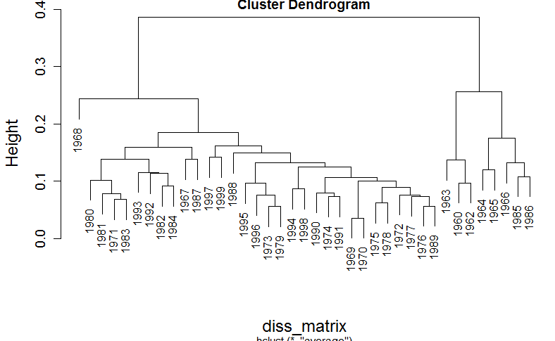
17.5 Nephrops CPUE
library(vegan)
diss_matrix <- dist(nephrops, "euclidean")
clust_result <- hclust(diss_matrix, "average")

Slide 43
17.5 Nephrops CPUE

Slide 44
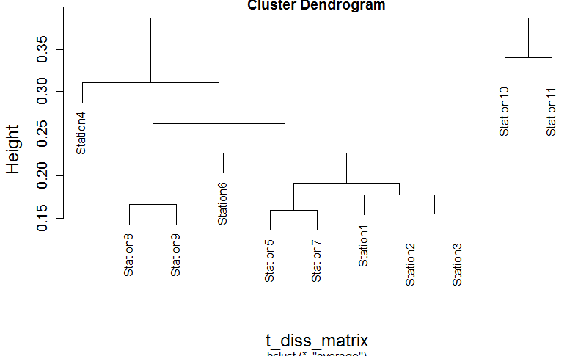
R-Mode (Spatial Clustering)
t_nephrops <- t(nephrops)
t_diss_matrix <- dist(t_nephrops, "euclidean")
t_clust_result <- hclust(t_diss_matrix, "average“)

Slide 45
R-Mode
11?
Eiríksson (1999)
proposed management units of 1-7 vs.
8-11

Slide 46
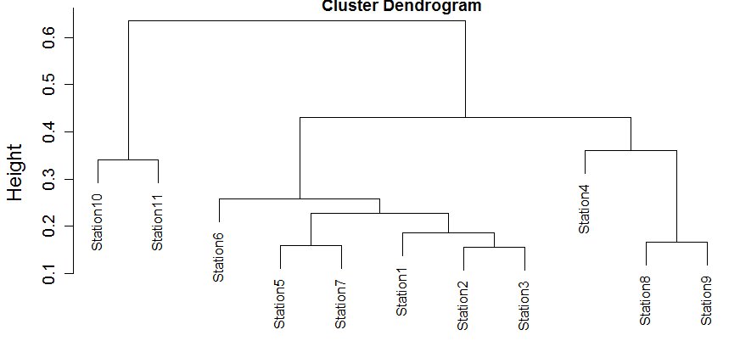
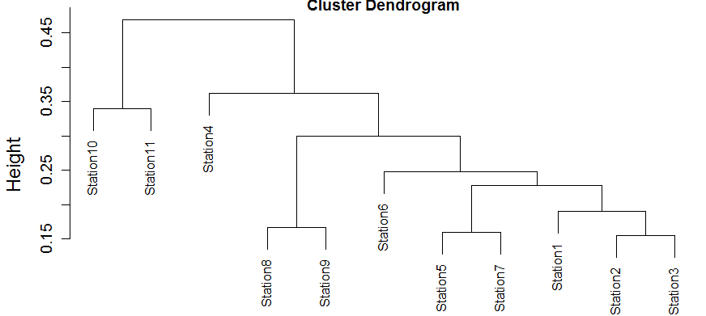
R-Mode
complete <- hclust(t_diss_matrix)
ward <- hclust(t_diss_matrix, "ward")

Slide 47
Summary
17.5 “Clustering is probably the most misused technique in multivariate analysis.”
Clustering should only be applied if there is prior knowledge that the observations (or variables) form groups.
>50 combinations of distance and clustering methods offer ‘high cheating potential’
Unless there is a mathematical reason to prefer one method, the most appropriate method should be based on known-groups tests.
An algorithm that is designed for one kind of pattern will not perform well on radically different kinds of patterns (e.g., k-means cannot find non-convex clusters).
Interpretability of clusters is an important criterion but is somewhat tautological (group membership is expected).

Slide 48


References
Galili, T. 2016. Hierarchical cluster analysis on famous data sets - enhanced with the dendextend package. (cran.r-project.org/web/packages/dendextend/
vignettes/Cluster_Analysis.html)
Legendre, P. & L. Legendre. 1998 Numerical Ecology 2nd Ed. Elsevier Developments in Environmental Modeling 20.
Tan, P-N., M. Steinbach & V. Kumar. 2006. Introduction to Data Mining. Addison Wesley.
Yau, C. 2013. Hierachical Linear Model. R Tutorial (r-tutor.com)

