Slide 1
MAR 536: Biological Statistics II
Lecture 15
Spatial mixed effects models
(Acknowledgements: Eric Ward, Sean Anderson)
27 March 2025

Slide 2
Today’s Outline
Review of linear mixed effects models
Spatial autocorrelation, variograms
Spatial mixed effects models
Implementing through sdmTMB

Slide 3
Linear Mixed Effects Models
Vector of fixed effects
Observations for group i
Vector of random effects
The traditional linear modeling framework is a special case
of this model in which there are no random effects.

Slide 4
Estimation of mixed effects models
Maximum Likelihood Estimation (MLE)
is the vector of fixed effects parameters.
are the parameters controlling the distribution for the random effects.
We integrate across the random effects.
Effectively weight the probability of the observations given values for random effects by the probability of those values.
In the linear case, closed form solutions exist. For nonlinear models, either evaluate numerically or use approximations.

Slide 5
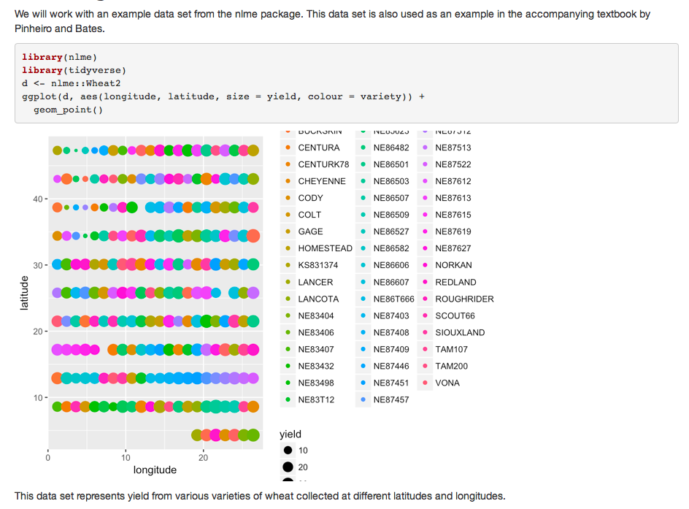
Spatial autocorrelation – wheat fields

Slide 6
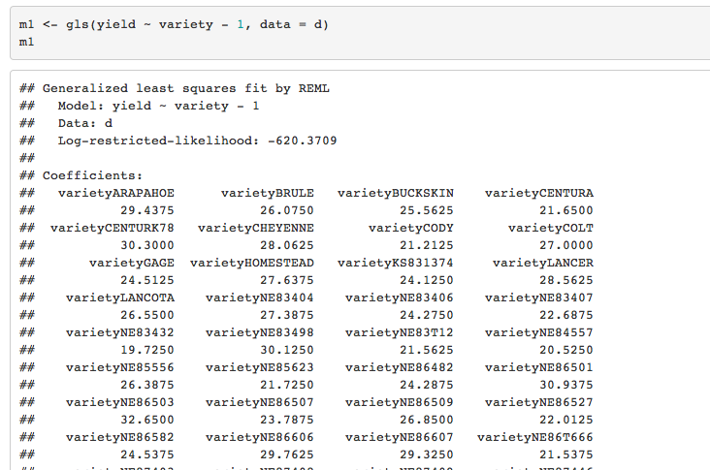
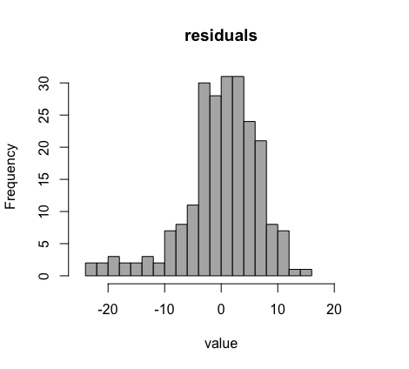
Model for wheat yield by variety

Slide 7
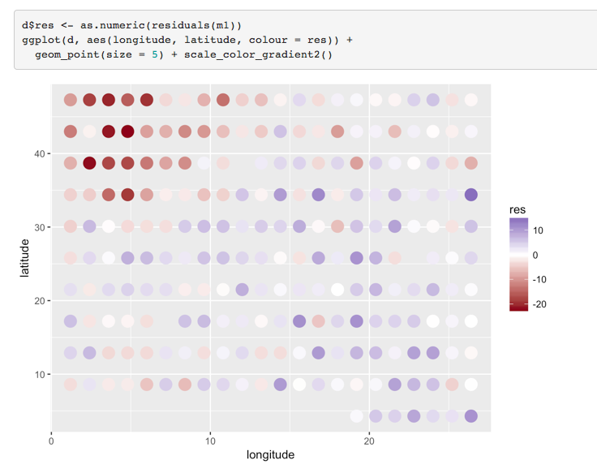
Residuals show spatial pattern

Slide 8
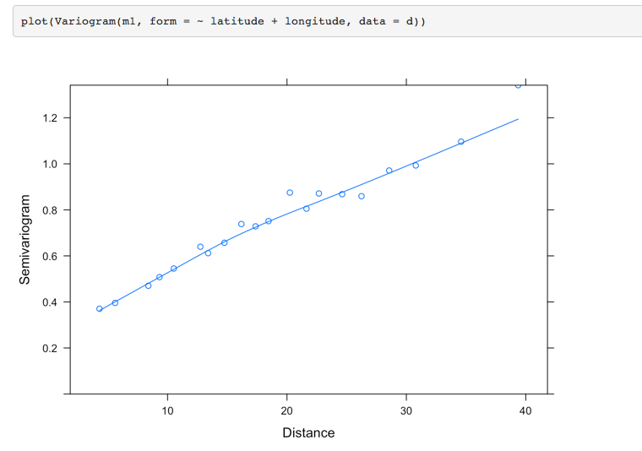
A variogram shows how the covariance changes with distance between observations.

Slide 9
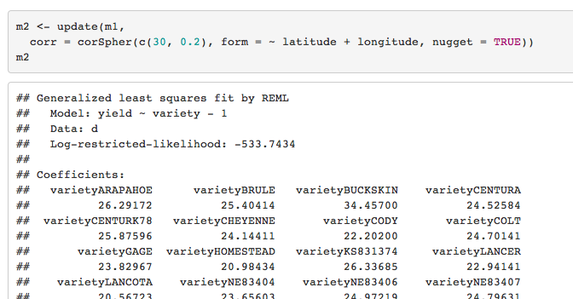
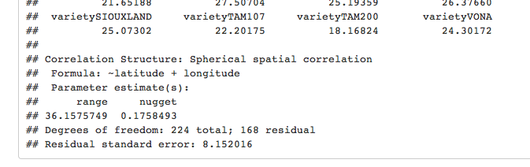
Update the model with correlation model in residuals

Slide 10
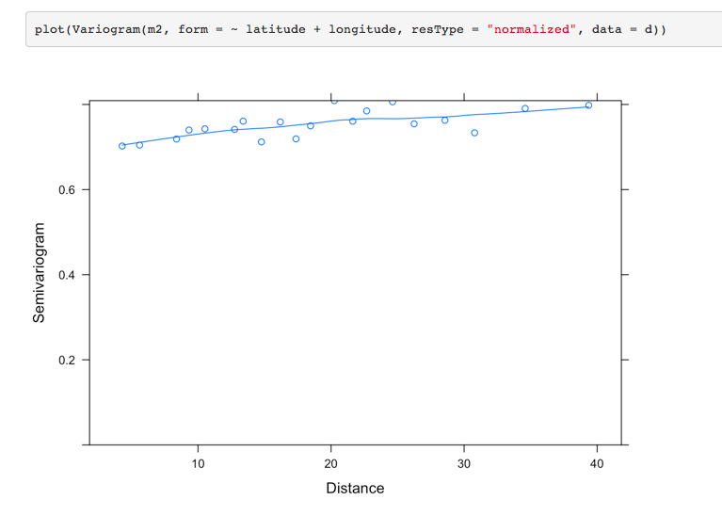
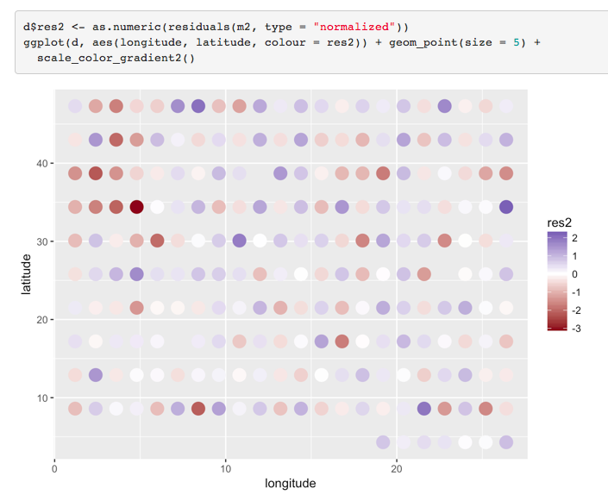
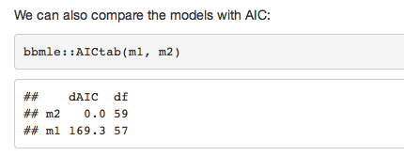
Residual pattern is removed

Slide 11
Spatial Mixed Effects Models
Spatial covariance
Vector of fixed effects
Observations at location j
spatial random effects
Include a spatial random effect term for each area, the distribution for these is governed by a variance-covariance matrix, often decomposed into a variance term, and a distance-based
spatial correlation matrix.

Slide 12
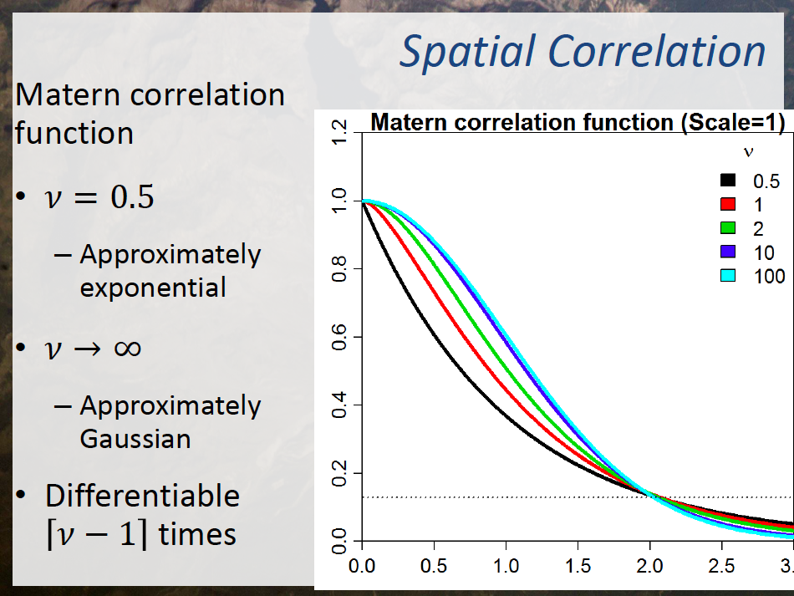

Slide 13
Fitting non-linear mixed effects models
R can be used to fit non-linear mixed effects models (function nlme).
To fit non-linear mixed effects models using EXCEL you need to evaluate the integral numerically, or apply a method such as the Laplace approximation.
is the value of ε obtained by maximizing given fixed values of θ and τ, and is the determinant of the matrix of second derivatives.
This approximation is exact when the distribution of random effects (given their hyper-prior and the available data) is exactly proportional to a multivariate normal distribution. (It is a convenient approximation in other cases)
Skaug & Fournier (2006), Thorson & Minto (2015)

Slide 14
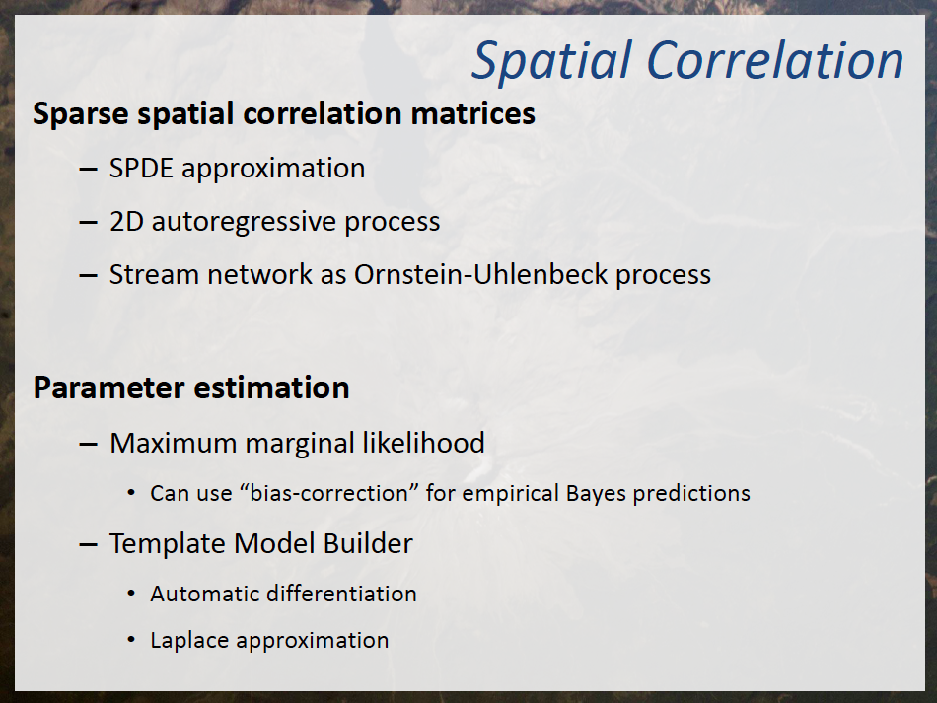

Slide 15
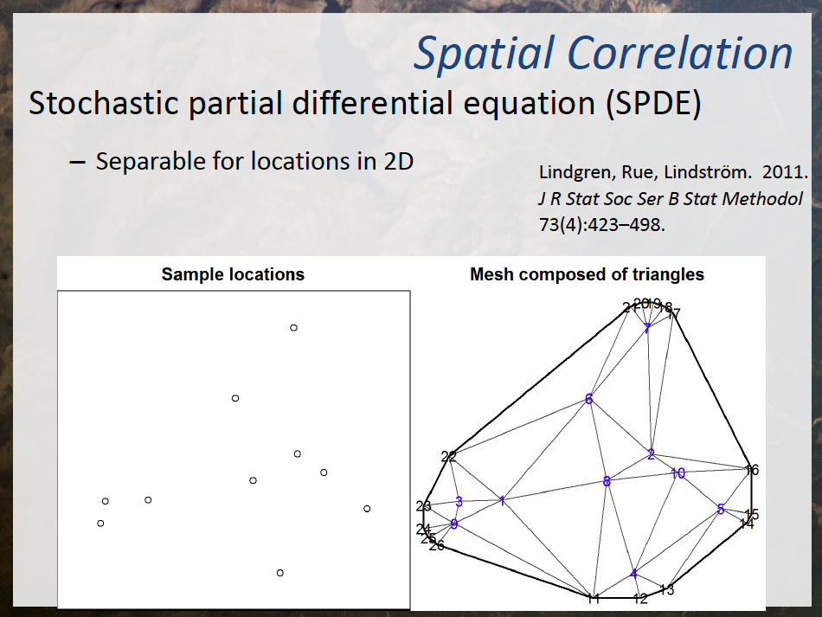

Slide 16
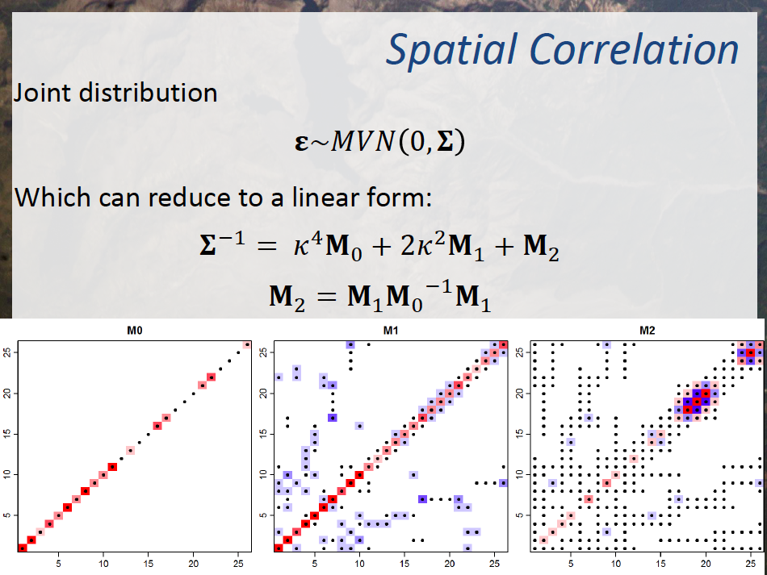

Slide 17
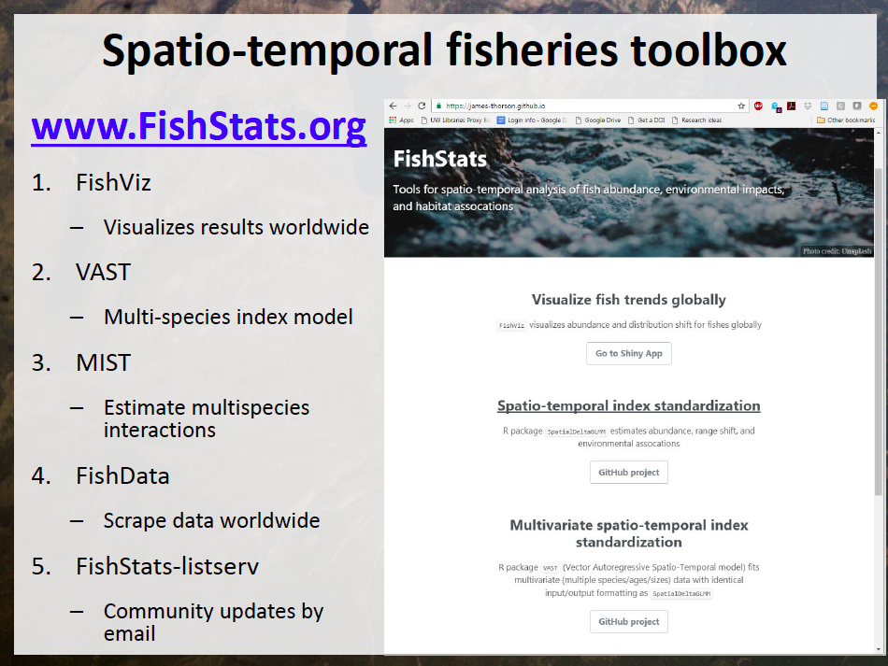

Slide 18
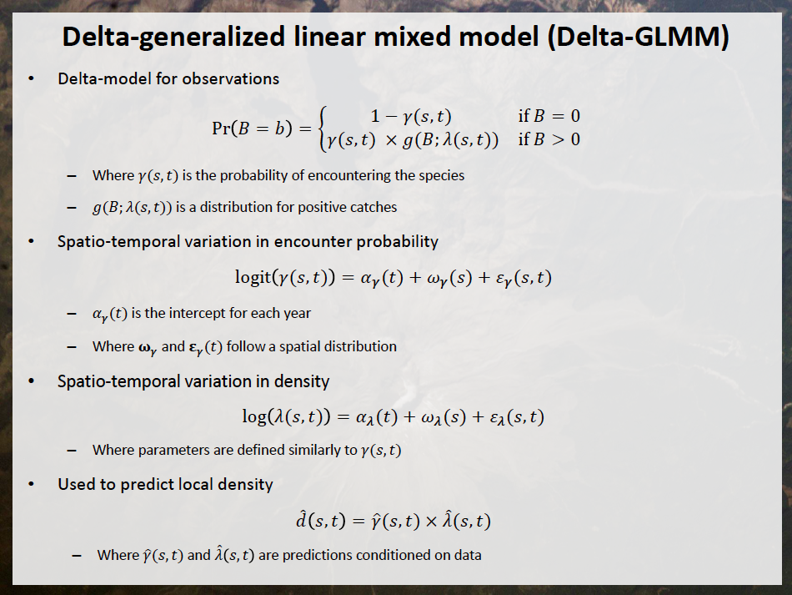

Slide 19
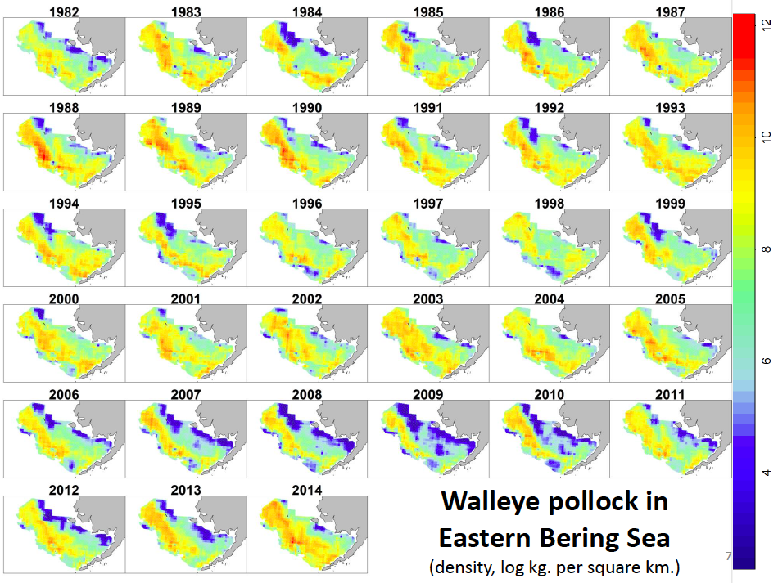

Slide 20
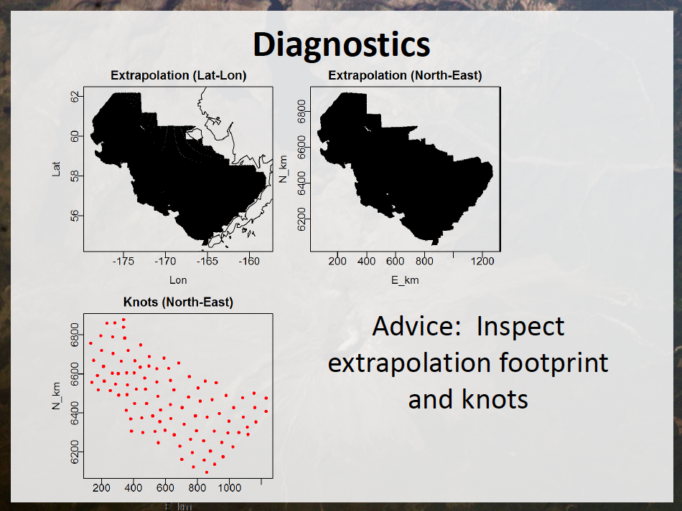

Slide 21
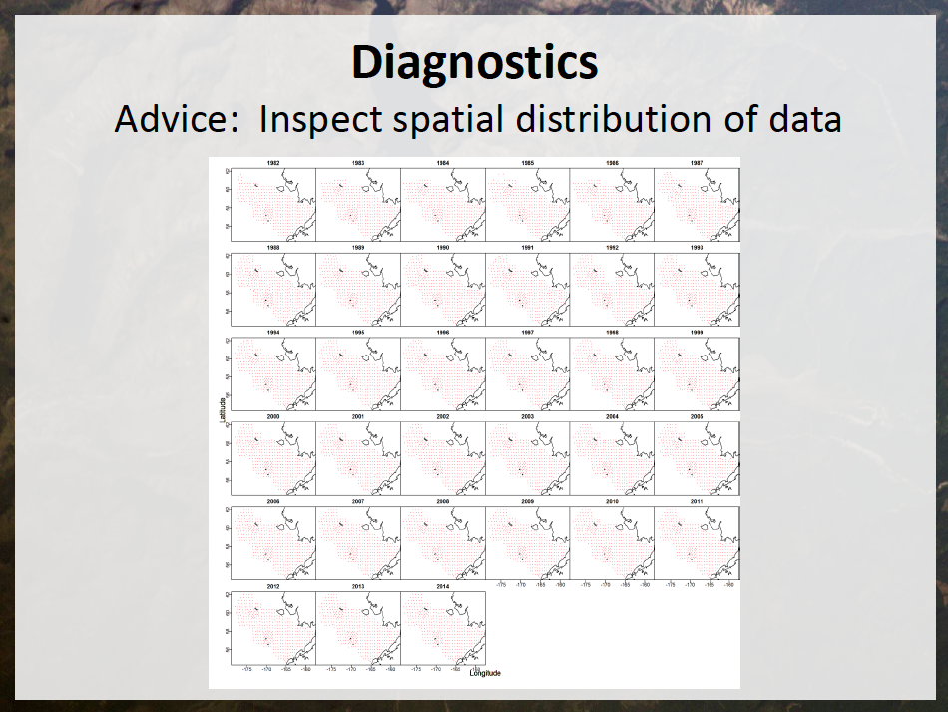

Slide 22
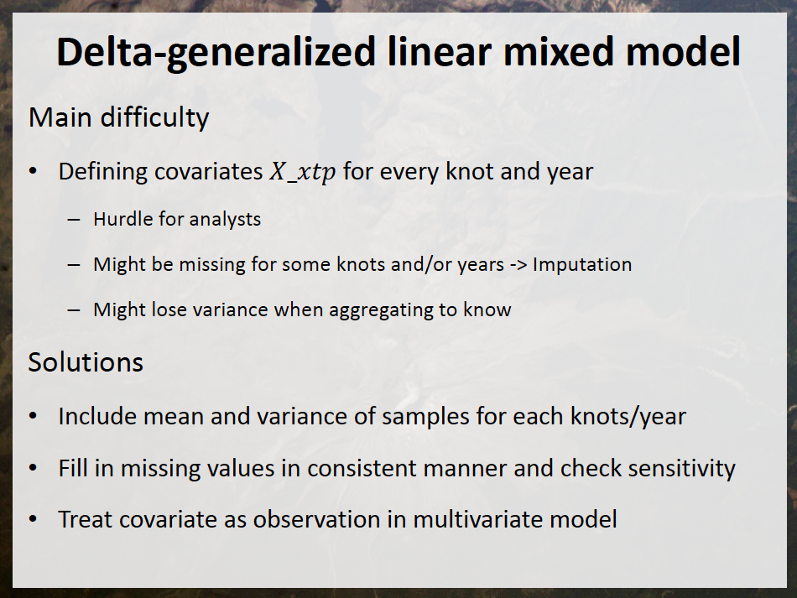

Slide 23
Recommended Reading
Bolker et al. (2008). Generalized linear mixed models: a practical guide for ecology and evolution. TREE: 24: 127-35.
Pinheiro, J.C. & Bates, D.M. (2000). Mixed-Effects Models in S and S-PLUS. New York: Springer-Verlag.
Skaug, H. J., & Fournier, D. A. (2006). Automatic approximation of the marginal likelihood in non-gaussian hierarchical models. Computational Statistics & Data Analysis, 51(2), 699-709.
Thorson, J. T., & Minto, C. (2014). Mixed effects: a unifying framework for statistical modelling in fisheries biology. ICES Journal of Marine Science: Journal du Conseil, fsu213.
Venables, W. N., & Dichmont, C. M. (2004). GLMs, GAMs and GLMMs: an overview of theory for applications in fisheries research. Fisheries Research, 70(2), 319-337.
Zuur et al. (2009). Mixed-effects Models and Extensions in Ecology with R. New York: Springer-Verlag.

