Slide 1
Generalized Linear Models I Poisson Regression
MAR 536 Biological Statistics II
February 11 2025
Acknowledgements: Steve Cadrin, Brooke Lowman

Slide 2

Lecture Outline
Review: linear regression (Chapter 5)
Generalized linear modeling
Zuur et al. Chapter 6.1
Venables & Dichmont (2004)

Slide 3
Approach to Advanced Methods

Slide 4
Review: Linear Regression
Implications of linear regression assumptions:
Species richness is expected to be zero at NAP ~2.4.
Large probability of negative richness at even intermediate NAP levels
Unequal variances

Slide 5
Model Validation
Important model assumptions need to be inspected:
Scatterplot of residuals on fitted values and scale-location plot show unequal variance.
Q-Q plot shows non-normality
Cook’s distance indicates influential observations.

Slide 6
Generalized Linear Models
Generalized Linear Models (GLMs):
Attempt to accommodate variance heterogeneity and non-normal behavior by offering a range of distributional types that cover common mean-variance relationships
useful for obviously non-normal data generating process
provide alternatives to data transformation; e.g., Y’ = log(Y + c)
first defined by Nelder and Wedderburn (1972)
(but principles extend earlier)

Slide 7
Ordinary Linear Models
Change notation from:
to:
Model distribution of stochastic response variable y in terms of explanatory variables x₁, x₂, x_{p}... or their known mathematical functions.
Simplified notation where fixed part of equation (η) is referred to as the linear predictor:

Slide 8
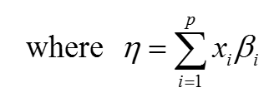

Transformation approach
Transform response variable to accommodate non-normal, heteroscadistic errors.

Slide 9
Generalized Linear Models
Distribution of y depends on the explanatory variables through linear predictor η, where x_{i}’s are known functions of explanatory variables.
The mean of y is related to η by a known function called the link function which transforms the distribution mean µ into the linear predictor η (not the other way around)
The link function acts like transformation of the response variable.

Slide 10
Generalized Linear Models
The variance of y is a function of the mean µ, where Φ is a scale parameter, A is a known prior weight, and v(µ) is a known function of µ called the variance function

Slide 11
Generalized Linear Models
Generalized Linear Models
The distribution of y has a density of known form:
This is the generic form for exponential distributions, including normal (Gaussian), gamma, Poisson and binomial, etc. where θ is the ‘canonical parameter’ of the distribution, and other parameters define the distribution

Slide 12
Generalized Linear Models

Slide 13
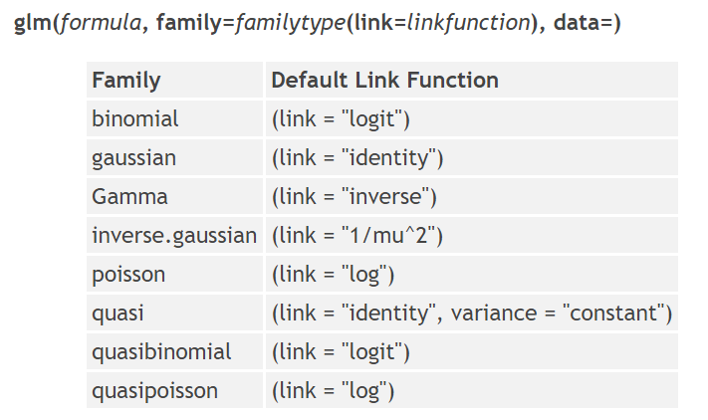
Generalized Linear Models in R
… …

Slide 14
Generalized Linear Models
The link function establishes the connection between the linear predictor η, and the mean of the distribution, µ
There is a ‘natural link’ and other associated parameters for each distribution

Slide 15
GLM estimation and inference
For normal linear regression:
estimation by least squares,
(recall that least squares is equivalent to maximum likelihood in this case)
Significance, by F-tests.
For GLMs:
estimation by maximum likelihood
Inference by analysis of deviance, essentially the likelihood ratio statistic.

Slide 16
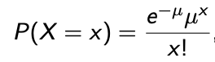
6.1 Poisson Regression
Poisson Distribution:
Values for Y_{i} are Poisson distributed with expectation µ_{i}: Y_{i} ~ Poisson(µ_{i})
Expected Y_{i} is equal to its variance: E[Y_{i}] = µ_{i} = Var(Y_{i})
Probability density function:
(µ here is the same as λ in lecture 4)
Allows for increased spread, avoids density curves that yield negative fitted values.
µ = 1
µ = 5
µ = 15
µ = 25

Slide 17
Linear Regression
linear predictor
predictor function:
Distributional assumption:
Model:
Expected:

Slide 18
Poisson Regression
link function
Log link for Poisson:
Distributional assumption:
Model:
Expected:
Notes:
Poisson models with log-links are often called log-linear models and are used for frequency data

Slide 19

Back to the Beach (Ch 27)
Abundance of 75 invertebrate species sampled from 45 sites
Response variable = species richness (R)
Explanatory variable = vertical position in beach relative to sea level (NAP)
> RIKZ <- read.table(file = "RIKZ.txt",header = TRUE)
> RIKZ$Richness <- rowSums(RIKZ[,2:76] > 0)
> RIKZ_poisson <- glm(Richness ~ NAP, data = RIKZ, family = poisson)

Slide 20
Poisson Regression
Notes:
Red crosses are observed values, curve is fitted Poisson regression curve (exponential), density distributions show probability of other realizations at the given NAP value (one distribution and µ for each observed value)

Slide 21
Poisson Regression
No negative fitted values, negative realizations not possible
Notes:
Red crosses are observed values, curve is fitted Poisson regression curve (exponential), density distributions show probability of other realizations at the given NAP value (one distribution and µ for each observed value)

Slide 22
Poisson Regression
GLM validation is similar to linear regression, but fitted values can be plotted on either the predictor scale or original scale.
In non-normal GLMs, the two most important types of residuals are the deviance (E^{D}) and the Pearson (E^{P}) residuals:
Where d_{i} is the contribution of the i^{th} observation to the residual deviance D, and µ_{i} the fitted value.
Large Pearson residuals can be due to poor model fit, misspecification, violation of independence, clustering, incorrect link function.

Slide 23
Poisson Regression
Deviance Residuals:
Min 1Q Median 3Q Max
-2.2029 -1.2432 -0.9199 0.3943 4.3256
Coefficients:
Estimate Std. Error z value Pr(>|z|)
(Intercept) 1.79100 0.06329 28.297 < 2e-16 ***
NAP -0.55597 0.07163 -7.762 8.39e-15 ***
Signif. codes: 0 '***' 0.001 '**' 0.01 '*' 0.05 '.' 0.1 ' ' 1
Null deviance: 179.75 on 44 degrees of freedom
Residual deviance: 113.18 on 43 degrees of freedom
AIC: 259.18
Notes:
Significance testing similar to linear, z-value analogous to t-value! See Venables and Dichmont (2004) for more details

Slide 24
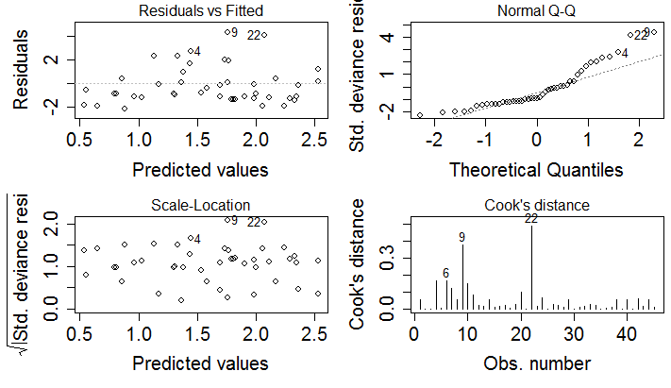
Poisson Regression

Slide 25
Poisson Distribution
Distribution described with a single parameter (µ)
Expected Y_{i} is equal to its variance:
E[Y_{i}] = µ_{i} = var(Y_{i})
µ = 1
µ = 5
µ = 15
µ = 25

Slide 26
Quasi-Poisson Distribution
Increasing spread in count data can be greater than what can be modeled using the Poisson distribution
We can introduce a dispersion parameter ρ such that:
Expected Y_{i} : E[Y_{i}] = µ_{i} and variance: var(Y_{i}) = ρµ_{i}
ρ > 1, allows for more spread, overdispersion
ρ < 1, underdispersion
Poisson regression with a dispersion parameter is called quasi-likelihood or quasi-Poisson
Notes:
See Venables and Dichmont (2004) for more on overdispersion, model extension, etc.

Slide 27
Quasi-Poisson Regression
Corrected for overdispersion (ρ = 3.04):
glm(formula = Richness ~ NAP, family = quasipoisson, data = RIKZ)
Coefficients:
Estimate Std. Error t value Pr(>|t|)
(Intercept) 1.7910 0.1104 16.218 < 2e-16 ***
NAP -0.5560 0.1250 -4.448 6.02e-05 ***
Greater standard error
Notes:
See Venables and Dichmont (2004) for more on overdispersion, model extension, etc., formula for dispersion parameter later

Slide 28
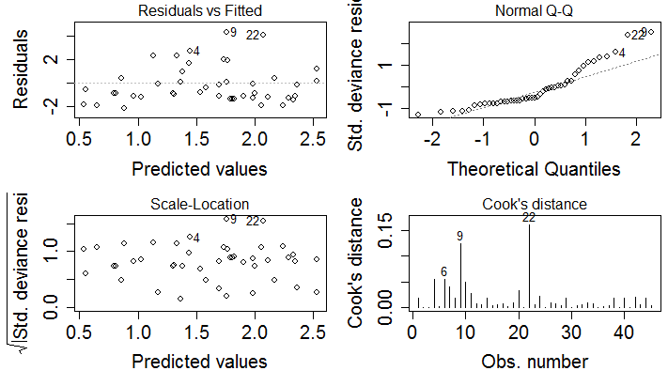
Quasi-Poisson Regression

Slide 29
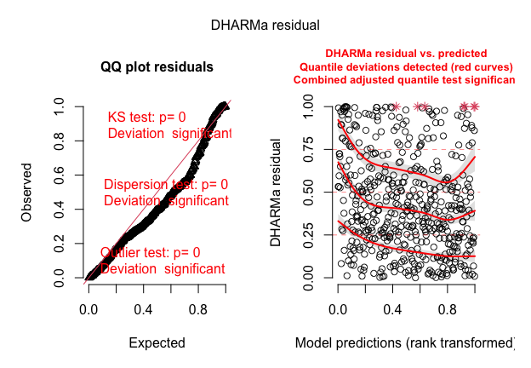
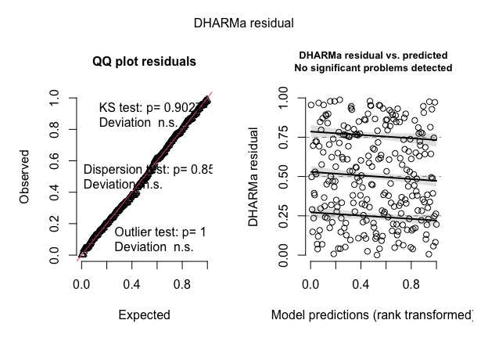
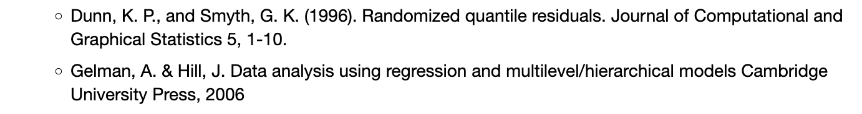
Randomized quantile residuals via DHARMa
DHARMa package vignette; Hartig, 2024

Slide 30
Generalized Linear Models in R

Slide 31
Full Model and Nested Models
Deviance:
Deviance is GLM equivalent of Sums of Squares
Residual deviance D is GLM equivalent of residual Sums of Squares.
Something like -2 ln L (but not quite, depending on the distribution, see Venables and Dichmont 2004)
Most useful for comparison of two nested models
Example: fit Poisson model to RIKZ data where exposure and week are nominal variables.
Compare model 1 with NAP, Exposure, and Week to model 2 with NAP and Week.
Notes:
See Venables and Dichmont (2004) for relationship with log-likelihood ratio, etc.

Slide 32
Full Poisson Model
> RIKZ_poisson.1 <- glm(Richness ~ NAP + factor(week) + factor(exposure), data = RIKZ, family = poisson)
Coefficients:
Estimate Std. Error z value Pr(>|z|)
(Intercept) 2.53136 0.12866 19.675 <2e-16 ***
NAP -0.48950 0.07449 -6.571 5e-11 ***
factor(week)2 -0.75723 0.35132 -2.155 0.0311 *
factor(week)3 -0.50717 0.21148 -2.398 0.0165 *
factor(week)4 0.12361 0.22617 0.547 0.5847
factor(exposure)10 -0.42602 0.19022 -2.240 0.0251 *
factor(exposure)11 -0.65481 0.33446 -1.958 0.0503 .
Notes:
See Venables and Dichmont (2004) for relationship with log-likelihood ratio, etc.

Slide 33
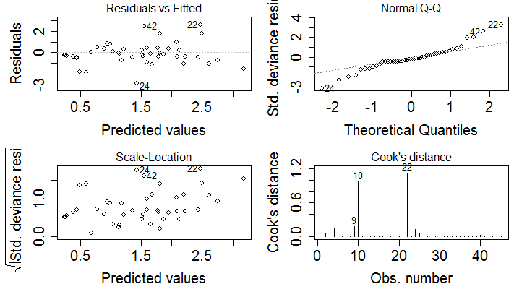
Full Poisson Model

Slide 34

Nested Poisson Model
Model 1 with NAP, Exposure, and Week to model 2 with NAP and Week – can exposure be dropped?
Deviance D₁ = 47.80; D₂ = 53.47
D₂ - D₁ = 5.67 (Chi-square with p₁ - p₂ df, p_{i} = # model parameters, p = 0.02)
Reject null hypothesis that all regression parameters for Exposure = 0 (keep Exposure)
Can also examine t-values or use Deviance Information Criterion:

Slide 35
Nested Poisson Model
> RIKZ_poisson.1 <- glm(Richness ~ NAP + factor(week) + factor(exposure), data = RIKZ, family = poisson)
> drop1(RIKZ_poisson.1, test = "Chisq")
Single term deletions
Model:
Richness ~ NAP + factor(week) + factor(exposure)
Df Deviance AIC LRT Pr(Chi)
<none> 47.800 203.799
NAP 1 93.460 247.459 45.660 1.407e-11 ***
factor(week) 3 58.372 208.371 10.572 0.01428 *
factor(exposure) 2 53.466 205.464 5.666 0.05885 .
Notes:
Cannot reject null hypothesis that regression parameters for exposure are zero – drop it! Shows NAP is most important! Note deviance relationships

Slide 36
Quasi-Poisson Regression
Model Comparison:
use dispersion parameter ρ (as in quasi-Poisson)
p + 1 & q + 1 are # parameters in model 1 & 2, respectively
H₀: regression parameters of omitted explanatory variables = 0, F-ratio follows an F-distribution with p - q and n - p df
> RIKZ_poisson.1 <- glm(Richness ~ NAP + factor(week) + factor(exposure), data = RIKZ, family = quasipoisson)
> RIKZ_poisson.2 <- glm(Richness ~ NAP + factor(week), data = RIKZ, family = quasipoisson)
> anova(RIKZ_poisson.1,RIKZ_poisson.2, test = "F")
Analysis of Deviance Table
Resid. Df Resid. Dev Df Deviance F Pr(>F)
1 38 47.800
2 40 53.466 -2 -5.666 2.3994 0.1044
Notes:
+ 1 for intercept

Slide 37
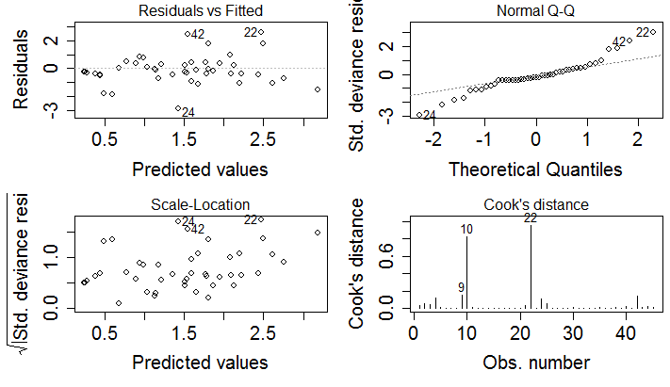
Quasi-Poisson Full Model

Slide 38
Randomized quantile residuals
GLM residuals are harder to interpret than LMs
expected distribution of the data changes with the fitted values.
Reweighting with the expected dispersion (e.g. Pearson, deviance) helps to some extent, but does not lead to visually homogenous residuals.
Standard residual plots often seem to show all kind of problems, such as non-normality, heteroscedasticity, even when model is correctly specified.
Quantile residuals using a simulation-based approach can help.
Hartig, 2024

Slide 39
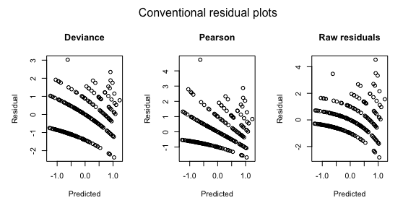
Randomized quantile residuals
GLM residuals are harder to interpret than LMs
expected distribution of the data changes with the fitted values.
Reweighting with the expected dispersion (e.g. Pearson, deviance) helps to some extent, but does not lead to visually homogenous residuals.
Standard residual plots often seem to show all kind of problems, such as non-normality, heteroscedasticity, even when model is correctly specified.
Quantile residuals using a simulation-based approach can help.
Hartig, 2024

Slide 40
Randomized quantile residuals
GLM residuals are harder to interpret than LMs
expected distribution of the data changes with the fitted values.
Reweighting with the expected dispersion (e.g. Pearson, deviance) helps to some extent, but does not lead to visually homogenous residuals.
Standard residual plots often seem to show all kind of problems, such as non-normality, heteroscedasticity, even when model is correctly specified.
Quantile residuals using a simulation-based approach can help.
Hartig, 2024

Slide 41
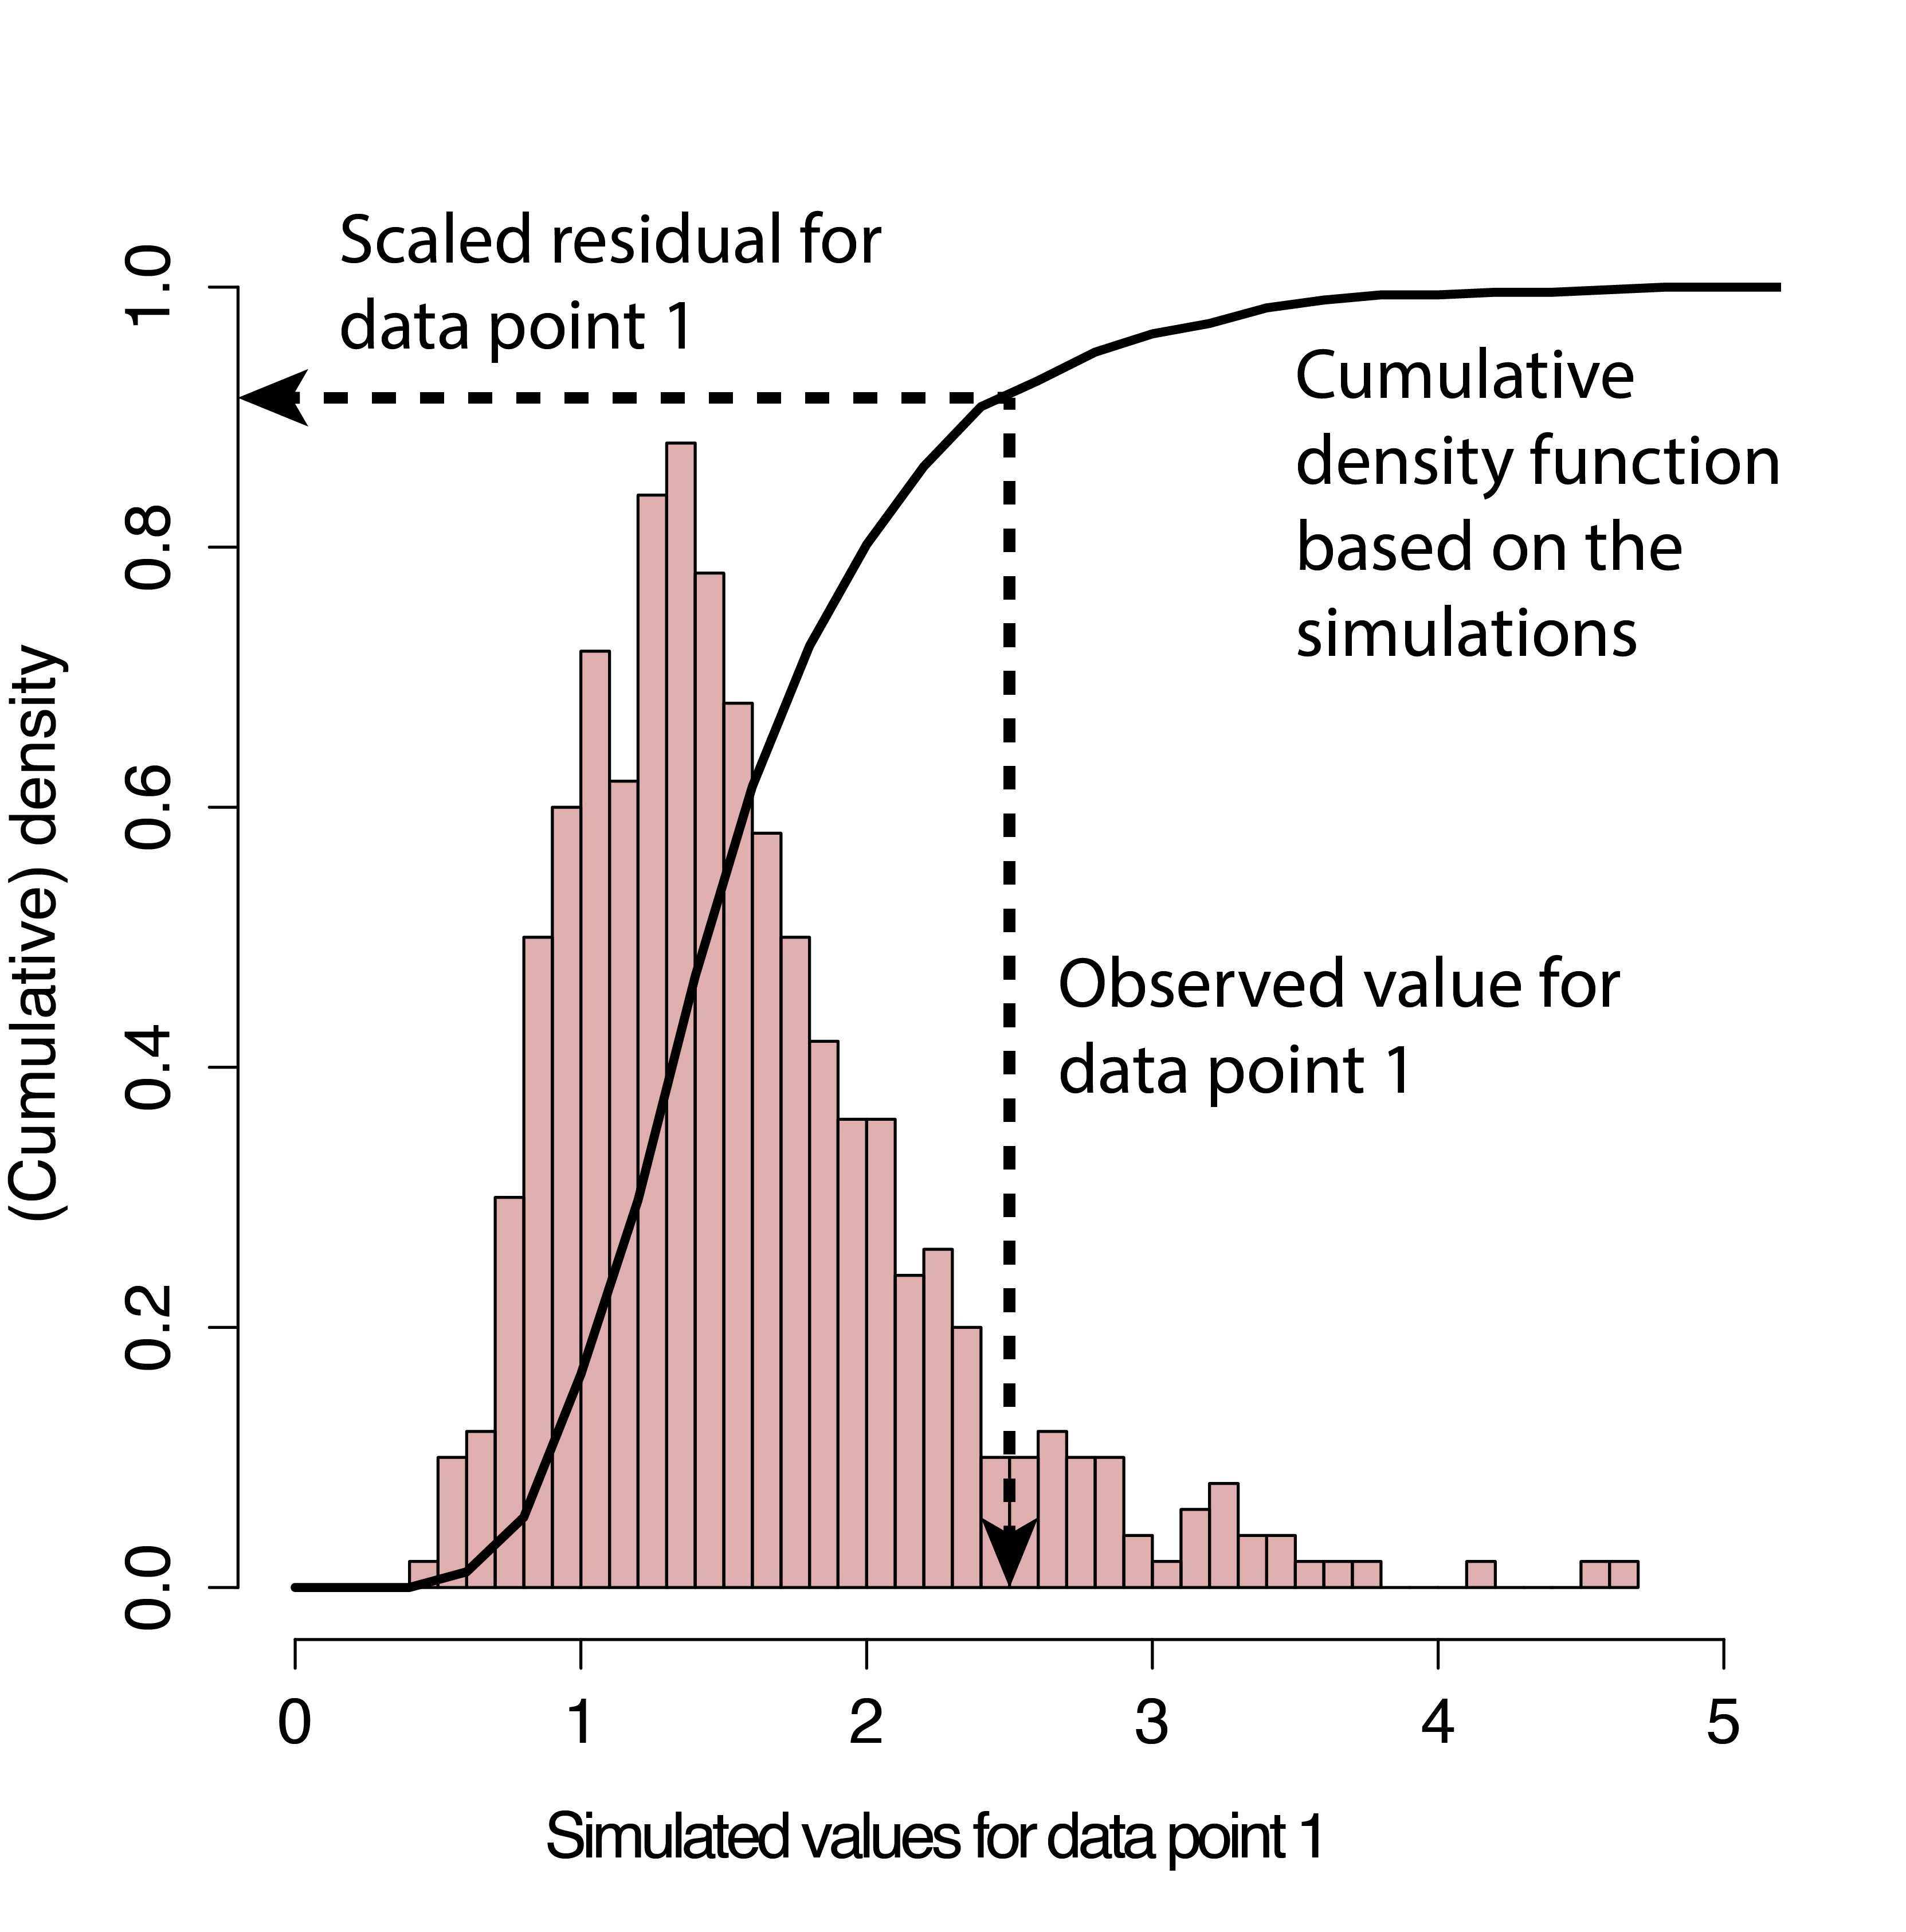
Randomized quantile residuals via DHARMa
(similar to Bayesian p-value or parametric bootstrap)
Simulate new response data from the fitted model for each observation.
For each observation, calculate the empirical cumulative density function for the simulated observations
The residual is defined as the value of the empirical density function at the value of the observed data,
residual of 0: all simulated values are larger than the observed value,
residual of 0.5: half of simulated values are larger than observed value.
Hartig, 2024

Slide 42
Summary & Further Modeling
Generalized Linear Models:
model data on original scale, but can accommodate large range of:
Links between linear predictor and mean
Dependence of variance on the mean
Many distributional forms beyond Poisson.
Many GLMs use Maximum Likelihood instead of standard regression parameters for estimation.
Inference for GLMs mainly based on deviance.
Model selection:
Select distribution most appropriate for variables (Venables and Dichmont 2004).
Some models have quasi-equivalents to handle dispersion.

Slide 43
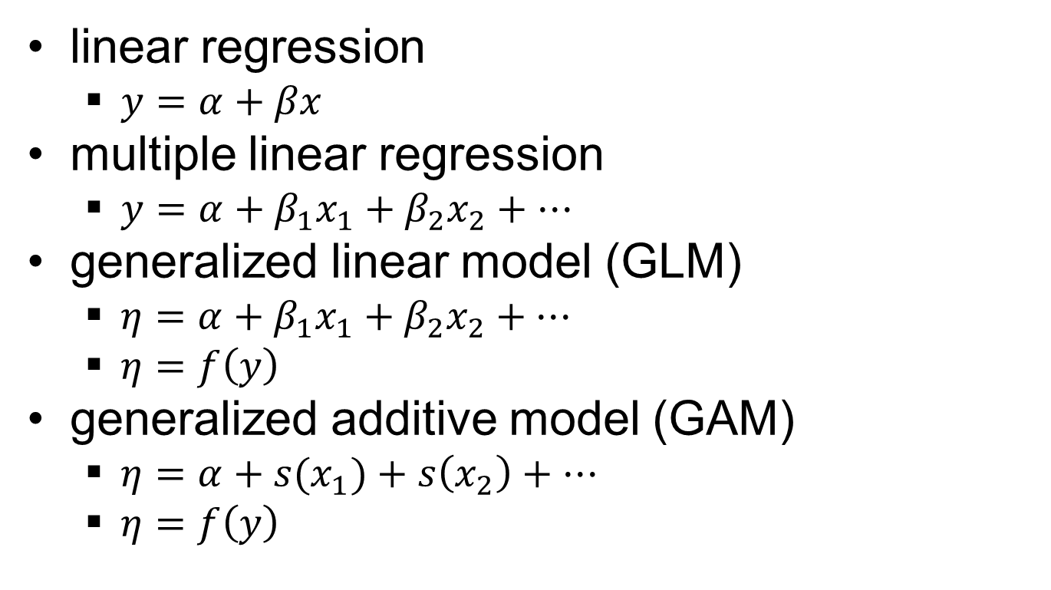

Statistical Modeling
What if my data aren’t normal?
How does x affect y?
How do some x’s affect y?
What if the relationships aren’t linear?
Notes:
**GO SLOWLY**
Expand on simpler concepts to build up general case
How does x affect y? -- linear regression
How do some x’s affect y? – multiple linear regression
What if my data aren’t normal? – GLM
specify the proper distribution for the response (e.g. binomial, Gamma, beta)
predictor function is linear
link function connects the predictor to the scale of the response (e.g. use logit link to connect the linear predictor to a probability (between 0 and 1)
What if the relationships aren’t linear? – GAM
specify the proper distribution for the response (e.g. binomial, Gamma, beta)
predictor function adds together smooths (like a running moving average, curvy lines that smooth out some noise; e.g. temperature is not expected to be linear – it should have an optimal range)
link function connects the predictor to the scale of the response (e.g. use logit link to connect the linear predictor to a probability (between 0 and 1)

Slide 44
Generalized Additive Models (GAM)
Generalized Linear Models (GLM)
Multiple Regression
Linear Regression
Acknowledgement: Brooke Lowman
Notes:
Recap: general to specific
GLM is special case of GAM when all smooths are lines (replace a smooth function with a slope coefficient).
Multiple regression is special case of GLM when response is normally distributed.
Linear regression is special case when only one predictor (x) is used.

Slide 45
Further Reading
Crawley, M.J., 2005. Statistics: An Introduction Using R. John Wiley & Sons, London.
Dobson, A.J., 2002. An Introduction to Generalized Linear Models, 2nd ed. Chapman & Hall, London.
McCullagh, P., Nelder, J.A., 1989. Generalized Linear Models, 2nd ed. Chapman & Hall, London.
Nelder, J.A.,Wedderburn, R.W.M., 1972. Generalized linear models. J. Roy. Stat. Soc. Ser. A. 135, 370–384.
Venables, W. N., Dichmont, C.M., 2004. GLMS, GAMS and GLMMs: an overview of theory for applications in fisheries research. Fish. Res. 70, 319-337.
Wood, S.N., 2006. Generalized Additive Models: An Introduction with R. Chapman & Hall, London.

