Slide 1
MAR 580: Advanced Population Modeling
multispecies models primer

Slide 2


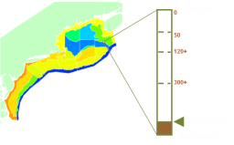

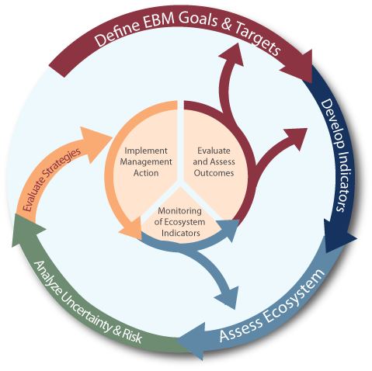
A spectrum of tools, a spectrum of uses
Stock/Single Species
Multi-species
Aggregate Biomass
Ecosystem
Gadids
Pelagics
Flatfish
Single stock models
Multi-species assessments
Functional group models
Whole system models
Stock assessments with add-ons: explicit M2 or habitat or climate considerations
Multiple stock assessments integrated
Economic assessments, social impacts
Integrated ecosystem assessments
Notes:
NEFSC heavily involved in NOAA IEA efforts

Slide 3
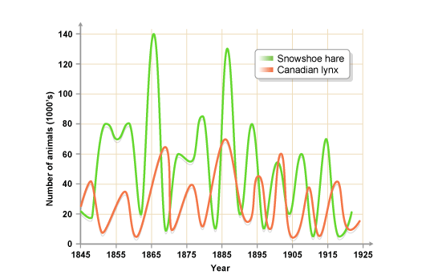
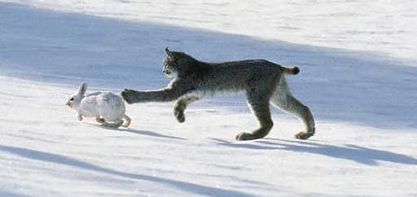
Multispecies models
Effectively a set of single species models with some form of linkage between them, usually species interactions, all modeled simultaneously.
Image from: http://www.anselm.edu/homepage/jpitocch/genbios/52-19a-PopCycleHareLynxPhot.jpg
Image from bbc.co.uk

Slide 4
Multispecies models
Models of multispecies dynamics have been around for a long time (e.g. Lotka 1910).
Add species interactions to simultaneous sets of population dynamics.
Lotka-Volterra Predator-Prey

Slide 5
Adding interactions to the logistic model
Competition
We can add interaction terms to ‘simple’ production models.
e.g. Lotka-Volterra competition terms to the logistic model. Here the α’s are positive.
(representing negative effects of species on eachother)
There are a myriad of ways for including these terms – choices should ideally be driven by some understanding of the system.
Here we model a Type II functional response in the consumption of prey N by predator P.
This is more realistic than the Lotka-Volterra equations as it implies saturation in the per capita predator consumption.
Predation

Slide 6
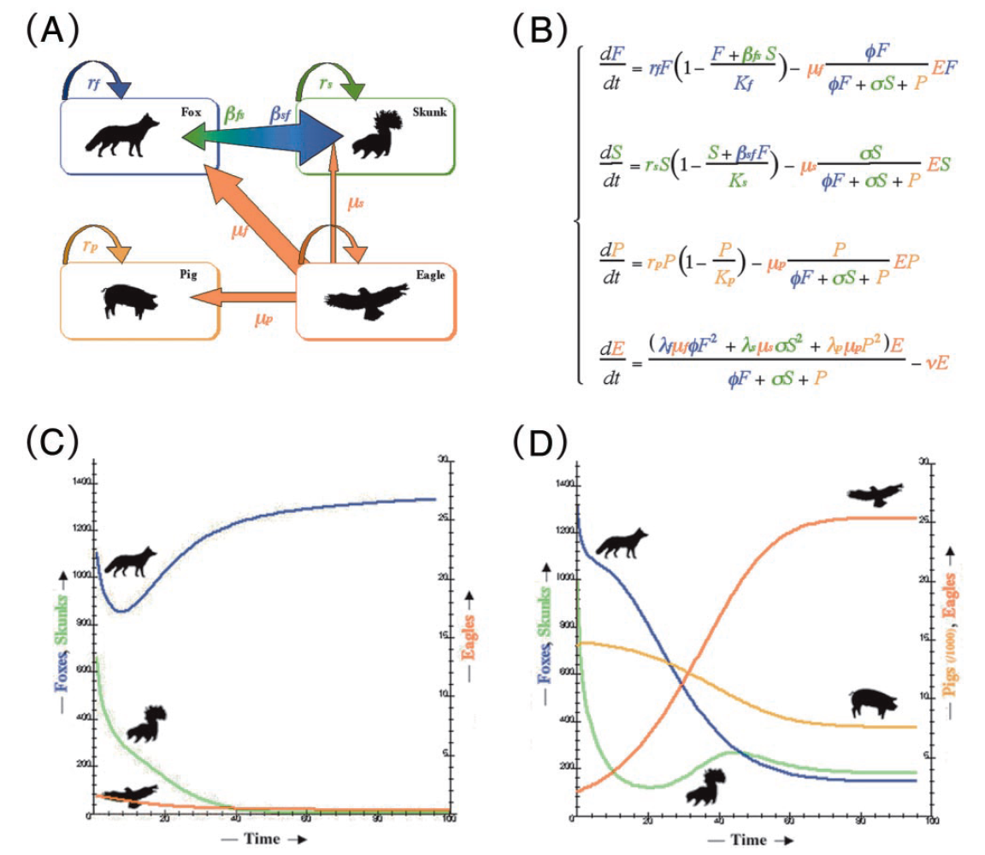
A simple multispecies model
Multispecies equations
Channel Islands: introduced feral pigs allowed golden eagles to establish and increase, greatly increasing predation (hyperpredation) on native foxes. Low fox numbers allowed competitively inferior skunks to flourish.
No pigs
Pigs
From Branch
Roemer, G.W., Donlan, C.J., and Courchamp, F. 2002. Golden eagles, feral pigs, and insular carnivores: How exotic species turn native predators into prey. Proc. Natl Acad. Sci. U.S.A. 99(2): 791-796.

Slide 7
Multispecies Models
Multispecies Yield-per-recruit (MSYPR)
These add technical interactions to YPR models.
Similar to YPR models, but effectively focus on bycatch, mixed species fisheries.

Slide 8
Multispecies Models
Multispecies Production Models
Non age-structured
Usually species interactions
e.g. add in terms for competition and predation to production model:
Gamble, R.J. and J.S. Link. 2009. Analyzing the tradeoffs among ecological and fishing effects on an example fish community: A multispecies (fisheries) production model. Ecol. Mod. 220: 2570-2582.

Slide 9
Multispecies Models
Multispecies Virtual Population Analysis (MSVPA)
Age structured assessments, linked with a predator-prey model

Slide 10
Stage-structured multispecies models
Like their single-species counterparts, these models include population structure such as age and/or length.
Species interactions can then be length or age dependent.
More realistic, big fish eat small fish….
The focus of these models has primarily been on trophic interactions.
Predation mortality
Prey-dependent growth largely not included.

Slide 11
Stage-structured multispecies models
Modeling predation via M2
M2 essentially treated as another fishing fleet, but with functional response replacing selectivity.

Slide 12
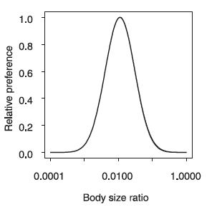
Modeling predation mortality
Size-based approaches (e.g. Hall et al. 2006)
Take advantage of scaling relationships associated with growth, consumption, and size ratios between predator and prey species.
Dramatically reduces number of parameters
Alternative is to estimate functional response parameters based on stomach contents data
Ration can be derived from growth curve, or a function of covariates.
Require ‘other food’ component.
Hall et al. (2006)

Slide 13
Structure of MSVPA Model
Suitability
Parameters
Diet Data
Consumption = Predator BM * %DR
Other Food
P_{prey} = (Suitable Biomass)_{prey} / Total Suitable Biomass
M2_{age}
C_{prey} = Consumption * P_{prey}
M2_{prey} = C_{prey} / BM_{prey}
BM_{age}
BM_{age}
BM_{age}
BM_{age}
BM_{age}
Other
Predators
Single Species VPA
Adapted from Garrison et al.

Slide 14

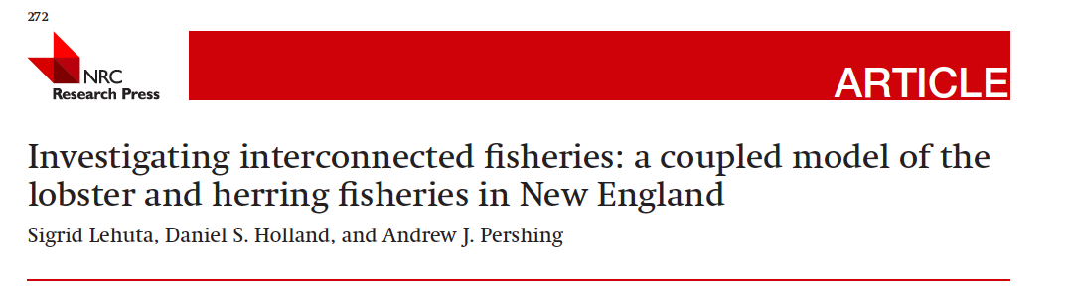
Multispecies Models
Bioeconomic Models
Explore tradeoffs among species interactions and value of different stocks simultaneously.

Slide 15
Minimal Realistic Models a.k.a. Models of Intermediate Complexity
Objective of these models is to consider the interactions among a small number of species and components.
Focus on ‘key’ system properties/components relevant to the research or management questions.
May include a suite of model types for each component.
Statistically estimate model parameters using data similar to single-species models.

Slide 16
Barents Sea Minke Whales-Cod-Capelin EXAMPLE
Several models:
GADGET,
BORMICON,
MULTSPEC, etc.
Explores tradeoffs among 4 main species interactions.
Environment and fishing contrasted.
Bogstad, B., Hauge, K. H., & Ulltang, Ø. (1997). MULTSPEC–a multi-species model for fish and marine mammals in the Barents Sea. Journal of Northwest Atlantic Fishery Science, 22(317-341), 1-1.

Slide 17
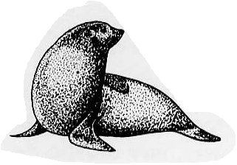
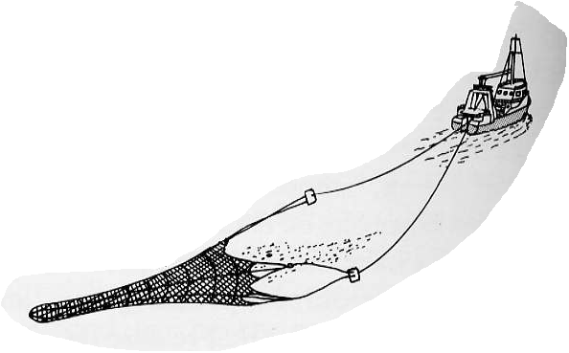
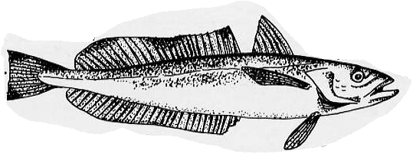
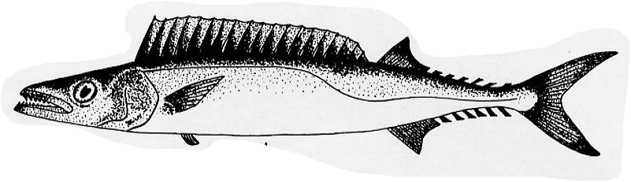



The South African Seal-Hake “Minimal Realistic Model”
Punt, A. E., & Butterworth, D. S. (1995). South African Journal of Marine Science, 16(1), 255-285.
Model Structures and
Management Systems
Management
Cull scenarios
Age-; sex-
structured
Catches
Fixed F
Species-; age-
structured
Delay-difference
A.E. Punt

Slide 18
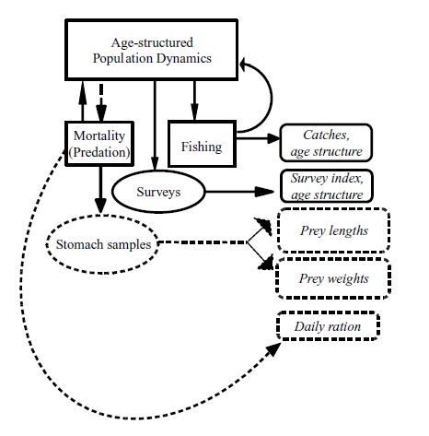
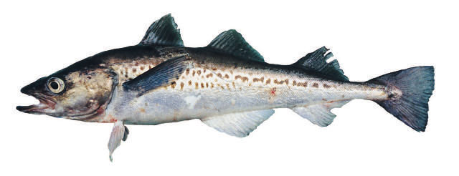

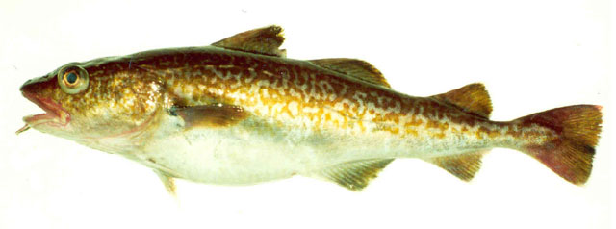
MICE example, a multispecies statistical catch-at-age model
Simultaneous stock assessments of multiple species fitted to numerous data, including diet information.
e.g. Aleutian Islands groundfish fishery.
Walleye pollock, Atka mackerel, and Pacific cod interact as predators and prey.
Kinzey & Punt (2009) Multispecies and single-species models of fish population dynamics: comparing parameter estimates. Natural resource modeling 22: 67-104.

Slide 19
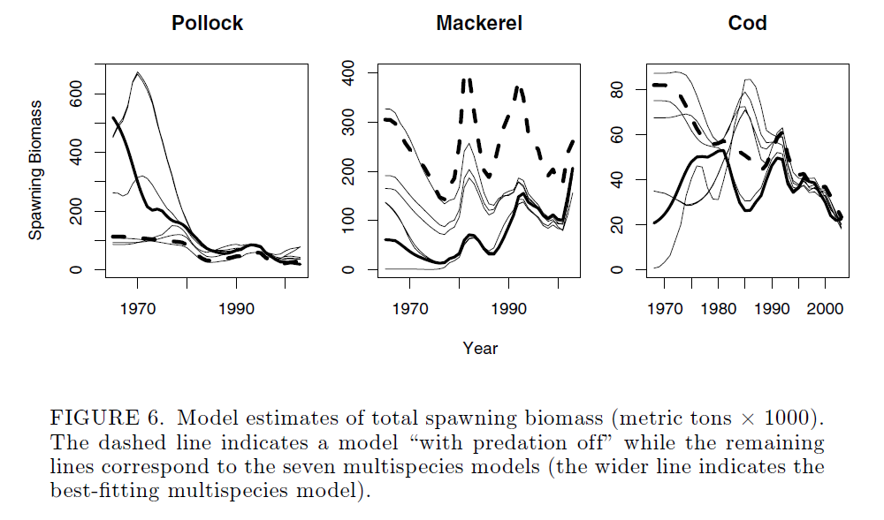
Multispecies statistical catch-at-age models
Again, outputs can differ substantially from single-species models.
Models sensitive to form of functional response.
Kinzey & Punt (2009) Multispecies and single-species models of fish population dynamics: comparing parameter estimates. Natural resource modeling 22: 67-104.

Slide 20
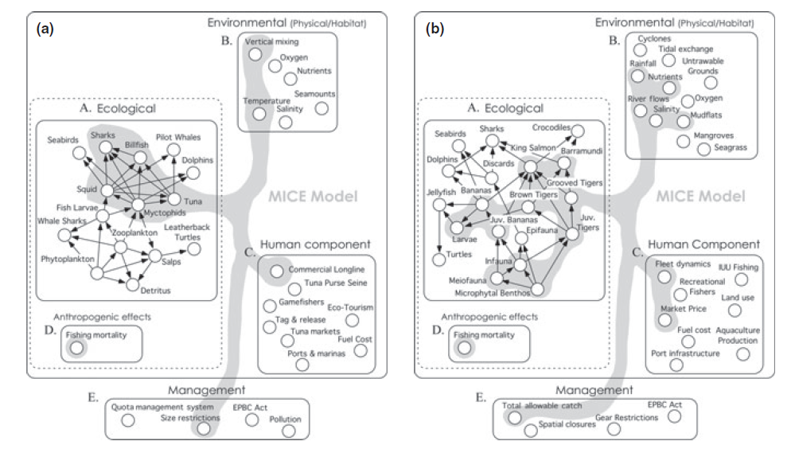
Models of Intermediate Complexity can address other system components
Plagányi et al. (2014) Multispecies fisheries management and conservation: tactical applications using models of intermediate complexity. Fish and Fisheries. doi: 10.1111/j.1467-2979.2012.00488.x

Slide 21
Estimating parameters
Previous models require typical stock assessment data, plus either:
Assumptions about ecological relationships
Stomach contents data
Alternative approaches to estimating parameters for multispecies models are less mechanistic:

Slide 22
Empirical multispecies models e.g. multivariate autoregressive (MAR) models
Take the form
B matrix can be VERY big
Simplified dynamics
Estimating parameters is often non-trivial
BUT, statistical machinery exists.
e.g. MARSS package in R (now a TMB version)
e.g. Ives et al. 2003 Ecol. Monographs, Holmes et al. 2012. R journal.

Slide 23
Challenges with multispecies reference points
Recall logistic growth model
Add single competitor
MSY now dependent on biomass of other species.
Sometimes possible to solve system of equations to obtain maximizing population state vector.
Implies a decision about what is the ‘right’ population size for other species.
1

Slide 24
Best practices in model development (FAO 2007, Fulton 2010)
Only include components needed for capturing critical dynamics
Important to explicitly include feedbacks
Address uncertainty: parameterization, model structure, associated requirements to try multiple management options
Across all the dimensions of model construction do not default to the finest scales, often inappropriate and unnecessary.
Spatial and temporal resolution
Taxonomic resolution
Process resolution and external forcing
Anthropogenic components
Multiple model forms should be considered. There is no one “right” model

Slide 25
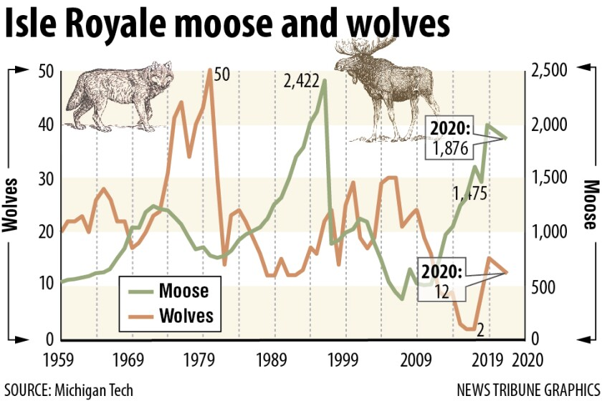
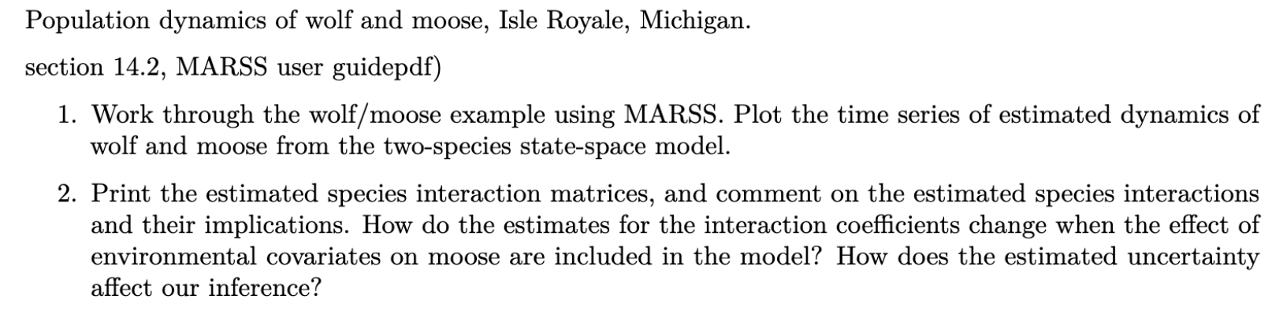
MARSS example: Isle Royale Wolves & Moose

Slide 26
MARSS user guide
https://cran.r-project.org/web/packages/MARSS/vignettes/UserGuide.pdf
MARSSTMB getting started
https://atsa-es.github.io/marssTMB/

