Slide 1
MAR 580: Advanced Population Modeling for Management of Living Marine Resources
RTMB Session III: State-space models
30 September 2025

Slide 2
Review
Mixed effects models

Slide 3
Process error
Most of the estimation models we have discussed so far have been measurement error models
Deterministic population dynamics
Variation solely due to observation error
Our modeled observation error can account for multiple effects:
sampling error
Random variation in availability to sampling gear
But, it is reasonable to assume that additional sources of variability in dynamics occur. e.g.
Stochastic variability in births/deaths,
Environmental drivers on growth, recruitment, etc.
This variability in the population dynamics process is termed ‘process error’.

Slide 4
Process error modeling in fisheries
Measurement OR Process error estimators
Total error estimators (errors in variables models)
e.g. linear model: error in both the X’s and the Y’s
Penalized likelihood models
Penalty added to likelihood function that describes the deviation of a parameter from distribution, estimated like a normal parameter.
e.g. recruitment deviations around a stock-recruit curve.
Most modern statistical stock assessment models use this approach to obtain MLEs (integration over the random effects is achieved when doing Bayesian estimation).
State-space models
Formally account for both process and observation error.
Reading: Comparing among error models, Punt (2003)

Slide 5
State-space models
Special case of mixed-effects models
As with mixed-effects models, the aim is to partition variance.
Two discrete time processes running in parallel.
State process model
Observation model

Slide 6


State-space modeling, hidden process
Observations
Fish population
?
Time
t = 0
t = 1
t = 2
t = 3

Slide 7
State-space modeling, hidden process
Observations
Fish population
?
Time
t = 0
t = 1
t = 2
t = 3

Slide 8
State-space modeling, hidden process
We are interested in separating variability associated with population process from that due to the observations.
Observations
Fish population
?
Time
t = 0
t = 1
t = 2
t = 3

Slide 9
State-space model: exponential growth
State process model
Observation model

Slide 10
State-space model: exponential growth
State process model
Observation model
Population size at time t
Process error variance
Annual deviation in population growth, process error
Population growth rate

Slide 11
State-space model: exponential growth
State process model
Observation model
Population size at time t
Process error variance
Annual deviation in population growth, process error
Population growth rate
Constant relating population size to observed values
Observation error variance
Observationat time t
Observation error residual

Slide 12
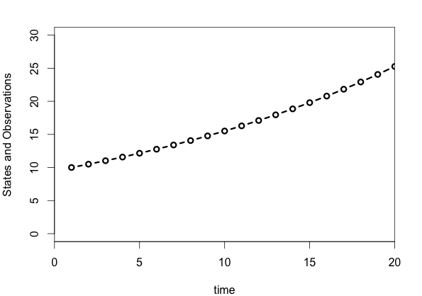
State-space models: exponential growth
Lamda = 1.05, tau=2, sigma=4, n0=10
Deterministic dynamics

Slide 13
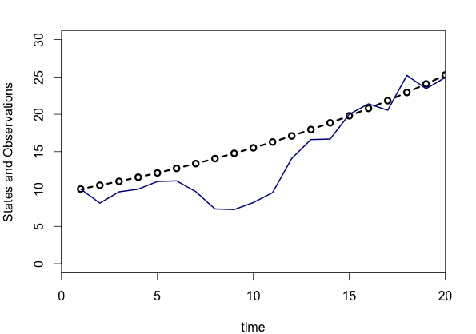
State-space models: exponential growth
Lamda = 1.05, tau=2, sigma=4, n0=10
Process error, one realization

Slide 14
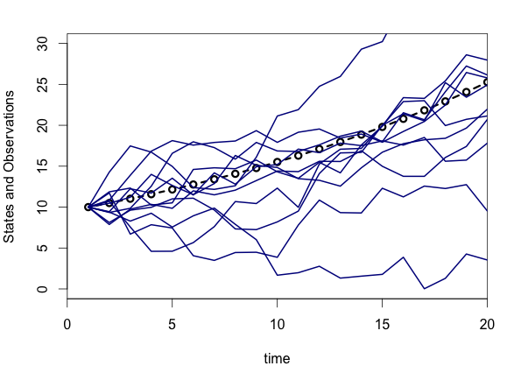
State-space models: exponential growth
Lamda = 1.05, tau=2, sigma=4, n0=10
Process error, 10 realizations

Slide 15
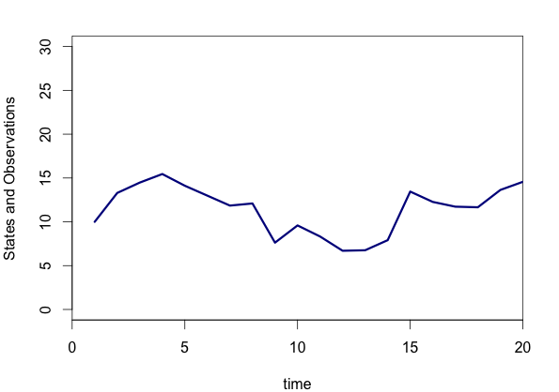
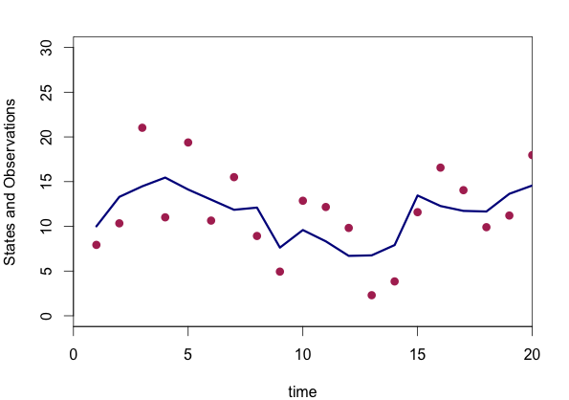
State-space models: exponential growth
Lamda = 1.05, tau=2, sigma=4, n0=10
Observations around the process
We might be interested in estimating the values for these parameters!

Slide 16
State-space models, more generally
Process and Observation modeled as conditional probability density functions.
State process model describes change in state vector from time t-1 to t.
Observation model relates the state to the observed data, given values for the states.
are the model parameters.
We also need the initial state,

Slide 17
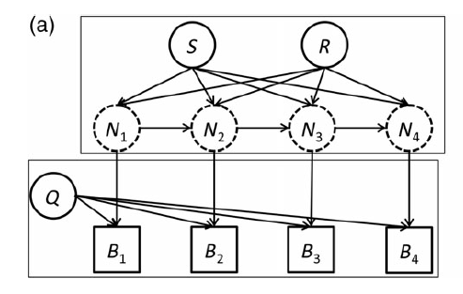
Relationship between models and parameters
Thorson & Minto (2015)

Slide 18
Inference for state-space models
Joint distribution for the observations and states:
Probability of the initial state.
Product over time steps t=1 to t=T.
Probability of state at time t conditional on state at time t-1 and the parameters of the state process model.
Probability of the observation at time t conditional on the state at time t and the parameters of the observation model.

Slide 19
Inference for state-space models
Joint distribution for the observations and states:
We are interested in the marginal distribution of the observations,
Likelihood of the parameters given the data from time t=1 to time=T.
Maximum likelihood estimates for the model parameters

Slide 20
Inference for state-space models
Joint distribution for the observations and states:
We are interested in the marginal distribution of the observations,
As before with mixed-effects models, we achieve this by integrating out the states in the joint distribution.

Slide 21
Estimating state-space models
Various methods exist for obtaining the (log) likelihood, and then to maximize it.
Kalman filter (Kalman, 1960)
Seminal work, for linear state and observation models when process and observation errors are Gaussian.
Additional filters relaxing some assumptions
(Extended Kalman filter, unscented Kalman filter, etc.)
Expectation-Maximization (EM) algorithm
Laplace approximation (e.g. TMB)
Importance sampling
Estimation can also be achieved in a Bayesian framework. (e.g. with Markov Chain Monte Carlo)

Slide 22
Estimating state-space models in RTMB
Take advantage of the conditional distribution for the states:
i.e. make the state variables the random effects, e.g.
For a biomass dynamics model:
Conditioned on the biomass at the previous time step, this model is separable, i.e. ln(B_{t}) does not depend on ln(B_{t-2}).

Slide 23
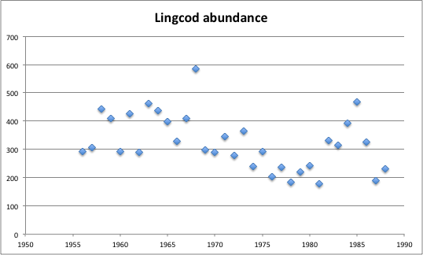
Linear state-space production model
The Gompertz population dynamics model:
Similar to other models, except density dependence is on ln(B) rather than B.
Application to lingcod survey data (Schnute 1994)
Schnute, J. T. (1994). A general framework for developing sequential fisheries models. Canadian Journal of Fisheries and Aquatic Sciences, 51(8), 1676-1688.

Slide 24
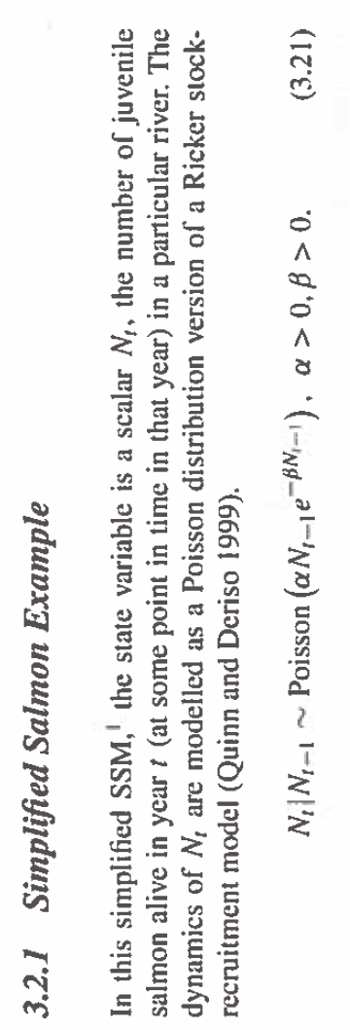
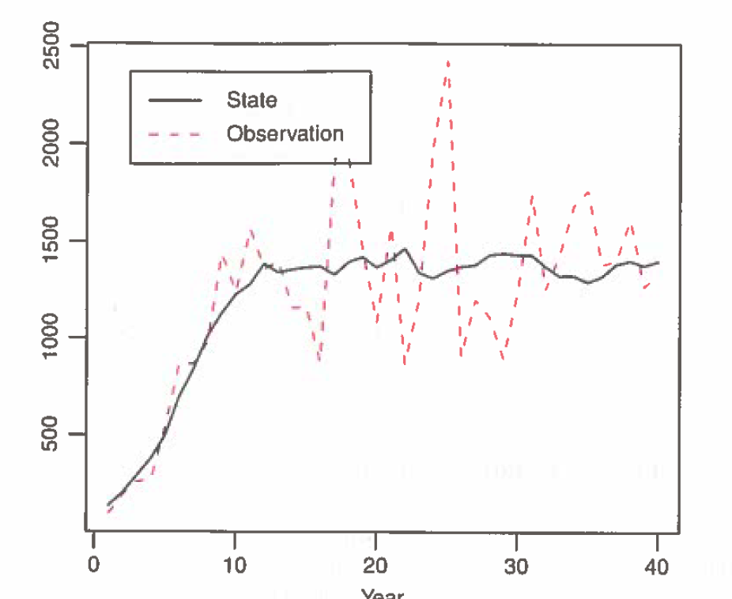
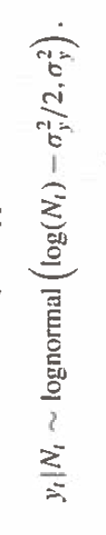
Coho Ricker model (Chaps 3 & 4)
0 < alpha < 2

Slide 25
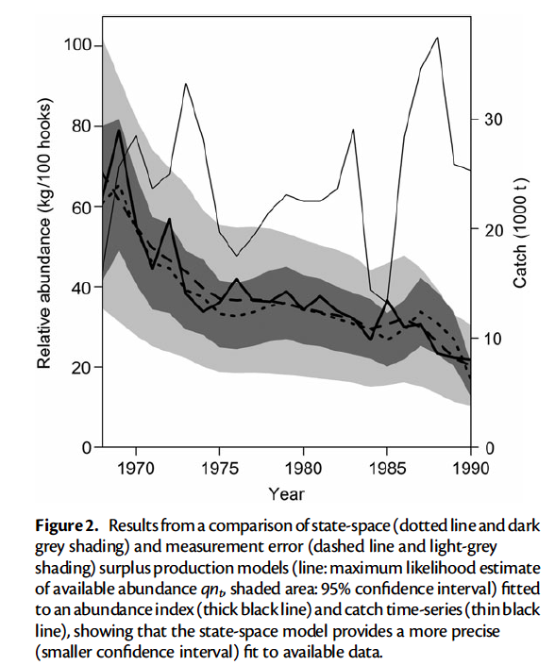
Non-linear state-space production model
Thorson & Minto (2015)
State-space Schaefer production model fitted to tuna data from Meyer & Millar (1999).

Slide 26
Take homes
State-space approach provides robust framework for simultaneously considering uncertainty associated with population processes and observations.
Increasingly being used for management advice.(e.g. SAM, age-structured state-space fisheries model (Nielsen & Berg 2014) ).
Readily handles missing data.
Easy to extend the univariate models considered here:
Multiple state variables for population stages
Parameters or environmental covariates modeled as state variables, and include process model for these.
Hierarchical approach to share information among time series (e.g. common trends, Dynamic Factor analysis)

Slide 27
Recommended Reading
de Valpine, P., & Hastings, A. (2002). Fitting population models incorporating process noise and observation error. Ecological Monographs, 72(1), 57-76.
Harvey, A. C. (1990). Forecasting, structural time series models and the Kalman filter. Cambridge university press.
Holmes, E. E., Ward, E. J., & Wills, K. (2012). Marss: Multivariate autoregressive state-space models for analyzing time-series data. The R Journal, 4(1), 11-19.
Kalman, R. E. 1960. A new approach to linear filtering and prediction problems. Transactions of the ASME–Journal of Basic Engineering 82(Series D): 35–45.
Meinhold, R. J., & Singpurwalla, N. D. (1983). Understanding the Kalman filter. The American Statistician, 37(2), 123-127.
Nielsen, A. and Berg, C. W. 2014. Estimation of time-varying selectivity in stock assessments using state–space models. Fisheries Research 158(1):96–101.
Newman, K. B., Buckland, S. T., Morgan, B. J., King, R., Borchers, D. L., Cole, D. J., ... & Thomas, L. (2014). Modelling Population Dynamics. Springer.
Pedersen, M.W., Berg, C.W., Thygesen,U. H., Nielsen, A., and Madsen, H. 2011. Estimation methods for nonlinear state-space models in ecology. Ecological Modelling, 222: 1394–1400.
Punt, A. E. (2003). Extending production models to include process error in the population dynamics. Canadian Journal of Fisheries and Aquatic Sciences, 60(10), 1217-1228.
Schnute, J. T. (1994). A general framework for developing sequential fisheries models. Canadian Journal of Fisheries and Aquatic Sciences, 51(8), 1676-1688.
Thorson, J. T., & Minto, C. (2015). Mixed effects: a unifying framework for statistical modelling in fisheries biology. ICES Journal of Marine Science: Journal du Conseil, fsu213.

