Slide 1
MAR 580: Advanced Population Modeling
Including covariates in stock assessment models
18 November 2025

Slide 2
Objectives
Including ecosystem covariates in stock assessment models
Approaches
Processes of interest: Recruitment, Mortality, Growth, Catchability
Do we already have this covered?
Time-varying parameters in stock assessments
Challenges with reference points
Exercise / example
Dynamic reference points for Atlantic herring

Slide 3
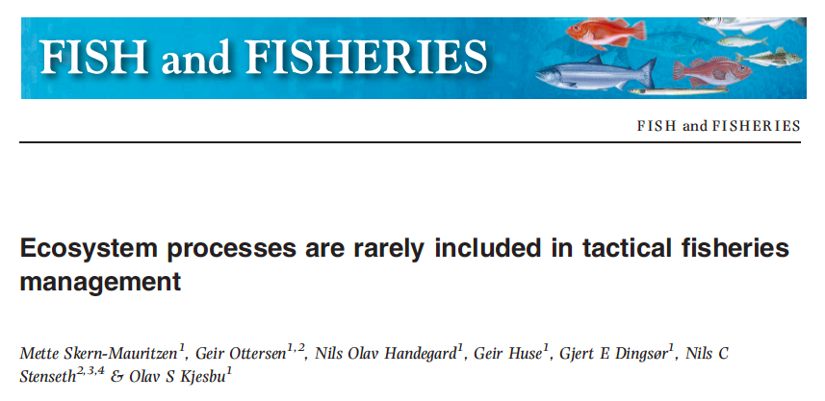
Rationale
here

Slide 4
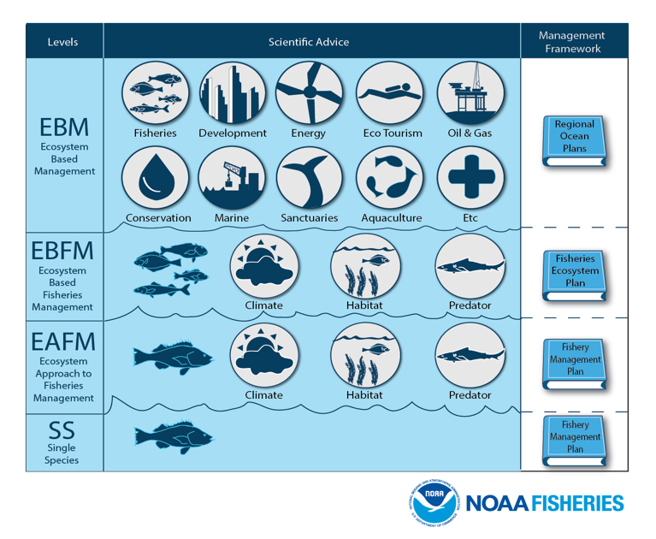
Ecosystem processes in single species models
Ecosystem Approach to Fisheries Management
Terms in literature.
Extended stock assessment models
Assessment models with covariates
Single-species add-ons
Almost a false categorization, lots of assessments have been considering ecosystem variables for some time.
Frequently part of sensitivity tests and model diagnostic checks
e.g. do we have information that explains apparent changes in recruitment, surplus production, mortality, etc.?
Dolan et al. 2016

Slide 5
Ecosystem processes in single species models
Ecosystem Approach to Fisheries Management
Terms in literature:
Extended stock assessment models
Assessment models with covariates
Single-species add-ons
Almost a false categorization, lots of assessments have been considering ecosystem variables for some time.
Frequently part of sensitivity tests and model diagnostic checks
e.g. is there information that explains apparent changes in recruitment, surplus production, mortality, etc.?

Slide 6
Approaches
Including environmental variables
Effectively, including ‘ecosystem’ variables is saying you are willing to accept that population processes change over time / life history stage.
Time-varying parameters
The Question is how you implement this.

Slide 7
Single Species Models
Index-based methods
Equilibrium & Generation methods
Yield-Per-Recruit / Stock-Recruitment
Population dynamics models
Biomass aggregated models
e.g. production models
Stage-Structured models
Delay difference models
Age structured models
virtual population analysis, statistical catch-at-age
Size-based models

Slide 8
Extended Single Species Models
All of these models can be expanded to include ecosystem processes.
e.g. adding in predation:
Z = F + M
Z = F + M1 + M2 + ….
Predation treated as another “fleet”
adding in other effects:
Stock-recruitment relationship
Productivity
Model covariates on life history parameters

Slide 9
Modifying the Graham-Schaefer production model (logistic growth)
Make parameters time-varying or functions of environment / other species

Slide 10
Modifying the basic age-structured model
Spawner-recruit function
Make parameters time-varying or functions of environment / other species

Slide 11
General approaches (1.)
Modify assessment model parameters as a function of environmental variables (Maunder & Watters 2003).
I_{i,t} are the environmental variables influencing parameter θ,
β is coefficient that relates the environmental variable to the assessment parameter,
ε is a process error.
β’s & ε’s would be estimated within the stock assessment.
θ could be any parameter (or a derived quantity, e.g. expected recruitment) that that was hypothesized to have temporal variation and be correlated with an environmental time series.

Slide 12
General approaches (1.)
Modify assessment model parameters as a function of environmental variables (Maunder & Watters 2003).
I_{i,t} are the environmental variables influencing parameter θ,
β is coefficient that relates the environmental variable to the assessment parameter,
ε is a process error.
β’s & ε’s would be estimated within the stock assessment.
Note that setting β to 0 and estimating the ε’s assumes purely stochastic variation in θ.

Slide 13
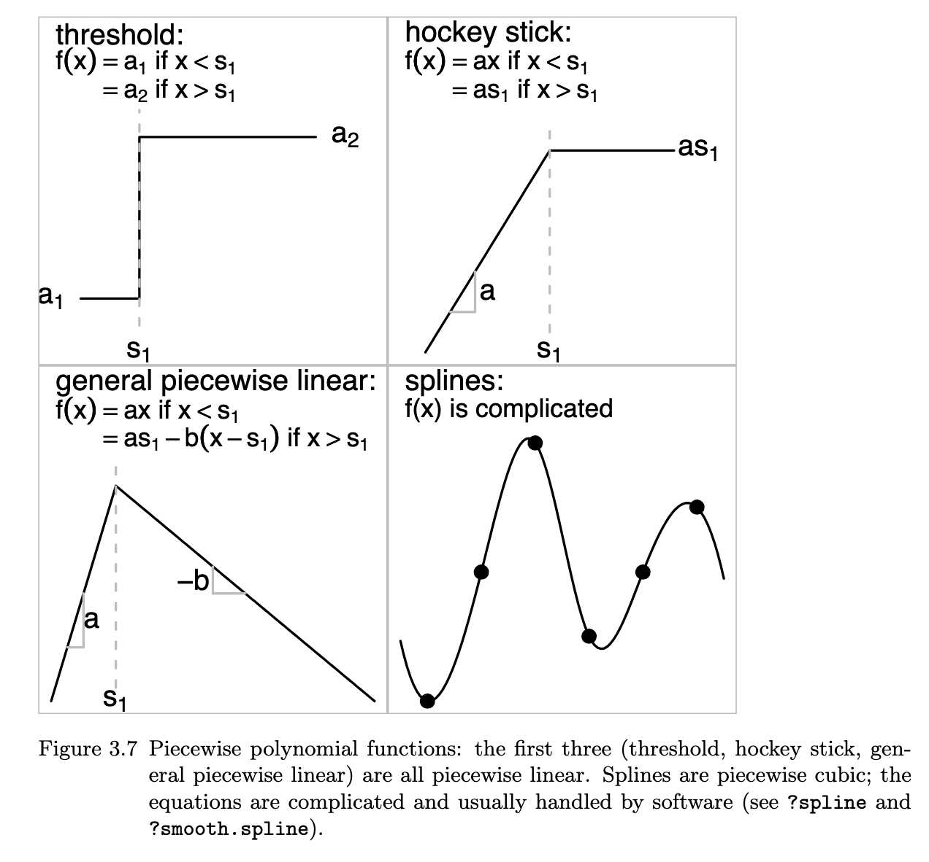
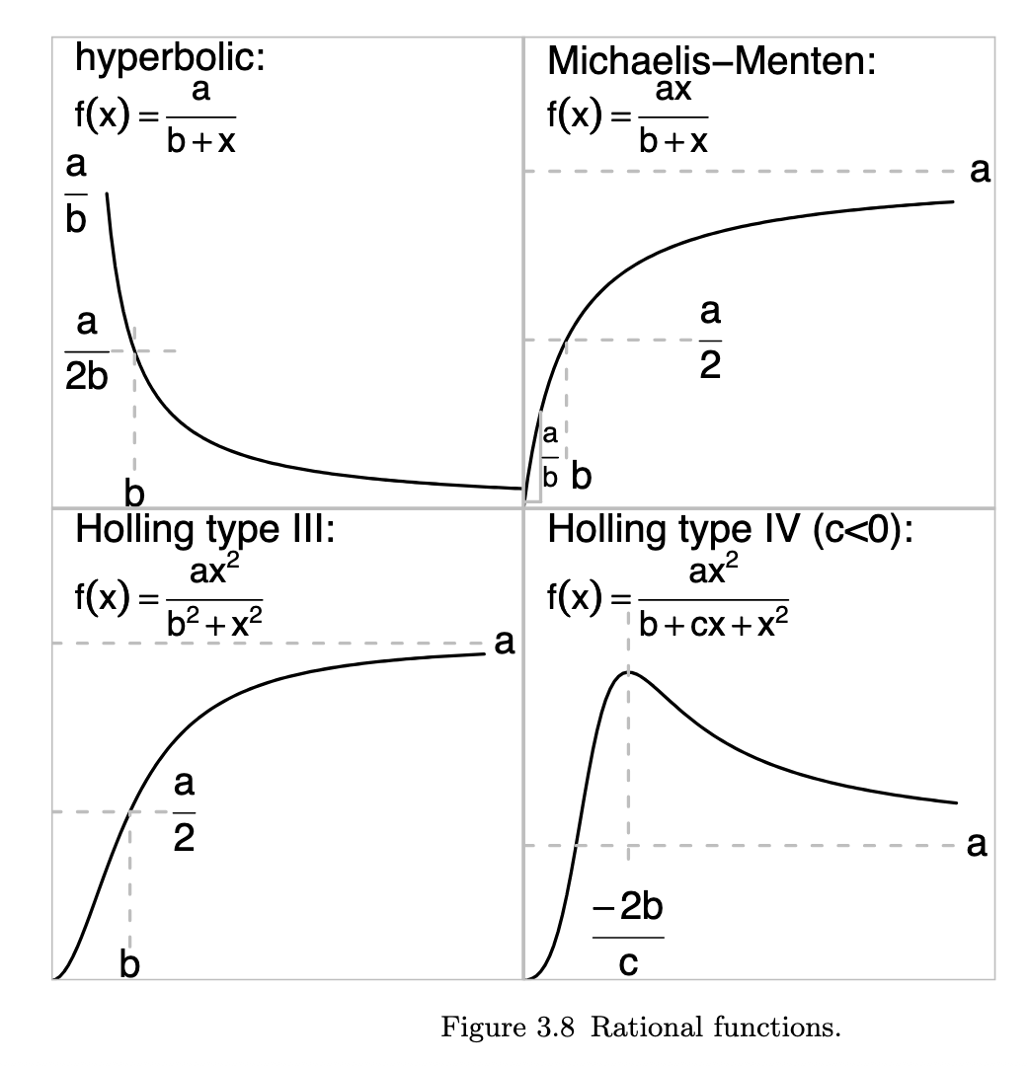
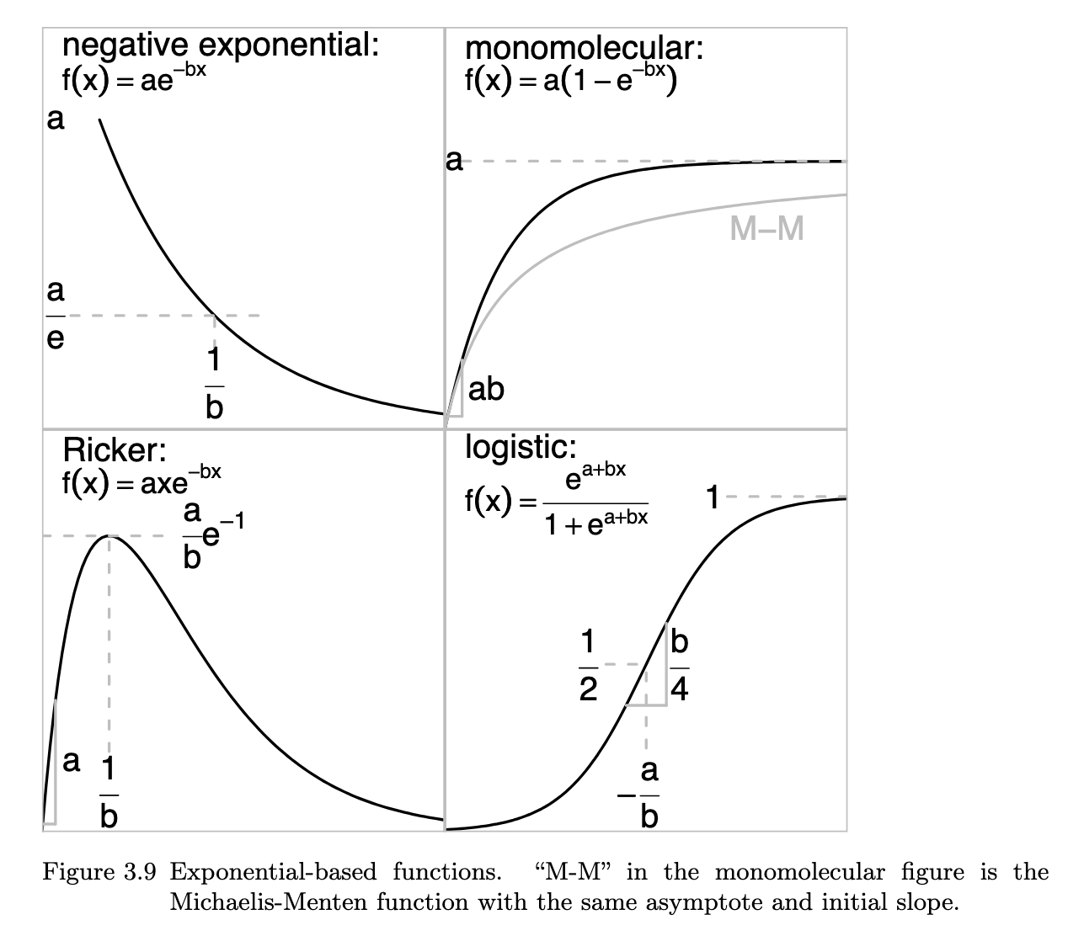
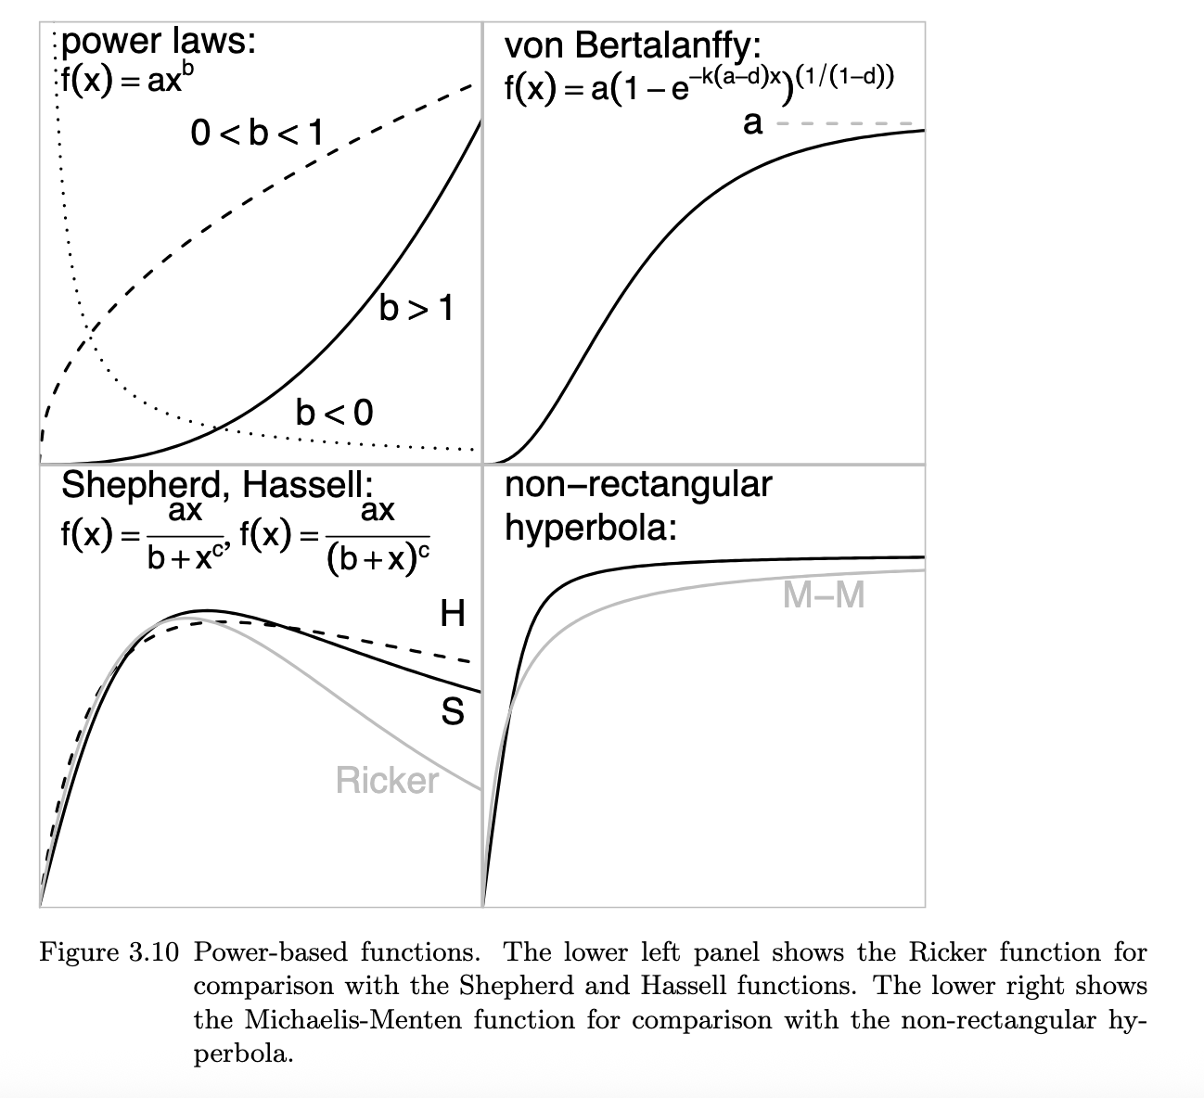
Choice of functional forms (see Bolker 2008 C3)

Slide 14

e.g. Recruitment
Ricker stock-recruit relationship
Recruitment is the most common process for which environmental correlation has been modeled in fisheries.
The identification of correlations between environmental variables and recruitment and subsequent assessment modeling is often revisited frequently (e.g. Pacific sardine).

Slide 15
General approaches (2.)
“Environment as data”
Assume that the environmental variable is an observation ‘index’ of the state variable, treated as a survey and included in the likelihood function. (Brandon 2007)
The index is fitted to along with the rest of the assessment data - does not assume that environmental variable is measured without error.
Typically has been done with recruitment (environment treated the same as an age-0 survey). In principle could apply to any state variable.

Slide 16
General approaches (3.)
“Environment as data & covariate”
Include an environmental-dependent relationship in model predictions (as for 1).
Assume that the environmental variable monitored is an observation of the latent environmental process influencing the population. Include an observation model in the likelihood (e.g. Xu et al. 2017, Miller et al. 2016)
Allows for comparison of mechanistic effects of environment on population dynamics.
The environmental index is fitted to along with the rest of the assessment data - does not assume that environmental variable is measured without error.
(facilitated by the state-space modeling approach)

Slide 17
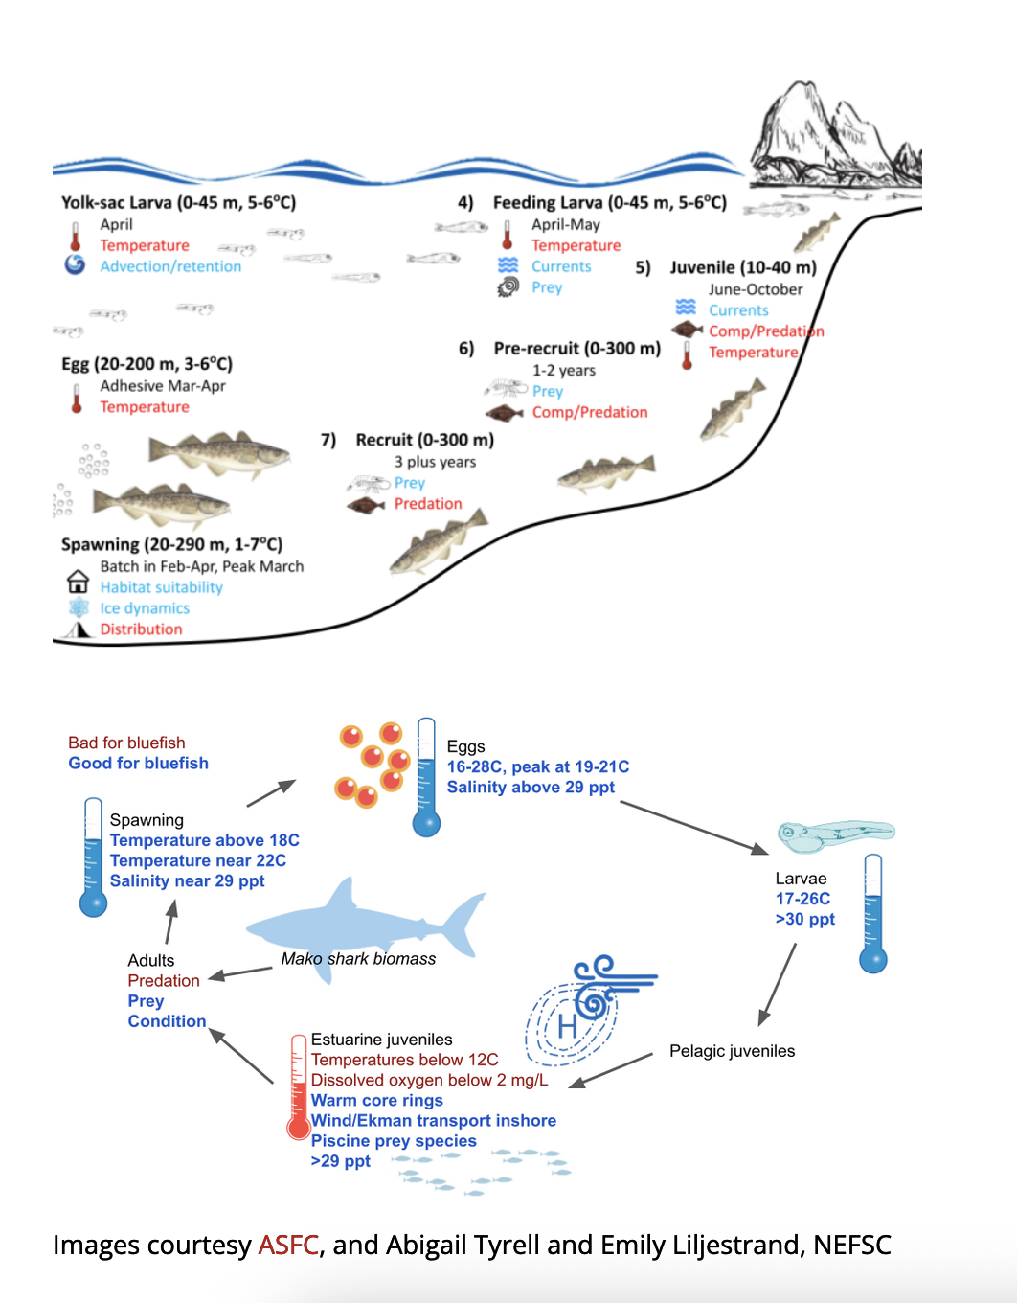
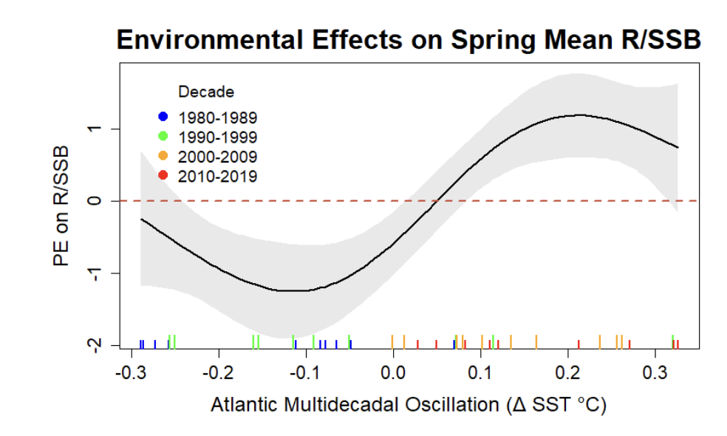
Identifying candidate covariates Conceptual modeling, Correlation analysis
Assemble plausible set of environmental covariates
Regression modeling to identify relationships, e.g. American Plaice (Behan & Kerr)

Slide 18
General approaches (4.)
“Predation as a fishery”
Partition mortality to include mortality from predators.
Z_{a,t} is total mortality,
M_{j,t} is the mortality from predator j,
s_{j,a} is the relative mortality from predator j on age a.
Requires an estimate of ‘removals’ by the predators.
Consumption can be estimated numerous ways.

Slide 19
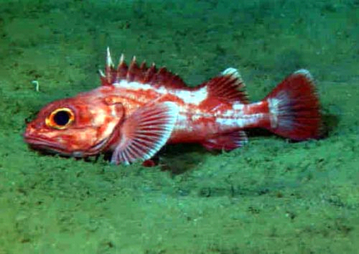
Adding Predation Longspine thornyhead, U.S. West Coast
Survey biomass estimates for longspine showed increasing trend
Assessment model with fixed M unable to capture increasing trend.
Sablefish and Shortspine prey heavily on Longspine
Biomass of both predators had declined substantially.
Including biomass of sablefish as a factor controlling the value of M improved model fit.
Fay & Field (2006) Pacific Fishery Management Council

Slide 20
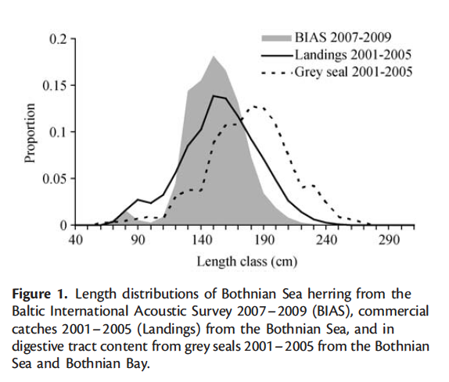
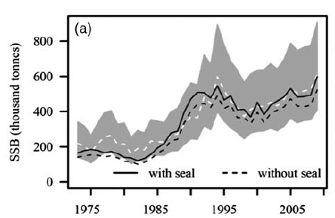
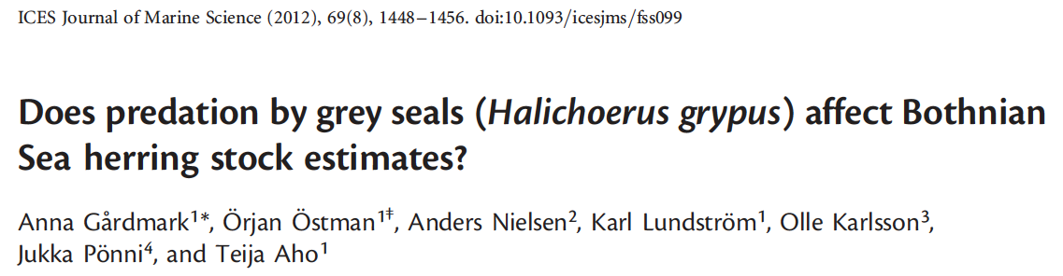
Modeling herring consumption by seals
here

Slide 21
Do we already have this covered?
Stock assessment models implicitly include the environment, often it is ‘averaged’ out by assuming stationary processes.
This might be OK if relative importance is low and/or there is no long-term change.
Uncertainty in magnitude and functional form of effects can mean simple approaches perform as well or better (e.g. Basson 1999).
Habitat related environmental variables often included in index standardization methods.
Annual recruitments are typically estimated as model parameters.
Younger year classes are (often) the most vulnerable to predation, environmental variability.
If these processes occur pre-recruitment to the fishery we will likely not have data and assessments can ‘soak up’ this variability in recruitment estimates / process error.
Environmental correlations have often been known to ‘break down’ after more data are collected.
Dangers of spurious relationships (Haltuch & Punt 2011)

Slide 22
Do we already have this covered?
Often modeling time-varying or age-varying parameters can do as well at estimating abundance and stock status as models that explicitly include/relate these changes to the environment or predators.
This is because our assessment data is (possibly) informative about the effects of these processes.
Year class strength & mortality reflected in age structure.
Growth changes affect size at age data.
Direct estimates of mortality (e.g. from tagging) may assist but intensive collection of these are less common.
Though note process error not sufficient to remove bias from trophic interactions (Trijoulet et al. 2020).

Slide 23
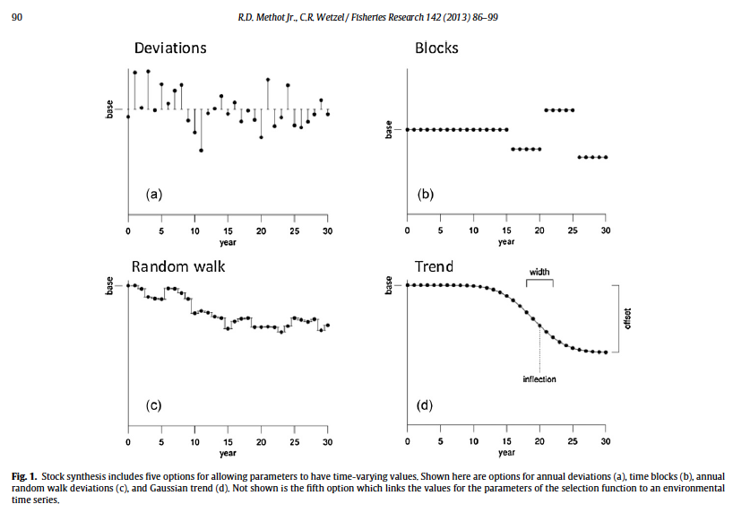
Time-varying parameters in assessment models
Many modern stock assessment software have multiple options for modeling time-varying parameters. Not all options require correlations with environmental variables.

Slide 24
Demographic processes
Growth
Use empirical weight at age to force accounting of changes (e.g. US/Canada Pacific hake assessment) This requires lots of data.
Model process error in growth curve parameters (e.g. adding a cohort effect on Von Bertalanffy k)
Natural Mortality
A multitude of estimators for relating M to body size, temperature, etc. (Pauly, Hoenig, Lorenzen, ….)
Coupling these approaches with expected changes in predation pressure can approximate mortality from more complex consumption estimators. (e.g. Atlantic Menhaden, Atlantic herring)

Slide 25
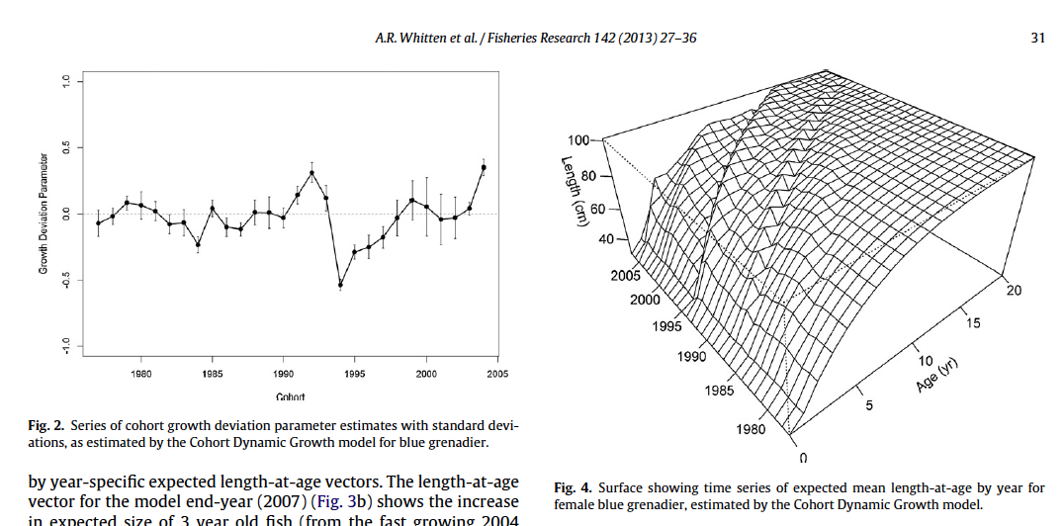
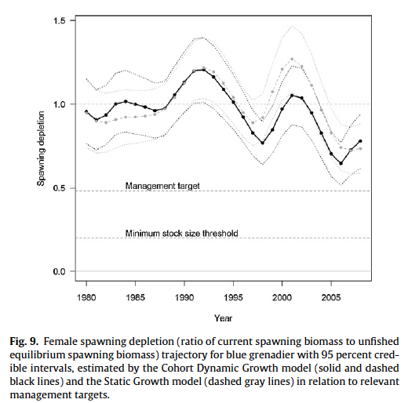

Southeast Australian blue grenadier assessment: stock status sensitive to inclusion of time varying growth.

Slide 26
Demographic processes
Growth
Use empirical weight at age to force accounting of changes (e.g. US/Canada Pacific hake assessment) This requires lots of data.
Model process error in growth curve parameters (e.g. adding a cohort effect on von Bertalanffy k)
Natural Mortality
A multitude of estimators for relating M to body size, temperature, etc. (Pauly, Hoenig, Lorenzen, ….)
Coupling these approaches with expected changes in predation pressure can approximate mortality from more complex consumption estimators. (e.g. Atlantic Menhaden, Atlantic herring)

Slide 27
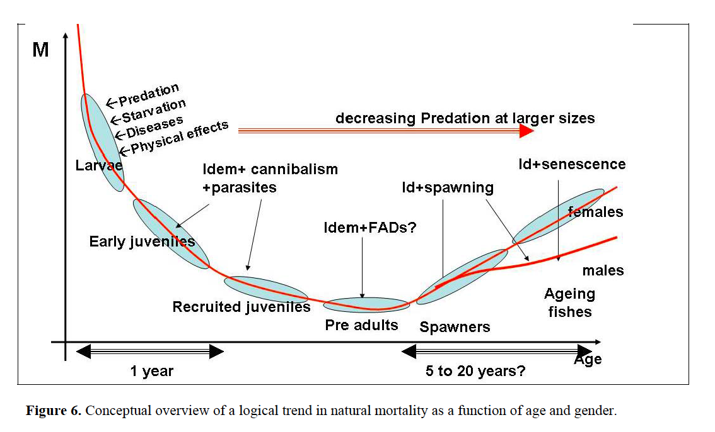
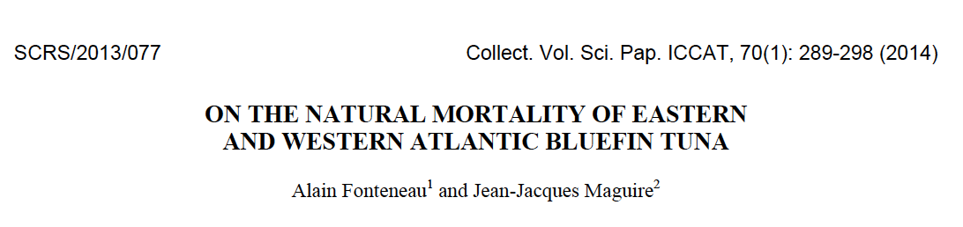
Sources of mortality likely to change throughout lifetime Relative influences may determine adequacy of ‘conventional’ approach

Slide 28
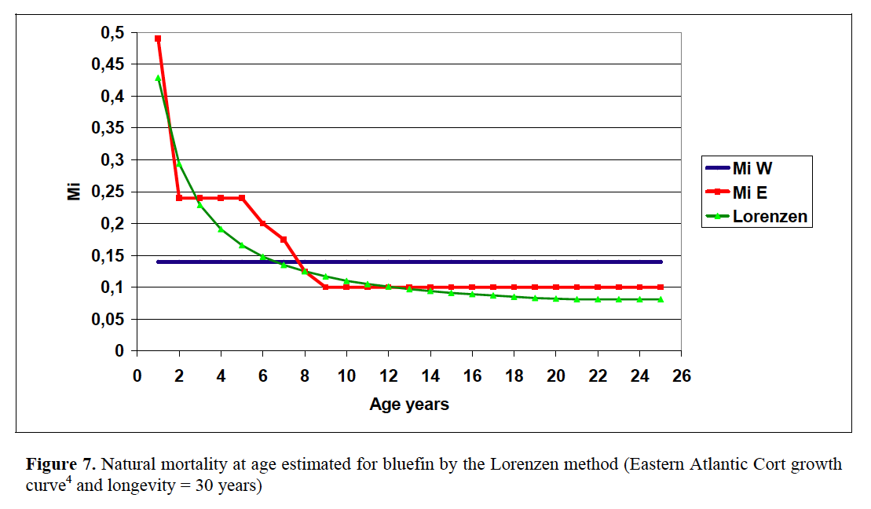
Age-varying M

Slide 29
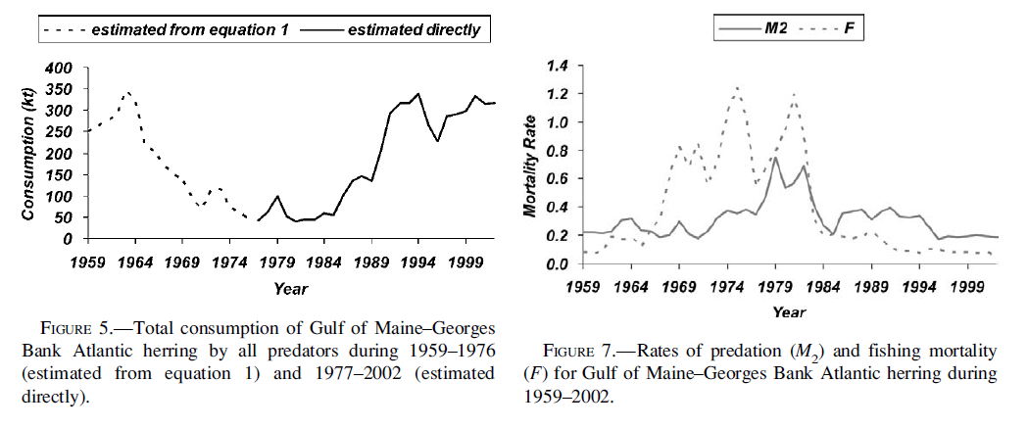
Gulf of Maine-Georges Bank Atlantic herring Estimates of mortality by explicit modeling of consumption
W. J. Overholtz , L. D. Jacobson & J. S. Link (2008): An Ecosystem Approach for Assessment Advice and Biological Reference Points for the Gulf of Maine–Georges Bank Atlantic Herring Complex, North American Journal of Fisheries Management, 28:1, 247-257
Overholtz & Link (2007) Consumption impacts by marine mammals, fish, and seabirds on the Gulf of Maine–Georges Bank Atlantic herring (Clupea harengus) complex during the years 1977–2002. ICES Journal of Marine Science, 64: 83–96.

Slide 30
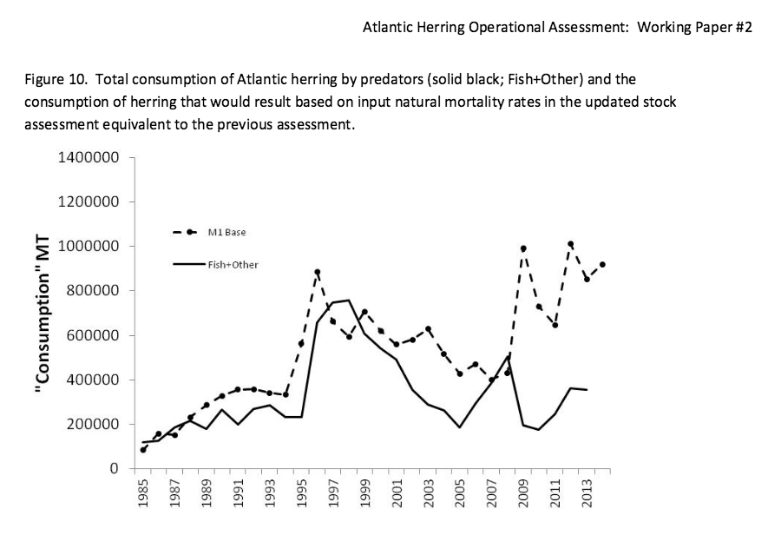
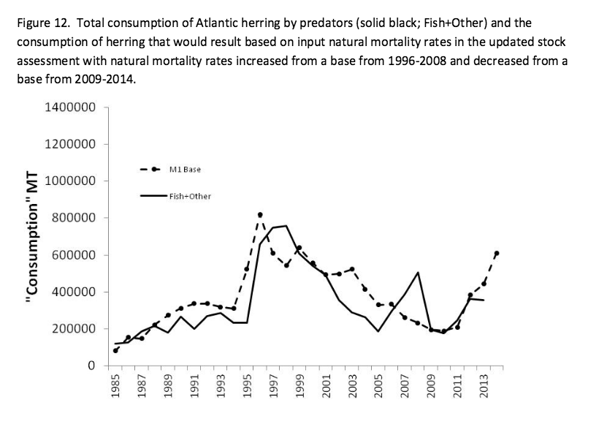
GoM-GB Atlantic herring assessment 2012 assessment changed to scaled Lorenzen approach 2015 operational update: alternative suggested Lorenzen mortality too high for consumption estimates.
Deroba, NEFSC (2015)

Slide 31
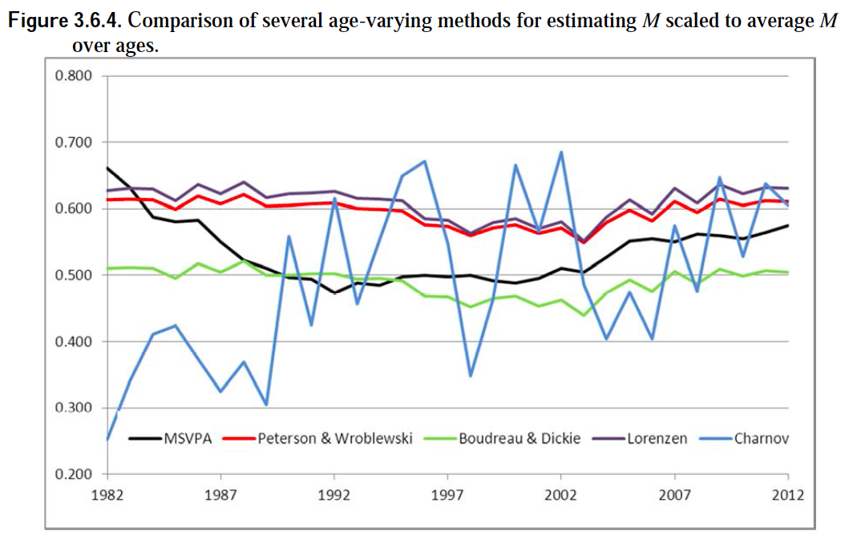
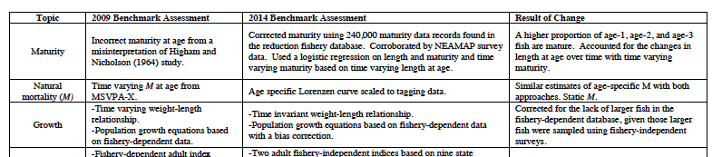

Atlantic Menhaden assessment (SEDAR 2014)

Slide 32
Some simulation studies on M
Biases induced by not accounting for age-variation in M are likely secondary to those caused by the misspecification of temporal trends.
More time should be dedicated to accounting for temporal shifts in M than accounting for age-variation in M.
The consequences of misspecification of M may also partially depend on life history.
(Deroba & Schueller 2013)
The most suitable approach to specifying M when it is thought to vary across time was to estimate M.
(Johnson et al. 2015)
Also see special issue of Fisheries Research on Natural Mortality from CAPAM workshop

Slide 33
But what about projections?
Where environmental correlations may be important is in forecasts/projections.
e.g.
Expectations for recruitment or growth under different climate scenarios.
Expected production given different levels of consumption by predators.

Slide 34
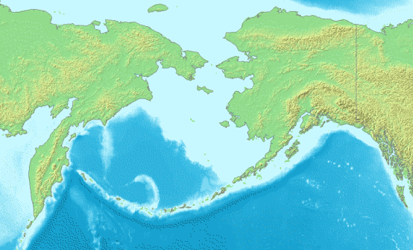

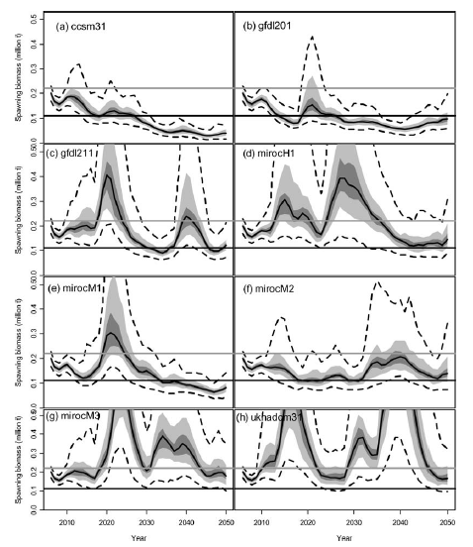

Climate effect on Recruitment Bering Sea Walleye pollock
Recruitment modeled as a function of a climate index.
Stock assessment model projections under different IPCC scenarios and fishing strategies.
Status quo management very sensitive to the IPCC model used.
A’mar, Z. T., Punt, A. E., and Dorn, M. W. 2009. The evaluation of two management strategies for the Gulf of Alaska walleye pollock fishery under climate change. – ICES Journal of Marine Science, 66: 1614–1632.

Slide 35
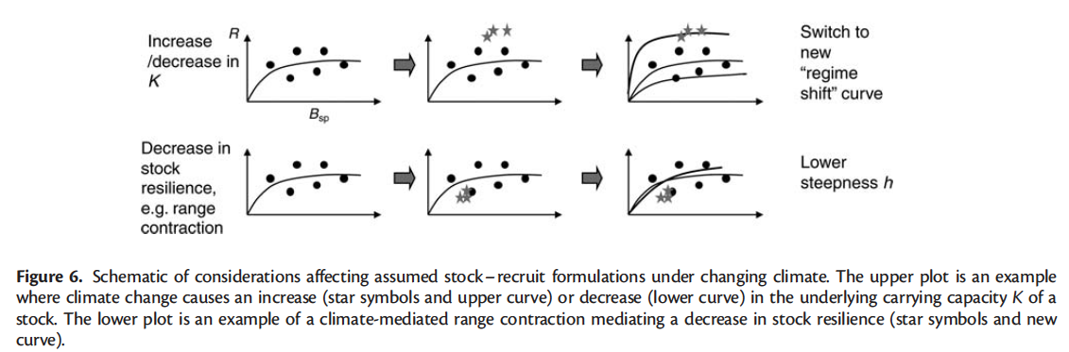
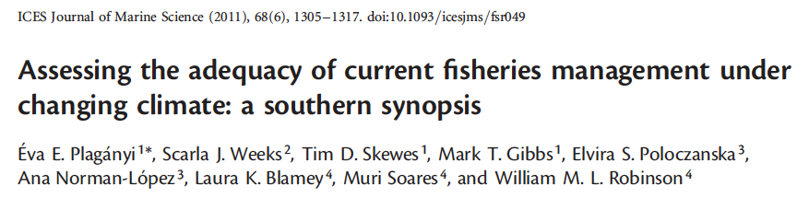
Changes in population forcing or characteristics may influence modeled relationships

Slide 36
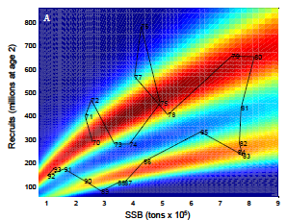
Nonstationarity and Reference points
Once we accept that we are in a world that changes, we have to make decisions about how to define reference points.
Specifically,
What set of conditions should reference points be based on?
How are these to be determined?
Should management reference points change with changing productivity? How fast? How important are timely forecasts for effective management?
Approaches include ‘dynamic B0’, moving window, regime shift analysis, and others.
After a time-period has been decided, the mathematical way in which reference points are implemented also has an influence.
e.g. spawner-per-recruit analyses vs total mortality
(Legault & Palmer 2015)
Munch et al. Environmental regimes and density-dependence: a Bayesian modeling approach for identifying recruitment regimes.

Slide 37
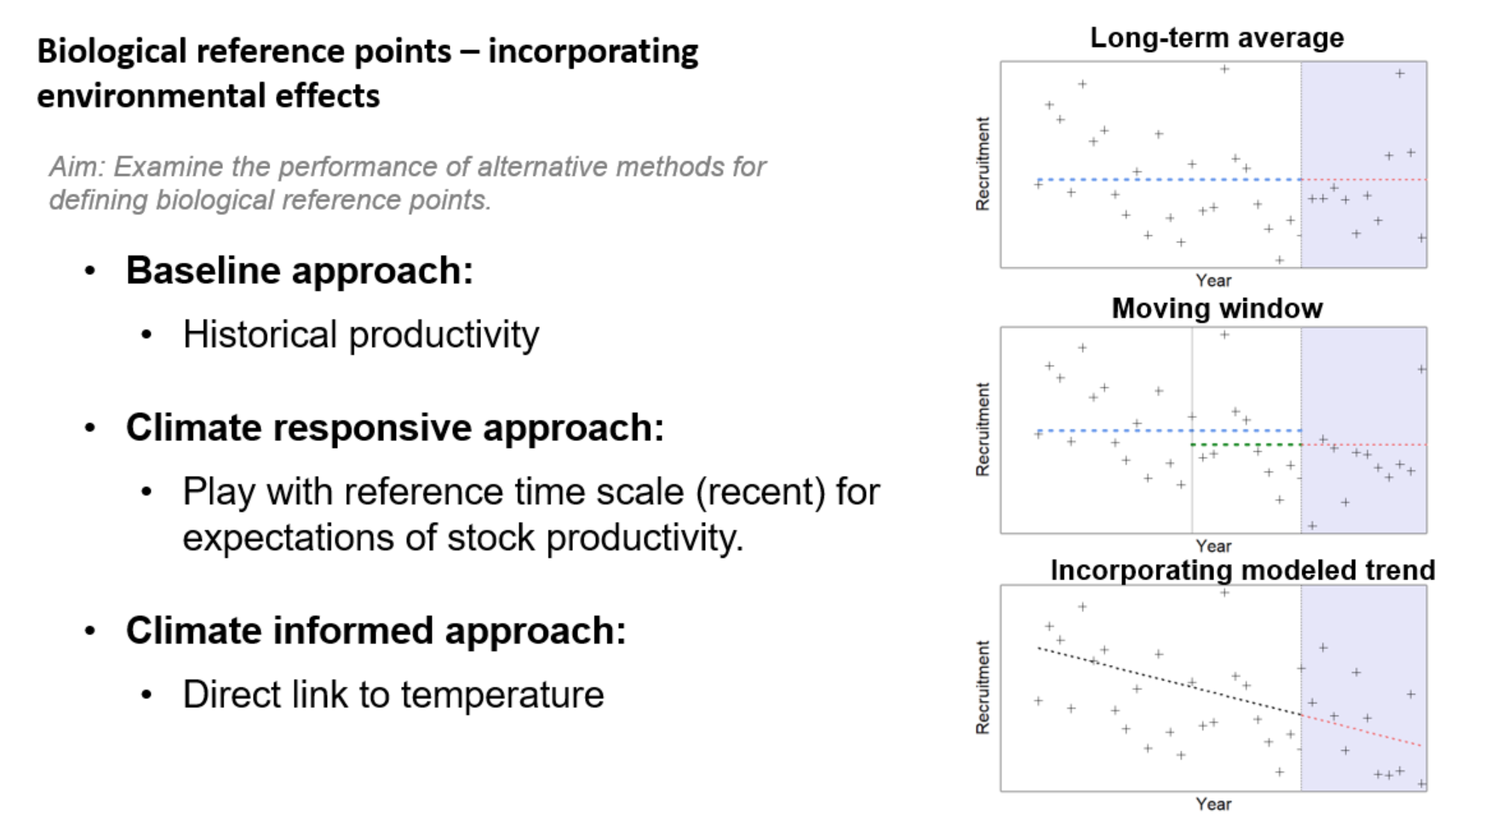
Modeling changing reference points, alternative time horizons

Slide 38
Dynamic B0 (MacCall 1985)
Provides an estimate of the size of the stock had fishing not occurred.
Estimate the parameters of the stock assessment model with the process error / environmental conditions etc. as usual.
Given the final parameter estimates, run the model over the historic period with catches set to zero.
Not clear that this is a good approach for models with predation, as consumption likely a result of a functional response determined by the biomass of the prey.

Slide 39
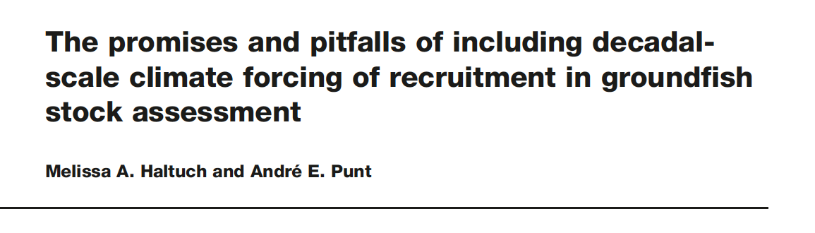

Challenges in implementing extended single-species approaches
Result-driven or data-driven?
Difficulty in defining relationships with covariates.
Gain in performance sometimes uncertain.
What to do about Reference points?
Difficult to choose one approach for modeling the effects of the environment over another.
Uncertainty about the performance of model selection tools.
e.g. 2012 Gulf of Maine Cod assessment
2 models, one with time-varying natural mortality
Results in (at least) four options for setting quota:
M_{0.2} model with M=0.2 for projections: standard procedures
M_{Ramp} model with M=0.2 for projections: standard procedures
M_{Ramp} model with M=0.4 for some period then reverting to M=0.2
M_{Ramp} model with M=0.4 in perpetuity (regime shift scenario)

Slide 40
Often significant effort spent during technical reviews to evaluate the effect/ability of including environment/predators.
Gains in assessment performance of including these processes are not always clear.

Slide 41

Lots of uses of ecosystem information even if not directly incorpoarated into models used for advice.
Current Northeast US research track assessments have a dedicated “ecosystem” ToR.

Slide 42
Much focus on “forage fish”
Short-lived, population productivity changes appear to be dependent on environment, or at least not only related to fishing.
Also have high levels of predation, often for other managed species.
Essington, T.E., Moriarty, P.E., Froehlich, H.E., Hodgson, E.E., Koehn, L.E., Oken, K.L., Siple, M.C. and Stawitz, C.C., 2015. Fishing amplifies forage fish population collapses. Proceedings of the National Academy of Sciences, 112(21), pp.6648-6652.
Hilborn, R., Buratti, C.C., Díaz Acuña, E., Hively, D., Kolding, J., Kurota, H., Baker, N., Mace, P.M., de Moor, C.L., Muko, S. and Osio, G.C., 2022. Recent trends in abundance and fishing pressure of agency‐assessed small pelagic fish stocks. Fish and Fisheries.

Slide 43
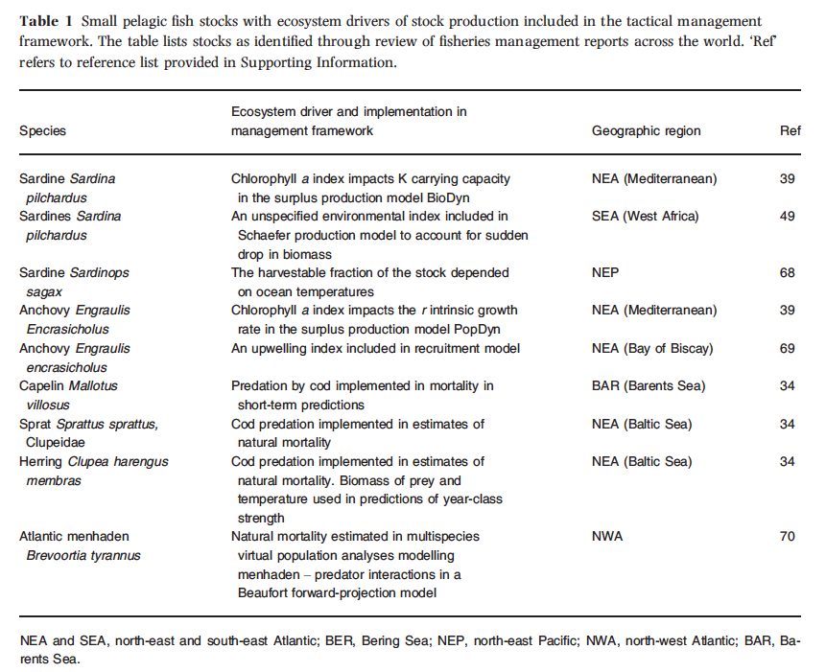
Skern-Mauritzen et al. (2015)

Slide 44
Maunder + Watters (2003) conclusion
Integrating environmental relationships in a statistical stock assessment model is an improvement over the traditional statistical model when there are large gaps in the data.
However, it is important to include process error to avoid the high probability of detecting spurious correlations seen in the environmental model….
Therefore, the environmental model with process error is the model of choice because
1) there is no bias in the estimates,
2) when there is no relationship with the environmental series, it is equivalent to the traditional model,
3) when such a relationship exists, the recruitment estimates are improved, particularly if there are important gaps in the data,
4) it may be used for prediction, and
5) uncertainty about the relationship can be modeled.

Slide 45
Take home messages
Single-species assessment models can be easily ‘extended’ to include ecosystem processes.
The effects of these processes can be modeled implicitly or made explicit
Relative benefit of specific approach may vary
Information on ecosystem processes can be included for context, validation, diagnostics.
Continued emphasis on understanding performance of assessment & management procedures to these effects.
Conducting and evaluating empirical/mechanistic projections of environmental effects likely very important.

Slide 46
Recommended Reading
Basson, M., 1999. The importance of environmental factors in the design of management procedures. ICES Journal of Marine Science: Journal du Conseil, 56(6), pp.933-942.
Bell, R.J., Hare, J.A., Manderson, J.P. and Richardson, D.E., 2014. Externally driven changes in the abundance of summer and winter flounder. ICES Journal of Marine Science: Journal du Conseil, 71(9), pp.2416-2428.
Deriso, R.B., Maunder, M.N. and Pearson, W.H., 2008. Incorporating covariates into fisheries stock assessment models with application to Pacific herring. Ecological Applications, 18(5), pp.1270-1286.
Deroba, J.J. and Schueller, A.M., 2013. Performance of stock assessments with misspecified age-and time-varying natural mortality. Fisheries Research, 146, pp.27-40.
Gårdmark, A., Östman, Ö., Nielsen, A., Lundström, K., Karlsson, O., Pönni, J. and Aho, T., 2012. Does predation by grey seals (Halichoerus grypus) affect Bothnian Sea herring stock estimates?. ICES Journal of Marine Science: Journal du Conseil, 69(8), pp.1448-1456.
Haltuch, M.A. and Punt, A.E., 2011. The promises and pitfalls of including decadal-scale climate forcing of recruitment in groundfish stock assessment. Canadian Journal of Fisheries and Aquatic Sciences, 68(5), pp.912-926.
Hollowed, A.B., Ianelli, J.N. and Livingston, P.A., 2000. Including predation mortality in stock assessments: a case study for Gulf of Alaska walleye pollock. ICES Journal of Marine Science: Journal du Conseil, 57(2), pp.279-293.
Hollowed, A.B., Bond, N.A., Wilderbuer, T.K., Stockhausen, W.T., A'mar, Z.T., Beamish, R.J., Overland, J.E. and Schirripa, M.J., 2009. A framework for modelling fish and shellfish responses to future climate change. ICES Journal of Marine Science: Journal du Conseil, 66(7), pp.1584-1594.
King, J.R., McFarlane, G.A. and Punt, A.E., 2015. Shifts in fisheries management: adapting to regime shifts. Philosophical Transactions of the Royal Society of London B: Biological Sciences, 370(1659), p.20130277.
Legault, C.M. and Palmer, M.C., 2015. In what direction should the fishing mortality target change when natural mortality increases within an assessment?. Canadian Journal of Fisheries and Aquatic Sciences, 73(999), pp.1-9.
Maunder, M.N. and Watters, G.M., 2003. A general framework for integrating environmental time series into stock assessment models: model description, simulation testing, and example. Fishery Bulletin, 101(1), pp.89-99.
Plagányi, É.E., Weeks, S.J., Skewes, T.D., Gibbs, M.T., Poloczanska, E.S., Norman-López, A., Blamey, L.K., Soares, M. and Robinson, W.M., 2011. Assessing the adequacy of current fisheries management under changing climate: a southern synopsis. – ICES Journal of Marine Science, 68: 1305–1317.
Schirripa, M. J., Goodyear, C. P., and Methot, R. M. 2009. Testing different methods of incorporating climate data into the assessment of US West Coast sablefish. – ICES Journal of Marine Science, 66: 1605–1613.
Skern‐Mauritzen, M., Ottersen, G., Handegard, N.O., Huse, G., Dingsør, G.E., Stenseth, N.C. and Kjesbu, O.S., 2015. Ecosystem processes are rarely included in tactical fisheries management. Fish and Fisheries.
Wilberg, M.J., Thorson, J.T., Linton, B.C. and Berkson, J., 2009. Incorporating time-varying catchability into population dynamic stock assessment models. Reviews in Fisheries Science, 18(1), pp.7-24.

Slide 47
Ecosystem processes in stock assessments
Questions?

Slide 48

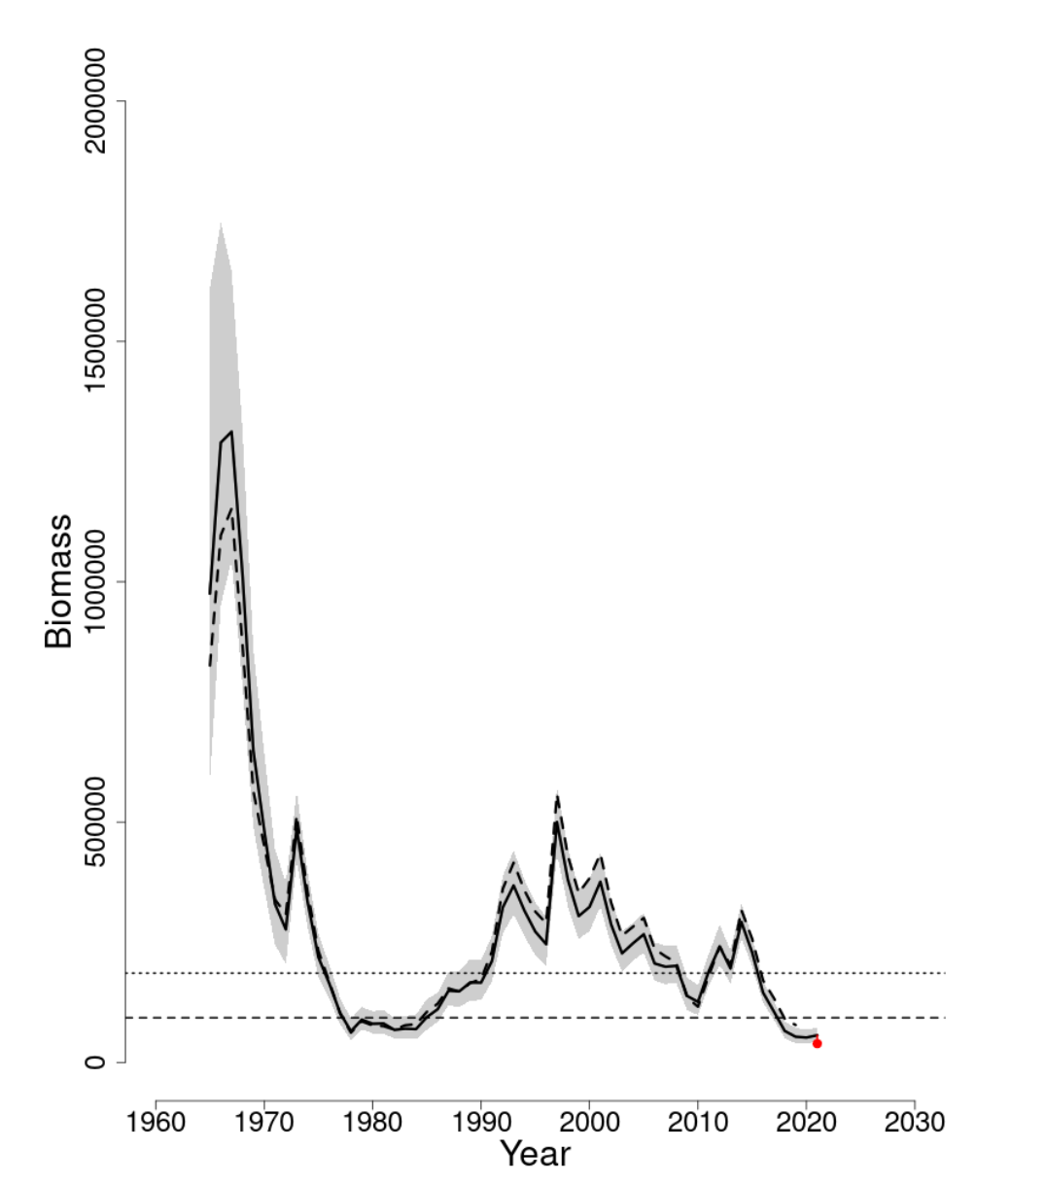
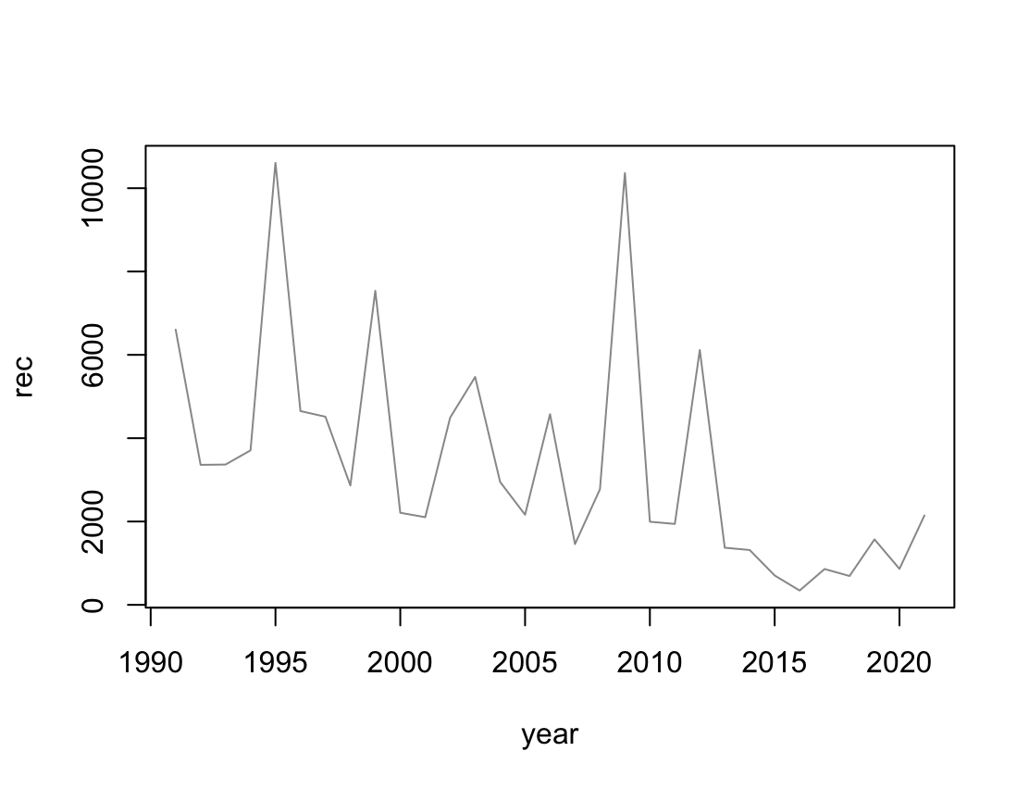
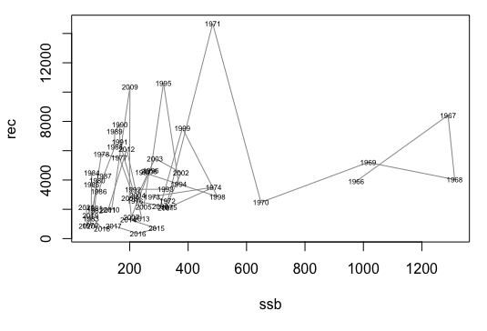
Lab: Dynamic reference points in stock recruit models for Northeast US Atlantic herring
Fit state-space model of stock-recruit dynamics for herring that includes time-varying productivity
Mass.gov

