Slide 1
MAR 580: Advanced Population Modeling for Management of Living Marine Resources
Bayesian Methods
Acknowledgements: André Punt
20 November 2025

Slide 2
Outline
Intro to Bayesian statistics
Bayesian estimation methods
Worked example with tmbSTAN 11/24

Slide 3
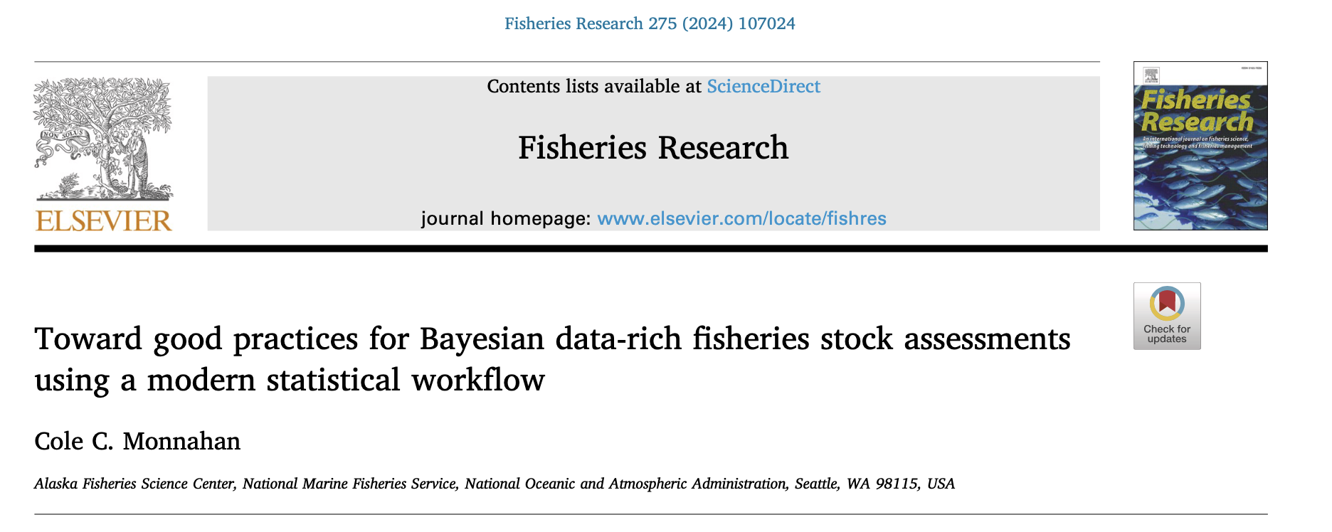
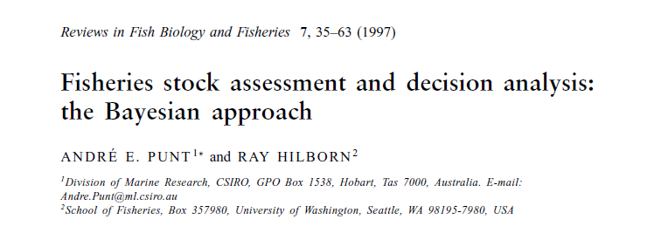
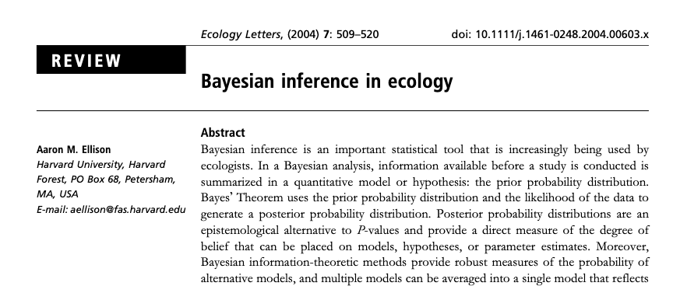
This is a good overview paper for fisheries but a little out of date.
There is far more on Bayesian statistics than can possibly be covered today. Suggested readings provided later.
Plug for Bayesian & hierarchical modeling course – I have taught this in the past and considering what a future offering would look like.
Good recent text
Good intro to Bayesian statistics and use in ecology

Slide 4
Decision Analysis
We often want to make statements about the consequences of alternative management actions given different states of nature.
To compute expected outcomes, we need to know the (relative) probability to associate with each state of nature, i.e. P(H|D) where H is the hypothesis and D is the data.
Management Action | State of Nature |  |  | Expected
 | r=0.1 | r=0.2 | r=0.3 | Outcome
Catch=10
Catch=20
Catch=30
Summary Statistic

Slide 5
Frequentists vs Bayesians
Frequentist approach: What is the probability of the data given that the parameter is true?
P(Data|Model)
Bayesian approach: What is the probability of the parameter given that the data is true?
P(Model|Data)
Which of these quantities are we interested in?
Main difference (and argument) is that Bayesian inference is based on making statements based on the data we have, rather than hypothetical data we haven’t observed.
Although Bayesians make use of the likelihood, so far we have taken a frequentist approach to using the likelihood for model inference and quantifying uncertainty, etc.

Slide 6
Confidence Intervals
What is a 95% confidence interval?
If the experiment is repeated, 95% of these intervals will contain the true value.
It is NOT that the true value lies within this interval with 95% probability.
But…. This sounds like something we would be interested in knowing, no?

Slide 7
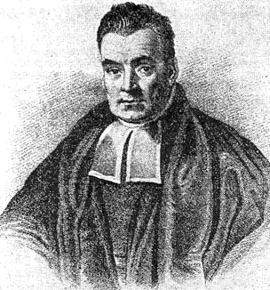
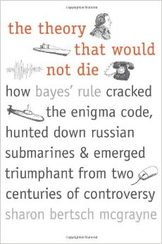
Thomas Bayes (1701-1761)
This (probably) isn’t Bayes.
Bayes’ system:
Initial Belief + New Data = Improved Belief
He didn’t publish!
Later picked up by Laplace
Bertrand (late 19th century), artillery
Bell telephone (early 20th)
1940s – Turing & Enigma
1960s – Tukey, Nixon/Kennedy election
http://lesswrong.com/lw/774/a_history_of_bayes_theorem/

Slide 8
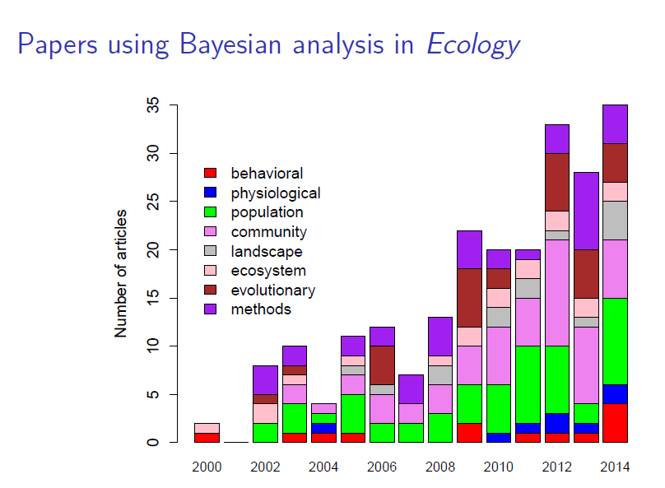
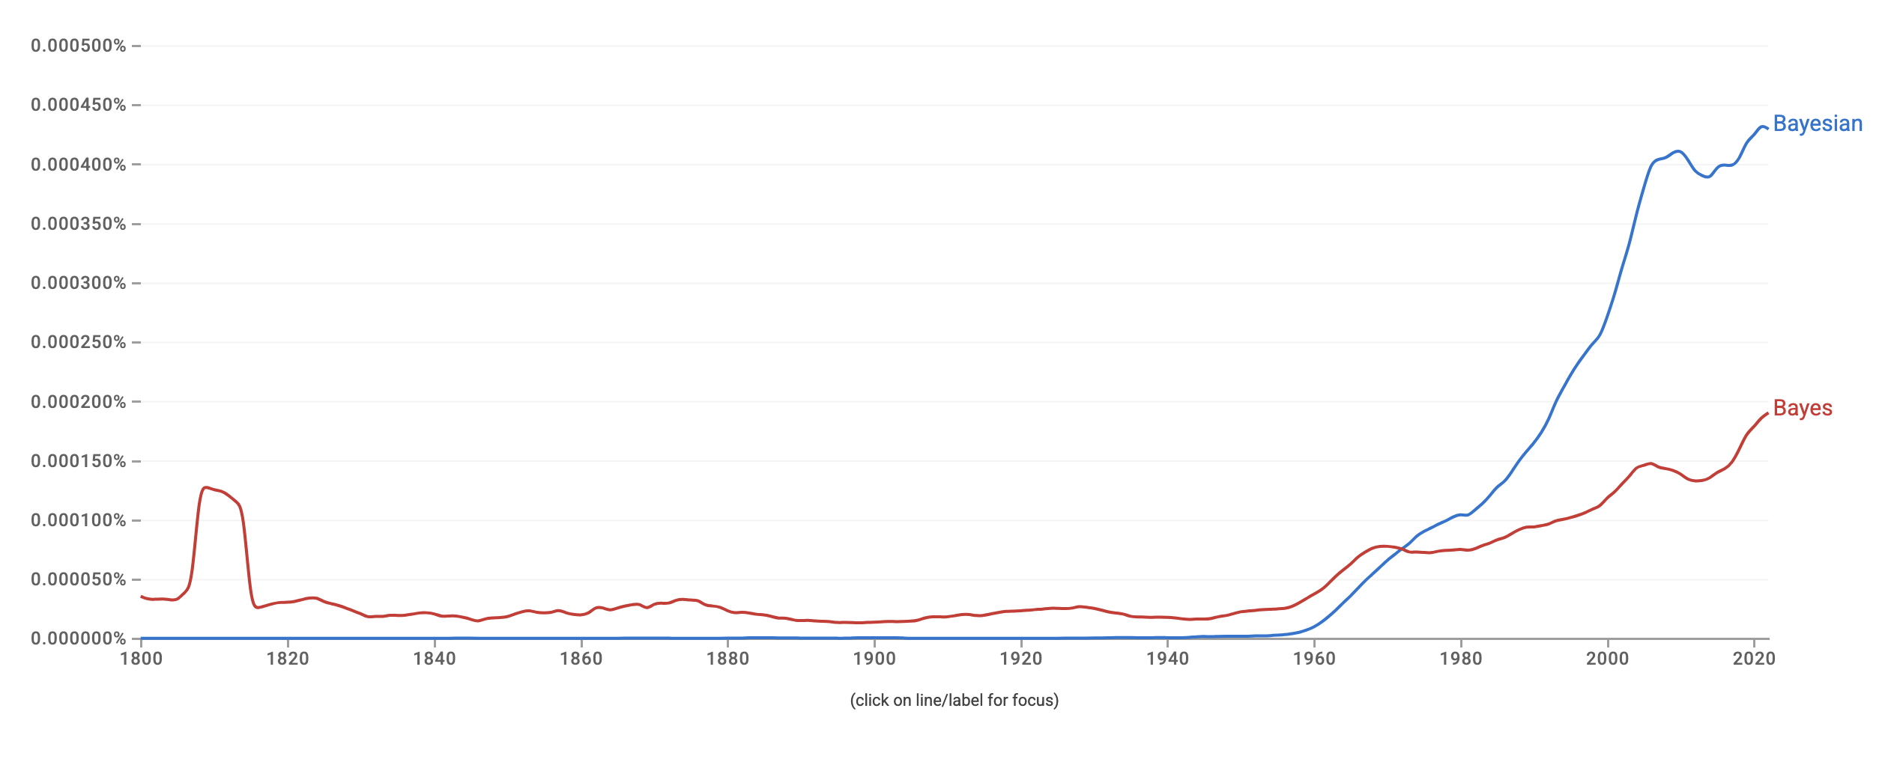
Rise of the Bayesians
Literature seeing increasing use of Bayesian methods for statistical inference.
I would like to say this is a result of a shift in statistical thinking…
In part this is due to the availability of software packages that can deal with the computational demands of estimation.

Slide 9
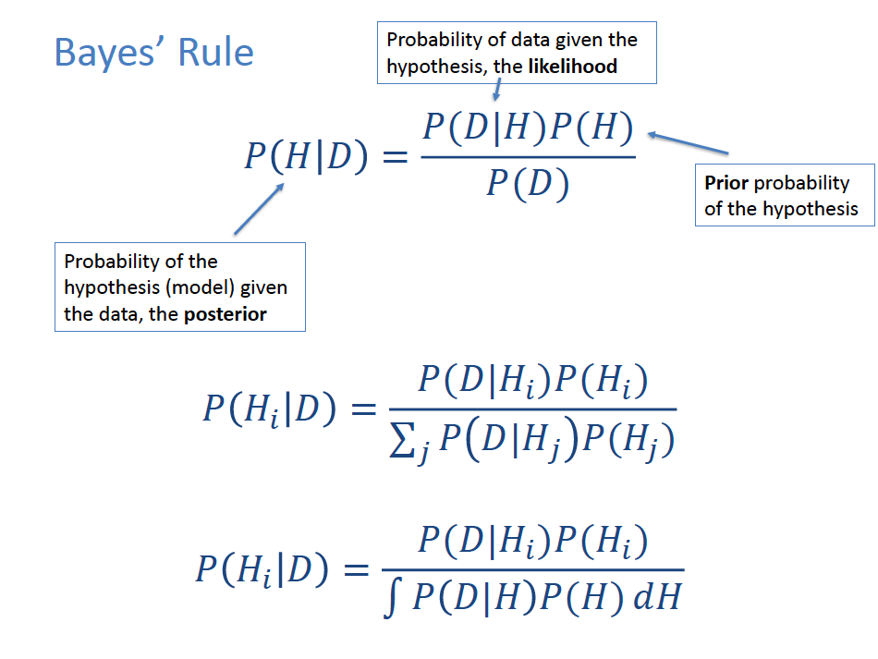
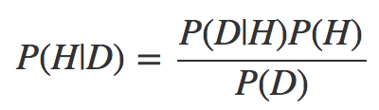
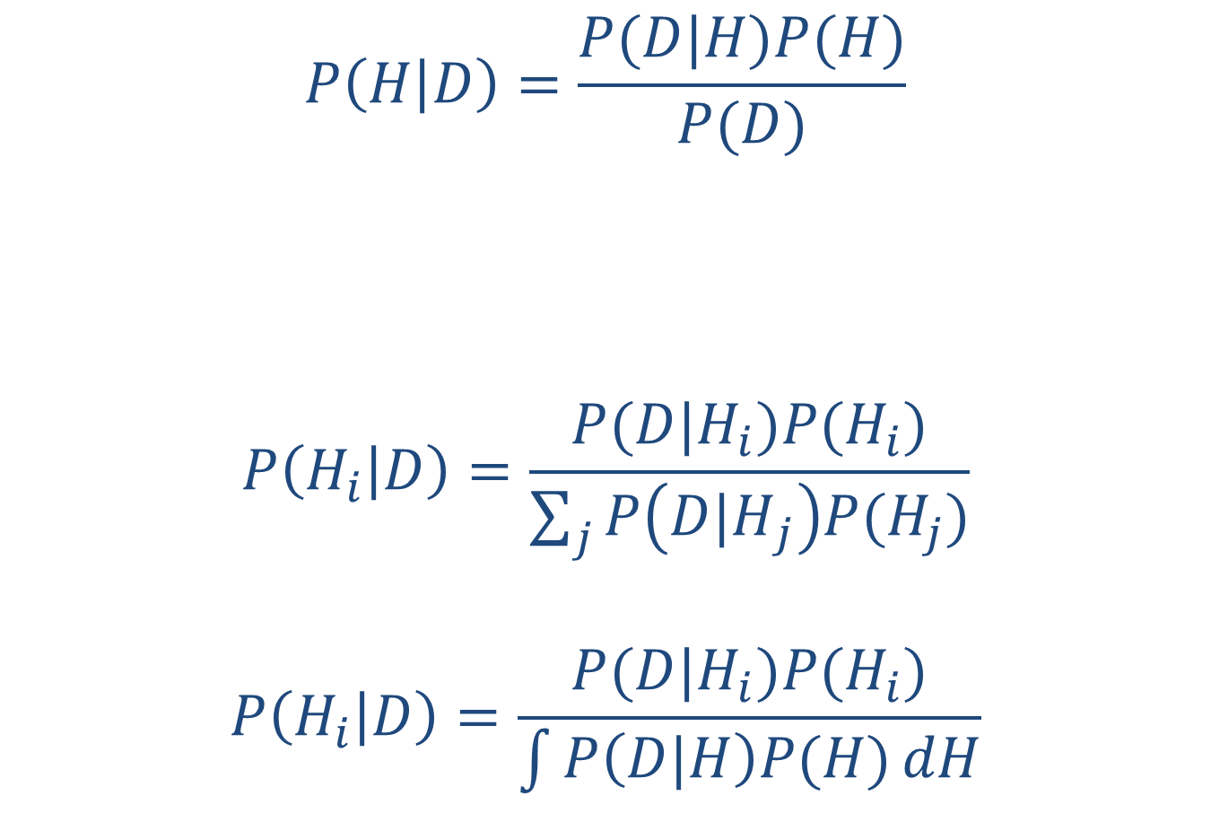
Bayes’ Rule
Probability of data given the hypothesis, the likelihood
Prior probability of the hypothesis
Probability of the hypothesis (model) given the data, the posterior

Slide 10
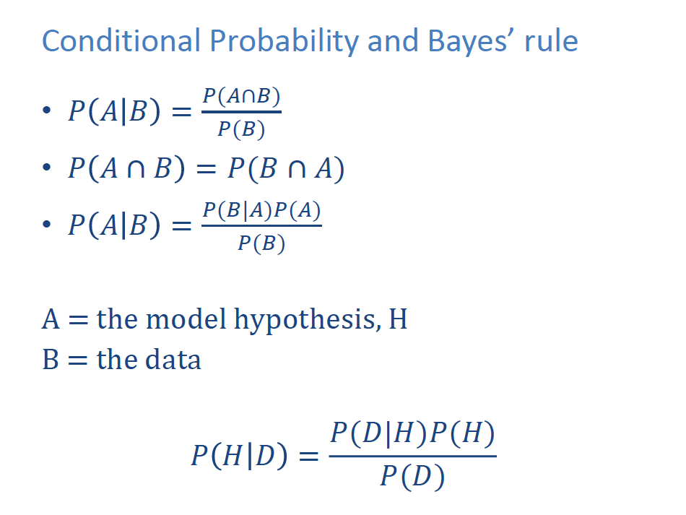
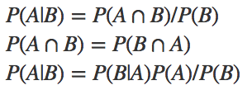

Conditional Probability and Bayes’ rule
A = the model hypothesis, H
B = the data

Slide 11
Bayesian estimation
Goal of estimation is to calculate the posterior distribution based on the likelihood function and the prior distribution.
If the likelihood and priors are conjugate, then the posterior is simple to calculate. (the product of the likelihood and prior is the same distribution as the posterior)
Often this is not the case, and we need to use numerical methods to sample from the posterior and deal with the integral on the denominator.

Slide 12
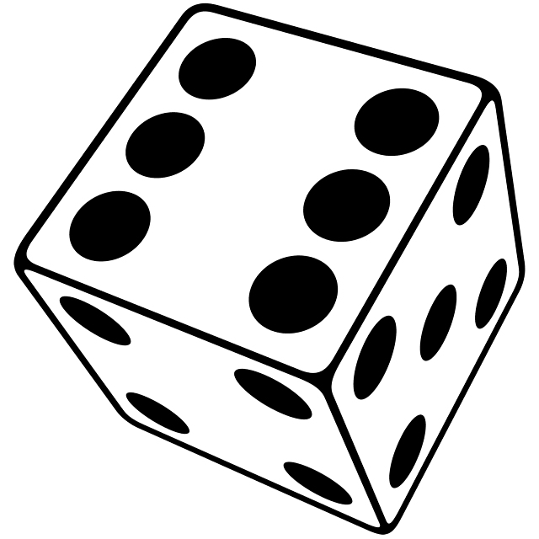

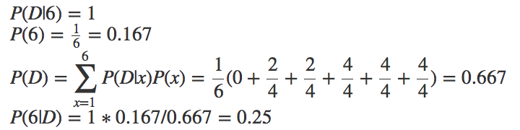
Like a Bayesian (Priors for the very first time)
We roll a standard die under a box.
We lift the box a little and a random corner of the upper side of the die becomes visible, it contains a dot.
What is the probability we rolled a six?

Slide 13
Example 2: Conjugate priors
θ is the proportion of people in England with genotype Z. We take a random sample of 2500 and find 50 with the genotype.
A previous study from the USA estimated θ to have a mean 0.06 and s.d of 0.0106 (i.e. P(θ) is beta distribution with α=30 and β=470).
Calculate the posterior distribution, P(θ|data).

Slide 14
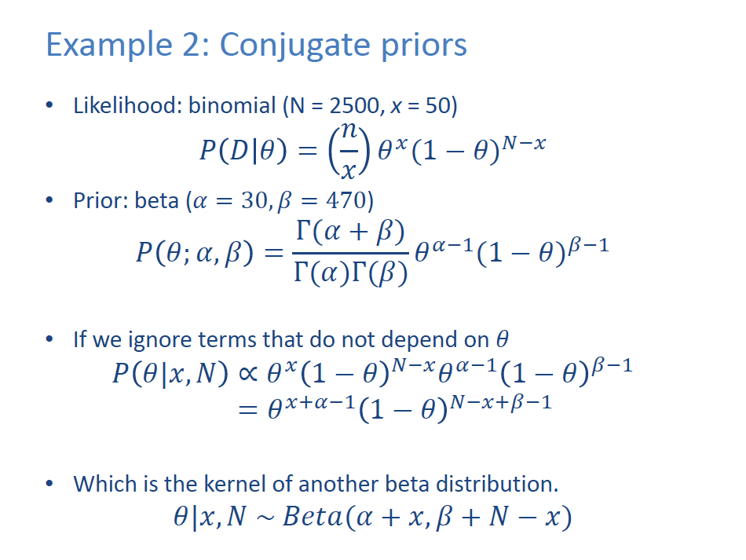

Slide 15
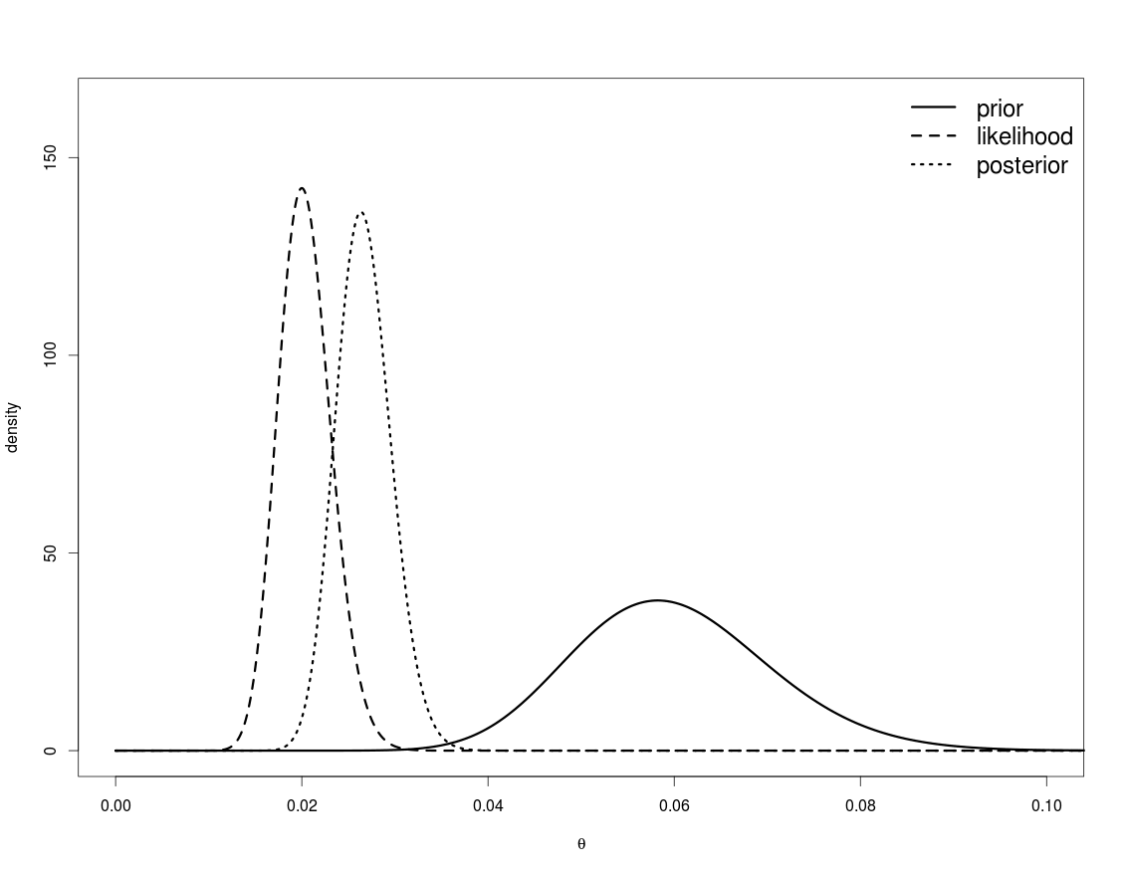
Example 2: Conjugate priors
The prior has been updated by the data.
Conjugate priors / likelihoods are not available for many of the management-related problems we are interested in, and so we rely on numerical methods to approximate the posterior.

Slide 16

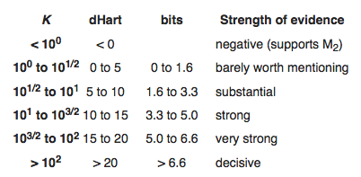
Assigning Probabilities to Models, Bayes Factors
To compare models A and B.
Calculate the Bayes factor, K:
The information to select among models depends on the ratio of the posterior to the prior odds.

Slide 17


Assigning Probabilities to Models (DIC)
[Spiegelhalter et al. 2002]
DIC is a Bayesian analogue of AIC and is generally calculated using samples from the posterior distribution:
Where is the ‘effective number of parameters’.
pD may be much smaller than the actual number of parameters because of the impact of the priors.
The posterior mean may be an inappropriate measure.

Slide 18
Assigning Probabilities (Alternative approaches)
Alternatives / frequentist methods:
The 95% confidence interval for a regression slope does not claim there is a 95% probability that the slope is in that range; rather only that if the experiment was repeated many times, 95% of the times the estimated slope would be in that range.
Bootstrapping:
easy to do (except for convergence to local minima);
doesn’t provide the probability of alternative hypotheses;
no way to formally incorporate priors / auxiliary information (see Poole et al. 1999); and
no way to assign probabilities to models.
Likelihood profile:
very computationally intensive and does not (without considerable effort and careful wording) provide the input needed to conduct projections.

Slide 19
Priors
Negatives:
Subjective and potentially influential.
Priors are often selected to be “non informative”, but no prior is really non-informative.
Positives:
Without them, we cannot calculate the probability of alternative hypotheses!
Increasingly, priors are being based on the results of meta-analysis (“standing on the shoulders of giants”).
Always examine the sensitivity of the results to the subjective priors – this is often minimal.

Slide 20
Numerical methods for Bayesian inference
There are many computer-intensive Monte Carlo procedures for obtaining samples from the posterior distribution.
Obtaining samples from the posterior is useful because:
it is necessary to have vectors of parameters to conduct forward projections / make predictions; and
given samples from the posterior, it is straightforward to calculate marginal posterior distributions for any quantity of interest.
The most common family of methods are Markov Chain Monte Carlo (MCMC), of which there are many flavors/algorithms.
Also: Importance Sampling, including: Sampling-Importance-Resampling (SIR). Sequential Importance Sampling

Slide 21
Markov Chain Monte Carlo (MCMC)
[Metropolis et al. (1953), Hastings (1970), Gilks et al. (1996), Brooks et al. (2011)]
General idea is to generate samples from a Markov chain which has a limiting distribution equal to the desired (posterior) distribution.
Set up a (long) “chain” which starts at a pre-specified parameter vector and then traverses the posterior distribution:
a sequence of parameter vectors, , which converges to the posterior distribution .
The sample from the posterior distribution is then every n’th element in the chain (ignoring the first “few” elements of the chain).

Slide 22
Starting vector
First “few” points

Slide 23
MCMC algorithm overview
Select an “initial” parameter vector (often the mode of the posterior) and compute its posterior density (the product of the likelihood and the prior).
Generate a “new” parameter vector based on the current one using a proposal function (‘jump’ function) and compute its posterior density.
Replace the current parameter vector by the new parameter vector:
if the posterior density of the new parameter vector is larger than that of the current parameter vector; or
with probability equal to the ratio of the new to the current posterior density if the posterior density of the new parameter vector is less than that of the current parameter vector.
Output the current parameter vector.
Repeat steps 2)- 4) many times!
Steps 2-4 are referred to as a cycle.

Slide 24
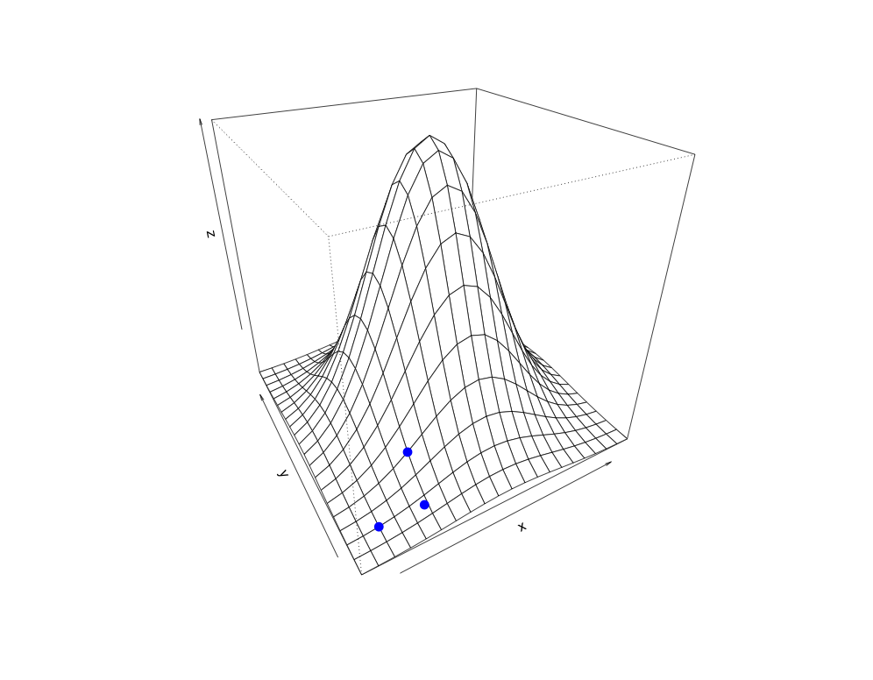
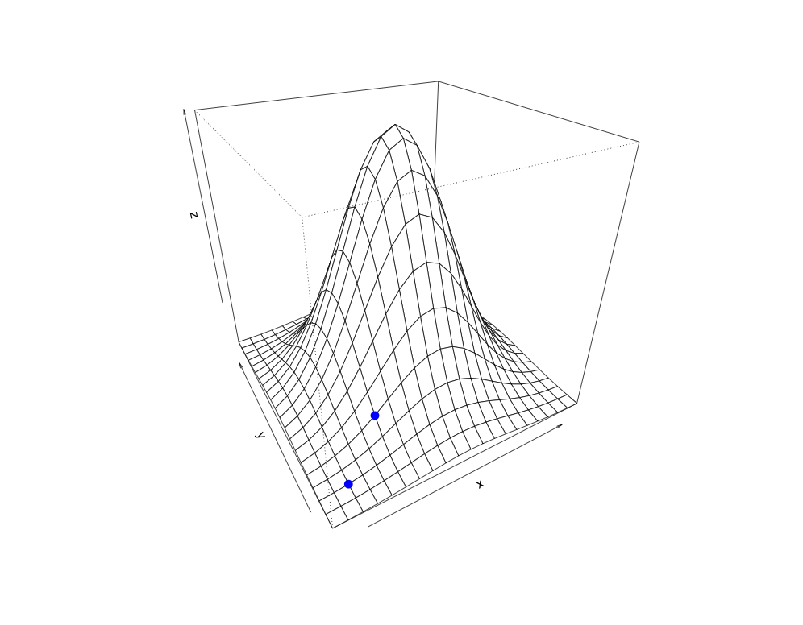
MCMC algorithm
α = 8.1
Accept the move.
α = 0.32
Accept the move with probability 0.32.

Slide 25
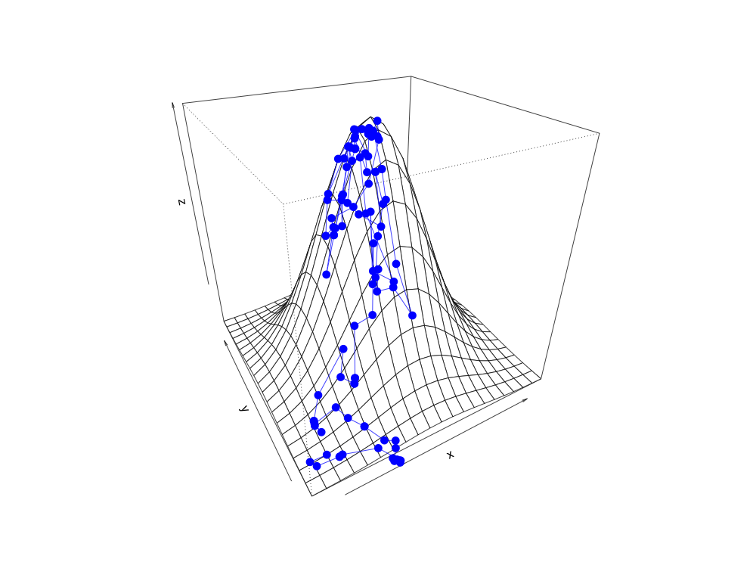
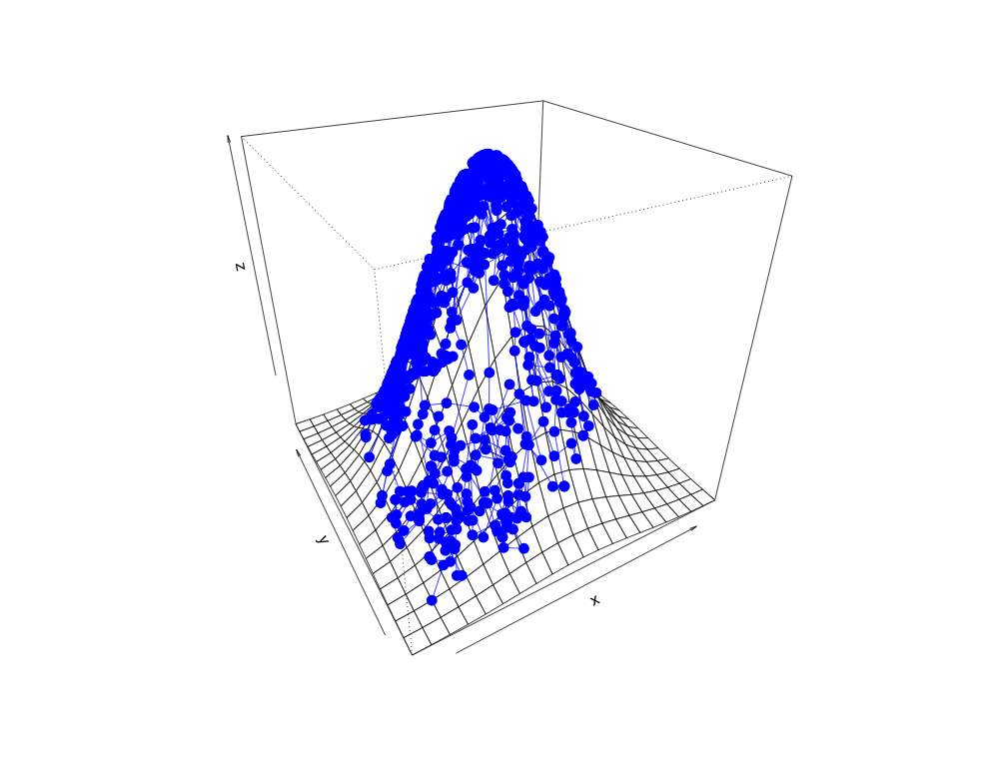
MCMC algorithm: run for N cycles

Slide 26
Proposal distribution (Jump function)
It should be possible to reach all possible parameter vectors “eventually” by applying the jump function long enough.
We only consider symmetric proposal distributions, i.e.
Proposal distributions can be multivariate (e.g. a multivariate normal or t centered on the current parameter vector). All the parameters are updated simultaneously.
ADMB proposal distribution is multivariate normal, with variance-covariance matrix a rescaled version of that generated during optimization.
Proposal distribution can be adjusted dynamically during the initial phase of an MCMC run to increase/decrease the size of the ‘jumps’.

Slide 27
“Burn-in” and “Thinning”
Several implementation decisions must be made when running MCMC.
Burn-in length: Discard first B cycles to remove the impact of the initial parameter vector.
Alternative (or additionally): run several chains from different starting values, use diagnostics to evaluate mixing.
‘Thin’ the chain by only taking the n’th sample to reduce Markov nature of the chain (autocorrelation).

Slide 28
MCMC and convergence
A key issue is whether the Markov chain has converged to the posterior.
Or, How many cycles is enough?
Convergence is an issue.
Strictly speaking, we can never say a chain has converged. However, we can use many diagnostic statistics to point to (hopefully no) evidence for non-convergence.

Slide 29
Categorizing Convergence Diagnostics
There is no One Ring when it comes to diagnostics. All diagnostics will fail to detect failure to achieve convergence sometimes.
Diagnostics:
monitoring (during a run).
evaluation (after a run).
Quantitative or graphical.
Requires single or multiple chains.
Based on single variables or the joint posterior.
Applicability (general or Gibbs sampler only).
Ease of use (generic or problem-specific).

Slide 30
MCMC diagnostics (what to keep track of during a run)
The fraction of jumps that are accepted (it should be possible to ensure that the desired fraction is achieved automatically).
The fraction of jumps that result in parameter values that are “out of range”.

Slide 31
Visual Methods
The trace is no more than a plot of various outputs (derived quantities as well as parameters) against cycle number.
Look for trends and evidence for strong auto-correlation.
The trace can be more interpretable if it is summarized by:
the cumulative posterior median, and upper and lower x% credibility intervals; and
moving averages.
Correlation plots easily display the relationships among key parameters.
Plot the distributions for the marginal posteriors (but do not assume convergence just because these look smooth).

Slide 32
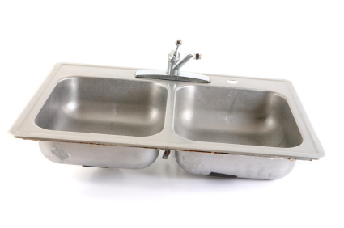
Numerical Statistics
Autocorrelation lags 1-20
Geweke statistic
“Effective” sample size
Heidelberger and Welch statistic
Raftery and Lewis statistic
Batch sd/naïve sd
Single chain Gelman statistic
Brooks-Gelman-Rubin statistic
Cumulative quantiles
Running mean
…
Many of these relate to changes in the mean or variance either among chains or among sections of the same chain.

Slide 33
The CODA Package
CODA is a R package that implements all of the diagnostic statistics outlined above. The user can select functions from a menu interface or run the functions directly.

Slide 34
Software for Bayesian inference
Lots of pre-written programs / code out there.
Some are more flexible than others.
A popular, generic program is BUGS
JAGS, OpenBUGS, WinBUGS
There are packages to run BUGS models from R.
STAN (Gelman et al.)
More involved coding than BUGS (e.g. need to write C++)
Interfaces with R, Python, etc.
Many packages use STAN functionality
e.g. brms, tmbstan
Several bespoke R packages for specific types of models
TMB
NUTS (HMC) [using stan]
NIMBLE
ADMB
Metropolis Hastings MCMC, No-U-Turn-Sampler HMC
Greta
Bambi

Slide 35
Tricks of the (MCMC) trade
Performance of MCMC deteriorates:
as the number of parameters increases. Integrate out any nuisance parameters analytically.
if parameters are highly correlated. Examine the variance-covariance matrix to identify highly-correlated parameters (rho>0.8) and re-parameterize the model to reduce correlations.
MCMC jumps may fall outside the allowable range if there are “hard” boundaries on parameters. Avoid these by working with transformations.
Always repeat the MCMC calculations for
different starting parameter vectors; and
different random number seeds.

Slide 36
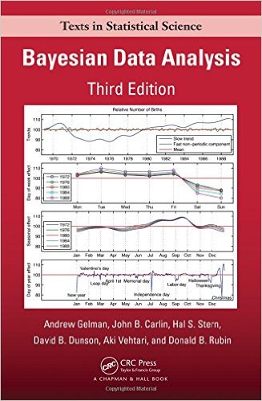
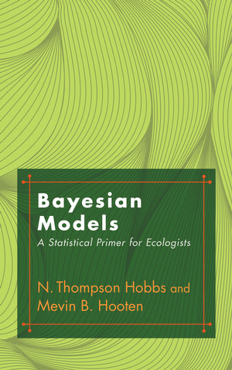
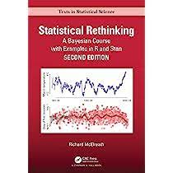
Recommended textbook reading
Gelman, A., Carlin, J. B., Stern, H. S., & Rubin, D. B. (2004). Bayesian data analysis. Texts in statistical science series. CRC Press
McElreath, R. 2022. Statitstical Rethinking: A Bayesian Course with Examples in R & Stan. 2nd Ed. CRC Press.
Hobbs, N. T., & Hooten, M. B. (2015). Bayesian models: a statistical primer for ecologists. Princeton University Press.

Slide 37
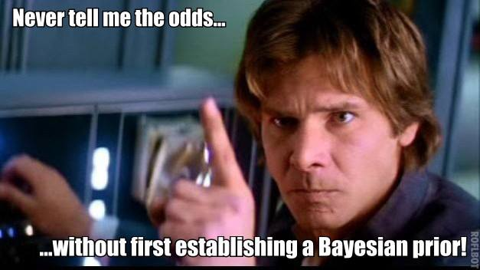
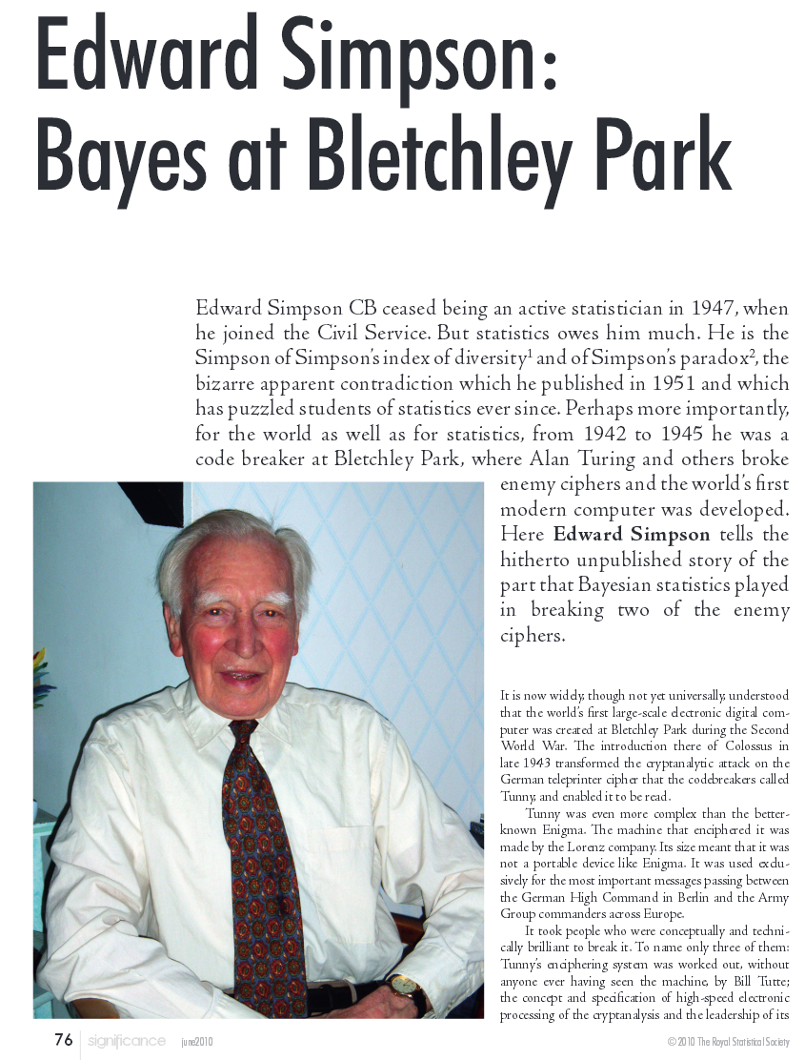
Lighter reading
https://www.countbayesie.com/blog/2015/2/18/hans-solo-and-bayesian-priors
Simpson, E. (2010). Edward Simpson: Bayes at Bletchley Park. Significance, 7(2), 76-80.

Slide 38
Readings:
Brooks, S. and A. Gelman. 1998. General methods for monitoring convergence of iterative simulations. Journal of Computational and Graphical Statistics 7: 434-55.
Ellison, A.M. 2004.Ecology letters 7: 509-520.
Gelman, A. and D.B. Rubin. 1992. Inference from iterative simulation using multiple sequences (with discussion). Statistical Science 7: 457-511.
Geweke, J. 1992. Evaluating the accuracy of sampling-based approaches to the calculation of posterior moments. pp. 169-93. In: Bayesian Statistics 4 (eds J.M. Bernardo, J. Berger, A.P. Dawid and A.F.M. Smith.) Oxford University Press, Oxford.
Kass, R.E. and A.E. Raftery. 1995. J. Am. Statist. Assoc. 90:773-795.
McAllister, M. K., & Ianelli, J. N. (1997). Bayesian stock assessment using catch-age data and the sampling-importance resampling algorithm. Canadian Journal of Fisheries and Aquatic Sciences, 54(2), 284-300.
Monnahan, C., Thorson, J., Branch, T. 2016. Faster estimation of Bayesian models in ecology using Hamiltonian Monte Carlo. Methods in Ecology & Evolution https://doi.org/10.1111/2041-210X.12681
Monnahan C & Kristensen K 2018. No-U-turn sampling for fast Bayesian inference in ADMB and TMB: Introducing the adnuts and tmbstan R packages. PLOS One. https://doi.org/10.1371/journal.pone.0197954
Poole, D., Givens, G.H. and A.E. Raftery. 1999. Fish. Bull US. 97:144-152.
Walters, C.[J.] and Ludwig, D. (1994) Calculation of Bayes posterior probability distributions for key population parameters. Can. J. Fish. Aquat. Sci. 51, 713-722.

Slide 39
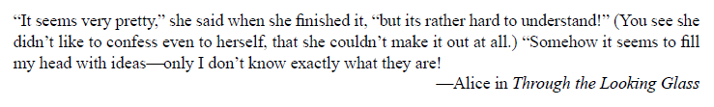
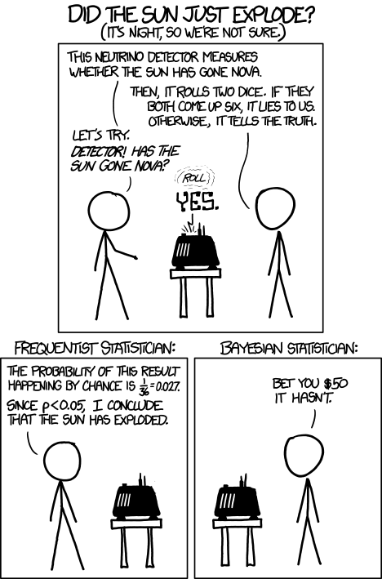
And of course, there’s an xkcd for that…
Questions?
https://xkcd.com/1132/

Slide 40
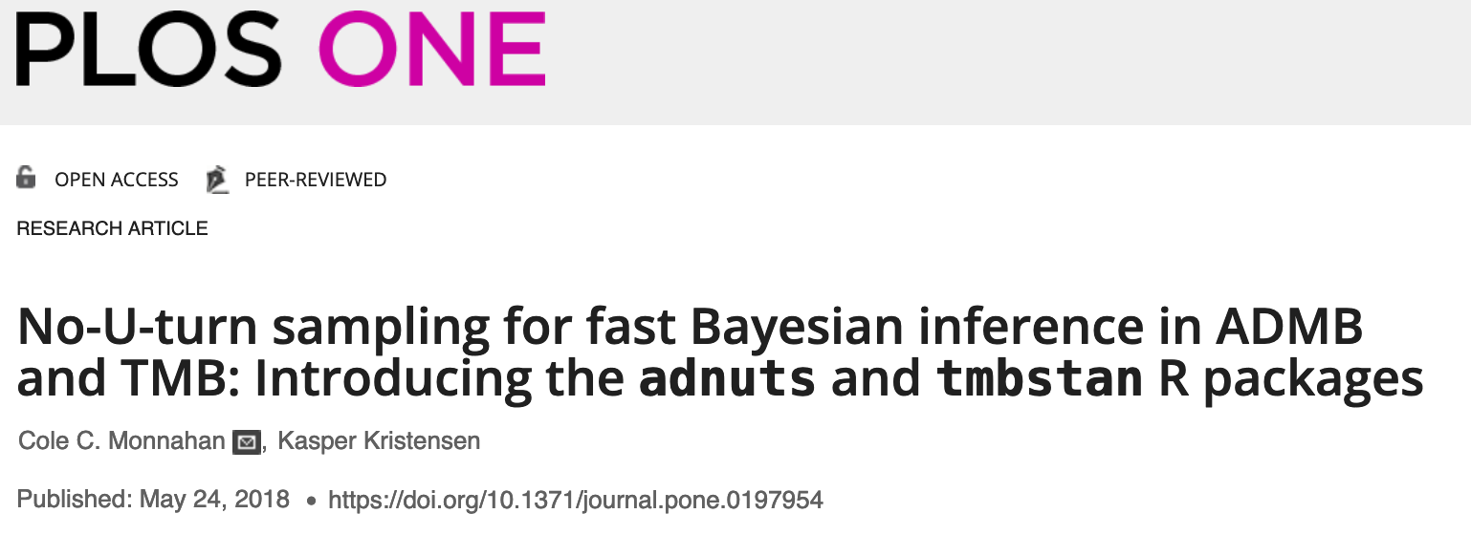
Bayesian estimation with TMB: tmbstan
Use tmbstan() function
Does MCMC sampling on our model parameters and random effects
Can use TMB INLA to integrate random effects
Need to add priors to our TMB model
Linear regression example

