Slide 1


MAR 580: Advanced Population Modeling for Management of Living Marine Resources
Biomass Dynamics Models
(Acknowledgements: Steve Cadrin)
07 October 2025

Slide 2
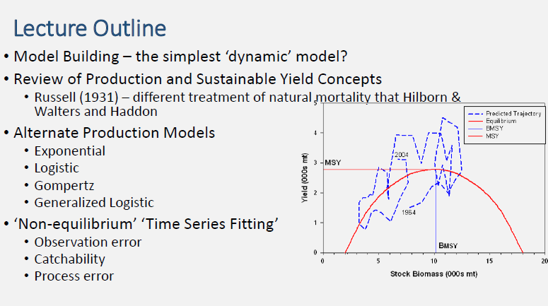

Slide 3
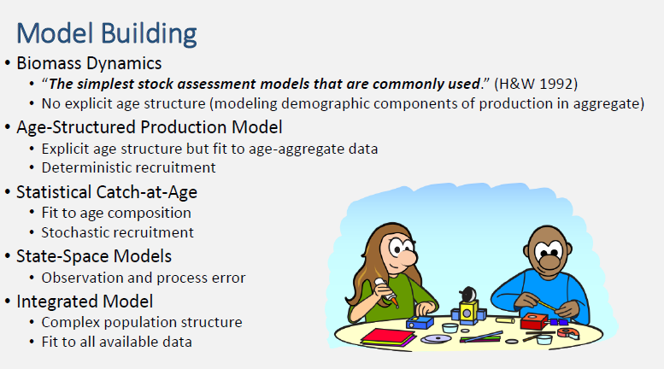

Slide 4
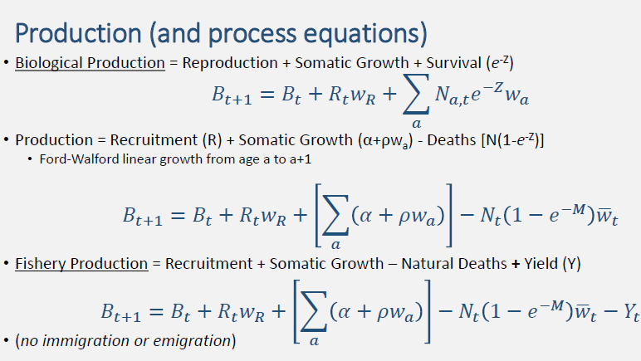

Slide 5
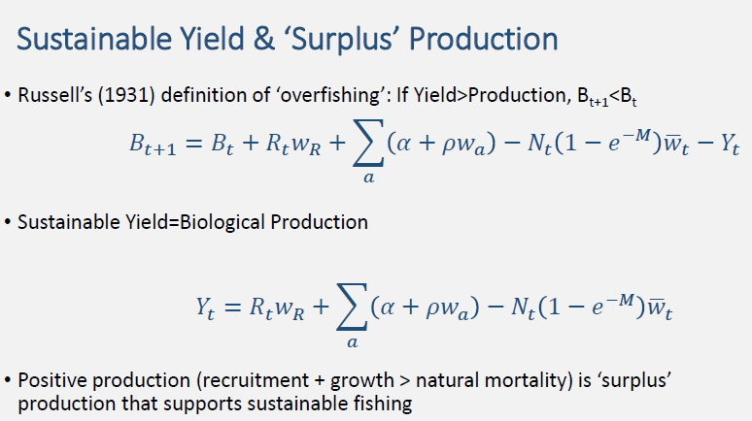

Slide 6
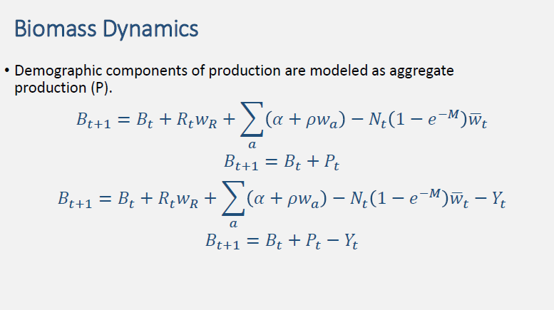

Slide 7
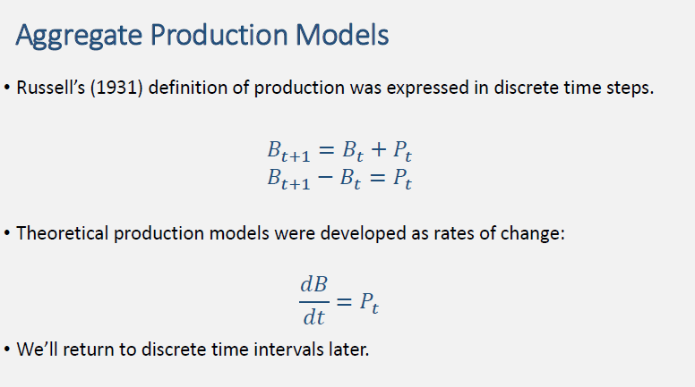

Slide 8
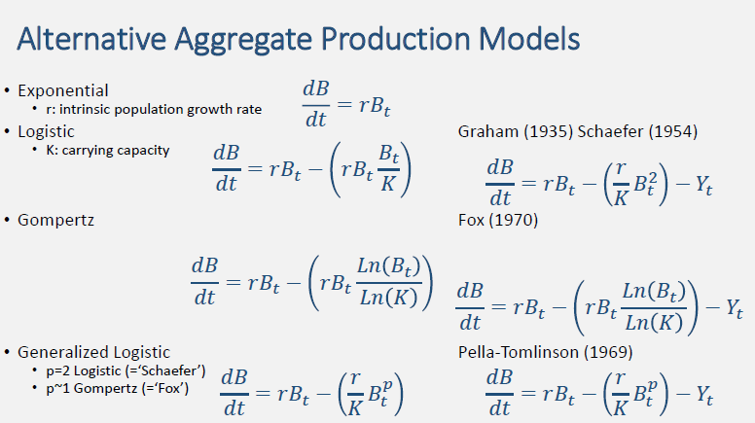

Slide 9
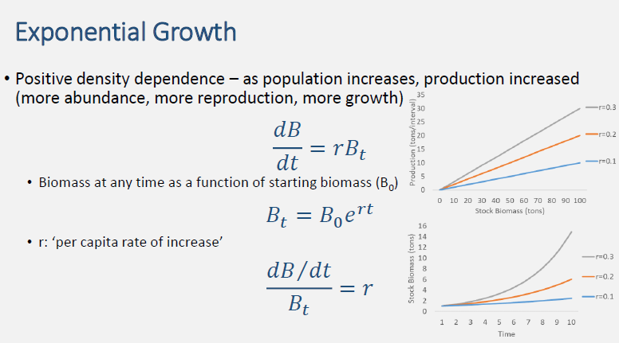

Slide 10
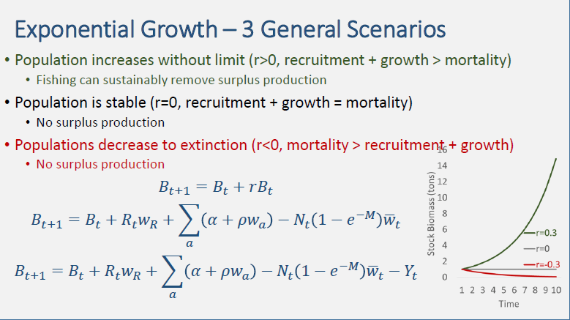

Slide 11
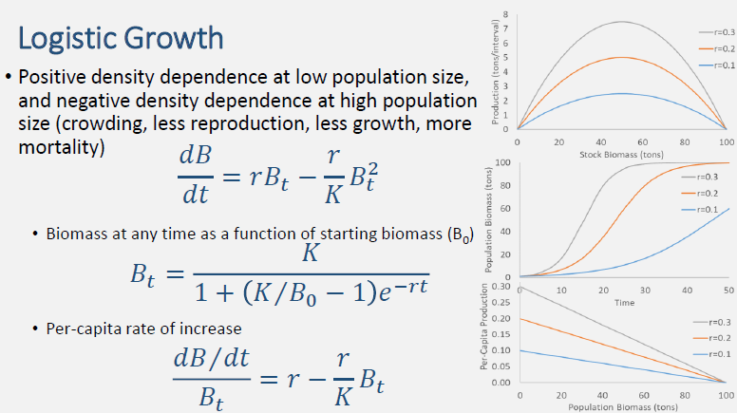

Slide 12
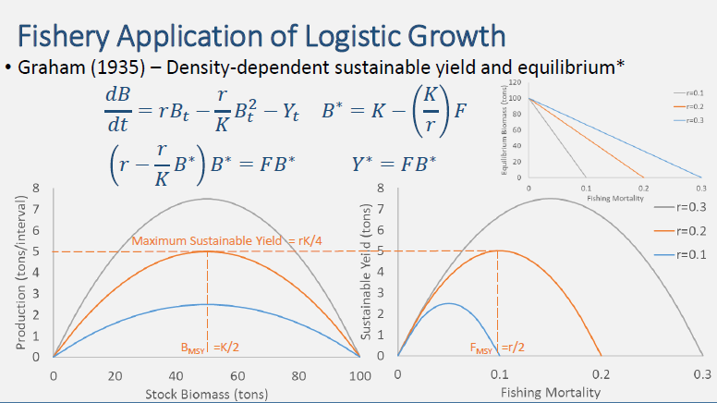

Slide 13
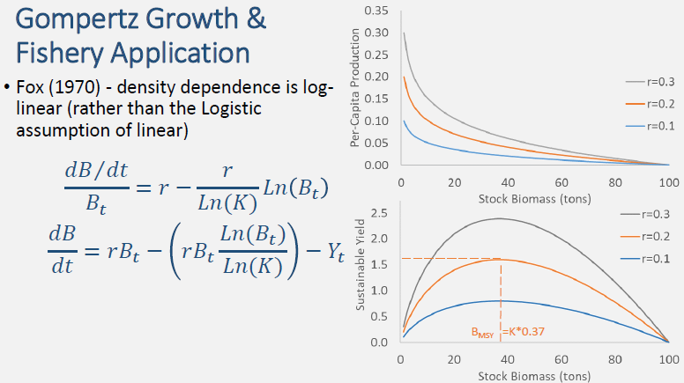

Slide 14
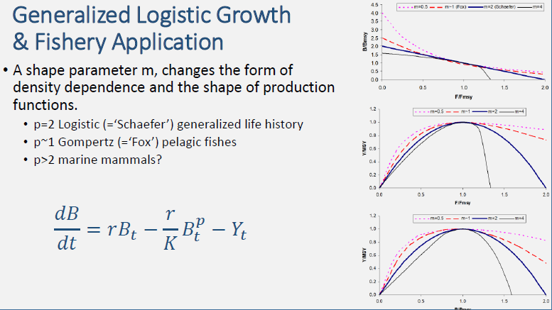

Slide 15
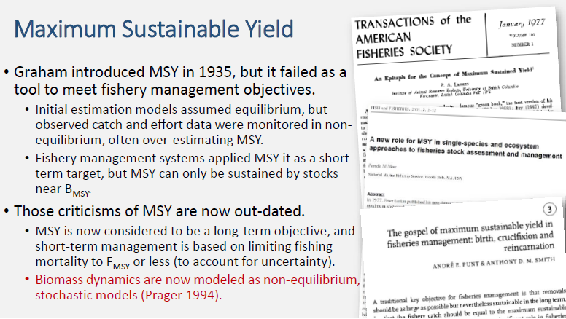

Slide 16
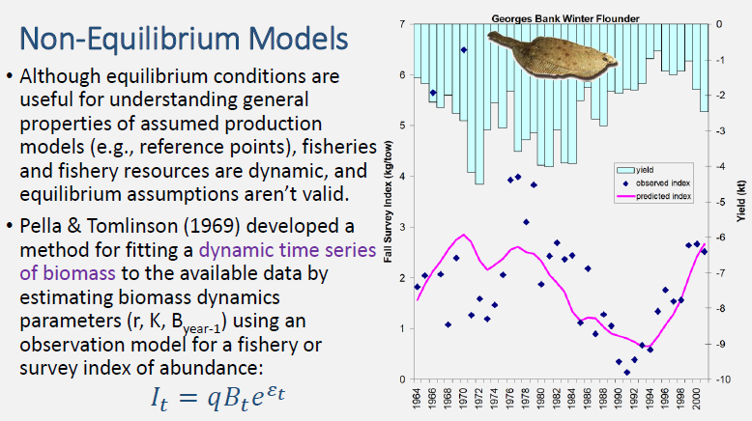

Slide 17
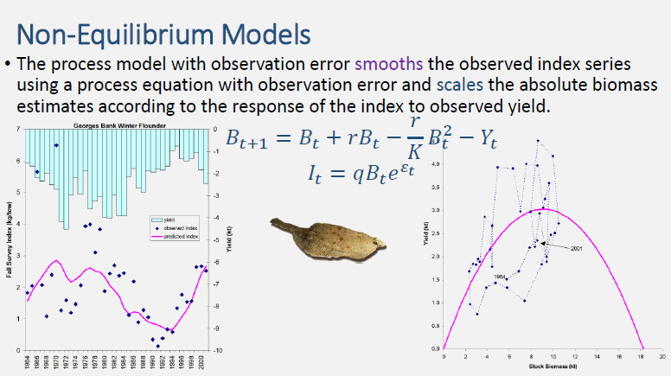

Slide 18
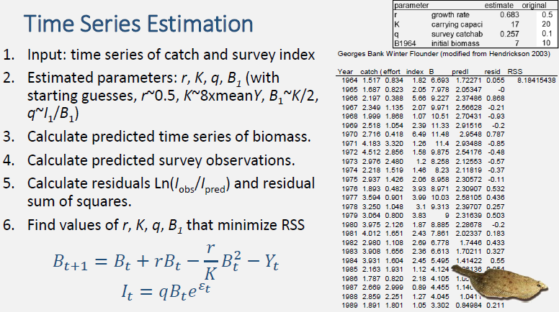

Slide 19
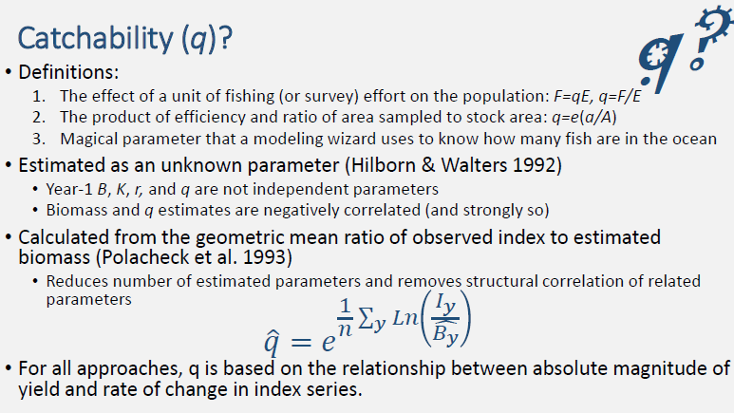

Slide 20
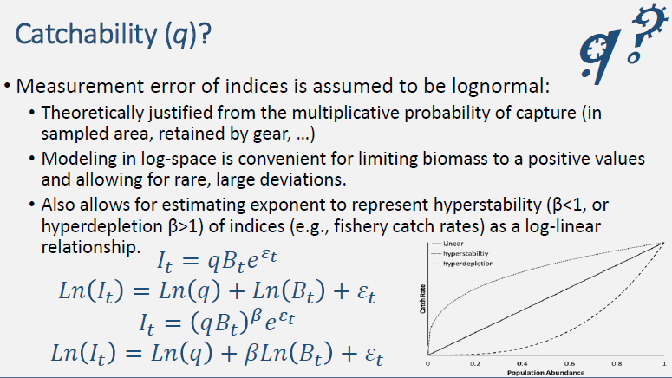

Slide 21
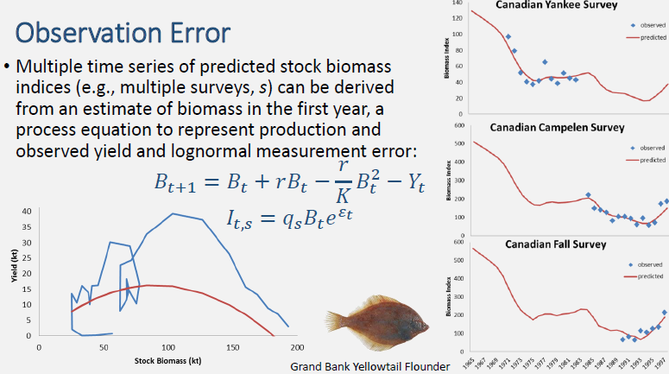

Slide 22
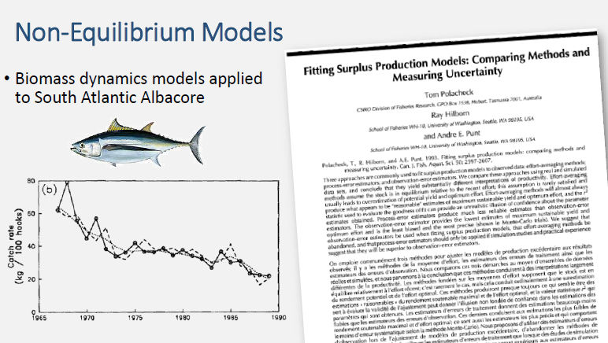

Slide 23
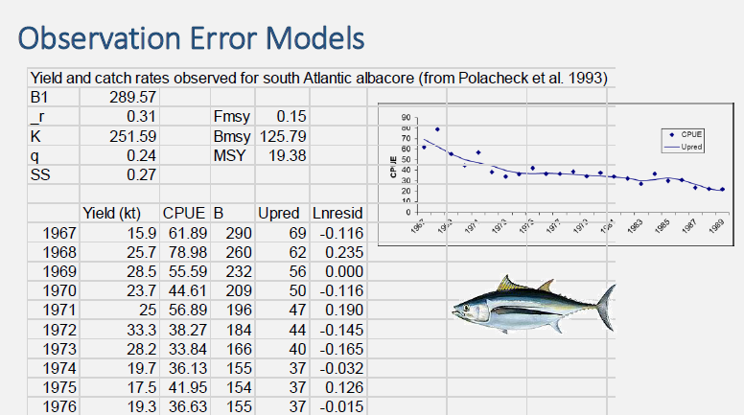

Slide 24
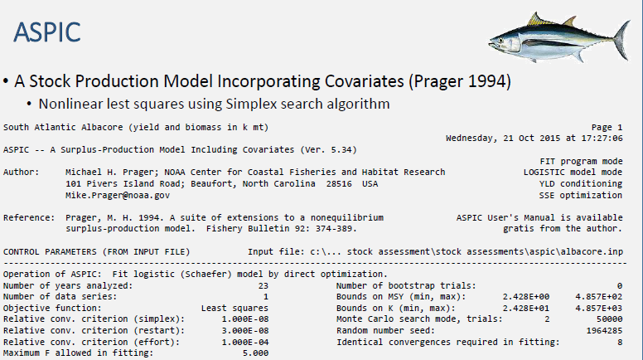

Slide 25
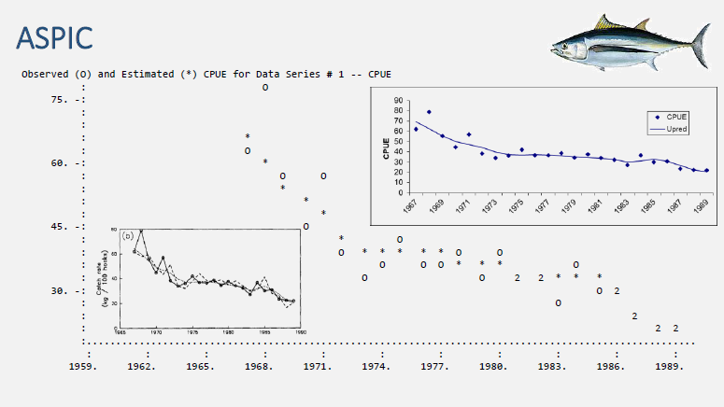

Slide 26
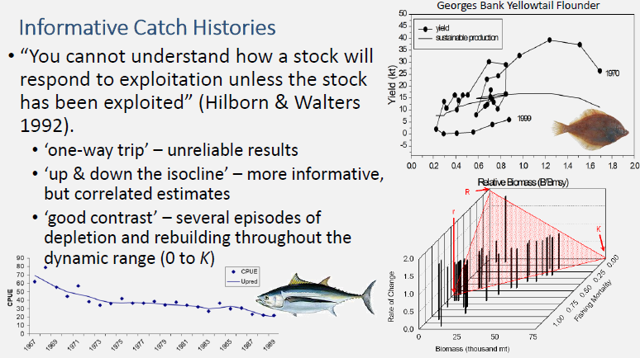

Slide 27
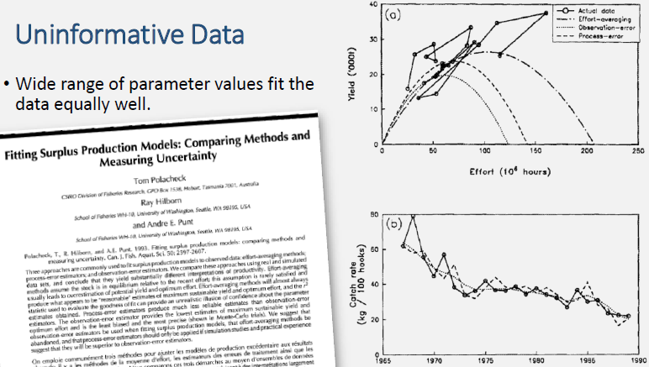

Slide 28
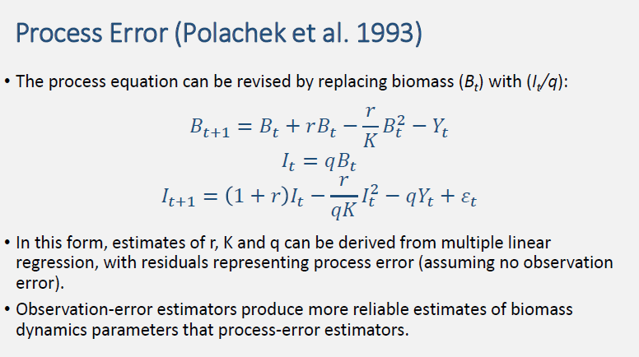

Slide 29
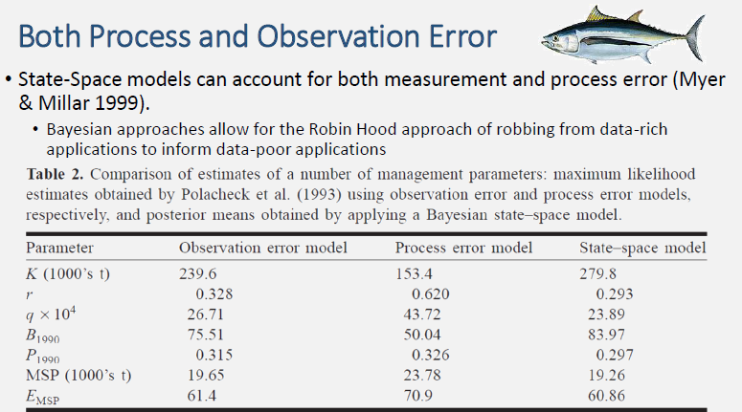

Slide 30
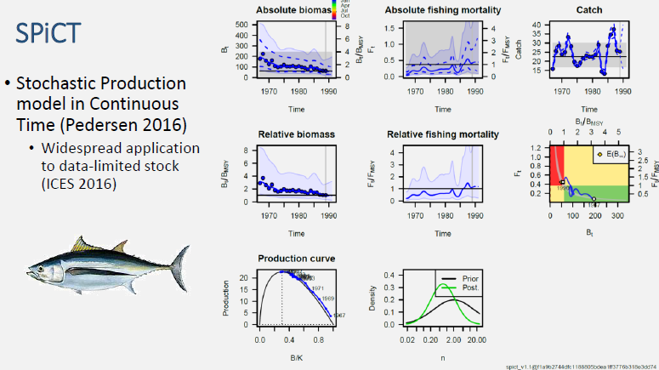

Slide 31
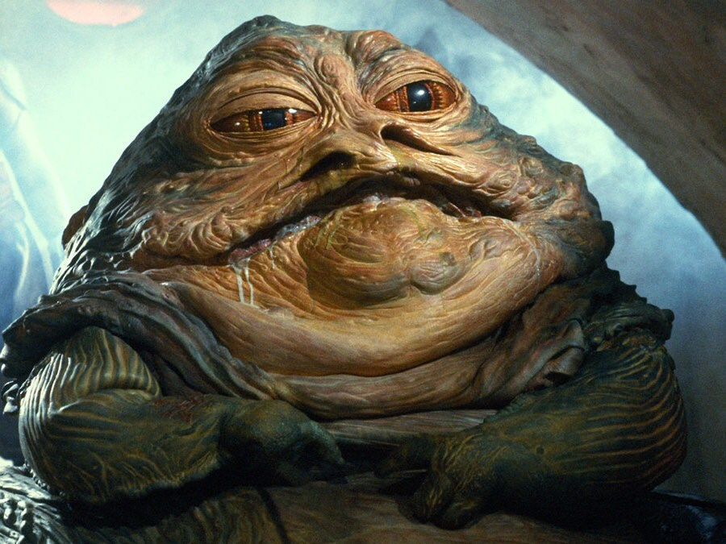
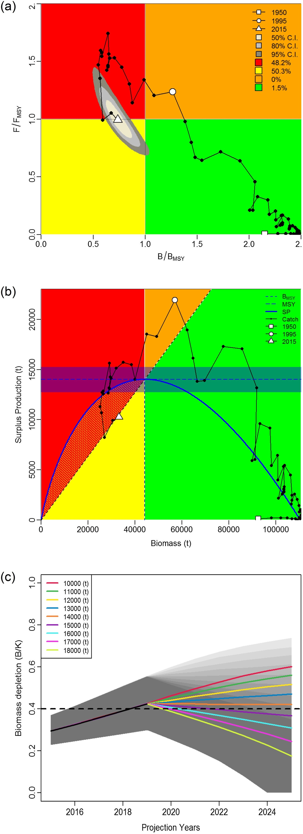
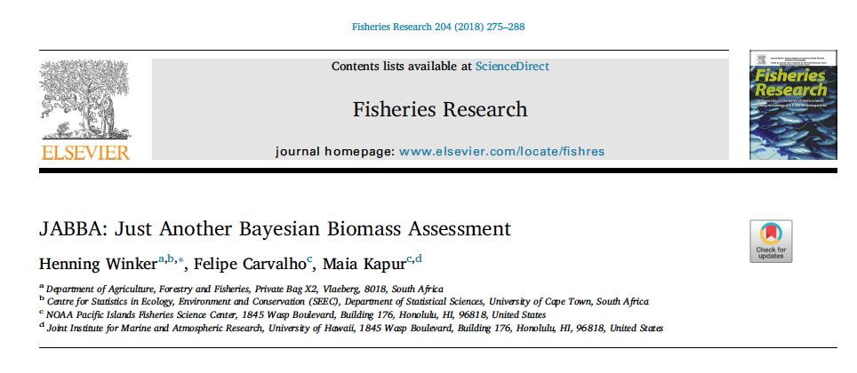
Lots of modern applications of biomass dynamics models, & packages e.g. JABBA (Just Another Bayesian Biomass Assessment)
an integrated state-space tool for averaging and automatically fitting multiple catch-per-unit-effort (CPUE) time series;
data-weighting through an estimation of additional observation variance for individual or grouped CPUE;
selection between Fox, Schaefer, or Pella-Tomlinson production functions, with the option to estimate the function as BMSY/K;
options to fix or estimate the process and observation variance components;
model diagnostics tools;
future projections for alternative catch regimes; and
a suite of inbuilt graphics illustrating model fits and diagnostics, surplus production estimates, historical stock status trajectories, Kobe plot, and future projections.
Winker et al. 2018, Fish Res
https://github.com/jabbamodel/JABBA

Slide 32
