Slide 1
MAR 580: Advanced Population Modeling for Management of Living Marine Resources
Numerical methods review &
State-space models revisited
02 October 2025

Slide 2
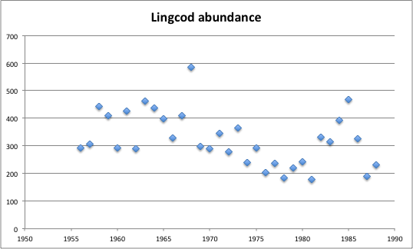
Linear state-space production model
The Gompertz population dynamics model:
Similar to other models, except density dependence is on ln(B) rather than B.
Application to lingcod survey data (Schnute 1994)
Schnute, J. T. (1994). A general framework for developing sequential fisheries models. Canadian Journal of Fisheries and Aquatic Sciences, 51(8), 1676-1688.

Slide 3
When are numerical methods used?
Main types of problems:
Differentiation
Integration
Interpolation / Extrapolation
Roots of equations
Solution of simultaneous equations
Nonlinear minimization
Matrix problems

Slide 4
Calculus
Differentiation
How steep is the curve at point x?
Integration
How much area is under the curve between a and b?
a
b
x

Slide 5
Taylor series approximation
“single most useful, and used, application of calculus for an ecologist” (Bolker 2009)
Approximates a complicated function near a point we care about using a simple function (e.g. 2nd order polynomial)
Useful applications:
Shapes of goodness of fit surfaces.
Delta method for estimating variance.

Slide 6
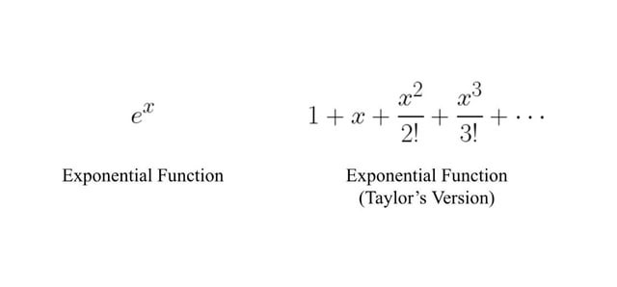
Taylor series approximation

Slide 7
Taylor series
Mathematically:
where the derivatives are evaluated at the point x₀
The approximation means dropping terms past the 2nd or 3rd. (e.g. ‘second-order Taylor approximation’…)

Slide 8
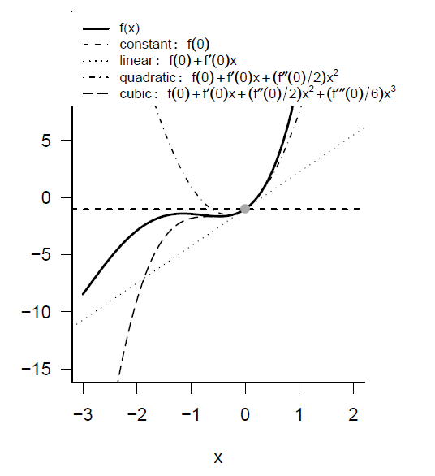
Taylor series expansion

Slide 9
Root-finding
Find the value for x such that the following system of equations is satisfied:
General problem frequently used in stock assessment and management.
Find K for a Schaefer model so that if the Schaefer model is projected from K in year 0 to year T, the biomass in year T equals Z.
Find the catch limit so that the probability of recovery equals a pre-specified value.
Find F_{0.1} so that:
Consider case when n=1.

Slide 10
Newton’s Method (Newton-Raphson)
Derivative-based method
Taylor series expansion of the function f:
For “small” values of δ and for “well-behaved” functions we can ignore the 2nd and higher order terms. We wish to find so:
Newton’s method iteratively applies the above equation.

Slide 11
Multi-dimensional problems
Find the vector x so that:
Either: use a multiple-dimension version of the Newton-Raphson method;
Or: Treat the problem as a non-linear minimization problem.

Slide 12
Multi-dimensional Newton-Raphson
The Taylor series expansion about x is:
This can be written as a series of linear equations:

Slide 13
Multi-dimensional Newton-Raphson
Given a current vector x^{old}, it can be updated according to the equation:
Rather than attempting to solve the system of equations, it is often more efficient to apply an optimization method to minimize a quantity:

Slide 14
Optimization
Non-linear minimization (or optimization) is the numerical technique that is used by far most frequently in fisheries assessments.
Problem:
Find the vector θ so that the function f(θ) is minimized.
maximizing f(θ) is the same as minimizing -f(θ)
We may place bounds on the values for some of the elements of f(θ)
(e.g. some must be positive).

Slide 15
Minimizing a function
Optimization is similar to root-finding
By definition, for a minimum:
There is no perfect algorithm.
The art of non-linear minimization is to know which method to use & how to determine whether the method has converged to the correct solution.

Slide 16
Minimizing a function
Many techniques to find the minimum (maximum) of a function. Choice among these depends on:
Cost of evaluating the function;
Cost of programming;
Cost of storing intermediate results;
Whether analytical or numerical derivatives are available;
Whether bounds are placed on some of the parameters.

Slide 17

Multidimensional methods
Most fisheries problems are (highly) multidimensional.
Derivative free:
Nelder-Mead (Simplex);
Direction-set methods (Powell’s method).
Derivatives required:
Conjugate gradient methods (Fletcher’s method);
Quasi-Newton methods
The basic result that drives these methods is the Hessian matrix.
Computing the Hessian matrix can be very demanding computationally so these methods approximate it numerically
Usually no reason not to use derivative-based methods if you can compute derivatives (cheaply).

Slide 18
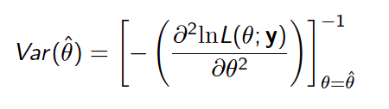
Calculating variance of estimates
Optimization routine provides us with the ‘best’ estimates.
Would like confidence intervals for parameters & derived variables (such as population size).
We can obtain variance estimates for parameters by inverting the Hessian.
How to obtain these for derived quantities?

Slide 19
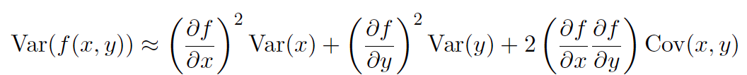
Delta method
The good news: RTMB will compute this for you automatically if you tell it to (i.e. via ADREPORT).

Slide 20
Fitting challenges
High-dimensional problems
Slow function evaluations
Use more efficient optimization method
Derive analytical expressions for parts
Rewrite code to compute objective function more efficiently, or implement in faster language
Allow lower tolerance for fits
Ask your advisor to buy you a faster computer
Discontinuities and thresholds
Multiple minima
Constraints
Add bounds to parameters [boundary issues]
Add penalties
Use transformations for parameters to avoid constraints

Slide 21
Troubleshooting
Understand the model you’re fitting
check starting conditions
check convergence conditions
adjust parameter scale/restart from previous best fit
switch from constraints to transformed parameters
adjust finite-difference tolerances
Results depend on starting conditions?
check slice between answers/around answers: multiple minima or just convergence problems?
Convergence problems: try restarting from previous stopping point, examine profile likelihoods.

Slide 22
Numerical integration
We wish to evaluate the integral:

Slide 23
Numerical integration: single step methods
We could approximate the integral by its height at its first point, at its last point, or at the middle.
Approximating the integral by the average of the first two approaches is the “Trapezoidal rule”.

Slide 24
Numerical integration
Trapezoidal rule: 0.68394
Simpson’s rule: 0.74718
Boole’s rule: 0.74683
Exact: 0.74682!

Slide 25
The error function, or how I learned to stop worrying & use someone else’s code.
Commonly required integral in fisheries is the “error function”:
Very accurate approximations to this integral have been programmed and are available in software libraries (e.g. NORMDIST in EXCEL, cumd_norm in ADMB, pnorm in R).
Someone may have already solved your problem; before writing your own code check if this is the case!

Slide 26
Estimation of mixed effects models
Maximum Likelihood Estimation (MLE)
is the vector of fixed effects parameters.
are the parameters controlling the distribution for the random effects.
We integrate across the random effects.
Effectively weight the probability of the observations given values for random effects by the probability of those values.
In the linear case, closed form solutions exist. For nonlinear models, we evaluate numerically or use approximations.

Slide 27
Fitting non-linear mixed effects models
R can be used to fit non-linear mixed effects models (function nlme).
To fit non-linear mixed effects models using RTMB or EXCEL you need to evaluate the integral numerically, or apply a method such as the Laplace approximation.
is the value of ε obtained by maximizing given fixed values of θ and τ, and is the determinant of the matrix of second derivatives.
This approximation is exact when the distribution of random effects (given their hyper-prior and the available data) is exactly proportional to a multivariate normal distribution. (It is a convenient approximation in other cases)
Skaug & Fournier (2006), Thorson & Minto (2015)

Slide 28
Estimating state-space models
Various methods exist for obtaining the (log) likelihood, and then to maximize it.
Kalman filter (Kalman, 1960)
Seminal work, for linear state and observation models when process and observation errors are Gaussian.
Additional filters relaxing some assumptions
(Extended Kalman filter, unscented Kalman filter, etc.)
Expectation-Maximization (EM) algorithm
Laplace approximation (e.g. ADMB)
Importance sampling
Estimation can also be achieved in a Bayesian framework. (e.g. with Markov Chain Monte Carlo)

Slide 29
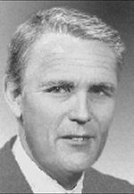

Kalman filter (Kalman, 1960)
statistical estimation theory
^
“…possibly the greatest discovery of the twentieth century”
(Grewal & Andrews, 2001)
Many applications in technology: guidance & navigation of aircraft and spacecraft. Widely applied concept in time series analysis, used a lot in signal processing and econometrics.
First implementation (Schmidt) at NASA applied to trajectory estimation for the Apollo program.
Yes, this really is rocket science.

Slide 30
Kalman filter
Has seen wide use in fisheries literature.
A recursive procedure to estimate the distribution for the state vector of a state-space model when:
The process model is linear
Observations are a linear function of the state variables
Process and Observation errors are additive and normally distributed.
Generates T probability distributions for the states n_{t}, t=1,...,T , conditioned on f(n_{t}|y_{1:t}).
Because of the constraints, these distributions are normal, so can be summarized by their mean and variance-covariance matrices.
Once applied, the Kalman filter opens the door to parameter estimation through maximum likelihood, smoothing, etc.

Slide 31
The Kalman filter cookbook
Define the initial estimate of the state vector at t=0, i.e. with mean a₀ and Var P₀
At time t:
Predict the mean and variance of the estimate of the state vector at time t from the estimate at time t-1 given the data until t-1
Confront estimate with observation at time t
Update estimate at time t given data at time t
And so on…

Slide 32
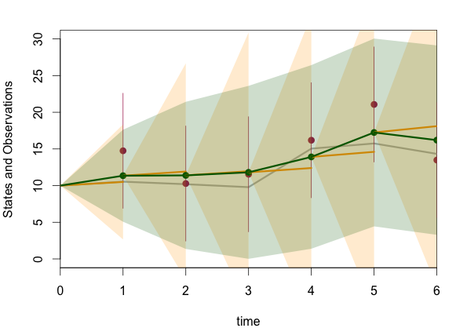
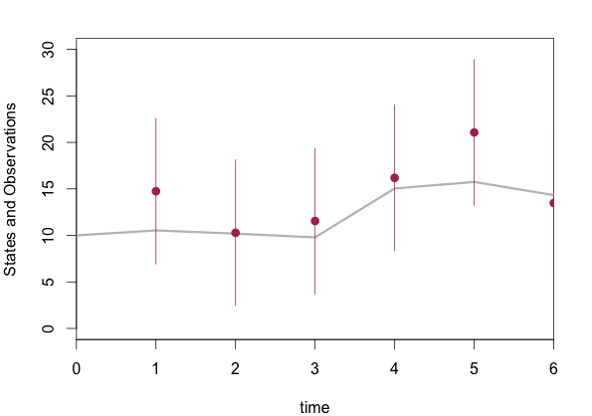
Kalman filter
Consider time series of observations, start at t=0

Slide 33
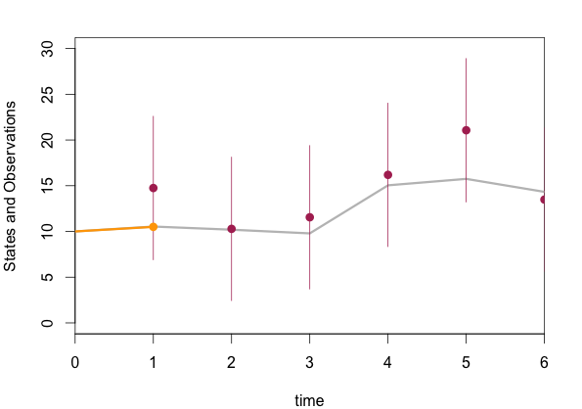
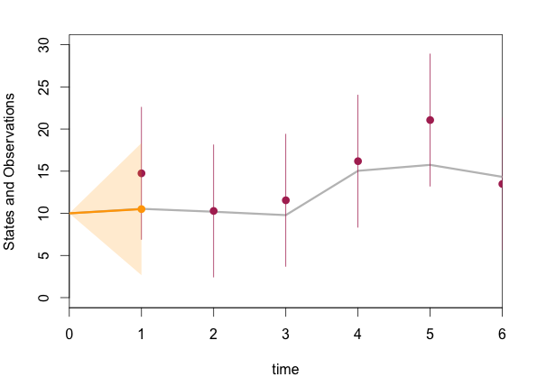
Kalman filter
Apply state process model to PREDICT state at t=1

Slide 34
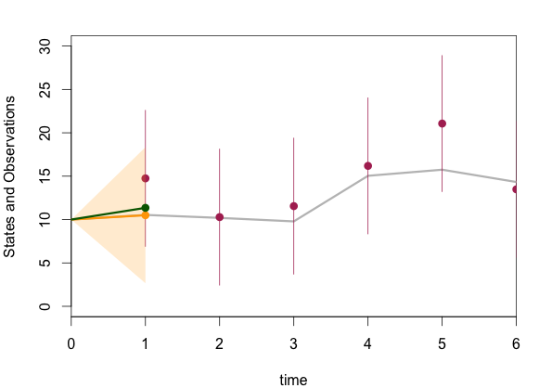
Kalman filter
Compare prediction to observation and UPDATE.

Slide 35
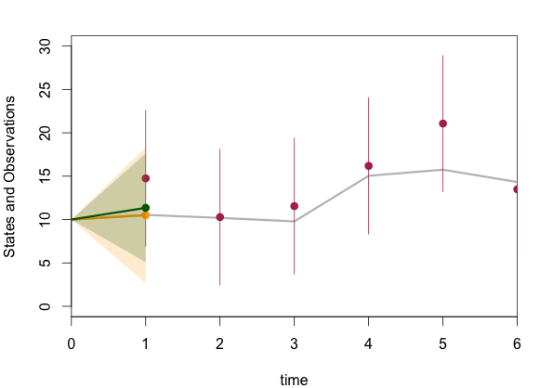
Kalman filter
Compare prediction to observation and UPDATE.

Slide 36
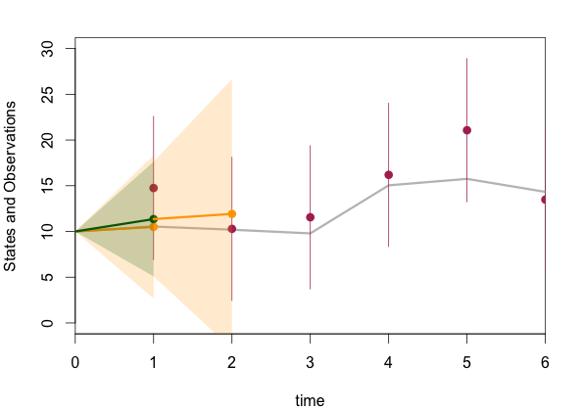
Kalman filter
Predict state vector at time t=2 using process model

Slide 37
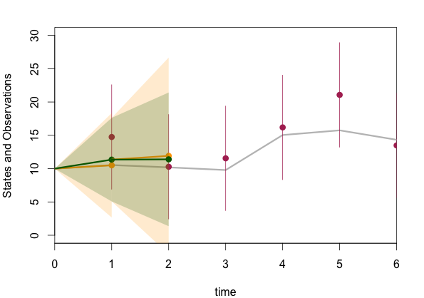
Kalman filter
Update prediction for t=2 based on data at t=2

Slide 38
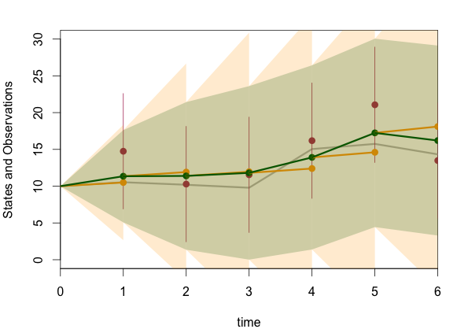
Kalman filter
Continue predict-update steps for t=3, 4, 5, …

Slide 39
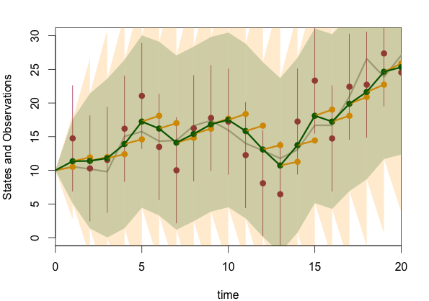
Kalman filter
Run filter through all time-steps

Slide 40
Parameter estimation using Kalman filter
Previous example, parameter values were known.
The Kalman filter yields:
Observation equation
Residual covariance
Predicted (apriori) state estimate covariance
Observation error variance

Slide 41
Estimation of linear state-space models in R
Lots of available functions that can apply KF and estimate parameters.
e.g. fkf() in package FKF, StructTS() in base stats.
Tusell (2011). J. Stat. Softw. 39(2) gives a good overview of options (likely now outdated).
Also the code provided by Newman et al. (2014).
The MARSS package is a very powerful and flexible framework for fitting multivariate linear state-space models. (https://cran.r-project.org/web/packages/MARSS/vignettes/UserGuide.pdf)
Estimation is primarily using the EM algorithm, however recent implementation in TMB via https://atsa-es.github.io/marssTMB/index.html

Slide 42
Estimating state-space models in RTMB
Take advantage of the conditional distribution for the states:
i.e. make the state variables the random effects, e.g.
For our biomass dynamics model:
Conditioned on the biomass at the previous time step, this model is separable, i.e. ln(B_{t}) does not depend on ln(B_{t-2}).

Slide 43
Estimating process and observation error
Separably estimating process and observation error can be problematic.
Often, best fit obtained when estimating either of these at zero (log of 0 is VERY small).
Performance of Kalman filter to estimate both process and observation error degrades with increasing missing data (hence why MARSS used the EM algorithm).
Early solution was to assume the ratio between these was known.

Slide 44
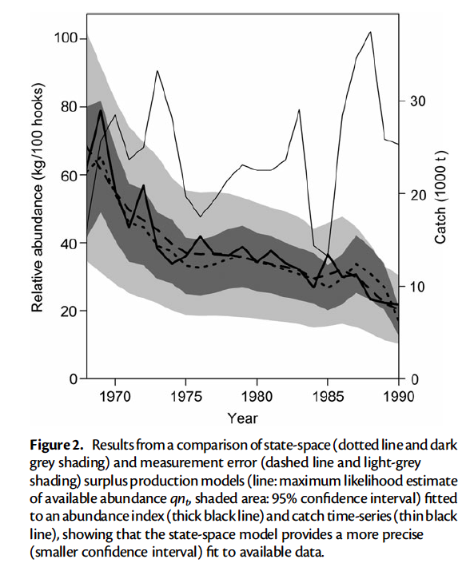
Non-linear state-space production model
Thorson & Minto (2015)
State-space Schaefer production model fitted to tuna data from Meyer & Millar (1999).

Slide 45
Take homes
State-space approach provides robust framework for simultaneously considering uncertainty associated with population processes and observations.
Increasingly being used for management advice.(e.g. SAM & WHAM, age-structured state-space fisheries model (Nielsen & Berg 2014, Stock and Miller )).
Readily handles missing data.
Easy to extend the univariate models considered here:
Multiple state variables for population stages
Parameters or environmental covariates modeled as state variables, and include process model for these.
Hierarchical approach to share information among time series (e.g. common trends, Dynamic Factor analysis)

Slide 46
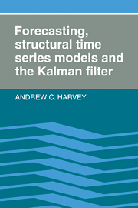
Recommended Reading

Slide 47
Course Projects
Analysis applying 1 or more methods in class to problem or data set
Individually or small groups
What are your ideas?

Slide 48
Recommended Reading
de Valpine, P., & Hastings, A. (2002). Fitting population models incorporating process noise and observation error. Ecological Monographs, 72(1), 57-76.
Harvey, A. C. (1990). Forecasting, structural time series models and the Kalman filter. Cambridge university press.
Holmes, E. E., Ward, E. J., & Wills, K. (2012). Marss: Multivariate autoregressive state-space models for analyzing time-series data. The R Journal, 4(1), 11-19.
Kalman, R. E. 1960. A new approach to linear filtering and prediction problems. Transactions of the ASME–Journal of Basic Engineering 82(Series D): 35–45.
Meinhold, R. J., & Singpurwalla, N. D. (1983). Understanding the Kalman filter. The American Statistician, 37(2), 123-127.
Nielsen, A. and Berg, C. W. 2014. Estimation of time-varying selectivity in stock assessments using state–space models. Fisheries Research 158(1):96–101.
Newman, K. B., Buckland, S. T., Morgan, B. J., King, R., Borchers, D. L., Cole, D. J., ... & Thomas, L. (2014). Modelling Population Dynamics. Springer.
Pedersen, M.W., Berg, C.W., Thygesen,U. H., Nielsen, A., and Madsen, H. 2011. Estimation methods for nonlinear state-space models in ecology. Ecological Modelling, 222: 1394–1400.
Punt, A. E. (2003). Extending production models to include process error in the population dynamics. Canadian Journal of Fisheries and Aquatic Sciences, 60(10), 1217-1228.
Schnute, J. T. (1994). A general framework for developing sequential fisheries models. Canadian Journal of Fisheries and Aquatic Sciences, 51(8), 1676-1688.
Thorson, J. T., & Minto, C. (2015). Mixed effects: a unifying framework for statistical modelling in fisheries biology. ICES Journal of Marine Science: Journal du Conseil, fsu213.

