Slide 1
Introduction to State Space Models for Ecology and Quantitative Fisheries Management
Greg Britten
11/01/2022

Slide 2
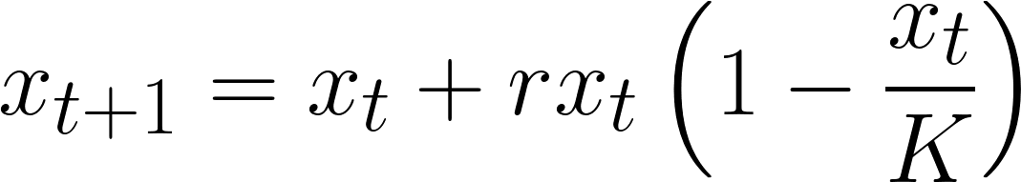
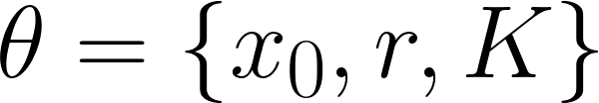
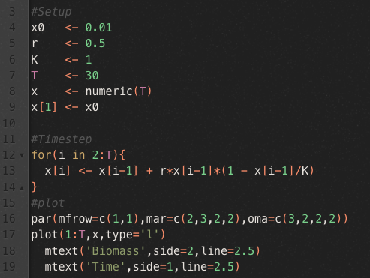
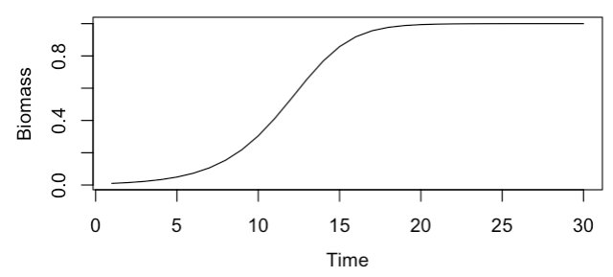
Simple starting point

Slide 3

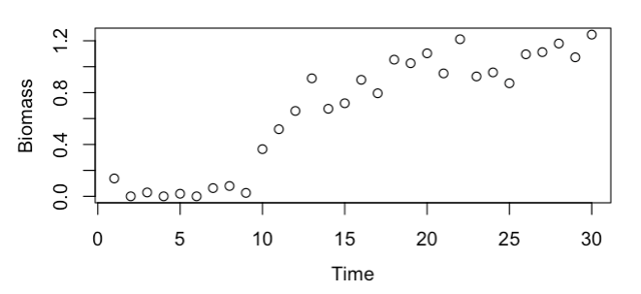
Add some observational noise

Slide 4
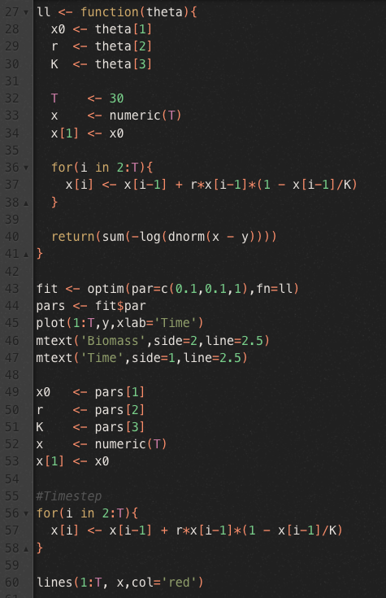
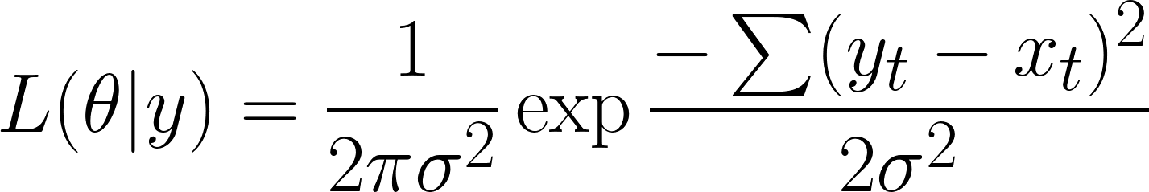
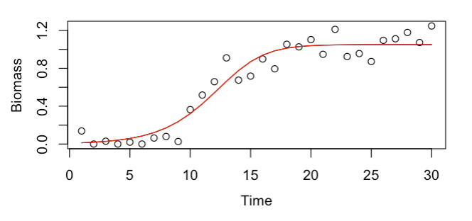
Traditional model fitting
Maximize the likelihood assuming the model is perfect

Slide 5
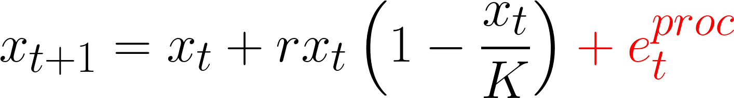
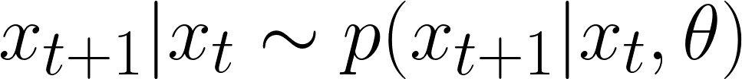
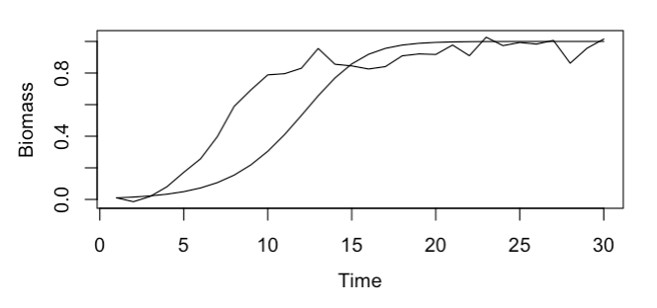
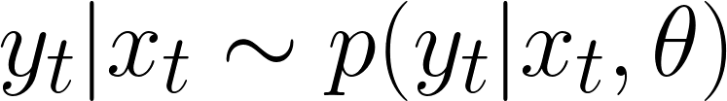
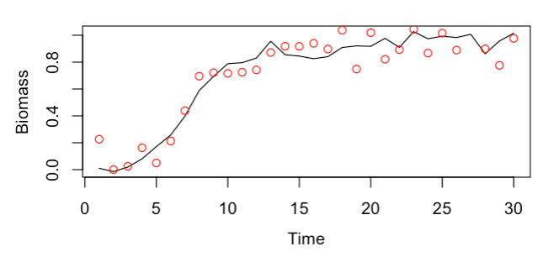
State space models do not assume the model is perfect
State probability
Data probability (likelihood)
Stochastic observation error added on top of stochastic state space

Slide 6






State space models do not assume the model is perfect
Conditional independence structure allows us to write down the joint likelihood

Slide 7

Stan: a language for specifying Bayesian statistical models
Introduction to Stan outside scope of course
Briefly, Stan performs fast Markov-Chain Monte Carlo which using random number generation to approximate the posterior probability distributions of a Bayesian model
Stan performs particularly fast calculations using Hamiltonian Monte Carlo
Bayesian vs. classical approach are just (slightly) different ways to estimate the parameters of the model - all other state space model concepts are Bayesian/classical agnostic
mc-stan.org

Slide 8
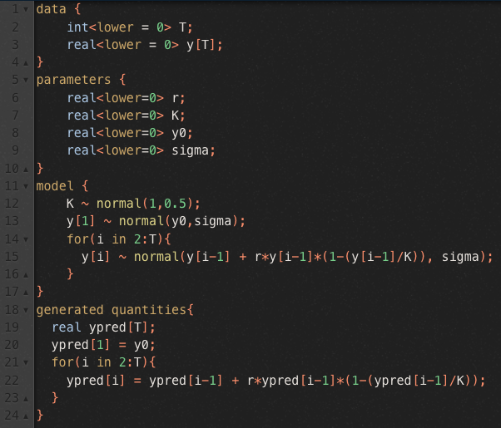
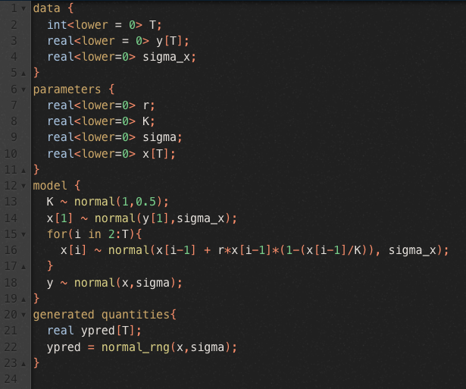
Two Stan codes
Deterministic process model
State space model

Slide 9
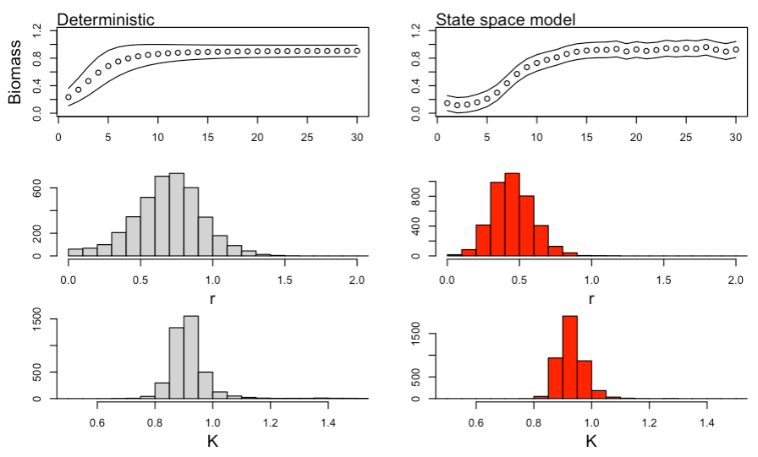
Two Stan codes

Slide 10
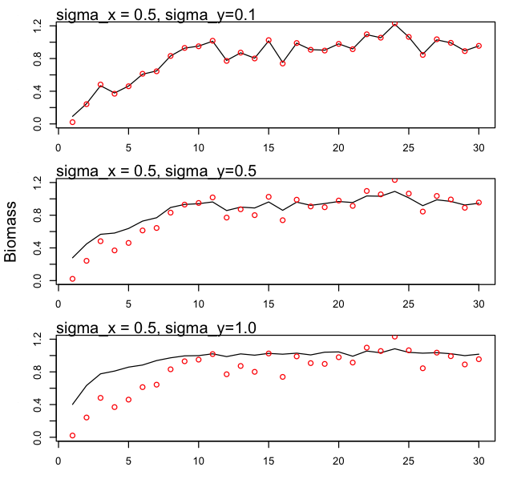
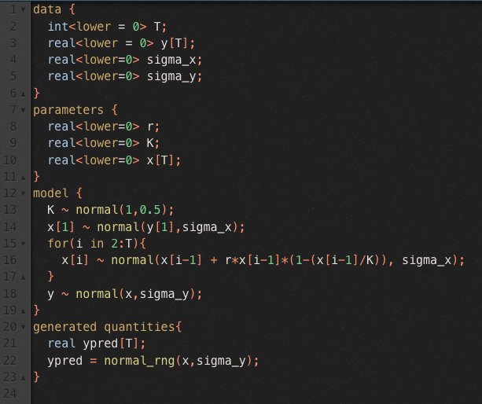
Do you believe the model or the data more?
State space models allow stochastic error in the model - but the relative amount of process vs. observation error matters

Slide 11
Do you believe the model or the data more?
State space models allow stochastic error in the model - but the relative amount of process vs. observation error matters
Separating process and observation error is often the most challenging aspect of state space modeling
Extremely helpful to have prior information about one, both, or the ratio of the two

Slide 12
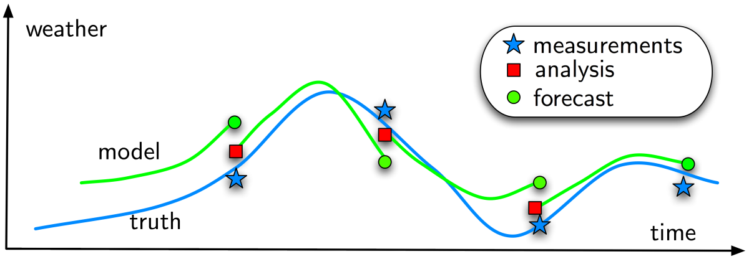
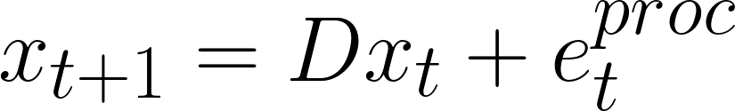
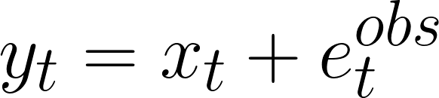
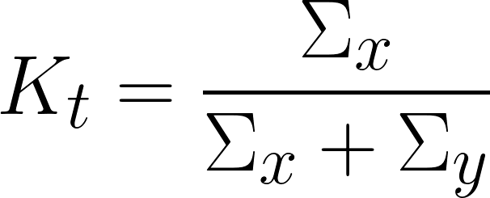
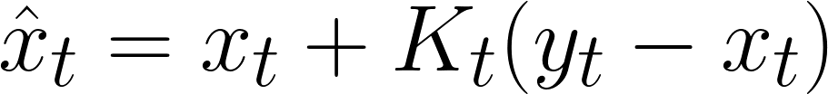
Connection to sequential data assimilation
State space models can also be solved sequentially by updating forecasts at individual time points where there are data
Common for numerical weather prediction
Simplified Kalman filter equations:
Kalman ‘gain matrix’ Kt take a weighted average of the model and observations according to the ratio of state and observation error
Application of Bayes theorem to individual state transitions for linear, Gaussian systems

Slide 13
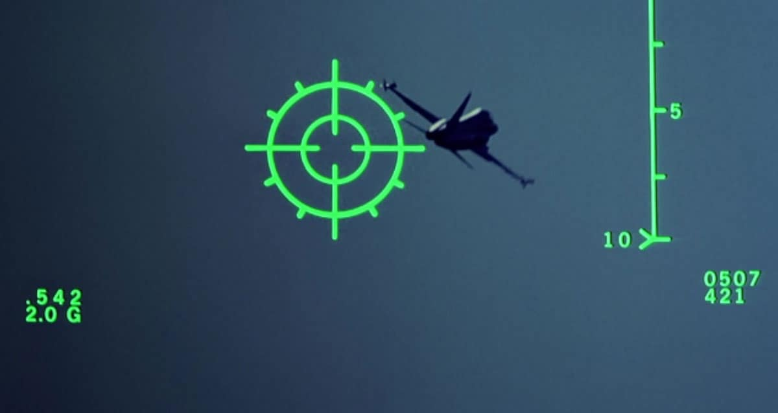
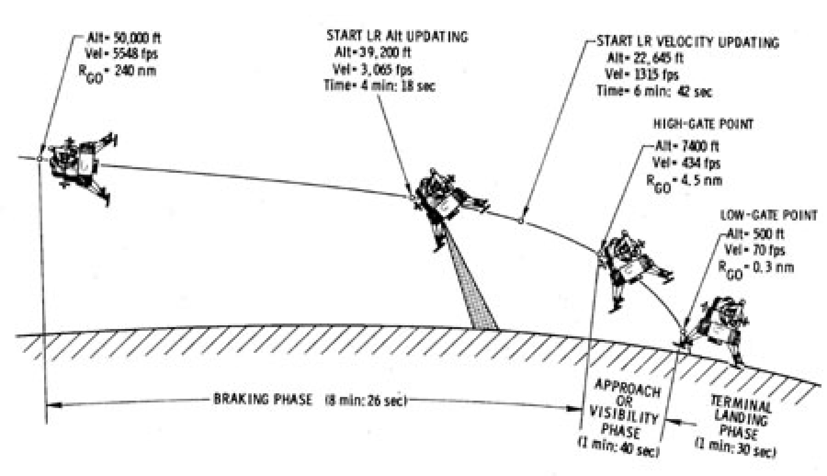
Connection to sequential data assimilation
State space models can also be solved sequentially by updating forecasts at individual time points where there are data
Common for numerical weather prediction
Simplified Kalman filter equations:
Kalman ‘gain matrix’ Kt take a weighted average of the model and observations according to the ratio of state and observation error
Application of Bayes theorem to individual state transitions for linear, Gaussian systems

Slide 14
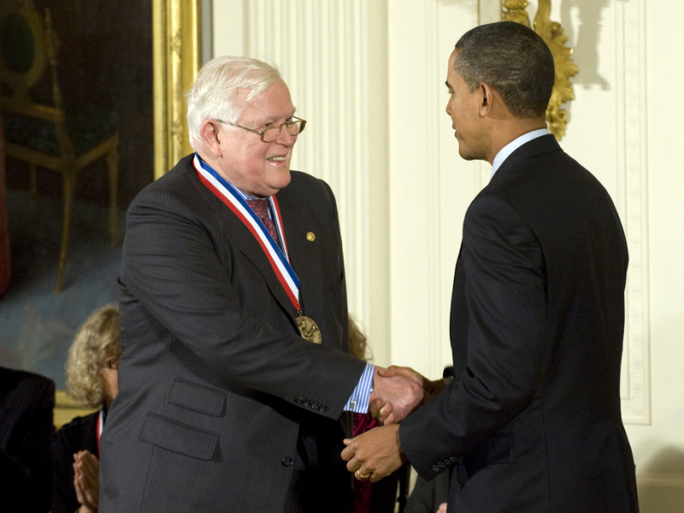
Connection to sequential data assimilation
State space models can also be solved sequentially by updating forecasts at individual time points where there are data
Common for numerical weather prediction
Simplified Kalman filter equations:
Rudy Kalman received National Medal of Science in 2009
“For his fundamental contributions to modern system theory, which provided rigorous mathematical tools for engineering, econometrics, and statistics, and in particular for his invention of the Kalman filter … which is an algorithm that removes “noise” from streams of data and increases accuracy.”
nationalmedals.org
Kalman ‘gain matrix’ Kt take a weighted average of the model and observations according to the ratio of state and observation error
Application of Bayes theorem to individual state transitions for linear, Gaussian systems

Slide 15
Extensions to the sequential approach
Kalman filter equations require matrix inversions which are computationally infeasible for large systems (like modern weather models)
Sample-based ‘ensemble’ Kalman filters are used where model ensemble is used to approximate some of the underlying covariance matrix calculations
Kalman filter equations based on linearity and normality assumptions
Nonlinear systems can be locally linearized to apply the Kalman filter equations
Particle filters propagate an ensemble of models using fully nonlinear equations and cull/resample ensemble members at each timestep based on the likelihood

Slide 16
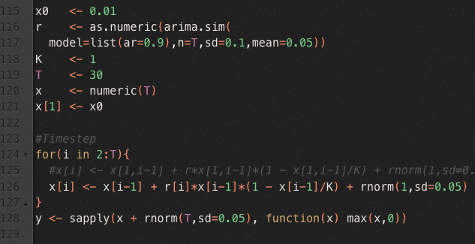
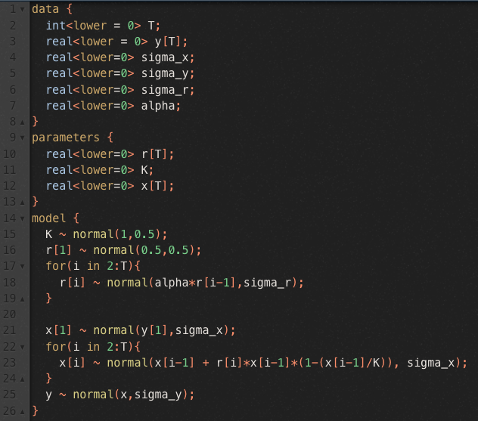
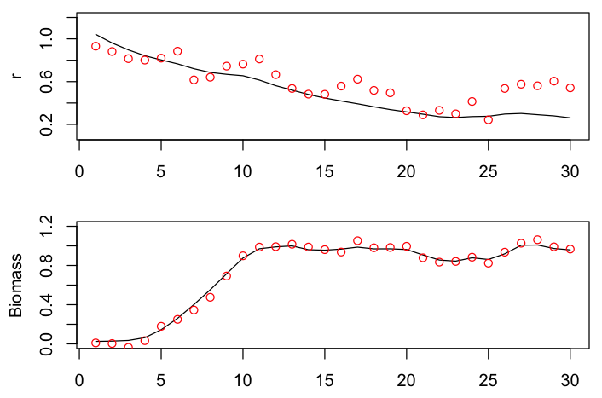
Time-variation in parameters
Temporal variation in system parameters is an important source of model error that can be described with state space models

Slide 17
Forecasting
State space models allow for probabilistic forecasting under multiple sources of uncertainty
Stochasticity in state/time-varying parameter naturally propagated into the future for uncertainty quantification
Sequential methods are algorithmically well suited for forecasting as one simply skips the update/analysis step

Slide 18
State vs. parameter estimation
A subtle but important distinction between states and parameters in state space models
A state is dynamically specified via the state equation A parameter is conditioned upon in the state equation
Ecological and statistical parameters are contained in theta
Parameter estimation generally much more challenging than state estimation
E.g. update step in Kalman filter
E.g. growth rate ‘r’ treated as both parameter and state in examples above

Slide 19
Software for estimation of state space models
MCMC
Stan, BUGS/JAGS
Maximum marginal likelihood (more on this next day)
AD Model Builder, TMB
Sequential filters
pomp, statespacer, KFAS, dlm

Slide 20
Software for estimation of state space models
MCMC
Stan, BUGS/JAGS
Maximum marginal likelihood (more on this next day)
AD Model Builder, TMB
Sequential filters
pomp, statespacer, KFAS, dlm
Likelihood/posterior using full data vector is the target
Individual state transition is the target Full likelihood/posterior built up recursively
In theory both are mathematically equivalent, but some approximations can be introduced depending on method

Slide 21
Summary
Key takeaway: state space models allow error in the underlying process model
Separating process and observation error allows us to better model the error processes and thereby better resolve underlying ecological dynamics
Specifying/estimating process and observation error contributions can be challenging
Key applications include modeling underlying time-variability in system parameters and forecasting
Several excellent software packages available for estimation of state space models

