Slide 1
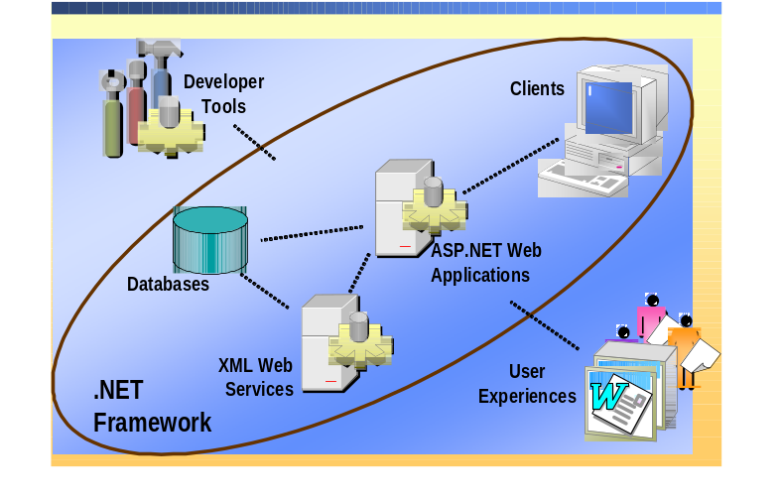
.NET Framework

Slide 2
.NET Framework and Tools
VB
C++
C#
J#
Cobol…
Visual Studio .NET
Common Language Specification
ASP .NET
Web Forms Web Services
Mobile Controls
Windows
Forms
ADO .NET and XML
Base Class Library
Common Language Runtime
Operating System

Slide 3




A Unified Programming Model
Windows
Web
Mobile
.NET Framework
Consistent API availability regardless of
language and programming model

Slide 4
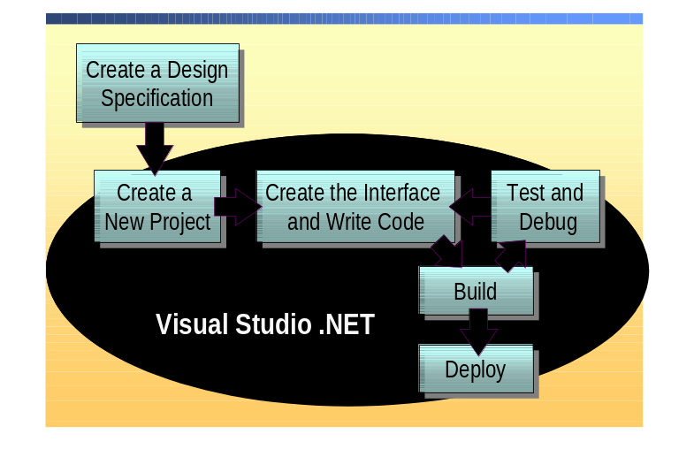
Creating an ASP.NET Web Application Project

Slide 5
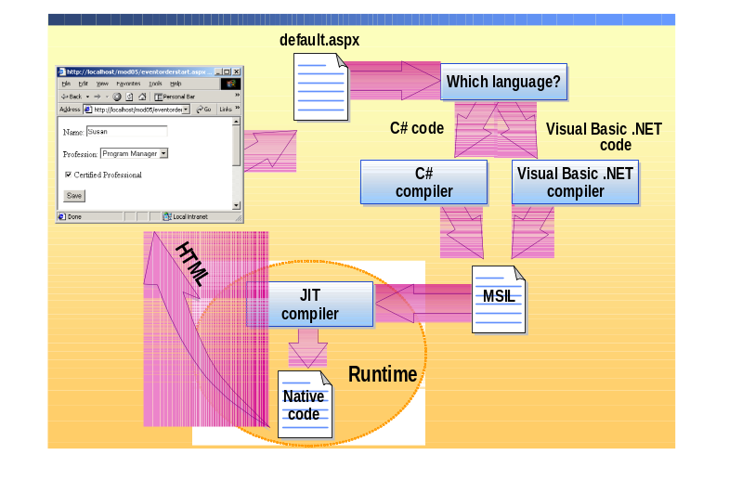
Runtime Compilation and Execution
Notes:
KEY MESSAGE: .NET is a complete application platform, Visual Studio is the best tool to access the resources of that platform.
BUILD STEPS: 5
BUILD 1:
.NET is built on top of the operating system. It isn’t directly a part of the OS, and multiple platforms are supported, including PocketPC. Because .NET has been standardized through ECMA, it can potentially be implemented on other operating systems. The specs are publicly available.
BUILD 2:
When you compile your source code, the file is compiled to an intermediate language, called MISL.
When your application executes, it will be managed by the Common Language Runtime. The runtime performs JIT compile, and monitors security access requests. The CLR also communicates with the underlying OS, to perform the tasks that your application requests.
BUILD 3:
Your project uses classes from the base class library, to access the database, file system, network, etc. This base class library is very comprehensive and features special classes for creating, manipulating and consuming XML.
These classes are available to every supported .NET language.
Though web apps and client apps are pretty different in a lot of ways, in Visual Studio the programming model for both is the same.
BUILD 4:
At the top, .NET lets you choose from a number of languages. The choice is made on which language is best suited to the application you are building. You can build different parts of the project in different languages, or reuse components previously written in a different language than the one you are currently using. And you can inherit and extend objects across languages, not just invoke them.
BUILD 5: You can create .NET applications using notepad or EMAX, but why would you want to?

Slide 6
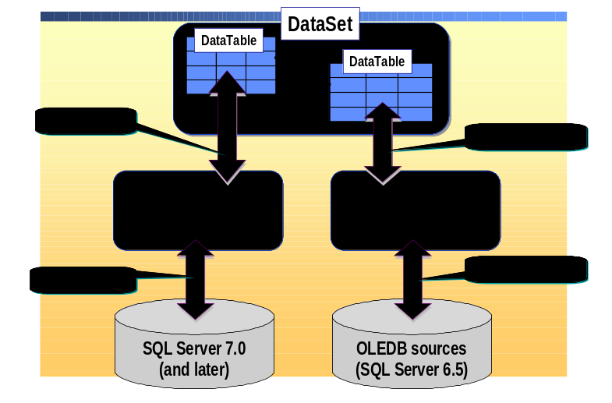
The ADO.NET Object Model

Slide 7
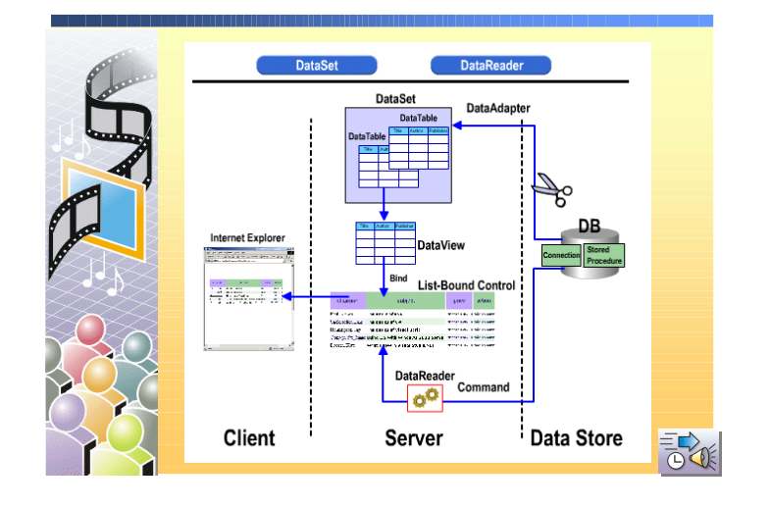
ADO.NET: DataSets vs. DataReaders

