Slide 1
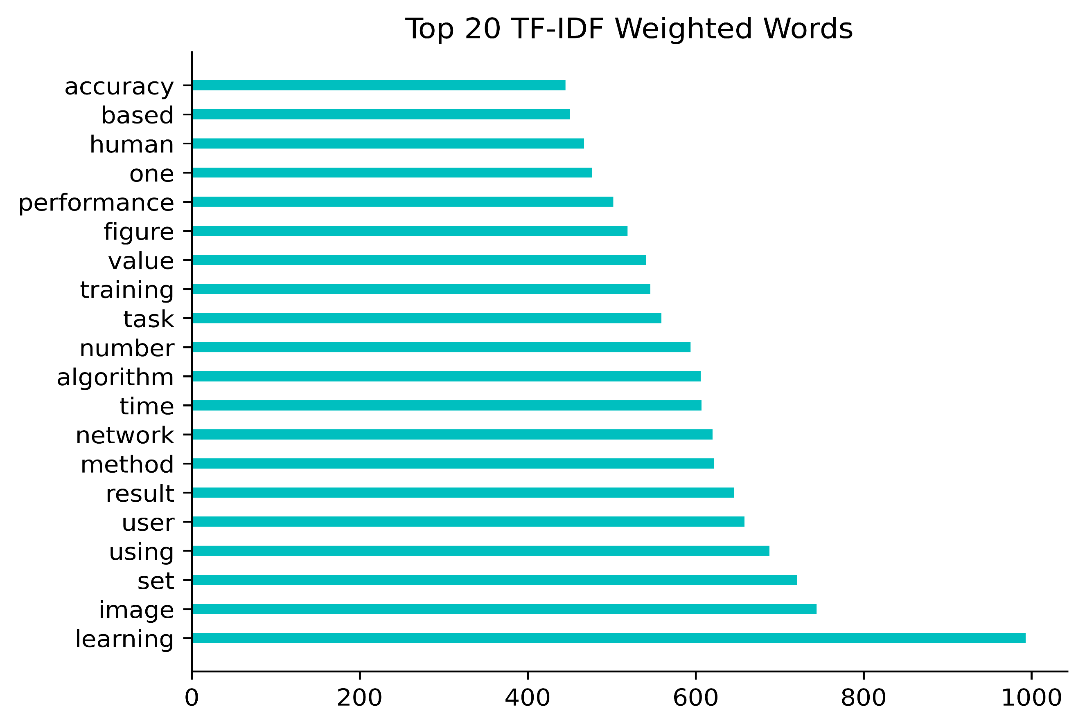
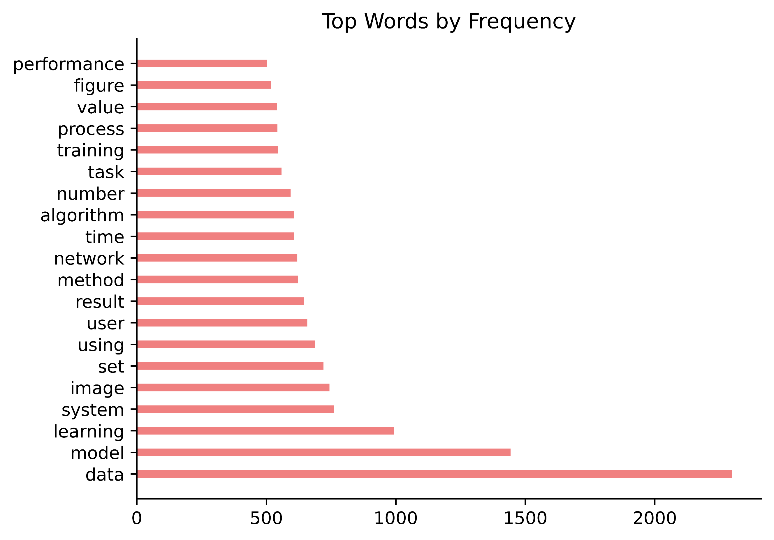
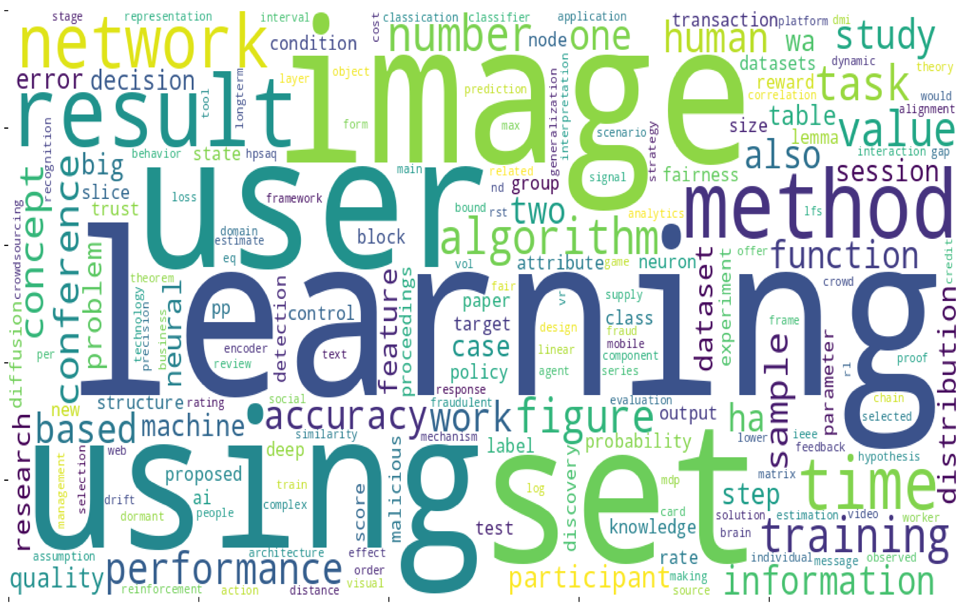
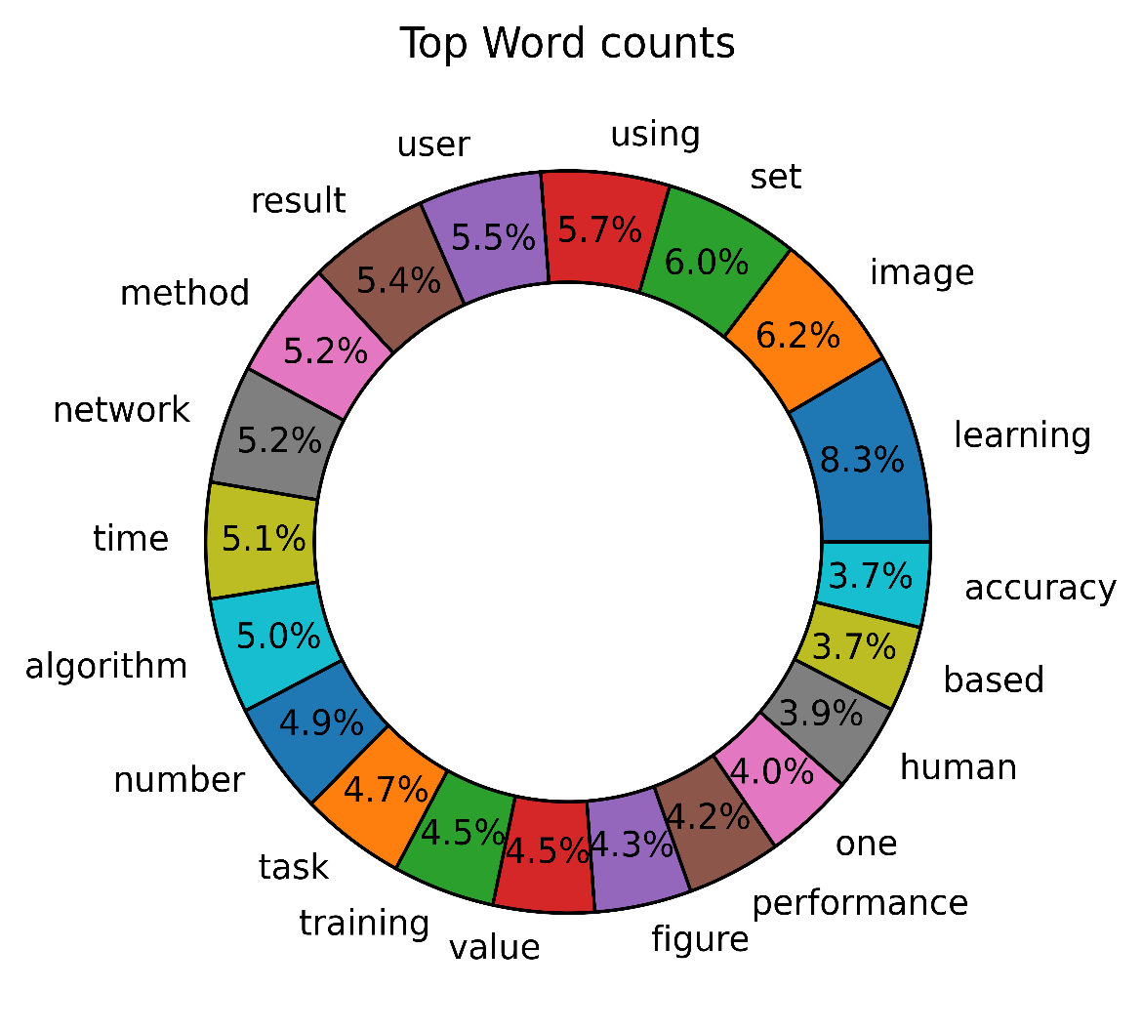
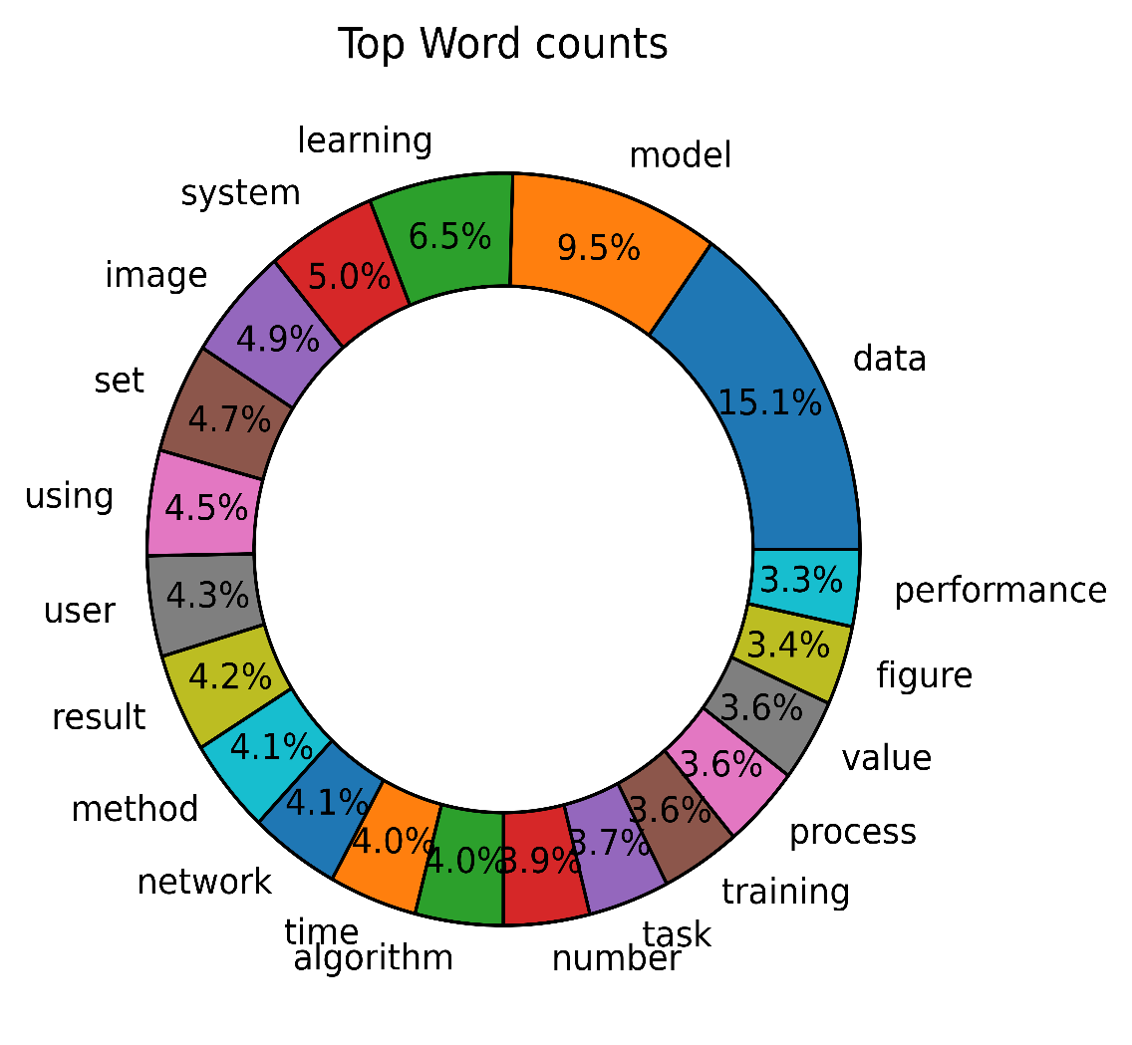
Identifying Relevant topics in Data Science
Gavin Gray, Zach Beck, Dr. Richa Sharma
Department of Mathematics, Computer Science & Digital Forensics, Commonwealth University
Abstract
Methodology and Algorithm
Identifying the topics in electronic documents has been of interest with increasing volume of various kinds of digital documents including news articles, research papers, blogs, feedbacks, review comments etc. The topics of electronic documents are governed by the characterizing words on them. One can apply Information Retrieval (IR) techniques to identify the characterizing words with the objective of finding thematic topic on the documents.
We have applied one of the IR techniques, TF-IDF to find the characterizing words on a set of research papers. We have worked to review 40 research papers within Data Science sub-area of Computer Science and identify topics in terms of words on those papers other than their listed keywords. We have found TF-IDF approach working good for research papers in our study. We present the visualized outputs of our study.
Objective: Our study is focused at validating if TF-IDF is an effective tool to identify topics on research papers. We have validated our results against the manual review of the research paper papers.
The research papers in Data Science center focus on either the development or improvement of an algorithm or the application of an algorithm to business or scientific domain. We carefully selected a mixed set of 40 papers including papers on algorithm design and their applications. Next, we conducted our study on this dataset.
Algorithm:
Generate text files from the pdf version of the research papers.
Clean the generated text files to get rid of non-alphabetical characters.
Remove standard stop-words from the cleaned text files.
Apply lemmatization to the terms on the text files.
Calculate TF-IDF for each document on the dataset and store the TF-IDF output in an appropriate data structure for further processing to get visualized results.
Sort the output, extract top weighted frequency terms as a set for each document, compute symmetrical differences of these sets.
Generate word cloud for the terms obtained in step-6.
Figure 1. Top 20 weighted frequency terms
Introduction
Research papers are different from other textual datasets that are usually not technical in nature. The vocabulary of these datasets is, therefore, quite different from that of the research papers. The IR techniques that work well for non-technical datasets, at times, are not equally applicable to technical documents such as research papers. However, there is an increasing interest in finding the relevant research paper that seem interesting and useful to the researcher. The title of the paper and the listed keywords of the paper are not always sufficient to get an insight into a detailed view of the research paper context.
We explored following research questions on our study:
Within the context of the research paper, do the retrieved words characterize the paper itself?
Are there trends to be found with reference to the retrieved words and the subtopics of the paper?
We decided to work with TF-IDF approach of the available IR techniques for its simplicity and meaningful coherence to the aim of our study. TF-IDF approach, as applied to a dataset of documents, can be understood as:
Term-Frequency (TF): is the frequency of each term in a document.
Inverse Document Frequency (IDF): is a measure of uniqueness of a term to a document with respect to a dataset of documents.
TF-IDF: being the product of TF and IDF, it serves as a measure of the term frequencies weighted by the terms unique to the dataset.
Figure 2. Top 20 non-weighted frequency terms
Chart 1. Word Cloud of 531 high-weighted frequency words
Observations and Results
The output from TF-IDF computations presents an obvious challenges in terms of interpreting that output. Having a table with ~12000 entry’s each consisting of 52 different unique values is a daunting task to analyze. We worked towards a logical solution to this challenge by finding top 15 high-weighted frequency terms on each document and store those terms as a set. We combined output from all the documents as union of those sets. We noticed that the sets have few common terms that are relevant to the subject matter such as ‘Data’, ‘system’, ‘process’ etc. but not value-adding to our study. Computing symmetric differences of those sets helped us drop such terms. Finally, we got 531 terms from the dataset of 40 documents that characterize the dataset.
Chart 1 presents the word cloud for the 531 terms obtained from our algorithm. These are the weighted frequency terms across the documents on our dataset. These terms represent the nature of papers on our dataset – algorithm performance, application to image processing, crowd-sourcing tasks and networking domain.
Figure 1 and 2 respectively present the top 20 weighted frequency terms and the top 20 non-weighted frequency terms.
Figure 3 and 4 respectively the distribution of these 20 highest weighted and non-weighted frequency terms in the form of donut chart.
Figure 3. Top 20 weighted terms
distribution
Figure 4. Top 20 non-weighted terms
distribution
Discussion and Conclusion
We aimed to study if TF-IDF approach, when applied to the context of research paper, returns valid characterizing words and do we get to notice a trend with these keywords which is similar to the one present on the dataset. Our pilot study reveals there are evidences to support the fact that there are underlying characterizing words within the academic research papers are not included within the key word section. We aim to work on the challenges we faced in this study in future and work with a larger dataset to test our approach. We plan to extend our approach to documents classification too.
Challenges
We faced some challenges too with our study. A major challenge was posed by the conversion of pdf version of the papers to the text format. We also noticed that lemmatization only partially works because of the context sensitive nature of some words. We’ll work to fix these issues in future. There were technical challenges too that we could resolve: working towards the solution required careful use of the data structures so as to capture correct information about the documents, the extracted words and the frequencies. We resolved this by using Python Data Frames (matrix format) and using its properties.
References
E. Sierra, D. A. Navastara and D. Purwitasari, "A Combination of Term Frequency and Topic Modeling with Public Attention to Detect Hot Topics on Texts of Indonesian Online News," 2023 IEEE 7th International Conference on Information Technology, Information Systems and Electrical Engineering (ICITISEE), Purwokerto, Indonesia, 2023, pp. 363-368, doi: 10.1109/ICITISEE58992.2023.10404337.
Kim, SW., Gil, JM. Research paper classification systems based on TF-IDF and LDA schemes. Hum. Cent. Comput. Inf. Sci. 9, 30 (2019). https://doi.org/10.1186/s13673-019-0192-7
https://programminghistorian.org/en/lessons/analyzing-documents-with-tfidf
Zhu, Zhiliang & Liang, Jie & Li, Deyang & Yu, Hai & Guoqi, Liu. (2019). Hot Topic Detection Based on a Refined TF-IDF Algorithm. IEEE Access. PP. 1-1. 10.1109/ACCESS.2019.2893980

