Slide 1
Option 1 Program
By Gavin Garcia

Slide 2
Polymorphism
A regular TreeMap can hold <key, value>
I would need <key, value or otherValue>
Polymorphism can fix this
private Map<String, DirectoryPiece> directory = new TreeMap<>();
DirectoryPiece is an abstract class
Both the File class and Folder class use it

Slide 3
How Do I Store Everything?
private Map<String, DirectoryPiece> directory = new TreeMap<>();
Would like to have files presented alphabetically
Fast look up time
Does not allow duplicate names
Easy to work with
I went with a TreeMap

Slide 4
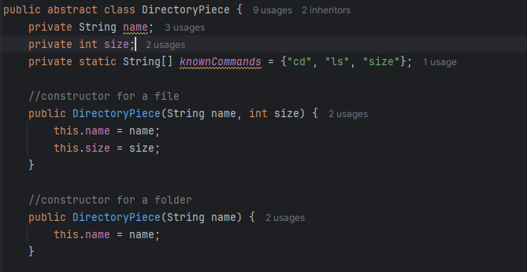
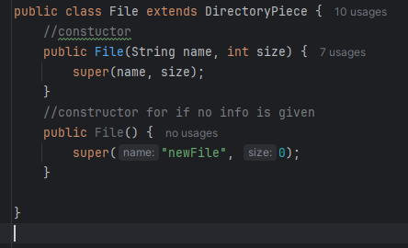
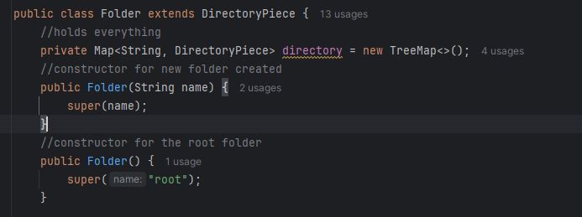
The Three Classes

Slide 5
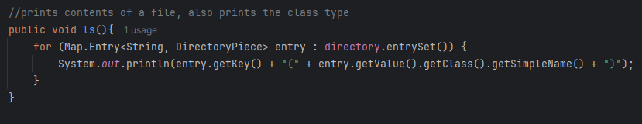
The LS Method
Prints every folder/file in the map, not including subfiles/subfolders
Gets the key(name)
Gets the class of the value(object)

Slide 6
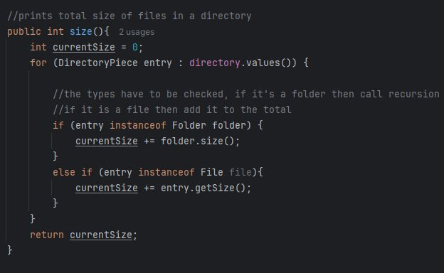
The Size Method
Goes through each map in every object
If a folder is found, then call the method recursively for that folder
If a file is found, then add it to the total

Slide 7
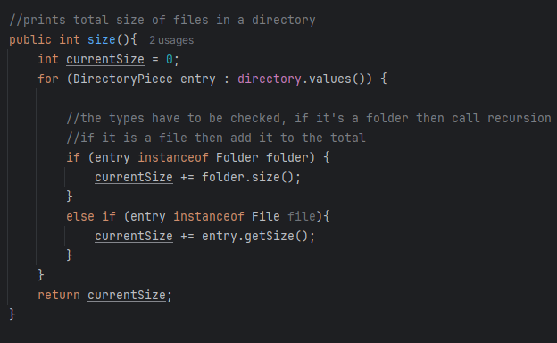
The CD Method
Takes the given new file path, the current file path, and the root file
Keep track of original new file path and current file path values
Keep track of original directory
This checks if the new file path is just "/"
If so, then simply make the current directory the root and set the current file path to "/"

Slide 8
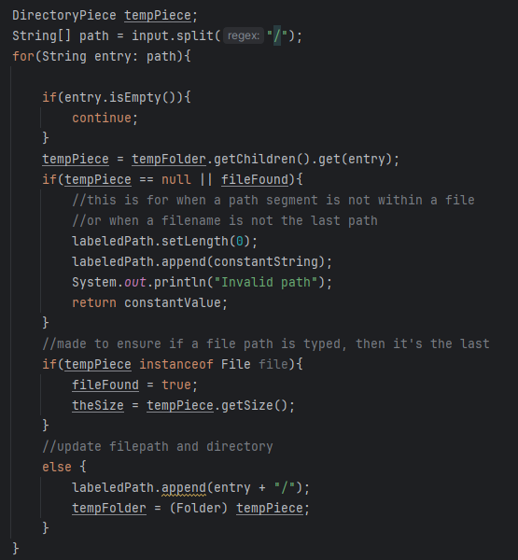
The CD Method Continued
Splits the input file path
Checks if a specific child exists inside of a directory
Needs check if object is a file or folder(very important)
Only allows files if they are the last path segment
Repeatedly adds onto the path and updates directory

Slide 9
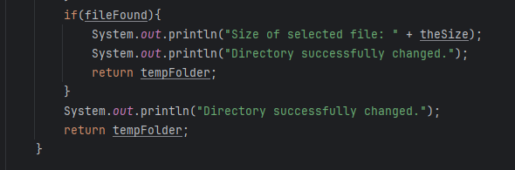
The CD Method Continued
If a file is the last path segment, then display the value and return the current directory
Otherwise just return the current directory

Slide 10
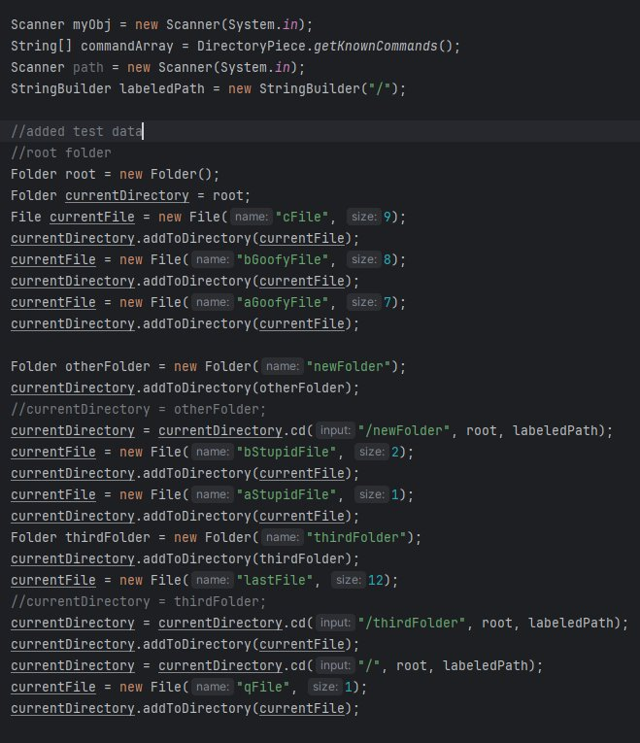
Test Data And Variables
Defines Scanner, path value, and gets commands
Root folder is created
addToDirectory() method created

Slide 11
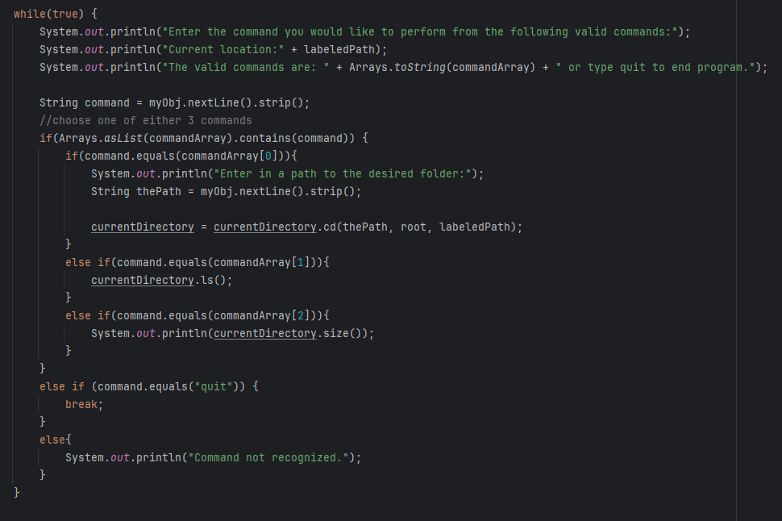
The Logic in Main

Slide 12
If I Were To Continue...
Add the addToDirectory method to be useable in the command line
Create an edit option
Create a delete option

Slide 13
Thank you!

