Slide 1
The EV Backdoor:
How Chinese Firms Route Around US Tariffs
Through ASEAN Connector Countries
Research Question: Does US tariff escalation on China directly trigger a surge in Chinese greenfield FDI
into pro-US Southeast Asian connector countries — Thailand, Indonesia, and Vietnam?
Presenters: Pia · Alicia · Gavin · Hanna · Linh · Dohyun Ju
Topics in International Finance | GSIS, Yonsei University | May 2026
"Today we show you the first empirical evidence that this backdoor is real."

Slide 2
The Policy Puzzle: US Tariff Escalation (2018–2026)
PIA
Year | Administration | Key Policy Action | EV/Battery Impact
2018 | Trump | Section 301 Lists 1–4A + Section 201 Solar (30%) | Broad tariffs on Chinese goods; supply chain pressure begins
2022 | Biden | 4-year extension of Section 201 | Continued pressure; no new EV-specific action
2024 ★ KEY | Biden | Strategic Escalation May 14: EVs 25%→100%, Li-Ion Batteries 7.5%→25%, Critical Minerals 0%→25% | Our primary treatment event
2025 | Biden/Trump | Semiconductors: 25% → 50% | Extends pressure to upstream tech
2026 | Trump | Non-EV Batteries 7.5%→25%, Natural Graphite & Magnets 0%→25% | Full upstream battery supply chain covered
Policy goal = decouple from Chinese capital. But did it actually work?
1 / 8
Source: USTR Section 301 Review; Biden Administration Trade Policy (2024)

Slide 3
What the Literature Tells Us — And What It Misses
GAVIN
✓ What We Know
✗ What Nobody Has Tested
Grover & Vézina (2025)
No sector-specific EV/battery evidence
Chinese firms invest significantly MORE in US-aligned countries post-2018 — aggregate FDI pattern confirmed (see Fig. 4b: upward-sloping line for Chinese FDI into US-aligned nations)
Existing studies use aggregate FDI — no one has isolated the EV and battery upstream sectors specifically
Aiyar & Ohnsorge (2024, IMF)
No event-study around the 2024 tariff
Connector countries systematically substitute for direct inter-bloc trade links — ASEAN absorbs displaced China–US flows
The 100% EV tariff (May 2024) is the sharpest natural experiment available, yet untested in the literature
General consensus
No project-level causal link
Trade diversion from Section 301 is real and measurable — Vietnam, Mexico benefit in electronics and machinery
Aggregate correlations exist, but firm-level groundbreaking decisions tied to specific tariff dates have not been documented
→ We zoom into the one sector where US policy is most exposed: EV & battery supply chains
2 / 8
Source: Grover & Vézina (2025); Aiyar & Ohnsorge (2024, IMF WP)

Slide 4
Evidence Part 1: Trade Flows Confirm the Backdoor
DOHYEON
China Battery Market Share Collapse
Transformer Transshipment: Near 1:1 Match
Chinese Import Content Rising
Metric
Value
Flow
Change (2020–25)
Metric
Finding
China Li-Ion Battery share (2023)
71%
China exports → Vietnam
+$1.5B
Tariff increase effect
+1.82 pp
China Li-Ion Battery share (2025)
59% ▼
US imports ← Vietnam
+$1.4B
What this means
Per 1% tariff hike on China, connector exports to US contain 1.82pp MORE Chinese content
Vietnam laptop share (2018)
1.7%
Match ratio
~1:1 ★
Vietnam laptop share (2024)
28% ▲
Interpretation
Rerouting signature
Conclusion
Backdoor is open
Direct exports fall — connectors fill the gap
Analysts identify 1:1 as statistical signature of rerouting
Source: PIIE trade content analysis
The backdoor is visible in trade data — next slide shows it in capital flows too
3 / 8
Source: USTR; PIIE; Pia (2025) — US Import Share Analysis

Slide 5
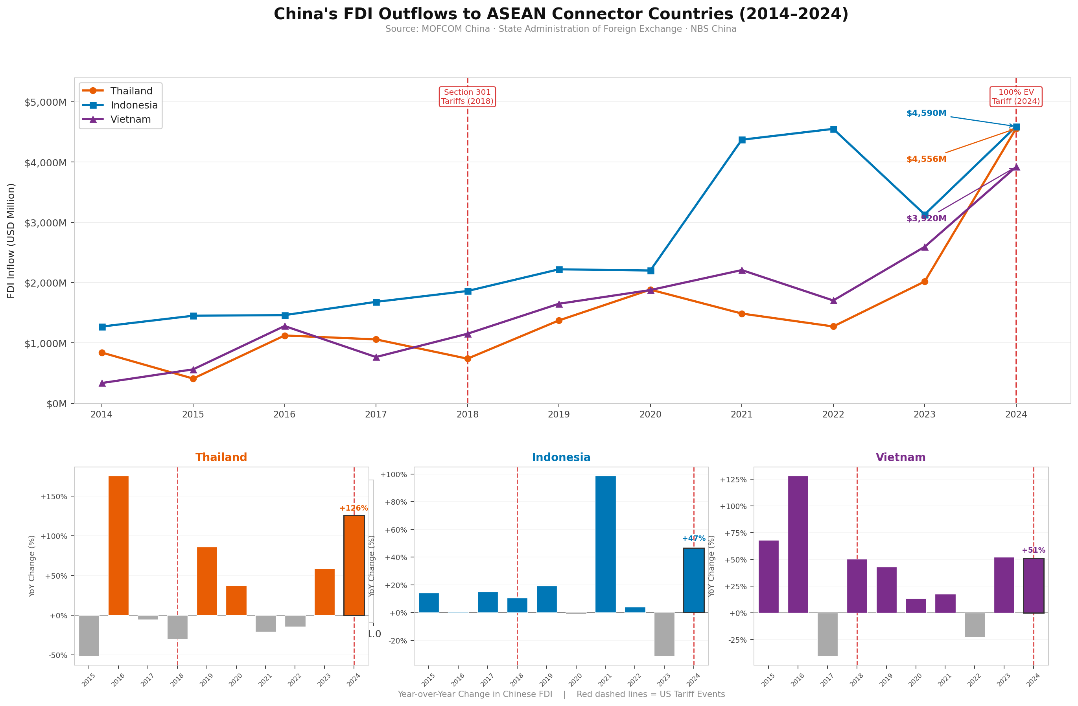
Evidence Part 2: Chinese FDI into Connector Countries
GAVIN
Data: MOFCOM China · SAFE · NBS China (via Statista, 2025)
⚠ Limitation: bilateral totals only — EV/battery sector not yet isolated
4 / 8

Slide 6
The Smoking Gun: 2024 Project-Level Evidence
ALICIA
2024 CROSSOVER: For the first time in history, Chinese EV firms invested MORE overseas than at home
$16B
$15B
+72×
Overseas ZEV Investment
(2024)
Domestic ZEV Investment
(2024)
China EV exports → Indonesia
Jan–Apr 2024 vs prior year
Company | Country | Date | Amount | Timing vs. Tariff
Huayou Cobalt | 🇮🇩 Indonesia | April 2024 | $2.04B | 1 month BEFORE — anticipatory positioning
BYD | 🇹🇭 Thailand | July 2024 | $1.3B (150k units/yr) | +2 months after tariff ★
CATL (CBL) | 🇮🇩 Indonesia | 2025 Groundbreaking | $6.0B integrated plant | Structural follow-through
Note: Huayou Cobalt's April 2024 deal — before the May announcement — shows anticipatory positioning, which strengthens the causal argument
5 / 8
Source: Company filings; Nikkei Asia; Reuters; BloombergNEF ZEV Investment Tracker (2024)

Slide 7
Our Planned Methodology: PPML Triple-Difference
ALL
FDIᵢⱼₜ = exp( β₁ · TariffEvent × Connector × EVsector + β₂ · IPD + γXᵢⱼ + αₜ + δⱼₜ ) · εᵢⱼₜ
Connector × EV sector
× Post-tariff
Triple interaction
Did the FDI surge happen specifically in connector countries (vs. others)?
Did it happen after the tariff event (2018 or 2024), not before?
Was the effect concentrated in EV/battery sectors specifically — not all FDI?
Data Source | Status | Role
fDi Markets (project-level FDI) | ⏳ Pending access | Primary dependent variable
AEI China Global Investment Tracker (≥$95M) | ✅ Available | Proxy — Transport + Metals sectors
CEPII Gravity dataset | ✅ Available | Bilateral gravity controls
Bailey et al. UN voting alignment | ✅ Available | IPD (ideal point distance)
Transparent note: fDi Markets access is pending — regression not yet run. Descriptive evidence on prior slides already supports the hypothesis.
6 / 8

Slide 8
Policy Implications & Next Steps
ALL
Core Finding: Country-of-origin ≠ Capital-of-origin
1
IRA Battery Sourcing Rules Have a Blind Spot
The Inflation Reduction Act's $7,500 EV tax credit excludes 'foreign entities of concern' — but does not screen for Chinese ownership of upstream nickel in Indonesia. Chinese firms control ~75% of Indonesian nickel smelting capacity. The IRA is effectively subsidising the relocation of Chinese capital into friendly territory.
2
Tariffs Redirect Assembly — Not Capital Control
Section 301 and the 100% EV tariff successfully reduced direct Chinese exports to the US. But our preliminary evidence shows they simultaneously accelerated Chinese FDI into connector countries — creating deeper structural entanglement, not decoupling.
Next Steps
① fDi Markets access → run PPML baseline ② Email Grover & Vézina authors for data ③ Add LVA variable (screwdriver assembly vs. durable integration) ④ Expand to EU tariff events
"The US thinks it is decoupling from Chinese supply chains. Our preliminary evidence suggests it is instead subsidising the relocation of Chinese capital into friendly territory."
7 / 8

Slide 9
Thank You
Questions & Discussion
Research Group: Pia · Alicia · Gavin · Hanna · Linh · Dohyun Ju
GSIS, Yonsei University | Topics in International Finance | May 2026
"Country-of-origin ≠ Capital-of-origin"

