Slide 1






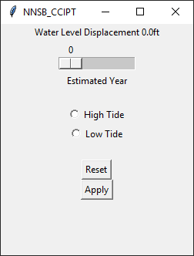
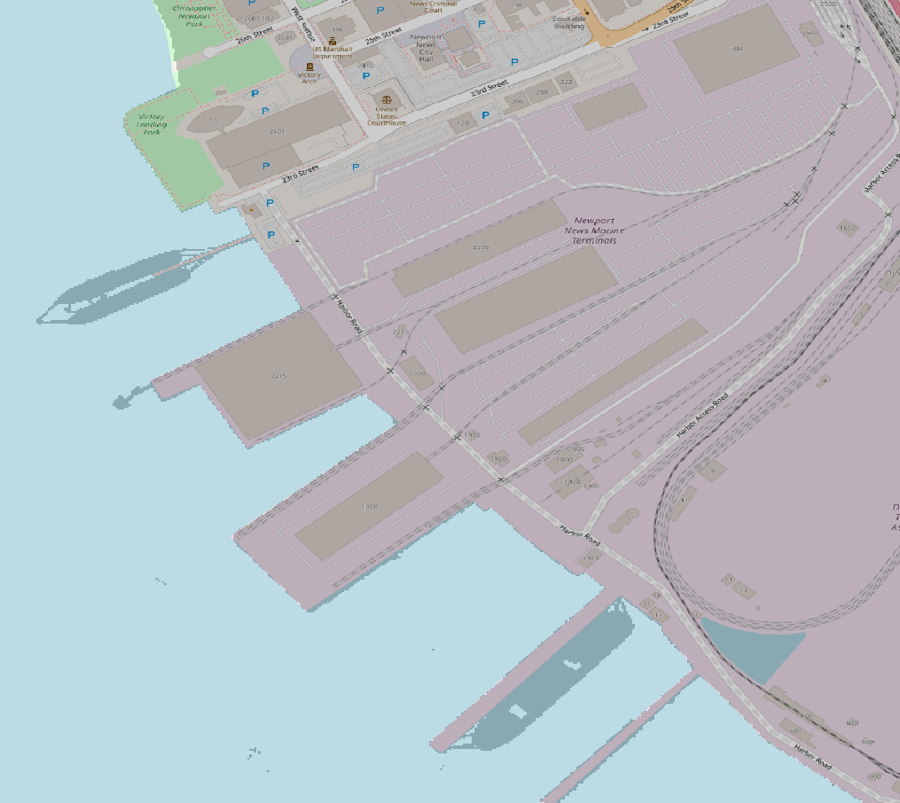
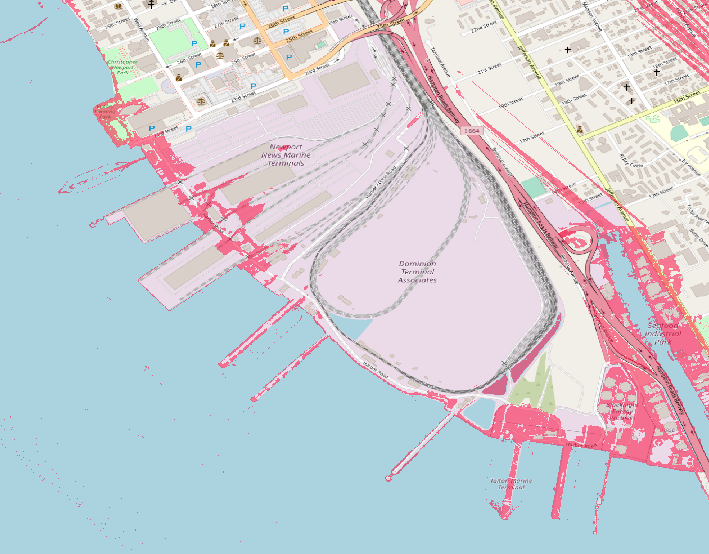







308
Climate Change Impact Prediction Tool (CCIPT)
Team Members: Gavin Alberghini, Christopher Maybush, Daniel Webster, Hakizimana Jeanmarie | Faculty Advisor: Robert Dahlberg | Sponsor: Newport News Shipbuilding | Mentor: Jeremy Hoffman, Jennifer Ciminelli
Why?
Application Front End
Application Back End
Community Awareness
Climate change is an up and coming issue for costal businesses.
Companies want to know how to best prepare for future climate conditions.
This project exposed major deficiencies in publicly available data regarding climate change.
Elevation and Storm Surge data were extremely difficult to find. Much of the existing information online was not usable.
What?
Social Benefit
CCIPT is a software tool build to accomplish the following:
Factor in local data gathered all around the southern Chesapeake bay region.
Create several regressive models to predict future climate conditions.
Simplify this knowledge discovery into GIS mapping software.
Visual representation of compounded climate change data in an easily understandable format.
Demonstrates the necessity for more readily available climate change information.
GUI
Empty GIS Map
Supporting Tools and Communities
User
Filtered GIS Map

