Slide 1
Distributed Computing*
Jie Wu Department of Computer and
Information Sciences
Temple University
*Part of the materials come from Distributed System Design, CRC Press, 1999. (Chinese Edition, China Machine Press, 2001.)

Slide 2
The Structure of Classnotes
Focus
Example
Exercise
Project

Slide 3
Table of Contents
Introduction and Motivation
Theoretical Foundations
Distributed Programming Languages
Distributed Operating Systems
Distributed Communication
Distributed Data Management
Reliability
Applications

Slide 4
Development of Computer Technology
1950s: serial processors
1960s: batch processing
1970s: time-sharing
1980s: personal computing
1990s: parallel, network, and distributed processing
2000s: wireless networks
2010s: mobile and cloud (edge, fog) computing
2020s: IoT, big data (AI), and blockchain (security)

Slide 5
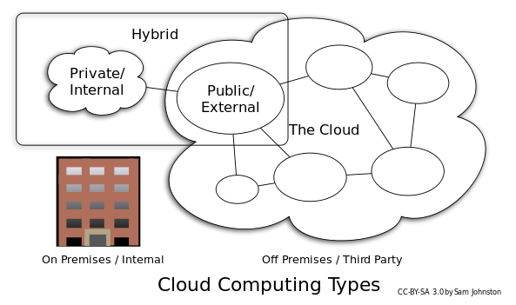
Application 1: Cloud
Cloud computing
Ubiquitous access to shared pools of configurable system resources that can be rapidly provisioned with minimal management effort, often over the Internet
Characteristics (by NIST)
On-demand self-service, broad network access, resource pooling, rapid elasticity, and measured service
Types
Public cloud and private cloud
Products
Amazon AWS, Microsoft Azure
Others: Google Cloud, Alibaba, and IBM

Slide 6
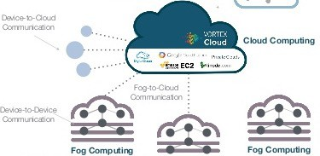
Fog: distributed cloud
Edge: devices at the edge network (e.g., IoT)
Fog: distributed cloud (e.g. cloud + IoT)
Reduce data communication and process demands
Data storage and processing outside the cloud
Products
Azure intelligent edge
Cloudlets (CMU)

Slide 7


Application 2: Hadoop
Apache Hadoop is built for big data (ML) processing
MapReduce: map, shuffle, and reduce
Pipeline
Data parallelism
HDFS (Hadoop distributed file systems)
Apache HIVE
Data warehouse on top of Hadoop
SQL-like interface (distributed database)
* gray color: concepts to be covered in this class

Slide 8
SPARK: beyond Hadoop
Apache Spark is built for speed, mainly for ML
Speed (10x to 100x compared to Hadoop)
Data in memory (Hadoop in hard disk)
RDD: resilient distributed dataset (extension from distributed shared memory, DSM and fault tolerance)
Streaming
Better API
New paradigm for reinforcement learning (RL)
Stanford DAWN
Berkeley Ray

Slide 9
TeraSort: map-shuffle-reduce
Map-Shuffle-Reduce
Map and Reduce: CPU-intensive
Shuffle: I/O-intensive
Map
Shuffle
Reduce
TeraSort (and word count)
Data partition
Local sort
Map: sample & partition data
Shuffle: partitioned data
Data
Local
Reduce: locally sort data
partition
sort
Parallelism and Data Size
At least 64 Gigabytes
Minimal MapReduce Algorithms, SIGMOD’13

Slide 10

Application 3: Bitcoin
Bitcoin: crytocurrency and worldwide payment system
First decentralized digital currency without a central bank or single administrator
Transactions: use of cryptograph and is recorded in a distributed ledger called blockchain
Most crowded trade

Slide 11

Blockchain: building block
Blockchain: distributed database on a set of communicating nodes
A list of records (transactions), called blocks.
Transactions: input node(s) to output node(s)
Mining: distributed book-keeping to ensure consistency, complete, and unalterable (using cryptograph hash chain)
Access through smart contracts: instance of programs, with state and methods
Properties: decentralized (trust-less) service
fault tolerance and decentralized consensus

Slide 12

Money transfer: ledger and minor
Distributed ledger in blockchain: Users broadcast its local transactions
$3
miner
A
A=$5
B
$3:A->B
$3
$1:B->C
$1
(invalid)
C
miner: copy of ledger
Miner: complete through a random process to get bitcoin
(1) validate, (2) find a key (puzzle solving based on Proof of Work, POW), and (3) broadcast result
Security: digital signature, hash of previous data
Notes:
In the past the banker would keep track of this but not really anymore
Gotta keep it secure

Slide 13
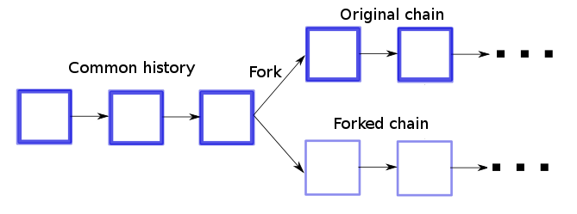
Ledger consistency: removing fork
No strict consistency: temporary fork may occur The fork consistency: following the longest chain
The branch with the maximum total POW will dominate
Scalability: layer-two solutions and sharding (store a database across multiple machines)

Slide 14
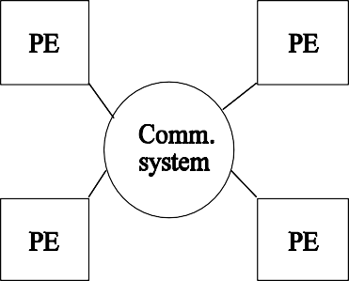
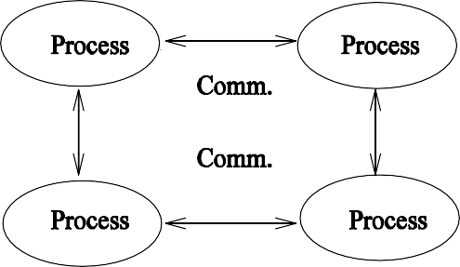
A Simple Definition
A distributed system is a collection of independent computers that appear to the users of the system as a single computer.
Distributed systems are "seamless": the interfaces among functional units on the network are for the most part invisible to the user.
System structure from the physical (a) or logical point of view (b).

Slide 15
Motivation
People are distributed, information is distributed (Internet and Intranet)
Performance/cost
Information exchange and resource sharing (WWW and CSCW)
Flexibility and extensibility
Dependability
Two Main Stimuli
Technological change
User needs

Slide 16
Goals
Transparency: hide the fact that its processes and resources are physically distributed across multiple computers.
Access
Location
Migration
Replication
Concurrency
Failure
Persistence
Scalability: in three dimensions
Size
Geographical distance
Administrative structure

Slide 17
Goals (Cont’d.)
Heterogeneity (mobile code and mobile agent)
Networks
Hardware
Operating systems and middleware
Program languages
Openness
Security
Fault Tolerance
Concurrency

Slide 18
Scaling Techniques
Latency hiding (pipelining and interleaving execution)
Distribution (spreading parts across the system: sharding)
Replication (replicate parts: caching)
Notes:
Terasort is when you partition the data evenly in some set of smaller sets
Replication, think web caching,
here you have a client and a server and you want to fetch a web page. The web page that you visited is now stored locally.
this is beneficial because if you cache a webpage, the next time you visit it, it will load incredibly fast.
you could also think domain name space.
→ public domain space, whenever we access a website we have a human readable domain name (e.g. www.cis.temple.edu) but machine have a readable ip address (155.247.19.2)
it works to just change from the table to the column.

Slide 19
Example 1: (Scaling Through Distribution)
URL searching based on hierarchical DNS name space (partitioned into zones).
DNS name space.

Slide 20
Design Requirements
Performance Issues
Responsiveness
Throughput
Load Balancing
Quality of Service
Reliability
Security
Performance
Dependability
Correctness
Security
Fault tolerance

Slide 21
Similar and Related Concepts
Distributed
Network
Parallel
Concurrent
Decentralized
Notes:
Usually all involve multiple computers
Parallel processing → focused on solving large problems in a synchronized manner; like a gpu, no delay
Distributed system → focuses on delay, think matrix multiplication (how might we calculate it very quickly? By using different algorithms)
Network → two processes that discuss things with each other
Concurrent → programs run at the same time, kind of like a parallel
Decentralized → no difference between decentralized and distributed

Slide 22
Schroeder's Definition
A list of symptoms of a distributed system
Multiple processing elements (PEs)
Interconnection hardware
PEs fail independently
Shared states
Notes:
Define state → little tricky kind of like the population example
consider the population of the whole country (~1Mill people)
local state vs state?
population in the city?
sometimes people are walking between the cities and may not be counted in the local state
here you don’t have a global snapshot of the population

Slide 23
Focus 1: Enslow's Definition
Distributed system = distributed hardware + distributed control + distributed data
A system could be classified as a distributed system if all three categories (hardware, control, data) reach a certain degree of decentralization.

Slide 24
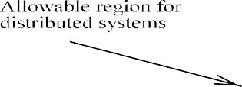
Focus 1 (Cont’d.)
Enslow's model of distributed systems.

Slide 25
Hardware
A single CPU with one control unit.
A single CPU with multiple ALUs (arithmetic and logic units).There is only one control unit.
Separate specialized functional units, such as one CPU with one floating-point co-processor.
Multiprocessors with multiple CPUs but only one single I/O system and one global memory.
Multicomputers with multiple CPUs, multiple I/O systems and local memories.

Slide 26
Control
Single fixed control point. Note that physically the system may or may not have multiple CPUs.
Single dynamic control point. In multiple CPU cases the controller changes from time to time among CPUs.
A fixed master/slave structure. For example, in a system with one CPU and one co-processor, the CPU is a fixed master and the co-processor is a fixed slave.
A dynamic master/slave structure. The role of master/slave is modifiable by software.
Multiple homogeneous control points where copies of the same controller are used.
Multiple heterogeneous control points where different controllers are used.

Slide 27
Data
Centralized databases with a single copy of both files and directory.
Distributed files with a single centralized directory and no local directory.
Replicated database with a copy of files and a directory at each site.
Partitioned database with a master that keeps a complete duplicate copy of all files.
Partitioned database with a master that keeps only a complete directory.
Partitioned database with no master file or directory.

Slide 28
Network Systems
Performance scales on throughput (transaction response time or number of transactions per second) versus load.
Work on burst mode.
Suitable for small transaction-oriented programs (collections of small, quick, distributed applets).
Handle uncoordinated processes.

Slide 29
Parallel Systems
Performance scales on elapsed execution times versus number of processors (subject to either Amdahl or Gustafson law).
Works on bulk mode.
Suitable for numerical applications (such as SIMD or SPMD vector and matrix problems).
Deal with one single application divided into a set of coordinated processes.

Slide 30
Distributed Systems
A compromise of network and parallel systems.

Slide 31
Comparison
Item Network sys.
Like a virtual No uniprocessor
Run the same operating No system
Copies of the operating N copies system
Means of Shared files communication
Agreed up network Yes protocols?
A single run queue No
Well defined file Usually no sharing
Distributed sys.
Multiprocessors
Yes
Yes
Yes
Yes
N copies
1 copy
Messages
Shared files
Yes
No
Yes
Yes
Yes
Yes
Comparison of three different systems.

Slide 32
Focus 2: Different Viewpoints
Architecture viewpoint
Interconnection network viewpoint
Memory viewpoint
Software viewpoint
System viewpoint

Slide 33
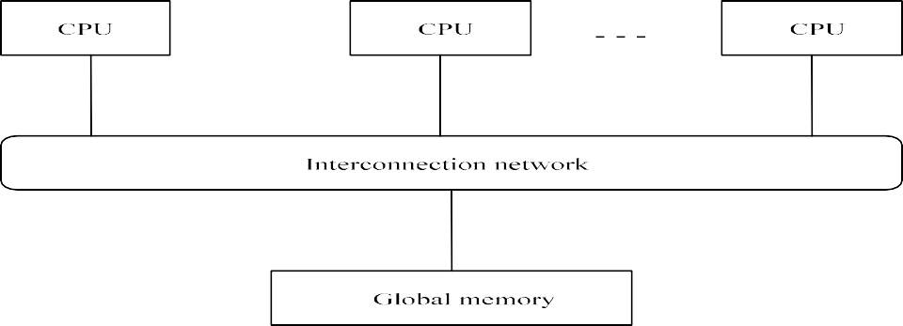
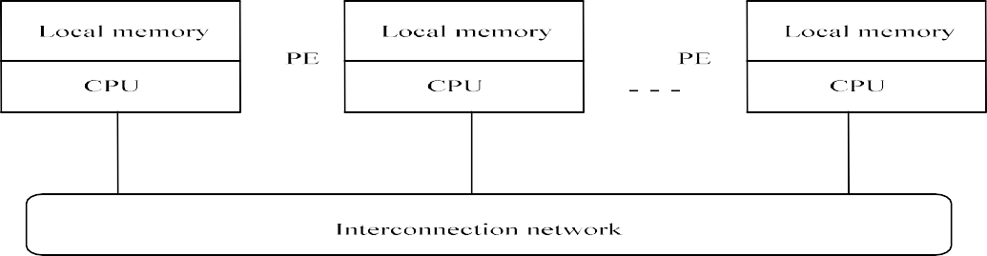
Architecture Viewpoint
Multiprocessor: physically shared memory structure
Multicomputer: physically distributed memory structure.
Notes:
B is multiprocessor
A is more similar to distributed system

Slide 34









Interconnection Network Viewpoint
static (point-to-point) vs. dynamics (ones with switches).
bus-based (Fast Ethernet) vs. switch-based (routed instead of broadcast).
Notes:
Node ---------------------- Node
link
Dynamic means two switch where there is a node going straight across,
the drawing above has inputs 1 & 2 and outputs 1 & 2 and can freely switch to whichever one may need depending on the outcome

Slide 35
Interconnection Network Viewpoint (Cont’d.)
Examples of dynamic interconnection networks: (a) shuffle-exchange, (b) crossbar, (c) baseline, and (d) Benes.
Notes:
P (1,2,3,….,8). ← processor
|
V
M or P (2,5,6,7,3,4,8) ← processor or memory
Nonblocking means that we need to switch the switch around to either straight or across and one can always find a set of switches
that will satisfy the desired output

Slide 36
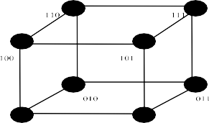
Interconnection Network Viewpoint (Cont’d.)
Node degree?
Examples of static interconnection networks: (a) linear array, (b) ring, (c) binary tree, (d) star, (e) 2-d torus, (f ) 2-d mesh, (g) completely connected, and (h) 3-cube.
3d-cube is 1-bit difference!!!
Very important!
N = # of nodes
Each node has [n*log(link)]/2
Relationship between nodes & dimension => logN(dimension)
Notes:
Minimum number of links in a node is 1-n
Diameter is different between the line and tree
longest distance between two points
Issue with star is that it can become congested → consider traffic distribution → bottleneck is likely
more popular build is called “fat tree” as you go up the tree you double the bandwidth
The wraparound connection of the lattice structure can result in the diameter being smaller which would mean ½ the diameter for the length
Hoffman code?
it is a very nice algorithm? Which character appears more often
smallest code for bit
Circle is only half diameter
Diameter of mesh is square root
Diameter of cube is log(# of points)

Slide 37
Measurements for Interconnection Networks
Node degree. The number of edges incident on a node.
Diameter. The maximum shortest path between any two nodes.
Bisection width. The minimum number of edges along a cut which divides a given network into equal halves.

Slide 38
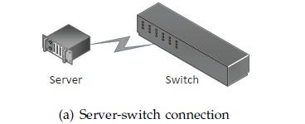
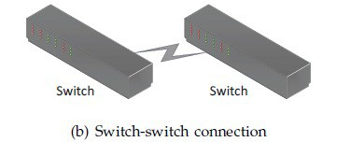
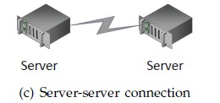
Application 4: Data Center Network (DCN)
DCN connects many servers to handle demands of cloud Three types of connections:
Server-switch connection (a) Switch-switch connection (b) Server-server connection (c)
Two classes of DCNs:
Switch-centric
Only server-switch and switch-switch connections (a and b), no server-server
Eg, Flattened Clos, Fat-Tree
Server-centric
Mostly, only server-switch and server- server connections (a and c), no switch-switch
Eg: Dcell, BCube, FiConn
Notes:
Server is essentially just a node
Switch could be not just a 2x2 switch but could have a wide variety of outputs and be incredibly powerful
We will need to remember the general configurations
most commonly to put the servers all the way down and have all of the switches on the way up
Switch carries the accessibility to connect multiple devices whereas, servers save and store data and helps in the execution.

Slide 39
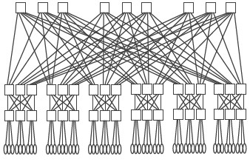
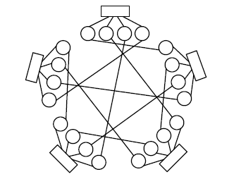
Switch- and Server-centric DCNs
Folded Clos (switch-centric)
Dcell (server-centric)
Server - centric
Here your switch will connect to switch but also server will connect to server
Switch →
Switch →
Switch →
Servers →
Youll go up first and then come down
D. Li, J. Wu, Z. Liu, and F. Zhang, "Dual-Centric Data Center Network Architectures,” ICPP, 2015.
Notes:
All of these multiple connections are to give you flexibility

Slide 40
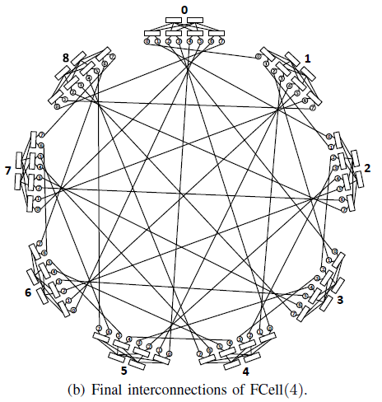
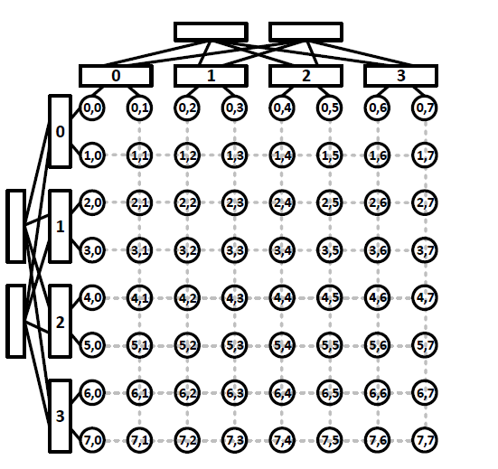
Dual-Centric DCNs
Three configurations (a), (b), and (c)
Cluster cluster connections are seen here
(a) Final interconnection of FSquare(4)
Notes:
Dual centric means you have all three types of connections
1. switch x switch
2. server x server
3. switch x server OR server x switch

Slide 41
What's the Best Choice? (Siegel 1994)
A compiler-writer prefers a network where the transfer time from any source to any destination is the same to simplify the data distribution.
A fault-tolerant researcher does not care about the type of network as long as there are three copies for redundancy.
A European researcher prefers a network with a node degree no more than four to connect Transputers.

Slide 42
What's the Best Choice? (Cont’d.)
A college professor prefers hypercubes and multistage networks because they are theoretically wonderful.
A university computing center official prefers whatever network is least expensive.
A NSF director wants a network which can best help deliver health care in an environmentally safe way.
A Farmer prefers a wormhole-routed network because the worms can break up the soil and help the crops!

Slide 43







Memory Viewpoint
Physically versus logically shared/distributed memory.

Slide 44
Software Viewpoint
Distributed systems as resource managers like traditional operating systems.
Multiprocessor/Multicomputer OS
Network OS
Middleware (on top of network OS)
Modern OS
Hypervisor creates and runs virtual machines (VMs) by virtually sharing its resources, such as memory and processing units.
Ability to run different operating systems and configurations.
Example: VMware, Zen, and Kurbernetes (containers on Docker)

Slide 45
Service Common to Many Middleware Systems
High level communication facilities (access transparency)
Naming
Special facilities for storage (integrated database)
Middleware

Slide 46
System Viewpoint
The division of responsibilities between system components and placement of the components.

Slide 47
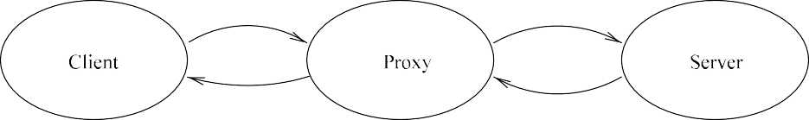
Client-Server Model
Client-server
Proxy server (multiple instance cases)
(a) Client and server and (b) proxy server.
Notes:
Client server is a web server → client accesses particular webpage and the server will return the results to the client

Slide 48
Mobile Code and Mobile Agents
Mobile code (web applets).

Slide 49
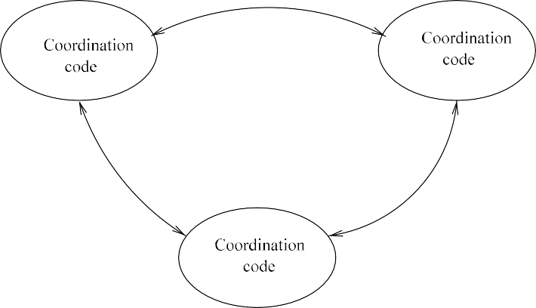
Peer Processes
Peer-to-Peer: P2P
Future trend
Microservice: P2P
(instead of monolithic based on client-server)

Slide 50
Hardware vs. Software
Hardware is physical and tangible components of a computer.
Software is a set of well-written instructions written in programming language.
Certain functions can be implemented by either hardware or software
E.g., software-defined network (SDN)

Slide 51
Future Trend on Distributed Systems
Cloud as a service
Infrastructure as a Service (IaaS)
Planform as a Service (PaaS)
Software as a Service (SaaS)
Elastic computing (adapted to workload changes)
Virtualization
Virtual machines (containers)
Virtual networks
Virtual storage (NAS and SAN technology)
Automation and orchestration
Automation: AIops using ML/AI
Orchestration: automated replication and parallelism (Kubernetes)
D. Comer: The Cloud Computing Book: The Future of Computing Explained, 2021

Slide 52
Key Issues (Stankovic's list)
Theoretical foundations
Reliability
Privacy and security
Design tools and methodology
Distribution and sharing
Accessing resources and services
User environment
Distributed databases
Network research

Slide 53
Wu's Book
Distributed Programming Languages
Basic structures
Theoretical Foundations
Global state and event ordering
Clock synchronization
Distributed Operating Systems
Mutual exclusion and election
Detection and resolution of deadlock
self-stabilization
Task scheduling and load balancing
Distributed Communication
One-to-one communication
Collective communication

Slide 54
Wu's Book (Cont’d.)
Reliability
Agreement
Error recovery
Reliable communication
Distributed Data Management
Consistency of duplicated data
Distributed concurrency control
Applications
Distributed operating systems
Distributed file systems
Distributed database systems
Distributed shared memory
Distributed heterogeneous systems

Slide 55
Wu's Book (Cont’d.)
Part 1: Foundations and Distributed Algorithms
Part 2: System infrastructure
Part 3: Applications

Slide 56
What is Distributed Algorithms
Parallel Computing: efficiency
Real-Time: On-time computing
Distributed (Message-Passing) Algorithms
Dealing with delay and uncertainty
Simplicity, elegance, and beauty are first-class citizens (Michel Raynal, 2013)

Slide 57
Distributed Algorithms
Termination
In a social network, each person exchanges his/her friend list with friends. What is the stoppage condition?
Global State
How to design an observation algorithm by observing an execution without modifying its behavior?
Distributed Consensus
How to reach distributed consensus (e.g., binary decisions) in the presence of traitors?

Slide 58
Distributed Algorithms (Cont’d)
Logical Clock
How to order events in different systems with asynchronous clocks? How to discard obsolete data?
Data
How to replicate data and keep them consistent?
Load
How to distribute load in a load balanced way?
Routing
How to perform efficient routing that is deadlock-free and fault-tolerant?

Slide 59
References
IEEE Transactions on Parallel and Distributed Systems (TPDS)
IEEE International Conference on Distributed Computing Systems (ICDCS) (theory/system)
IEEE International Conference on Reliable Distributed Systems (SRDS) (theory/system)
ACM Symposium on Principles of Distributed Computing (PODC) (theory)
IEEE/ACM International Symposium on Cluster, Cloud and Internet Computing (CCGrid) (system)
ACM Special Interest Group on Data Communication (SIGCOMM) (system)

Slide 60
Exercise 1
In your opinion, what is the future of the computing and the field of distributed systems?
Use your own words to explain the differences between distributed systems, multiprocessors, and network systems.
Calculate (a) node degree, (b) diameter, (c) bisection width, and (d) the number of links for an n x n 2-d mesh, an n x n x n 3-d torus, and an n-dimensional hypercube.
Notes:
Homework for two weeks
Very important to distinguish if it is even or odd.

