Slide 1
Table of Contents
Introduction and Motivation
Theoretical Foundations
Distributed Programming Languages
Distributed Operating Systems
Distributed Communication
Distributed Data Management
Reliability
Applications
Conclusions
Appendix

Slide 2
Distributed Operating Systems
Operating Systems: provide problem-oriented abstractions of the underlying physical resources.
Files (rather than disk blocks) and sockets (rather than raw network access).

Slide 3
Selected Issues
Mutual exclusion and election
Non-token-based vs. token-based
Election and bidding
Detection and resolution of deadlock
Four conditions for deadlock: mutual exclusion, hold and wait, no preemption, and circular wait.
Graph-theoretic model: wait-for graph
Two situations: AND model (process deadlock) and OR model (communication deadlock)
Task scheduling and load balancing
Static scheduling vs. dynamic scheduling

Slide 4
Mutual Exclusion and Election
Requirements:
Freedom from deadlock.
Freedom from starvation.
Fairness.
Measurements:
Number of messages per request.
Synchronization delay.
Response time.

Slide 5
Non-Token-Based Solutions:
Lamport's Algorithm
To request the resource process P_{i} sends its timestamped message to all the processes (including itself ).
When a process receives the request resource message, it places it on its local request queue and sends back a timestamped acknowledgment.
To release the resource, P_{i} sends a timestamped release resource message to all the processes (including itself ).
When a process receives a release resource message from P_{i}, it removes any requests from P_{i} from its local request queue. A process P_{j} is granted the resource when
Its request r is at the top of its request queue, and,
It has received messages with timestamps larger than the timestamp of r from all the other processes.

Slide 6




Example for Lamport’s Algorithm

Slide 7


Extension
There is no need to send an acknowledgement when process P_{j} receives a request from process P_{i} after it has sent its own request with a timestamp larger than the one of P_{i}'s request.
An example for Extended Lamport’s Algorithm

Slide 8
Ricart and Agrawala's Algorithm
It merges acknowledge and release messages into one message reply.
An example using Ricart and Agrawala's algorithm.

Slide 9
Token-Based Solutions: Ricart and
Agrawala's Second Algorithm
When token holder P_{i} exits CS, it searches other processes in the order i + 1,i + 2,…,n,1,2,…,i - 1 for the first j such that the timestamp of P_{j} 's last request for the token is larger than the value recorded in the token for the timestamp of P_{j} 's last holding of the token.

Slide 10

Token-based Solutions (Cont’d)
Ricart and Agrawala's second algorithm.

Slide 11
Pseudo Code
P(i)::=*[ request-resource
consume release-resource
treat-request-message others
]
distributed-mutual-exclusion ::= ||P(i:1..n)
clock: 0,1,…, (initialized to 0)
token-present: Boolean (F for all except one process)
token-held: Boolean (F)
token: array (1..n) of clock (initialized 0)
request: array (1..n) of clock (initialized 0)

Slide 12
Pseudo Code (Cont’d)
others::= all the other actions that do not request to enter the critical section.
consume::= consumes the resource after entering the critical section
request-resource::=
[ token present = F
→ [ send (request-signal, clock, i) to all;
receive (access-signal, token); token-present:= T;
token-held:= T
]
]

Slide 13
Pseudo Code (Cont’d)
release-resource::=
[ token (i):=clock;
token-held:= F;
min j in the order [i + 1,… n,1,2,…,i – 2, i – 1]
∧ (request(j) > token(j))
→ [ token-present:= F;
send (access-signal, token) to P_{j}
]
]

Slide 14
Pseudo Code (Cont’d)
treat-request-message::=
[ receive (request-signal, clock; j)
→[request(j):=max(request(j),clock);
token-present ∧¬token-held → release-resource
]
]

Slide 15
Ring-Based Algorithm
P(i:0..n-1)::=
[ receive token from P((i-1) mod n); consume the resource if needed;
send token to P ((i + 1) mod n)
]
distributed-mutual-exclusion::= ||P(i:0..n-1)

Slide 16
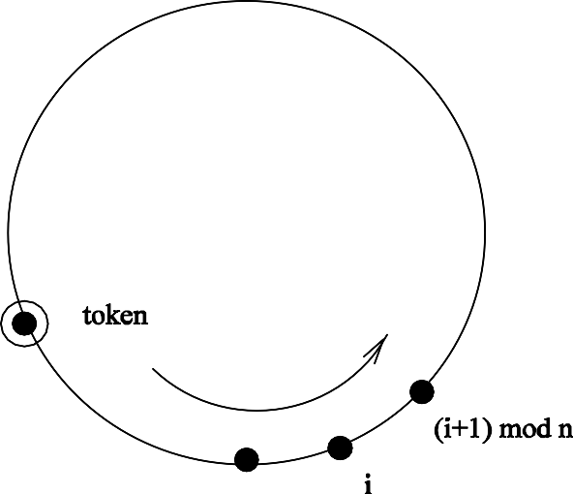
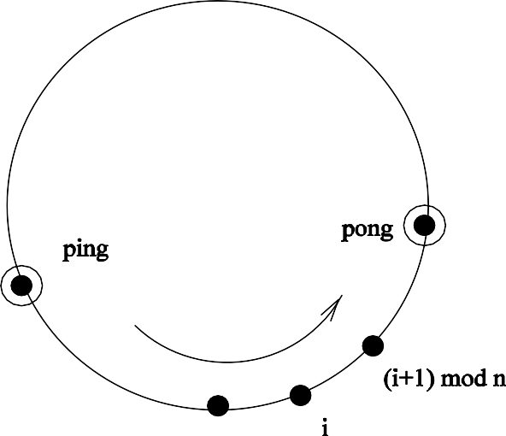
Ring-Based Algorithm (Cont’d)
The simple token-ring-based algorithm (a) and the fault-tolerant token-ring-based algorithm (b).

Slide 17
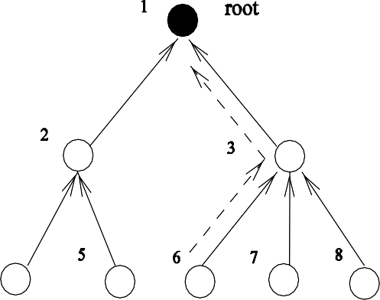
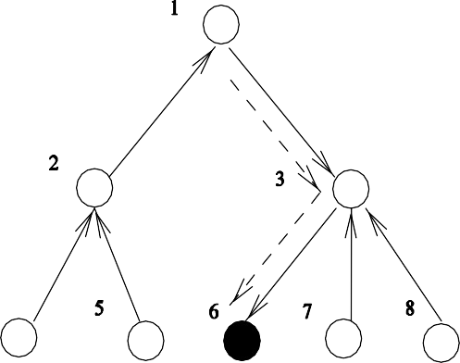
Tree-Based Algorithm
A tree-based mutual exclusion algorithm.

Slide 18
Maekawa's Algorithm
Permission from every other process but only from a subset of processes.
If R_{i} and R_{j} are the request sets for processes P_{i} and
P_{j} , then R_{i} ∩ R_{j} ≠φ.

Slide 19
Example 11
R₁ : {P₁; P₃; P₄}
R₂ : {P₂; P₄; P₅}
R₃ : {P₃; P₅; P₆}
R₄ : {P₄; P₆; P₇}
R₅ : {P₅; P₇; P₁}
R₆ : {P₆; P₁; P₂}
R₇ : {P₇; P₂; P₃}

Slide 20
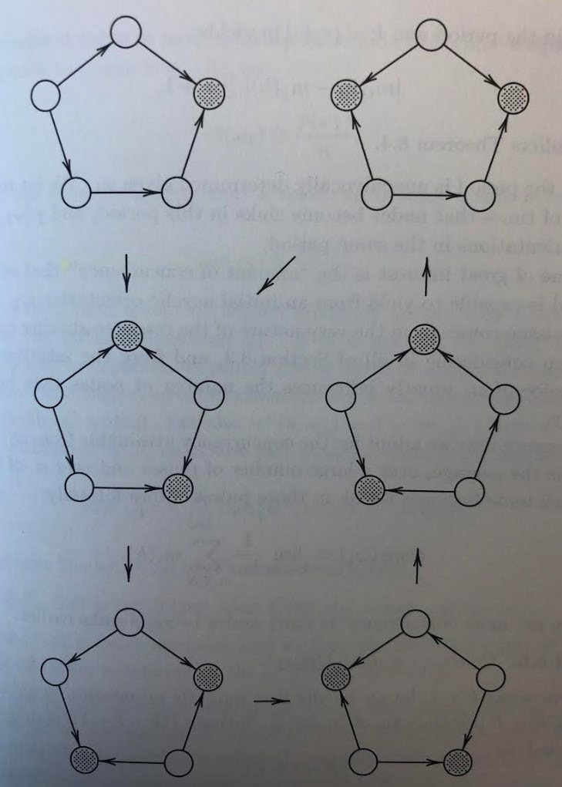
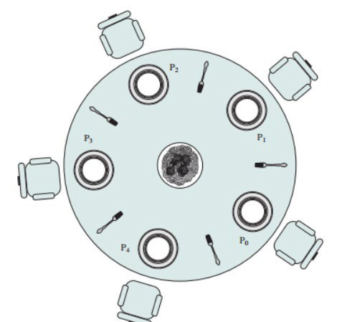
The Dining Philosophers Problem
Sharing multiple resources ■ edge reversal
Mutual exclusion
Deadlock prevention
Amount of concurrency
Two neighbors i and j: holds_fork_{i}^{j} and holds_turn_{i}
j
Extended DP Problem on G
Drinking Philosophers Problem

Slide 21
Related Issues
Election: After a failure occurs in a distributed system, it is often necessary to reorganize the active nodes so that they can continue to perform a useful task.
Bidding: Each competitor selects a bid value out of a given set and sends its bid to every other competitor in the system. Every competitor recognizes the same winner.
Self-stabilization: A system is self-stabilizing if, regardless of its initial state, it is guaranteed to arrive at a legitimate state in a finite number of steps.

Slide 22
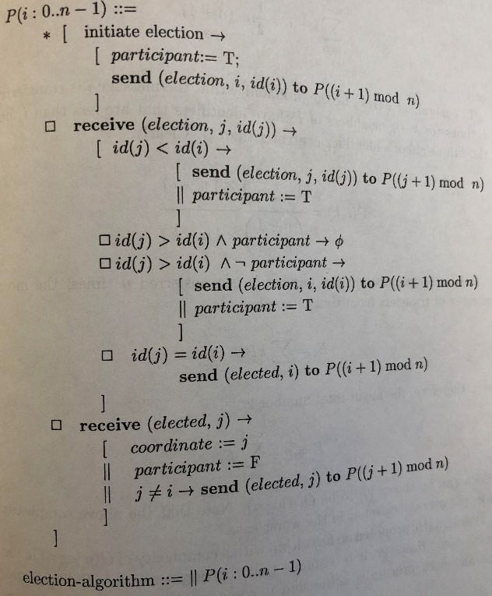
Focus 11: Chang and Robert’s algorithm
Election on a ring
Election and elected signals
Smallest ID is the winner
Two rounds of circulation
O(n log n) messages

Slide 23
Garcia-Molina's Bully Algorithm for
Election
When P detects the failure of the coordinator or receives an ELECTION packet, it sends an ELECTION packet to all processes with higher priorities.
If no one responds (with packet ACK), P wins the election and broadcast the ELECTED packet to all.
If one of the higher processes responds, it takes over. P's job is done.

Slide 24
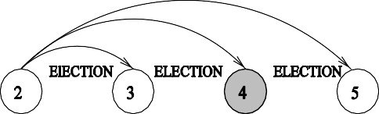
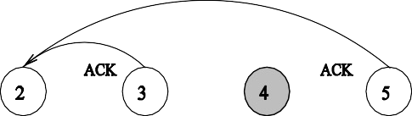
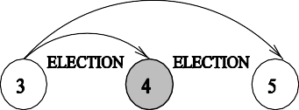
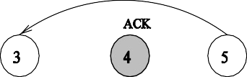
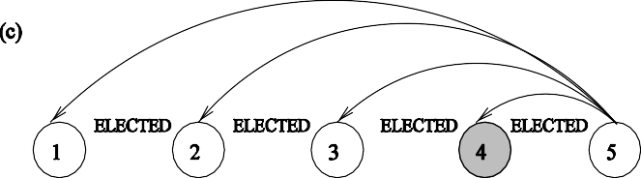
Focus 11 (Cont’d)
Bully algorithm.

Slide 25
Lynch's Non-Comparison-Based Election
Algorithms
Process id is tied to time in terms of rounds.
Time-slice algorithm: (n, the total number of processes, is known)
Process Pi (with its id(i)) sends its id in round id(i)2n, i.e., at most one process sends its id in every 2n consecutive rounds.
Once an id returns to its original sender, that sender is elected. It sends a signal around the ring to inform other processes of its winning status.
message complexity: O(n)
time complexity: min{id(i)} n

Slide 26
Lynch's Algorithms (Cont’d)
Variable-speed algorithm: (n is unknown)
When a process Pi sends its id (id(i)), this id travels at the rate of one transmission for every 2id(i) rounds.
If an id returns to its original sender, that sender is elected.
message complexity: n + n/2 + n/2² + … + n/2^{(n-1)}
< 2n = O(n)
time complexity: 2 ^{min{id(i)}}n

Slide 27
Dijkstra's Self-Stabilization
Legitimate state P : A system is in a legitimate state P if and only if one process has a privilege.
Convergence: Starting from an arbitrary global state, S is guaranteed to reach a global state satisfying P within a finite number of state transitions.

Slide 28
Example 12
A ring of finite-state machines with three states. A privileged process is the one that can perform state transition.
For P_{i}, 0 < i ≤n - 1,
P_{i}≠P_{i-1} → P_{i} := P_{i-1},
P₀=P_{n-1} → P₀:=(P₀+1) mod k
Theorem: If k > n, then Dijkstra’s token ring for mutual exclusion always eventually reaches a correct configuration.
For n > 2, theorem also hold if k = n-1.

Slide 29
 | P0 | P1 | P2 | Privileged processes | Process to make move
 | 2 | 1 | 2 | P0,P1,P2 | P0
 | 3 | 1 | 2 | P1,P2 | P1
 | 3 | 3 | 2 | P2 | P2
 | 3 | 3 | 3 | P0 | P0
 | 0 | 3 | 3 | P1 | P1
 | 0 | 0 | 3 | P2 | P2
 | 0 | 0 | 0 | P0 | P0
 | 1 | 0 | 0 | P1 | P1
 | 1 | 1 | 0 | P2 | P2
 | 1 | 1 | 1 | P0 | P0
 | 2 | 1 | 1 | P1 | P1
 | 2 | 2 | 1 | P2 | P2
 | 2 | 2 | 2 | P0 | P0
 | 3 | 2 | 2 | P1 | P1
 | 3 | 3 | 2 | P2 | P2
 | 3 | 3 | 3 | P0 | P0
Table 1: Dijkstra’s self-stabilization algorithm (n =3 and k =4).

Slide 30
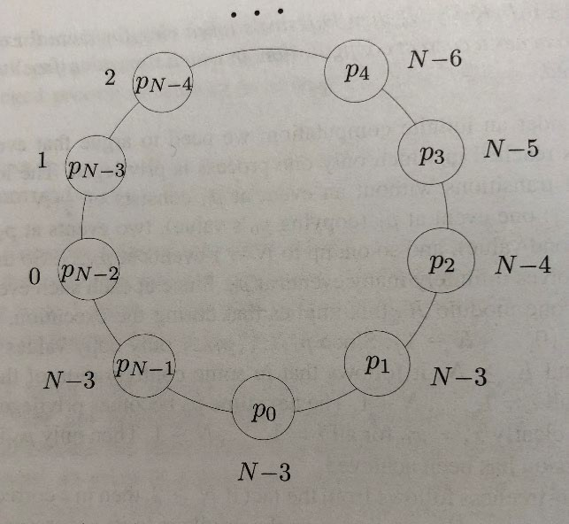
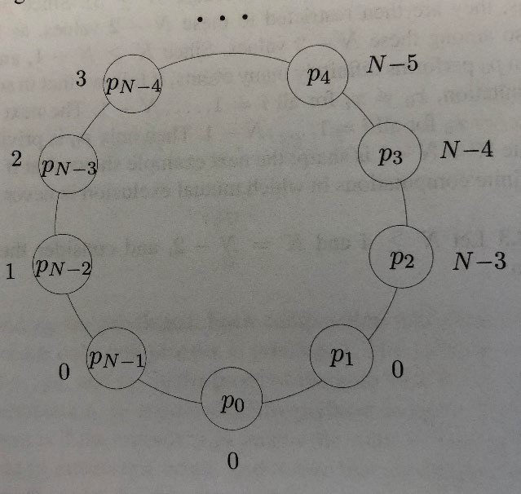
Non-Convergence Example
When n > 3, k = n-2.
Infinite computation exists in which always n-1 processes are privileged

Slide 31
Extensions
The role of demon (that selects one privileged process)
The role of asymmetry.
The role of topology.
The role of the number of states

Slide 32
Detection and Resolution of Deadlock
Mutual exclusion. No resource can be shared by more than one process at a time.
Hold and wait. There must exist a process that is holding at least one resource and is waiting to acquire additional resources that are currently being held by other processes.
No preemption. A resource cannot be preempted.
Circular wait. There is a cycle in the wait-for graph.

Slide 33










Detection and Resolution of Deadlock (Cont’d)
Two cities connected by (a) one bridge and by (b) two bridges.

Slide 34
Strategies for Handling Deadlocks
Deadlock prevention
Deadlock avoidance (based on "safe state")
Deadlock detection and recovery
Different Models
AND condition
OR condition

Slide 35
Types of Deadlock
Resource deadlock
Communication deadlock
An example of communication deadlock

Slide 36
Conditions for Deadlock
AND model: a cycle in the wait-for graph.
OR model: a knot in the wait-for graph.

Slide 37
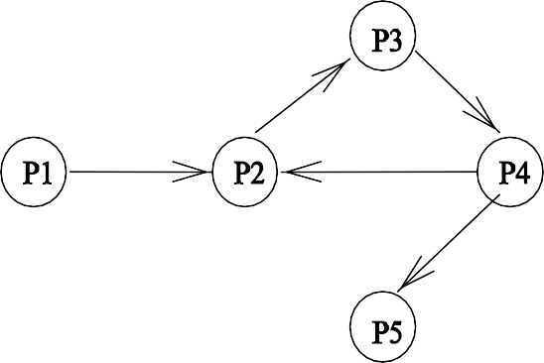
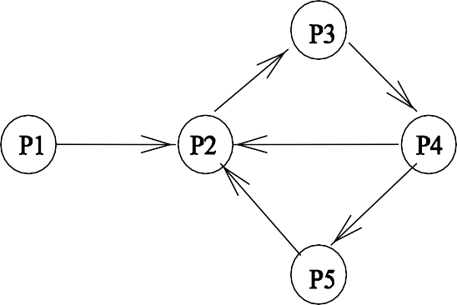


Conditions for Deadlock (Cont’d)
A knot (K) consists of a set of nodes such that for every node a in K , all nodes in K and only the nodes in K are reachable from node a.
Two systems under the OR condition with
(a) no deadlock and without (b) deadlock.

Slide 38
Focus 12: Rosenkrantz' Dynamic Priority
Scheme (using timestamps)
T1:
lock A; lock B;
transaction starts; unlock A;
unlock B;
wait-die (non-preemptive method) [ LC_{i} < LC_{j} → halt P_{i} (wait)
LC_{i} ≥LC_{j} → kill P_{i} (die)
]
wound-wait (preemptive method)
[ LC_{i} < LC_{j} → kill P_{j} (wound) LCi ≥LCj → halt P_{i} (wait)
]

Slide 39
Example 13
Process id | Priority | 1st request time | Length | Retry interval
P1 | 2 | 1 | 1 | 1
P2 | 1 | 1.5 | 2 | 1
P3 | 4 | 2.1 | 2 | 2
P4 | 5 | 3.3 | 1 | 1
P5
3
4.0
2
3
A system consisting of five processes.

Slide 40
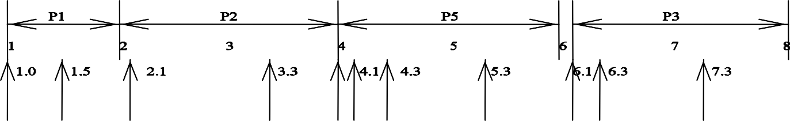
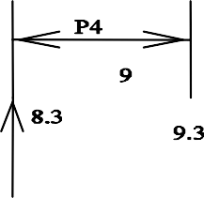
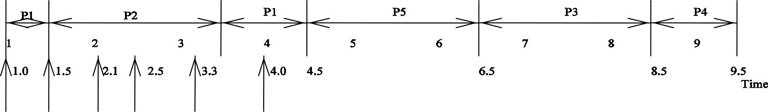
Example 13 (Cont’d)
wait-die:
wound-wait:

Slide 41
Load Distribution
A taxonomy of load distribution algorithms.

Slide 42
Static Load Distribution (task scheduling)
Processor interconnections
Task partition
Horizontal or vertical partitioning.
Communication delay minimization partition.
Task duplication.
Task allocation

Slide 43
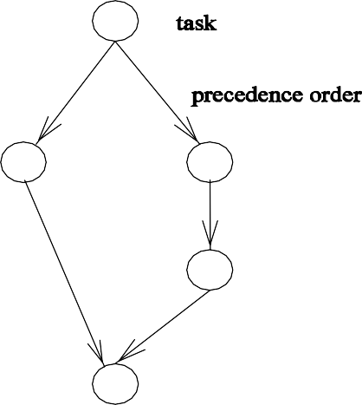
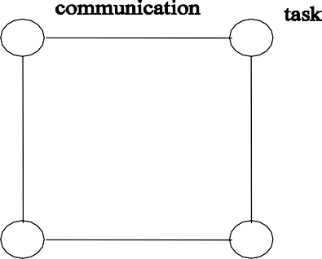
Models
Task precedence graph: each link defines the precedence order among tasks.
Task interaction graph: each link defines task interactions between two tasks.
(a) Task precedence graph and (b) task interaction graph.

Slide 44
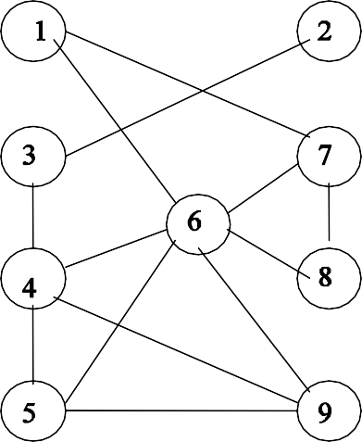
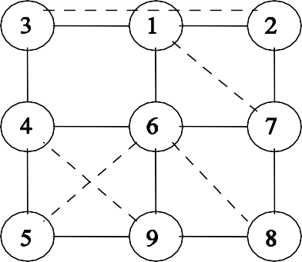
Example 14
Mapping a task interaction graph (a) to a processor graph (b).

Slide 45
Example 14 (Cont’d)
The dilation of an edge of G_{t} is defined as the length of the path in G_{p} onto which an edge of G_{t} is mapped. The dilation of the embedding is the maximum edge dilation of G_{t}.
The expansion of the embedding is the ratio of the number of nodes in G_{t} to the number of nodes in G_{p}.
The congestion of the embedding is the maximum number of paths containing an edge in G_{p} where every path represents an edge in G_{t}.
The load of an embedding is the maximum number of processes of G_{t} assigned to any processor of G_{t}.

Slide 46
Periodic Tasks With Real-time Constraints
Task T_{i} has request period t_{i} and run time c_{i}.
Each task has to be completed before its next request.
All tasks are independent without communication.

Slide 47
Liu and Layland's Solutions (priority-driven
and preemptive)
Rate monotonic scheduling (fixed priority assignment). Tasks with higher request rates will have higher priorities.
Deadline driven scheduling (dynamic priority assignment). A task will be assigned the highest priority if the deadline of its current request is the nearest.

Slide 48
Schedulability
Deadline driven schedule: iff
n
∑ c_{i}/t_{i} ≤1
i=0
Rate monotonic schedule: if
n
∑ c_{i}/t_{i} ≤n(2^{1/n} - 1);
i=0
may or may be not when
n
n(2^{1/n} - 1) < ∑ c_{i}/t_{i} ≤1
i=0

Slide 49
Example 15 (schedulable)
T₁: c₁ = 3, t₁ = 5 and T₂: c₂ = 2, t₂ = 7 (with the same initial request time).
The overall utilization is 0:887 > 0:828 (bound for n = 2).

Slide 50
Example 16 (un-schedulable under rate
monotonic scheduling)
T₁: c₁ = 3, t₁ = 5 and T₂: c₂ = 3, t₂ = 8 (with the same initial request time).
The overall utilization is 0:975 > 0:828
An example of periodic tasks that is not schedulable.

Slide 51
Example 16 (Cont’d)
If each task meets its first deadline when all tasks are started at the same time then the deadlines for all tasks will always be met for any combination of starting times.
scheduling points for task T : T 's first deadline and the ends of periods of higher priority tasks prior to T 's first deadline.
If the task set is schedulable for one of scheduling points of the lowest priority task, the task set is schedulable; otherwise, the task set is not schedulable.

Slide 52
Example 17 (schedulable under rate
monotonic schedule)
c₁ = 40, t₁ = 100, c₂ = 50, t₂ = 150, and c₃ = 80, t₃ = 350.
The overall utilization is 0:2 + 0:333 + 0:229 = 0:762 < 0:779 (the bound for n > 3).
c₁ is doubled to 40. The overall utilization is 0:4+0:333+0:229 = 0:962 > 0:779.
The scheduling points for T₃: 350 (for T₃), 300 (for T₁ and T₂), 200 (for T₁), 150 (for T₂), 100 (for T₁).

Slide 53
Example 17 (Cont’d)
c₁ + c₂ + c₃ ≤t₁,
40 + 50 + 80 > 100;
2c₁ + c₂ + c₃ ≤t₂, 80 + 50 + 80 > 150;
2c₁ + 2c₂ + c₃ ≤2t₁,
80 + 100 + 80 > 200;
3c₁ + 2c₂ + c₃ ≤2t₂,
120 + 100 + 80 = 300;
4c₁ + 3c₂ + c₃ ≤t₃,
160 + 150 + 80 > 350.

Slide 54
Example 17 (Cont’d)
A schedulable periodic task.

Slide 55














Dynamic Load Distribution (load balancing)
A state-space traversal example.

Slide 56
Dynamic Load Distribution (Cont’d)
A dynamic load distribution algorithm has six policies:
Initiation
Transfer
Selection
Profitability
Location
Information

Slide 57
Focus 13: Initiation
Sender-initiated approach:
Sender-initiated load balancing.

Slide 58
Focus 13 (Cont’d)
/* a new task arrives */ queue length ≥HWM →
* [ poll_set := φ ;
[| poll_set | < poll_limit →
[ select a new node u randomly; poll_set := poll_set ∪ node u; queue_length at u < HWM →
transfer a task to node u and stop
]
]
]

Slide 59
Receiver-Initiated Approach
Receiver-initiated load balancing.

Slide 60
Receiver-Initiated Approach (Cont’d)
/* a task departs */ queue length < LWM → [ poll limit:=φ ;
* [ | poll_set | < poll limit →
[ select a new node u randomly; poll_set := poll set ∪ node u; queue_length at u > HWM →
transfer a task from node u and stop
]
]
]

Slide 61






Bidding Approach
Bidding algorithm.

Slide 62
Focus 14: Sample Nearest Neighbor Algorithms
Diffusion
At round t + 1 each node u exchanges its load L_{u}(t) with its neighbors' L_{v}(t).
L_{u}(t + 1) should also include new incoming load φ_{u}(t) between rounds t and t + 1.
Load at time t + 1:
L_{u}(t + 1) = L_{u}(t) + ∑ α_{u,v}(L_{v}(t)- L_{u}(t)) + φ_{u}(t)
v ∈A(u)
where 0 ≤α_{u,v} ≤1 is called the diffusion parameter of nodes u and v.

Slide 63
Gradient
Maintain a contour of the gradients formed by the differences in load in the system.
Load in high points (overloaded nodes) of the contour will flow to the lower regions (underloaded nodes) following the gradients.
The propagated pressure of a processor u, p(u), is defined as p(u) =
0 (if u is lightly loaded)
1 + min{p(v)|v ∈A(u)} (otherwise)

Slide 64
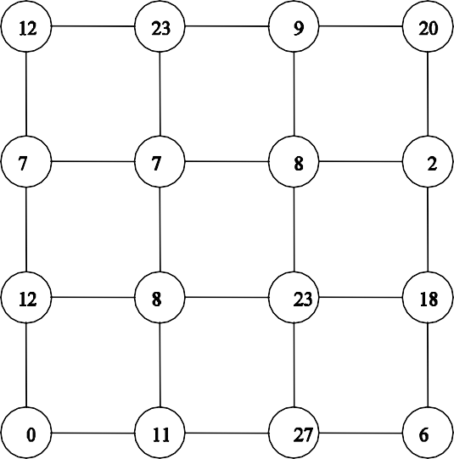
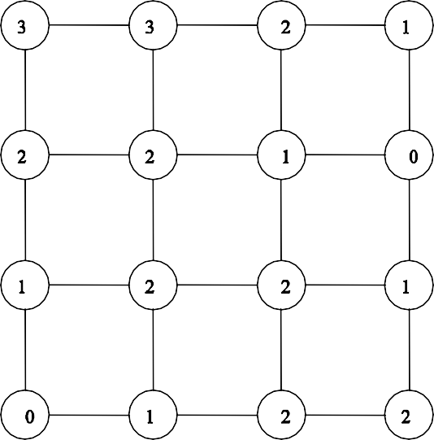
Gradient (Cont’d)
(a) A 4 x 4 mesh with loads. (b) The corresponding propagated pressure of each node (a node is lightly loaded if its load is less than 3).

Slide 65
Dimension Exchange: Hypercubes
A sweep of dimensions (rounds) in the n-cube is applied.
In the i^{th} round neighboring nodes along the i^{th} dimension compare and exchange their loads.

Slide 66
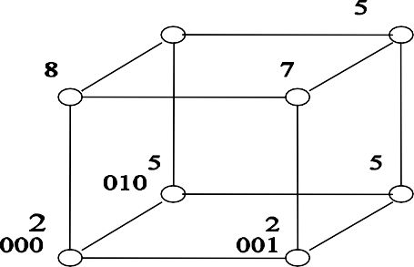
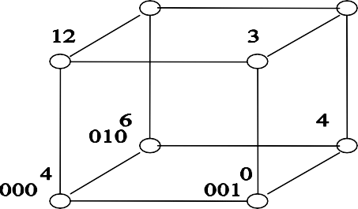
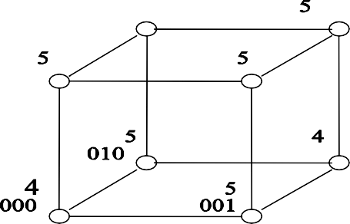
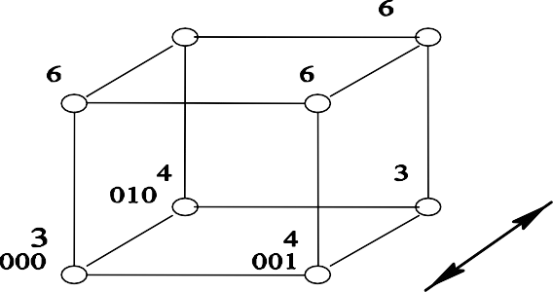
Dimension Exchange: Hypercubes (Cont’d)
Load balancing on a healthy 3-cube.

Slide 67
Extended Dimension Exchange:
Edge-Coloring
Extended dimension exchange model through edge-coloring.

Slide 68






Exercise 4
Apply wound-wait and wait-die schemes to the example shown in Table 2.
Show the state transition sequence for the following system with n = 3 and k = 5 using Dijkstra's self-stabilizing algorithm. Assume that P₀ = 3, P₁ = 1, and P₂ = 4.
Determine if there is a deadlock in each of the following wait-for graphs assuming the OR model is used.

Slide 69
Exercise 4 (Cont’d)
Process id | Priority | 1st request time | Length | Retry interval | Resource(s)
P1 | 3 | 1 | 1 | 1 | A
P2 | 4 | 1.5 | 2 | 1 | B
P3 | 1 | 2.5 | 2 | 2 | A,B
P4 | 2 | 3 | 1 | 1 | B,A
Table 2: A system consisting of four processes.
Consider the following two periodic tasks (with the same request time)
Task T₁: c₁ = 4, t₁ = 9
Task T₂: c₂ = 6, t₂ = 14
(a) Determine the total utilization of these two tasks and compare it with Liu and Layland's least upper bound for the fixed priority schedule. What conclusion can you derive?

Slide 70
Exercise 4 (Cont’d)
Show that these two tasks are schedulable using the rate-monotonic priority assignment. You are required to provide such a schedule.
Determine the schedulability of these two tasks if task T₂ has a higher priority than task T₁ in the fixed priority schedule.
Split task T₂ into two parts of 3 units computation each and show that these two tasks are schedulable using the rate-monotonic priority assignment.
Provide a schedule (from time unit 0 to time unit 30) based on deadline driven scheduling algorithm. Assume that the smallest preemptive element is one unit.

Slide 71
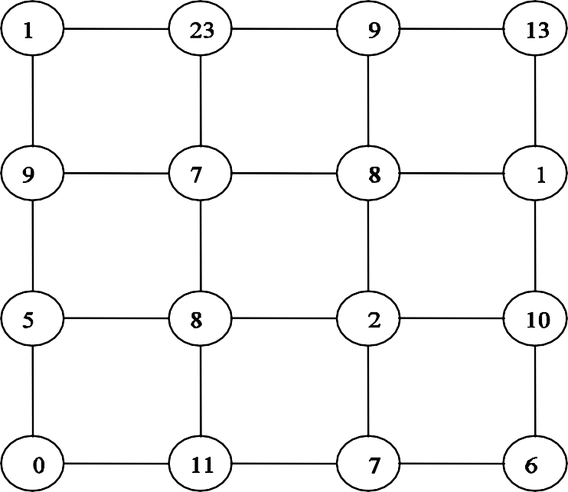
Exercise 4 (Cont’d)
5. For the following 4 x 4 mesh find the corresponding propagated pressure of each node. Assume that a node is considered lightly loaded if its load is less than 2.

