Slide 1
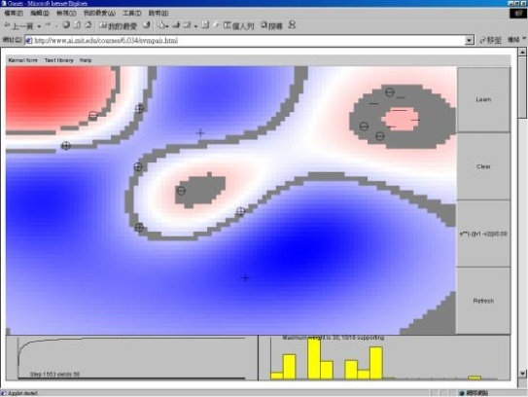

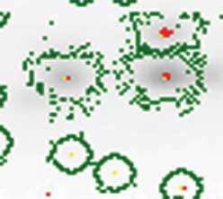

Lecture 25: Support Vector Machines
Objectives:
Empirical Risk Minimization
Large Margin Classifiers Soft Margin Classifiers SVM Training Relevance Vector Machines
Resources:
ML: Introduction to SVMs AM: SVM Tutorial SD: Support Vector Machines TDS: SVM Classification TDSS: Complete Guide
Class 2
Class 1

Slide 2
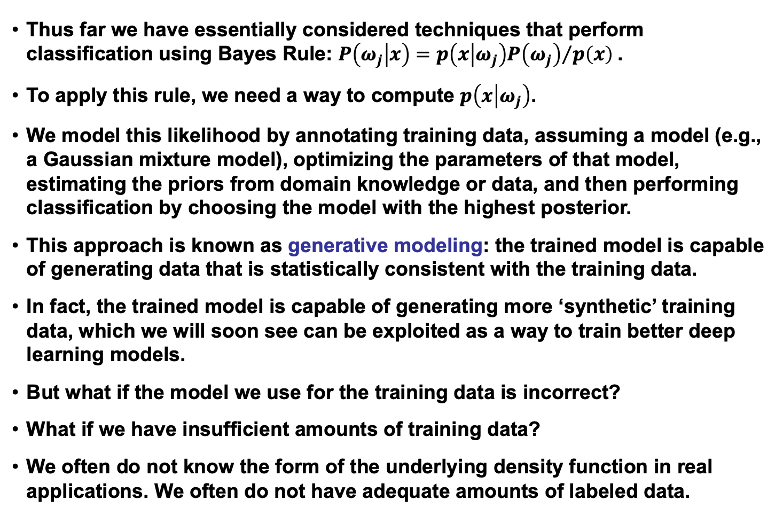
Generative Models
Thus far we have essentially considered techniques that perform classification using Bayes Rule: $P\left(ω_{j} | x\right)={p\left(x | ω_{j}\right)P\left(ω_{j}\right)}/{p\left(x\right)}$.
To apply this rule, we need a way to compute $p\left(x | ω_{j}\right)$.
We model this likelihood by annotating training data, assuming a model (e.g., a Gaussian mixture model), optimizing the parameters of that model, estimating the priors from domain knowledge or data, and then performing classification by choosing the model with the highest posterior.
This approach is known as generative modeling: the trained model is capable of generating data that is statistically consistent with the training data.
In fact, the trained model is capable of generating more ‘synthetic’ training data, which we will soon see can be exploited as a way to train better deep learning models.
But what if the model we use for the training data is incorrect?
What if we have insufficient amounts of training data?
We often do not know the form of the underlying density function in real applications. We often do not have adequate amounts of labeled data.

Slide 3
Convergence in Maximum Likelihood
Does convergence in maximum likelihood guarantee optimal classification?
Gaussian models can produce an incorrect decision surface.
Gaussian mixture modeling tends to overfit data.
How do we know the correct number of mixture components to use?
Real data is often not separable by hyperplanes.
Goal: balance representation and discrimination in a common framework (rather than alternating between the two).

Slide 4
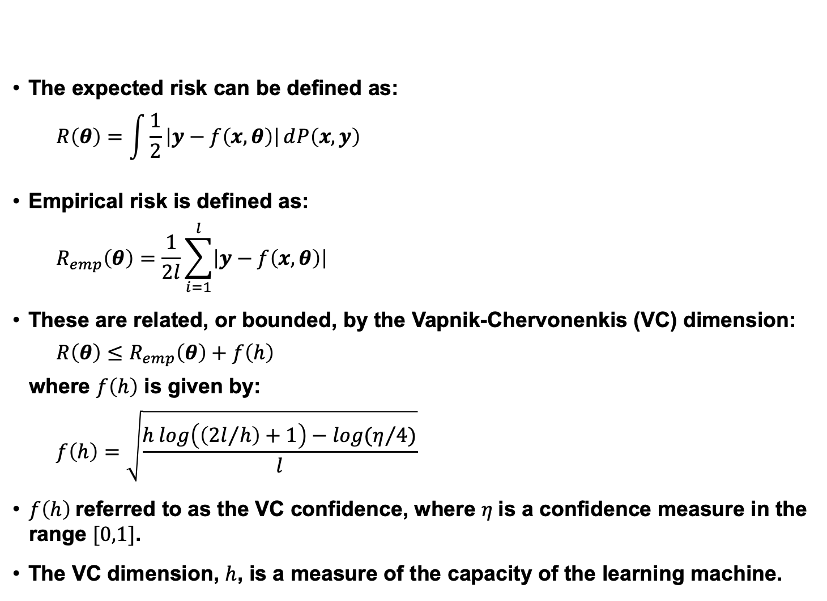
Risk Minimization Revisited
The expected risk can be defined as:
$$R\left(θ\right)=\int{\frac{1}{2}}\left|y−f\left(x,θ\right)\right|ⅆP\left(x,y\right)$$
Empirical risk is defined as:
$$R_{emp}\left(θ\right)=\frac{1}{2l}\sum_{i=1}^{l}{\left|y−f\left(x,θ\right)\right|}$$
These are related, or bounded, by the Vapnik-Chervonenkis (VC) dimension:
$R\left(θ\right)≤$ $R_{emp}\left(θ\right)+f\left(h\right)$
where $f\left(h\right)$ is given by:
$$f\left(h\right)=\sqrt{\frac{h log\left(\left({2l}/h\right)+1\right)−log(η/4)}{l}}$$
$f\left(h\right)$referred to as the VC confidence, where $η$is a confidence measure in the range $[0,1]$.
The VC dimension, $h$, is a measure of the capacity of the learning machine.

Slide 5
Expected Risk vs. VC Dimension
The principle of structural risk minimization (SRM) involves finding the subset of functions that minimizes the bound on the empirical risk.
Optimal hyperplane classifiers achieve zero empirical risk for linearly separable data.
A Support Vector Machine (SVM) is an approach that gives the least upper bound on the risk.
SVMs first appeared in the 1970’s, but it took many years for researchers to understand their potential and find practical implementations that would allow training on large datasets.
Offline training was very computationally expensive and convergence was problematic.
In the 1990’s, however, fast training techniques emerged.

Slide 6
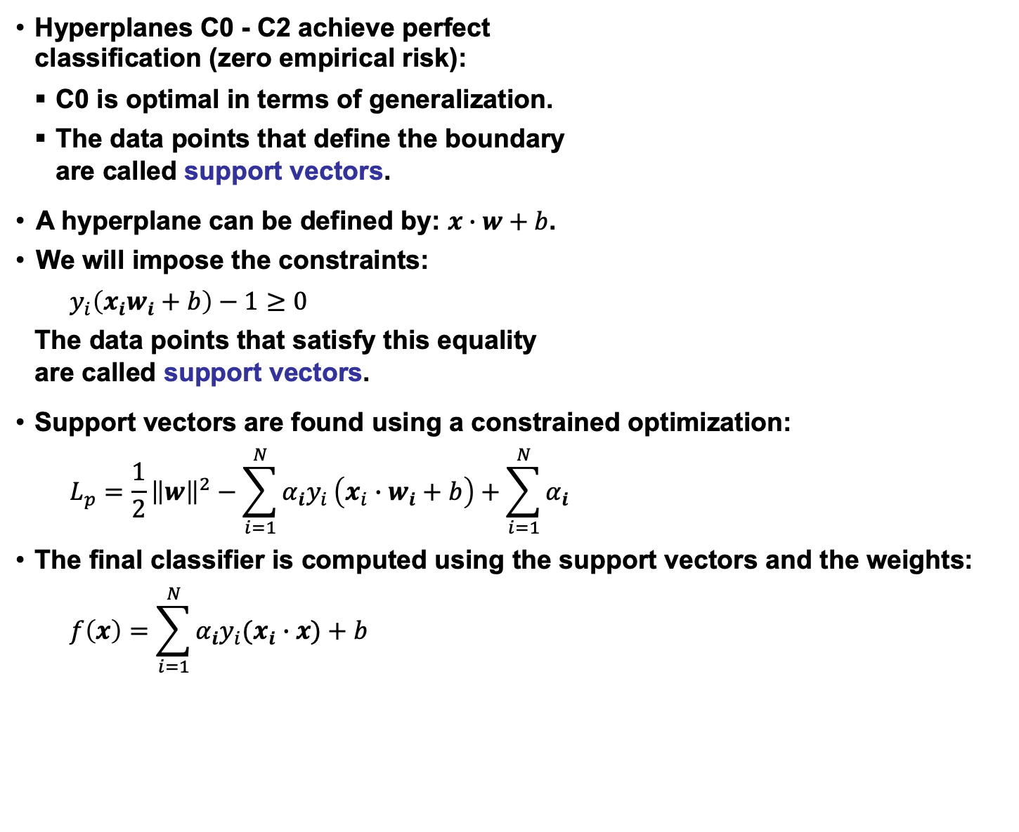
Large Margin Classification
Hyperplanes C0 - C2 achieve perfect classification (zero empirical risk):
C0 is optimal in terms of generalization.
The data points that define the boundary are called support vectors.
A hyperplane can be defined by: $x∙w+b$.
We will impose the constraints:
$$y_{i}\left(x_{i}w_{i}+b\right)−1≥0$$
The data points that satisfy this equality are called support vectors.
Support vectors are found using a constrained optimization:
$$L_{p}=\frac{1}{2}{\left\|w\right\|}^{2}−\sum_{i=1}^{N}{α_{i}y_{i}}\left(x_{i}{∙w}_{i}+ b\right)+\sum_{i=1}^{N}{α_{i}}$$
The final classifier is computed using the support vectors and the weights:
$$f\left(x\right)=\sum_{i=1}^{N}{α_{i}y_{i}(x_{i}∙x)}+b$$

Slide 7
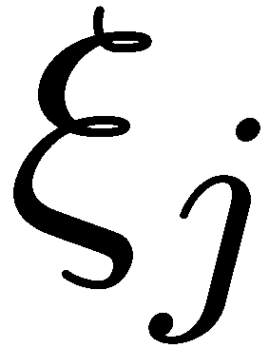
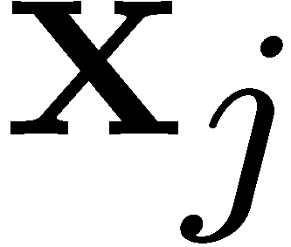
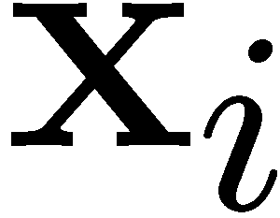
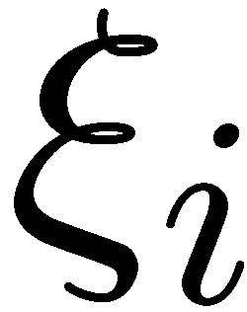



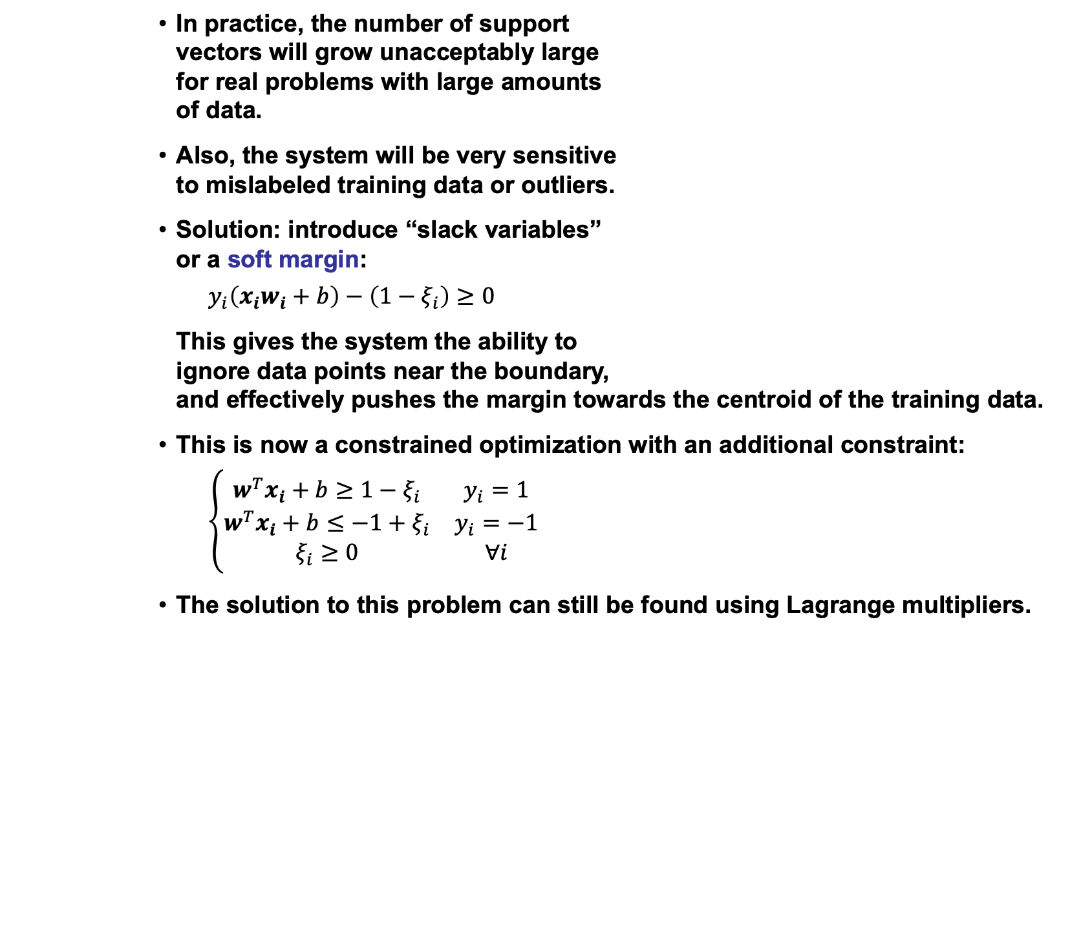
Soft Margin Classification
In practice, the number of support vectors will grow unacceptably large for real problems with large amounts of data.
Also, the system will be very sensitive to mislabeled training data or outliers.
Solution: introduce “slack variables” or a soft margin:
$$y_{i}\left(x_{i}w_{i}+b\right)−\left(1−ξ_{i}\right)≥0$$
This gives the system the ability to ignore data points near the boundary, and effectively pushes the margin towards the centroid of the training data.
This is now a constrained optimization with an additional constraint:
$$\left\{\begin{matrix}w^{T}x_{i}+b≥1−ξ_{i} & y_{i}=1 \\ w^{T}x_{i}+b≤−1+ξ_{i} & y_{i}=−1 \\ ξ_{i}≥0 & ∀i\end{matrix}\right.$$
The solution to this problem can still be found using Lagrange multipliers.
Class 2
Class 1

Slide 8
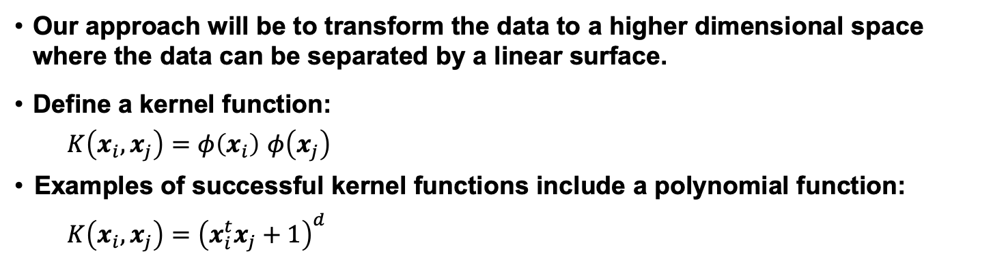
Nonlinear Decision Surfaces
Thus far we have only considered linear decision surfaces. How do we generalize this to a nonlinear surface?
φ( )
φ( )
φ( )
φ( )
φ( )
φ(.)
φ( )
φ( )
φ( )
φ( )
φ( )
φ( )
φ( )
φ( )
φ( )
φ( )
φ( )
φ( )
φ( )
Input space
Feature space
Our approach will be to transform the data to a higher dimensional space where the data can be separated by a linear surface.
Define a kernel function:
$K\left(x_{i},x_{j}\right)=φ\left(x_{i}\right)$ $φ\left(x_{j}\right)$
Examples of successful kernel functions include a polynomial function:
$$K\left(x_{i},x_{j}\right)={\left(x_{i}^{t}x_{j}+1\right)}^{d}$$
Notes:
XOR: x_1, x_2, and we want to transform to x_1^2, x_2^2, x_1 x_2
It can also be viewed as feature extraction from the feature vector x, but now we extract more feature than the number of features in x.

Slide 9
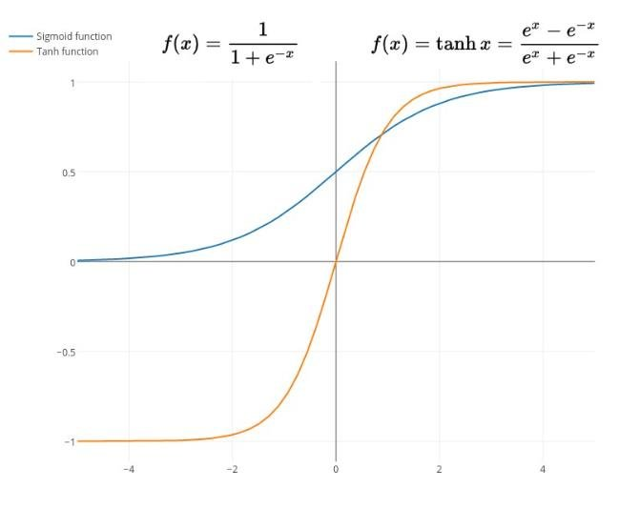
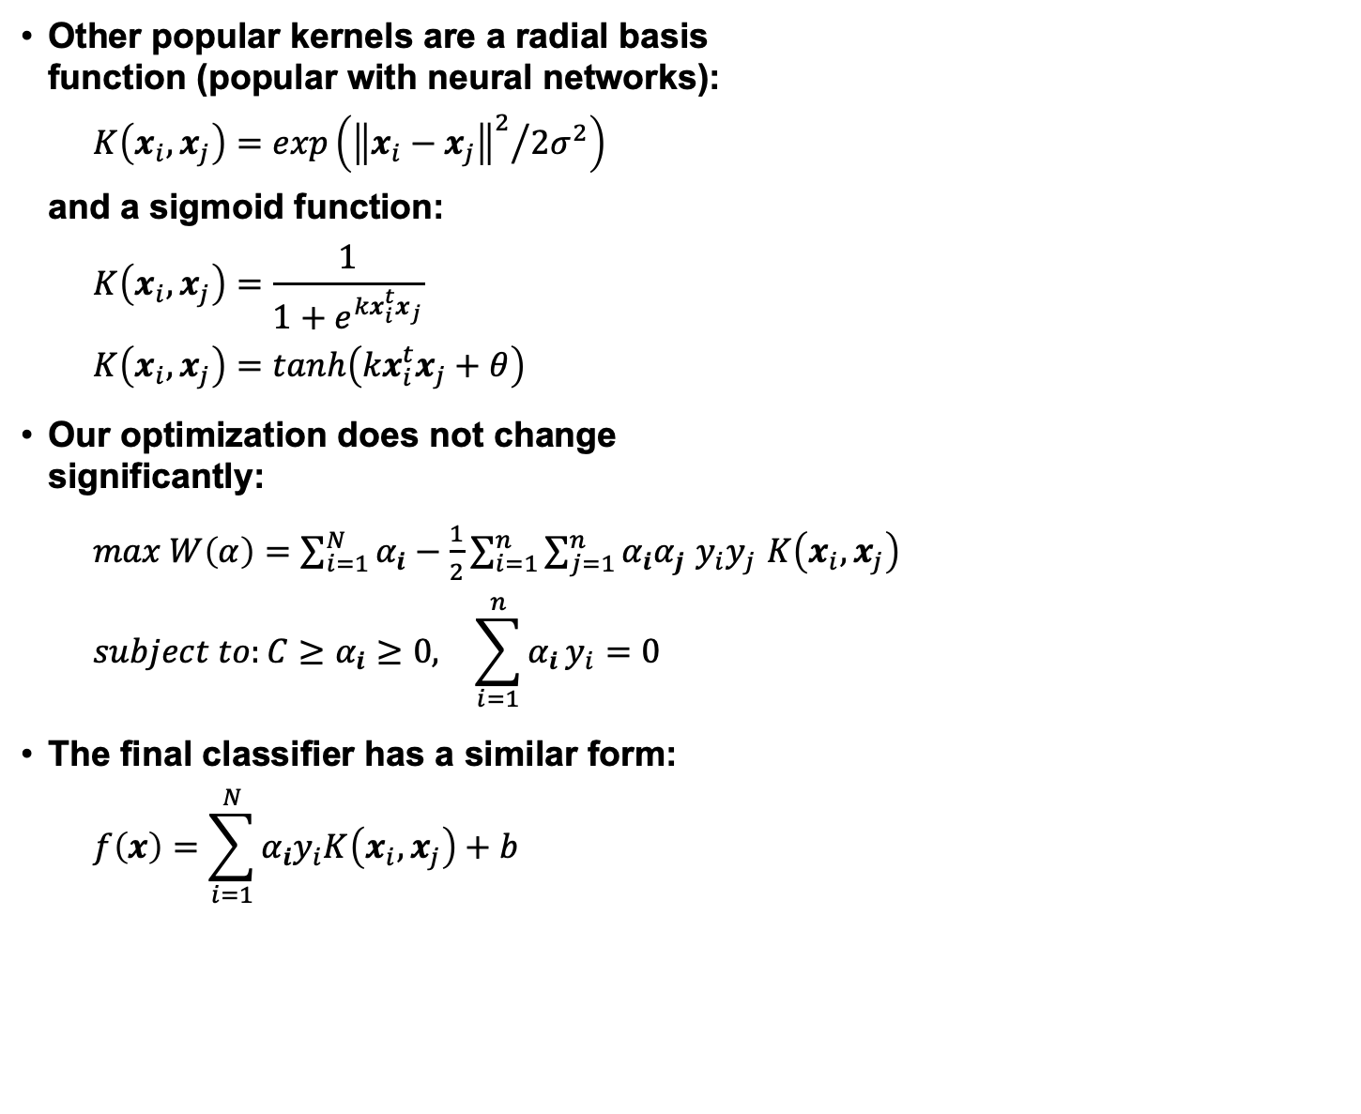
Kernel Functions
Other popular kernels are a radial basis function (popular with neural networks):
$$K\left(x_{i},x_{j}\right)=exp\left({{\left\|x_{i}−x_{j}\right\|}^{2}}/{2σ^{2}}\right)$$
and a sigmoid function:
$$K\left(x_{i},x_{j}\right)=\frac{1}{1+e^{{kx}_{i}^{t}x_{j}}}$$
$$K\left(x_{i},x_{j}\right)=tanh\left({kx}_{i}^{t}x_{j}+θ\right)$$
Our optimization does not change significantly:
$max W\left(α\right)=$ $\sum_{i=1}^{N}{α_{i}−\frac{1}{2}}\sum_{i=1}^{n}{\sum_{j=1}^{n}{α_{i}α_{j}}}$ $y_{i}y_{j}$ $K\left(x_{i},x_{j}\right)$
$$subject to:C≥α_{i}≥0, \sum_{i=1}^{n}{α_{i}}y_{i}=0$$
The final classifier has a similar form:
$$f\left(x\right)=\sum_{i=1}^{N}{α_{i}y_{i}K\left(x_{i},x_{j}\right)}+b$$
Notes:
XOR: x_1, x_2, and we want to transform to x_1^2, x_2^2, x_1 x_2
It can also be viewed as feature extraction from the feature vector x, but now we extract more feature than the number of features in x.

Slide 10
Historical Limitations of SVMs
Uses a binary (yes/no) decision rule
Generates a distance from the hyperplane, but this distance is often not a good measure of our “confidence” in the classification
Can produce a “probability” as a function of the distance (e.g. using sigmoid fits), but they are inadequate (often lack dynamic range)
Number of support vectors grows linearly with the size of the data set
Requires the estimation of trade-off parameter, C, via held-out sets:
Error
Open-Loop
Error
Optimum
Training Set
Error
Model Complexity

Slide 11
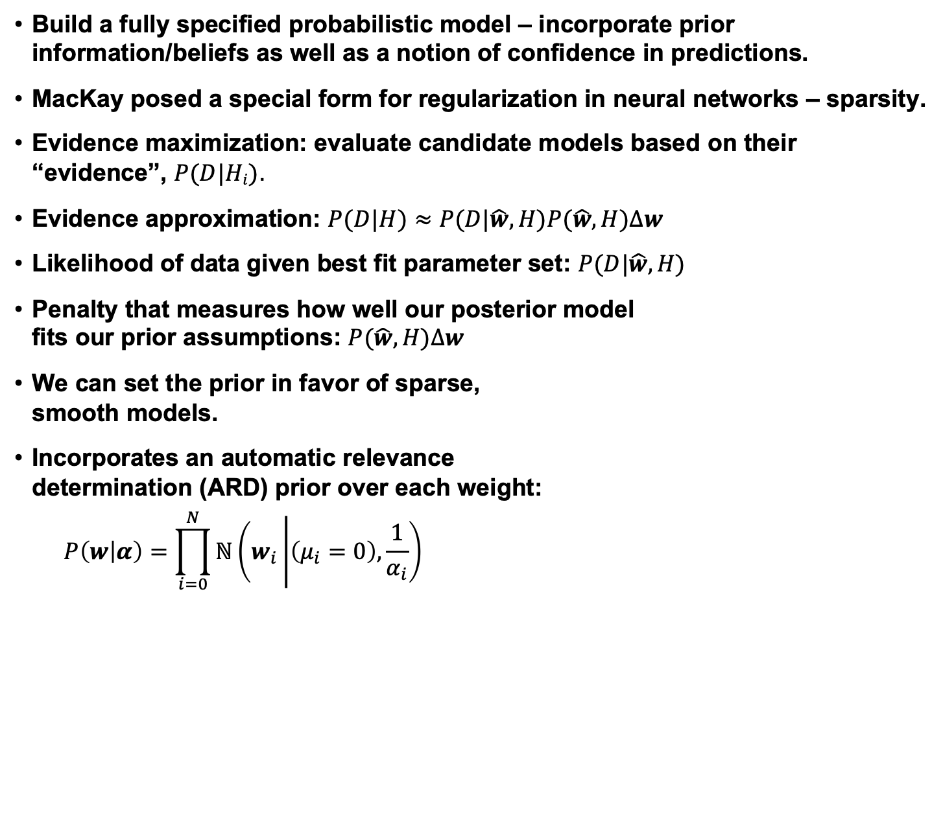
Evidence Maximization
Build a fully specified probabilistic model – incorporate prior information/beliefs as well as a notion of confidence in predictions.
MacKay posed a special form for regularization in neural networks – sparsity.
Evidence maximization: evaluate candidate models based on their “evidence”, $P(D|Hi)$.
Evidence approximation: $P(D|H)≈P(D|\hat{w},H)P(\hat{w},H)∆w$
Likelihood of data given best fit parameter set: $P(D|\hat{w},H)$
Penalty that measures how well our posterior model fits our prior assumptions: $P(\hat{w},H)∆w$
We can set the prior in favor of sparse, smooth models.
Incorporates an automatic relevance determination (ARD) prior over each weight:
$$P\left(w | α\right)=\prod_{i=0}^{N}{ℕ\left(w_{i}\left|\left(μ_{i}=0\right),\frac{1}{α_{i}}\right.\right)}$$
P(w|D,H_{i})
Δ
w
P(w|H_{i})
w
σ
w

Slide 12
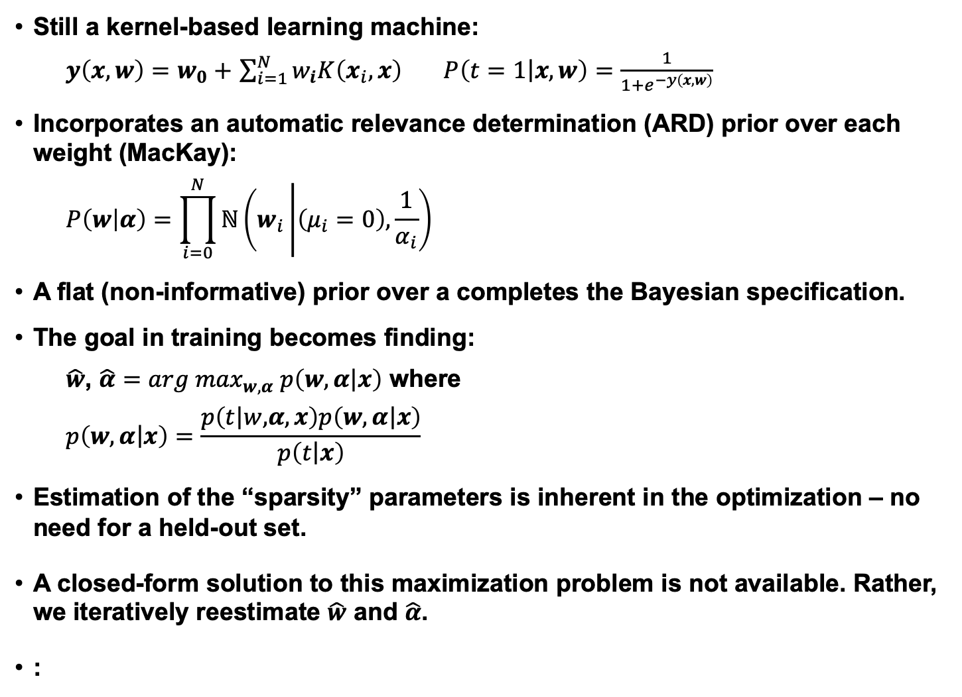
Relevance Vector Machines
Still a kernel-based learning machine:
$y\left(x,w\right)=w_{0}+$ $\sum_{i=1}^{N}{w_{i}K\left(x_{i},x\right)}$ $P\left(t=1\left|x,w\right.\right)=\frac{1}{1+e^{−y\left(x,w\right)}}$
Incorporates an automatic relevance determination (ARD) prior over each weight (MacKay):
$$P\left(w | α\right)=\prod_{i=0}^{N}{ℕ\left(w_{i}\left|\left(μ_{i}=0\right),\frac{1}{α_{i}}\right.\right)}$$
A flat (non-informative) prior over a completes the Bayesian specification.
The goal in training becomes finding:
$\hat{w}$, $\hat{α}={arg max}_{w,α} p\left(w,α\left|x\right.\right)$ where
$$p\left(w,α\left|x\right.\right)=\frac{p\left(t\left|w,\right.α,x\right)p\left(w,α\left|x\right.\right)}{p\left(t\left|x\right.\right)}$$
Estimation of the “sparsity” parameters is inherent in the optimization – no need for a held-out set.
A closed-form solution to this maximization problem is not available. Rather, we iteratively reestimate $\hat{w}$ and $\hat{α}$.
:
Notes:
The Relevance vector machine introduced by Michael Tipping of Microsoft is a Bayesian modeling approach that addresses the problems with the SVM, while retaining many of the desirable properties of SVMs. As with SVMs, the basic form of the relevance vector machine is that of a linear combination of basis functions. You’ll note from the equation that the basis functions we are considering here are the same kernel functions that were used with SVMs. Thus, the advantage of working in a high-dimensional space is maintained when we move to RVMs.
A major complaint with using the SVMs was that they were not in the form of a probabilistic model as we are accustomed to using in speech recognition systems. The RVM addresses that complaint by building a fully specified probabilistic model. The first step in building that model is defining a posterior probability model through the use of the logistic link function shown. It simply maps values on an infinite range to the range [0,1]. This step is common to many types of machine learning including neural networks.
What is not so common is the second step or what you might consider the Bayesian step in building our probabilistic model. That is the specification of a prior distribution across the weights that we wish to learn. In this case, we are using an automatic relevance determination prior originally suggested by MacKay in his thesis. This prior imposes a zero-mean Gaussian distribution across each weight. Notice that each weight has associated with it a hyperparameter indicated by alpha sub i. A goal of our methods becomes learning the optimal value for this hyperparameter. As the alpha goes to infinity, the prior becomes infinitely peaked at zero and the weight can, thus, be pruned. In practice, we find that a great majority of the hyperparameters go to infinity and sparseness is, thus, sparseness is achieved. To complete the Bayesian specification of the model, we need to define the prior over the hyperparameters. We choose a flat or non-informative prior which indicates our lack of knowledge about the appropriate value for the hyperparameters.

Slide 13
Summary
Support Vector Machines are one example of a kernel-based learning machine that is trained in a discriminative fashion (directly models the boundary region between two classes; directly minimizes the error rate).
Integrates notions of risk minimization, large margin and soft margin classification.
Two fundamental innovations:
maximize the margin between the classes using actual data points,
rotate the data into a higher-dimensional space in which the data is linearly separable.
Training can be computationally expensive, but classification is very fast.
Note that SVMs are inherently non-probabilistic (e.g., non-Bayesian).
SVMs can be used to estimate posteriors by mapping the SVM output to a likelihood-like quantity using a nonlinear function (e.g., sigmoid).
SVMs are not inherently suited to an N-way classification problem. Typical approaches include a pairwise comparison or “one vs. world” approach.

Slide 14
Summary (Cont.)
Many alternate forms include Transductive SVMs, Sequential SVMs, Support Vector Regression, Relevance Vector Machines, and data-driven kernels.
Key lesson learned: a linear algorithm in the feature space is equivalent to a nonlinear algorithm in the input space. Standard linear algorithms can be generalized (e.g., kernel principal component analysis, kernel independent component analysis, kernel canonical correlation analysis, kernel k-means).
What we didn’t discuss:
How do you train SVMs?
Computational complexity?
How to deal with large amounts of data?
See Ganapathiraju for an excellent, easy to understand discourse on SVMs and Hamaker (Chapter 3) for a nice overview on RVMs. There are many other tutorials available online (see the links on the title slide) as well.
Other methods based on kernels – more to follow.

