Slide 1
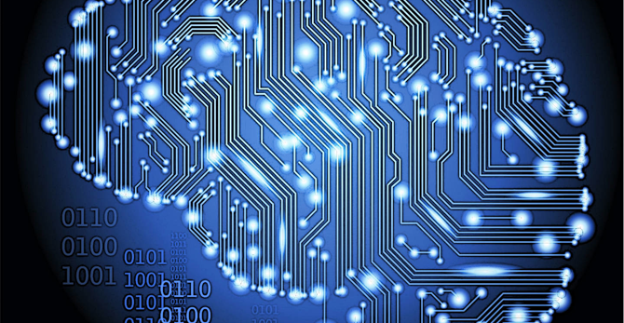
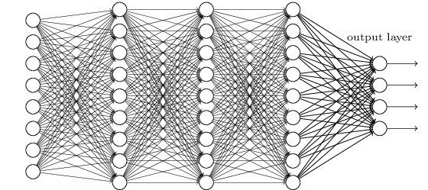
Lecture 31: Deep Learning
Objectives:
Deep Learning
Restricted Boltzmann Machines
Deep Belief Networks
Resources:
Textbook (Sects. 6.1, 6.2)
Learning Architectures for AI
Contrastive Divergence RBMs
Boltzmann Machines
Derivation of Learning
Contrastive Divergence

Slide 2
Deep Learning
Deep learning is a branch of machine learning that has gained great popularity in the latest years
The first deep network descriptions emerged in the late 60s and early 70s. Ivankhnenko (1971) published a paper that described a deep network with 8 layers trained by the Group Method of Data Handling algorithm
In 1989 LeCun was able to apply the standard backpropagation algorithm to train a deep network to recognize handwritten Zip codes. This process was not very practical, since it took three days for training
In 1998, a team led by Larry Heck achieved the first success for deep learning on speaker recognition.
Nowadays, several speech recognition problems have been approached with a deep learning method called a Long Short Term Memory (LSTM), a recurrent neural network proposed by Schmidhuber in 1997
New training methodologies (greedy-layer-wise learning algorithm) and advances in hardware (GPUs) have contributed to the renewed interest on this topic.

Slide 3


Vanishing Gradient and Backpropagation
One of the reasons that made the training of deep neural networks a difficult task is related to the vanishing gradient, which results from gradient based training techniques and the backpropagation algorithm
Considering a very simple deep network, with only one neuron per layer, a cost C and a sigmoid activation function:
A small change in $b_{1}$ sets off a series of cascading changes in the network
$∆a_{1}≈\frac{dσ\left(ω_{1}a_{0}+b_{1}\right)}{db_{1}}∆b_{1}$ or ${∆a_{1}=σ}^{′}\left(z_{1}\right)∆b_{1}$ The change in $a_{1}$, then causes a change in the weighted input $z_{2}$, which would be given by $∆z_{2}≈σ^{′}\left(z_{1}\right)ω_{2}∆b_{1}$. Basically, a term $σ′(z_{j})$ and $ω_{j}$ is picked up in every neuron
The resulting change in cost (divided by $∆b_{1}$), produced by the change $∆b_{1}$ is given by:
$$\frac{ⅆC}{db_{1}}=σ^{′}\left(z_{1}\right)×ω_{2}×σ^{′}\left(z_{2}\right)×ω_{3}×σ^{′}\left(z_{3}\right)×ω_{4}×σ^{′}\left(z_{4}\right)×\frac{ⅆC}{da_{4}}$$
For a sigmoid, $σ^{′}\left(0\right)=\frac{1}{4}$, in this sense, the terms $\left|ω_{j}σ^{′}\left(z_{j}\right)\right|<\frac{1}{4}$, contributing to a vanishing gradient
Notes:
If the weights tend to increase during training and the terms get large enough, the gradient would grow exponentially and the problem would be an exploding gradient instead.

Slide 4
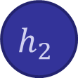
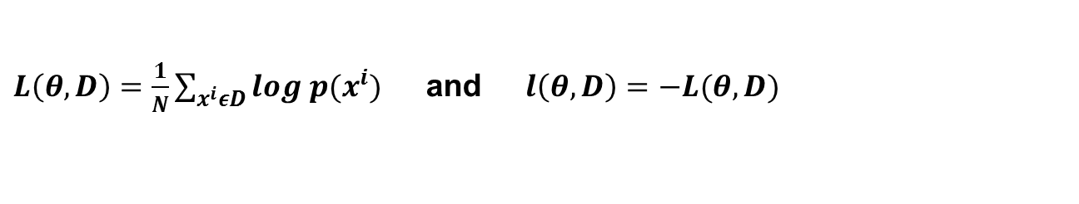
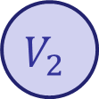
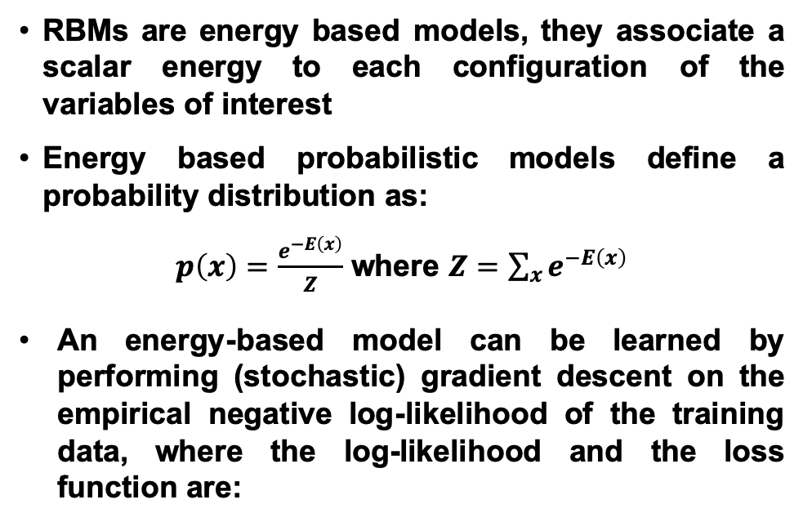

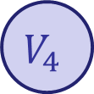

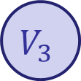

Boltzmann Machines (BM)
The vanishing gradient results in very slow training for the front layers of the network
One of the solutions to this issue was proposed by Hinton (2006). He proposed to use a Restricted Boltzmann Machine (RBM) to model each new layer of higher level features
RBMs are energy based models, they associate a scalar energy to each configuration of the variables of interest
Energy based probabilistic models define a probability distribution as:
$p\left(x\right)=\frac{e^{−E\left(x\right)}}{Z}$ where $Z=\sum_{x}{e^{−E\left(x\right)}}$
An energy-based model can be learned by performing (stochastic) gradient descent on the empirical negative log-likelihood of the training data, where the log-likelihood and the loss function are:
$$V_{1}$$
RBM
$$h_{1}$$
$$V_{2}$$
$$h_{2}$$
$$V_{3}$$
$$h_{2}$$
$$V_{4}$$
$L\left(θ, D\right)=\frac{1}{N}\sum_{x^{i}εD}{log p(x^{i})}$ and $l\left(θ,D\right)=−L(θ, D)$

Slide 5
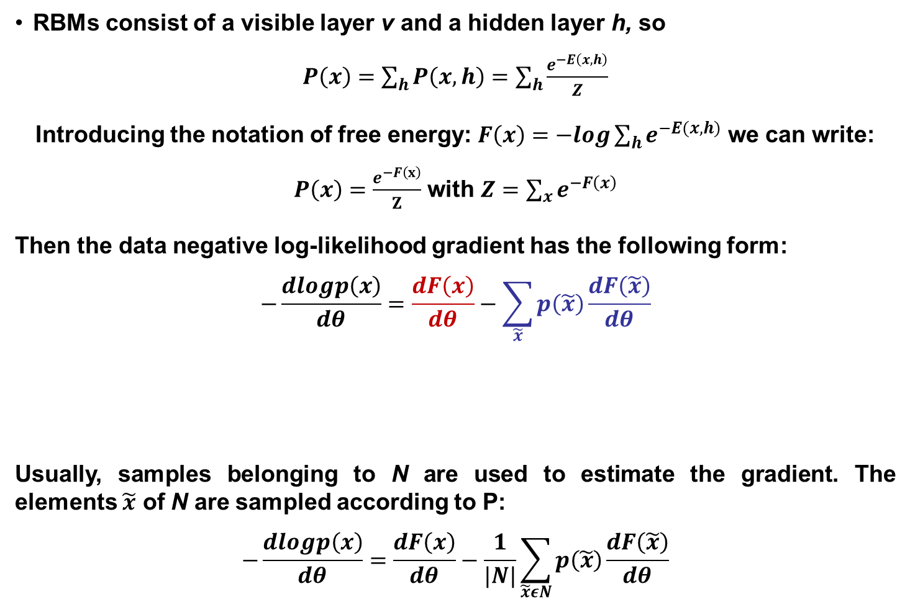
Boltzmann Machines (BM)
RBMs consist of a visible layer v and a hidden layer h, so
$P\left(x\right)=\sum_{h}{P\left(x,h\right)=\sum_{h}{\frac{e^{−E\left(x,h\right)}}{Z}}}$
Introducing the notation of free energy: $F\left(x\right)=−log\sum_{h}{e^{−E(x,h)}}$ we can write:
$P\left(x\right)=\frac{e^{−F\left(x\right)}}{Z}$ with $Z=\sum_{x}{e^{−F\left(x\right)}}$
Then the data negative log-likelihood gradient has the following form:
$$−\frac{dlogp\left(x\right)}{dθ}=\frac{dF\left(x\right)}{dθ}−\sum_{\tilde{x}}{p\left(\tilde{x}\right)}\frac{dF\left(\tilde{x}\right)}{dθ}$$
Usually, samples belonging to N are used to estimate the gradient. The elements $\tilde{x}$ of N are sampled according to P:
$$−\frac{dlogp\left(x\right)}{dθ}=\frac{dF\left(x\right)}{dθ}−\frac{1}{|N|}\sum_{\tilde{x}εN}{p\left(\tilde{x}\right)}\frac{dF\left(\tilde{x}\right)}{dθ}$$
Positive Phase: increase probability of training data
Negative Phase:
Decrease probability of samples generated by model

Slide 6

Restricted Boltzmann Machines (RBM)
RBMs have energy functions that are linear in their free parameters. Some of the variables are never observed (hidden) and restrict BMs to those without interconnections in the same layer
The energy function for an RBM with weights W is
$E\left(v,h\right)=−b^{′}v−c^{′}h−h^{′}Wv$ or $F\left(v\right)=−b^{′}v−\sum_{i}{log\sum_{h_{i}}{e^{h_{i}\left(c_{i}+W_{i}v\right)}}}$
Where b and c are offsets of the visible and hidden layers
Given that visible and hidden units are conditionally independent given one another:
$p\left(h | v\right)=\prod_{i}{p\left(h_{i} | v\right)}$ and $p\left(v | h\right)=\prod_{j}{p(v_{j}|h)}$
If using binary units, the free energy and the probabilistic version of the activation function are given by:
$$F\left(v\right)=−b^{′}v−\sum_{i}{log(1+e^{c_{i}+W_{i}v})}$$
$$P\left(h_{i}=1 | v\right)=σ\left(c_{i}+W_{i}v\right)$$
$$P\left(v_{j}=1 | h\right)=σ(b_{j}+{W′}_{j}h)$$

Slide 7

Restricted Boltzmann Machines (RBM)
Considering the previous information, the update equations are theoretically given by:
$$−\frac{dlog\left(p\left(v\right)\right)}{dW_{ij}}=E_{v}\left[p\left(h_{i} | v\right)∙v_{j}\right]−v_{j}^{\left(i\right)}∙σ\left(W_{i}∙v^{\left(i\right)}+c_{i}\right)$$
$−\frac{dlog\left(p\left(v\right)\right)}{dc_{i}}=E_{v}\left[p\left(h_{i} | v\right)\right]−σ\left(W_{i}∙v^{\left(i\right)}\right)$
$$−\frac{dlog\left(p\left(v\right)\right)}{db_{j}}=E_{v}\left[p\left(v_{j} | h\right)\right]−v_{j}^{(i)}$$
In practice, the log-likelihood gradients are commonly approximated by algorithms such as Contrastive Divergence (CD-k), which does the following:
Since we want $p\left(v\right)≈p_{train}\left(v\right)$ a Markov Chain is initialized with a training example that is close to p (so chain is close to convergence)
CD selects samples after only k steps of Gibbs sampling (does not wait for convergence)
Notes:
http://www.iro.umontreal.ca/~bengioy/papers/ftml.pdf

Slide 8




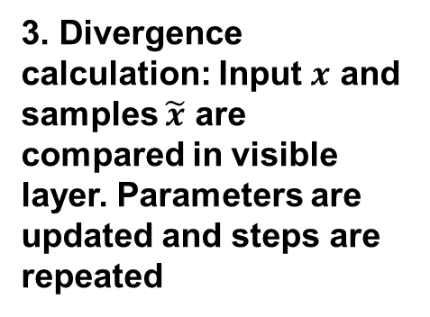
























RBM Training Summary
1. Forward Pass: Inputs are combined with an individual weights and a bias. Some hidden nodes are activated.
2. Backward Pass: Activations are combined with an individual weight and a bias. Results are passed to the visible layer.
3. Divergence calculation: Input $x$ and samples $\tilde{x}$ are compared in visible layer. Parameters are updated and steps are repeated
$$w_{1}$$
$$c$$
$$V_{1}$$
$$w_{2}$$
$$−\frac{dlogp\left(x\right)}{dθ}$$
$$h_{2}$$
$$V_{2}$$
$$w_{1}$$
$$h_{1}$$
$$b$$
$$h_{3}$$
$$w_{3}$$
$$h_{1}$$
$$h_{2}$$
$$V_{1}$$
$$V_{2}$$
$$w_{4}$$
Input being passed to first hidden node
$$h_{2}$$
$$h_{1}$$
$$h_{3}$$
$$V_{2}$$
$$V_{1}$$
$$h_{3}$$
$$h_{2}$$
Activations are passed to visible layer for reconstruction
$$V_{2}$$
$$h_{3}$$
$$Update W, b, c$$
$h_{1}$ activates in this example
Notes:
http://www.iro.umontreal.ca/~bengioy/papers/ftml.pdf

Slide 9




Deep Belief Networks (DBN)
These networks can be seen as a stack of RBMs. The hidden layer of one RBM is the Visible layer of the one above it
A pre-training step is done by training the layers one RBM at a time. The output for one set is used as the input for the next one
In this sense, each RBM layer learns the entire input. The DBN fine tunes the entire input in succession as the model improves.
This is called unsupervised, layer-wise, greedy pre-training
$$RBM_{1}$$
$$RBM_{2}$$
$$RBM_{3}$$
$$RBM_{4}$$
Notes:
http://www.iro.umontreal.ca/~bengioy/papers/ftml.pdf

Slide 10
Supervised Fine-Tuning of DBNs
After unsupervised pre-training, the network can be further optimized by gradient descent with respect to a supervised training criterion.
As a small set of labeled samples is introduced, the parameters are slightly updated to improve the network’s perception of the patterns
This training process can be accomplished in a reasonable amount of time (depending on the depth and other parameters of the DBN) in a GPU
Given that DBN attempt to sequentially learn the entire input and then reconstruct it in a backward pass, they are commonly used to learn features for the data.
Labels
Notes:
http://www.iro.umontreal.ca/~bengioy/papers/ftml.pdf

Slide 11
Example: Movie Recommendations
In this example, a simple RBM will be constructed and utilized for movie recommendations
In 2007, Hinton proposed the utilization of RBMs in order to produce more accurate movie recommendations with Netflix data
Essentially, the input data is comprised of the movies that users liked. The output is a set of weights that activate (or not) the hidden units that, in this case will represent movie genre.
As it was shown in the RBM training section, the input will be passed to the hidden layer, where the activation energy is calculated, and the weights and biases are updated
The input is then attempted to be reconstructed in a similar manner and the hidden units are updated accordingly
In this example the visible units will represent a movie and the input will be 1 if the user liked it, and 0 if the user did not like it
For a new user, the activation (or not activation) of the hidden units, indicates whether or not the use should be recommended to a set of movies
Note that this is a simple example to illustrate one application of RBMs.
Notes:
http://www.iro.umontreal.ca/~bengioy/papers/ftml.pdf

Slide 12





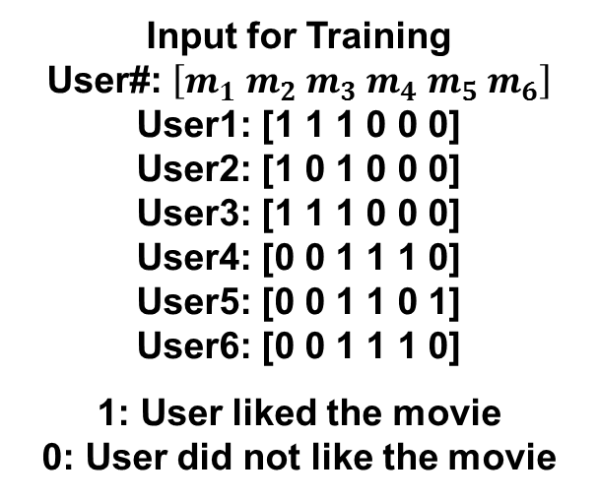


Example: Movie Recommendations
The RBM used in this example is constructed to have 6 visible units and 2 hidden units
$$m_{1}:Harry Potter$$ $m_{2}:Avatar$ $m_{3}:Lord of the Rings 3$
$$m_{4}:Gladiator \\ m_{5}:Titanic \\ m_{6}:Glitter$$
Hidden Layer
Visible Layer
$$m_{1}$$
$$m_{2}$$
$$m_{4}$$
$$m_{5}$$
$$m_{6}$$
Input for Training User#: $\left[m_{1} m_{2} m_{3} m_{4} m_{5} m_{6}\right]$ User1: [1 1 1 0 0 0] User2: [1 0 1 0 0 0] User3: [1 1 1 0 0 0] User4: [0 0 1 1 1 0] User5: [0 0 1 1 0 1] User6: [0 0 1 1 1 0]
1: User liked the movie 0: User did not like the movie
$$m_{3}$$
In this case, the hidden units will learn two latent variables underlying the movie preferences.
For example: It could learn to identify the Sci-Fi/Fantasy movies from the Oscar winning movies
Notes:
http://www.iro.umontreal.ca/~bengioy/papers/ftml.pdf

Slide 13
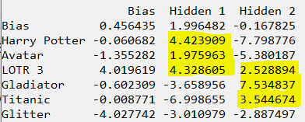

Example: Movie Recommendations
Running the code for the specified RBM and the provided examples produces the following weights:
The probability of activation is the sigmoid of the activation energy, negative values will correspond to low probability of activation.
It can be seen that the first hidden layer activates for Sci-Fi/Fantasy movies, while the second hidden layer corresponds to Oscar Winners.
When entering the information of a new user that likes Titanic and Gladiator, we get this result:
In this sense, the system is more likely to recommend Oscar Winning Movies to the new user.
Notes:
http://www.iro.umontreal.ca/~bengioy/papers/ftml.pdf

Slide 14
So, 1. what exactly is deep learning ?
And, 2. why is it generally better than other methods on image, speech and certain other types of data?
David Corne, and Nick Taylor, Heriot-Watt University - dwcorne@gmail.com
These slides and related resources: http://www.macs.hw.ac.uk/~dwcorne/Teaching/dmml.html

Slide 15
So, 1. what exactly is deep learning ?
And, 2. why is it generally better than other methods on image, speech and certain other types of data?
The short answers
1. ‘Deep Learning’ means using a neural network
with several layers of nodes between input and output
2. the series of layers between input & output do
feature identification and processing in a series of stages,
just as our brains seem to.

Slide 16
hmmm… OK, but:
3. multilayer neural networks have been around for
25 years. What’s actually new?

Slide 17
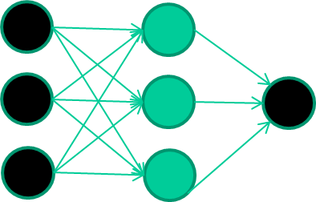
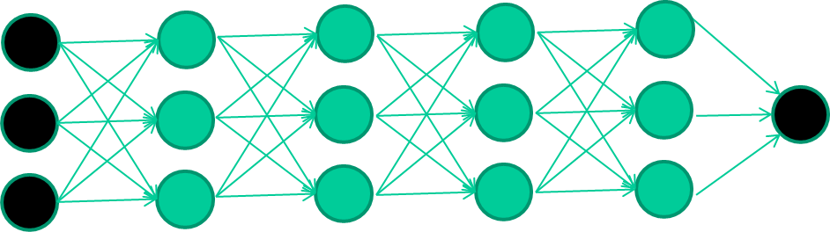
hmmm… OK, but:
3. multilayer neural networks have been around for
25 years. What’s actually new?
we have always had good algorithms for learning the
weights in networks with 1 hidden layer
but these algorithms are not good at learning the weights for
networks with more hidden layers
what’s new is: algorithms for training many-later networks

Slide 18
longer answers
reminder/quick-explanation of how neural network weights are learned;
the idea of unsupervised feature learning (why ‘intermediate features’ are important for difficult classification tasks, and how NNs seem to naturally learn them)
The ‘breakthrough’ – the simple trick for training Deep neural networks

Slide 19
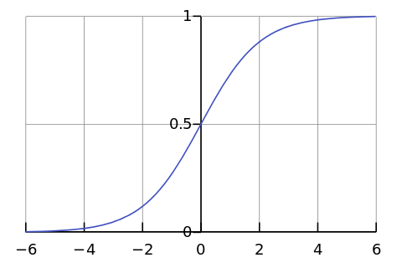

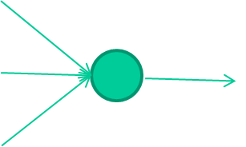
-0.06
W1
W2
f(x)
-2.5
W3
1.4

Slide 20
-0.06
2.7
-8.6
f(x)
-2.5
0.002
x = -0.06×2.7 + 2.5×8.6 + 1.4×0.002 = 21.34
1.4

Slide 21
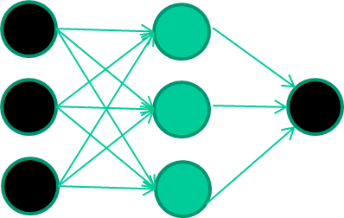
A dataset
Fields class
1.4 2.7 1.9 0
3.8 3.4 3.2 0
6.4 2.8 1.7 1
4.1 0.1 0.2 0
etc …

Slide 22
Training the neural network
Fields class
1.4 2.7 1.9 0
3.8 3.4 3.2 0
6.4 2.8 1.7 1
4.1 0.1 0.2 0
etc …

Slide 23
Training data
Fields class
1.4 2.7 1.9 0
3.8 3.4 3.2 0
6.4 2.8 1.7 1
4.1 0.1 0.2 0
etc …
Initialise with random weights

Slide 24
Training data
Fields class
1.4 2.7 1.9 0
3.8 3.4 3.2 0
6.4 2.8 1.7 1
4.1 0.1 0.2 0
etc …
Present a training pattern
1.4
2.7
1.9

Slide 25
Training data
Fields class
1.4 2.7 1.9 0
3.8 3.4 3.2 0
6.4 2.8 1.7 1
4.1 0.1 0.2 0
etc …
Feed it through to get output
1.4
2.7 0.8
1.9

Slide 26
Training data
Fields class
1.4 2.7 1.9 0
3.8 3.4 3.2 0
6.4 2.8 1.7 1
4.1 0.1 0.2 0
etc …
Compare with target output
1.4
2.7 0.8
0
1.9 error 0.8

Slide 27


Training data
Fields class
1.4 2.7 1.9 0
3.8 3.4 3.2 0
6.4 2.8 1.7 1
4.1 0.1 0.2 0
etc …
Adjust weights based on error
1.4
2.7 0.8
0
1.9 error 0.8

Slide 28
Training data
Fields class
1.4 2.7 1.9 0
3.8 3.4 3.2 0
6.4 2.8 1.7 1
4.1 0.1 0.2 0
etc …
Present a training pattern
6.4
2.8
1.7

Slide 29
Training data
Fields class
1.4 2.7 1.9 0
3.8 3.4 3.2 0
6.4 2.8 1.7 1
4.1 0.1 0.2 0
etc …
Feed it through to get output
6.4
2.8 0.9
1.7

Slide 30
Training data
Fields class
1.4 2.7 1.9 0
3.8 3.4 3.2 0
6.4 2.8 1.7 1
4.1 0.1 0.2 0
etc …
Compare with target output
6.4
2.8 0.9
1
1.7 error -0.1

Slide 31
Training data
Fields class
1.4 2.7 1.9 0
3.8 3.4 3.2 0
6.4 2.8 1.7 1
4.1 0.1 0.2 0
etc …
Adjust weights based on error
6.4
2.8 0.9
1
1.7 error -0.1

Slide 32
Training data
Fields class
1.4 2.7 1.9 0
3.8 3.4 3.2 0
6.4 2.8 1.7 1
4.1 0.1 0.2 0
etc …
And so on ….
6.4
2.8 0.9
1
1.7 error -0.1
Repeat this thousands, maybe millions of times – each time
taking a random training instance, and making slight
weight adjustments
Algorithms for weight adjustment are designed to make
changes that will reduce the error

Slide 33
The decision boundary perspective…
Initial random weights

Slide 34
The decision boundary perspective…
Present a training instance / adjust the weights

Slide 35
The decision boundary perspective…
Present a training instance / adjust the weights

Slide 36
The decision boundary perspective…
Present a training instance / adjust the weights

Slide 37
The decision boundary perspective…
Present a training instance / adjust the weights

Slide 38
The decision boundary perspective…
Eventually ….

Slide 39
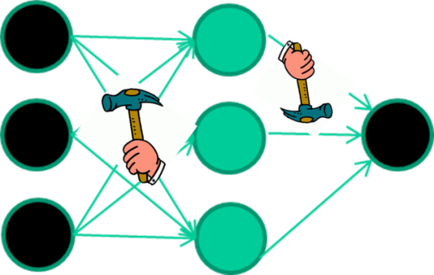
The point I am trying to make
weight-learning algorithms for NNs are dumb
they work by making thousands and thousands of tiny adjustments, each making the network do better at the most recent pattern, but perhaps a little worse on many others
but, by dumb luck, eventually this tends to be good enough to
learn effective classifiers for many real applications

Slide 40
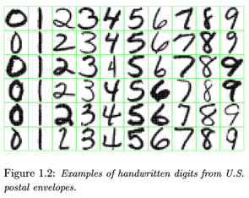
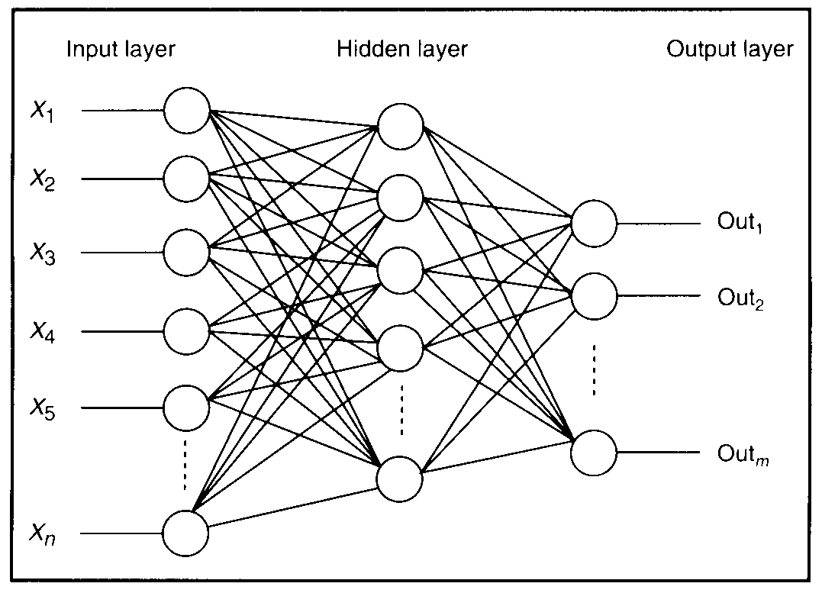
Feature detectors

Slide 41
what is this unit doing?

Slide 42
Hidden layer units become self-organised feature detectors
1 5 10 15 20 25 …
…
1
strong +ve weight
low/zero weight
63

Slide 43
What does this unit detect?
1 5 10 15 20 25 …
…
1
strong +ve weight
low/zero weight
63

Slide 44
What does this unit detect?
1 5 10 15 20 25 …
…
1
strong +ve weight
low/zero weight
it will send strong signal for a horizontal
line in the top row, ignoring everywhere else
63

Slide 45
What does this unit detect?
1 5 10 15 20 25 …
…
1
strong +ve weight
low/zero weight
63

Slide 46
What does this unit detect?
1 5 10 15 20 25 …
…
1
strong +ve weight
low/zero weight
Strong signal for a dark area in the top left
corner
63

Slide 47
What features might you expect a good NN
to learn, when trained with data like this?

Slide 48
vertical lines
1
63

Slide 49
Horizontal lines
1
63

Slide 50
Small circles
1
63

Slide 51
Small circles
1
But what about position invariance ???
our example unit detectors were tied to
specific parts of the image
63

Slide 52
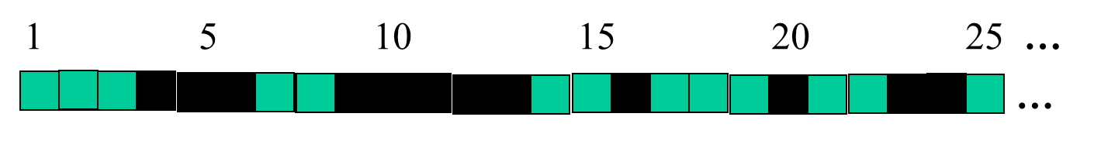
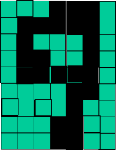
successive layers can learn higher-level features …
detect lines in
Specific positions
etc …
Higher level detetors
( horizontal line,
“RHS vertical lune”
“upper loop”, etc…
etc …
v

Slide 53
successive layers can learn higher-level features …
detect lines in
Specific positions
etc …
Higher level detetors
( horizontal line,
“RHS vertical lune”
“upper loop”, etc…
etc …
v
What does this unit detect?

Slide 54
So: multiple layers make sense

Slide 55
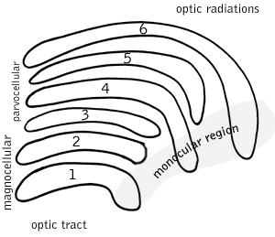
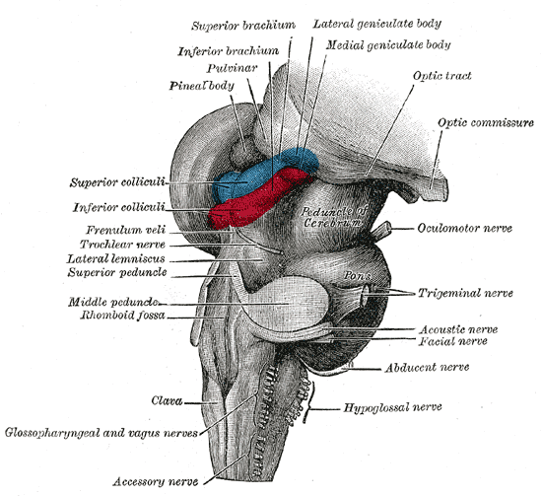
So: multiple layers make sense
Your brain works that way

Slide 56
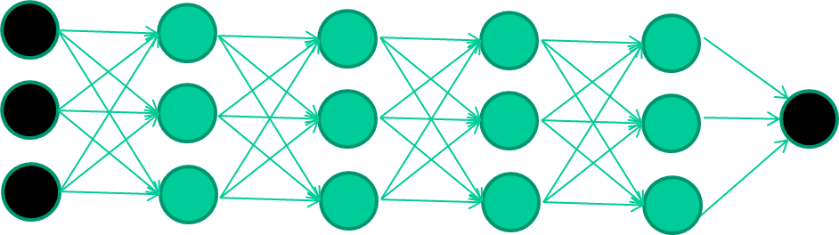
So: multiple layers make sense
Many-layer neural network architectures should be capable of learning the true underlying features and ‘feature logic’, and therefore generalise very well …

Slide 57
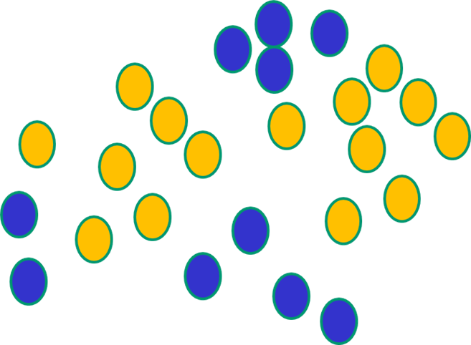

But, until very recently, our weight-learning algorithms simply did not work on multi-layer architectures

Slide 58
Along came deep learning …

Slide 59
The new way to train multi-layer NNs…

Slide 60
The new way to train multi-layer NNs…
Train this layer first

Slide 61
The new way to train multi-layer NNs…
Train this layer first
then this layer

Slide 62
The new way to train multi-layer NNs…
Train this layer first
then this layer
then this layer

Slide 63
The new way to train multi-layer NNs…
Train this layer first
then this layer
then this layer
then this layer

Slide 64
The new way to train multi-layer NNs…
Train this layer first
then this layer
then this layer
then this layer
finally this layer

Slide 65
The new way to train multi-layer NNs…
EACH of the (non-output) layers is trained to be an auto-encoder
Basically, it is forced to learn good features that describe what comes from the previous layer

Slide 66
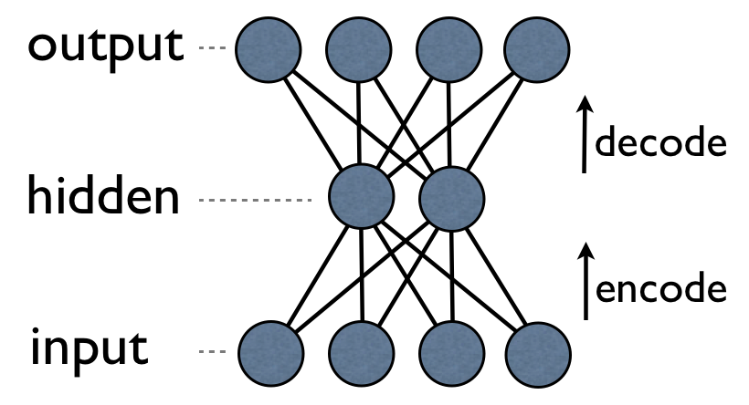
an auto-encoder is trained, with an absolutely standard weight-adjustment algorithm to reproduce the input

Slide 67
an auto-encoder is trained, with an absolutely standard weight-adjustment algorithm to reproduce the input
By making this happen with (many) fewer units than the inputs, this forces the ‘hidden layer’ units to become good feature detectors

Slide 68
intermediate layers are each trained to be auto encoders (or similar)

Slide 69
Final layer trained to predict class based on outputs from previous layers

Slide 70
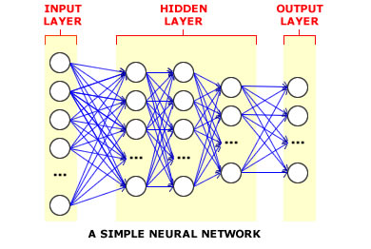
And that’s that
That’s the basic idea
There are many many types of deep learning,
different kinds of autoencoder, variations on architectures and training algorithms, etc…
Very fast growing area …

Slide 71
Summary
Deep learning has gained popularity in the latest years due to hardware advances (GPUs, etc.) and new training methodologies, which helped overcome the issue of the vanishing gradient
RBMs are shallow 2 layer networks (visible and hidden) that can find patterns in data by reconstructing the input in an unsupervised manner.
RBM training can be accomplished through algorithms such as Contrastive Divergence (CD)
To learn more:
https://deeplearning4j.org/restrictedboltzmannmachine
The ability to train deep networks has disrupted the field of machine learning.
Many practical details obstruct the process of convergence during training.
Strictly layering networks and training one level at a time has also emerged as a powerful training technique for deep networks.
Unsupervised training using autoencoders has also revolutionized how architectures are designed and trained.
Notes:
http://www.iro.umontreal.ca/~bengioy/papers/ftml.pdf

