Slide 1
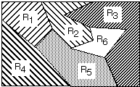
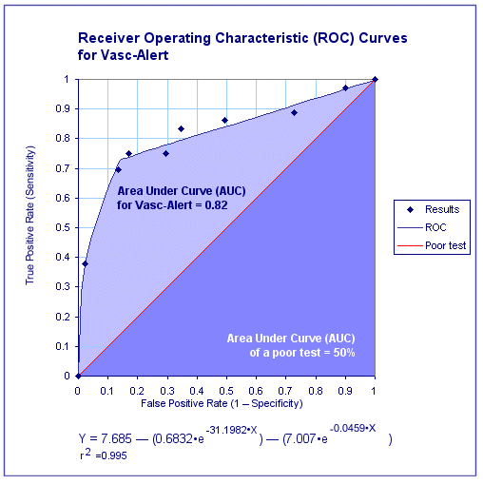
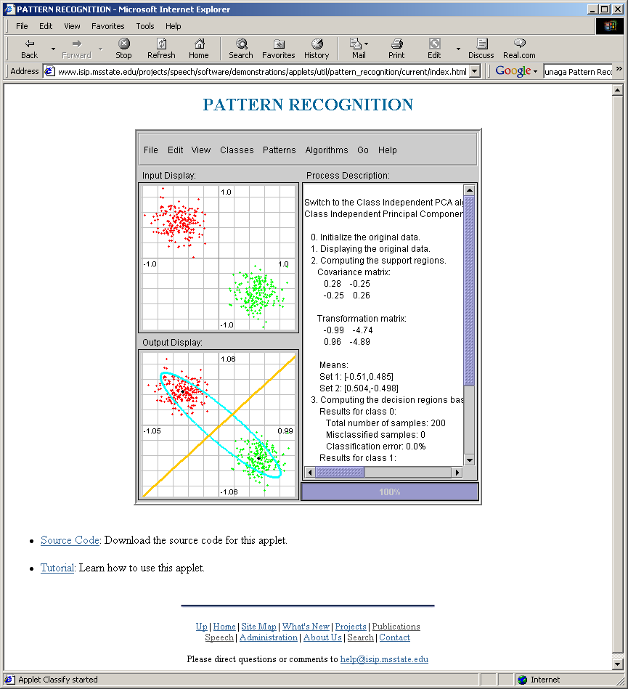
Lecture 04: Generalized Gaussian Classifiers
• Objectives:
Discriminant Functions Generalized Gaussian Classifiers Geometric Interpretation Examples
• Resources:
Textbook (Sections 9.5 – 9.A)
DHS: Chapter 2
MurphK: Gaussian Classifiers
ISIP: IMLD Demonstration Tool

Slide 2
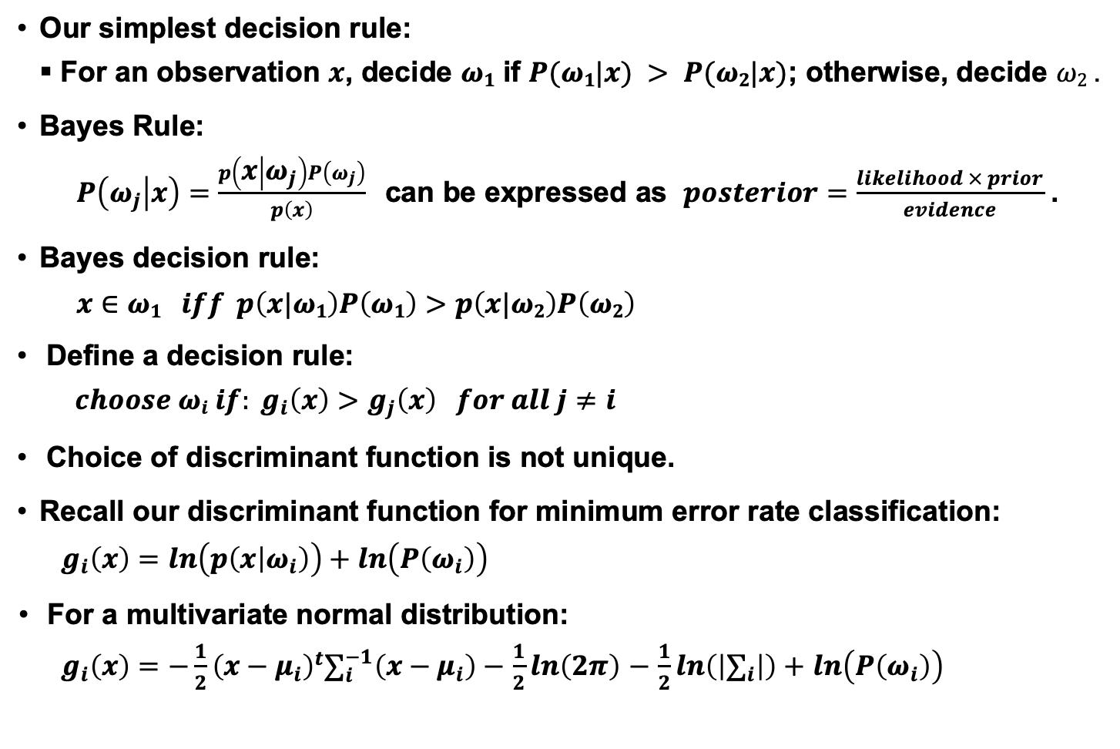
Posterior Probabilities
Our simplest decision rule:
For an observation $x$, decide $ω1$ if $P(ω1|x) > P(ω2|x)$; otherwise, decide $ω2$ .
Bayes Rule:
$P\left(ω_{j} | x\right)=\frac{p\left(x | ω_{j}\right)P\left(ω_{j}\right)}{p\left(x\right)}$ can be expressed as $posterior=\frac{likelihood × prior}{evidence}$ .
Bayes decision rule:
$$x∈ω1 iff p\left(x|ω1\right)P\left(ω1\right)>p\left(x|ω2\right)P\left(ω2\right)$$
Define a decision rule:
$$choose ωi if: g_{i}\left(x\right)>g_{j}\left(x\right) for all j≠i$$
Choice of discriminant function is not unique.
Recall our discriminant function for minimum error rate classification:
$$g_{i}\left(x\right)=ln\left(p\left(x | ω_{i}\right)\right)+ln\left(P\left(ω_{i}\right)\right)$$
For a multivariate normal distribution:
$g_{i}\left(x\right)=−\frac{1}{2}{\left(x−μ_{i}\right)}^{t}∑_{i}^{−1}\left(x−μ_{i}\right)−$ $\frac{1}{2}ln\left(2π\right)$ $−$ $\frac{1}{2}ln\left(\left|∑_{i}\right|\right)+$ $ln\left(P\left(ω_{i}\right)\right)$

Slide 3
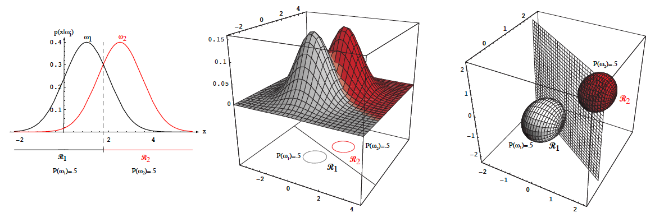
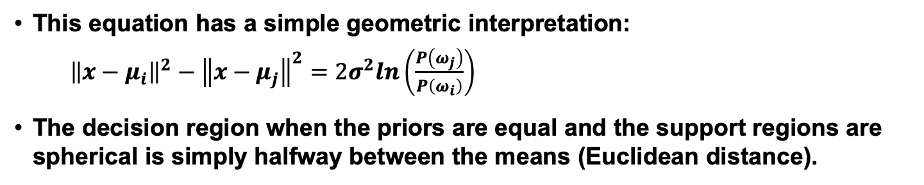
Threshold Decoding
This equation has a simple geometric interpretation:
${\left\|x−μ_{i}\right\|}^{2}−{\left\|x−μ_{j}\right\|}^{2}=2σ^{2}ln\left(\frac{P\left(ω_{j}\right)}{P\left(ω_{i}\right)}\right)$
The decision region when the priors are equal and the support regions are spherical is simply halfway between the means (Euclidean distance).

Slide 4
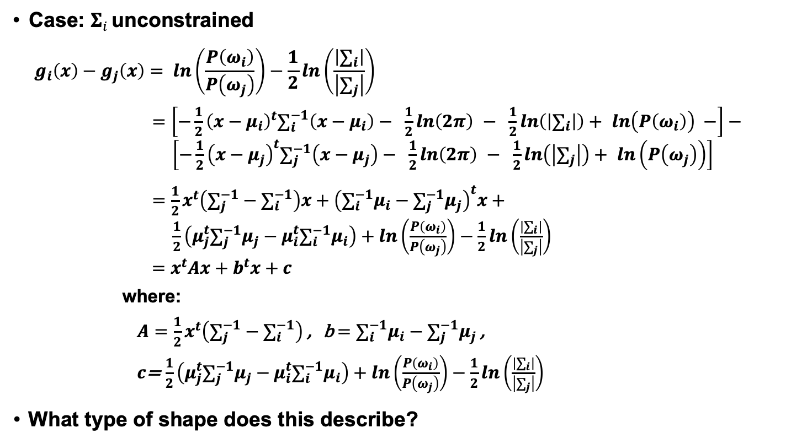
General Case for Gaussian Classifiers
Case: $Σi$ unconstrained
$$g_{i}\left(x\right)−g_{j}\left(x\right)= ln\left(\frac{P\left(ω_{i}\right)}{P\left(ω_{j}\right)}\right)−\frac{1}{2}ln\left(\frac{\left|∑_{i}\right|}{\left|∑_{j}\right|}\right)$$
$=\left[−\frac{1}{2}{\left(x−μ_{i}\right)}^{t}∑_{i}^{−1}\left(x−μ_{i}\right)− \frac{1}{2}ln\left(2π\right) − \frac{1}{2}ln\left(\left|∑_{i}\right|\right)+ ln\left(P\left(ω_{i}\right)\right) −\right]−$
$\left[−\frac{1}{2}{\left(x−μ_{j}\right)}^{t}∑_{j}^{−1}\left(x−μ_{j}\right)− \frac{1}{2}ln\left(2π\right) − \frac{1}{2}ln\left(\left|∑_{j}\right|\right)+ ln\left(P\left(ω_{j}\right)\right)\right]$
$=\frac{1}{2}x^{t}\left(∑_{j}^{−1}−∑_{i}^{−1}\right)x+{\left(∑_{i}^{−1}μ_{i}−∑_{j}^{−1}μ_{j}\right)}^{t}x+$
$\frac{1}{2}\left(μ_{j}^{t}∑_{j}^{−1}μ_{j}−μ_{i}^{t}∑_{i}^{−1}μ_{i}\right)+ln\left(\frac{P\left(ω_{i}\right)}{P\left(ω_{j}\right)}\right)−\frac{1}{2}ln\left(\frac{\left|∑_{i}\right|}{\left|∑_{j}\right|}\right)$
$=x^{t}Ax+b^{t}x+c$
where:
$A=$ $\frac{1}{2}x^{t}\left(∑_{j}^{−1}−∑_{i}^{−1}\right)$ , b $=$ $∑_{i}^{−1}μ_{i}−∑_{j}^{−1}μ_{j}$ ,
$c$= $\frac{1}{2}\left(μ_{j}^{t}∑_{j}^{−1}μ_{j}−μ_{i}^{t}∑_{i}^{−1}μ_{i}\right)+ln\left(\frac{P\left(ω_{i}\right)}{P\left(ω_{j}\right)}\right)−\frac{1}{2}ln\left(\frac{\left|∑_{i}\right|}{\left|∑_{j}\right|}\right)$
What type of shape does this describe?

Slide 5
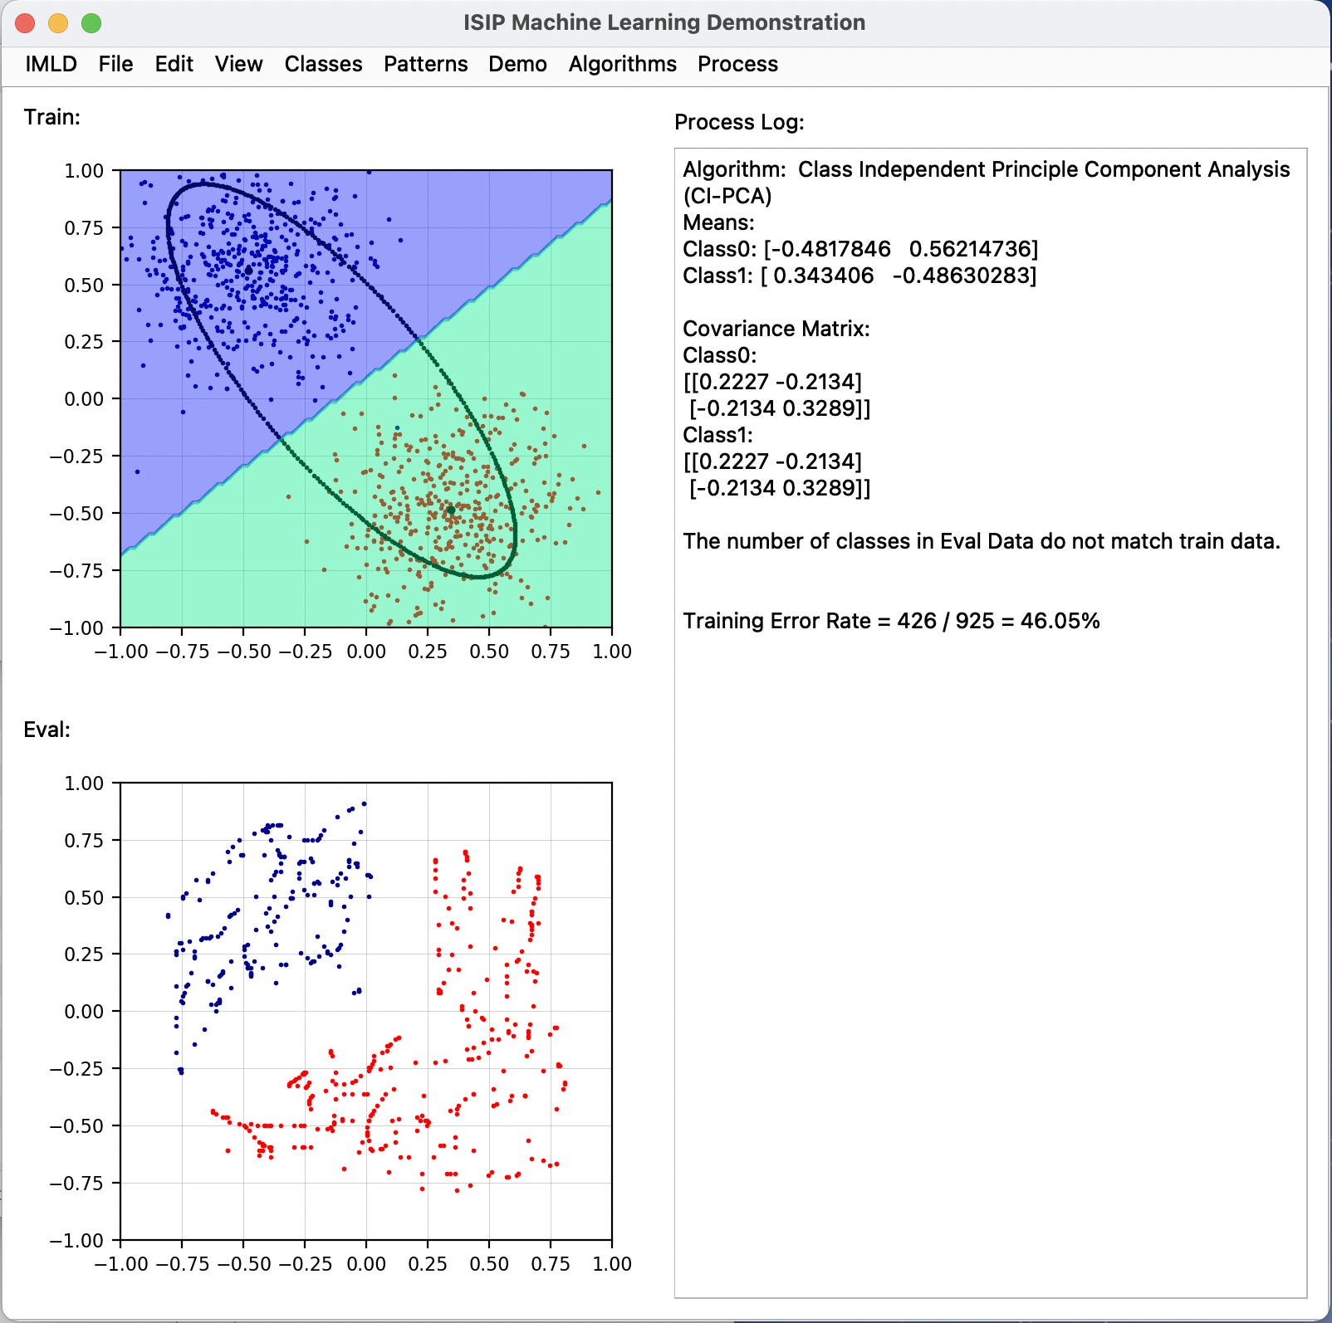
ISIP Machine Learning Demo (IMLD)
There are many excellent resources on the Internet that demonstrate pattern recognition concepts.
There are many Python, MATLAB and C++ toolboxes that implement state of the art algorithms.
One such resource is the ISIP Machine Learning Demo (IMLD) that lets you quickly explore how a variety of algorithms process the same data.
Users can create data sets with the application, save them to disk, or upload new data sets.
Users can select from a variety of machine learning algorithms.
Users can test generalization by creating training and open-set evaluation sets.
….
The application is written in Python using PyQT5, PyQtGraph and the Python machine learning package SciKit-Learn.
Warning: still under development.

Slide 6
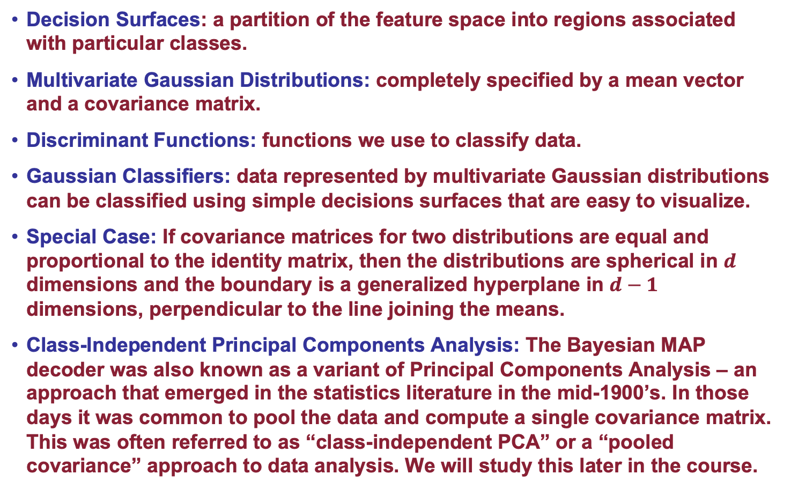
Summary
Decision Surfaces: a partition of the feature space into regions associated with particular classes.
Multivariate Gaussian Distributions: completely specified by a mean vector and a covariance matrix.
Discriminant Functions: functions we use to classify data.
Gaussian Classifiers: data represented by multivariate Gaussian distributions can be classified using simple decisions surfaces that are easy to visualize.
Special Case: If covariance matrices for two distributions are equal and proportional to the identity matrix, then the distributions are spherical in $d$ dimensions and the boundary is a generalized hyperplane in $d−1$ dimensions, perpendicular to the line joining the means.
Class-Independent Principal Components Analysis: The Bayesian MAP decoder was also known as a variant of Principal Components Analysis – an approach that emerged in the statistics literature in the mid-1900’s. In those days it was common to pool the data and compute a single covariance matrix. This was often referred to as “class-independent PCA” or a “pooled covariance” approach to data analysis. We will study this later in the course.

Slide 7
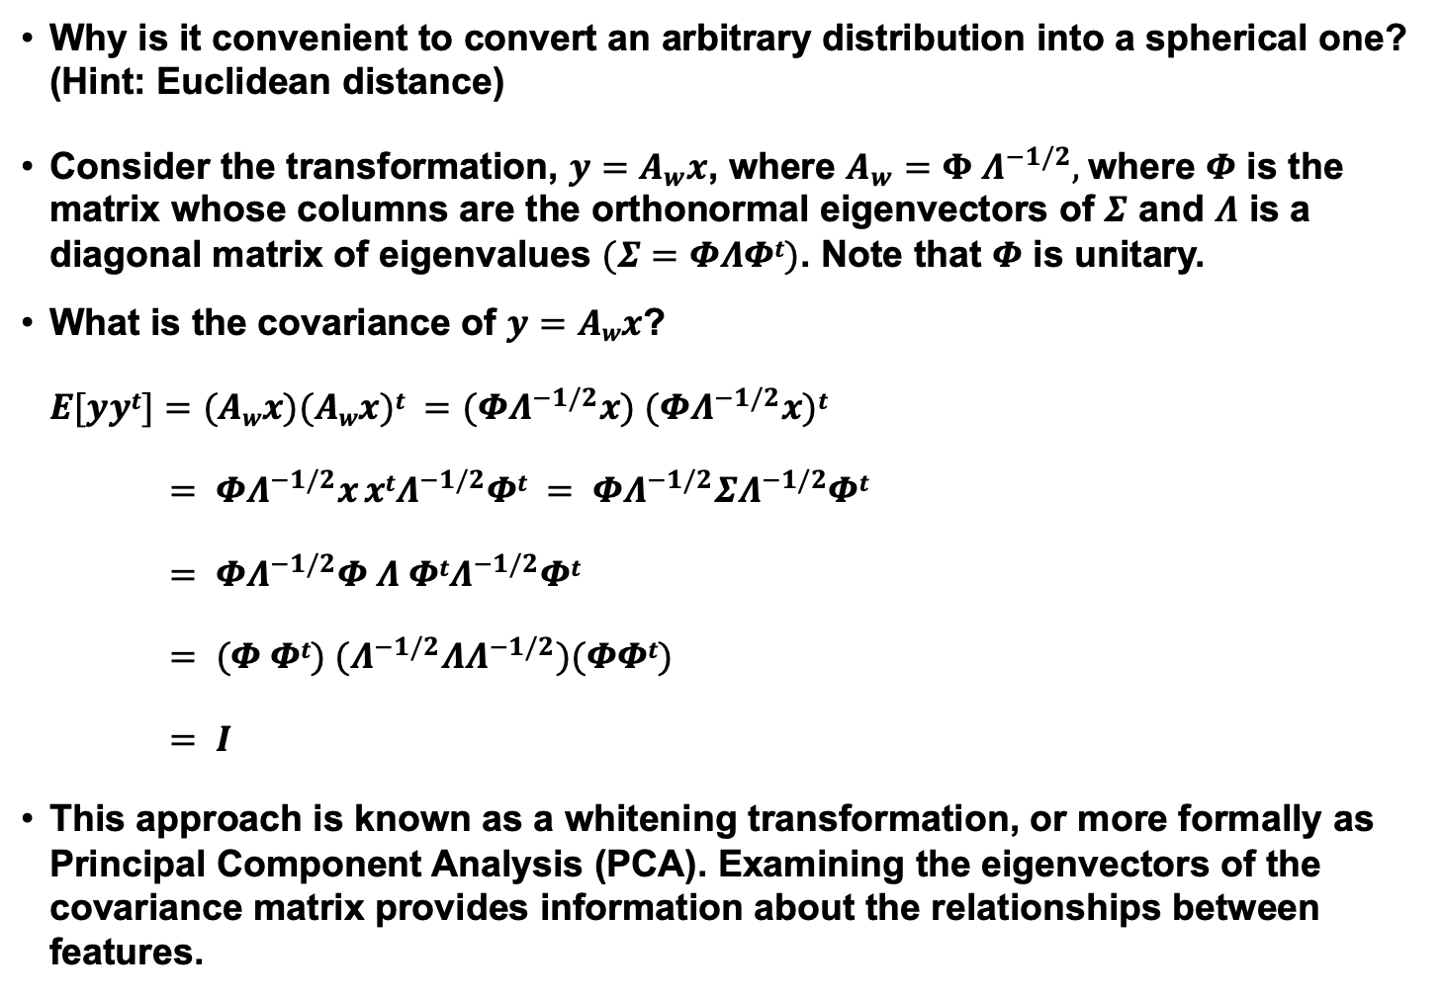
Coordinate Transformations
Why is it convenient to convert an arbitrary distribution into a spherical one? (Hint: Euclidean distance)
Consider the transformation, $y=A_{w}x$, where $A_{w}=Φ Λ^{−1/2},$where $Φ$ is the matrix whose columns are the orthonormal eigenvectors of $Σ$ and $Λ$ is a diagonal matrix of eigenvalues $(Σ=ΦΛΦt)$. Note that $Φ$ is unitary.
What is the covariance of $y=Awx$?
$E[yyt]=(Awx)(Awx)t =(ΦΛ^{−1/2}x) (ΦΛ^{−1/2}x)t$
$= ΦΛ^{−1/2}x xtΛ^{−1/2}Φt = ΦΛ^{−1/2}ΣΛ^{−1/2}Φt$
$= ΦΛ^{−1/2}Φ Λ ΦtΛ^{−1/2}Φt$
$= (Φ Φt) (Λ^{−1/2}ΛΛ^{−1/2})(ΦΦt)$
$= I$
This approach is known as a whitening transformation, or more formally as Principal Component Analysis (PCA). Examining the eigenvectors of the covariance matrix provides information about the relationships between features.

Slide 8
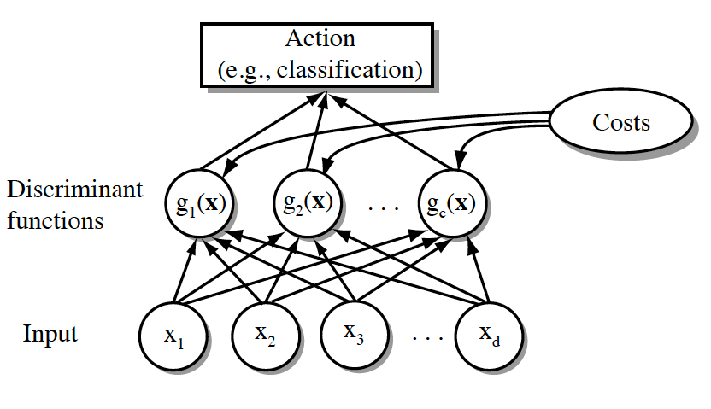
Network Representation of a Classifier
A classifier can be visualized as a connected graph with arcs and weights:
What are the advantages of this type of visualization?

