Slide 1
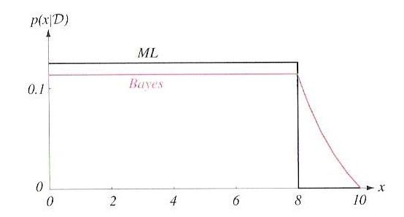
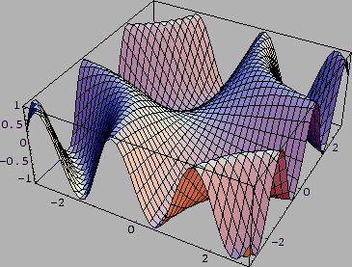
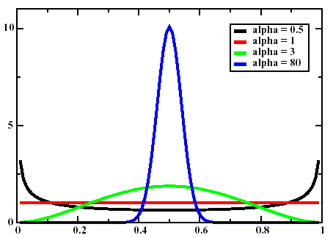
Lecture 06: Bayesian Parameter Estimation
• Objectives:
The Parameter Estimation Problem
Class-Conditional Densities
Bayesian Estimation
Reproducing Density
Conjugate Prior
Example: Unknown Mean
Application: Biased Coin
Resources:
DHS: Sections 3.3 - 3.5
J.O.S.: Bayesian Parameter Estimation
J.H.: Euro Coin

Slide 2
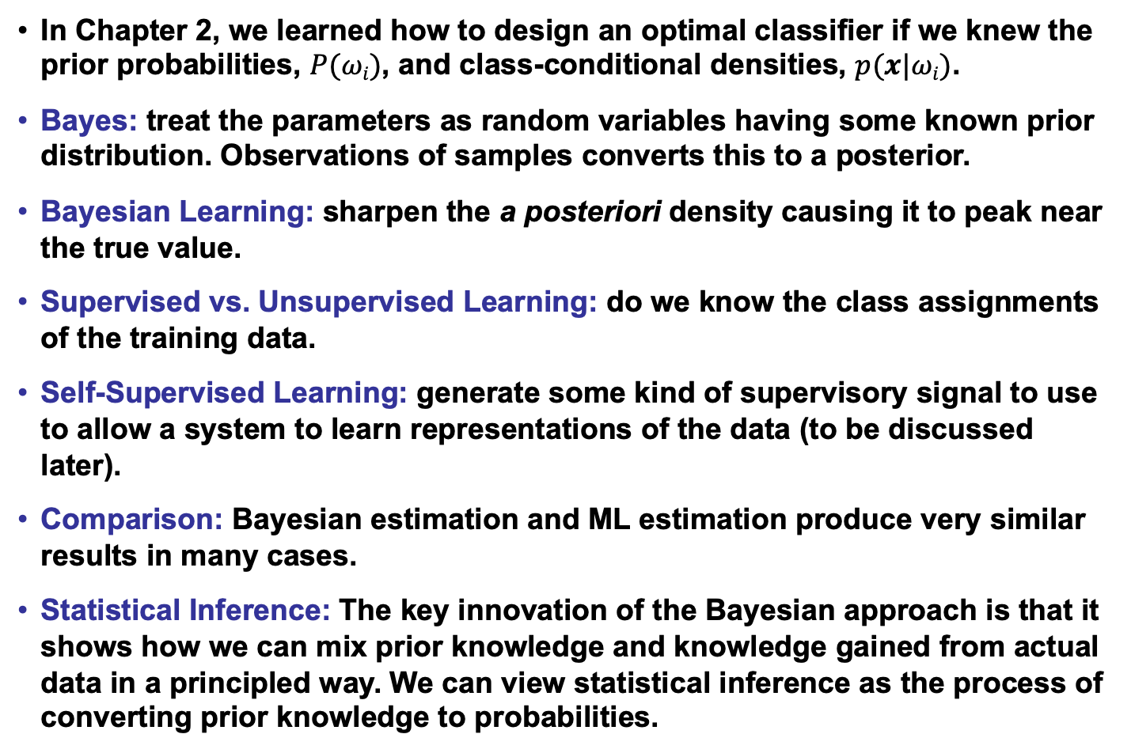
Introduction to Bayesian Parameter Estimation
In Chapter 2, we learned how to design an optimal classifier if we knew the prior probabilities, $P(ωi)$, and class-conditional densities, $p(x|ωi)$.
Bayes: treat the parameters as random variables having some known prior distribution. Observations of samples converts this to a posterior.
Bayesian Learning: sharpen the a posteriori density causing it to peak near the true value.
Supervised vs. Unsupervised Learning: do we know the class assignments of the training data.
Self-Supervised Learning: generate some kind of supervisory signal to use to allow a system to learn representations of the data (to be discussed later).
Comparison: Bayesian estimation and ML estimation produce very similar results in many cases.
Statistical Inference: The key innovation of the Bayesian approach is that it shows how we can mix prior knowledge and knowledge gained from actual data in a principled way. We can view statistical inference as the process of converting prior knowledge to probabilities.

Slide 3
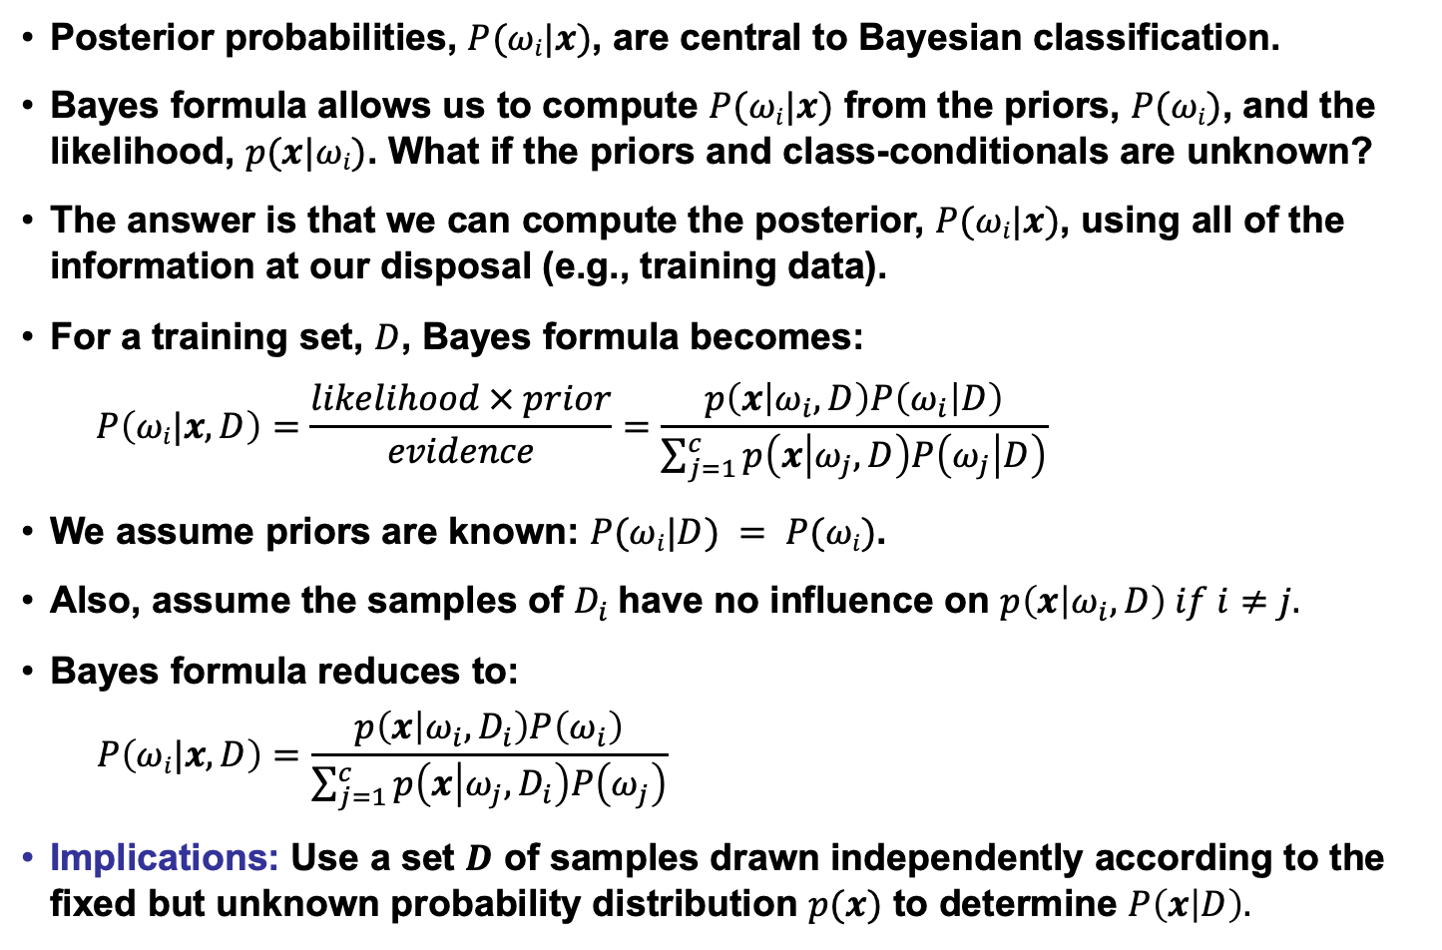
Class-Conditional Densities
Posterior probabilities, $P(ωi|x)$, are central to Bayesian classification.
Bayes formula allows us to compute $P(ωi|x)$ from the priors, $P(ωi)$, and the likelihood, $p(x|ωi)$. What if the priors and class-conditionals are unknown?
The answer is that we can compute the posterior, $P(ωi|x)$, using all of the information at our disposal (e.g., training data).
For a training set, $D$, Bayes formula becomes:
$$P\left(ωi|x,D\right)=\frac{likelihood × prior}{evidence}=\frac{p\left(x | ω_{i},D\right)P\left(ω_{i} | D\right)}{\sum_{j=1}^{c}{p\left(x | ω_{j},D\right)P\left(ω_{j} | D\right)}}$$
We assume priors are known: $P(ωi|D) = P(ωi)$.
Also, assume the samples of $D_{i}$have no influence on $p\left(x | ω_{i}, D\right) if i≠j.$
Bayes formula reduces to:
$$P\left(ωi|x,D\right)=\frac{p\left(x | ω_{i},D_{i}\right)P\left(ω_{i}\right)}{\sum_{j=1}^{c}{p\left(x | ω_{j},D_{i}\right)P\left(ω_{j}\right)}}$$
Implications: Use a set $D$ of samples drawn independently according to the fixed but unknown probability distribution $p(x)$ to determine $P\left(x | D\right).$

Slide 4
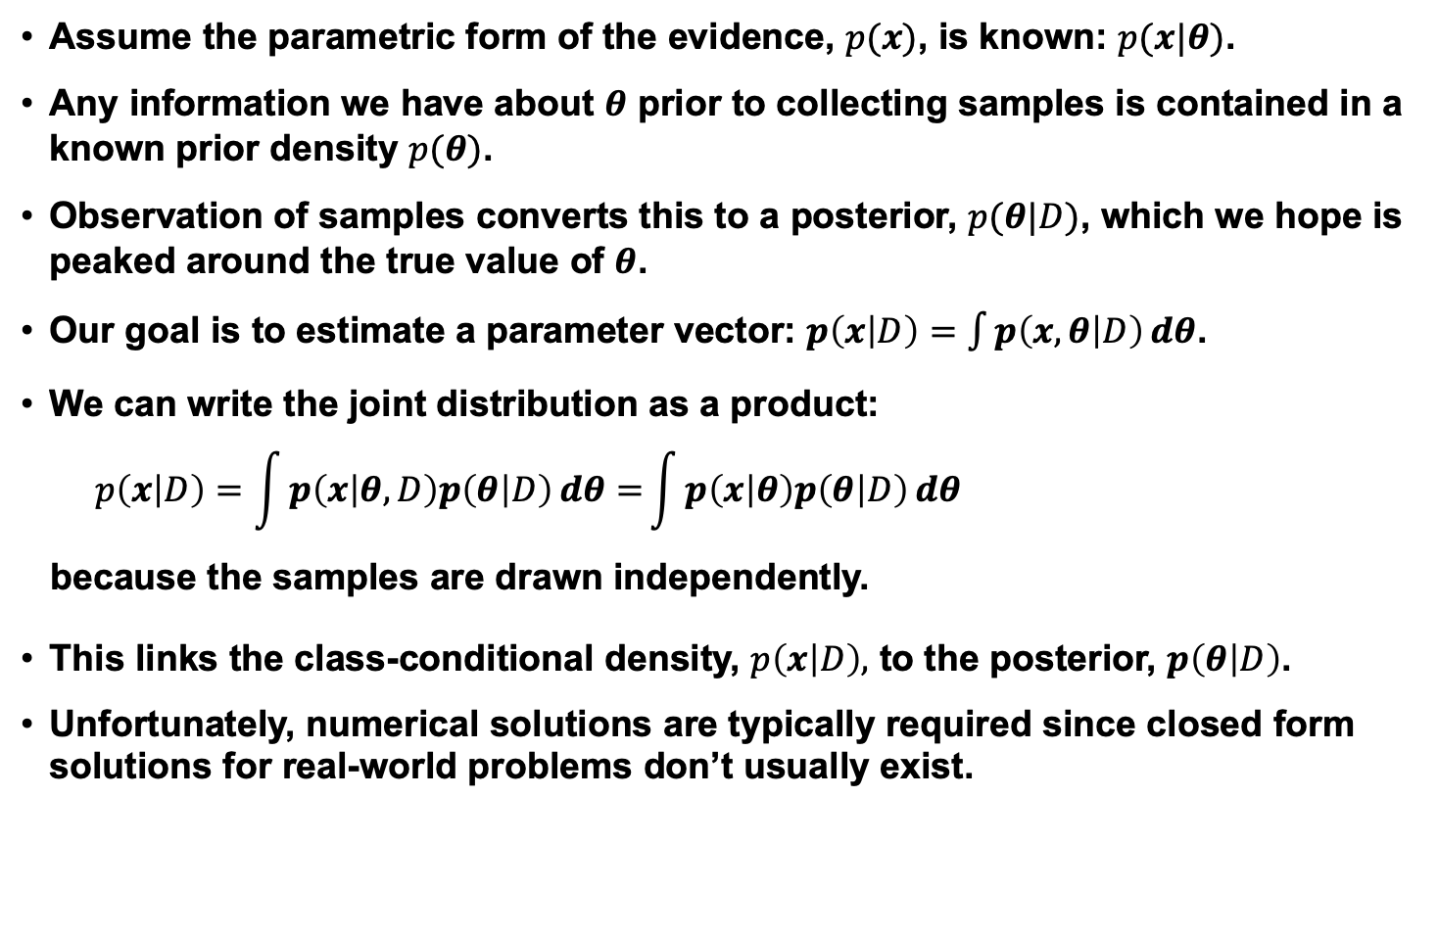
The Parameter Distribution
Assume the parametric form of the evidence, $p(x)$, is known: $p(x|θ)$.
Any information we have about $θ$ prior to collecting samples is contained in a known prior density $p(θ)$.
Observation of samples converts this to a posterior, $p(θ|D)$, which we hope is peaked around the true value of $θ$.
Our goal is to estimate a parameter vector: $p\left(x | D\right)=\int{p\left(x,θ | D\right)ⅆθ}$.
We can write the joint distribution as a product:
$$p\left(x | D\right)=\int{p\left(x | θ,D\right)p\left(θ | D\right)ⅆθ=}\int{p\left(x | θ\right)p\left(θ | D\right)ⅆθ}$$
because the samples are drawn independently.
This links the class-conditional density, $p\left(x | D\right),$ to the posterior, $p\left(θ | D\right)$.
Unfortunately, numerical solutions are typically required since closed form solutions for real-world problems don’t usually exist.

Slide 5
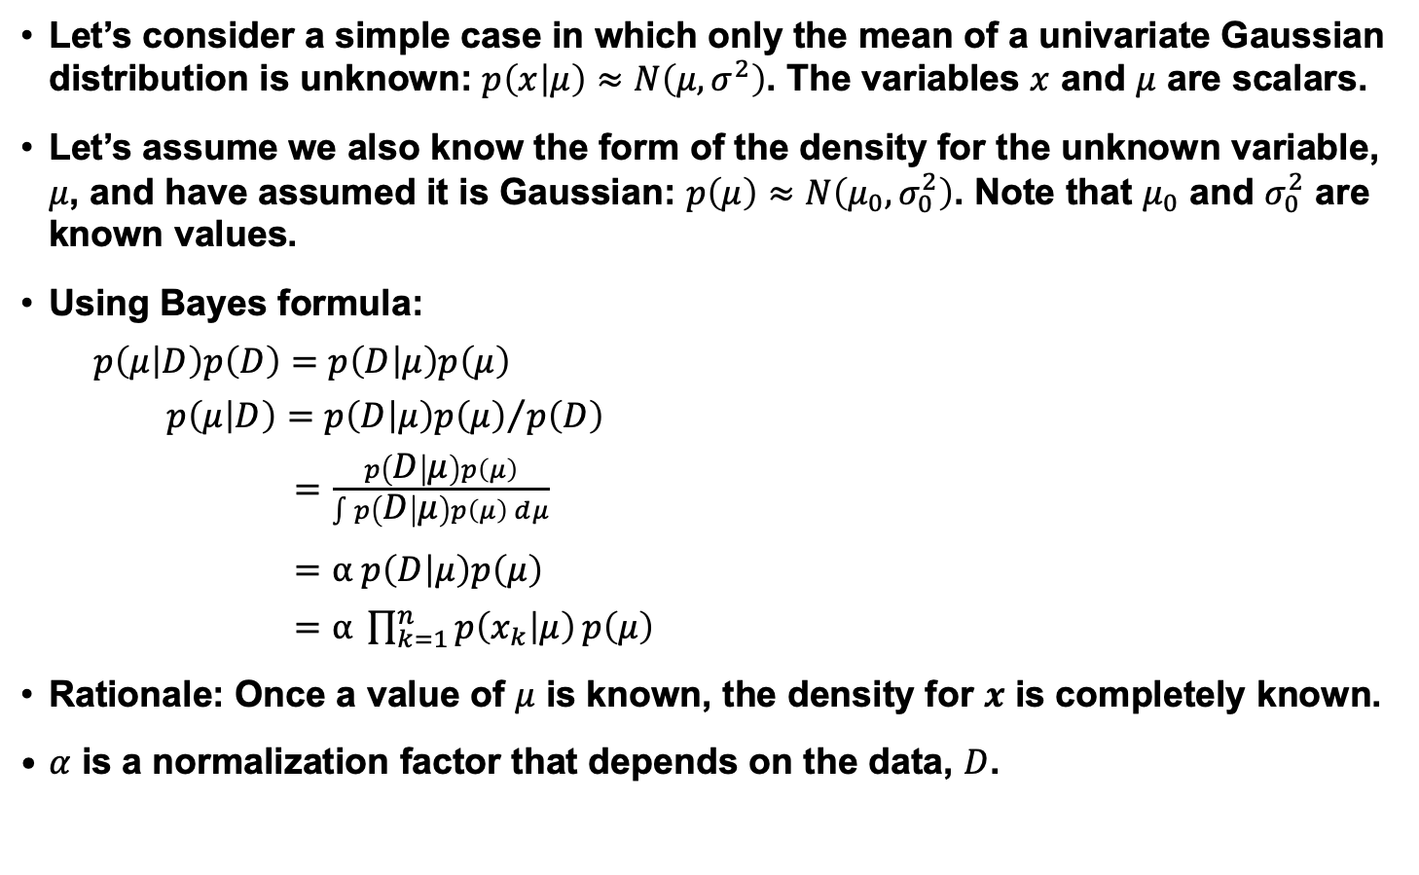
Univariate Gaussian Case
Let’s consider a simple case in which only the mean of a univariate Gaussian distribution is unknown: $p\left(x | μ\right)≈N\left(μ,σ^{2}\right)$. The variables $x$ and $μ$ are scalars.
Let’s assume we also know the form of the density for the unknown variable, $μ$, and have assumed it is Gaussian: $p\left(μ\right)≈N\left(μ_{0}, σ_{0}^{2}\right)$. Note that $μ_{0}$ and $σ_{0}^{2}$ are known values.
Using Bayes formula:
$p\left(μ | D\right)p\left(D\right)=$ $p\left(D | μ\right)p\left(μ\right)$
$p\left(μ | D\right)=$ ${p\left(D | μ\right)p\left(μ\right)}/{p\left(D\right)}$
$=$ $\frac{p\left(D | μ\right)p\left(μ\right)}{\int{p\left(D | μ\right)p\left(μ\right)ⅆμ}}$
$=$ $α p\left(D | μ\right)p\left(μ\right)$
$=$ $α \prod_{k=1}^{n}{p\left(x_{k} | μ\right)}p\left(μ\right)$
Rationale: Once a value of $μ$ is known, the density for $x$ is completely known.
$α$ is a normalization factor that depends on the data, $D$.

Slide 6
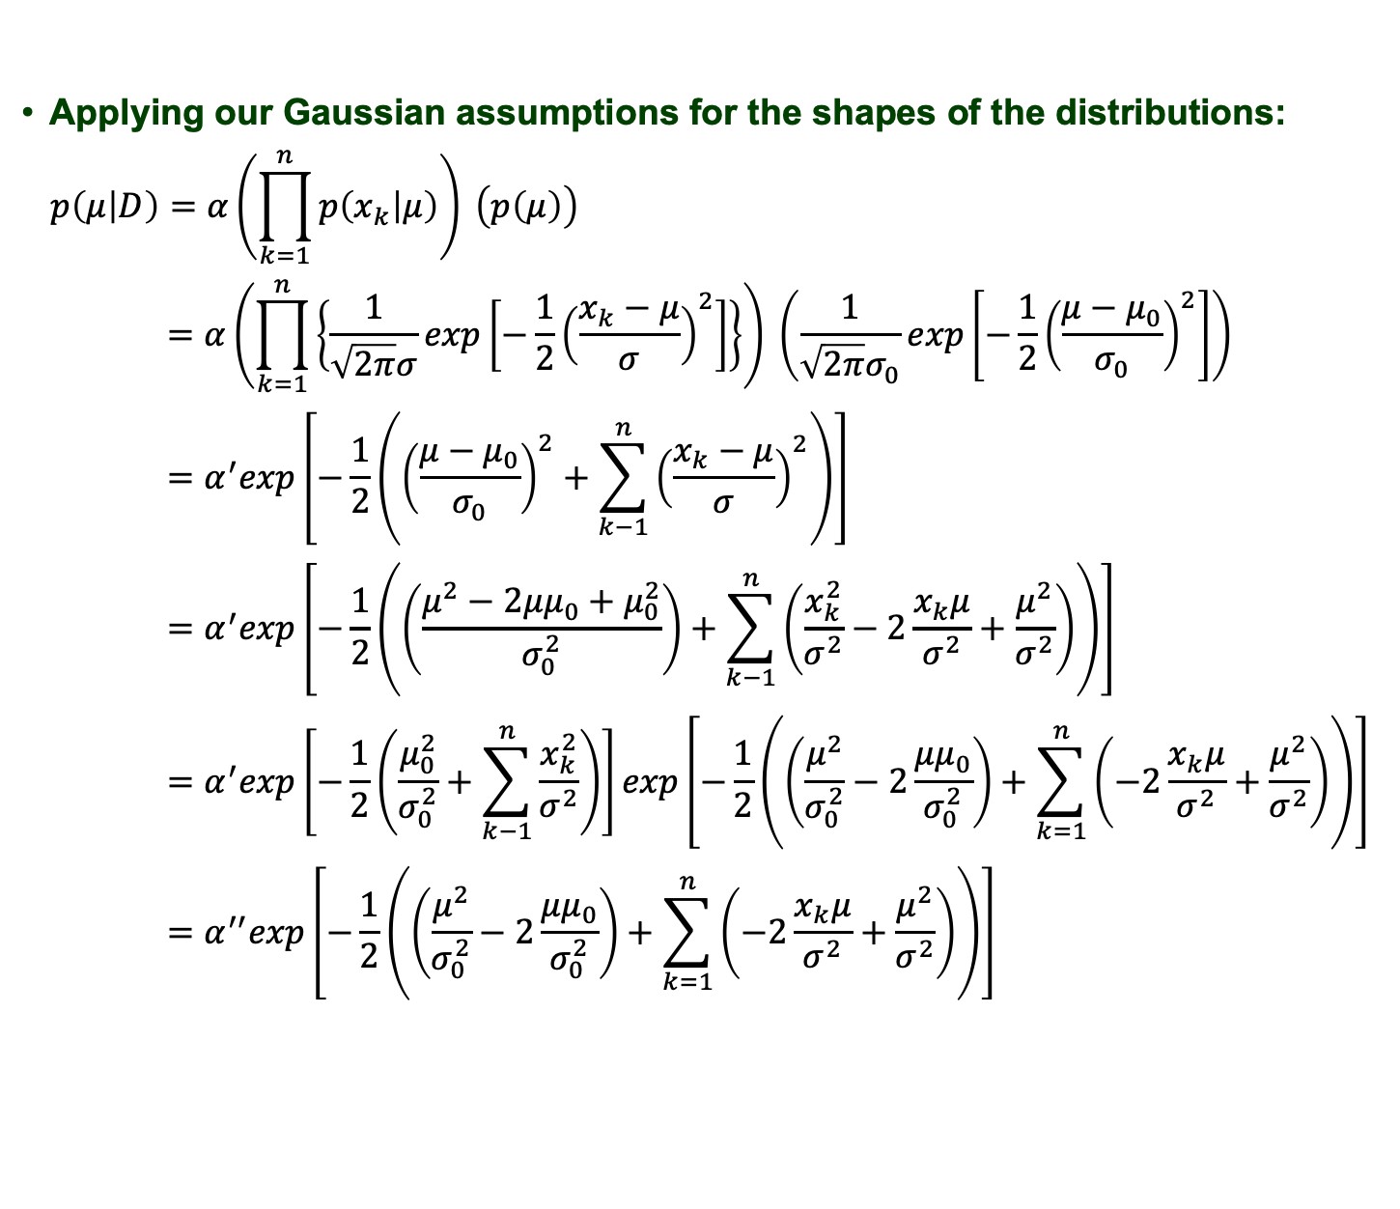
Univariate Gaussian Case
Applying our Gaussian assumptions for the shapes of the distributions:
$$p\left(μ | D\right)=α\left(\prod_{k=1}^{n}{p\left(x_{k} | μ\right)}\right) \left(p\left(μ\right)\right)$$
$$=α\left(\prod_{k=1}^{n}{\left\{\frac{1}{\sqrt{2π}σ}exp\left[−\frac{1}{2}{\left(\frac{x_{k}−μ}{σ}\right)}^{2}\right]\right\}}\right) \left(\frac{1}{\sqrt{2π}σ_{0}}exp\left[−\frac{1}{2}{\left(\frac{μ−μ_{0}}{σ_{0}}\right)}^{2}\right]\right)$$
$$=α^{′}exp\left[−\frac{1}{2}\left({\left(\frac{μ−μ_{0}}{σ_{0}}\right)}^{2}+\sum_{k−1}^{n}{{\left(\frac{x_{k}−μ}{σ}\right)}^{2}}\right)\right]$$
$$=α^{′}exp\left[−\frac{1}{2}\left(\left(\frac{μ^{2}−2μμ_{0}+μ_{0}^{2}}{σ_{0}^{2}}\right)+\sum_{k−1}^{n}{\left(\frac{x_{k}^{2}}{σ^{2}}−2\frac{x_{k}μ}{σ^{2}}+\frac{μ^{2}}{σ^{2}}\right)}\right)\right]$$
$$=α^{′}exp\left[−\frac{1}{2}\left(\frac{μ_{0}^{2}}{σ_{0}^{2}}+\sum_{k−1}^{n}{\frac{x_{k}^{2}}{σ^{2}}}\right)\right]exp\left[−\frac{1}{2}\left(\left(\frac{μ^{2}}{σ_{0}^{2}}−2\frac{μμ_{0}}{σ_{0}^{2}}\right)+\sum_{k=1}^{n}{\left(−2\frac{x_{k}μ}{σ^{2}}+\frac{μ^{2}}{σ^{2}}\right)}\right)\right]$$
$$=α^{′′}exp\left[−\frac{1}{2}\left(\left(\frac{μ^{2}}{σ_{0}^{2}}−2\frac{μμ_{0}}{σ_{0}^{2}}\right)+\sum_{k=1}^{n}{\left(−2\frac{x_{k}μ}{σ^{2}}+\frac{μ^{2}}{σ^{2}}\right)}\right)\right]$$

Slide 7
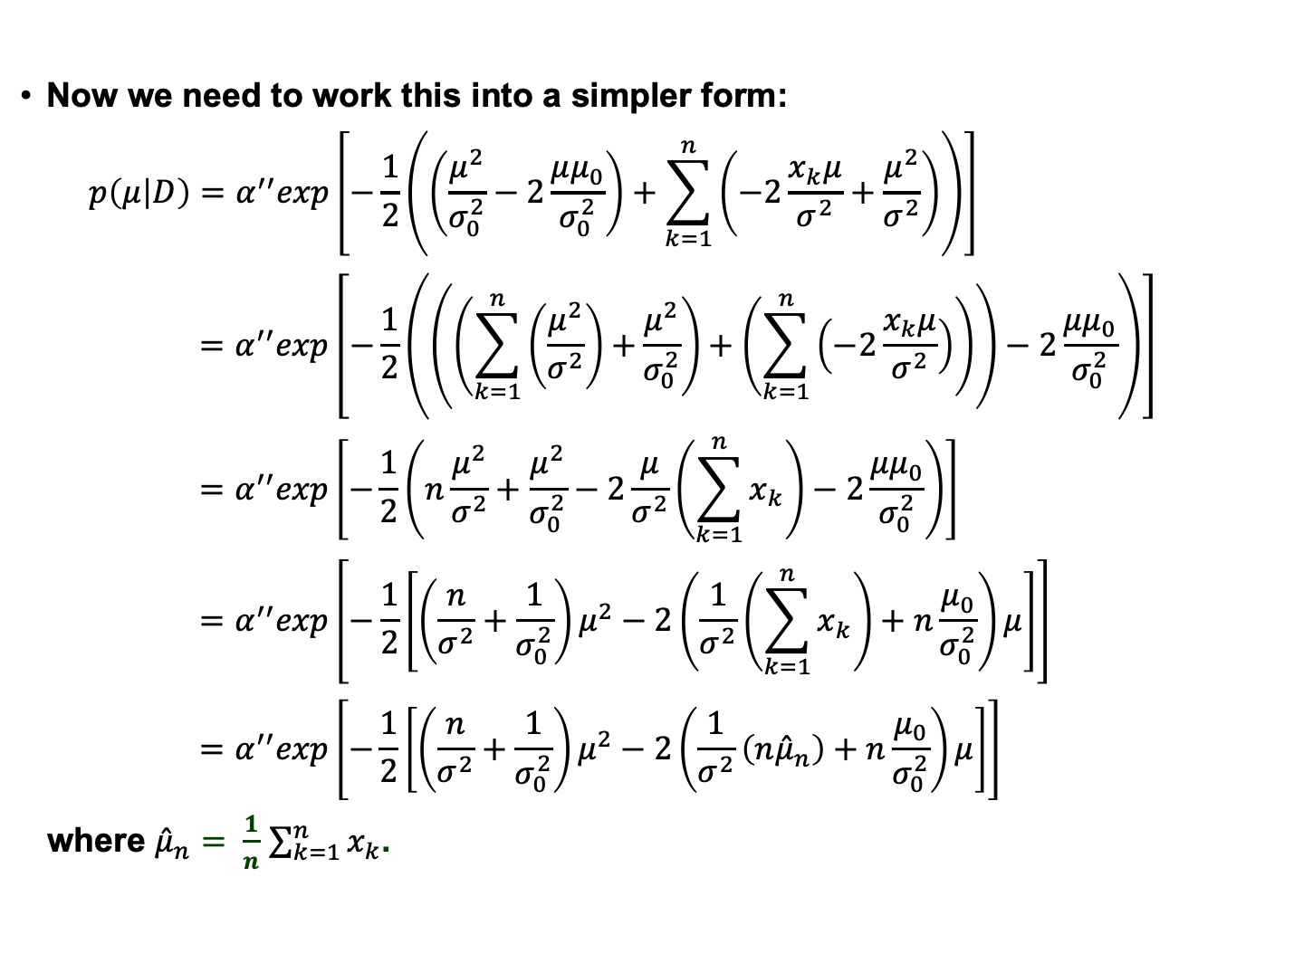
Univariate Gaussian Case (Cont.)
Now we need to work this into a simpler form:
$$p\left(μ | D\right)=α^{′′}exp\left[−\frac{1}{2}\left(\left(\frac{μ^{2}}{σ_{0}^{2}}−2\frac{μμ_{0}}{σ_{0}^{2}}\right)+\sum_{k=1}^{n}{\left(−2\frac{x_{k}μ}{σ^{2}}+\frac{μ^{2}}{σ^{2}}\right)}\right)\right]$$
$$=α^{′′}exp\left[−\frac{1}{2}\left(\left(\left(\sum_{k=1}^{n}{\left(\frac{μ^{2}}{σ^{2}}\right)+}\frac{μ^{2}}{σ_{0}^{2}}\right)+\left(\sum_{k=1}^{n}{\left(−2\frac{x_{k}μ}{σ^{2}}\right)}\right)\right)−2\frac{μμ_{0}}{σ_{0}^{2}}\right)\right]$$
$$=α^{′′}exp\left[−\frac{1}{2}\left(n\frac{μ^{2}}{σ^{2}}+\frac{μ^{2}}{σ_{0}^{2}}−2\frac{μ}{σ^{2}}\left(\sum_{k=1}^{n}{x_{k}}\right)−2\frac{μμ_{0}}{σ_{0}^{2}}\right)\right]$$
$$=α^{′′}exp\left[−\frac{1}{2}\left[{\left(\frac{n}{σ^{2}}+\frac{1}{σ_{0}^{2}}\right)μ}^{2}−2\left(\frac{1}{σ^{2}}\left(\sum_{k=1}^{n}{x_{k}}\right)+n\frac{μ_{0}}{σ_{0}^{2}}\right)μ\right]\right]$$
$$=α^{′′}exp\left[−\frac{1}{2}\left[{\left(\frac{n}{σ^{2}}+\frac{1}{σ_{0}^{2}}\right)μ}^{2}−2\left(\frac{1}{σ^{2}}\left(n{\hat{μ}}_{n}\right)+n\frac{μ_{0}}{σ_{0}^{2}}\right)μ\right]\right]$$
where ${\hat{μ}}_{n}= \frac{1}{n}$ $\sum_{k=1}^{n}{x_{k}}$.

Slide 8
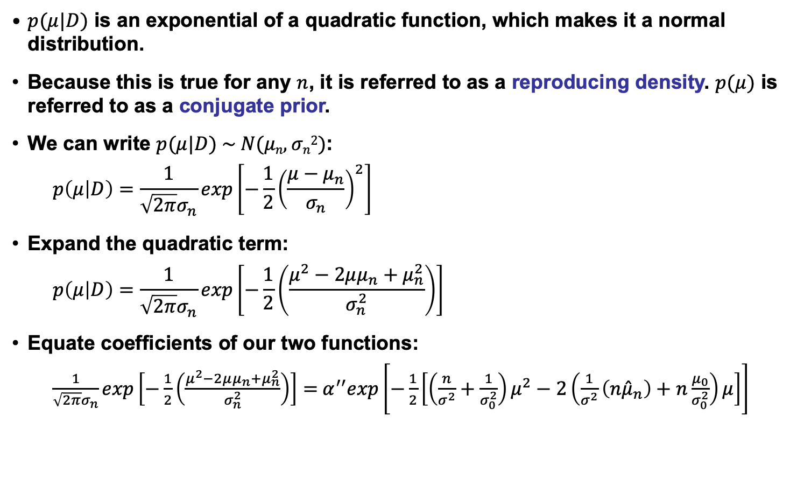
Univariate Gaussian Case (Cont.)
$p(μ|D)$ is an exponential of a quadratic function, which makes it a normal distribution.
Because this is true for any $n$, it is referred to as a reproducing density. $p(μ)$ is referred to as a conjugate prior.
We can write $p(μ|D) \sim N(μn,σn2)$:
$$p\left(μ | D\right)=\frac{1}{\sqrt{2π}σ_{n}}exp\left[−\frac{1}{2}{\left(\frac{μ−μ_{n}}{σ_{n}}\right)}^{2}\right]$$
Expand the quadratic term:
$$p\left(μ | D\right)=\frac{1}{\sqrt{2π}σ_{n}}exp\left[−\frac{1}{2}\left(\frac{μ^{2}−2μμ_{n}+μ_{n}^{2}}{σ_{n}^{2}}\right)\right]$$
Equate coefficients of our two functions:
$\frac{1}{\sqrt{2π}σ_{n}}exp\left[−\frac{1}{2}\left(\frac{μ^{2}−2μμ_{n}+μ_{n}^{2}}{σ_{n}^{2}}\right)\right]=$ $α^{′′}exp\left[−\frac{1}{2}\left[{\left(\frac{n}{σ^{2}}+\frac{1}{σ_{0}^{2}}\right)μ}^{2}−2\left(\frac{1}{σ^{2}}\left(n{\hat{μ}}_{n}\right)+n\frac{μ_{0}}{σ_{0}^{2}}\right)μ\right]\right]$

Slide 9
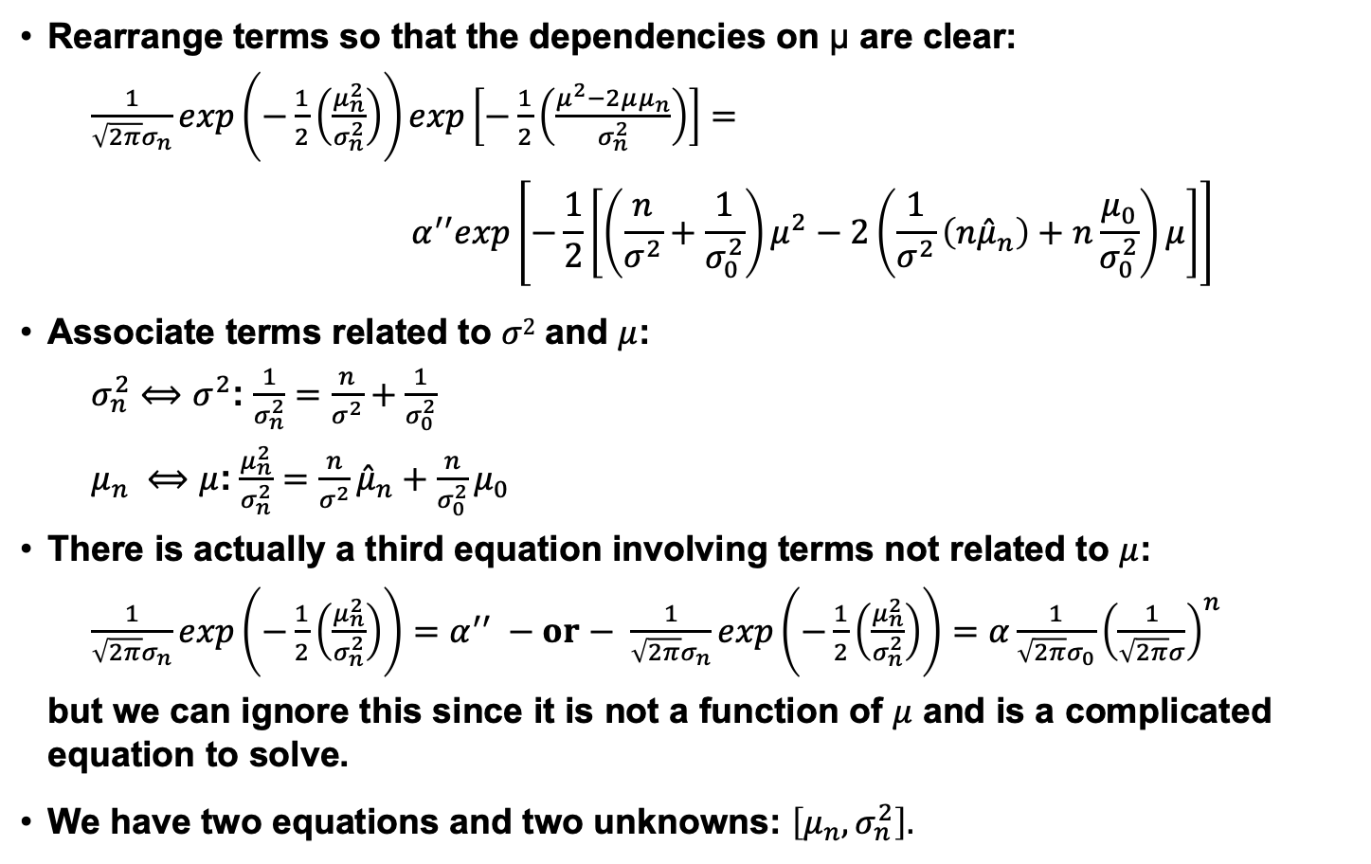
Univariate Gaussian Case (Cont.)
Rearrange terms so that the dependencies on μ are clear:
$\frac{1}{\sqrt{2π}σ_{n}}exp\left(−\frac{1}{2}\left(\frac{μ_{n}^{2}}{σ_{n}^{2}}\right)\right)exp\left[−\frac{1}{2}\left(\frac{μ^{2}−2μμ_{n}}{σ_{n}^{2}}\right)\right]=$
$$α^{′′}exp\left[−\frac{1}{2}\left[{\left(\frac{n}{σ^{2}}+\frac{1}{σ_{0}^{2}}\right)μ}^{2}−2\left(\frac{1}{σ^{2}}\left(n{\hat{μ}}_{n}\right)+n\frac{μ_{0}}{σ_{0}^{2}}\right)μ\right]\right]$$
Associate terms related to $σ2$ and $μ$:
$σ_{n}^{2}⟺$ $σ^{2}$: $\frac{1}{σ_{n}^{2}}=$ $\frac{n}{σ^{2}}+\frac{1}{σ_{0}^{2}}$
$μ_{n} ⟺μ$:$\frac{μ_{n}^{2}}{σ_{n}^{2}}=$ $\frac{n}{σ^{2}}{\hat{μ}}_{n}+\frac{n}{σ_{0}^{2}}μ_{0}$
There is actually a third equation involving terms not related to $μ$:
$\frac{1}{\sqrt{2π}σ_{n}}exp\left(−\frac{1}{2}\left(\frac{μ_{n}^{2}}{σ_{n}^{2}}\right)\right)=$ $α^{′′} −or− \frac{1}{\sqrt{2π}σ_{n}}exp\left(−\frac{1}{2}\left(\frac{μ_{n}^{2}}{σ_{n}^{2}}\right)\right)=α\frac{1}{\sqrt{2π}σ_{0}}{\left(\frac{1}{\sqrt{2π}σ}\right)}^{n}$
but we can ignore this since it is not a function of $μ$ and is a complicated equation to solve.
We have two equations and two unknowns: $\left[μ_{n},σ_{n}^{2}\right].$

Slide 10

Univariate Gaussian Case (Cont.)
First, solve for $σ_{n}^{2}$:
$$σ_{n}^{2}=\frac{1}{\frac{n}{σ^{2}}+\frac{1}{σ_{0}^{2}}}=\frac{σ^{2}σ_{0}^{2}}{nσ_{0}^{2}+σ^{2}}$$
Next, solve for $μn$:
$μ_{n}={\hat{μ}}_{n}\left(\frac{nσ_{n}^{2}}{σ^{2}}\right)+μ_{0}\left(\frac{σ_{n}^{2}}{σ_{0}^{2}}\right)={\hat{μ}}_{n}\left(\frac{n}{σ^{2}}\right)\left(\frac{σ^{2}σ_{0}^{2}}{nσ_{0}^{2}+σ^{2}}\right)+$ $μ_{0}\left(\frac{1}{σ_{0}^{2}}\right)\left(\frac{σ^{2}σ_{0}^{2}}{nσ_{0}^{2}+σ^{2}} \right)$
$={\hat{μ}}_{n}\left(\frac{nσ_{0}^{2}}{nσ_{0}^{2}+σ^{2}}\right)+$ $μ_{0}\left(\frac{σ^{2}}{nσ_{0}^{2}+σ^{2}} \right)$
Summarizing:
$μ_{n}= {\hat{μ}}_{n}\left(\frac{nσ_{0}^{2}}{nσ_{0}^{2}+σ^{2}}\right)+$ $μ_{0}\left(\frac{σ^{2}}{nσ_{0}^{2}+σ^{2}} \right)$ ${\hat{μ}}_{n}= \frac{1}{n}$ $\sum_{k=1}^{n}{x_{k}}$
$$σ_{n}^{2}=\frac{σ^{2}σ_{0}^{2}}{nσ_{0}^{2}+σ^{2}}$$
These equations describe how to mix prior knowledge, $\left[μ_{0},σ_{0}^{2}\right]$, with observations, ${\hat{μ}}_{n}$.
What happens as $n⟶∞$? What happens when $n$ is small?

Slide 11
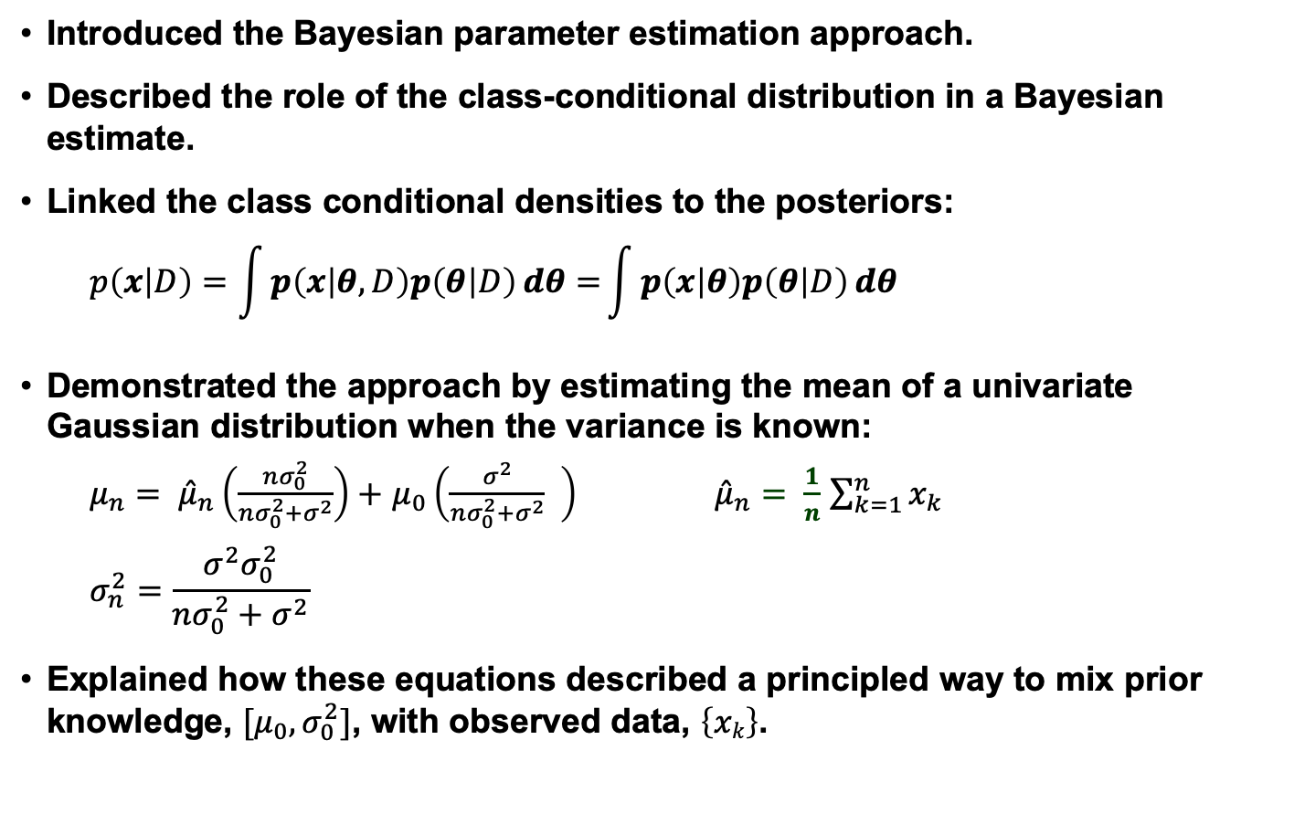
Summary
Introduced the Bayesian parameter estimation approach.
Described the role of the class-conditional distribution in a Bayesian estimate.
Linked the class conditional densities to the posteriors:
$$p\left(x | D\right)=\int{p\left(x | θ,D\right)p\left(θ | D\right)ⅆθ=}\int{p\left(x | θ\right)p\left(θ | D\right)ⅆθ}$$
Demonstrated the approach by estimating the mean of a univariate Gaussian distribution when the variance is known:
$μ_{n}= {\hat{μ}}_{n}\left(\frac{nσ_{0}^{2}}{nσ_{0}^{2}+σ^{2}}\right)+$ $μ_{0}\left(\frac{σ^{2}}{nσ_{0}^{2}+σ^{2}} \right)$ ${\hat{μ}}_{n}= \frac{1}{n}$ $\sum_{k=1}^{n}{x_{k}}$
$$σ_{n}^{2}=\frac{σ^{2}σ_{0}^{2}}{nσ_{0}^{2}+σ^{2}}$$
Explained how these equations described a principled way to mix prior knowledge, $[μ_{0}, σ_{0}^{2}]$, with observed data, $\left\{xk\right\}$.

Slide 12
“The Euro Coin”
Getting ahead a bit, let’s see how we can put these ideas to work on a simple example due to David MacKay, and explained by Jon Hamaker.

