Slide 1
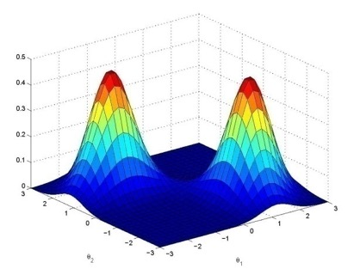
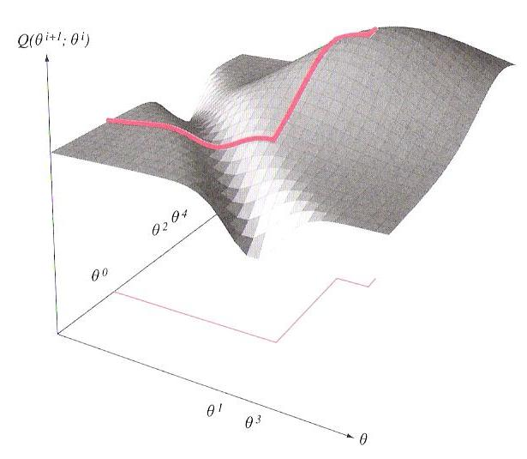
Lecture 08: The Expectation Maximization (EM) Theorem
Objectives:
Synopsis
Algorithm Preview
Jensen’s Inequality (Special Case)
Theorem and Proof Gaussian Mixture Modeling
Resources:
Textbook (Section 10.1)
Wiki: EM History TomDean: EM Tutorial FredJelinek: Statistical Methods Edureka: Demonstration

Slide 2
Synopsis
Expectation maximization (EM) is an approach that is used in many ways to find maximum likelihood estimates of parameters in probabilistic models.
EM is an iterative optimization method to estimate some unknown parameters given measurement data. Most commonly used to estimate parameters of a probabilistic model (e.g., Gaussian mixture distributions).
Can also be used to discover hidden variables or estimate missing data.
The intuition behind EM is an old one: alternate between estimating the unknowns and the hidden variables. This idea has been around for a long time. However, in 1977, Dempster, et al., proved convergence and explained the relationship to maximum likelihood estimation.
EM alternates between performing an expectation (E) step, which computes an expectation of the likelihood by including the latent variables as if they were observed, and a maximization (M) step, which computes the maximum likelihood estimates of the parameters by maximizing the expected likelihood found on the E step. The parameters found on the M step are then used to begin another E step, and the process is repeated.
Cornerstone of important algorithms such as hidden Markov modeling; used in many fields including human language technology and image processing.

Slide 3
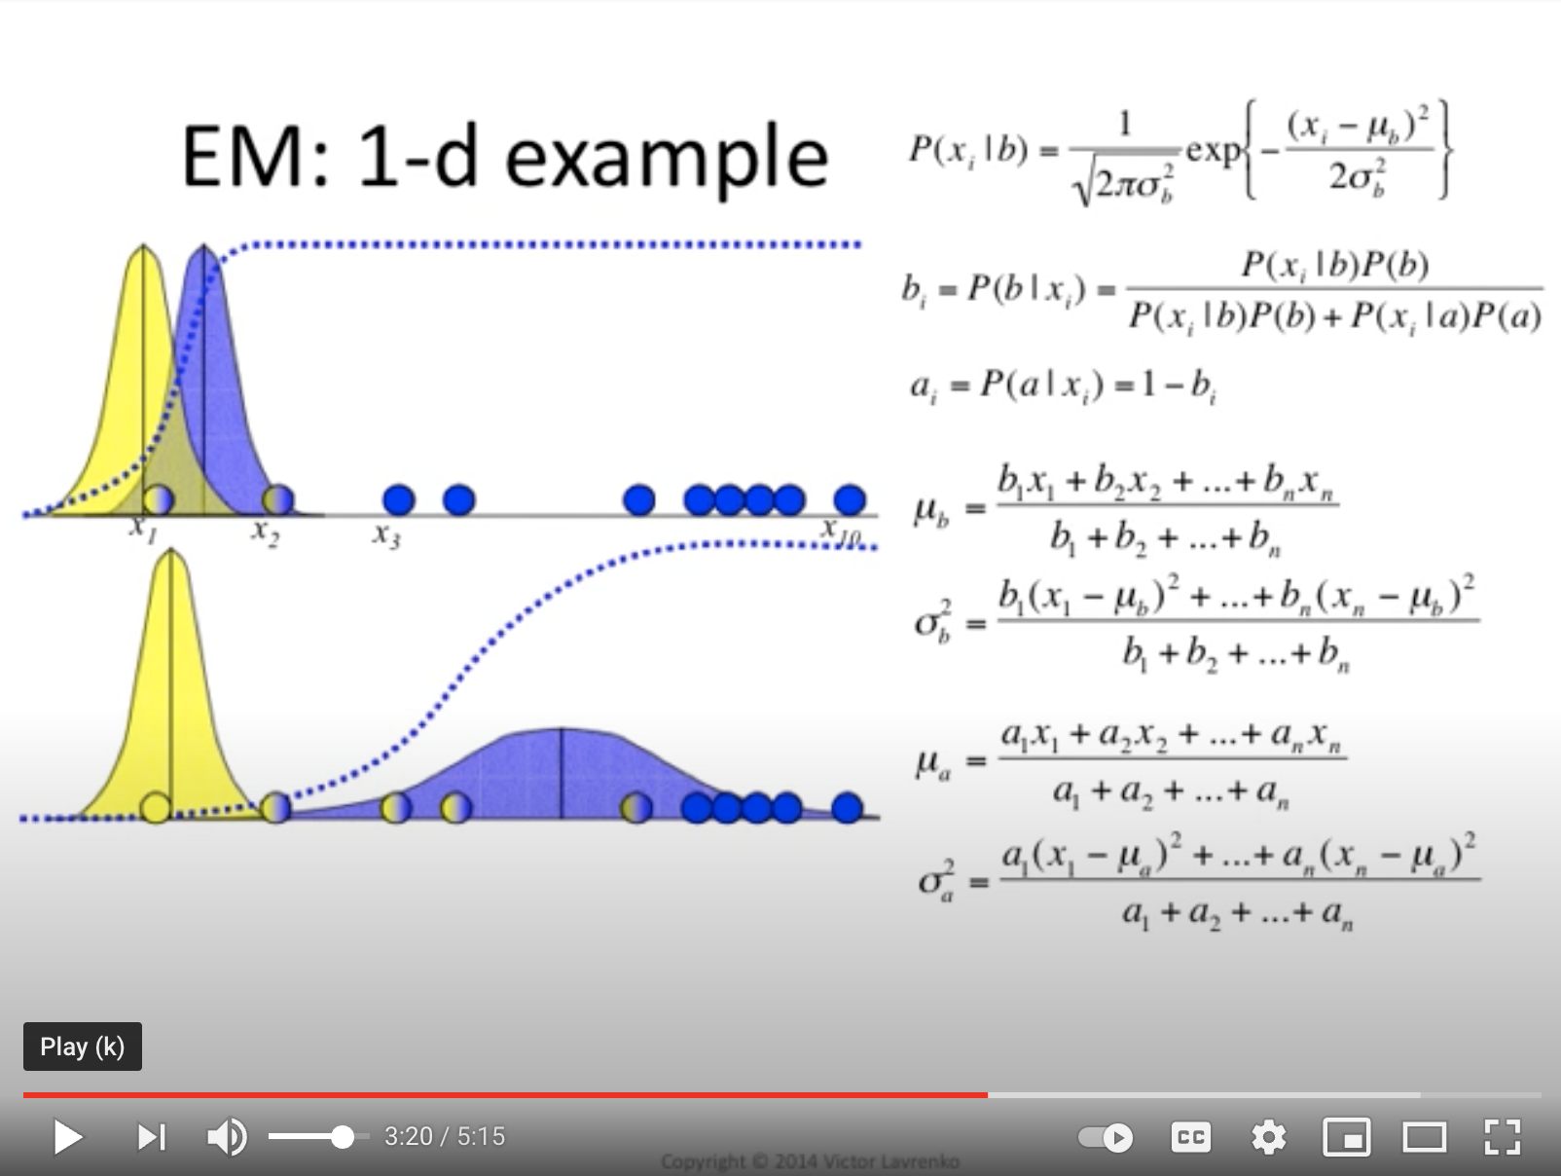
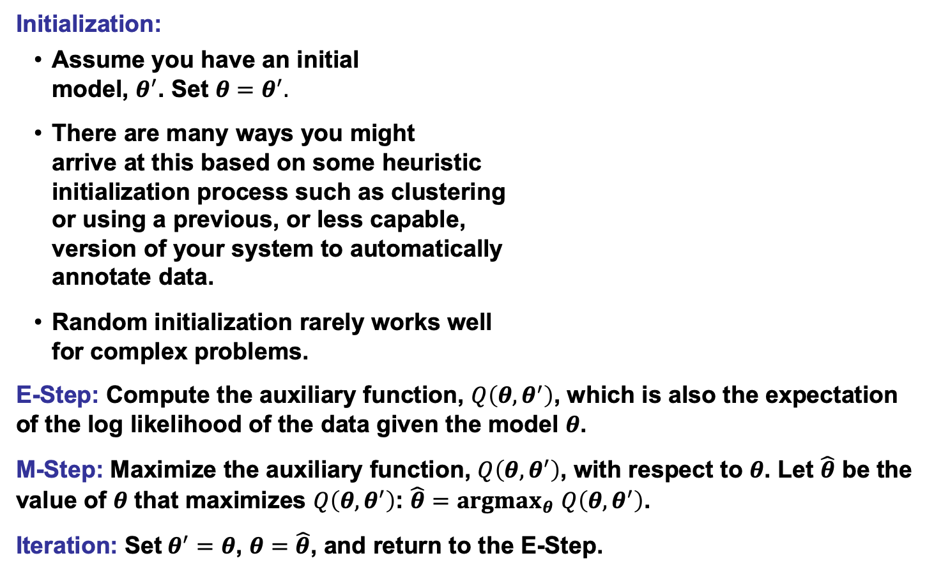
The Expectation Maximization Algorithm
Initialization:
Assume you have an initial model, $θ^{′}$. Set $θ=θ^{′}.$
There are many ways you might arrive at this based on some heuristic initialization process such as clustering or using a previous, or less capable, version of your system to automatically annotate data.
Random initialization rarely works well for complex problems.
E-Step: Compute the auxiliary function, $Q\left(θ,θ^{′}\right)$, which is also the expectation of the log likelihood of the data given the model $θ$.
M-Step: Maximize the auxiliary function, $Q\left(θ,θ^{′}\right)$, with respect to $θ$. Let $\hat{θ}$ be the value of $θ$ that maximizes $Q\left(θ,θ^{′}\right)$: $\hat{θ}={argmax}_{θ}$ $Q\left(θ,θ^{′}\right)$.
Iteration: Set$θ^{′}=θ$, $θ=\hat{θ}$, and return to the E-Step.

Slide 4
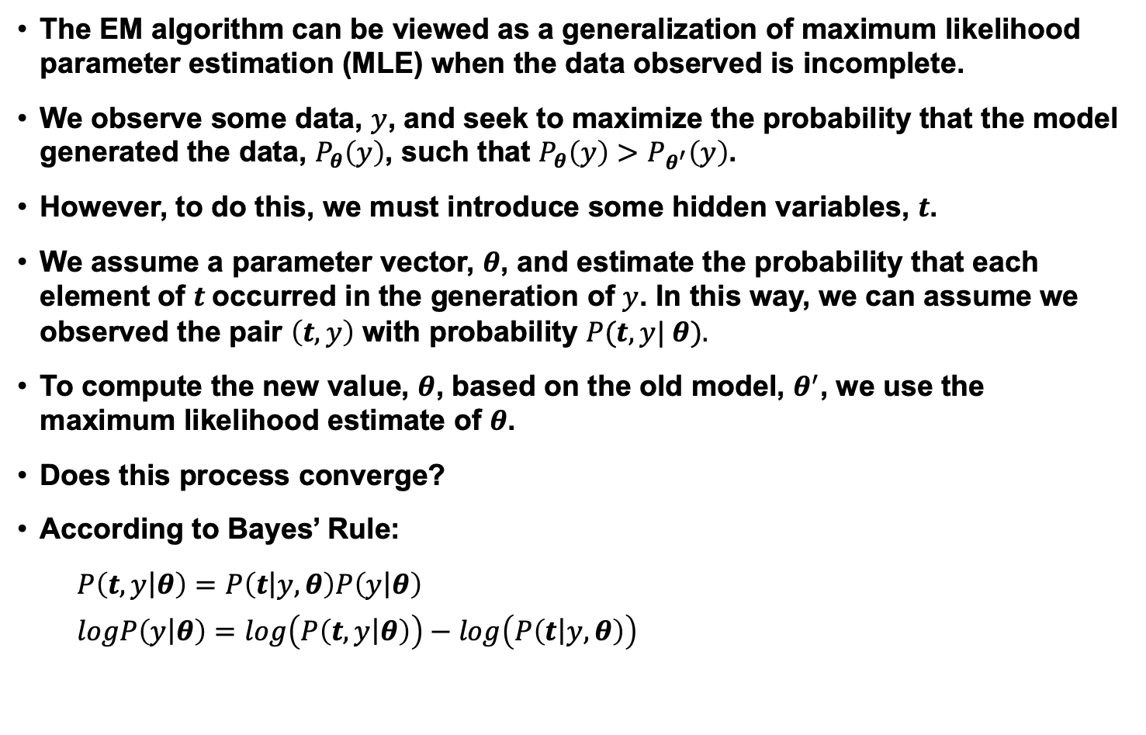
The Expectation Maximization Theorem (Preview)
The EM algorithm can be viewed as a generalization of maximum likelihood parameter estimation (MLE) when the data observed is incomplete.
We observe some data, $y$, and seek to maximize the probability that the model generated the data, $P_{θ}\left(y\right)$, such that $P_{θ}\left(y\right)>P_{θ^{′}}\left(y\right)$.
However, to do this, we must introduce some hidden variables, $t$.
We assume a parameter vector, $θ$, and estimate the probability that each element of $t$occurred in the generation of $y$. In this way, we can assume we observed the pair $\left(t,y\right)$ with probability $P(t,y| θ).$
To compute the new value, $θ$, based on the old model, $θ^{′}$, we use the maximum likelihood estimate of $θ$.
Does this process converge?
According to Bayes’ Rule:
$$P\left(t,y\left|θ\right.\right)=P\left(t\left|y,θ\right.\right)P\left(y\left|θ\right.\right)$$
$$logP\left(y\left|θ\right.\right)=log\left(P\left(t,y\left|θ\right.\right)\right)−log\left(P\left(t\left|y,θ\right.\right)\right)$$

Slide 5
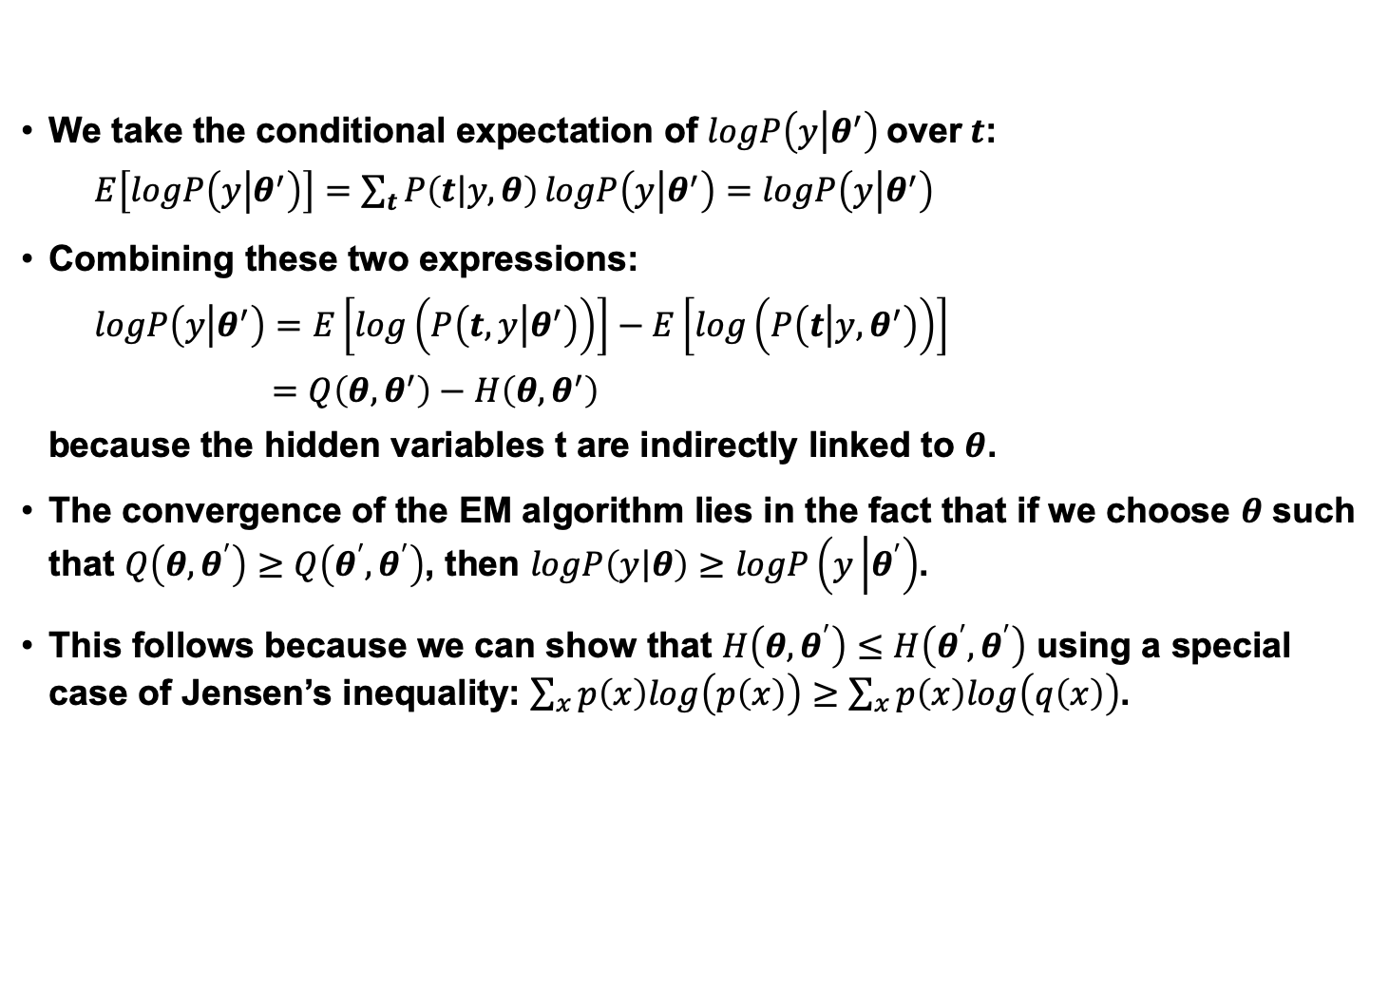
EM Convergence
We take the conditional expectation of $logP\left(y\left|θ^{′}\right.\right)$over$t$:
$E\left[logP\left(y\left|θ^{′}\right.\right)\right]=\sum_{t}{P\left(t\left|y,θ\right.\right)}logP\left(y\left|θ^{′}\right.\right)=$ $logP\left(y\left|θ^{′}\right.\right)$
Combining these two expressions:
$$logP\left(y\left|θ^{′}\right.\right)=E\left[log\left(P\left(t,y\left|θ^{′}\right.\right)\right)\right]−E\left[log\left(P\left(t\left|y,θ^{′}\right.\right)\right)\right]$$
$$=Q\left(θ,θ^{′}\right)−H\left(θ,θ^{′}\right)$$
because the hidden variables t are indirectly linked to $θ$.
The convergence of the EM algorithm lies in the fact that if we choose $θ$ such that $Q\left(θ,θ^{′}\right)≥Q\left(θ^{′},θ^{′}\right)$, then $logP\left(y\left|θ\right.\right)≥$ $logP\left(y\left|θ^{′}\right.\right)$.
This follows because we can show that $H\left(θ,θ^{′}\right)≤H\left(θ^{′},θ^{′}\right)$ using a special case of Jensen’s inequality: $\sum_{x}{p\left(x\right)log\left(p\left(x\right)\right)}≥\sum_{x}{p\left(x\right)log\left(q\left(x\right)\right)}$.

Slide 6
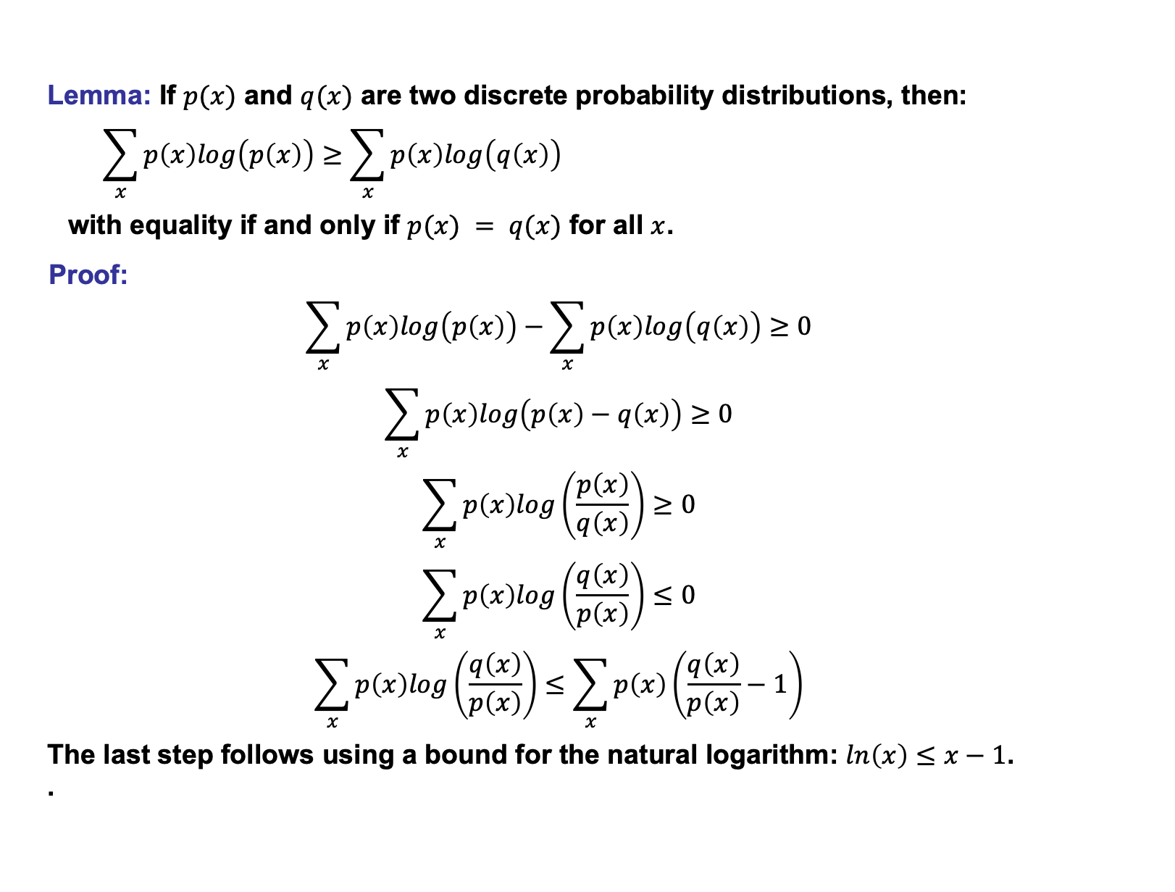
Special Case of Jensen’s Inequality
Lemma: If $p(x)$ and $q(x)$ are two discrete probability distributions, then:
$$\sum_{x}{p\left(x\right)log\left(p\left(x\right)\right)}≥\sum_{x}{p\left(x\right)log\left(q\left(x\right)\right)}$$
with equality if and only if $p(x) = q(x)$ for all $x$.
Proof:
$$\sum_{x}{p\left(x\right)log\left(p\left(x\right)\right)}−\sum_{x}{p\left(x\right)log\left(q\left(x\right)\right)≥0}$$
$$\sum_{x}{p\left(x\right)log\left(p\left(x\right)−q\left(x\right)\right)}≥0$$
$$\sum_{x}{p\left(x\right)log\left(\frac{p\left(x\right)}{q\left(x\right)}\right)}≥0$$
$$\sum_{x}{p\left(x\right)log\left(\frac{q\left(x\right)}{p\left(x\right)}\right)}≤0$$
$$\sum_{x}{p\left(x\right)log\left(\frac{q\left(x\right)}{p\left(x\right)}\right)}≤\sum_{x}{p\left(x\right)\left(\frac{q\left(x\right)}{p\left(x\right)}−1\right)}$$
The last step follows using a bound for the natural logarithm: $ln\left(x\right)≤x−1$. .

Slide 7
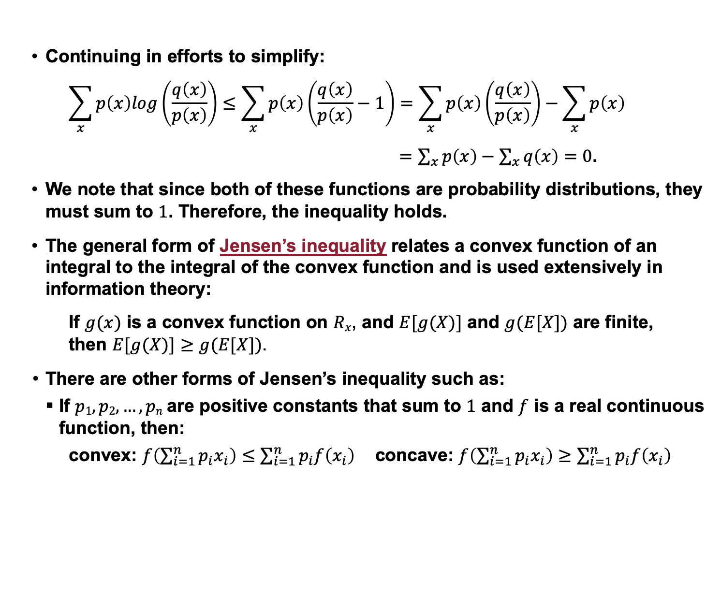
Special Case of Jensen’s Inequality
Continuing in efforts to simplify:
$$\sum_{x}{p\left(x\right)log\left(\frac{q\left(x\right)}{p\left(x\right)}\right)}≤\sum_{x}{p\left(x\right)\left(\frac{q\left(x\right)}{p\left(x\right)}−1\right)=\sum_{x}{p\left(x\right)\left(\frac{q\left(x\right)}{p\left(x\right)}\right)−\sum_{x}{p\left(x\right)}}}$$
$=\sum_{x}{p\left(x\right)}−\sum_{x}{q\left(x\right)=0}$.
We note that since both of these functions are probability distributions, they must sum to $1$. Therefore, the inequality holds.
The general form of Jensen’s inequality relates a convex function of an integral to the integral of the convex function and is used extensively in information theory:
If $g(x)$ is a convex function on $Rx$, and $E[g(X)]$ and $g(E[X])$ are finite, then $E[g(X)]≥g(E[X])$.
There are other forms of Jensen’s inequality such as:
If $p1, p2, …, pn$are positive constants that sum to $1$ and $f$ is a real continuous function, then:
convex: $f\left(\sum_{i=1}^{n}{p_{i}x_{i}}\right)≤\sum_{i=1}^{n}{p_{i}f\left(x_{i}\right)}$ concave: $f\left(\sum_{i=1}^{n}{p_{i}x_{i}}\right)≥\sum_{i=1}^{n}{p_{i}f\left(x_{i}\right)}$

Slide 8
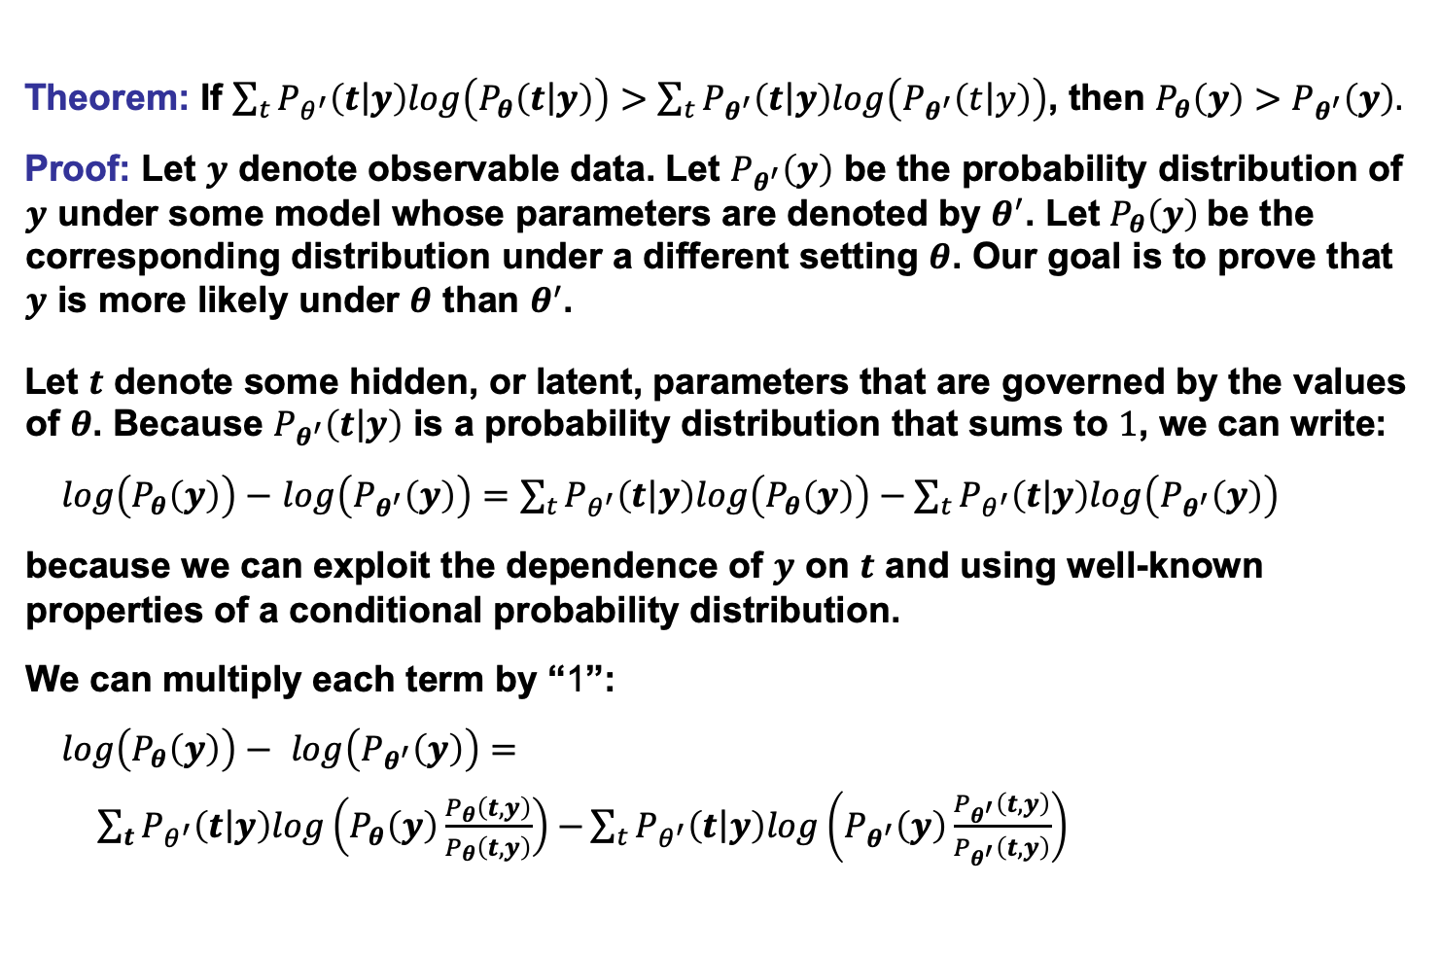
The EM Theorem
Theorem: If $\sum_{t}{P_{θ^{′}}\left(t\left|y\right.\right)log\left(P_{θ}\left(t\left|y\right.\right)\right)}>\sum_{t}{P_{θ^{′}}\left(t\left|y\right.\right)log\left(P_{θ^{′}}\left(t\left|y\right.\right)\right)}$, then $P_{θ}\left(y\right)>$ $P_{θ^{′}}\left(y\right).$
Proof: Let $y$ denote observable data. Let $P_{θ^{′}}\left(y\right)$ be the probability distribution of $y$ under some model whose parameters are denoted by $θ^{′}$. Let $P_{θ}\left(y\right)$be the corresponding distribution under a different setting $θ$. Our goal is to prove that $y$ is more likely under $θ$ than $θ^{′}$.
Let $t$ denote some hidden, or latent, parameters that are governed by the values of $θ$. Because $P_{θ^{′}}\left(t\left|y\right.\right)$ is a probability distribution that sums to $1$, we can write:
$log\left(P_{θ}\left(y\right)\right)−$ $log\left(P_{θ^{′}}\left(y\right)\right)=\sum_{t}{P_{θ^{′}}\left(t\left|y\right.\right)log\left(P_{θ}\left(y\right)\right)−\sum_{t}{P_{θ^{′}}\left(t\left|y\right.\right)log\left(P_{θ^{′}}\left(y\right)\right)}}$
because we can exploit the dependence of $y$ on $t$ and using well-known properties of a conditional probability distribution.
We can multiply each term by “1”:
$log\left(P_{θ}\left(y\right)\right)− log\left(P_{θ^{′}}\left(y\right)\right)=$
$\sum_{t}{P_{θ^{′}}\left(t\left|y\right.\right)log\left(P_{θ}\left(y\right)\frac{P_{θ}\left(t,y\right)}{P_{θ}\left(t,y\right)}\right)−}\sum_{t}{P_{θ^{′}}\left(t\left|y\right.\right)log\left(P_{θ^{′}}\left(y\right)\frac{P_{θ^{′}}\left(t,y\right)}{P_{θ^{′}}\left(t,y\right)}\right)}$

Slide 9
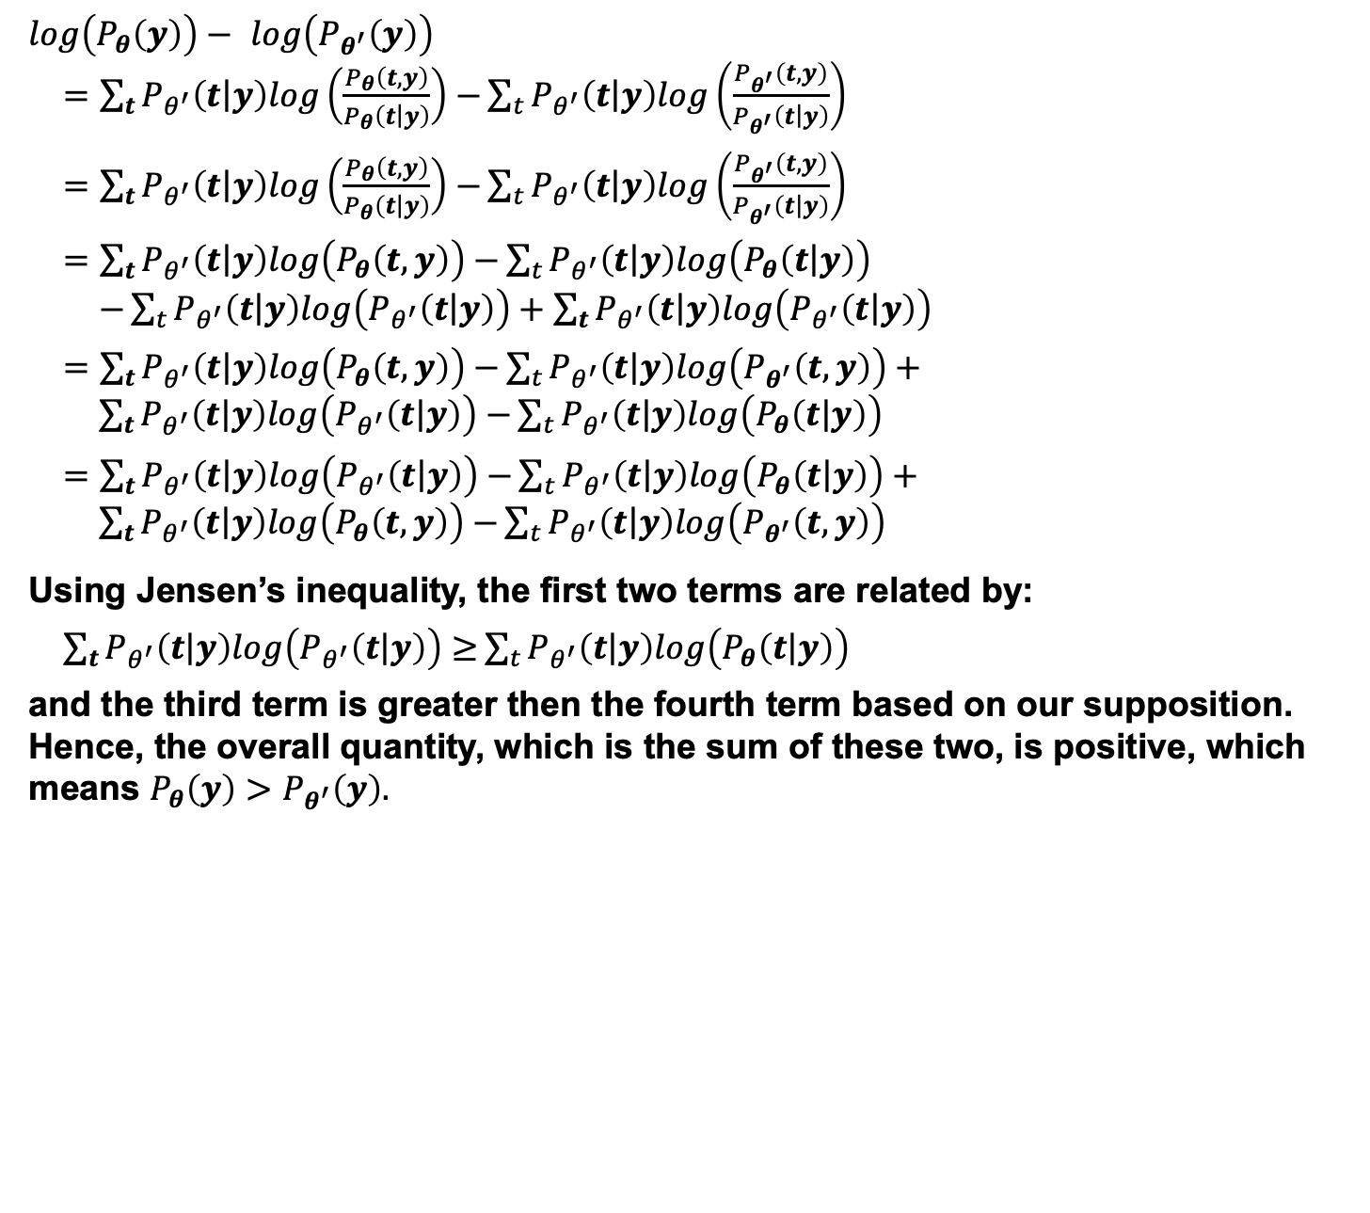
Proof Of The EM Theorem
$$log\left(P_{θ}\left(y\right)\right)− log\left(P_{θ^{′}}\left(y\right)\right)$$
$=$ $\sum_{t}{P_{θ^{′}}\left(t\left|y\right.\right)log\left(\frac{P_{θ}\left(t,y\right)}{P_{θ}\left(\left.t\right|y\right)}\right)−}\sum_{t}{P_{θ^{′}}\left(t\left|y\right.\right)log\left(\frac{P_{θ^{′}}\left(t,y\right)}{P_{θ^{′}}\left(\left.t\right|y\right)}\right)}$
$=$ $\sum_{t}{P_{θ^{′}}\left(t\left|y\right.\right)log\left(\frac{P_{θ}\left(t,y\right)}{P_{θ}\left(\left.t\right|y\right)}\right)−}\sum_{t}{P_{θ^{′}}\left(t\left|y\right.\right)log\left(\frac{P_{θ^{′}}\left(t,y\right)}{P_{θ^{′}}\left(\left.t\right|y\right)}\right)}$
$=$ $\sum_{t}{P_{θ^{′}}\left(t\left|y\right.\right)log\left(P_{θ}\left(t,y\right)\right)−}\sum_{t}{P_{θ^{′}}\left(t\left|y\right.\right)log\left(P_{θ}\left(\left.t\right|y\right)\right)}$
$−\sum_{t}{P_{θ^{′}}\left(t\left|y\right.\right)log\left(P_{θ^{′}}\left(\left.t\right|y\right)\right)}+\sum_{t}{P_{θ^{′}}\left(t\left|y\right.\right)log\left(P_{θ^{′}}\left(\left.t\right|y\right)\right)}$
$=$ $\sum_{t}{P_{θ^{′}}\left(t\left|y\right.\right)log\left(P_{θ}\left(t,y\right)\right)−}\sum_{t}{P_{θ^{′}}\left(t\left|y\right.\right)log\left(P_{θ^{′}}\left(t,y\right)\right)}+$
$\sum_{t}{P_{θ^{′}}\left(t\left|y\right.\right)log\left(P_{θ^{′}}\left(\left.t\right|y\right)\right)−}\sum_{t}{P_{θ^{′}}\left(t\left|y\right.\right)log\left(P_{θ}\left(\left.t\right|y\right)\right)}$
$=\sum_{t}{P_{θ^{′}}\left(t\left|y\right.\right)log\left(P_{θ^{′}}\left(\left.t\right|y\right)\right)−}\sum_{t}{P_{θ^{′}}\left(t\left|y\right.\right)log\left(P_{θ}\left(\left.t\right|y\right)\right)}+$
$\sum_{t}{P_{θ^{′}}\left(t\left|y\right.\right)log\left(P_{θ}\left(t,y\right)\right)−}\sum_{t}{P_{θ^{′}}\left(t\left|y\right.\right)log\left(P_{θ^{′}}\left(t,y\right)\right)}$
Using Jensen’s inequality, the first two terms are related by:
$\sum_{t}{P_{θ^{′}}\left(t\left|y\right.\right)log\left(P_{θ^{′}}\left(\left.t\right|y\right)\right)≥}\sum_{t}{P_{θ^{′}}\left(t\left|y\right.\right)log\left(P_{θ}\left(\left.t\right|y\right)\right)}$
and the third term is greater then the fourth term based on our supposition. Hence, the overall quantity, which is the sum of these two, is positive, which means $P_{θ}\left(y\right)>$ $P_{θ^{′}}\left(y\right).$

Slide 10
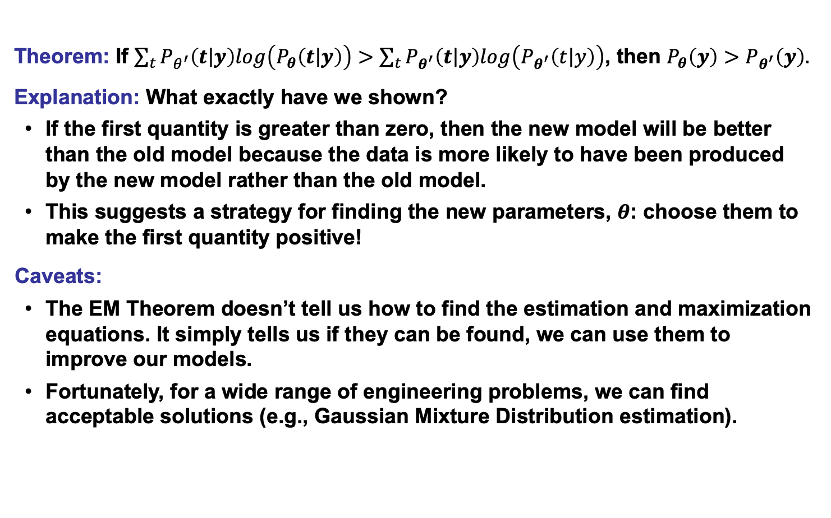
Discussion of the EM Theorem
Theorem: If $\sum_{t}{P_{θ^{′}}\left(t\left|y\right.\right)log\left(P_{θ}\left(t\left|y\right.\right)\right)}>\sum_{t}{P_{θ^{′}}\left(t\left|y\right.\right)log\left(P_{θ^{′}}\left(t\left|y\right.\right)\right)}$, then $P_{θ}\left(y\right)>$ $P_{θ^{′}}\left(y\right).$
Explanation: What exactly have we shown?
If the first quantity is greater than zero, then the new model will be better than the old model because the data is more likely to have been produced by the new model rather than the old model.
This suggests a strategy for finding the new parameters, $θ$: choose them to make the first quantity positive!
Caveats:
The EM Theorem doesn’t tell us how to find the estimation and maximization equations. It simply tells us if they can be found, we can use them to improve our models.
Fortunately, for a wide range of engineering problems, we can find acceptable solutions (e.g., Gaussian Mixture Distribution estimation).

Slide 11
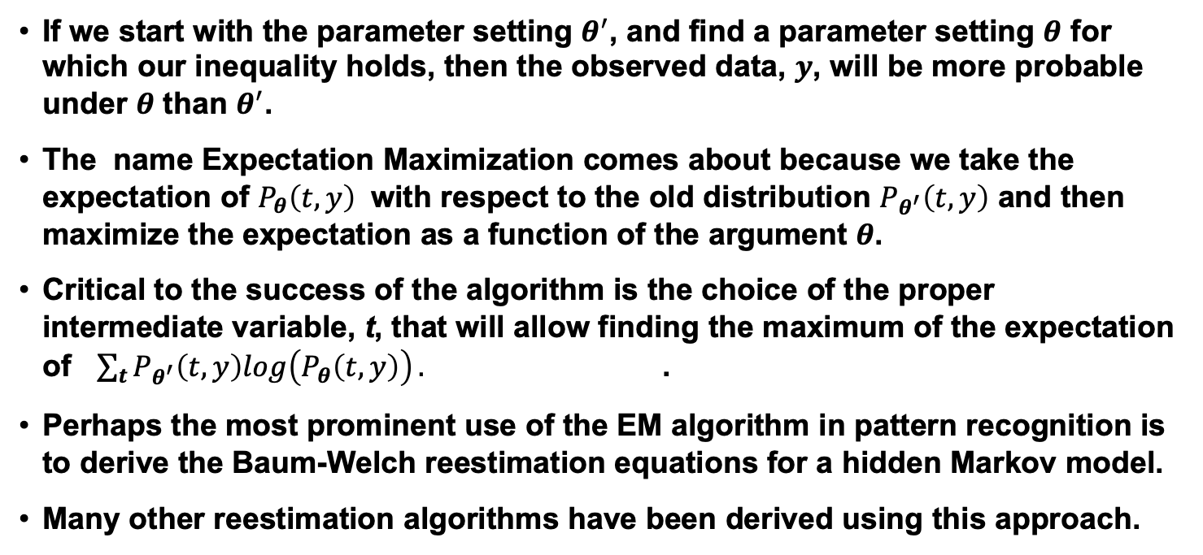
Discussion
If we start with the parameter setting $θ^{′}$, and find a parameter setting $θ$ for which our inequality holds, then the observed data, $y$, will be more probable under $θ$ than $θ^{′}$.
The name Expectation Maximization comes about because we take the expectation of $P_{θ}\left(t,y\right)$ with respect to the old distribution $P_{θ^{′}}\left(t,y\right)$ and then maximize the expectation as a function of the argument $θ$.
Critical to the success of the algorithm is the choice of the proper intermediate variable, t, that will allow finding the maximum of the expectation of $\sum_{t}{P_{θ^{′}}\left(t,y\right)log\left(P_{θ}\left(t,y\right)\right)}.$ .
Perhaps the most prominent use of the EM algorithm in pattern recognition is to derive the Baum-Welch reestimation equations for a hidden Markov model.
Many other reestimation algorithms have been derived using this approach.

Slide 12
Summary
Expectation Maximization (EM) Algorithm: a generalization of Maximum Likelihood Estimation (MLE) based on maximization of a posterior that data was generated by a model. EM is a special case of Jensen’s inequality.
Jensen’s Inequality: describes a relationship between two probability distributions in terms of an entropy-like quantity. A key tool in proving that EM estimation converges.
The EM Theorem: proved that estimation of a model’s parameters using an iteration of EM increases the posterior probability that the data was generated by the model.
Application: explained how EM can be used to reestimate parameters of a Gaussian mixture distribution.

Slide 13
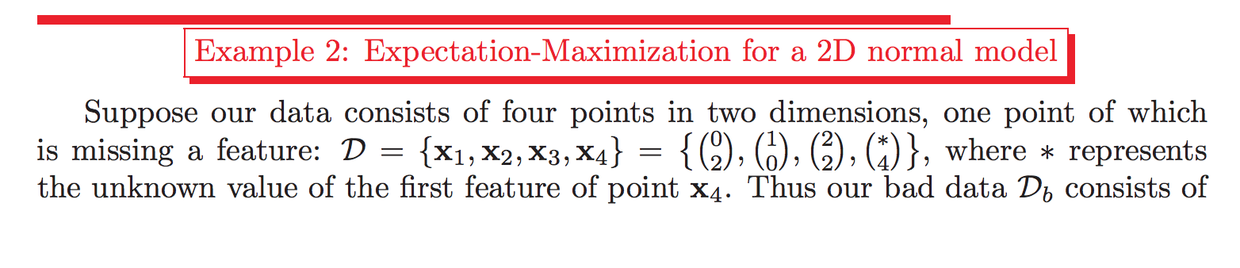
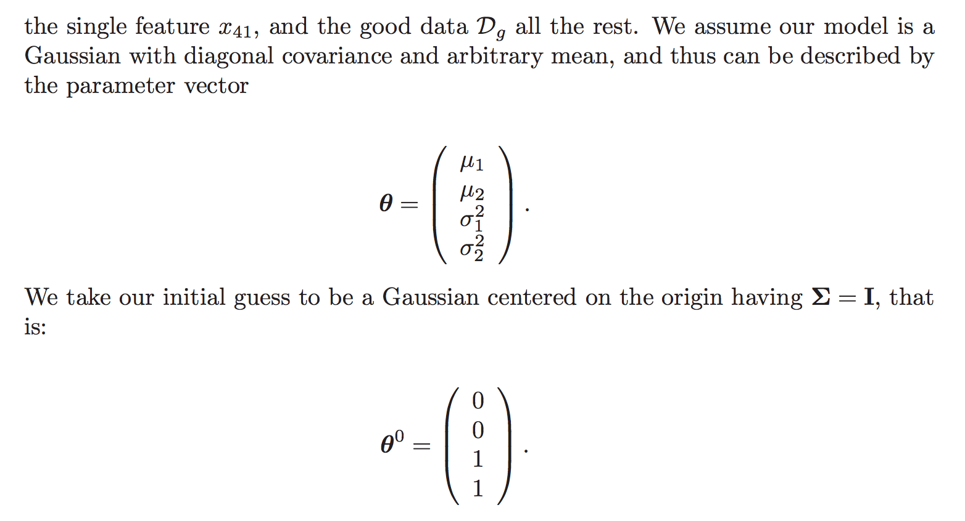
Example: Estimating Missing Data

Slide 14
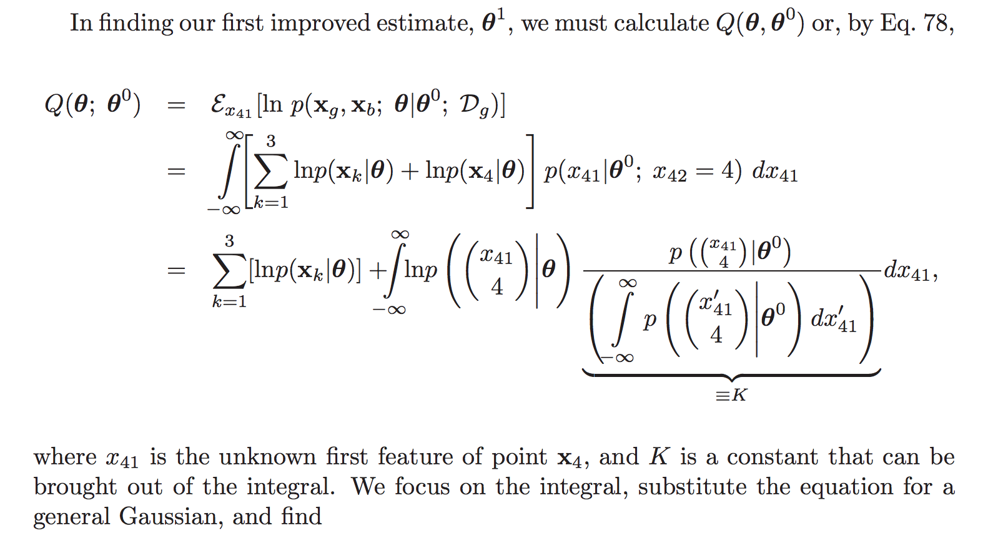
Example: Estimating Missing Data

Slide 15
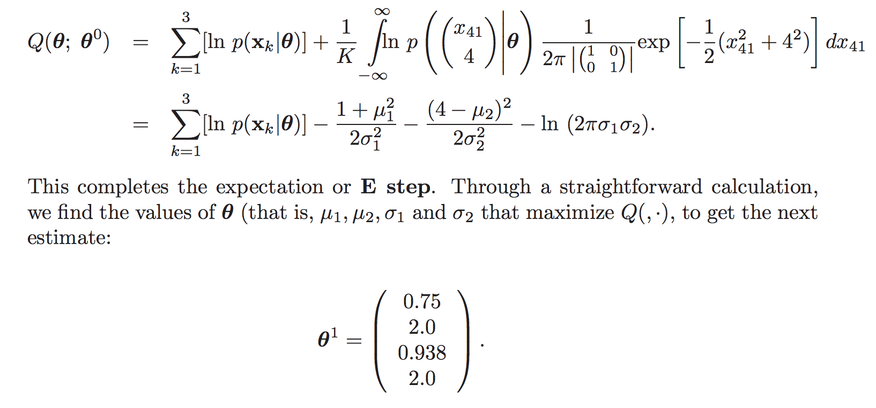
Example: Estimating Missing Data

Slide 16
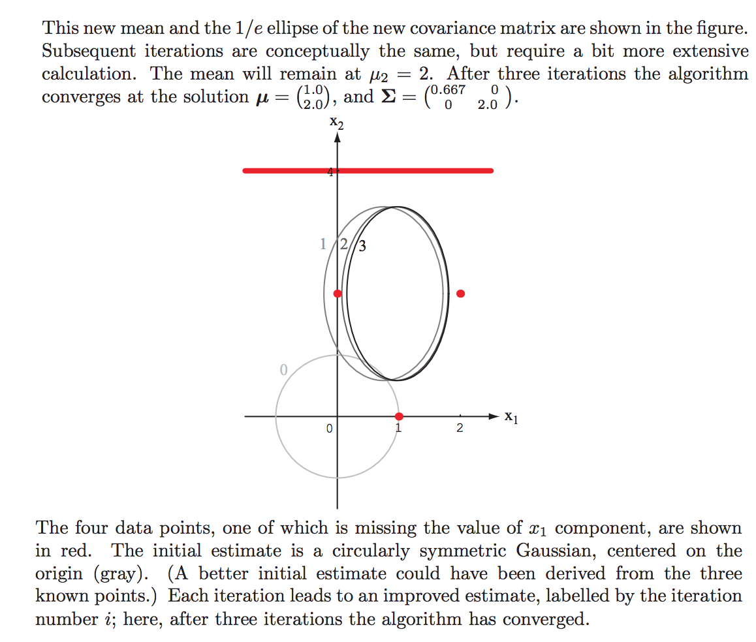
Example: Estimating Missing Data

Slide 17
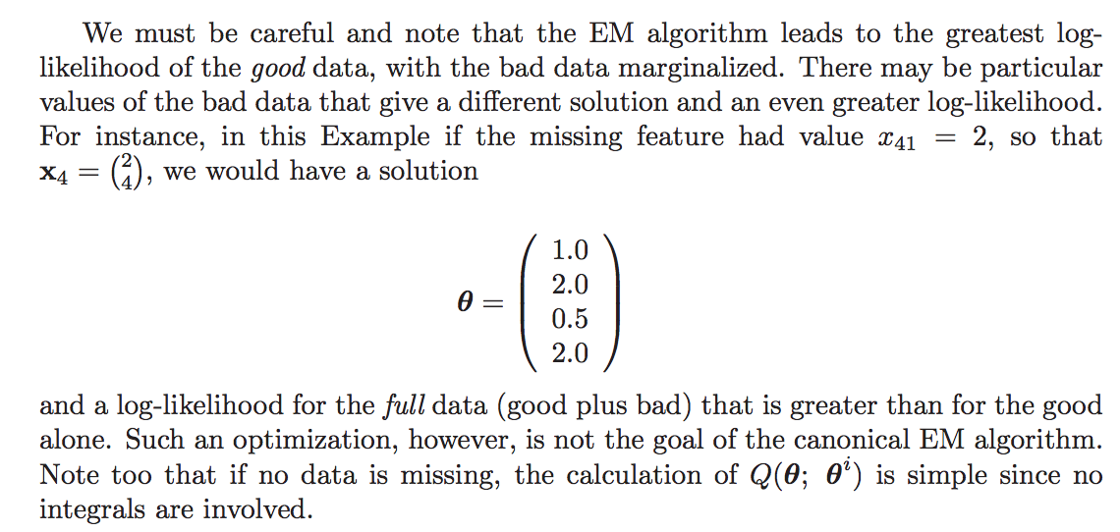
Example: Estimating Missing Data

Slide 18
Example: Gaussian Mixtures
An excellent tutorial on Gaussian mixture estimation can be found at J. Bilmes, EM Estimation
An interactive demo showing convergence of the estimate can be found at I. Dinov, Demonstration

