Slide 1
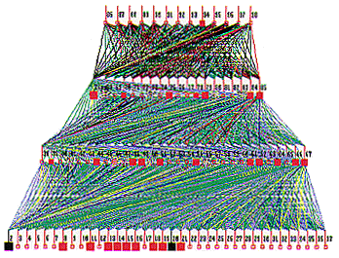
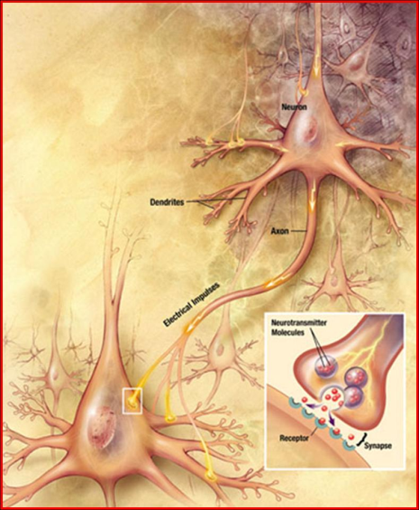
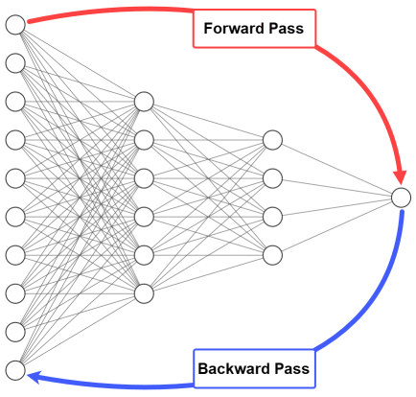
Lecture 29: Backpropagation and Vanishing Gradients
Objectives: Supervised Learning Backpropagation Vanishing Gradients
Resources: Textbook (Section 6.2) Mazur: Backpropagation Example MachineLearningMastery: Coding Backpropagation TowardsDataScience: Understanding Backpropagation

Slide 2
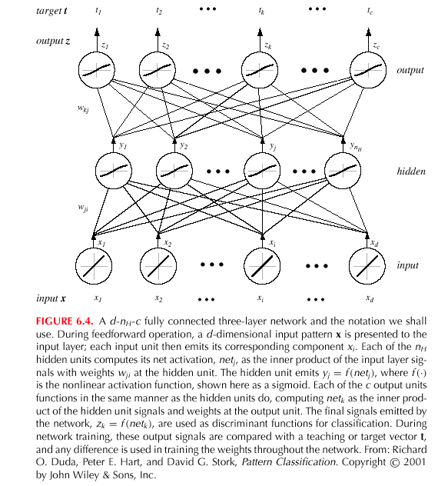
Backpropagation (Cont.)
Notes:
XOR: x_1, x_2, and we want to transform to x_1^2, x_2^2, x_1 x_2
It can also be viewed as feature extraction from the feature vector x, but now we extract more feature than the number of features in x.

Slide 3
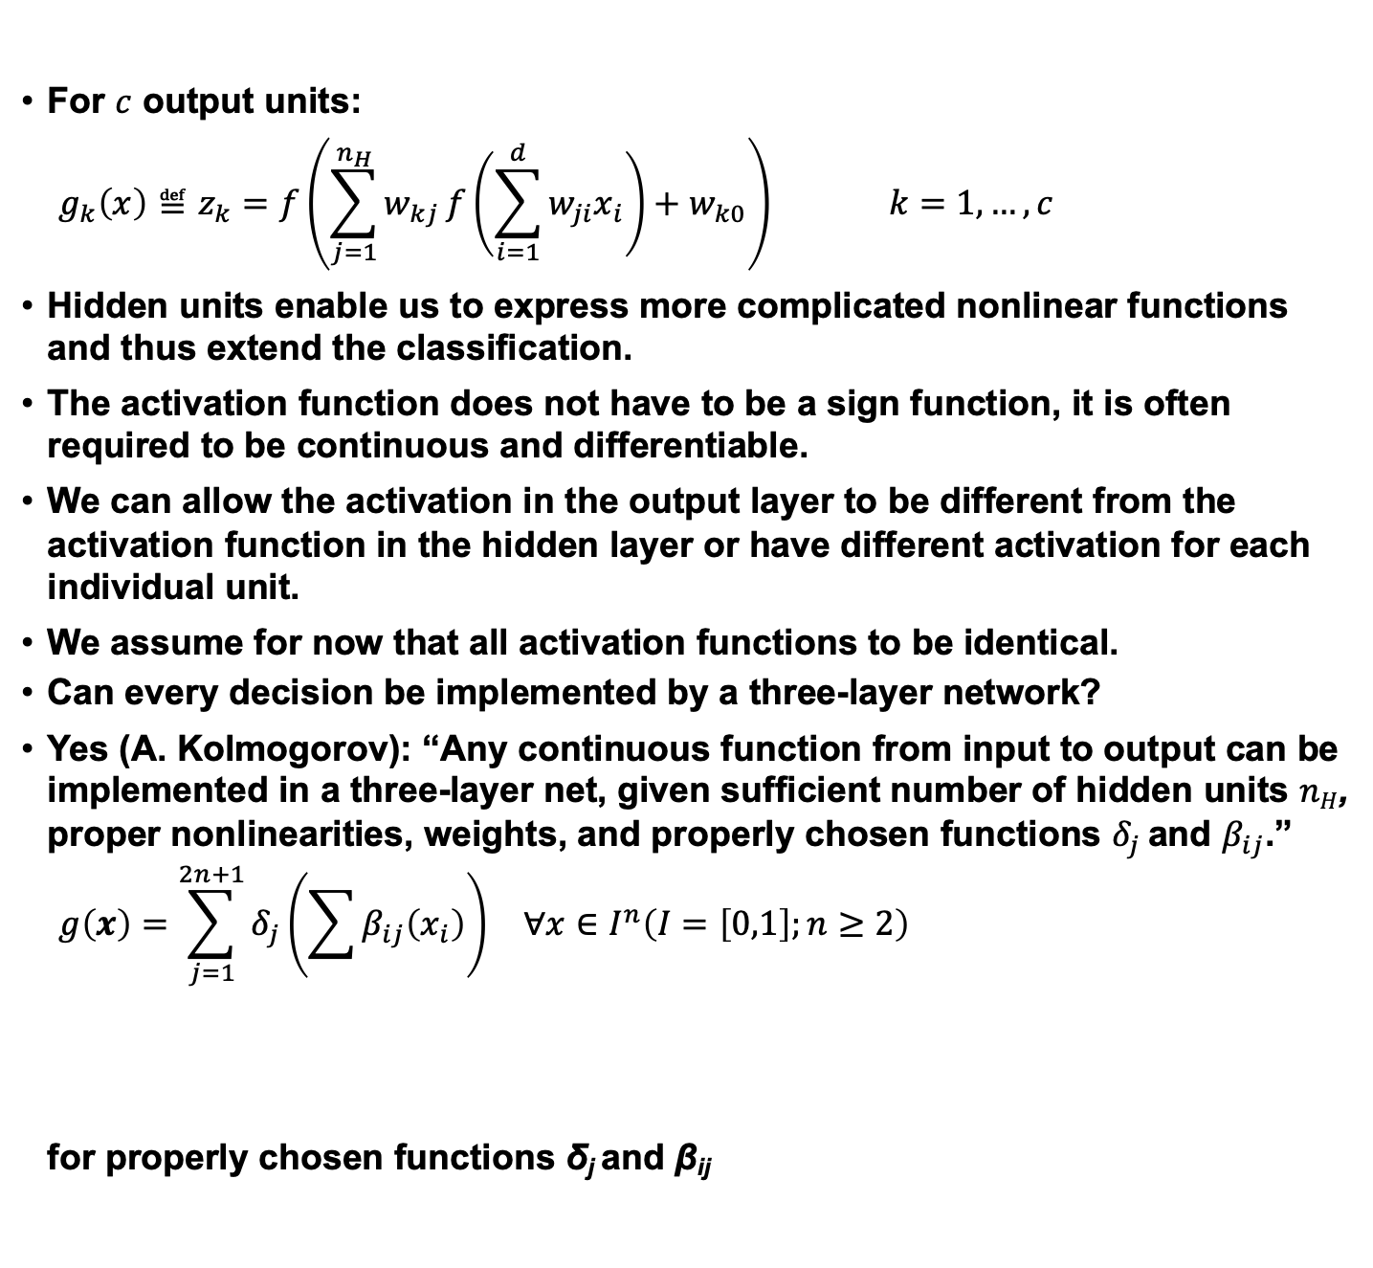
General Feedforward Operation
For $c$ output units:
$$g_{k}\left(x\right)≝z_{k}=f\left(\sum_{j=1}^{n_{H}}{w_{kj}}f\left(\sum_{i=1}^{d}{w_{ji}x_{i}}\right)+w_{k0}\right) k=1,…,c$$
Hidden units enable us to express more complicated nonlinear functions and thus extend the classification.
The activation function does not have to be a sign function, it is often required to be continuous and differentiable.
We can allow the activation in the output layer to be different from the activation function in the hidden layer or have different activation for each individual unit.
We assume for now that all activation functions to be identical.
Can every decision be implemented by a three-layer network?
Yes (A. Kolmogorov): “Any continuous function from input to output can be implemented in a three-layer net, given sufficient number of hidden units $nH$, proper nonlinearities, weights, and properly chosen functions $δ_{j}$ and $β_{ij}$.”
$$\begin{matrix}g\left(x\right)=\sum_{j=1}^{2n+1}{δ_{j}\left(\sum{β_{ij}\left(x_{i}\right)}\right)} & ∀x∈I^{n}\left(I=\left[0,1\right];n≥2\right)\end{matrix}$$
for properly chosen functions δ_{j} and β_{ij}
Notes:
XOR: x_1, x_2, and we want to transform to x_1^2, x_2^2, x_1 x_2
It can also be viewed as feature extraction from the feature vector x, but now we extract more feature than the number of features in x.

Slide 4
Backpropagation
Any function from input to output can be implemented as a three-layer neural network.
These results are of greater theoretical interest than practical, since the construction of such a network requires the nonlinear functions and the weight values which are unknown!
Our goal now is to set the interconnection weights based on the training patterns and the desired outputs.
In a three-layer network, it is a straightforward matter to understand how the output, and thus the error, depend on the hidden-to-output layer weights.
The power of backpropagation is that it enables us to compute an effective error for each hidden unit, and thus derive a learning rule for the input-to-hidden weights, this is known as “the credit assignment problem.”
Networks have two modes of operation:
Feedforward: consists of presenting a pattern to the input units and passing (or feeding) the signals through the network in order to get outputs units.
Learning: Supervised learning consists of presenting an input pattern and modifying the network parameters (weights) to reduce distances between the computed output and the desired output.
Notes:
XOR: x_1, x_2, and we want to transform to x_1^2, x_2^2, x_1 x_2
It can also be viewed as feature extraction from the feature vector x, but now we extract more feature than the number of features in x.

Slide 5
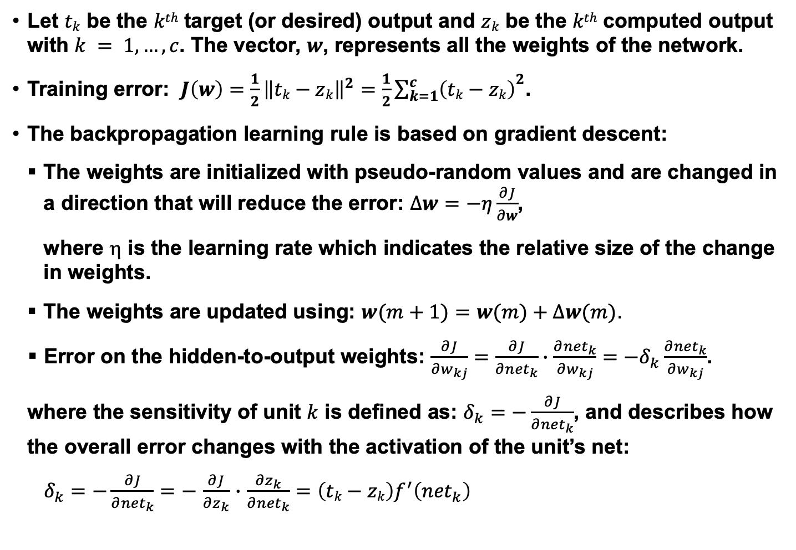
Network Learning
Let $tk$ be the $kth$ target (or desired) output and $zk$ be the $kth$ computed output with $k = 1, …, c$. The vector, $w$, represents all the weights of the network.
Training error: $J\left(w\right)=\frac{1}{2}{\left\|tk−zk\right\|}^{2}=\frac{1}{2}{\sum_{k=1}^{c}{\left(tk−zk\right)}}^{2}$.
The backpropagation learning rule is based on gradient descent:
The weights are initialized with pseudo-random values and are changed in a direction that will reduce the error: $∆w=−η\frac{∂J}{∂w}$,
where $$ is the learning rate which indicates the relative size of the change in weights.
The weights are updated using: $w(m+1)=w(m)+Δw(m)$.
Error on the hidden-to-output weights: $\frac{∂J}{∂w_{kj}}=\frac{∂J}{∂{net}_{k}}∙\frac{∂{net}_{k}}{∂w_{kj}}=−δ_{k}\frac{∂{net}_{k}}{∂w_{kj}}$.
where the sensitivity of unit $k$ is defined as: $δ_{k}=−\frac{∂J}{∂{net}_{k}}$, and describes how the overall error changes with the activation of the unit’s net:
$δ_{k}=−\frac{∂J}{∂{net}_{k}}=−$ $\frac{∂J}{∂z_{k}}$ $∙$ $\frac{∂z_{k}}{∂{net}_{k}}=\left(tk−zk\right)f^{′}\left({net}_{k}\right)$

Slide 6
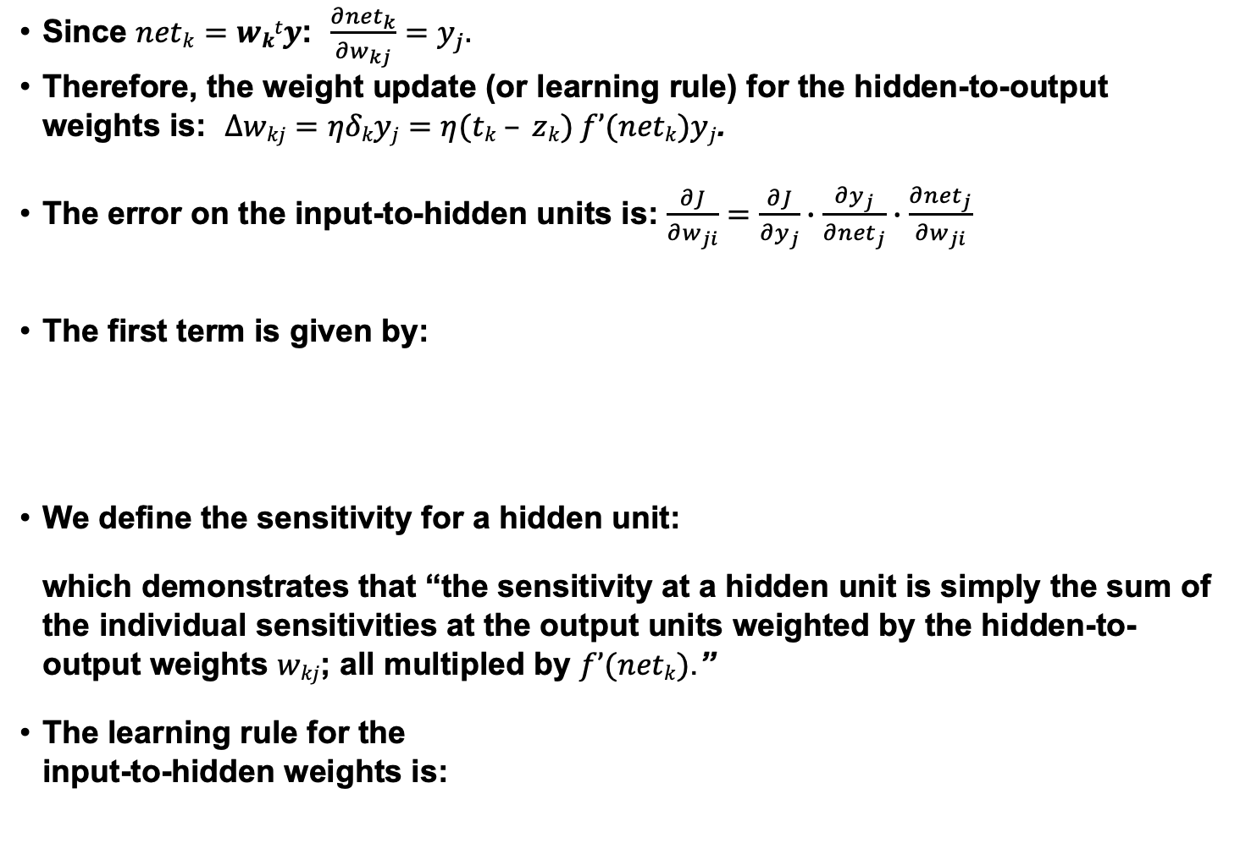
Network Learning (Cont.)
Since $netk=wkty$: $\frac{∂{net}_{k}}{∂w_{kj}}=y_{j}.$
Therefore, the weight update (or learning rule) for the hidden-to-output weights is: $Δwkj=ηδkyj=η(tk – zk) f’(netk)yj$.
The error on the input-to-hidden units is: $\frac{∂J}{∂w_{ji}}=\frac{∂J}{∂y_{j}}∙\frac{∂y_{j}}{∂{net}_{j}}∙\frac{∂{net}_{j}}{∂w_{ji}}$
The first term is given by:
We define the sensitivity for a hidden unit:
which demonstrates that “the sensitivity at a hidden unit is simply the sum of the individual sensitivities at the output units weighted by the hidden-to-output weights $wkj$; all multipled by $f’(netk)$.”
The learning rule for the input-to-hidden weights is:

Slide 7
Stochastic Back Propagation
Starting with a pseudo-random weight configuration, the stochastic backpropagation algorithm can be written as:
Begin
initialize n_{H}; w, criterion θ, η, m ⬅ 0
do m ⬅ m + 1
x^{m} ⬅ randomly chosen pattern
w_{ji} ⬅ w_{ji} + ηδ_{j}x_{i}; w_{kj} ⬅ w_{kj} + ηδ_{k}y_{j}
until ||∇J(w)|| < θ
return w
End

Slide 8
Stopping Criterion
One example of a stopping algorithm is to terminate the algorithm when the change in the criterion function J(w) is smaller than some preset value θ.
There are other stopping criteria that lead to better performance than this one. Most gradient descent approaches can be applied.
So far, we have considered the error on a single pattern, but we want to consider an error defined over the entirety of patterns in the training set.
The total training error is the sum over the errors of n individual patterns:
A weight update may reduce the error on the single pattern being presented but can increase the error on the full training set.
However, given a large number of such individual updates, the total error decreases.

Slide 9
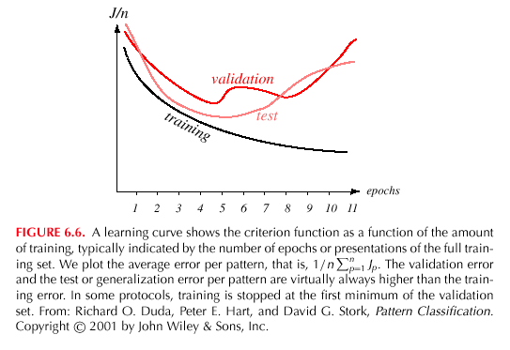
Learning Curves
Before training starts, the error on the training set is high; through the learning process, the error becomes smaller.
The error per pattern depends on the amount of training data and the expressive power (such as the number of weights) in the network.
The average error on an independent test set is always higher than on the training set, and it can decrease as well as increase.
A validation set is used in order to decide when to stop training; we do not want to overfit the network and decrease the power of the classifier generalization.

Slide 10
Gradient descent
pick a starting point (w)
repeat until loss doesn’t decrease in all dimensions:
pick a dimension
move a small amount in that dimension towards decreasing loss (using the derivative)
What is this doing?

Slide 11
Perceptron learning algorithm!
repeat until convergence (or for some # of iterations):
for each training example (f₁, f₂, …, f_{m}, label):
if prediction * label ≤ 0: // they don’t agree
for each w_{j}:
w_{j} = w_{j} + f_{j}*label
b = b + label
or
where

Slide 12
The constant
learning rate
label
prediction
When is this large/small?

Slide 13
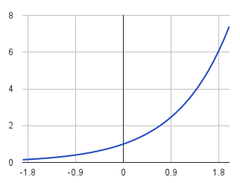
The constant
label
prediction
If they’re the same sign, as the predicted gets larger there update gets smaller
If they’re different, the more different they are, the bigger the update

Slide 14
One concern
loss
What is this calculated on?
Is this what we want to optimize?
w

Slide 15
Perceptron learning algorithm!
repeat until convergence (or for some # of iterations):
for each training example (f₁, f₂, …, f_{m}, label):
if prediction * label ≤ 0: // they don’t agree
for each w_{j}:
w_{j} = w_{j} + f_{j}*label
b = b + label
Note: for gradient descent, we always update
or
where

Slide 16
One concern
loss
We’re calculating this on the training set
We still need to be careful about overfitting!
The min w,b on the training set is generally NOT the min for the test set
w
How did we deal with this for the perceptron algorithm?

Slide 17
Overfitting revisited: regularization
A regularizer is an additional criteria to the loss function to make sure that we don’t overfit
It’s called a regularizer since it tries to keep the parameters more normal/regular
It is a bias on the model forces the learning to prefer certain types of weights over others

Slide 18
Regularizers
Should we allow all possible weights?
Any preferences?
What makes for a “simpler” model for a linear model?

Slide 19
Regularizers
Generally, we don’t want huge weights
If weights are large, a small change in a feature can result in a large change in the prediction
Also gives too much weight to any one feature
Might also prefer weights of 0 for features that aren’t useful
How do we encourage small weights? or penalize large weights?

Slide 20
Regularizers
How do we encourage small weights? or penalize large weights?

Slide 21
Common regularizers
sum of the weights
sum of the squared weights
What’s the difference between these?

Slide 22
Summary
Introduced the concept of a feedforward neural network.
Described the basic computational structure.
Described how to train this network using backpropagation.
Discussed stopping criterion.
Described the problems associated with learning, notably overfitting.
What we didn’t discuss:
Many, many forms of neural networks. Three historically important types of networks to consider:
Basis functions:
Boltzmann machines: a type of simulated annealing stochastic recurrent neural network.
Recurrent networks: used extensively in time series analysis.
Posterior estimation: in the limit of infinite data the outputs approximate a true a posteriori probability in the least squares sense.
Alternative training strategies and learning rules.

